Slide 1

Database Management System
18CS52
Module: 2
Approved by AICTE |Affiliated to VTU | Recognized by UGC with 2(f) & 12(B) status |Accredited by NBA and NAAC

Slide 2
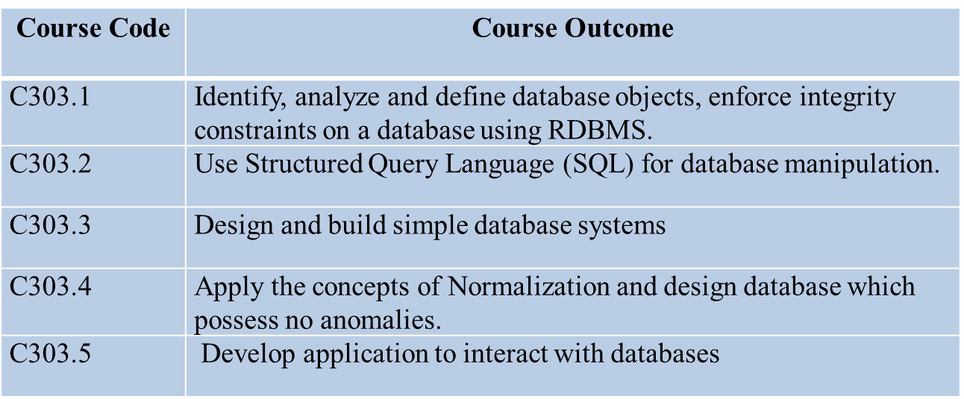
Objectives
Course objectives: This course will enable students to
Provide a strong foundation in database concepts, technology, and practice.
Practice SQL programming through a variety of database problems.
Demonstrate the use of concurrency and transactions in database
Design and build database applications for real world problems.
Course Outcome
Approved by AICTE |Affiliated to VTU | Recognized by UGC with 2(f) & 12(B) status |Accredited by NBA and NAAC

Slide 3
Books
Prescribed Books
Elmasri and Navathe: Fundamentals of Database Systems, 5th Edition, Pearson Education, 2007 (Chapters 1, 2, 3 except 3.8, 5, 6.1 to​ 6.5, 7.1, 8, 9.1, 9.2 except SQLJ, 9.4, 10)​
Raghu Ramakrishnan and Johannes Gehrke: Database Management Systems, 3rd Edition, McGraw-Hill, 2003. (Chapters 16, 17.1,​ 17.2, 18)​
Reference Books:​
Silberschatz, Korth and Sudharshan: Database System​, Concepts, 6th Edition, Mc-GrawHill, 2010.​
C.J. Date, A. Kannan, S. Swamynatham: An Introduction to Database Systems, 8th Edition, Pearson Education, 2006​
Approved by AICTE |Affiliated to VTU | Recognized by UGC with 2(f) & 12(B) status |Accredited by NBA and NAAC

Slide 4
Contents
Relational Model Concepts
Relational Model Constraints
Relational Database Schemas
Update operations, Transactions and dealing with constrain violation
Relational Algebra: Unary and Binary relation operations
Additional relational operations (aggregate, grouping, etc)
Example queries in Relational algebra
Relational database design using ER-to-relational mapping
SQL: Data definition and data types, specifying constraints in SQL
Retrieval queries in SQL
Insert, Delete, and update statement in SQL
Approved by AICTE |Affiliated to VTU | Recognized by UGC with 2(f) & 12(B) status |Accredited by NBA and NAAC

Slide 5
Bridge Topics
File systems Vs Database system - advantages and benefits by using Relation Database
The Logical design can be understood by Entity Relation Model
How the SQL can easily manage and retrieve the datas in large database by referring to real time applications19,20, udit,l,n

Slide 6
Relational Model Concepts
The table is called relation (or) simply, a table is a collections of related attributes and there is a relation among the attributes.
The relational model is today the primary data model for commercial data processing applications.
A relational database consists of a collection of tables, each of which is assigned a unique name.
a row in a table represents a relationship among a set of values. Since a table is a collection of such relationships, there is a close correspondence between the concept of table and the mathematical concept of relation, from which the relational data model takes its name.
Thus, in the relational model the term relation is used to refer to a table, while the term tuple is used to refer to a row. Similarly, the term attribute refers to a column of a table.

Slide 7
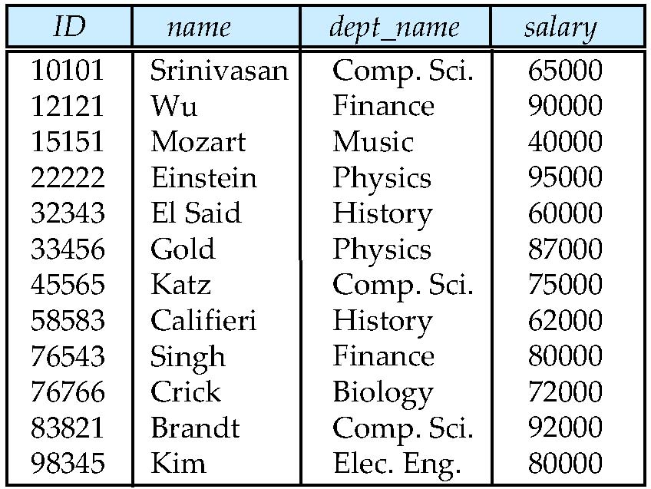
Example of a Relation
attributes
(or columns)
tuples
(or rows)

Slide 8
Basic structure
Formally, given sets D1, D2, …. Dn, a relation r is a subset of D1 x D2 x … x. Dn
Thus a relation is a set of n-tuples (a1, a2, …, an) where each ai ∈ Di
Example: if
customer-name = {Jones, Smith, Curry, Lindsay}
customer-street = {Main, North, Park}
customer-city = {Harrison, Rye, Pittsfield}
Then r = { (Jones, Main, Harrison),
(Smith, North, Rye),
(Curry, North, Rye),
(Lindsay, Park, Pittsfield)}
is a relation over customer-name x customer-street x customer-city

Slide 9
Attribute Types
Each attribute of a relation has a name
The set of allowed values for each attribute is called the domain of the attribute
Attribute values are (normally) required to be atomic; that is, indivisible
E.g. multivalued attribute values are not atomic
E.g. composite attribute values are not atomic
The special value null is a member of every domain. Indicated that the value is “unknown”
The null value causes complications in the definition of many operations
we shall ignore the effect of null values in our main presentation and consider their effect later

Slide 10
Relation Schema and Instance
A₁, A₂, …, A_{n} are attributes
R = (A₁, A₂, …, A_{n} ) is a relation schema
Example:
instructor = (ID, name, dept_name, salary)
Formally, given sets D₁, D₂, …. D_{n} a relation r is a subset of D₁ x D₂ x … x D_{n} Thus, a relation is a set of n-tuples (a₁, a₂, …, a_{n}) where each a_{i} ∈ D_{i}
The current values (relation instance) of a relation are specified by a table
An element t of r is a tuple, represented by a row in a table

Slide 11
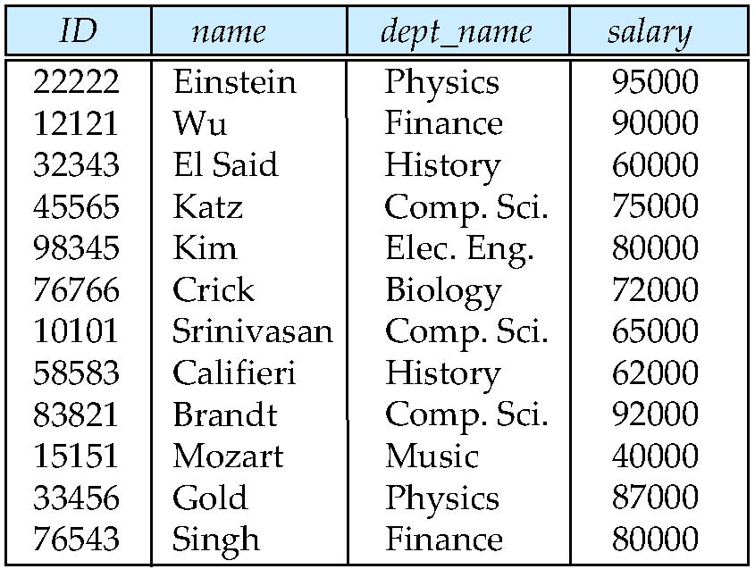
Relations are Unordered
Order of tuples is irrelevant (tuples may be stored in an arbitrary order)
Example: instructor relation with unordered tuples

Slide 12
Constraints on Relational database model
On modeling the design of the relational database we can put some restrictions like what values are allowed to be inserted in the relation, what kind of modifications and deletions are allowed in the relation. These are the restrictions we impose on the relational database.
In models like ER models, we did not have such features.
Constraints in the databases can be categorized into 3 main categories:
Constraints that are applied in the data model is called Implicit constraints.
Constraints that are directly applied in the schemas of the data model, by specifying them in the DDL(Data Definition Language). These are called as schema-based constraints or Explicit constraints.
Constraints that cannot be directly applied in the schemas of the data model. We call these Application based or semantic constraints.

Slide 13
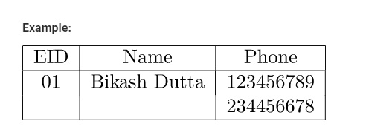
Constraints on Relational database model
Mainly Constraints on the relational database are of 4 types:
Domain constraints
Key constraints
Entity Integrity constraints
Referential integrity constraints
1. Domain constraints :
Every domain must contain atomic values(smallest indivisible units) it means composite and multi-valued attributes are not allowed.
We perform datatype check here, which means when we assign a data type to a column we limit the values that it can contain. Eg. If we assign the datatype of attribute age as int, we cant give it values other then int datatype.
Example:
Explanation:
In the above relation, Name is a composite attribute and Phone is a multi-values attribute, so it is violating domain constraint.

Slide 14
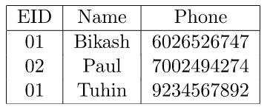
Constraints on Relational database model
2. Key Constraints or Uniqueness Constraints :
These are called uniqueness constraints since it ensures that every tuple in the relation should be unique.
A relation can have multiple keys or candidate keys(minimal superkey), out of which we choose one of the keys as primary key, we don’t have any restriction on choosing the primary key out of candidate keys, but it is suggested to go with the candidate key with less number of attributes.
Null values are not allowed in the primary key, hence Not Null constraint is also a part of key constraint.
Explanation:
In the above table, EID is the primary key, and first and the last tuple has the same value in EID ie 01, so it is violating the key constraint.

Slide 15
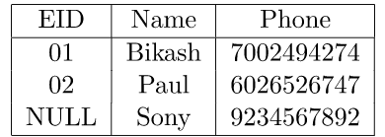
Constraints on Relational database model
3. Entity Integrity Constraints :
Entity Integrity constraints says that no primary key can take NULL value, since using primary key we identify each tuple uniquely in a relation.
Example:
Explanation:
In the above relation, EID is made primary key, and the primary key cant take NULL values but in the third tuple, the primary key is null, so it is a violating Entity Integrity constraints.

Slide 16
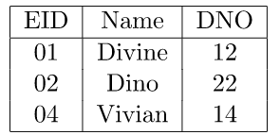
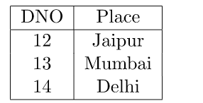
Constraints on Relational database model
4. Referential Integrity Constraints :
The Referential integrity constraints is specified between two relations or tables and used to maintain the consistency among the tuples in two relations.
This constraint is enforced through foreign key, when an attribute in the foreign key of relation R1 have the same domain(s) as the primary key of relation R2, then the foreign key of R1 is said to reference or refer to the primary key of relation R2.
The values of the foreign key in a tuple of relation R1 can either take the values of the primary key for some tuple in relation R2, or can take NULL values, but can’t be empty.
Example:
Explanation:
In the above, DNO of the first relation is the foreign key, and DNO in the second relation is the primary key. DNO = 22 in the foreign key of the first table is not allowed since DNO = 22 is not defined in the primary key of the second relation. Therefore Referential integrity constraints is violated here

Slide 17
Relational Database Schema
When we talk about a database, we must differentiate between the database schema, which is the logical design of the database, and the database instance, which is a snapshot of the data in the database at a given instant in time.
A relational database schema is the tables, columns and relationships that link together the components into a database.
The relational model (RM) for database management is an approach to managing data using a structure and language consistent with first-order predicate logic, first described in 1969 by Edgar F. Codd, where all data is represented in terms of tuples, grouped into relations. A database organized in terms of the relational model is a relational database.
The term database design can be used to describe many different parts of the design of an overall database system.
Principally, and most correctly, it can be thought of as the logical design of the base data structures used to store the data. In the relational model these are the tables and views. In an object database the entities and relationships map directly to object classes and named relationships

Slide 18
Relational Database Schema
Purpose of a Schema
A relational database schema helps you to organize and understand the structure of a database. This is particularly useful when designing a new database, modifying an existing database to support more functionality, or building integration between databases.
The process of doing database design generally consists of a number of steps which will be carried out by the database designer. Usually, the designer must:
Determine the data to be stored in the database.
Determine the relationships between the different data elements.
Superimpose a logical structure upon the data on the basis of these relationships.
Within the relational model the final step above can generally be broken down into two further steps, that of determining the grouping of information within the system, generally determining what are the basic objects about which information is being stored, and then determining the relationships between these groups of information, or objects.

Slide 19
Relational Database Schema
Creating the Schema
There are two steps to creating a relational database schema: creating the logical schema and creating the physical schema.
The logical schema depicts the structure of the database, showing the tables, columns and relationships with other tables in the database and can be created with modeling tools or spreadsheet and drawing software.
The physical schema is created by actually generating the tables, columns and relationships in the relational database management software (RDBMS). Most modeling tools can automate the creation of the physical schema from the logical schema, but it can also be done by manually.
Modifying the Schema
The structure of a relational database will inevitably change over time as data needs change. It’s just as important to document changes to your relational database schema as it was to document the original design, otherwise it becomes increasingly difficult to update or integrate the database.
Be sure to save copies of previous configurations, so that changes can be removed if problems occur.

Slide 20
Relational Database Schema
A database consists of multiple relations
Information about an enterprise is broken up into parts, with each relation storing one part of the information, some examples follows:
• student (ID, name, dept name, tot cred)
• advisor (s id, i id)
• takes (ID, course id, sec id, semester, year, grade)
• classroom (building, room number, capacity)
• time slot (time slot id, day, start time, end time)

Slide 21
Keys
Let K ⊆ R
K is a superkey of R if values for K are sufficient to identify a unique tuple of each possible relation r(R)
Example: {ID} and {ID,name} are both superkeys of instructor.
Superkey K is a candidate key if K is minimal Example: {ID} is a candidate key for Instructor
One of the candidate keys is selected to be the primary key.
which one?
Foreign key constraint: Value in one relation must appear in another
Referencing relation
Referenced relation
Example – dept_name in instructor is a foreign key from instructor referencing department

Slide 22
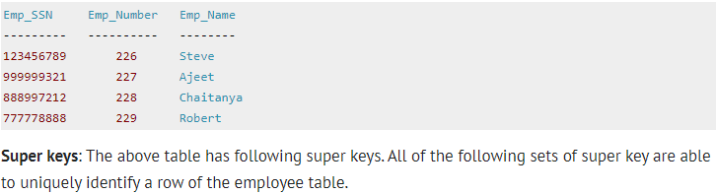
Super Key: One or more attributes used to identify the record from record set is called super key.
{Emp_SSN}
{Emp_Number}
{Emp_SSN, Emp_Number}
{Emp_SSN, Emp_Name}
{Emp_SSN, Emp_Number, Emp_Name}
{Emp_Number, Emp_Name}

Slide 23
Candidate Key: Minimal sub-set of super key is called candidate key.
Minimal super key with no redundant attributes. The following two set of super keys are chosen from the above sets as there are no redundant attributes in these sets.
{Emp_SSN}
{Emp_Number}
Only these two sets are candidate keys as all other sets are having redundant attributes that are not necessary for unique identification.
Primary Key: The Database Admin can assign any one of the candidate key as ‘Primary key’.
A Primary key is selected from a set of candidate keys. This is done by database admin or database designer. We can say that either {Emp_SSN} or {Emp_Number} can be chosen as a primary key for the table Employee.

Slide 24
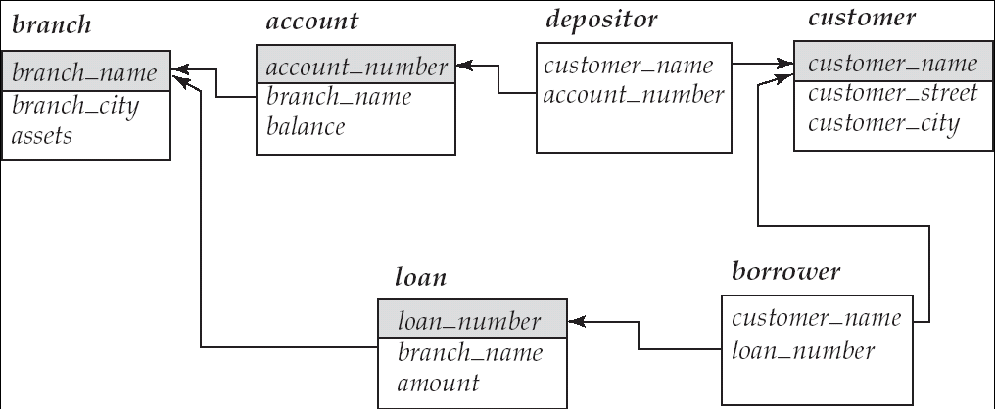
Foreign key: The value in one relation must appear in another relation.

Slide 25
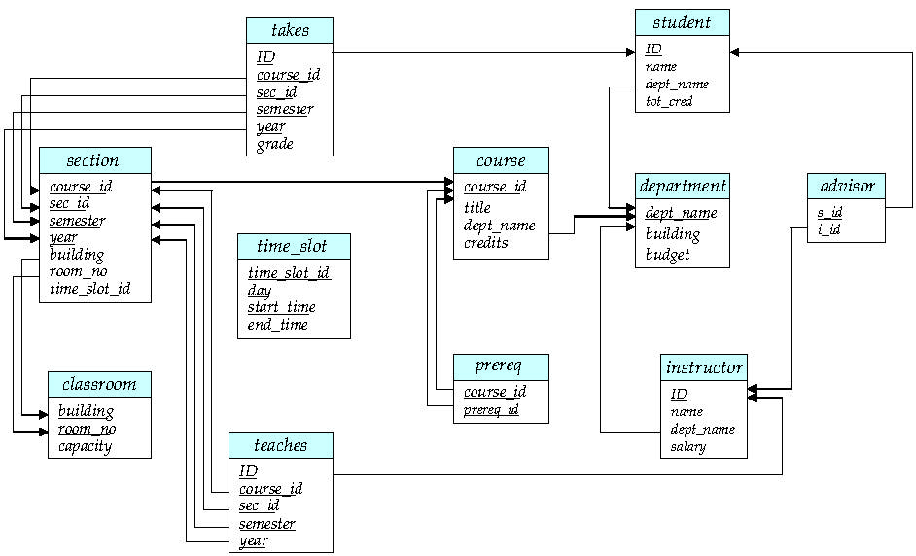
Schema Diagram for University Database

Slide 26
Update Operations
In certain situations, we may wish to change a value in a tuple without changing all values in the tuple. For this purpose, the update statement can be used.
As we could for insert and delete, we can choose the tuples to be updated by using a query.
Suppose that annual salary increases are being made, and salaries of all instructors are to be increased by 5 percent. We write:
update instructor
set salary= salary * 1.05;

Slide 27
Transactions
A transaction consists of a sequence of query and/or update statements. The SQL standard specifies that a transaction begins implicitly when an SQL statement is executed.
One of the following SQL statements must end the transaction:
Commit work: commits the current transaction; that is, it makes the updates performed by the transaction become permanent in the database. After the transaction is committed, a new transaction is automatically started.
Rollback work: causes the current transaction to be rolled back; that is, it all the updates performed by the SQL statements in the transaction. Thus, the database state is restored to what it was before the first statement of the transaction was executed.
Transaction rollback is useful if some error condition is detected during execution of a transaction
Once a transaction has executed commit work, its effects can no longer be undone by rollback work

Slide 28
Constraints
The data values stored in the database must satisfy certain consistency constraints
account balance of a department must never be negative.
The DDL provides facilities to specify such constraints. The database system checks these constraints every time the database is updated
Domain Constraints: A domain of possible values must be associated with every attribute (for example, integer types, character types, date/time types). Declaring an attribute to be of a particular domain acts as a constraint on the values that it can take.
Referential Integrity: There are cases where we wish to ensure that a value that appears in one relation for a given set of attributes also appears in a certain set of attributes in another relation
Assertions: An assertion is any condition that the database must always satisfy. Domain constraints and referential-integrity constraints are special forms of assertions.

Slide 29
Relation Algebra
Relational algebra is a procedural query language that works on relational model. The purpose of a query language is to retrieve data from database or perform various operations such as insert, update, delete on the data
Types of operations in relational algebra
We have divided these operations in two categories:
1. Basic Operations
2. Derived Operations
Basic/Fundamental Operations:
1. Select (σ)
2. Project (∏)
3. Union (∪)
4. Set Difference (-)
5. Cartesian product (X)
6. Rename (ρ)

Slide 30
Relation Algebra
Derived Operations:
1. Natural Join (⋈)
2. Left, Right, Full outer join (⟕, ⟖, ⟗)
3. Intersection (∩)
4. Division (÷)

Slide 31
Relational Algebra consists of several groups of operations
Unary Relational Operations
SELECT (symbol: σ (sigma))
PROJECT (symbol: ∏ (pi))
RENAME (symbol: ρ (rho))
Relational Algebra Operations From Set Theory
UNION (∪ ), INTERSECTION (∩ ), DIFFERENCE (or MINUS, – )
CARTESIAN PRODUCT ( x )
Binary Relational Operations
JOIN (several variations of JOIN exist)
DIVISION
Additional Relational Operations
OUTER JOINS, OUTER UNION
AGGREGATE FUNCTIONS (These compute summary of information: for example, SUM, COUNT, AVG, MIN, MAX)

Slide 32
Relation Algebra
Select Operation
The select operation selects tuples that satisfy a given predicate
Notation: σ p(r)
p is called the selection predicate
Defined as:
σp(r) = {t | t ∈ r and p(t)}
Where p is a formula in propositional calculus consisting of terms connected by : ∧ (and), ∨ (or), ¬ (not)
Each term is one of: <attribute> op <attribute> or <constant>
where op is one of: =, ≠, >, ≥. <. ≤
Example of selection:
σ branch-name=“Perryridge”(account)

Slide 33
dept name =“Physics” (instructor )
We can find all instructors with salary greater than $90,000 by writing:
salary>90000 (instructor)
The Project Operation
The project operation is a unary operation that returns its argument relation, with certain attributes left out.
Suppose we want to list all instructors’ ID, name, and salary, but do not care about the dept name. Projection is denoted by the uppercase Greek letter pi (π)
The result is defined as the relation of k columns obtained by erasing the columns that are not listed
Duplicate rows removed from result, since relations are sets
Example
π ID, name, salary (instructor )

Slide 34
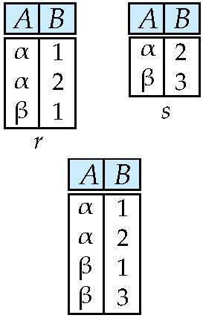
The Union Operation
Relations r, s:
r ∪ s:

Slide 35
Examples
To find the set of all courses taught in the Fall 2009 semester, we write:
π course id (semester =“Fall”∧ year=2009 (section))
To find the set of all courses taught in the Spring 2010 semester, we write:
π course id (semester =“Spring”∧year=2010 (section))
To answer the query, we need the union of these two sets; that is, we need all section IDs that appear in either or both of the two relations. We find these data binary operation union, denoted, as in set theory, by ∪. So the expression needed is:
course id (semester =“Fall”∧ year=2009 (section)) ∪ course id (semester =“Spring” ∧ year=2010 (section))

Slide 36
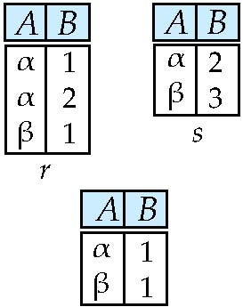
Set difference of two relations
Relations r, s:
r – s

Slide 37
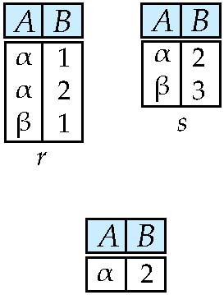
Set intersection of two relations
Relation r, s:
r ∩ s
Note: r ∩ s = r – (r – s)

Slide 38
Example Queries
The following command creates a relation department in the database.
create table department
(dept name varchar (20),
building varchar (15),
budget numeric (12,2),
primary key (dept name));
Queries: “Find the names of all instructors.”
The instructor’s name appears in the name attribute, so we put that in the select clause.
select name from instructor;
Example query: “Find the department names of all instructors,”
select dept name from instructor;

Slide 39
The select clause is used to list the attributes desired in the result of a query.
• The from clause is a list of the relations to be accessed in the evaluation of the query.
• The where clause is a predicate involving attributes of the relation in the from clause.
A typical SQL query has the form
select A1, A2, . . . , An
from r1, r2, . . . , rm
where P;

Slide 40
An example arises in the query “Find the total number of instructors who teach a course in the Spring 2010 semester.”
select count (distinct ID) from teaches
where semester = ’Spring’ and year = 2010;
consider the query “Find the average salary in each department.” We write this query as follows:
select dept name, avg (salary) as avg salary
from instructor
group by dept name;
consider the query “Find the average salary of all instructors.” We write this query as follows:
select avg (salary) from instructor;

Slide 41
Relational database design using ER-to-relational mapping
Entity-Relationship Model. The entity-relationship (E-R) data model uses a collection of basic objects, called entities, and relationships among these objects. An entity is a “thing” or “object” in the real world that is distinguishable from other objects. The entity-relationship model is widely used in database design.
The entity-relationship (E-R) data model was developed to facilitate database design by allowing specification of an enterprise schema that represents the overall logical structure of a database.
The E-R model is very useful in mapping the meanings and interactions of real-world enterprises onto a conceptual schema.
The E-R data model employs three basic concepts: entity sets, relationship sets, and attributes.

Slide 42
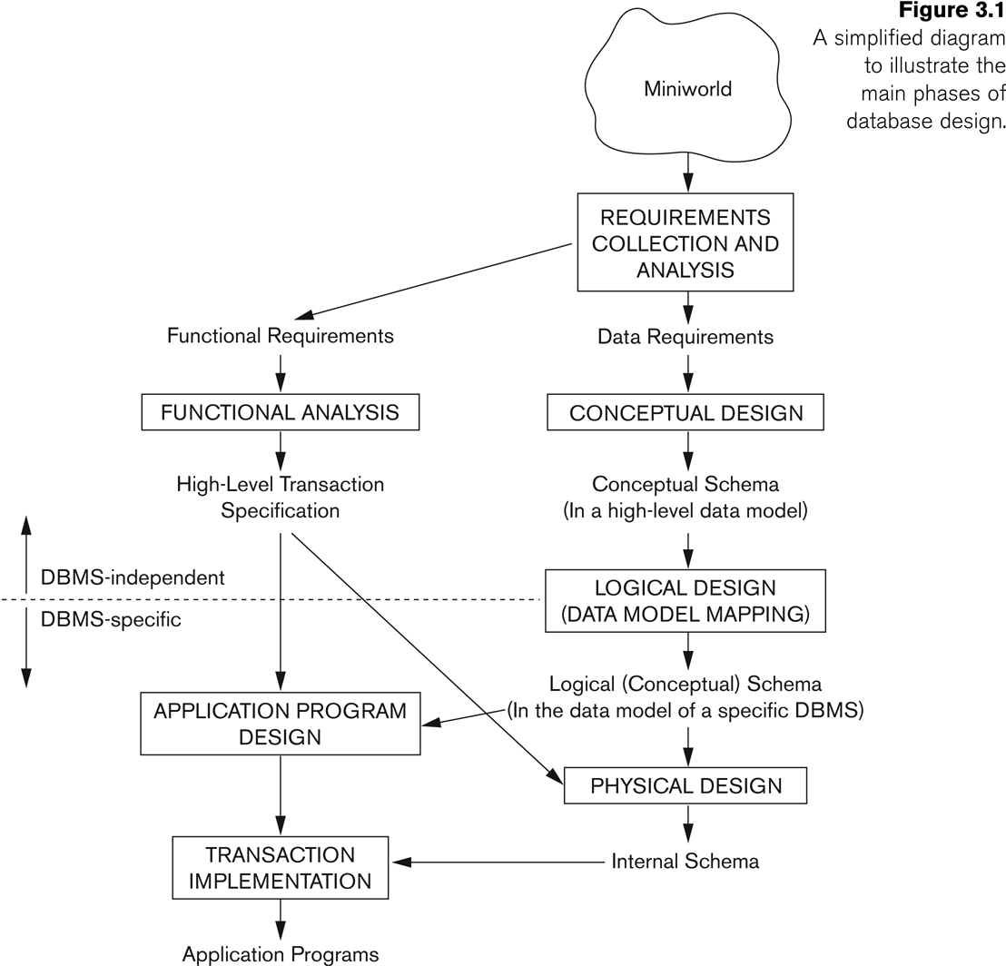
Relational database design using ER-to-relational mapping

Slide 43
Relational database design using ER-to-relational mapping
Example COMPANY Database
We need to create a database schema design based on the following (simplified) requirements of the COMPANY Database:
The company is organized into DEPARTMENTs. Each department has a name, number and an employee who manages the department. We keep track of the start date of the department manager. A department may have several locations.
Each department controls a number of PROJECTs. Each project has a unique name, unique number and is located at a single location.
We store each EMPLOYEE’s social security number, address, salary, sex, and birthdate.
Each employee works for one department but may work on several projects.
We keep track of the number of hours per week that an employee currently works on each project.
We also keep track of the direct supervisor of each employee.
Each employee may have a number of DEPENDENTs.
For each dependent, we keep track of their name, sex, birthdate, and relationship to the employee

Slide 44
Relational database design using ER-to-relational mapping
Entities and Attributes
Entities are specific objects or things in the mini-world that are represented in the database.
For example the EMPLOYEE John Smith, the Research DEPARTMENT, the ProductX PROJECT
Attributes are properties used to describe an entity.
For example an EMPLOYEE entity may have the attributes Name, SSN, Address, Sex, BirthDate
A specific entity will have a value for each of its attributes.
For example a specific employee entity may have Name='John Smith', SSN='123456789', Address ='731, Fondren, Houston, TX', Sex='M', BirthDate='09-JAN-55‘
Each attribute has a value set (or data type) associated with it – e.g. integer, string, subrange, enumerated type,

Slide 45
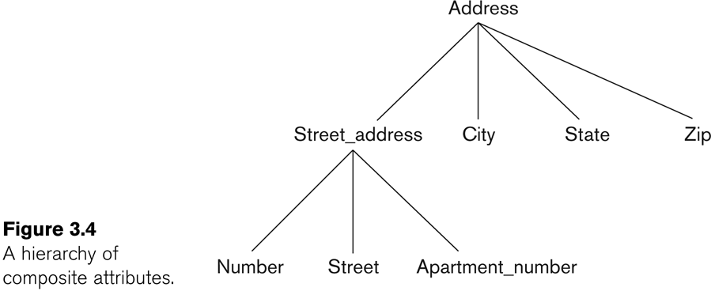
Relational database design using ER-to-relational mapping
Simple
Each entity has a single atomic value for the attribute. For example, SSN or Sex.
Composite
The attribute may be composed of several components.
For example:
Address(Apt#, House#, Street, City, State, ZipCode, Country), or
Name(FirstName, MiddleName, LastName).
Composition may form a hierarchy where some components are themselves composite.

Slide 46
Relational database design using ER-to-relational mapping
Entity Types and Key Attributes
Entities with the same basic attributes are grouped or typed into an entity type.
For example, the entity type EMPLOYEE and PROJECT.
An attribute of an entity type for which each entity must have a unique value is called a key attribute of the entity type.
For example, SSN of EMPLOYEE.
A key attribute may be composite.
VehicleTagNumber is a key of the CAR entity type with components (Number, State).
An entity type may have more than one key.
The CAR entity type may have two keys:
VehicleIdentificationNumber (popularly called VIN)
VehicleTagNumber (Number, State), aka license plate number.
Each key is underlined

Slide 47
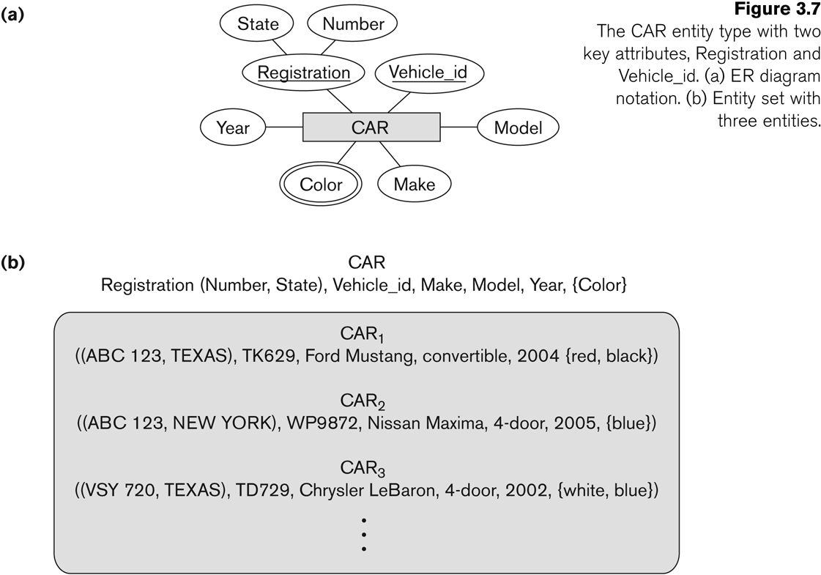
Relational database design using ER-to-relational mapping
In ER diagrams, an entity type is displayed in a rectangular box
Attributes are displayed in ovals
Each attribute is connected to its entity type
Components of a composite attribute are connected to the oval representing the composite attribute
Each key attribute is underlined
Multivalued attributes displayed in
double ovals
See CAR example on next slide

Slide 48
Relational database design using ER-to-relational mapping
Each entity type will have a collection of entities stored in the database
Called the entity set
Previous slide shows three CAR entity instances in the entity set for CAR
Same name (CAR) used to refer to both the entity type and the entity set
Entity set is the current state of the entities of that type that are stored in the database
Based on the requirements, we can identify four initial entity types in the COMPANY database:
DEPARTMENT
PROJECT
EMPLOYEE
DEPENDENT
Their initial design is shown on the following slide
The initial attributes shown are derived from the requirements description

Slide 49
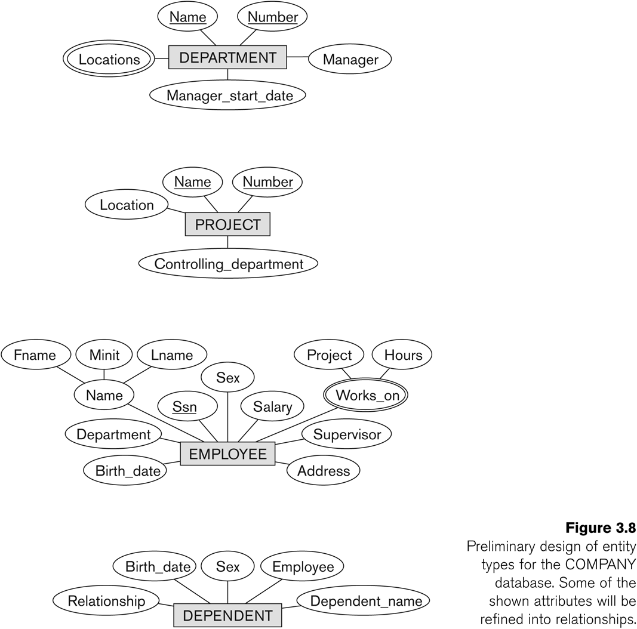
Initial Design of Entity Types: EMPLOYEE, DEPARTMENT, PROJECT, DEPENDENT

Slide 50
Relationship Sets
A relationship relates two or more distinct entities with a specific meaning.
For example,
EMPLOYEE John Smith works on the ProductX PROJECT, or EMPLOYEE Franklin Wong manages the Research DEPARTMENT.
Relationships of the same type are grouped or typed into a relationship type.
For example,
the WORKS_ON relationship type in which EMPLOYEEs and PROJECTs participate, or the MANAGES relationship type in which EMPLOYEEs and DEPARTMENTs participate.
The degree of a relationship type is the number of participating entity types.
Both MANAGES and WORKS_ON are binary relationships

Slide 51
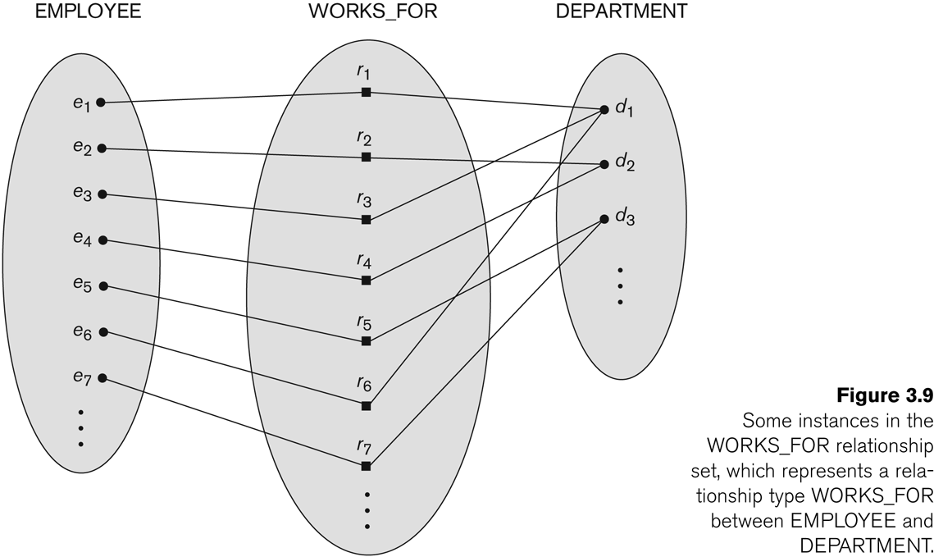
Relationship instances of the WORKS_FOR N:1 relationship between
EMPLOYEE and DEPARTMENT

Slide 52
SQL: Data definition and data types, specifying constraints in SQL
Data Definition, Constraints, and Schema Changes
Used to CREATE, DROP, and ALTER the descriptions of the tables (relations) of a database
Specifies a new base relation by giving it a name, and specifying each of its attributes and their data types (INTEGER, FLOAT, DECIMAL(i,j), CHAR(n), VARCHAR(n))
A constraint NOT NULL may be specified on an attribute CREATE TABLE DEPARTMENT ( DNAME VARCHAR(10) NOT NULL, DNUMBER INTEGER NOT NULL, MGRSSN CHAR(9), MGRSTARTDATE CHAR(9) );

Slide 53
SQL: Data definition and data types, specifying constraints in SQL
In SQL2, can use the CREATE TABLE command for specifying the primary key attributes, secondary keys, and referential integrity constraints (foreign keys).
Key attributes can be specified via the PRIMARY KEY and UNIQUE phrases
CREATE TABLE DEPT (
DNAME VARCHAR(10) NOT NULL,
DNUMBER INTEGER NOT NULL,
MGRSSN CHAR(9),
MGRSTARTDATE CHAR(9),
PRIMARY KEY (DNUMBER),
UNIQUE (DNAME),
FOREIGN KEY (MGRSSN) REFERENCES EMP );

Slide 54
SQL: Data definition and data types, specifying constraints in SQL
DROP TABLE
Used to remove a relation (base table) and its definition
The relation can no longer be used in queries, updates, or any other commands since its description no longer exists
Example: DROP TABLE DEPENDENT;
ALTER TABLE
Used to add an attribute to one of the base relations
The new attribute will have NULLs in all the tuples of the relation right after the command is executed; hence, the NOT NULL constraint is not allowed for such an attribute
Example: ALTER TABLE EMPLOYEE ADD JOB VARCHAR(12);
The database users must still enter a value for the new attribute JOB for each EMPLOYEE tuple.
This can be done using the UPDATE command.

Slide 55
SQL: Data definition and data types, specifying constraints in SQL
CREATE SCHEMA
Specifies a new database schema by giving it a name.
REFERENTIAL INTEGRITY OPTIONS
We can specify RESTRICT, CASCADE, SET NULL or SET DEFAULT on referential integrity constraints (foreign keys)
CREATE TABLE DEPT ( DNAME VARCHAR(10) NOT NULL, DNUMBER INTEGER NOT NULL, MGRSSN CHAR(9), MGRSTARTDATE CHAR(9), PRIMARY KEY (DNUMBER), UNIQUE (DNAME), FOREIGN KEY (MGRSSN) REFERENCES EMP ON DELETE SET DEFAULT ON UPDATE CASCADE);

Slide 56
SQL: Data definition and data types, specifying constraints in SQL
Has DATE, TIME, and TIMESTAMP data types
DATE:
Made up of year-month-day in the format yyyy-mm-dd
TIME:
Made up of hour:minute:second in the format hh:mm:ss
TIME(i):
Made up of hour:minute:second plus i additional digits specifying fractions of a second
format is hh:mm:ss:ii...i

Slide 57
SQL: Data definition and data types, specifying constraints in SQL
TIMESTAMP:
Has both DATE and TIME components
INTERVAL:
Specifies a relative value rather than an absolute value
Can be DAY/TIME intervals or YEAR/MONTH intervals
Can be positive or negative when added to or subtracted from an absolute value, the result is an absolute value
Retrieval Queries in SQL
SQL has one basic statement for retrieving information from a database; the SELECT statement
This is not the same as the SELECT operation of the relational algebra
Important distinction between SQL and the formal relational model:
SQL allows a table (relation) to have two or more tuples that are identical in all their attribute values
Hence, an SQL relation (table) is a multi-set (sometimes called a bag) of tuples; it is not a set of tuples
SQL relations can be constrained to be sets by specifying PRIMARY KEY or UNIQUE attributes, or by using the DISTINCT option in a query

Slide 58
SQL: Data definition and data types, specifying constraints in SQL
Basic form of the SQL SELECT statement is called a mapping or a SELECT-FROM-WHERE block
SELECT <attribute list>
FROM <table list>
WHERE<condition>
<attribute list> is a list of attribute names whose values are to be retrieved by the query
<table list> is a list of the relation names required to process the query
<condition> is a conditional (Boolean) expression that identifies the tuples to be retrieved by the query

Slide 59
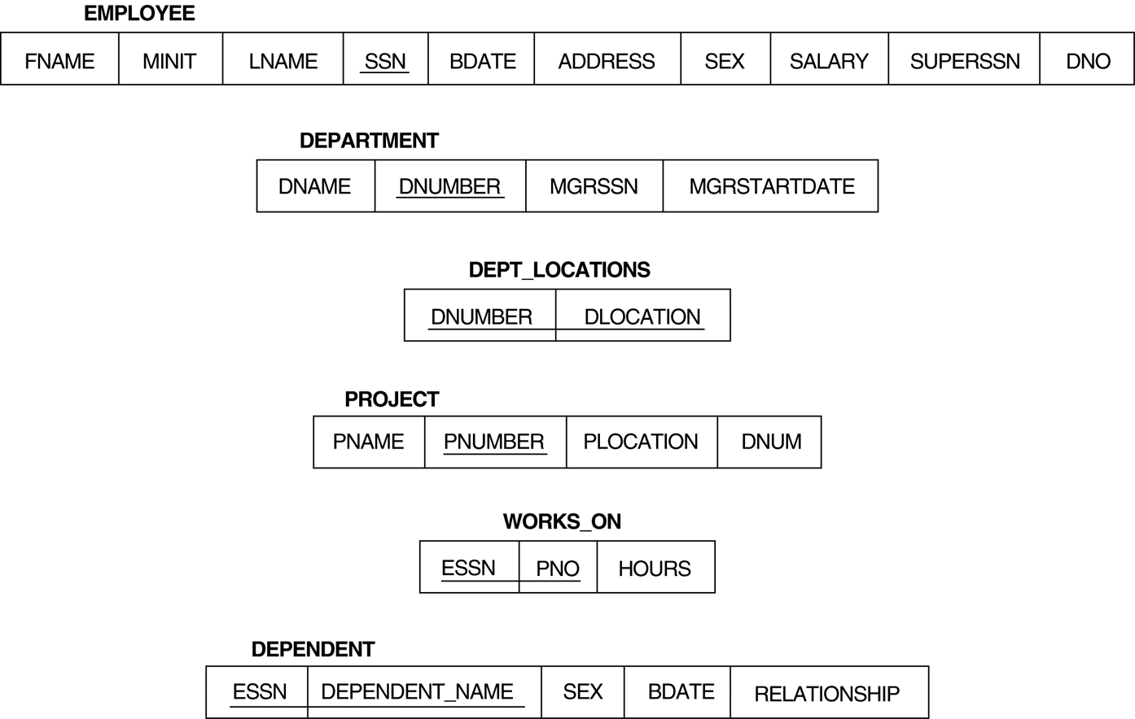
Relational Database Schema

Slide 60
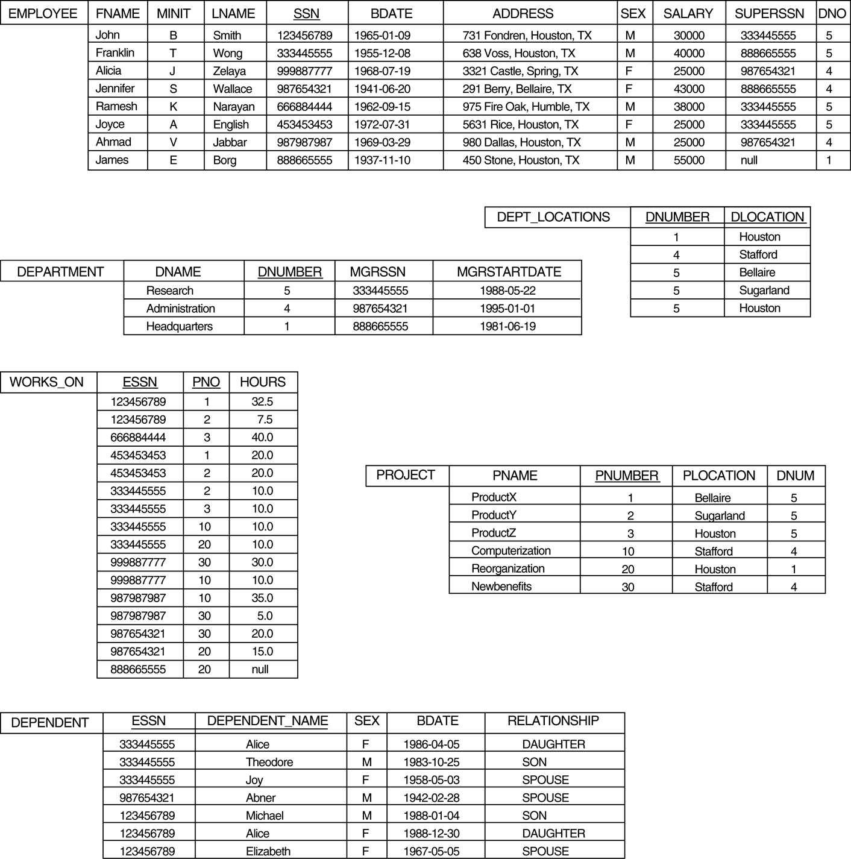
Relational Database Schema

Slide 61
Relational Database Schema
Basic SQL queries correspond to using the following operations of the relational algebra:
SELECT
PROJECT
JOIN
All subsequent examples use the COMPANY database
Example of a simple query on one relation
Query 0: Retrieve the birthdate and address of the employee whose name is 'John B. Smith'.
Q0: SELECT BDATE, ADDRESS FROM EMPLOYEE WHERE FNAME='John' AND MINIT='B’ AND LNAME='Smith’
Similar to a SELECT-PROJECT pair of relational algebra operations:
The SELECT-clause specifies the projection attributes and the WHERE-clause specifies the selection condition
However, the result of the query may contain duplicate tuples

Slide 62
Relational Database Schema
Basic SQL queries correspond to using the following operations of the relational algebra:
SELECT
PROJECT
JOIN
All subsequent examples use the COMPANY database
Example of a simple query on one relation
Query 0: Retrieve the birthdate and address of the employee whose name is 'John B. Smith'.
Q0: SELECT BDATE, ADDRESS FROM EMPLOYEE WHERE FNAME='John' AND MINIT='B’ AND LNAME='Smith’
Similar to a SELECT-PROJECT pair of relational algebra operations:
The SELECT-clause specifies the projection attributes and the WHERE-clause specifies the selection condition
However, the result of the query may contain duplicate tuples

Slide 63
In SQL, we can use the same name for two (or more) attributes as long as the attributes are in different relations
A query that refers to two or more attributes with the same name must qualify the attribute name with the relation name by prefixing the relation name to the attribute name
Example:
EMPLOYEE.LNAME, DEPARTMENT.DNAME
Some queries need to refer to the same relation twice
In this case, aliases are given to the relation name
In the given query which of the keyword has to be inserted?
INSERT INTO employee _____ (1002,Joey,2000);
a) Table
b) Values*
c) Relation
d) Field

Slide 64
Query 8: For each employee, retrieve the employee's name, and the name of his or her immediate supervisor. SELECT E.FNAME, E.LNAME, S.FNAME, S.LNAME FROM EMPLOYEE E S WHERE E.SUPERSSN=S.SSN
In Q8, the alternate relation names E and S are called aliases or tuple variables for the EMPLOYEE relation
We can think of E and S as two different copies of EMPLOYEE; E represents employees in role of supervisees and S represents employees in role of supervisors
SELECT * FROM employee WHERE dept_name="Comp Sci";
In the SQL given above there is an error . Identify the error.
a) Dept_name
b) Employee
c) “Comp Sci”*
d) From

Slide 65
Relationship type vs. relationship set
Relationship Type:
Is the schema description of a relationship
Identifies the relationship name and the participating entity types
Also identifies certain relationship constraints
Relationship Set:
The current set of relationship instances represented in the database
The current state of a relationship type
Each instance in the set relates individual participating entities – one from each participating entity type
In ER diagrams, we represent the relationship type as follows:
Diamond-shaped box is used to display a relationship type
Connected to the participating entity types via straight lines

Slide 66
Relationship type vs. relationship set
By examining the requirements, six relationship types are identified
All are binary relationships( degree 2)
Listed below with their participating entity types:
WORKS_FOR (between EMPLOYEE, DEPARTMENT)
MANAGES (also between EMPLOYEE, DEPARTMENT)
CONTROLS (between DEPARTMENT, PROJECT)
WORKS_ON (between EMPLOYEE, PROJECT)
SUPERVISION (between EMPLOYEE (as subordinate), EMPLOYEE (as supervisor))
DEPENDENTS_OF (between EMPLOYEE, DEPENDENT)

Slide 67
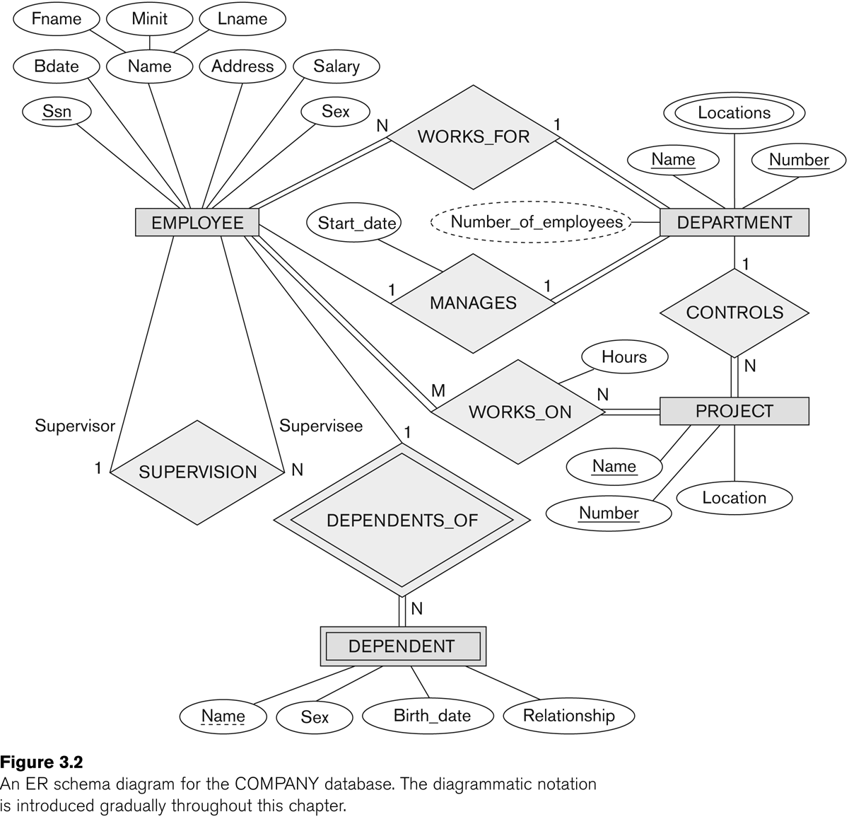
ER DIAGRAM – Relationship Types are: WORKS_FOR, MANAGES, WORKS_ON, CONTROLS, SUPERVISION, DEPENDENTS_OF

Slide 68
Insert, Delete, and update statement in SQL
To insert data into a relation, we either specify a tuple to be inserted or write a Query whose result is a set of tuples to be inserted.
insert into course
values (’CS-437’, ’Database Systems’, ’Comp. Sci.’, 4);
(OR)
insert into course (course id, title, dept name, credits)
values (’CS-437’, ’Database Systems’, ’Comp. Sci.’, 4);
In certain situations, we may wish to change a value in a tuple without changing all values in the tuple. For this purpose, the update statement can be used.
Suppose that annual salary increases are being made, and salaries of all instructors are to be increased by 5 percent. We write:
update instructor
set salary= salary * 1.05;

Slide 69
MCQ’s
1. A relational database consists of a collection of
a) Tables*
b) Fields
c) Records
d) Keys
2. The term _______ is used to refer to a row.
a) Attribute
b) Tuple*
c) Field
d) Instance
3. Course(course_id,sec_id,semester) Here the course_id,sec_id and semester are __________ and course is a _________
a) Relations, Attribute
b) Attributes, Relation*
c) Tuple, Relation
d) Tuple, Attributes
4. A domain is atomic if elements of the domain are considered to be ____________ units.
a) Different
b) Indivisbile*
c) Constant
d) Divisible

Slide 70
5.Using which language can a user request information from a database?
a) Query*
b) Relational
c) Structural
d) Compiler
6.Which one of the following is a procedural language?
a) Domain relational calculus
b) Tuple relational calculus
c) Relational algebra*
d) Query language
7.The_____ operation allows the combining of two relations by merging pairs of tuples, one from each relation, into a single tuple.
a) Select
b) Join*
c) Union
d) Intersection
8.The result which operation contains all pairs of tuples from the two relations, regardless of whether their attribute values match.
a) Join
b) Cartesian product*
c) Intersection
d) Set difference

Slide 71
9. The _______operation performs a set union of two “similarly structured” tables
a) Union*
b) Join
c) Product
d) Intersect
10. The _______ operator takes the results of two queries and returns only rows that appear in both result sets.
a) Union
b) Intersect*
c) Difference
d) Projection
11.A ________ is a pictorial depiction of the schema of a database that shows the relations in the database, their attributes, and primary keys and foreign keys.
a) Schema diagram*
b) Relational algebra
c) Database diagram
d) Schema flow

Slide 72
Insert, Delete, and update statement in SQL
12.Here which of the following displays the unique values of the column?
SELECT ________ dept_name FROM instructor;
a) All
b) From
c) Distinct*
d) Name
13.The ______ clause allows us to select only those rows in the result relation of the ____ clause that satisfy a specified predicate.
a) Where, from*
b) From, select
c) Select, from
d) From, where
14.he query given below will not give an error. Which one of the following has to be replaced to get the desired output?
SELECT ID, name, dept name, salary * 1.1 WHERE instructor;
a) Salary*1.1
b) ID
c) Where*
d) Instructor

Slide 73
Insert, Delete, and update statement in SQL
15.This Query can be replaced by which one of the following?
SELECT name, course_id FROM instructor, teaches WHERE instructor_ID= teaches_ID;
a) Select name,course_id from teaches,instructor where instructor_id=course_id;
b) Select name, course_id from instructor natural join teaches;*
c) Select name, course_id from instructor;
d) Select course_id from instructor join teaches;
16.SELECT * FROM employee WHERE salary>10000 AND dept_id=101;
Which of the following fields are displayed as output?
a) Salary, dept_id
b) Employee
c) Salary
d) All the field of employee relation*

Slide 74
Insert, Delete, and update statement in SQL
17. Employee_id Name Salary
1001 Annie 6000
1009 Ross 4500
1018 Zeith 7000
This is Employee table.
Which of the following employee_id will be displayed for the given query?
SELECT * FROM employee WHERE employee_id>1009;
a) 1009, 1001, 1018
b) 1009, 1018
c) 1001
d) 1018*
18.Which of the following statements contains an error?
a) Select * from emp where empid = 10003;
b) Select empid from emp where empid = 10006;
c) Select empid from emp;
d) Select empid where empid = 1009 and lastname = ‘GELLER’;*

Slide 75
QUESTION BANK
1. Explain the various update operations involved in the Relational model.
2. Explain the steps involved in ER mapping to relational mapping taking a suitable example.
3. Discuss entity integrity and referential integrity constraints. Why is each considered important?
4. Discuss the different relational algebra operations.
5. Explain the different relational model constraints & possible violation during an update operation.
6. With an example explain clearly JOIN and UNION operations in relational algebra. Bring out the difference between natural JOIN and OUTER JOIN.
7. Define different set operations in relational algebra. Give one example of each.
8. With respect to ER model explain with example.
9.What is meant by partial key? Explain.
10.Define an entity and an attribute, explain the different types of attributes that occur in an ER diagram model,with an example
11. Design an ER Diagram for keeping track of Information about Bank Database,Taking into account 4 entities?
12.Define referential integrity constraint. Explain the importance of referential integrity constraint. How is this constraint implemented in SQL
13.Discuss the characteristics of a relation, with an example
14.Briefly discuss the different types of update operations on relational database. show an example of a violation ofreferential integrity in each of the update operation
15. Explain Foreign key and its importance. Can foreign key exist, only for single table explain?
16. Write queries in Relational Algebra?
17.How does E.FNAME=DEPENDENT_NAME) SQL inplement the entity integrity constraints of relational Data Model?Explain with an example?

Slide 76
Innovative Content link
Catalog Views / Data Dictionary Views
The data dictionary views, also known as catalog views, let you monitor the state of the database in real time:
The USER, ALL, and DBA, views show information about schema objects that are accessible to you,
at different levels of privilege.
The V$ views show performance-related information.
The _PRIVS views show privilege information for different combinations of users, roles, and objects.

Slide 77
Insert, Delete, and update statement in SQL
17. Employee_id Name Salary
1001 Annie 6000
1009 Ross 4500
1018 Zeith 7000
This is Employee table.
Which of the following employee_id will be displayed for the given query?
SELECT * FROM employee WHERE employee_id>1009;
a) 1009, 1001, 1018
b) 1009, 1018
c) 1001
d) 1018*
18.Which of the following statements contains an error?
a) Select * from emp where empid = 10003;
b) Select empid from emp where empid = 10006;
c) Select empid from emp;
d) Select empid where empid = 1009 and lastname = ‘GELLER’;*

Slide 78
Case Studies
Case Study 1: A customized solution was needed to handle their expanding business. Homegrown systems were being used to enter and process orders, manage books offered, and track customers. Day to day operation was becoming inefficient and unorganized. A re-organization of the systems used for operations was needed. The company also wanted to build an E-commerce website to generate additional business and allow existing and new customers to place orders online.
Case Study 2: The company manages many different types of construction projects. Each project type has a different set of tasks that need to be completed. Goldmine Customer Relationship Manager (CRM) was being used by their Project Managers to track projects. As the business grew, Goldmine became inefficient and a customized system was needed to enable their Project Managers to work effectively

Slide 79
Insert, Delete, and update statement in SQL
References
Elmasri and Navathe: Fundamentals of Database Systems, 5th Edition, Pearson Education, 2007 (Chapters 1, 2, 3 except 3.8, 5, 6.1 to 6.5, 7.1, 8, 9.1, 9.2 except SQLJ, 9.4, 10)
Raghu Ramakrishnan and Johannes Gehrke: Database Management Systems, 3rd Edition, McGraw-Hill, 2003. (Chapters 16, 17.1, 17.2, 18)
https://www.w3schools.com/sql/
https://nptel.ac.in/courses/106/104/106104135/

