Slide 1
SUBJECT NAME: WEB TECHNOLOGY TOPIC: MODULE V
SUBJECT CODE:19cs54
DEPARTMENT:COMPUTER SCIENCE AND ENGINEERING

Slide 2
Advanced JavaScript & JQuery

Slide 3
JAVASCRIPT PSEUDO-CLASSES

Slide 4
JavaScript has no formal class mechanism, it does support
objects (DOM).
While most OO languages that supports objects also support classes formally, JavaScript does not.
Instead we define Pseudo – classes through a variety of syntax.

Slide 5
Using Object Literals
Without Classes
An array in JavaScript can be instantiated
var daysofweek = [“sun” , ”mon” , “tue”…..];
An object can be instantiated using object literals.
Object literals are a list of key-value pairs with colons between the
key and value with commas separating key-value pairs.
Object literals are also known as Plain Objects in jQuery.

Slide 6
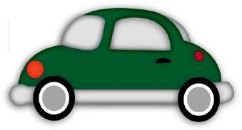
Object Oriented Design
Without Classes
JavaScript has no formal class mechanism.
Simple Variable var car = "Fiat";
Then this
var car = {type:"Fiat", model:500, color:"white"};
Properties car.name = Fiat car.model = 500 car.weight = 850kg car.color = white
Methods: car.start() car.drive() car.brake() car.stop()

Slide 7
Using Object Literals
Consider a die (single dice)
//define a 6 faced dice, with a red color.
var oneDie = { color : "FF0000",
faces : [1,2,3,4,5,6]
};
These elements can be accessed using dot notation.
For instance
oneDie.color="0000FF";

Slide 8
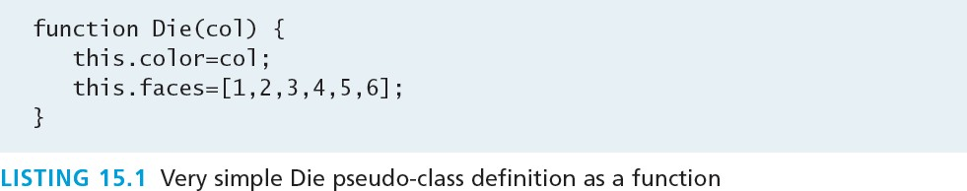
Emulate Classes with functions
We told you this would get weird
Use functions to encapsulate variables and methods together.
Instantiation looks much like in PHP:
var oneDie = new Die("0000FF");

Slide 9
Emulate Classes with functions
Adding methods to the objects
To define a method in an object’s function one can either define it internally or use a reference to a function define outside the class.
One technique for adding a method inside of a class definition is by assigning an anonymous function to a variable

Slide 10
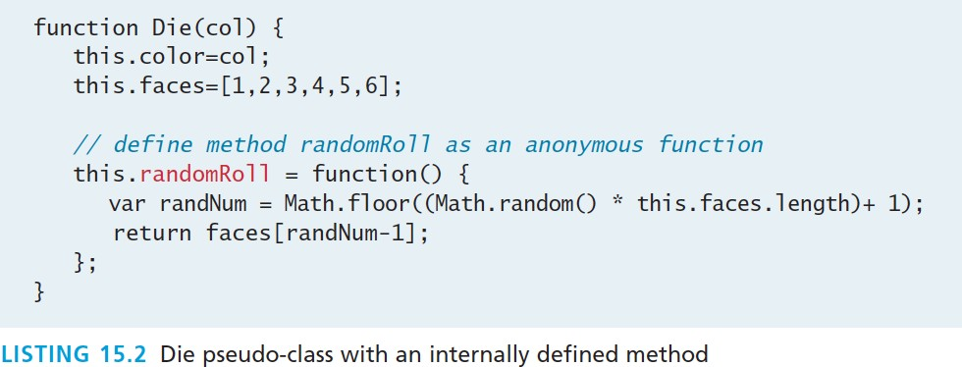
Emulate Classes with functions
var oneDie = new Die("0000FF"); console.log(oneDie.randomRoll() + " was rolled");

Slide 11
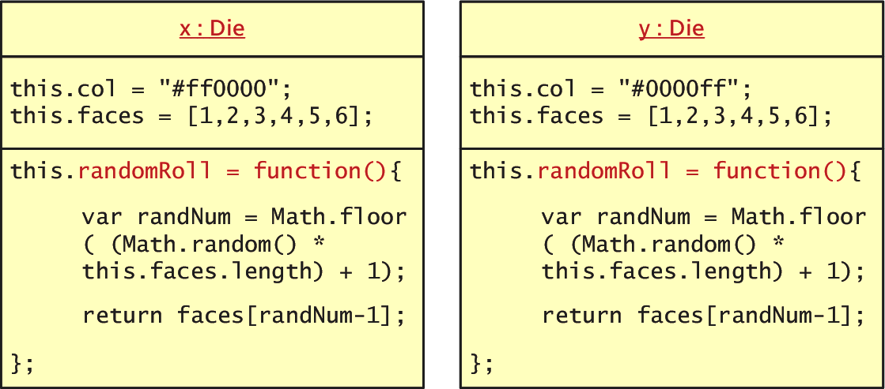
Emulate Classes with functions
Not very efficient
This mechanism for methods in effective, it is not a memory efficient approach because each inline method is redefined for each new object

Slide 12
Using Prototypes
Prototypes
So you can use a prototype of the class.
Prototypes are used to make JavaScript behave more like an object-oriented language.
The prototype properties and methods are defined once for
all instances of an object.
Every object has a prototype

Slide 13
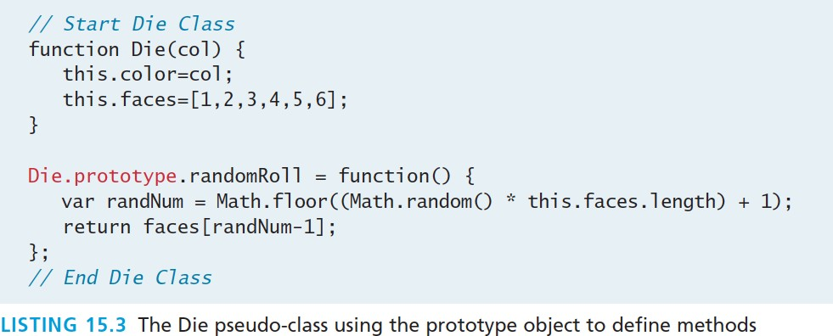
Using Prototypes
moving the randomRoll() function into the prototype.
This definition is better because it defines the method only
once, no matter how many instance of die are created.
How many ever created it will be reference to that one method. (fig below)

Slide 14
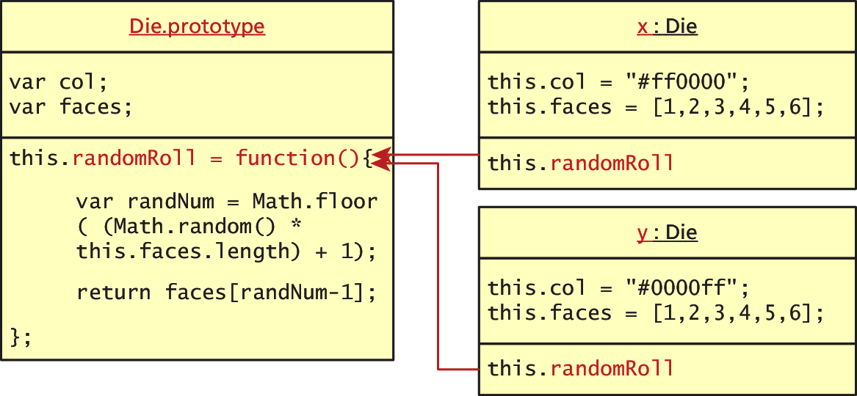
Using Prototypes
No duplication of methods
Since all instances of a Die share the same prototype object, the function declaration only happens one time and is shared with all Die instances.
A prototype is an object from which other
objects inherit.

Slide 15
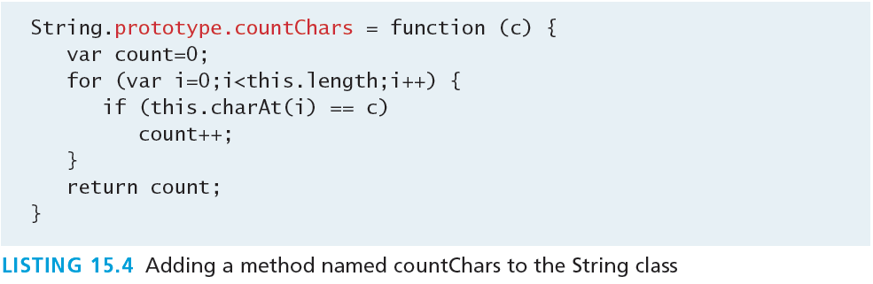
More about Prototypes
Extend any Object
Every object (and method) in JavaScript has a prototype.
In addition to using prototypes for our own pseudo-classes, prototypes enable you to extend existing classes by adding to their prototypes
Below we extend String:

Slide 16
JQUERY FOUNDATIONS

Slide 17
jQuery
Framework
A library or framework is software that you can utilize in your own software, which provides some common implementations of standard ideas.
Many developers find that once they start using a
framework like jQuery, there’s no going back to “pure”
JavaScript because the framework offers so
many useful
shortcuts and breif ways of doing things

Slide 18
jQuery
A 1 slide history
In August 2005 jQuery founder John Resig was looking into how to better combine CSS selectors with succinct JavaScript notation.
Within 1 year AJAX and animations were added
Additional modules
jQuery UI extension
mobile device support
Continues to improve.

Slide 19
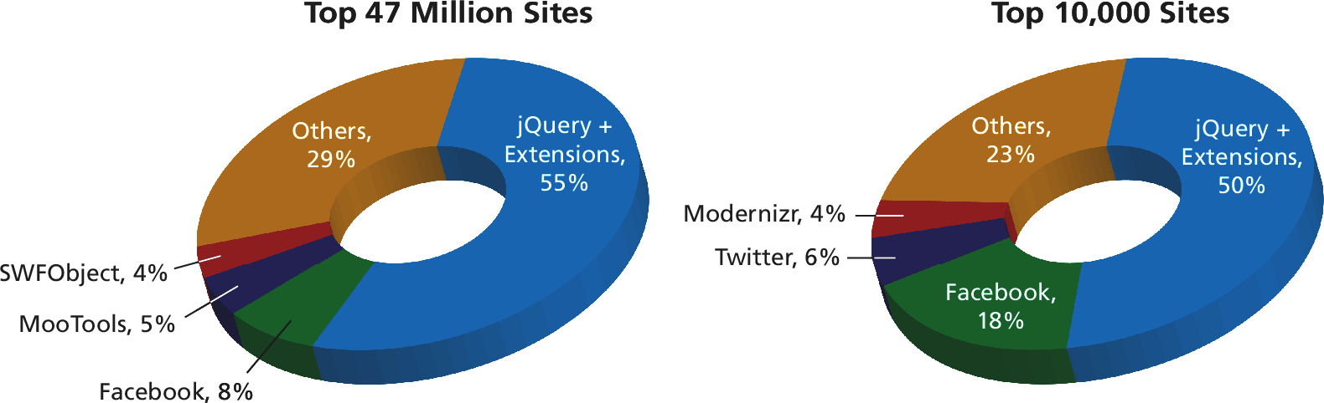
jQuery
Not the only one, but a popular one
jQuery is now the most popular JavaScript library currently in
use as supported by the statistics from BuiltWith.com

Slide 20
Including jQuery
Let’s get started
You must either:
link to a locally hosted version of the library
Use an approved third-party host, such
as Google,
Microsoft, or jQuery itself

Slide 21
Including jQuery
Content Delivery Network
Using a third-party content delivery network (CDN) is
advantageous for several reasons.
The bandwidth of the file is offloaded to reduce the demand on your servers.
The user may already have cached the third-party file and thus not have to download it again, thereby reducing the total loading time.
A disadvantage to the third-party CDN is that your jQuery will fail if the third-party host fails (unlikely but possible)

Slide 22
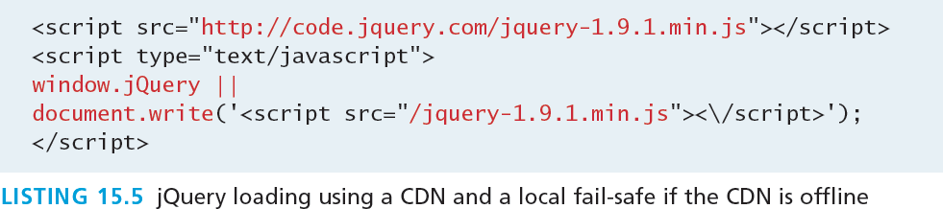
Including jQuery
Content Delivery Network and fallback

Slide 23
jQuery Selectors
Should ring a bell
When discussing basic JavaScript we introduced the getElementByID() and querySelector() selector functions in JavaScript.
Although the advanced querySelector() methods allow selection of DOM elements based on CSS selectors, it is only implemented in newest browsers
jQuery introduces its own way to select an element, which
under the hood supports a myriad of older browsers for you!

Slide 24
jQuery Selectors
The easiest way to select an element yet
The relationship between DOM objects and selectors is so important in JavaScript programming that the pseudo-class bearing the name of the framework,
jQuery()
Is reserved for selecting elements from the DOM.
Because it is used so frequently, it has a shortcut notation
and can be written as
$()

Slide 25
Basic Selectors
All the way back to CSS
The four basic selectors are:
$("*") Universal selector matches all elements (and is slow).
$("tag") Element selector matches all elements with the
given element name.
$(".class") Class selector matches all elements with the given CSS class.
$("#id") Id selector matches all elements with a given HTML
id attribute.

Slide 26
Basic Selectors
All the way back to CSS
For example, to select the single <div> element with
id="grab" you would write:
var singleElement = $("#grab");
To get a set of all the <a> elements the selector would be:
var allAs = $("a");
These selectors replace the use of getElementById()
entirely.

Slide 27
More CSS Selectors
jQuery’s selectors are powerful indeed
In addition to these basic selectors, you can use the other
CSS selectors that were covered in Chapter 3 on CSS:
attribute selectors,
pseudo-element selectors, and
contextual selectors

Slide 28
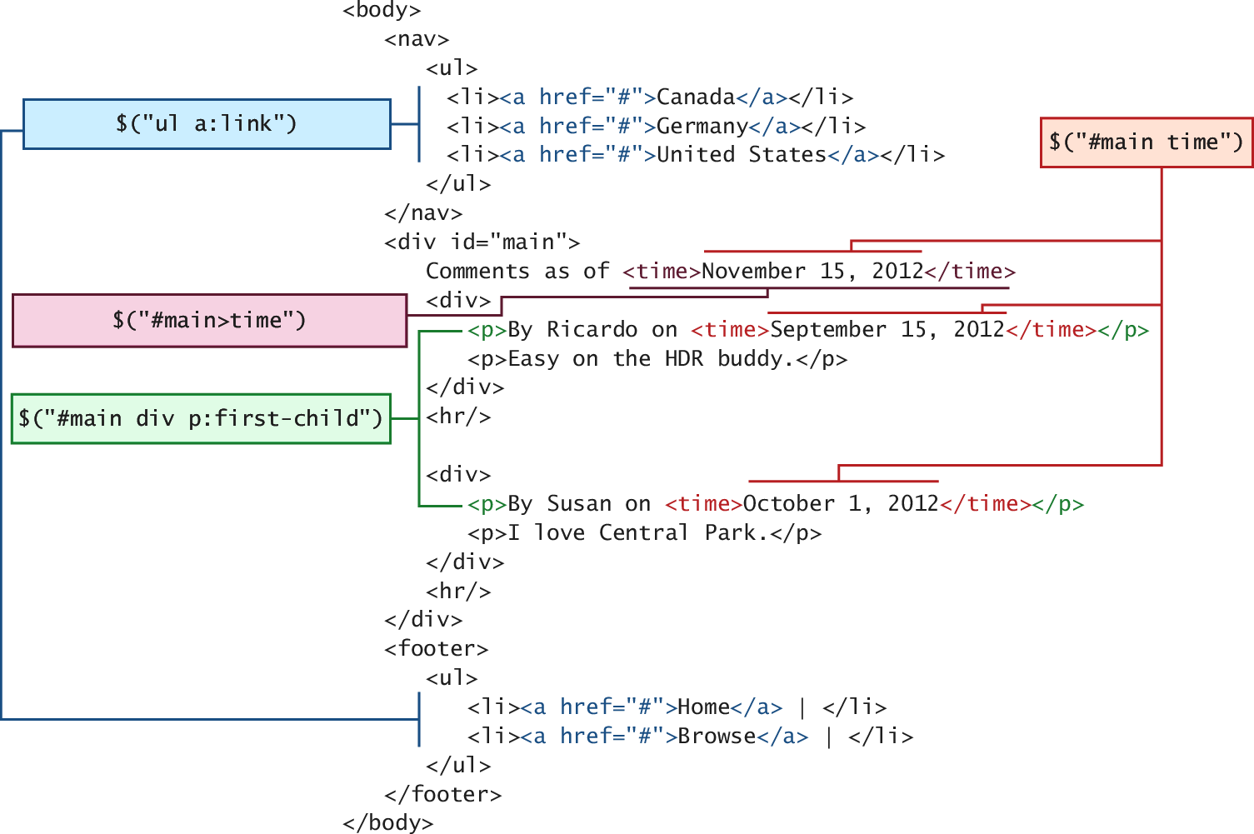
More CSS Selectors
jQuery’s selectors are powerful indeed

Slide 29
Attribute Selector
Really a review of CSS
Recall from CSS that you can select
by attribute with square brackets
[attribute]
Specify a value with an equals sign
[attribute=value]
Search for a particular value in the beginning, end, or anywhere
inside a string
[attribute^=value]
[attribute$=value]
[attribute*=value]

Slide 30
Attribute Selector
Really a review of CSS
Consider a selector to grab all <img> elements with an src
attribute beginning with /artist/ as:
var artistImages = $("img[src^='/artist/']");

Slide 31
Pseudo-Element Selector
Not to be confused with the pseudo-classes in JavaScript
pseudo-element selectors are also from CSS and allow you
to append to any selector using the colon and one of
:link
:visited
:focus
:hover
:active
:checked
:first-child, :first-line, and :first-letter

Slide 32
Pseudo-Element Selector
Not to be confused with the pseudo-classes in JavaScript
Selecting all links that have been visited, for example,
would be specified with:
var visitedLinks = $("a:visited");

Slide 33
Contextual Selector
Put it into context
Contextual selectors are also from CSS. Recall that
these include:
descendant (space)
child (>)
adjacent sibling (+)
and general sibling (~).
To select all <p> elements inside of <div> elements you would write
var para = $("div p");

Slide 34
Content Filters
Above and Beyond CSS
The content filter is the only jQuery selector that allows you to append filters to all of the selectors you’ve used thus far and match a particular pattern.
Select elements that have:
a particular child using :has()
have no children using :empty
match a particular piece of text with :contains()

Slide 35
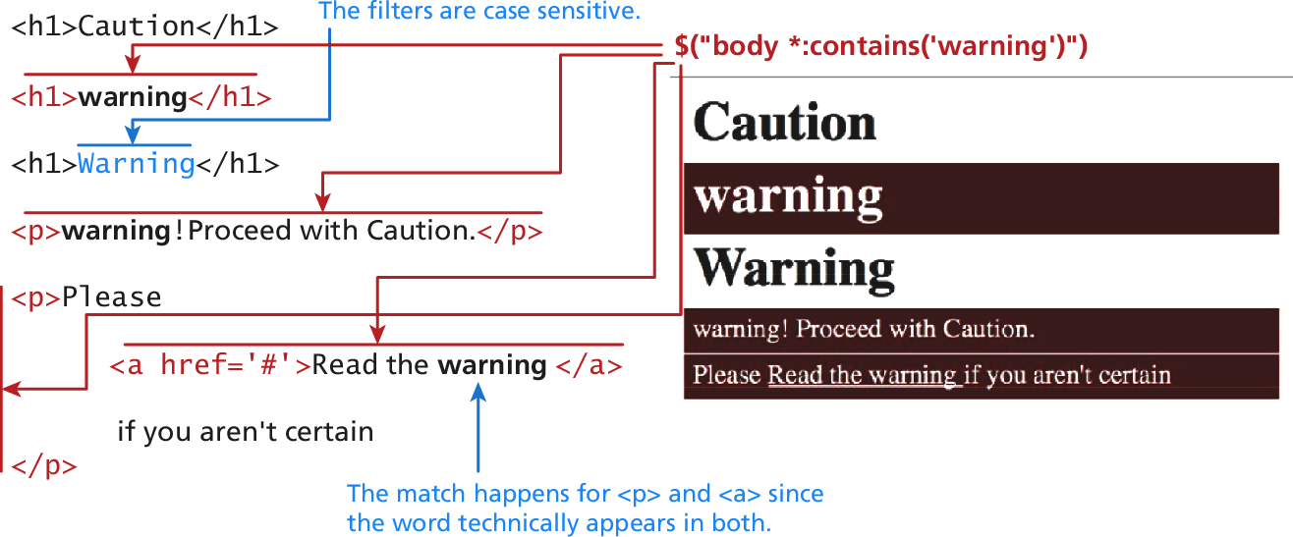
Content Filters
Above and Beyond CSS
$("body *:contains('warning')”)

Slide 36
Form Selectors
Selector | CSS Equivalent | Description
$(:button) | $("button, input[type='button']") | Selects all buttons
$(:checkbox ) | $('[type=checkbox]‘) | Selects all checkboxes
$(:checked) | No Equivalent | Selects elements that are checked. This includes radio buttons and checkboxes.
$(:disabled) | No Equivalent | Selects form elements that are disabled.
$(:enabled) | No Equivalent | Opposite of :disabled
$(:file) | $('[type=file]') | Selects all elements of type file
$(:focus) | $( document.activeElement ) | The element with focus
$(:image) | $('[type=image]') | Selects all elements of type image
$(:input) | No Equivalent | Selects all <input>, <textarea>, <select>, and <button> elements.
$(:password ) | $('[type=password]') | Selects all password fields
$(:radio) | $('[type=radio]') | Selects all radio elements
$(:reset) | $('[type=reset]') | Selects all the reset buttons
$(:selected) | No Equivalent | Selects all the elements that are currently selected of type <option>. It does not include checkboxes or radio buttons.
$(:submit) | $('[type=submit]') | Selects all submit input elements
$(:text) | No Equivalent | Selects all input elements of type text. $('[type=text]') is almost the same, except that $(:text) includes <input> fields with no type
Above an
d Beyond CSS
specified.

Slide 37
jQuery Attributes
Back to HTML now.
In order to understand how to fully manipulate the elements you now have access to, one must understand an element’s attributes and properties.
The core set of attributes related to DOM elements are the
ones specified in the HTML tags.
The href attribute of an <a> tag
The src attribute of an <img>
The class attribute of most elements

Slide 38
jQuery Attributes
And some examples
In jQuery we can both set and get an attribute value by using
the attr() method on any element from a selector.
// var link is assigned the href attribute of the first <a> tag
var link = $("a").attr("href");
// change all links in the page to http://funwebdev.com
$("a").attr("href","http://funwebdev.com");
// change the class for all images on the page to fancy
$("img").attr("class","fancy");

Slide 39
HTML Properties
Full circle
Many HTML tags include properties as well as attributes, the most common being the checked property of a radio button or checkbox.
The prop() method is the preferred way to retrieve and set the value of a property although, attr() may return some (less useful) values.
<input class ="meh" type="checkbox" checked="checked">
Is accessed by jQuery as follows:
to "checked"

Slide 40
HTML Properties
Full circle
var theBox = $(".meh"); theBox.prop("checked"); // evaluates to TRUE theBox.attr("checked"); // evaluates to "checked"

Slide 41
Changing CSS
With jQuery
jQuery provides the extremely intuitive css() methods.
To get a css value use the css() method with 1 parameter:
$color = $("#colourBox").css("background-color"); // get the color
To set a CSS variable use css() with two parameters: the first being the CSS attribute, and the second the value.
// set color to red
$("#colourBox").css("background-color", "#FF0000");

Slide 42
Shortcut Methods
With jQuery
The html() method is used to get the HTML contents of an element. If passed with a parameter, it updates the HTML of that element.
The val() method returns the value of the element.
The shortcut
/
removeClass(className) add or remove a CSS class to the
methods addClass(className)
element being worked on. The className used for these functions can contain a space-separated list of classnames to be added or removed.
The hasClass(classname) method returns true if the element has the className currently assigned. False, otherwise.

Slide 43
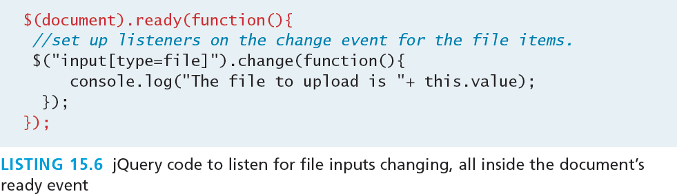
jQuery Listeners
Set up after page load
In JavaScript, you learned why having your listeners set up inside
of the window.onload() event was a good practice.
With jQuery we do the same thing but use the
$(document).ready() event

Slide 44
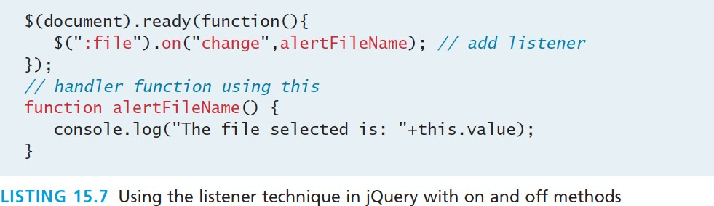
jQuery Listeners
Listener Management
While pure JavaScript uses the addEventListener() method, jQuery has on() and off() methods as well as shortcut methods to attach events.

Slide 45
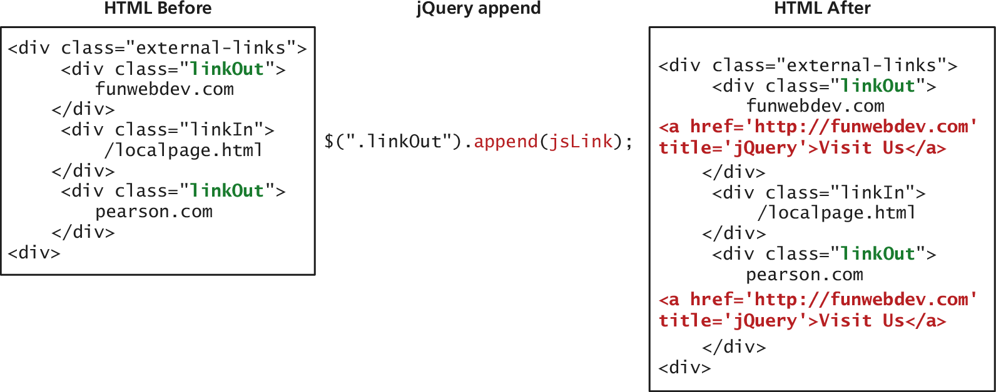
Modifying the DOM
Appending DOM Elements
The append() method takes as a parameter an HTML string, a DOM object, or a jQuery object. That object is then added as the last child to the element(s) being selected.

Slide 46
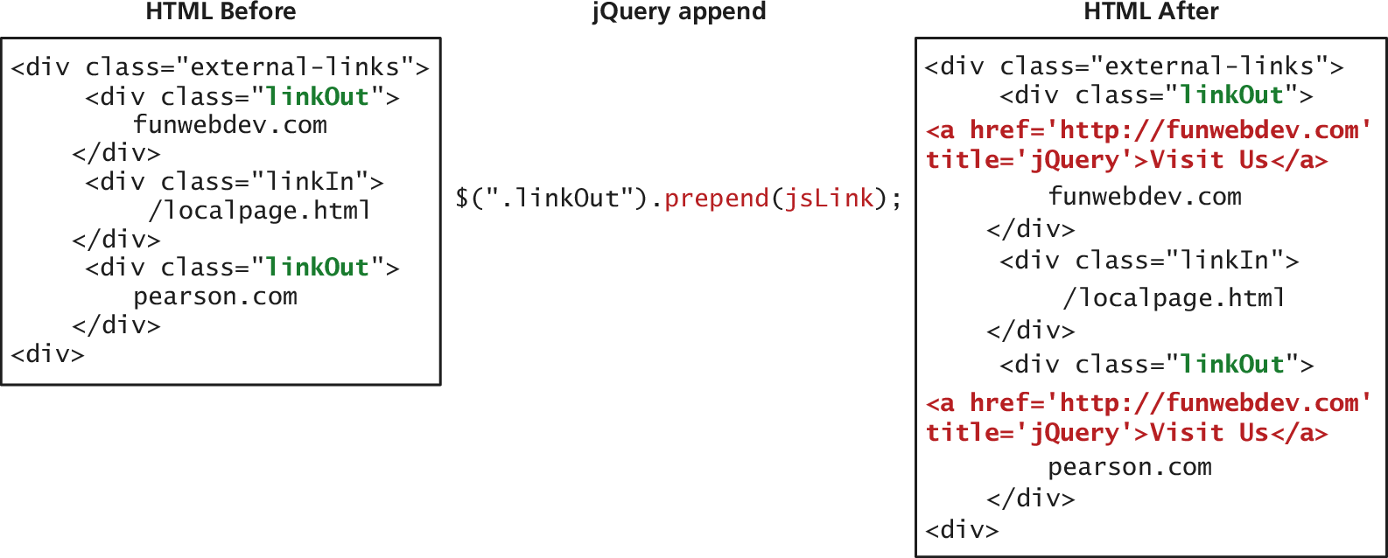
Modifying the DOM
Prepending DOM Elements
The prepend() and prependTo() methods operate in a similar manner except that they add the new element as the first child rather than the last.

Slide 47
Modifying the DOM
Wrapping Existing DOM in New Tags
A more advanced technique might make use of the content of each div being modified. In that case we use a callback function in place of a simple element.
The wrap() method is a callback function, which is called
for each element in a set (often an array).
Each element then becomes this for the duration of one of the wrap() function’s executions, allowing the unique title attributes as shown in Listing 15.12.

Slide 48
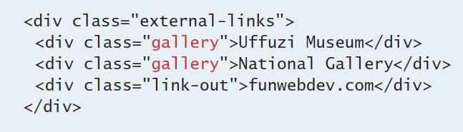
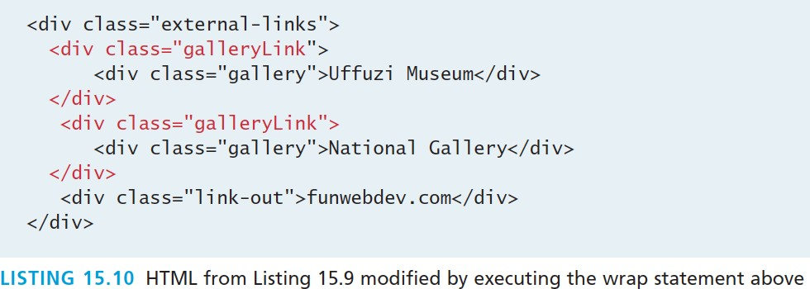
Modifying the DOM
Wrapping Existing DOM in New Tags
$(".gallery").wrap('<div class="galleryLink"/>');

Slide 49
AJAX

Slide 50
AJAX
Asynchronous JavaScript with XML
Asynchronous JavaScript with XML (AJAX) is a term used to describe a paradigm that allows a web browser to send messages back to the server without interrupting the flow of what’s being shown in the browser.

Slide 51
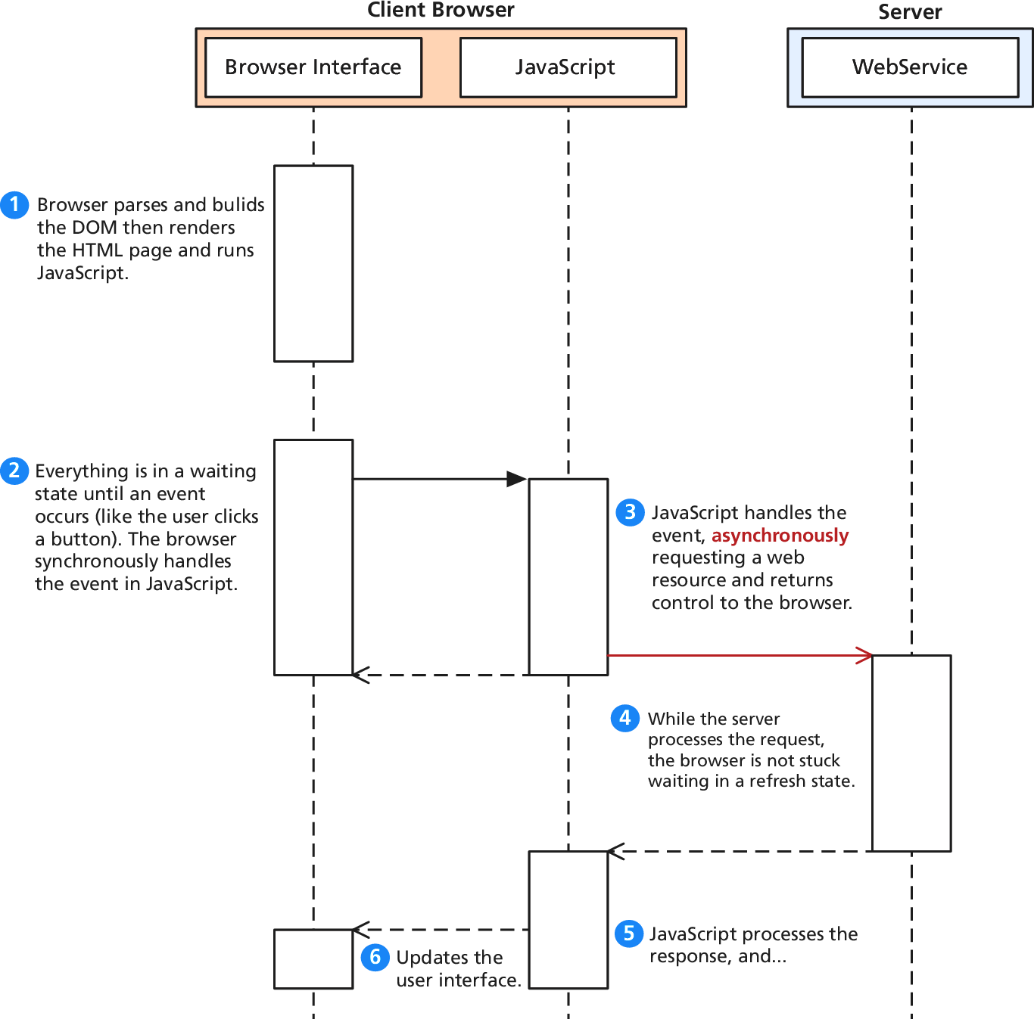
AJAX
UML of an asynchronous request

Slide 52
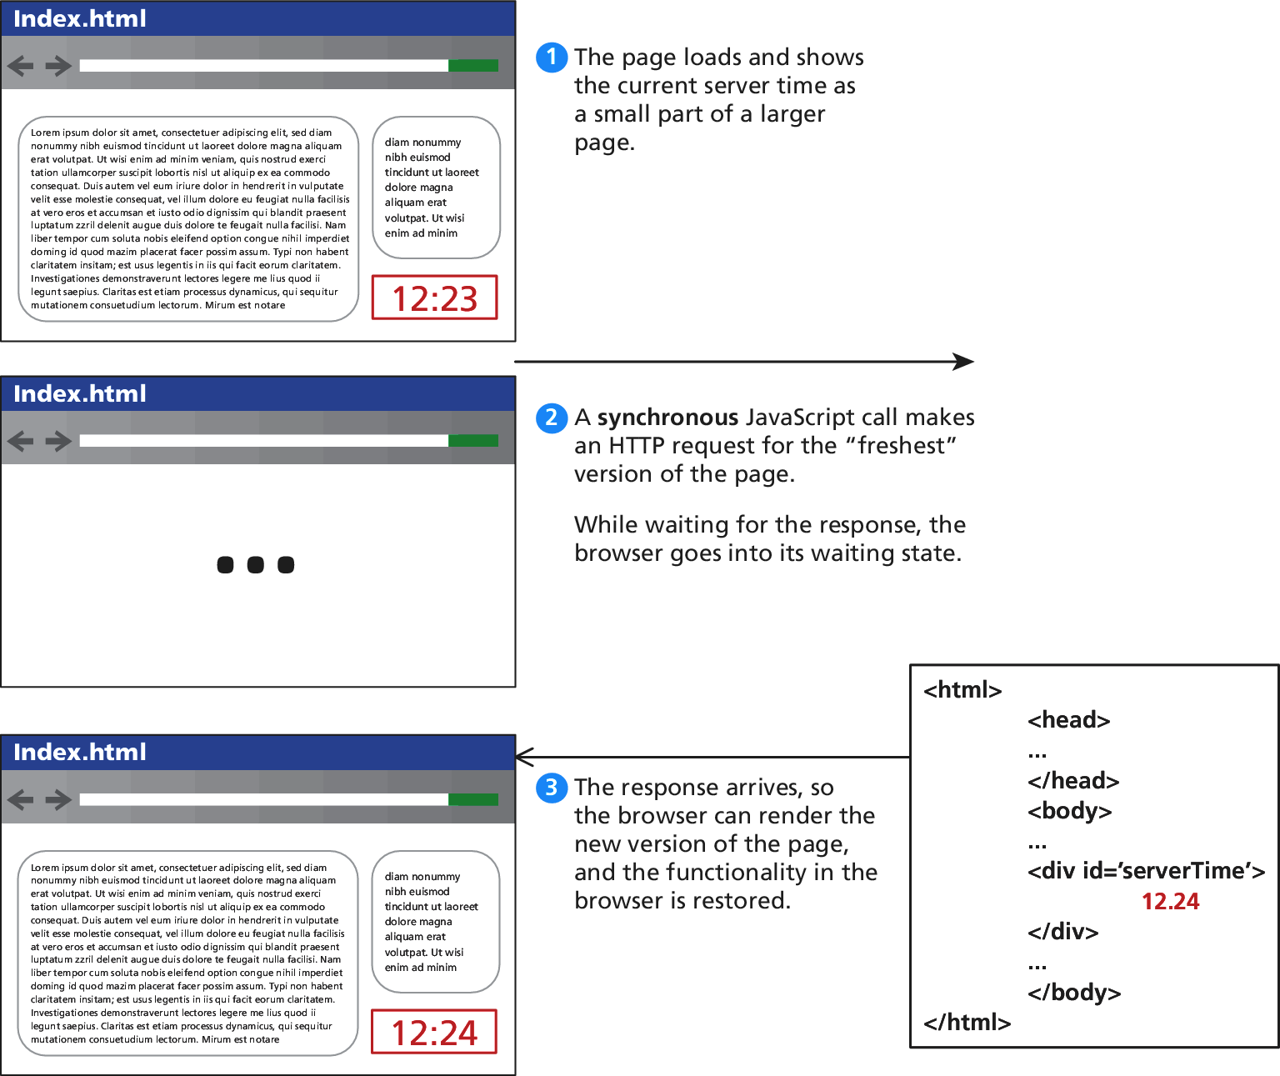
AJAX
Consider a webpage that displays the server’s time

Slide 53
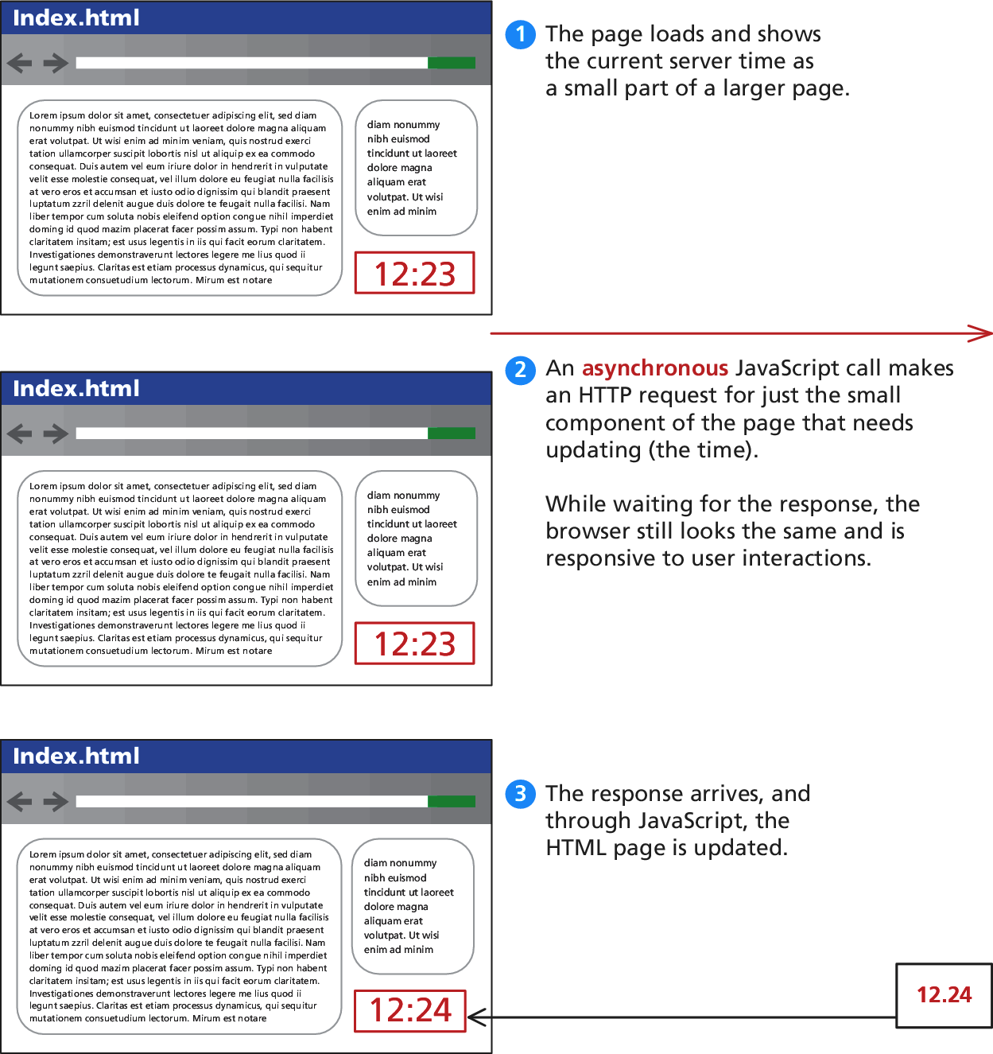
AJAX
Consider a webpage that displays the server’s time

Slide 54
AJAX
Making Asynchronous requests
jQuery provides a family of methods to make asynchronous
requests. We will start simple and work our way up.
Consider the very simple server time example we just saw. If currentTime.php returns a single string and you want to
into the
load that value asynchronously
<div id="timeDiv"> element, you could write:
$("#timeDiv").load("currentTime.php");

Slide 55
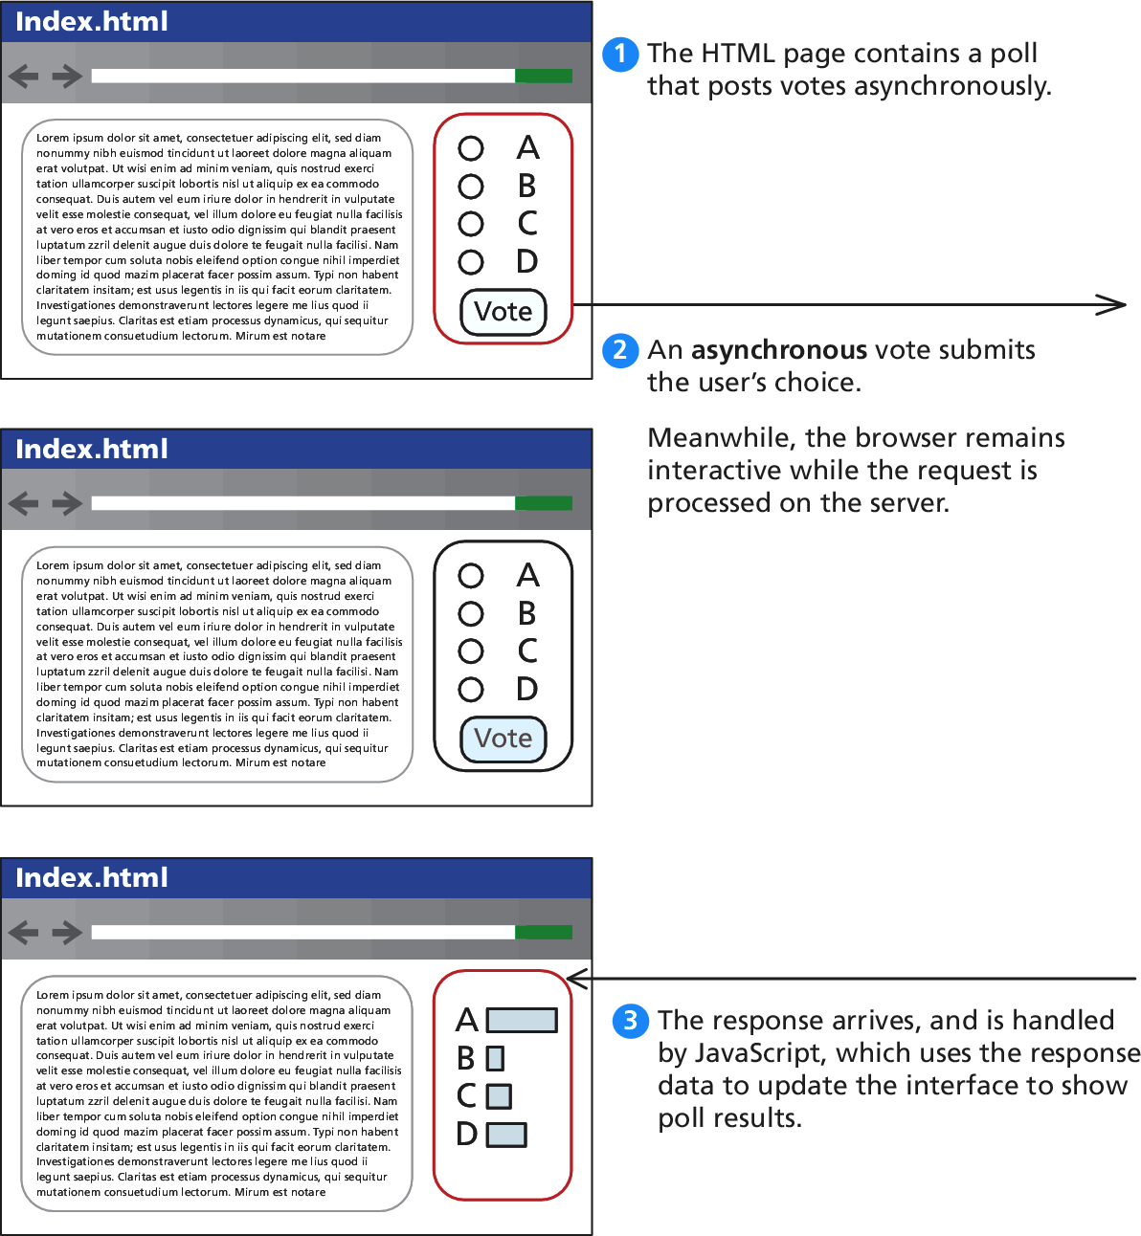
AJAX
GET Requests
$.get("/vote.php?option=C");

Slide 56
AJAX
GET Requests – formal definition
jQuery.get ( url [, data ] [, success(data, textStatus, jqXHR) ] [, dataType ] )
url is a string that holds the location to send the request.
data is an optional parameter that is a query string or a Plain Object.
success(data,textStatus,jqXHR) is an optional callback function that
executes when the response is received.
data holding the body of the response as a string.
textStatus holding the status of the request (i.e., “success”).

Slide 57
AJAX
GET Requests – formal definition
jqXHR holding a jqXHR object, described shortly.
dataType is an optional parameter to hold the type of data expected from the server.

Slide 58
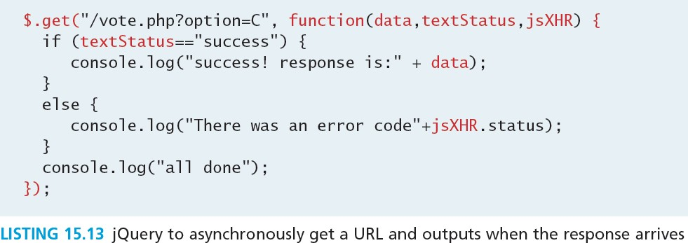
AJAX
GET Requests – an example

Slide 59
AJAX
The jqXHR Object
All of the $.get() requests made by jQuery return a jqXHR
object to encapsulate the response from the server.
In practice that means the data being referred to in the callback from Listing 15.13 is actually an object with backward compatibility with XML HttpRequest.

Slide 60
AJAX
jqXHR - XMLHttpRequest compatibility
abort() stops execution and prevents any callback or handlers from receiving the trigger to execute.
getResponseHeader() takes a parameter and gets the current value of that header.
readyState is an integer from 1 to 4 representing the state of the request. The values include 1:successful call open() 2: sending, 3: response being processed, and 4: completed.
responseXML and/or responseText the main response to the request.

Slide 61
AJAX
jqXHR - XMLHttpRequest compatibility
setRequestHeader(name, value) when used before actually instantiating the request allows headers to be changed for the request.
status is the HTTP request status codes (200 = ok)
statusText is the associated description of the status code.

Slide 62
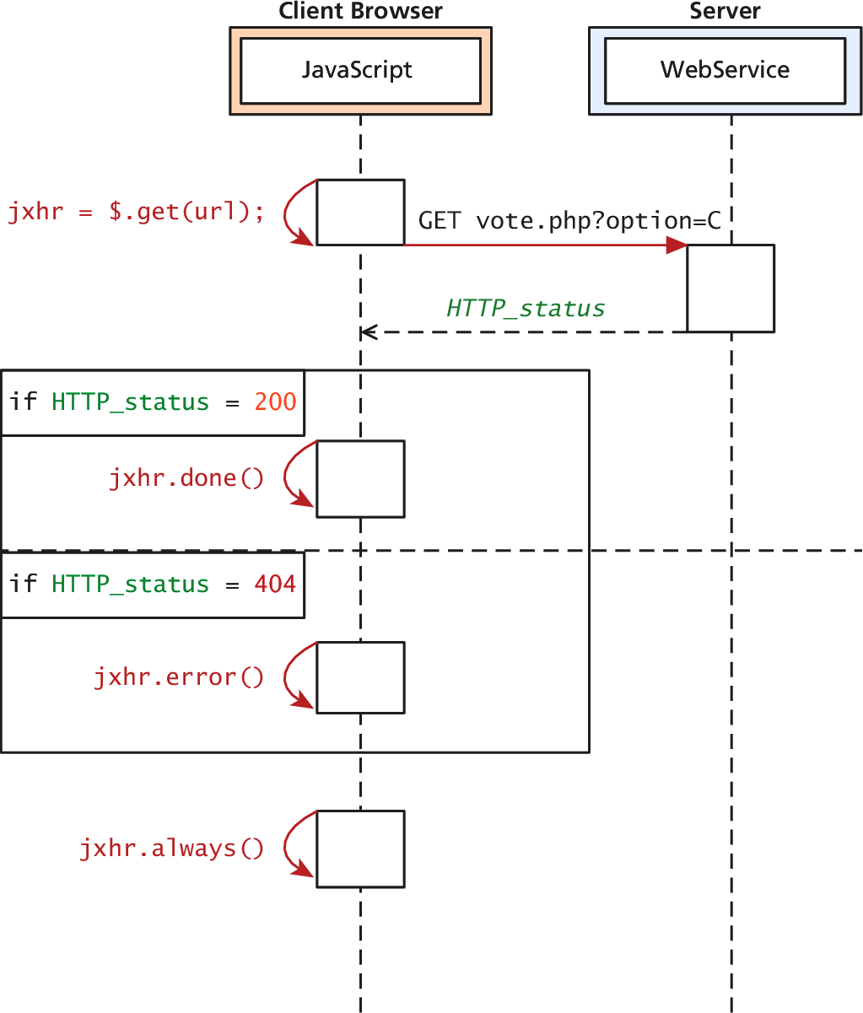
jqXHR
Actually quite easy to use
jqXHR objects have
methods
done()
fail()
always()
which allow us to structure our code in a more modular way than the inline callback

Slide 63
POST requests
Via jQuery AJAX
POST requests are often preferred to GET requests because one can post an unlimited amount of data, and because they do not generate viewable URLs for each action.
GET requests are typically not used when we have forms because of the messy URLs and that limitation on how much data we can transmit.
With POST it is possible to transmit files, something which is
not possible with GET.

Slide 64
POST requests
Via jQuery AJAX
The HTTP 1.1 definition describes GET as a safe method meaning that they should not change anything, and should only read data.
POSTs on the other hand are not safe, and should be used whenever we are changing the state of our system (like casting a vote). get() method.
POST syntax is almost identical to GET.
jQuery.post ( url [, data ] [, success(data, textStatus, jqXHR) ] [, dataType ] )

Slide 65
POST requests
Via jQuery AJAX
If we were to convert our vote casting code it would
simply change the first line from
var jqxhr = $.get("/vote.php?option=C");
to
var jqxhr = $.post("/vote.php", "option=C");

Slide 66
POST requests
Serialize() will seriously help
serialize() can be called on any form object to return its current key-value pairing as an & separated string, suitable for use with post().
var postData = $("#voteForm").serialize();
$.post("vote.php", postData);

Slide 67
Ajax
You have complete control
It turns out both the $.get() and $.post() methods are
actually shorthand forms for the jQuery().ajax() method
The ajax() method has two versions. In the first it takes two parameters: a URL and a Plain Object, containing any of over 30 fields.
A second version with only one parameter is more commonly used, where the URL is but one of the key-value pairs in the Plain Object.

Slide 68
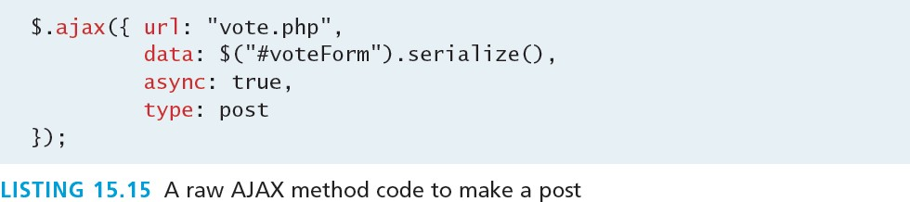
Ajax
More verbose
The one line required to post our form using get()
becomes the more verbose code

Slide 69
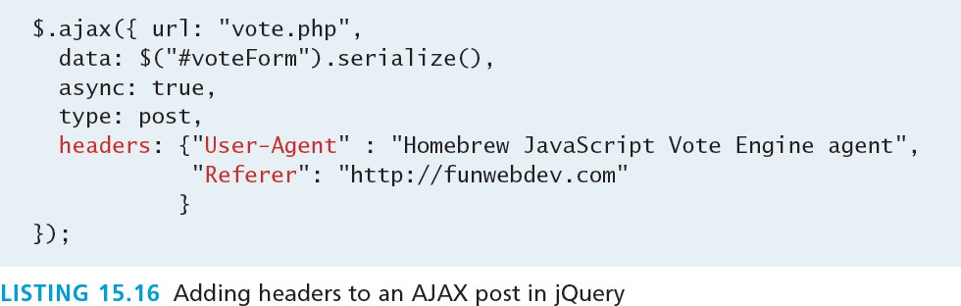
Ajax
You have complete control
To pass HTTP headers to the ajax() method, you enclose as many as you would like in a Plain Object. To illustrate how you could override User-Agent and Referer headers in the POST

Slide 70
JSON

Slide 71
JSON
JSON stands for JavaScript Object Notation (though its use
is not limited to JavaScript)
Like XML, JSON is a data serialization format. It provides a more concise format than XML.
Many REST web services encode their returned data in the JSON data format instead of XML.

Slide 72
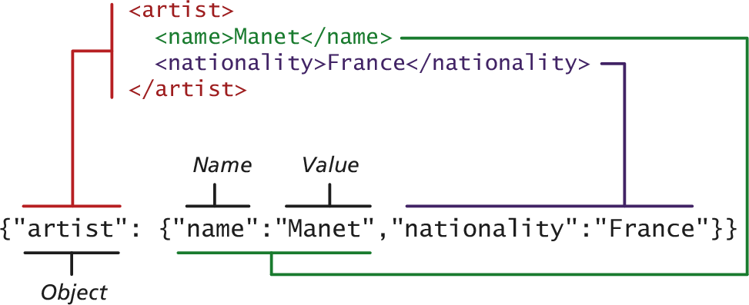
JSON
An example XML object in JSON

Slide 73
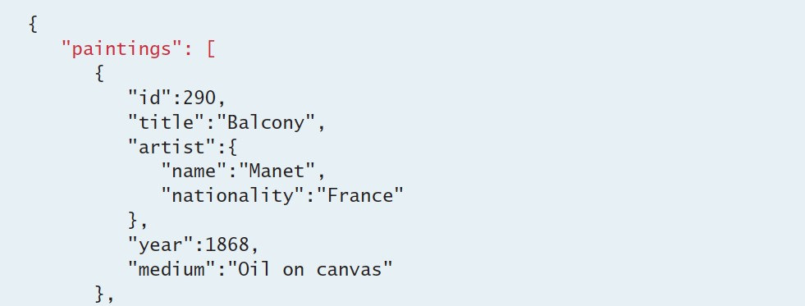
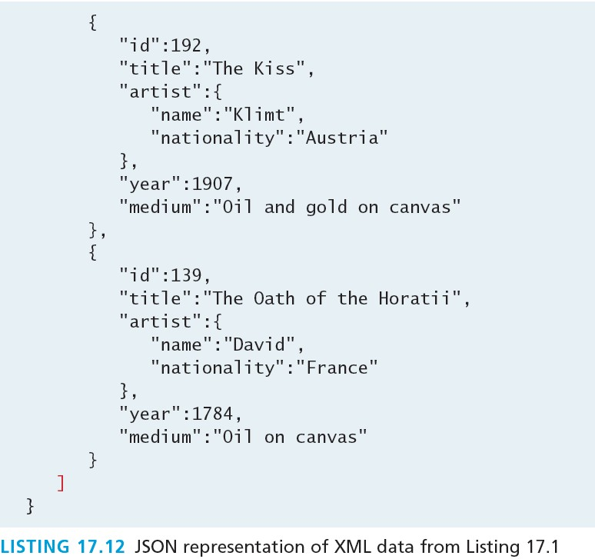
JSON
An example XML object in JSON

Slide 74
Using JSON in JavaScript
Creating JSON JavaScript objects
it is easy to make use of the JSON format in JavaScript:
var a = {"artist": {"name":"Manet","nationality":"France"}}; alert(a.artist.name + " " + a.artist.nationality);
When the JSON information will be contained within a string (say when downloading) the JSON.parse() function can be used to transform the string containing into a JavaScript object

Slide 75
Using JSON in JavaScript
Convert string to JSON object and vice versa
var text = '{"artist": {"name":"Manet","nationality":"France"}}';
var a = JSON.parse(text); alert(a.artist.nationality);
JavaScript also provides a mechanism to translate a JavaScript object into a JSON string:
var text = JSON.stringify(artist);

Slide 76
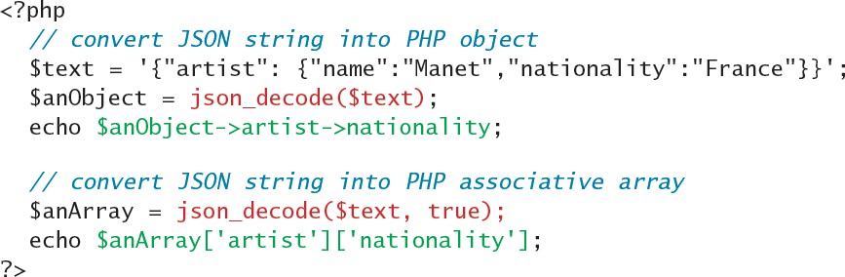
Using JSON in PHP
JSON on the server
Converting a JSON string into a PHP object is quite
straightforward:
Notice that the json_decode() function can return either a PHP object or an associative array.

Slide 77
Using JSON in PHP
Go the other way
To go the other direction (i.e., to convert a PHP object into a
JSON string), you can use the json_encode() function.

Slide 78
OVERVIEW OF WEB SERVICES

Slide 79
Web Services
An overview
Web services
are the most common
example
of a
computing paradigm commonly referred to as service- oriented computing (SOC).
A service is a piece of software with a platform- independent interface that can be dynamically located and invoked.
Web services are a relatively standardized mechanism by which one software application can connect to and communicate with another software application using web protocols.

Slide 80
Web Services
Benefits
they can provide interoperability between different
software applications running on different platforms
they can be used to implement a service-oriented architecture (SOA)
they can be offered by different systems within an organization as well as by different organizations

Slide 81
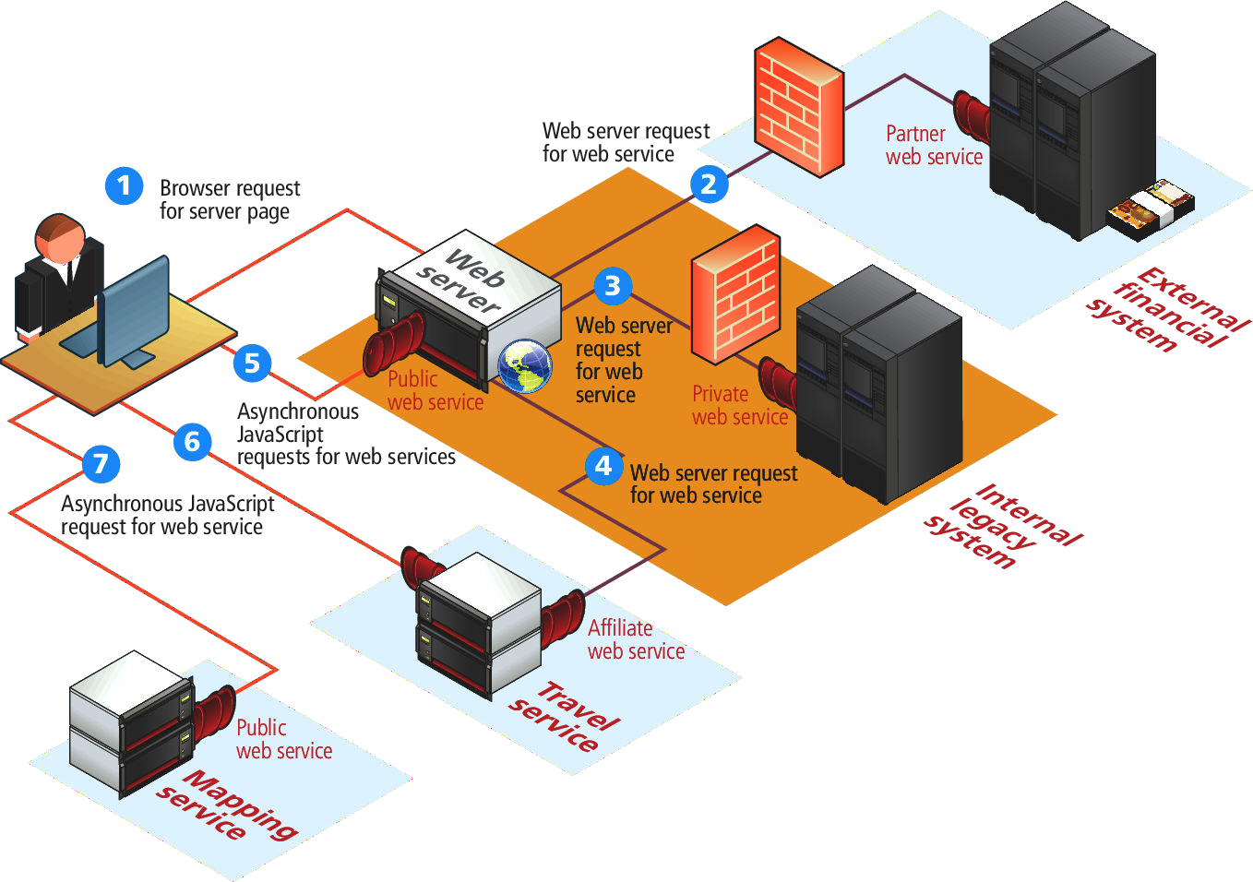
Web Services
Visual Overview

Slide 82
Web Services
SOAP Services
SOAP is the message protocol used to encode the service invocations and their return values via XML within the HTTP header.
SOAP and WSDL are complex XML schemas
akin to using a compiler: its output may be complicated to understand
the enthusiasm for SOAP-based web services had cooled.

Slide 83
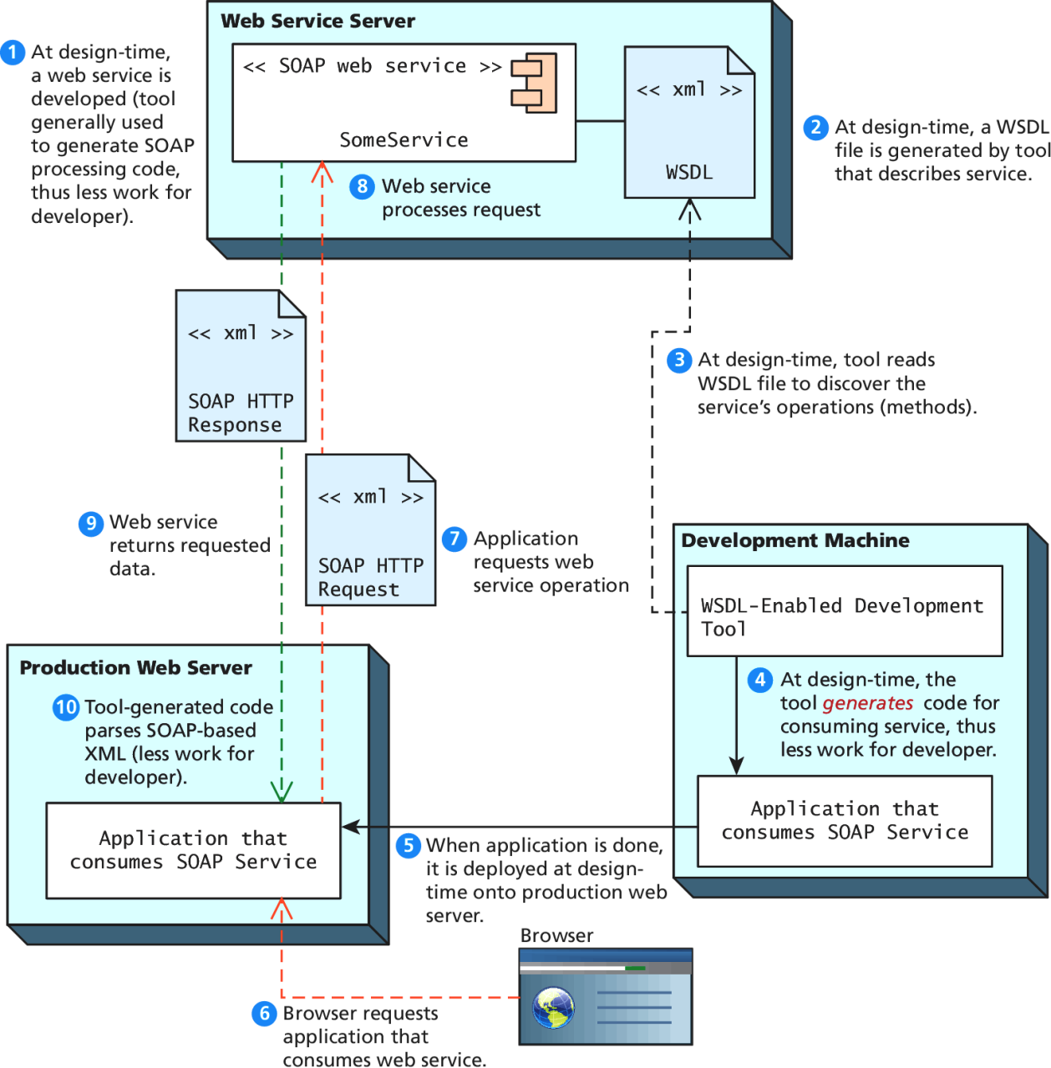
Web Services
SOAP Services

Slide 84
Web Services
REST stands for Representational State Transfer.
RESTful web service does away with the service description layer, and needs no separate protocol for encoding message requests and responses.
It simply uses HTTP URLs for requesting a resource/object (and for encoding input parameters).
The serialized representation of this object, usually an XML or JSON stream, is then returned to the requestor as a normal HTTP response.
REST appears to have almost completely displaced SOAP services.

Slide 85
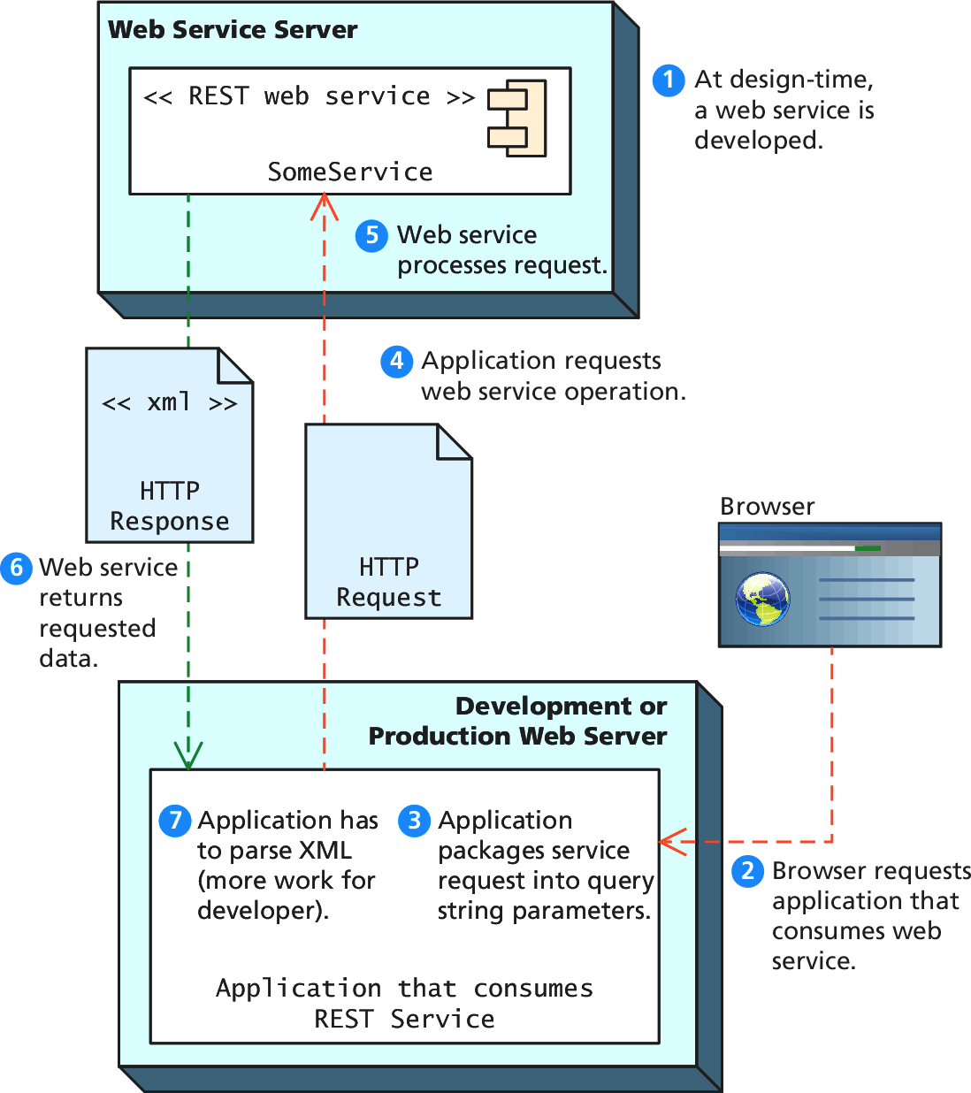
Web Services
REST Services

Slide 86
An Example Web Service
Consider the Google Geocoding API.
The Google Geocoding API provides a way to perform geocoding operations via an HTTP GET request, and thus is an especially useful example of a RESTful web service.
Geocoding typically refers to the process of turning a real- world address into geographic coordinates, which are usually latitude and longitude values
Reverse geocoding is the process of converting geographic coordinates into a human-readable address.

Slide 87
An Example Web Service
More details
In this case the request will take the following form:
http://maps.googleapis.com/maps/api/geocode/xml?address An example geocode request would look like the following:
http://maps.googleapis.com/maps/api/geocode/xml?address=B ritish%20Museum,+Great+Russell+Street,+London,+WC1B+3DG &sensor=false
From trendsmap.com

Slide 88
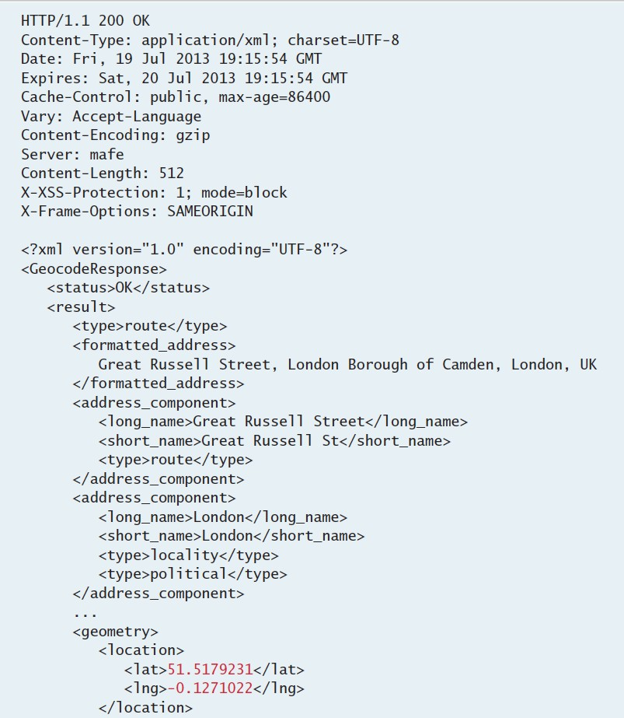


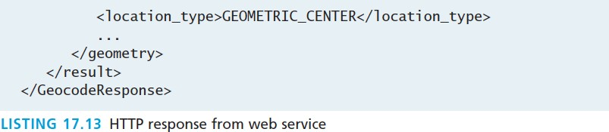
An Example Web Service
The Response
The response is a standard HTTP response with headers
This response is XML
The lat/lng is in there somewhere

Slide 89
Identifying and Authenticating Service Requests
Most web services are not open. Instead they typically
employ one of the following techniques:
Identity. Each web service request must identify who is making the request.
Authentication. Each web service request must provide additional evidence that they are who they say they are.

Slide 90
Identity examples
Real World ways of limiting service
Web services that make use of an API key typically require the user (i.e., the developer) to register online with the service for an API key. This API key is then added to the GET request as a query string parameter.
For instance, to request to the Microsoft Bing Maps web
service will look like the following :
http://dev.virtualearth.net/REST/v1/Locations?o=xml&quer y=British%20Museum,+Great+Russell+Street,+London,+WC1 B+3DG,+UK&key=[BING API KEY HERE]

Slide 91
Authentication
Real World ways of limiting service
Some web services are providing private/proprietary
information or are involving financial transactions.
In this case, these services not only may require an API key, but they also require some type of user name and password in order to perform an authorization.
Many of the most well-known web services instead make use of the OAuth standard.

Slide 92
AJAX
AJAX is not a programming language.
AJAX is a technique for accessing web servers from a web page.
AJAX stands for Asynchronous JavaScript And XML.

Slide 93
<!DOCTYPE html> <html> <body> <div id="demo"> <h2>Let AJAX change this text</h2> <button type="button" onclick="loadDoc()">Change Content</button> </div> </body> </html>

Slide 94
The HTML page contains a <div> section and a <button>.
The <div> section is used to display information from a server.
The <button> calls a function (if it is clicked).
The function requests data from a web server and displays it:
function loadDoc() { var xhttp = new XMLHttpRequest(); xhttp.onreadystatechange = function() { if (this.readyState == 4 && this.status == 200) { document.getElementById("demo").innerHTML = this.responseText; } }; xhttp.open("GET", "ajax_info.txt", true); xhttp.send(); }

Slide 95
The "ajax_info.txt" file used in the example above, is a simple text file and looks like this:
<h1>AJAX</h1> <p>AJAX is not a programming language.</p> <p>AJAX is a technique for accessing web servers from a web page.</p> <p>AJAX stands for Asynchronous JavaScript And XML.</p>

Slide 96
What is AJAX?
AJAX = Asynchronous JavaScript And XML.
AJAX is not a programming language.
AJAX just uses a combination of:
A browser built-in XMLHttpRequest object (to request data from a web server)
JavaScript and HTML DOM (to display or use the data)

Slide 97
AJAX allows web pages to be updated asynchronously by exchanging data with a web server behind the scenes. This means that it is possible to update parts of a web page, without reloading the whole page.

Slide 98
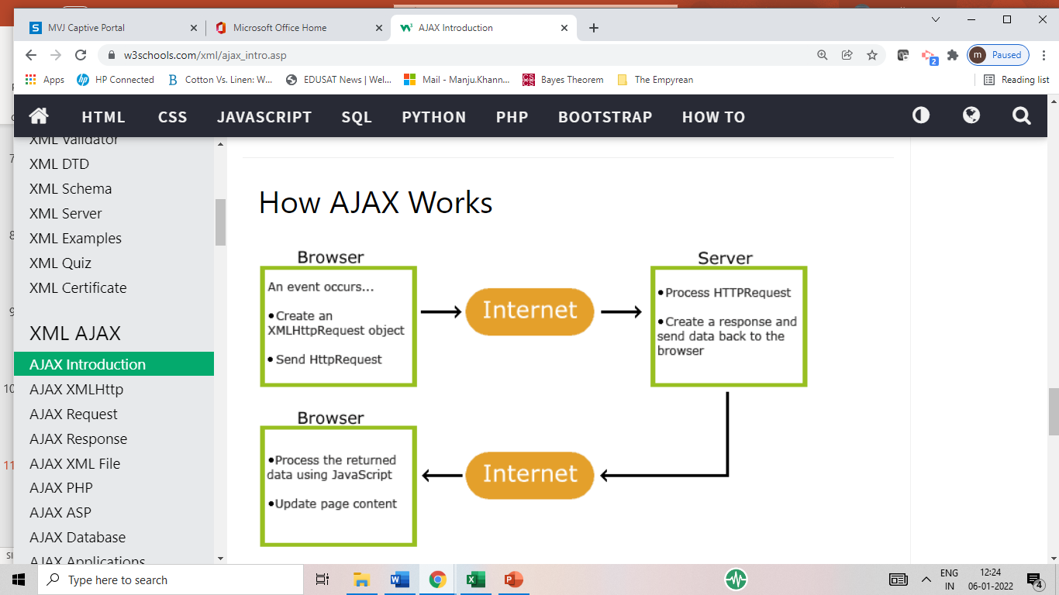

Slide 99
1. An event occurs in a web page (the page is loaded, a button is clicked)
2. An XMLHttpRequest object is created by JavaScript
3. The XMLHttpRequest object sends a request to a web server
4. The server processes the request
5. The server sends a response back to the web page
6. The response is read by JavaScript
7. Proper action (like page update) is performed by JavaScript

Slide 100
Difference between a web service and web application
Web applications are meant for users and to be accessed in browser having human readable format whereas web services are meant for applications to access data in the format of XML, JSON etc.
Web applications always use HTTP/HTTPS protocol whereas traditional web services use SOAP protocol. Recently REST is getting popularity that is an architecture style and almost all times run on HTTP/HTTPS protocol.
Web applications are not meant for reusability whereas this is one of the benefit of web services. A single web service can be used by different kinds of applications.
Web application can access web services to access some data or to perform some tasks, web services can’t access web applications to fetch some data.
Web applications are capable to maintain user session, web services are stateless.

Slide 101
The basic web services platform is XML + HTTP. All the standard web services work using the following components −
SOAP (Simple Object Access Protocol)
UDDI (Universal Description, Discovery and Integration)
WSDL (Web Services Description Language)

Slide 102
How Does a Web Service Work?
A web service enables communication among various applications by using open standards such as HTML, XML, WSDL, and SOAP. A web service takes the help of −
XML to tag the data
SOAP to transfer a message
WSDL to describe the availability of service.

Slide 103
Example
Consider a simple account-management and order processing system. The accounting personnel use a client application built with Visual Basic or JSP to create new accounts and enter new customer orders.
The processing logic for this system is written in Java and resides on a Solaris machine, which also interacts with a database to store information.
The steps to perform this operation are as follows −

Slide 104
The client program bundles the account registration information into a SOAP message.
This SOAP message is sent to the web service as the body of an HTTP POST request.
The web service unpacks the SOAP request and converts it into a command that the application can understand.
The application processes the information as required and responds with a new unique account number for that customer.
Next, the web service packages the response into another SOAP message, which it sends back to the client program in response to its HTTP request.
The client program unpacks the SOAP message to obtain the results of the account registration process.

Slide 105
Web services have the following special behavioural characteristics −
XML-Based
Loosely Coupled
A consumer of a web service is not tied to that web service directly. The web service interface can change over time without compromising the client's ability to interact with the service. A tightly coupled system implies that the client and server logic are closely tied to one another, implying that if one interface changes, the other must be updated.
Supports Remote Procedure Calls(RPCs)
Web services allow clients to invoke procedures, functions, and methods on remote objects using an XML-based protocol. Remote procedures expose input and output parameters that a web service must support.
Component development through Enterprise JavaBeans (EJBs) and .NET Components has increasingly become a part of architectures and enterprise deployments over the past couple of years. Both technologies are distributed and accessible through a variety of RPC mechanisms.
A web service supports RPC by providing services of its own, equivalent to those of a traditional component, or by translating incoming invocations into an invocation of an EJB or a .NET component.

Slide 106
Supports Document Exchange
One of the key advantages of XML is its generic way of representing not only data, but also complex documents.
Web Service Roles
There are three major roles within the web service architecture −
Service Provider
This is the provider of the web service. The service provider implements the service and makes it available on the Internet.
Service Requestor
This is any consumer of the web service. The requestor utilizes an existing web service by opening a network connection and sending an XML request.

Slide 107
Service Registry
This is a logically centralized directory of services. The registry provides a central place where developers can publish new services or find existing ones. It therefore serves as a centralized clearing house for companies and their services.

Slide 108
Types of Web Services
There are two types of web services.
SOAP: SOAP stands for Simple Object Access Protocol. SOAP is an XML based industry standard protocol for designing and developing web services. Since it’s XML based, it’s platform and language independent. So our server can be based on JAVA and client can be on .NET, PHP etc. and vice versa.
REST: REST is an architectural style for developing web services. It’s getting popularity recently because it has small learning curve when compared to SOAP. Resources are core concepts of Restful web services and they are uniquely identified by their URIs.

Slide 109
SOAP
SOAP is an XML-based protocol for exchanging information between computers.
SOAP is a communication protocol.
SOAP is for communication between applications.
SOAP is a format for sending messages.
SOAP is designed to communicate via Internet.
SOAP is platform independent.
SOAP is language independent.
SOAP is simple and extensible.
SOAP allows you to get around firewalls.
SOAP will be developed as a W3C standard.

Slide 110
WSDL
WSDL is an XML-based language for describing web services and how to access them.
WSDL stands for Web Services Description Language.
WSDL was developed jointly by Microsoft and IBM.
WSDL is an XML based protocol for information exchange in decentralized and distributed environments.
WSDL is the standard format for describing a web service.
WSDL definition describes how to access a web service and what operations it will perform.
WSDL is a language for describing how to interface with XML-based services.
WSDL is an integral part of UDDI, an XML-based worldwide business registry.
WSDL is the language that UDDI uses.
WSDL is pronounced as 'wiz-dull' and spelled out as 'W-S-D-L'.

Slide 111
Based on the web service architecture, we create the following two components as a part of web services implementation −
Service Provider or Publisher
This is the provider of the web service. The service provider implements the service and makes it available on the Internet or intranet.
Service Requestor or Consumer
This is any consumer of the web service. The requestor utilizes an existing web service by opening a network connection and sending an XML request.
We will also write two web service requestors: one web-based consumer (ASP.NET application) and another Windows application-based consumer.

Slide 112
Java Web Services
Java provides it’s own API to create both SOAP as well as REST web services.
JAX-WS: JAX-WS stands for Java API for XML Web Services. JAX-WS is XML based Java API to build web services server and client application.
JAX-RS: Java API for RESTful Web Services (JAX-RS) is the Java API for creating REST web services. JAX-RS uses annotations to simplify the development and deployment of web services.

Slide 113
Hello World JAX-WS Application Let’s create a very simple Hello World JAX-WS application.
package com.journaldev.jaxws.service;
import javax.jws.WebMethod;
import javax.jws.WebService;
import javax.jws.soap.SOAPBinding;
import javax.xml.ws.Endpoint;
@WebService ----These are annotations from JAX-WS API
@SOAPBinding(style = SOAPBinding.Style.DOCUMENT) –--SOAP web services in document or RPC style
public class TestService
{ @WebMethod public String sayHello(String msg)
{ return "Hello "+msg; }
public static void main(String[] args){ Endpoint.publish("https://localhost:8888/testWS",
new TestService());
}
}

