Slide 1


AirBNB Hotel Booking Analysis
Harsh More B.Tech Mechanical MIT Manipal
AICTE ID - STU682d64896b6471747805321

Slide 2

Objective and Scope
AirBNB has a lot of data about hotel bookings. The goal is to find simple patterns—like what affects the price, which areas are popular, and what guests like most—by looking at the data with Python and charts.

Slide 3
Project Description I checked the AirBNB booking dataset using Python. First, I cleaned the messy data and then made some graphs. These helped me understand things like which neighborhoods and room types have more bookings, which prices are common, and what makes a listing popular. I wrote my code in VSC and made it easy for others to follow.

Slide 4

Who are the End Users ?
People who work with data and want to find patterns in hotel bookings.
Travel companies who wish to know where guests prefer to stay and how much they pay.
Hotel managers trying to improve their services and change prices based on booking trends.

Slide 5

Technology Used
Used Python programming because it is great for working with data.
Used the Pandas tool to clean data and make calculations.
Used the Matplotlib for graphical visuals.
Made all my code and graphs in VS Code for better visuals.

Slide 6
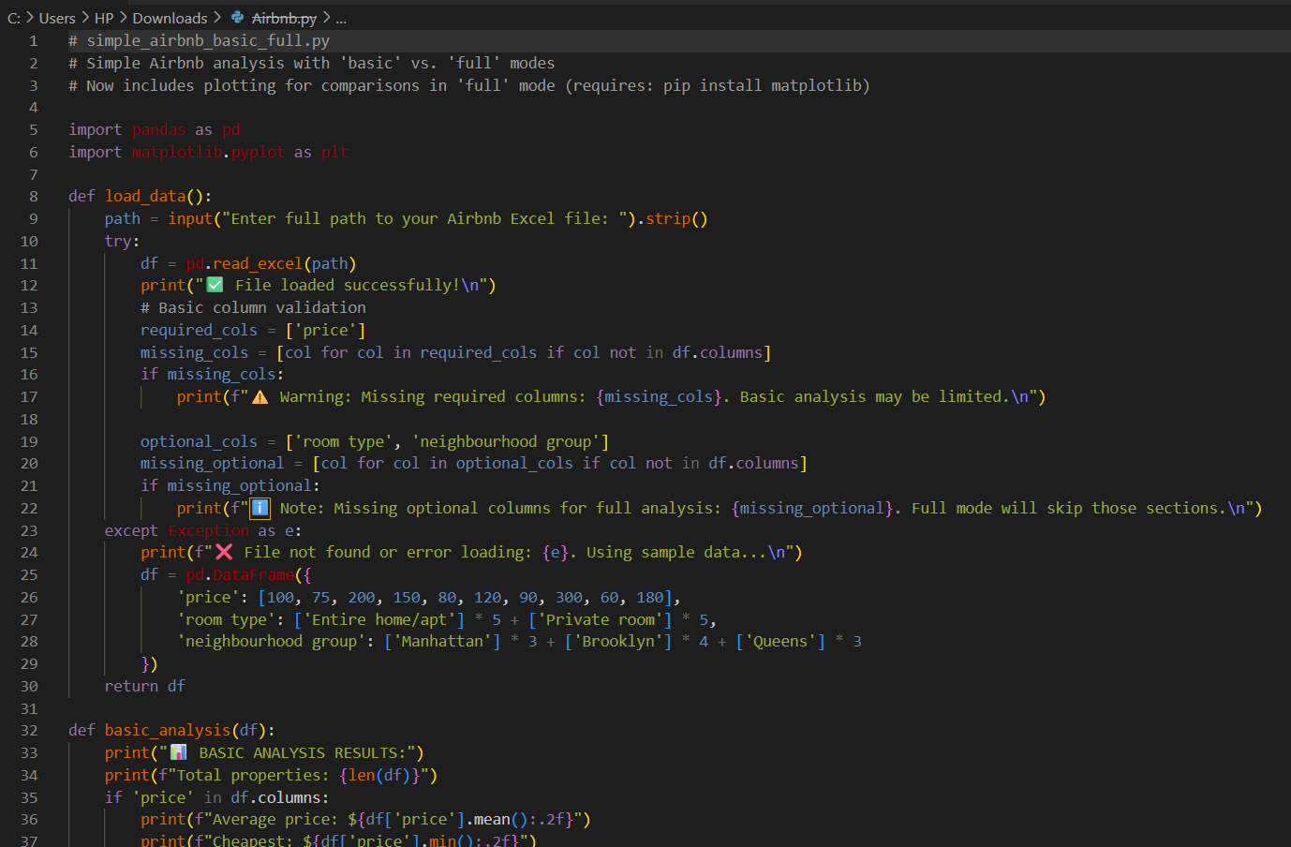
Code and Snippet

Slide 7
Results
The results showed that the place/location and type of room (entire home, private room) change the price a lot.
Places with good ratings and reviews are booked more.
Most guests like clean rooms and flexible booking rules.
The graphs helped see which areas and room types are most popular among travelers
Github Demo Link

Slide 8
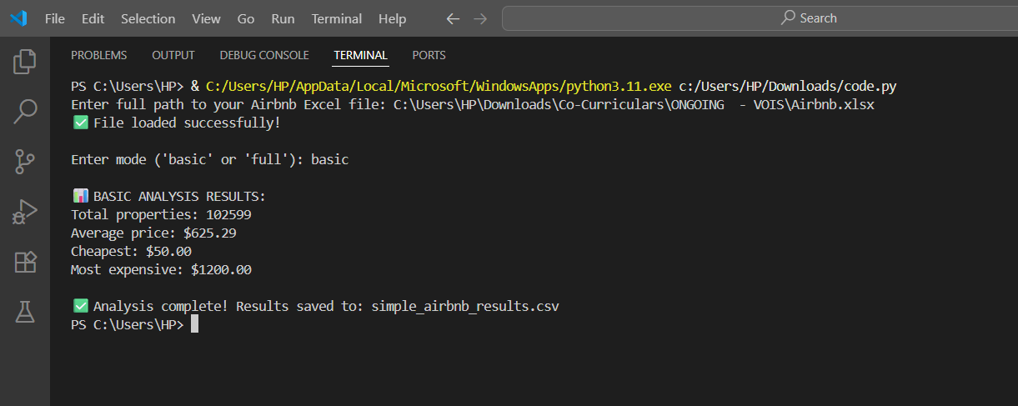
Terminal Prompt – Basic Details

Slide 9
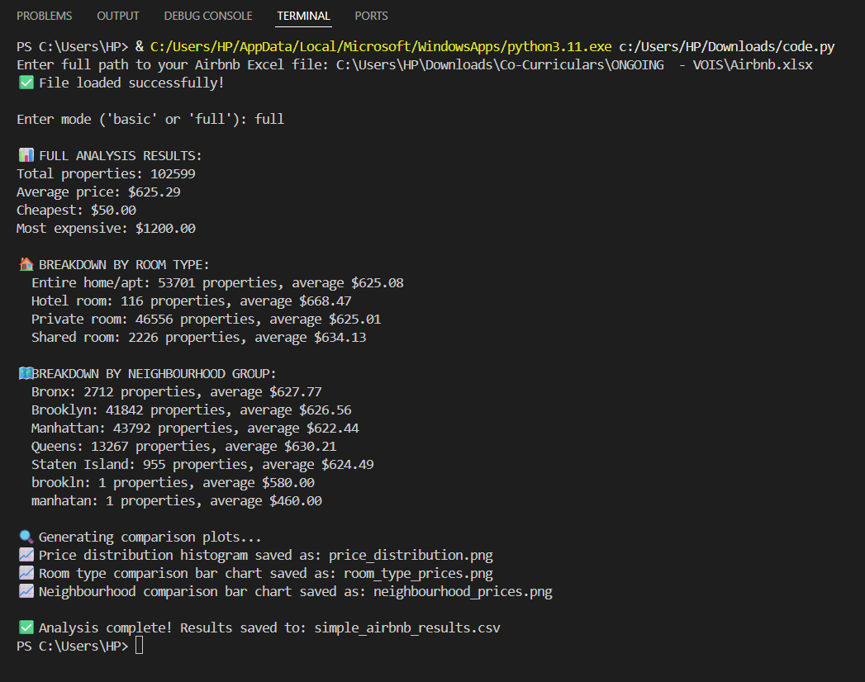
Terminal Prompt – Full Details

Slide 10
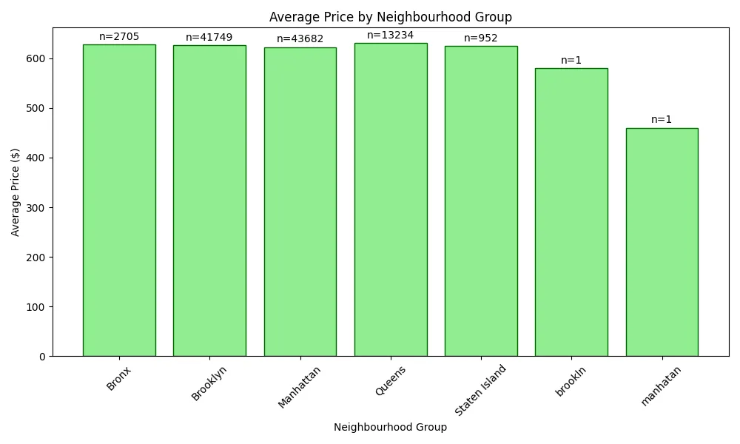
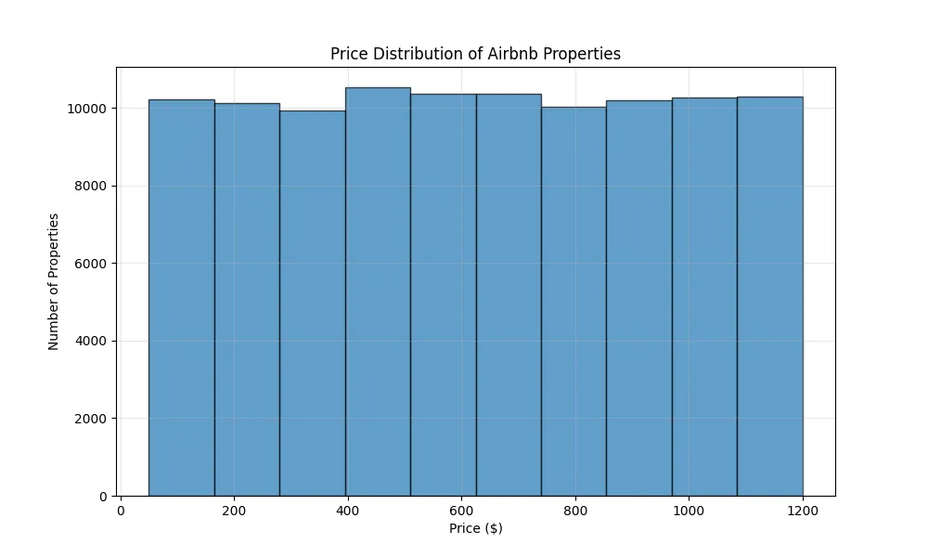
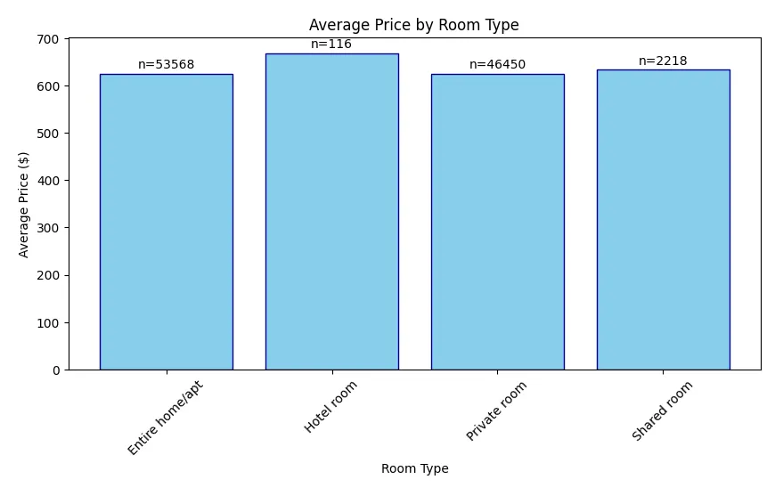
Graphs generated (Visuals)

Slide 11
Thank you
.
.

