Slide 1
SHADOW CHICKENS

Slide 2
Did you know?
1 Cyber attack every 39 seconds
That is a study from 2007
https://eng.umd.edu/news/story/study-hackers-attack-every-39-seconds

Slide 3
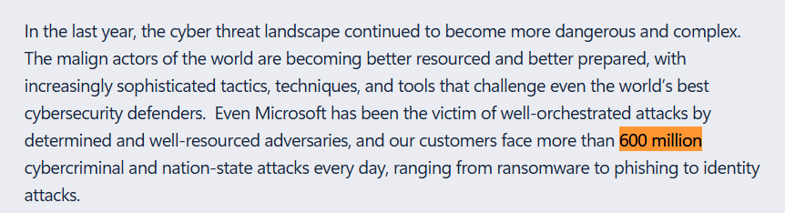
Did you know?
Microsoft Digital Defense Report 2024
https://www.microsoft.com/en-us/security/security-insider/threat-landscape/microsoft-digital-defense-report-2024

Slide 4
How do you protect yourself?

Slide 5
How do you protect yourself?
74% people are unaware of security breaches affecting them
https://news.umich.edu/data-breaches-most-victims-unaware-when-shown-evidence-of-multiple-compromised-accounts/

Slide 6

Meet Your AI Stealth Buddy
SIMPLY
SECURE

Slide 7
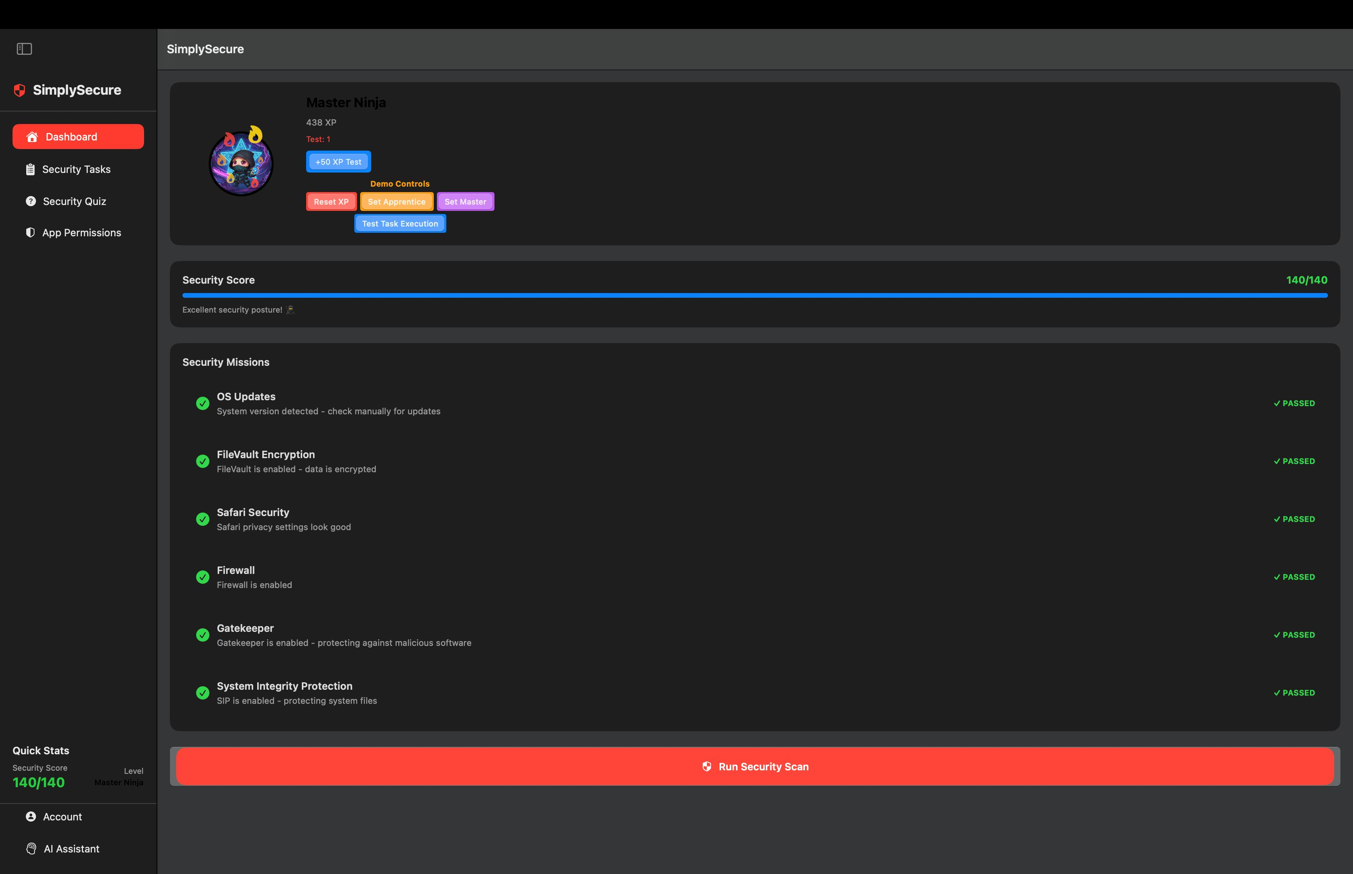
SIMPLY
SECURE
Ninja Level:
Security Score

Slide 8
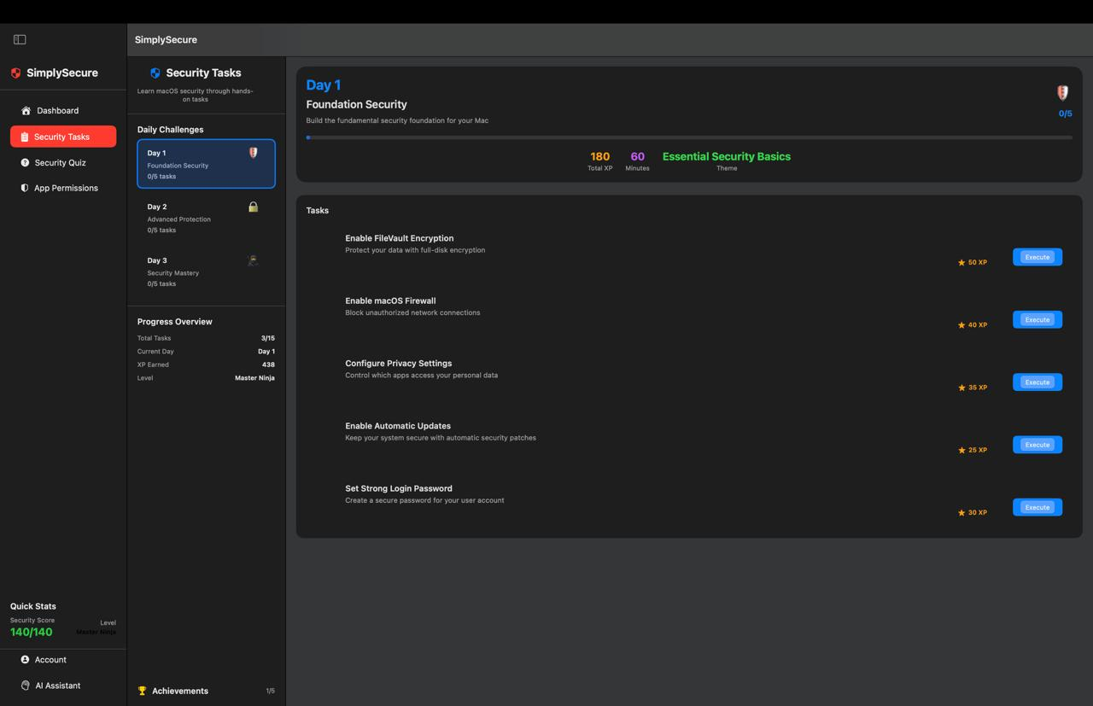
SIMPLY
SECURE
Daily Challenges:
Earn XP

Slide 9
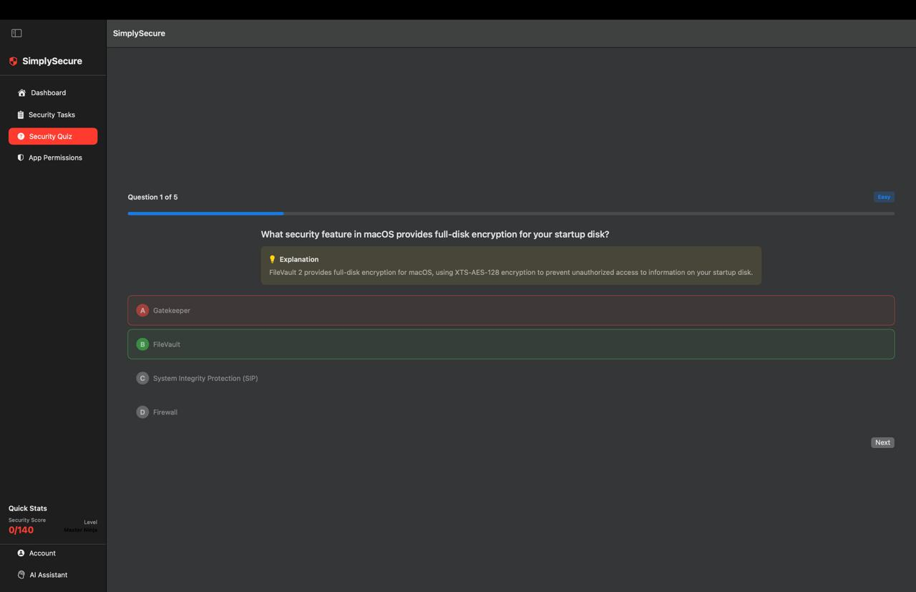
SIMPLY
SECURE
Quizzes
Learn the basics!

Slide 10
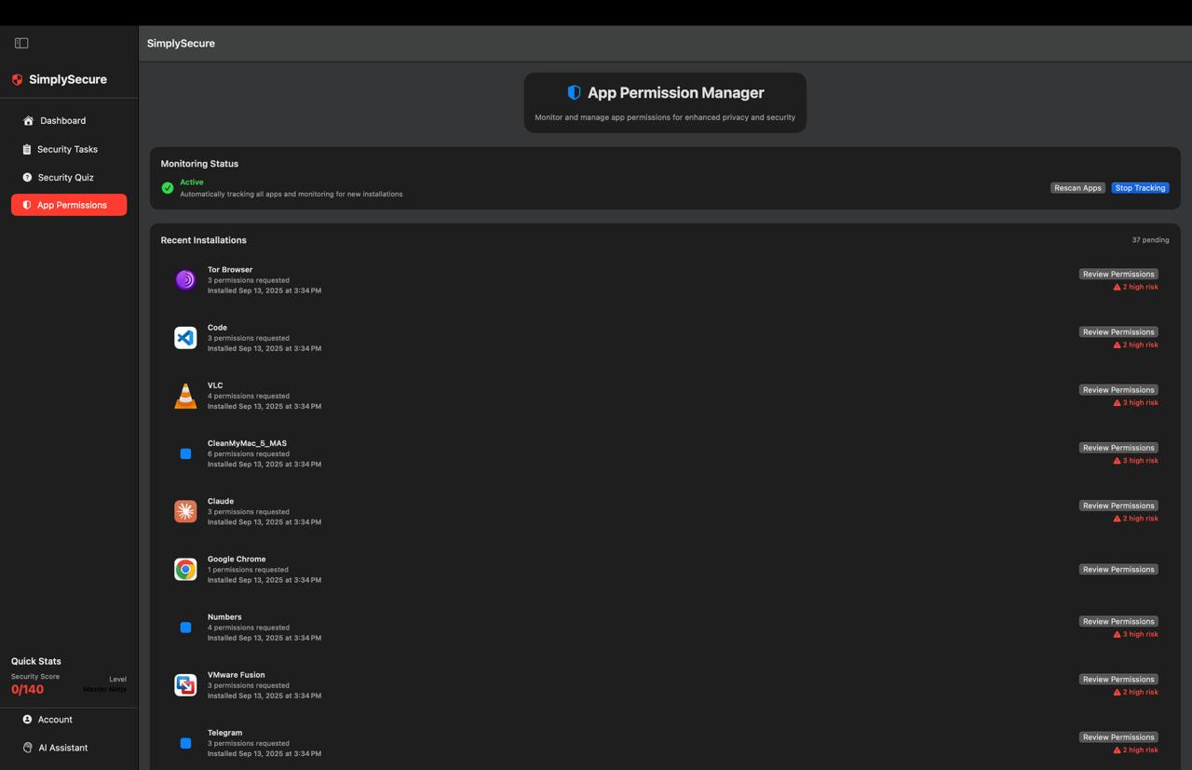
SIMPLY
SECURE
Permissions
Simplified!

Slide 11
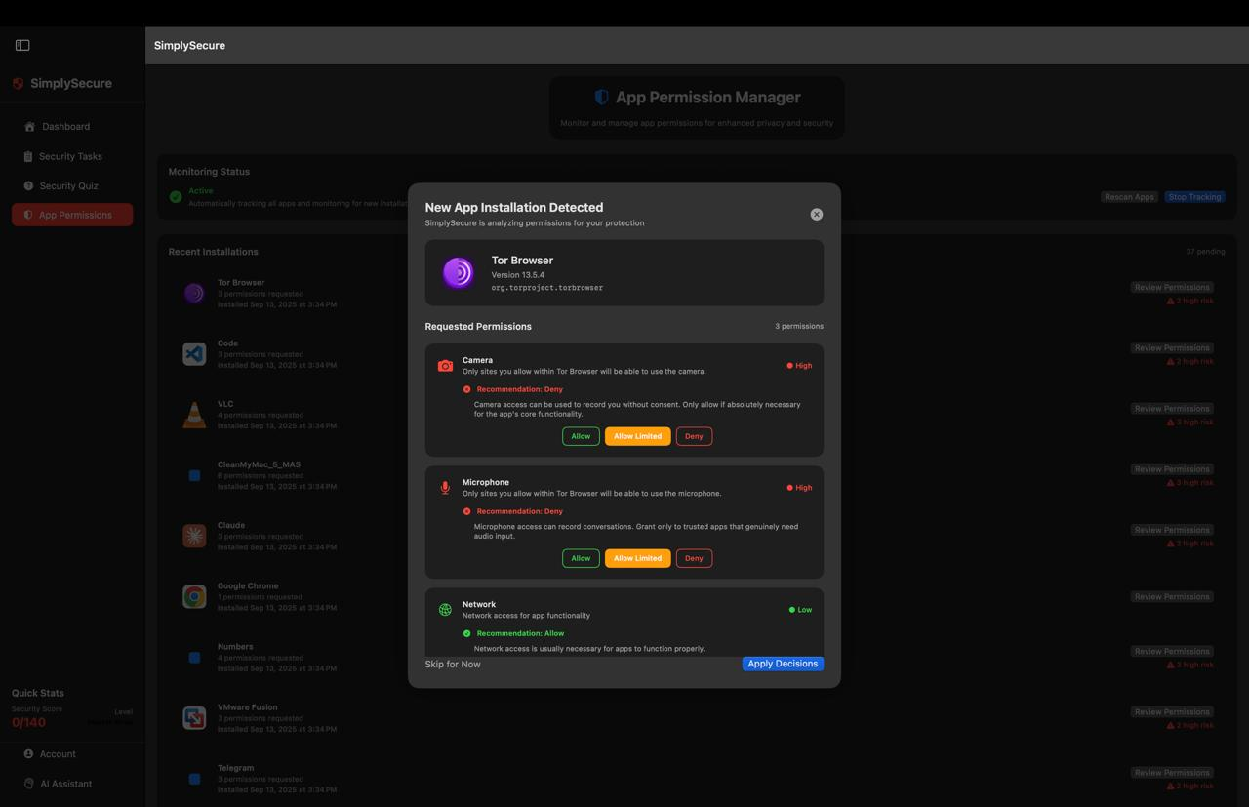
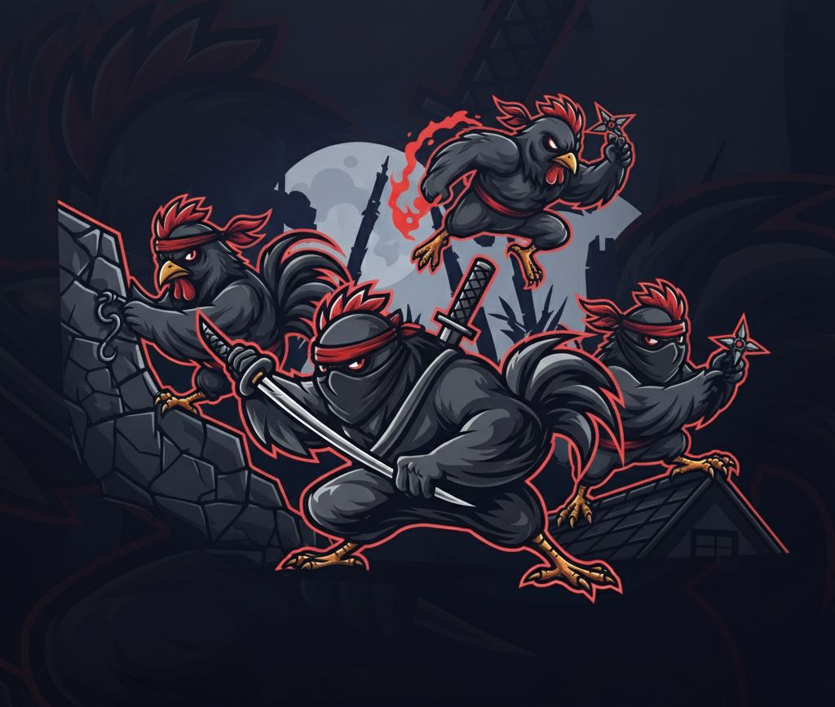
SIMPLY
SECURE
Permissions
Simplified!

Slide 12
SIMPLY
SECURE
by
SHADOW CHICKENS

