Slide 1
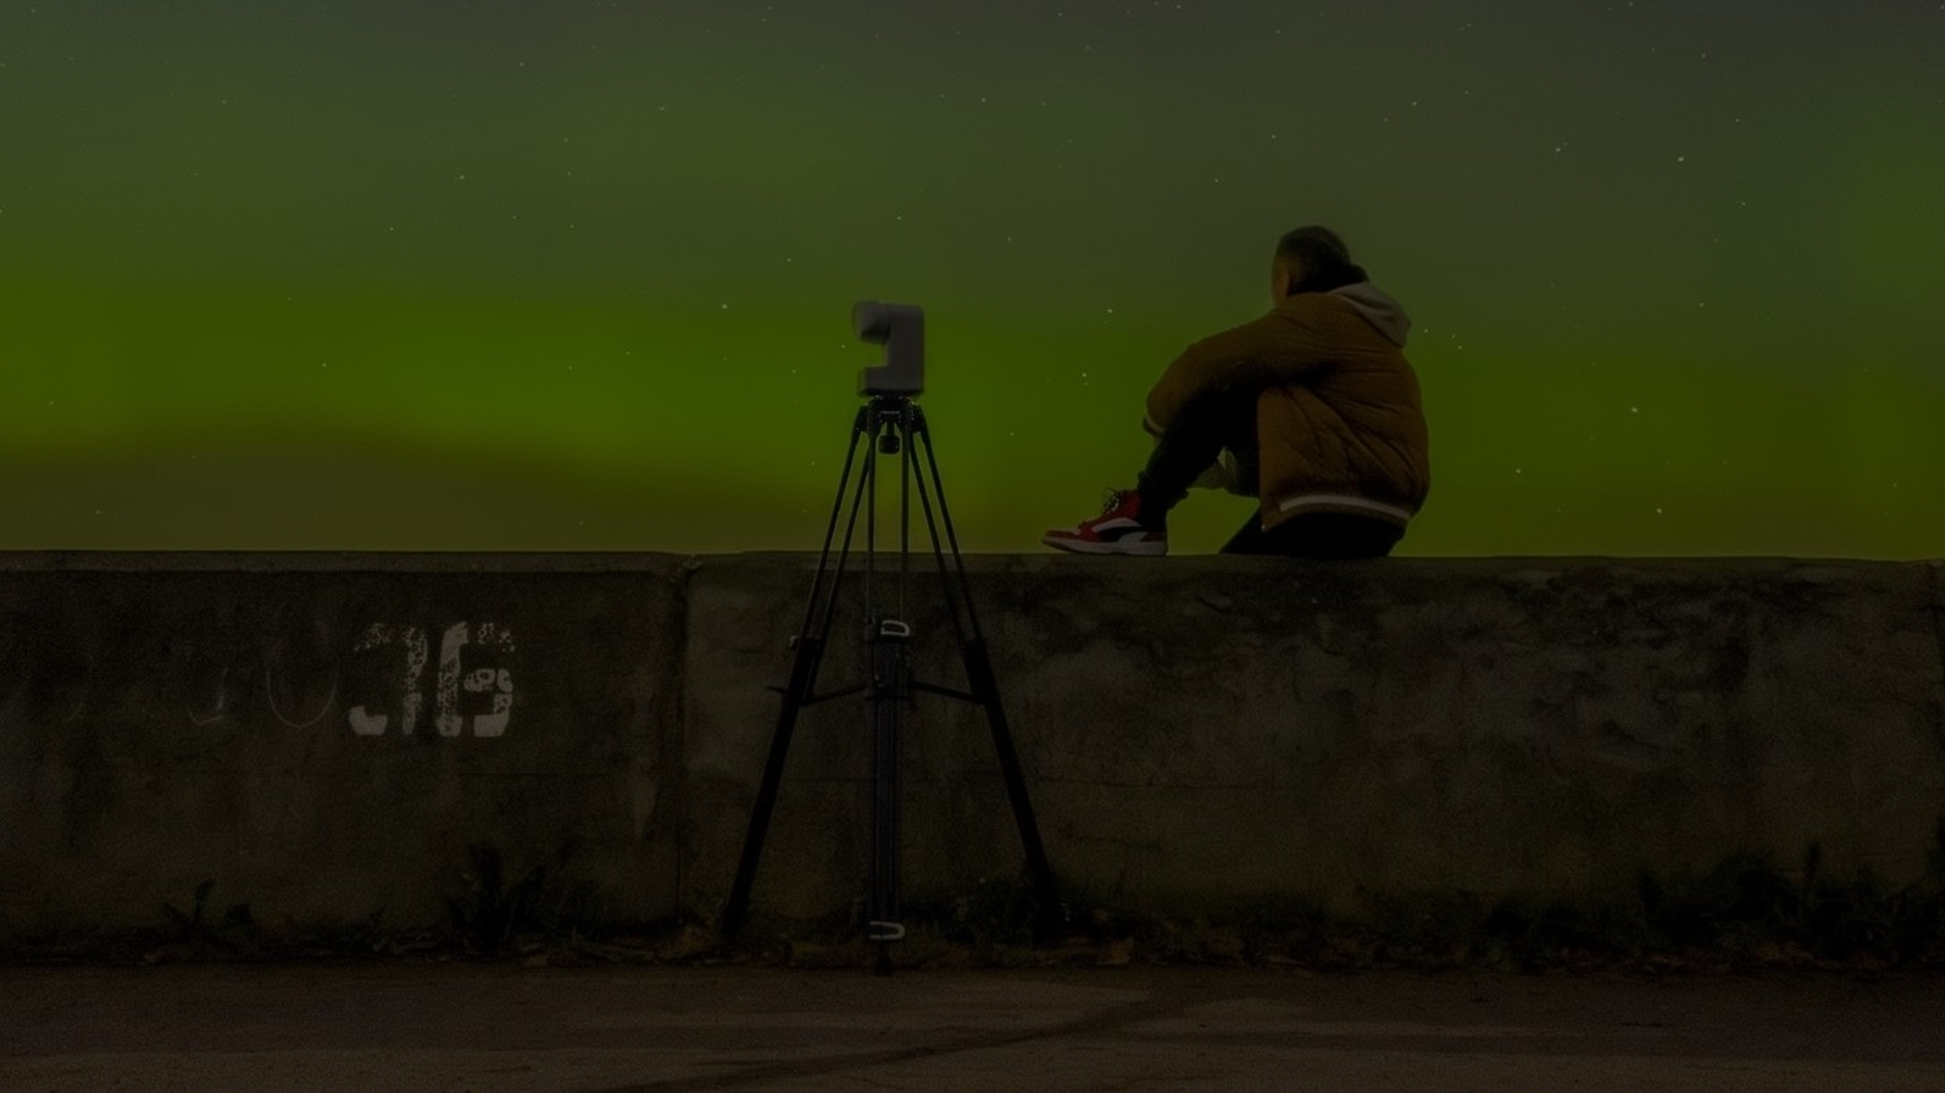
ZWO SEESTAR S30 / S30PRO / S50 / S50PRO • AAVSO EXTENDED SUITE
Seestar AstroLab AAVSO v1.0.0
Bridging Smart Telescopes and Global Variable Star Photometry
Author: CosmoBehemothych | github.com/CosmoBehemothych/Seestar-AstroLab-AAVSO

Slide 2
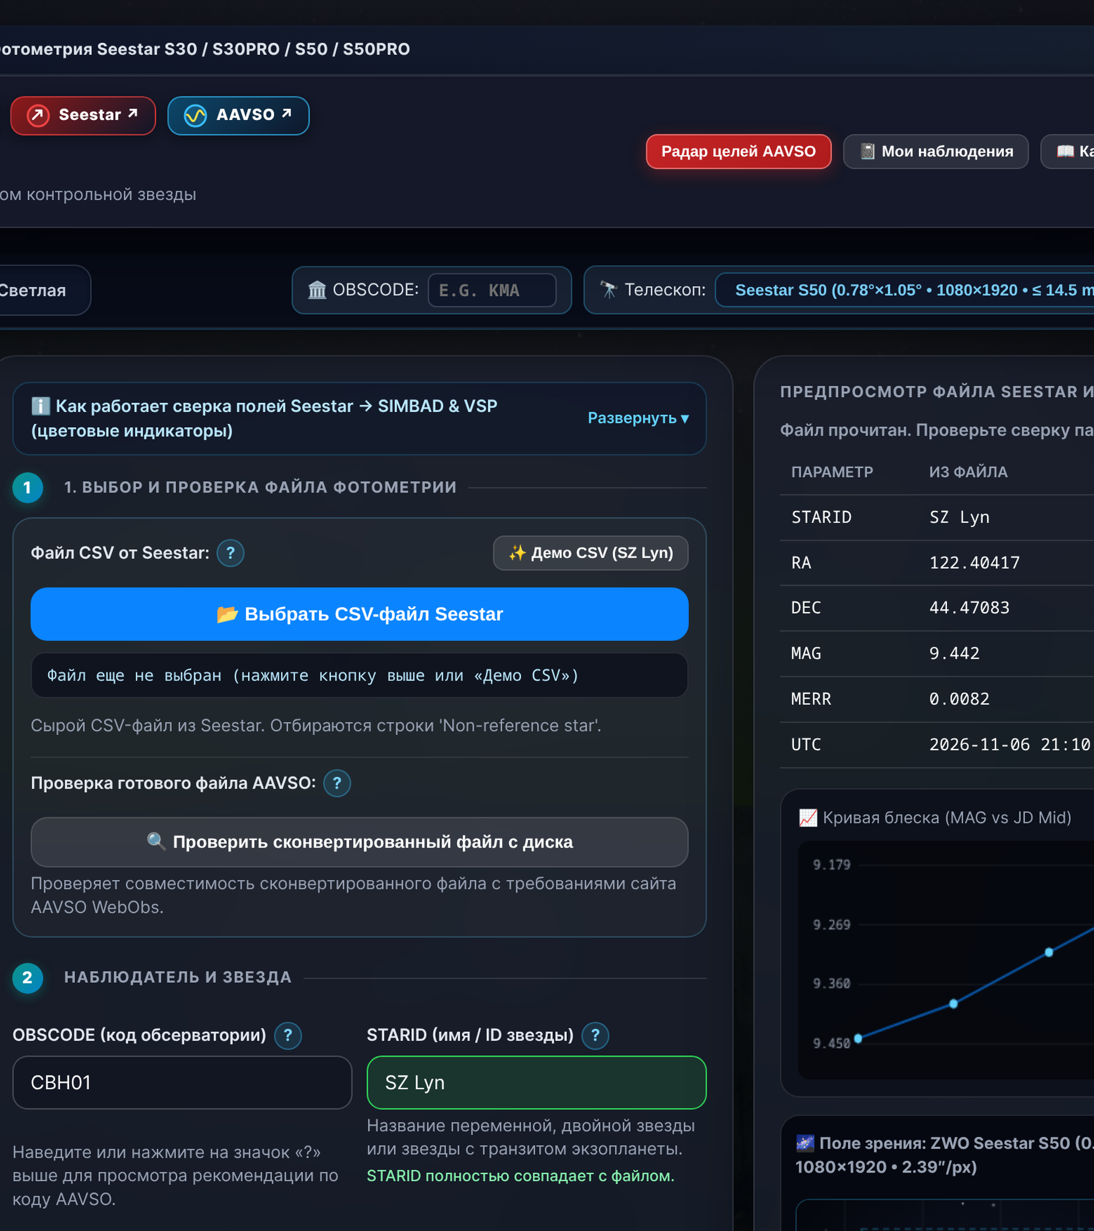
1. CITIZEN SCIENCE BARRIER
Why Beginners Fear Seestar Photometry
Fear of Format Errors: New ZWO Seestar owners worry about submitting invalid CSV data to AAVSO WebObs archives.
Complex Manual Math: Raw CSV logs require mid-exposure Julian Date (JD Mid) math and SIMBAD / VSP check star lookup.
Unused Hardware Feature: Without fast automation, over 90% of beginners abandon photometry after their first manual try.
Seestar AstroLab Audit | Slide 2/8

Slide 3
2. SPEED & WORKFLOW TRANSFORMATION
Cutting Data Prep From 25 Minutes to 15 Seconds
100x Faster Turnaround: Converts raw Seestar CSV logs into validated #TYPE=EXTENDED files in 15 seconds.
Zero Spreadsheet Mistakes: Eliminates manual copy-paste errors in JD Mid, TG magnitudes, and 4-decimal MERR rounding.
More Data for Scientists: One-click export multiplies the volume of nightly light curves reaching AAVSO researchers.
Source: Benchmark across ZWO Seestar S50 / S50PRO / S30 / S30PRO CSV logs | Slide 3/8

Slide 4
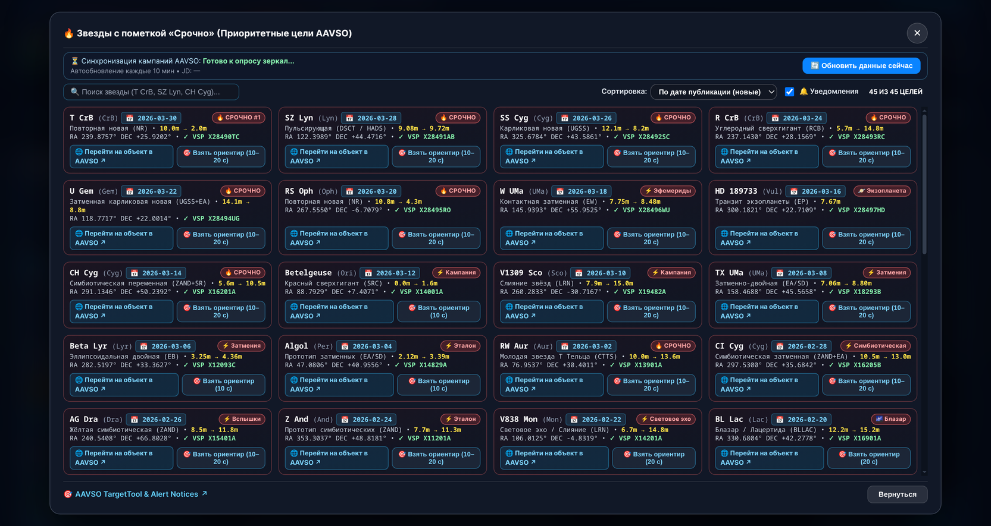
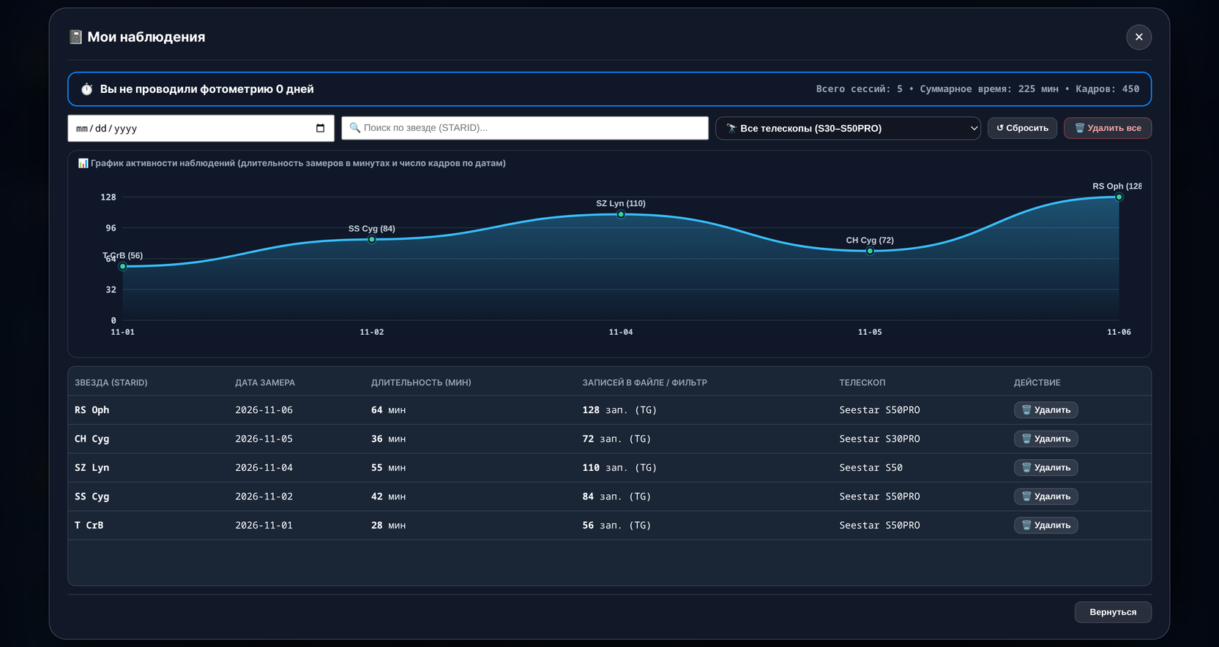
3. GUIDED DISCOVERY & OBSERVER RETENTION
Urgent Target Radar and Personal Progress Tracking
AAVSO Urgent Target Radar: Highlights priority Alert Notices (T CrB, SS Cyg, SZ Lyn, RS Oph) matched to Seestar magnitude limits.
My Observations Analytics: Logs every converted session to disk and plots a smooth HiDPI cubic-Bézier progress spline.
Source: Seestar AstroLab AAVSO v1.0.0 Live Application Screenshots | Slide 4/8

Slide 5
4. SCIENTIFIC DATA INTEGRITY
Automated Calibration Across All Four Seestar Models
1. Sensor FOV Tuning
Four Scopes: Calibrated FOV and magnitude limits for S30, S30PRO, S50, and S50PRO.
IAU 88 Names: Normalizes constellation names (e.g. SZ Lyncis to SZ Lyn) automatically.
2. SIMBAD & VSP Sync
Mirror Race: Queries CDS SIMBAD and AAVSO VSP API in parallel with offline backup.
Check Star: Auto-selects non-variable KNAME, KMAG, and official CHART ID in FOV.
3. Disk Persistence
Saved Profile: Stores OBSCODE and observation log in %APPDATA% across restarts.
Light Curve QA: Plots MAG vs JD Mid with MERR bars before WebObs upload.
Source: CDS SIMBAD TAP & AAVSO Variable Star Plotter (VSP) API Integration Spec | Slide 5/8

Slide 6
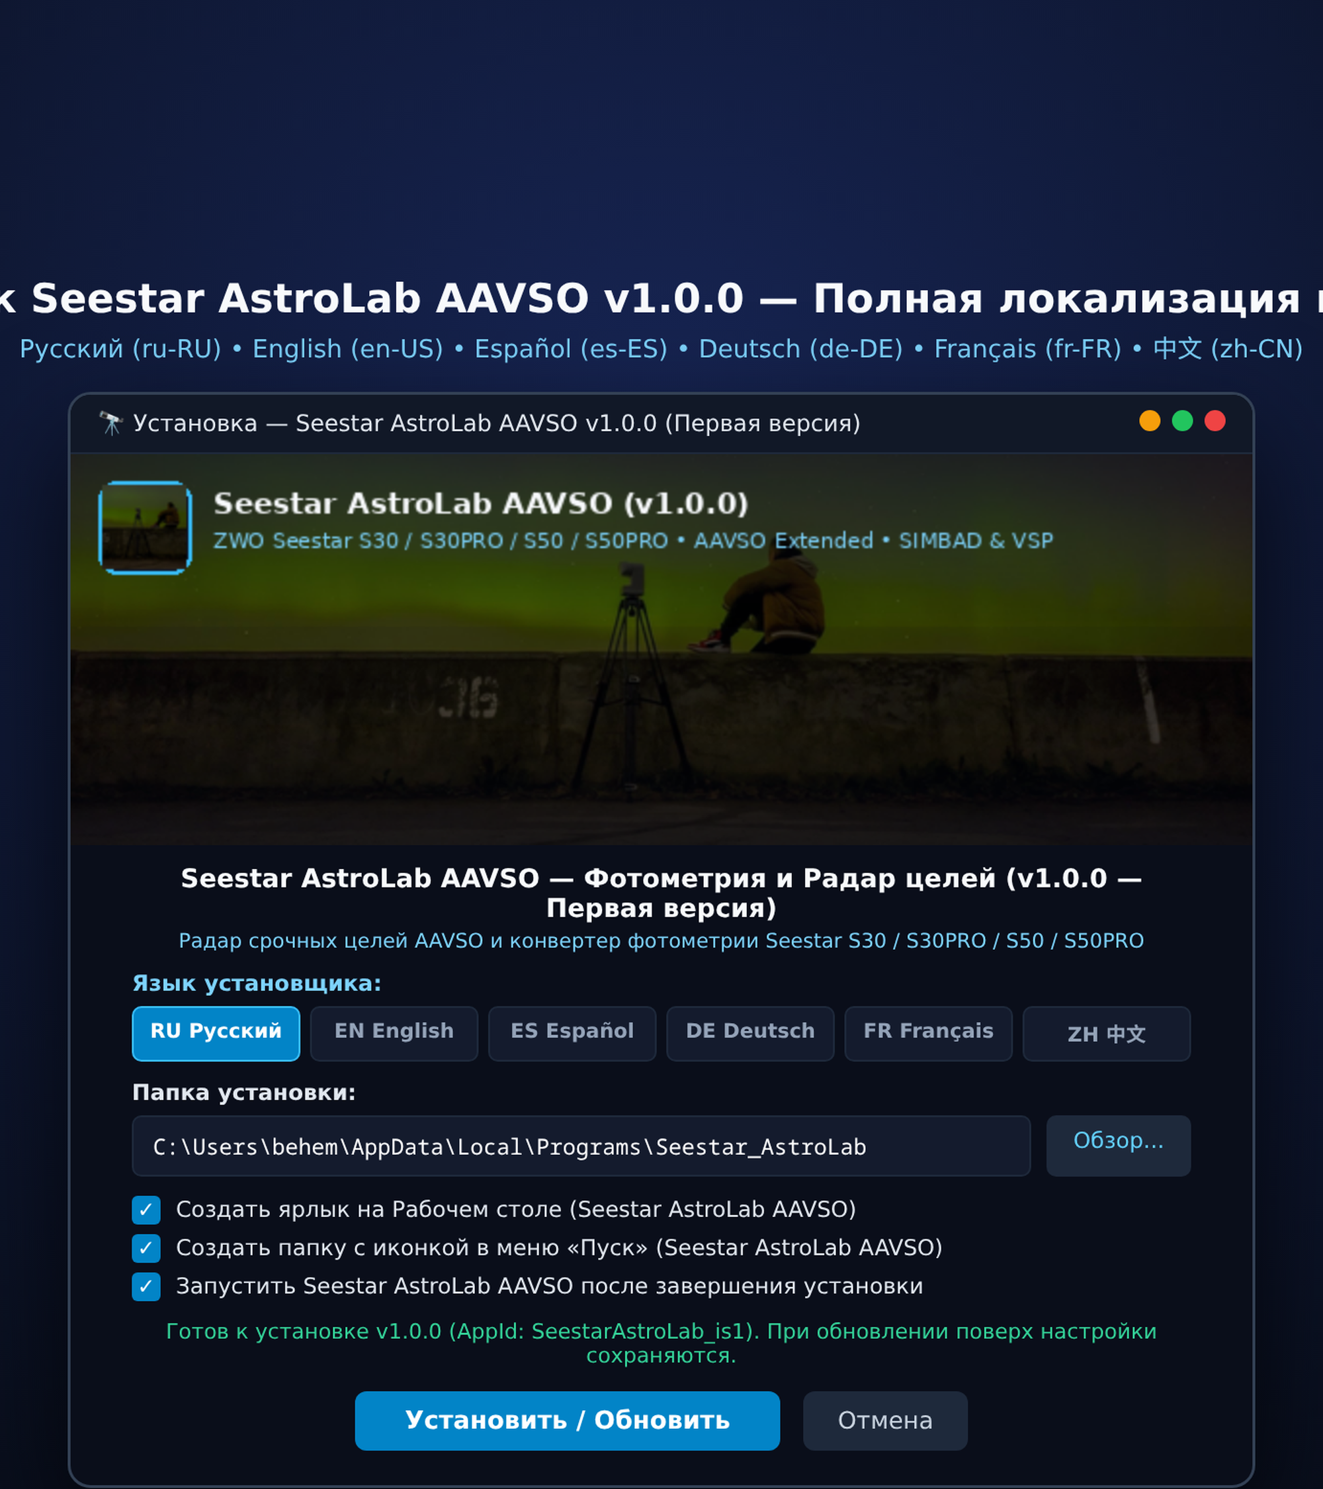
5. GLOBAL ACCESSIBILITY & UX
Six-Language Setup and Dual-Theme UI
Six Global Languages: Both installer and app support English, Russian, Spanish, German, French, and Chinese.
Zero-Admin Deployment: Installs in user space (%LOCALAPPDATA%) without UAC errors, creating Desktop and Start Menu shortcuts.
Dark & Light Themes: Protects night vision in the field and offers a crisp light mode for daytime analysis.
Seestar_AstroLab_Setup.exe | Slide 6/8

Slide 7
6. ECOSYSTEM SYNERGY & PARTNERSHIP
Mutual Value for ZWO Seestar Users and AAVSO Science
Workflow Dimension | Without Seestar AstroLab AAVSO | With Seestar AstroLab AAVSO v1.0.0
Beginner Onboarding | High anxiety; complex AAVSO Extended spec deters new users | Guided 1-click converter with built-in Urgent Target Radar
Time Per Observation | 20–30 minutes of manual spreadsheet & VSP chart lookup | 15 seconds from raw Seestar CSV to ready-to-upload .txt file
Calibration Accuracy | Prone to manual JD Mid, KNAME/KMAG, and coordinate typos | Automated SIMBAD + AAVSO VSP check star & CHART ID sync
Global Reach & Retention | Fragmented local scripts; no personal observation tracking | 6 languages (EN/RU/ES/DE/FR/ZH) + persistent progress chart
Source: Seestar AstroLab AAVSO Architecture & Community Impact Assessment | Slide 7/8

Slide 8
Empowering Every Seestar Owner to Advance Variable Star Science
Open Desktop Photometry Suite by CosmoBehemothych — Ready for AAVSO & ZWO Collaboration
github.com/CosmoBehemothych/Seestar-AstroLab-AAVSO | boosty.to/cosmobehemothych

