Slide 1


Capture The Flag
NAME: Braeden
Team Name: new order of the stone

Slide 2
Introduction
The CTF Problem
Steps to Solve
The Solution
Workplace Relevance
Notes:
Tell your audience what you intend to cover in your project. This is the purpose of your communication.
In Section 1, provide some background of the category of your CTF challenge.
Introduce the audience to the problem and tell us how you plan to approach it and get the solution.
In Section 2, cover the steps you used to solve the problem. This may cover multiple solves.
In Section 3, talk about how you found the solution and discuss the pitfalls and recommendations when facing these types of problems.
In Section 4, talk about the relevance of Capture the Flag problems to the workplace and your job role.

Slide 3

CTF Category Description
I chose the Category 2 File Analysis challenge. This challenge involves finding out what the filename and extension are for a corrupted file.
Notes:
Before presenting this problem, discuss the category of the CTF challenge and the relevant skills needed to solve this type of problem.
Answer the four questions below in your slide and make these questions your talking points.
Describe the category of question that you attempted.
What is the important background knowledge needed?
How does this relate to the Ethical Hacking course?
What lab in the course covered the topic from this CTF problem?

Slide 4
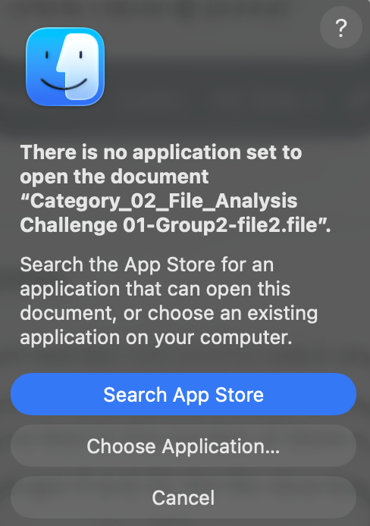
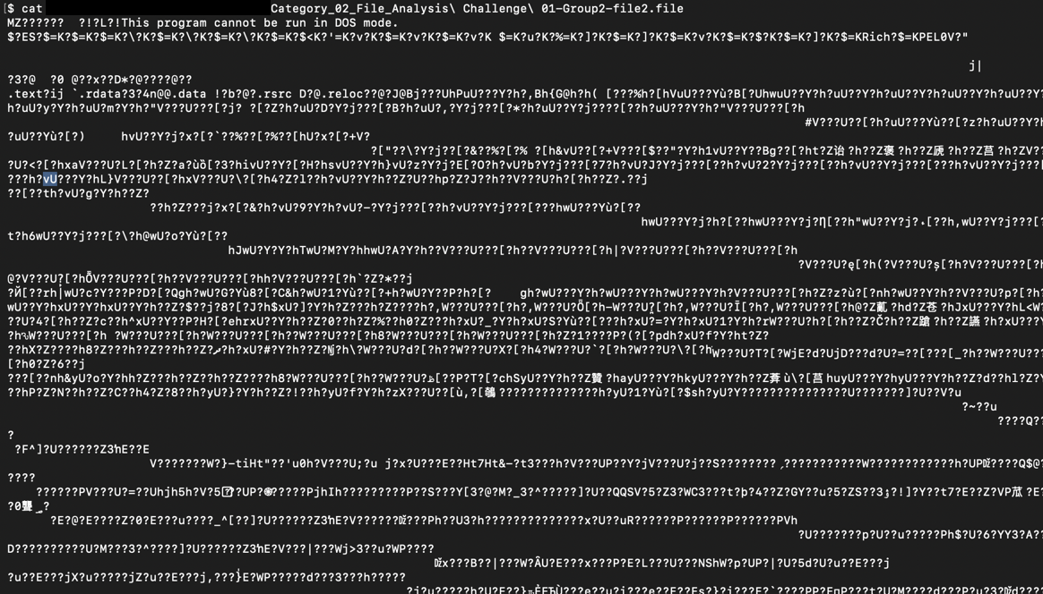
Introduction to the Problem
Upon trying to open the file, I was met with this screen. My computer didn’t know what to do with this file.
When attempting to print the file using the cat command, mere gibberish is spat out.
It’s time to figure out what this file is based off the magic bytes; a file’s Metadata.
Notes:
Sample text for narration: We open the .pcap using Wireshark and set a filter for the File Transfer Protocol (FTP) using “ftp” in the display filter box and click Apply to show only the FTP traffic in the capture file.

Slide 5
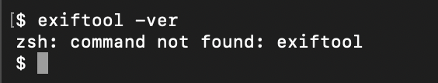
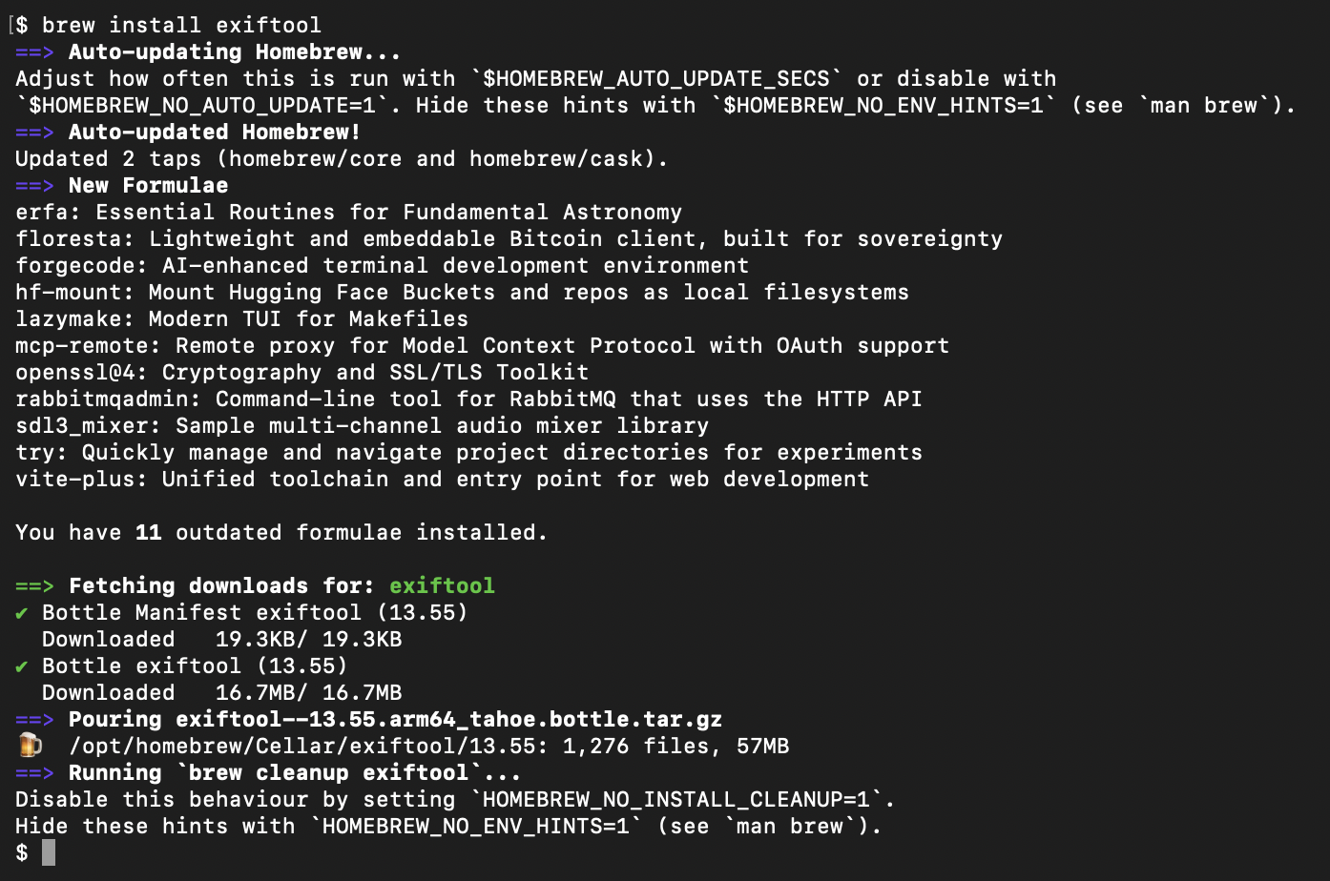
Download exiftool
A great tool to use here is a parser like exiftool.
Exiftool works by reading the metadata embedded in the file, and comparing it to known signatures to identify the file and its contents
Notes:
Sample text for narration: Right-click one of the packet frames (below frame #71) and choose the Follow > TCP Stream to show the conversation between the FTP server and the client machine. Note: TCP is the Transmission Control Protocol, a connection-oriented protocol.
You may choose to add additional slides.

Slide 6
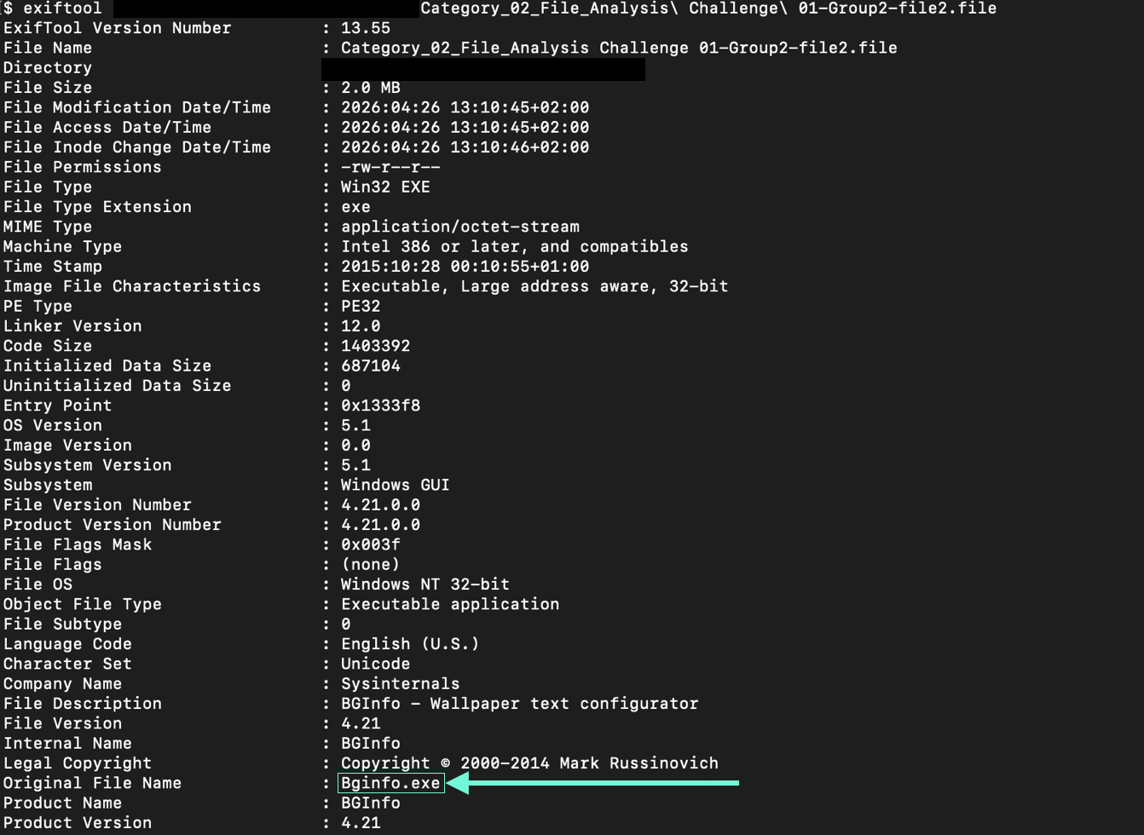
Arriving at the Solution
All it takes is a single command; exiftool <filename>
Notes:
Sample text for narration: In the Follow TCP Stream pop-up window, search for the flag, in the format of UMGC-XXXXX (below, UMGC-ABC123).
Write out the flag in your documentation. Your screenshot of the Follow TCP Stream pop-up window must include the date/time from the host system. Each student is responsible for providing at least one screenshot as shown below.

Slide 7
Strategies, Pitfalls, Lessons Learned
The strategy employed was a simple one that revealed the original filename and extension as well as a myriad of other information.
When deciding upon a strategy, I also considered using the “strings <filename>” command, but decided against using it unless exiftool failed.
I learned the difference between a parser like exiftool and a scavenger like strings.
Notes:
In this section, discuss some of the strategies you used to solve your CTF problem, as well as some of the pitfalls that can lead to the wrong path. This will all be part of the lessons learned section that will help you know how to approach this kind of problem.

Slide 8
The Relationship to the Workplace
File analysis is an essential tool for identifying lost, corrupted, or suspicious files in the workplace. Take an SOC Analyst role for example. Perhaps a file was downloaded but flagged by an antivirus and quarantined. Upon using the strings command, you find a URL exfiltrating data, hiding deep in the application, only visible when examining the binary through brute force. Perhaps a file was recovered from a corrupted drive and has lost some of its data. Using exiftool, you can parse the metadata in a way that’s readable and can aid in a file’s recovery.
Notes:
In this section, discuss how you think Capture the Flag competitions can benefit you in the workplace.

Slide 9
Summary
In this presentation, I analyzed a corrupted file that was unrecognizable to my laptop, utilized exiftool to extract the metadata, and successfully identified the file name and extension.
The core takeaway of this presentation is the demonstrated importance of file analysis in digital forensics, incident response, and data recovery.
Notes:
This is your summary and your last opportunity to connect with your audience.
Do not merely repeat your agenda topics. Add one to two important details about each main point to review for your audience.
What is/are the main takeaway(s)?

Slide 10
References
[1] P. Harvey, "ExifTool by Phil Harvey," ExifTool.org. [Online]. Available: https://exiftool.org/. [Accessed: Apr. 26, 2026].
[2] "exiftool — Homebrew Formulae," Brew.sh. [Online]. Available: https://formulae.brew.sh/formula/exiftool. [Accessed: Apr. 26, 2026].
Notes:
The example above uses IEEE style. Ask your instructor for clarification on the style to be used.
A narration for this slide is not required.

