Slide 1
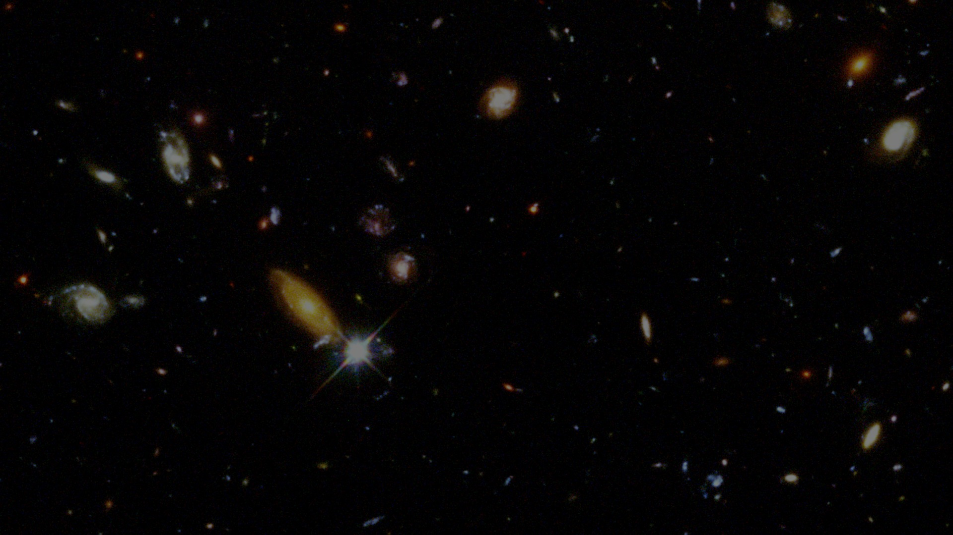
Decoding the Universe’s
Hidden Distortions
Lecture 1 · Cosmology Background
Big Bang · expansion · dark matter · dark energy · cosmic web
Image: Hubble Deep Field, NASA/ESA/STScI
01
Notes:
Welcome the student. Explain that this first lecture is not about machine learning yet; it builds the physical story behind the later ML project. Tell them the goal is to understand why cosmologists need indirect observational probes.

Slide 2
Learning outcomes
By the end of this 2-hour lecture, the student should be able to say:
Expansion
The universe is expanding; distant light is redshifted.
Big Bang
The early universe was hot, dense, and simple.
Dark matter
Extra gravity is needed to explain galaxies and clusters.
Dark energy
Cosmic expansion is accelerating today.
Structure
The cosmic web motivates observational probes.
Lecture 1 · Cosmology background
03
Notes:
Read the outcomes. Make clear that these outcomes are conceptual and exam-like: define, explain evidence, connect concepts.

Slide 3
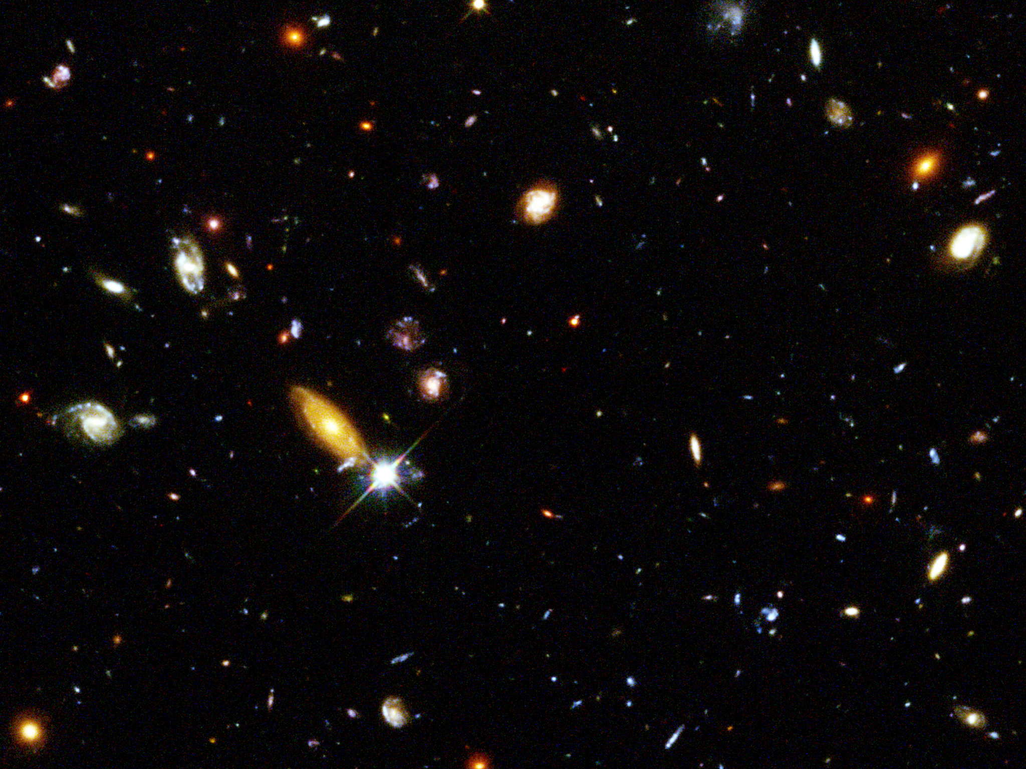
Cosmology is detective work
We cannot experiment with the whole universe. We infer its history from signals that reach us.
Observation
Light from galaxies, spectra, shapes, maps
Physical model
Expansion, gravity, matter, energy
Inference
What must the universe be like?
Lecture 1 · Cosmology background
Image: Hubble Deep Field, NASA/ESA/STScI
04
Notes:
Emphasize the scientific method in cosmology: observe, model, infer. Ask the student what information is carried by light: brightness, color, direction, shape, spectrum.

Slide 4
Scale ladder: where are we?
Cosmology studies the largest scales, but starts from familiar physics.
1
2
3
4
5
6
Human
Earth
Solar system
Milky Way
Galaxy clusters
Cosmic web
1 m
10⁷ m
10¹³ m
10²¹ m
10²³ m
10²⁶ m
Key link: gravity is the same force, but the objects and distances become enormous.
Lecture 1 · Cosmology background
05
Notes:
Use this scale ladder to ground the student. Mention that powers of ten are a useful language for astronomy. Cosmology is not different physics everywhere; it uses physics at different scales.

Slide 5
Looking far away means looking back in time
Light travels at a finite speed. Distant galaxies show the universe when it was younger.
Nearby galaxy
shorter lookback time
Farther galaxy
longer lookback time
This is why telescopes are also time machines.
Lecture 1 · Cosmology background
Image: Hubble Deep Field, NASA/ESA/STScI
06
Notes:
Introduce lookback time. Give an analogy: seeing the Sun as it was about 8 minutes ago. Then scale up to galaxies: millions to billions of years.

Slide 6
The Big Bang is not “an explosion into space”
It is the idea that the universe itself was hotter, denser, and smaller in the past.
Common picture
Better picture
Matter flying into empty space
Space expands; all large distances grow
earlier
later
Do not ask: “Where did it explode?”
Ask: “How has space changed with time?”
Lecture 1 · Cosmology background
07
Notes:
Correct the common misconception. The Big Bang model describes how the scale of the universe changes with time. It does not require a center in ordinary space.

Slide 7
A short timeline of cosmic history
We will use this timeline many times during the course.
Hot dense universe
CMB released
First stars
Galaxies grow
Today
Very early
~375k years
hundreds of Myr
billions of years
13.8 billion years
The universe changes from simple → structured.
Lecture 1 · Cosmology background
08
Notes:
Do not overload with details. The main story is: early universe is smooth and hot; small ripples grow into galaxies and cosmic web. Mention that the CMB is the next important evidence.

Slide 8
Expansion analogy: raisins in rising bread
Every raisin sees other raisins moving away as the dough expands.
Later
Earlier
Important: this analogy helps with distances, not with edges or outside space.
Lecture 1 · Cosmology background
09
Notes:
Use the raisin bread analogy. Make it precise: raisins are galaxies; dough is space. Warn that the analogy has limits because bread has an outside but the universe does not need one.

Slide 9
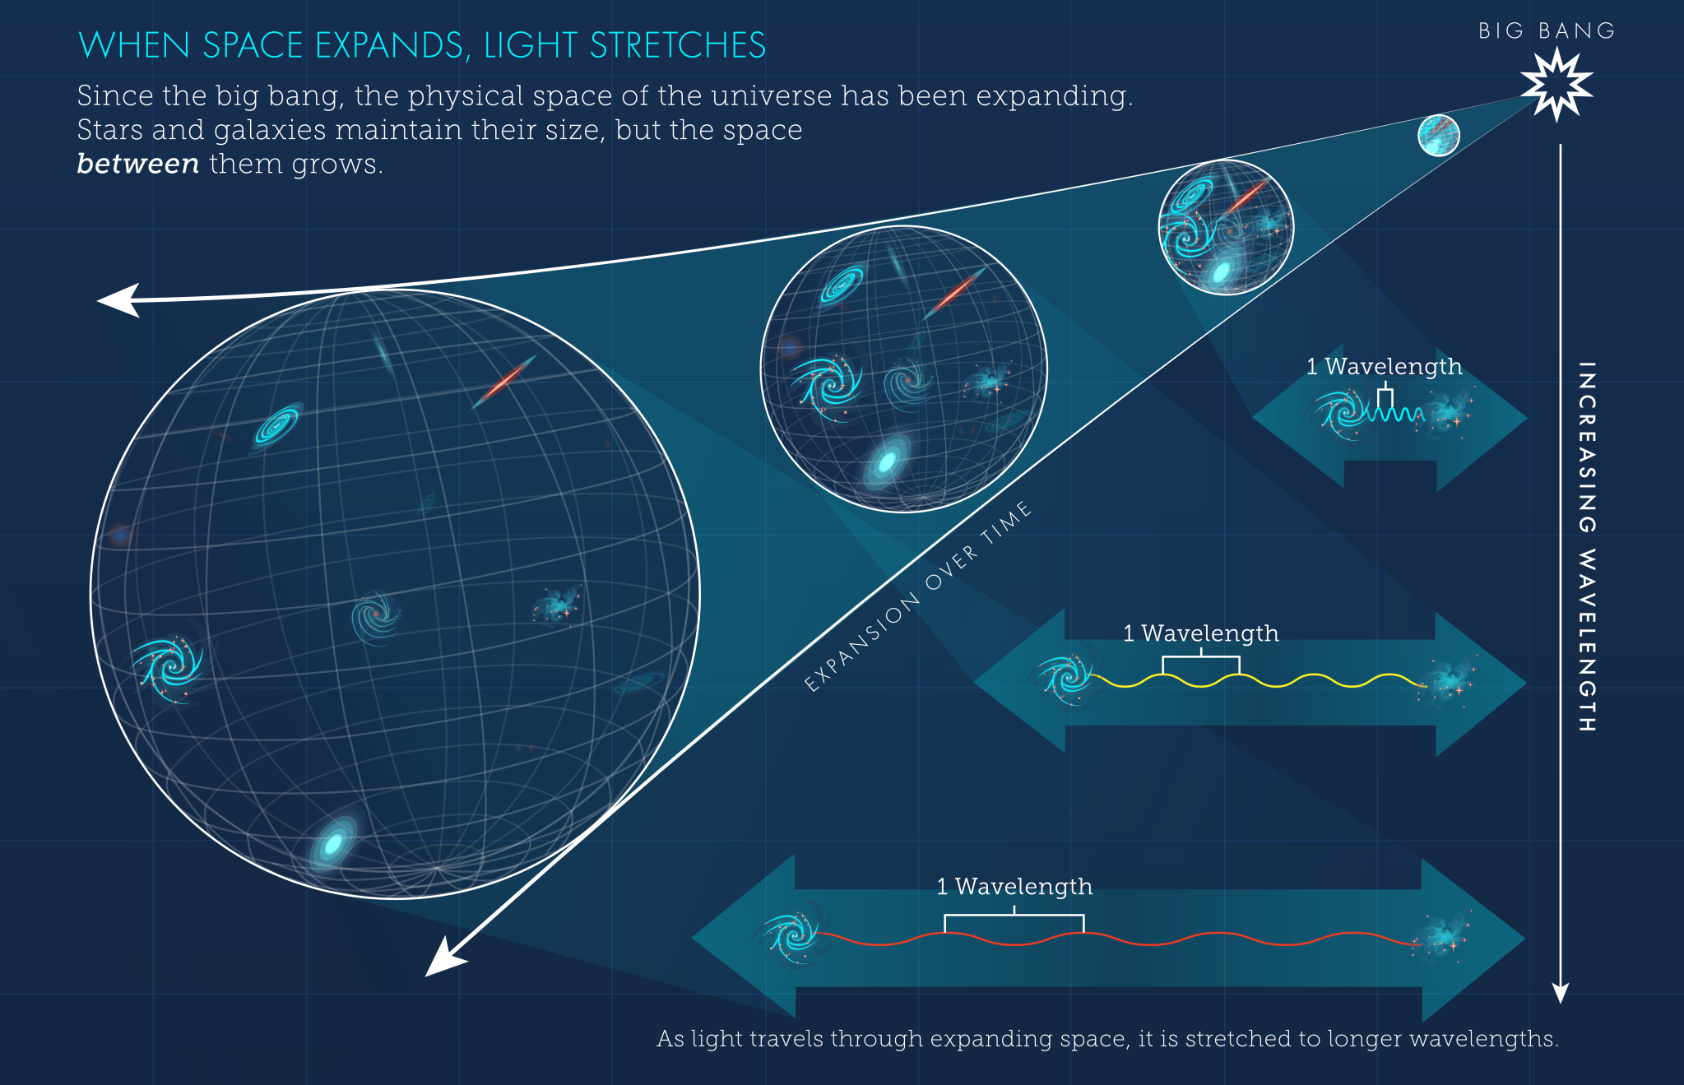
Redshift: expansion stretches light
A longer wavelength means light shifts toward red/infrared.
Key link: wavelength ↑ means frequency ↓.
Lecture 1 · Cosmology background
Image: NASA/ESA/STScI, cosmological redshift diagram
10
Notes:
Explain that redshift is not simply a Doppler shift from motion through space; on cosmological scales it is often light being stretched by expanding space.

Slide 10
Hubble’s law: farther galaxies appear to recede faster
At low redshift, velocity is roughly proportional to distance: v ≈ H₀D.
The straight-line pattern is evidence that space is expanding.
recession speed
This is one of the most important observational discoveries in modern cosmology.
Concept, not calculation
distance
Lecture 1 · Cosmology background
11
Notes:
Do not spend time deriving the equation. Emphasize the observed pattern: farther galaxies have larger redshifts. This supports expansion.

Slide 11
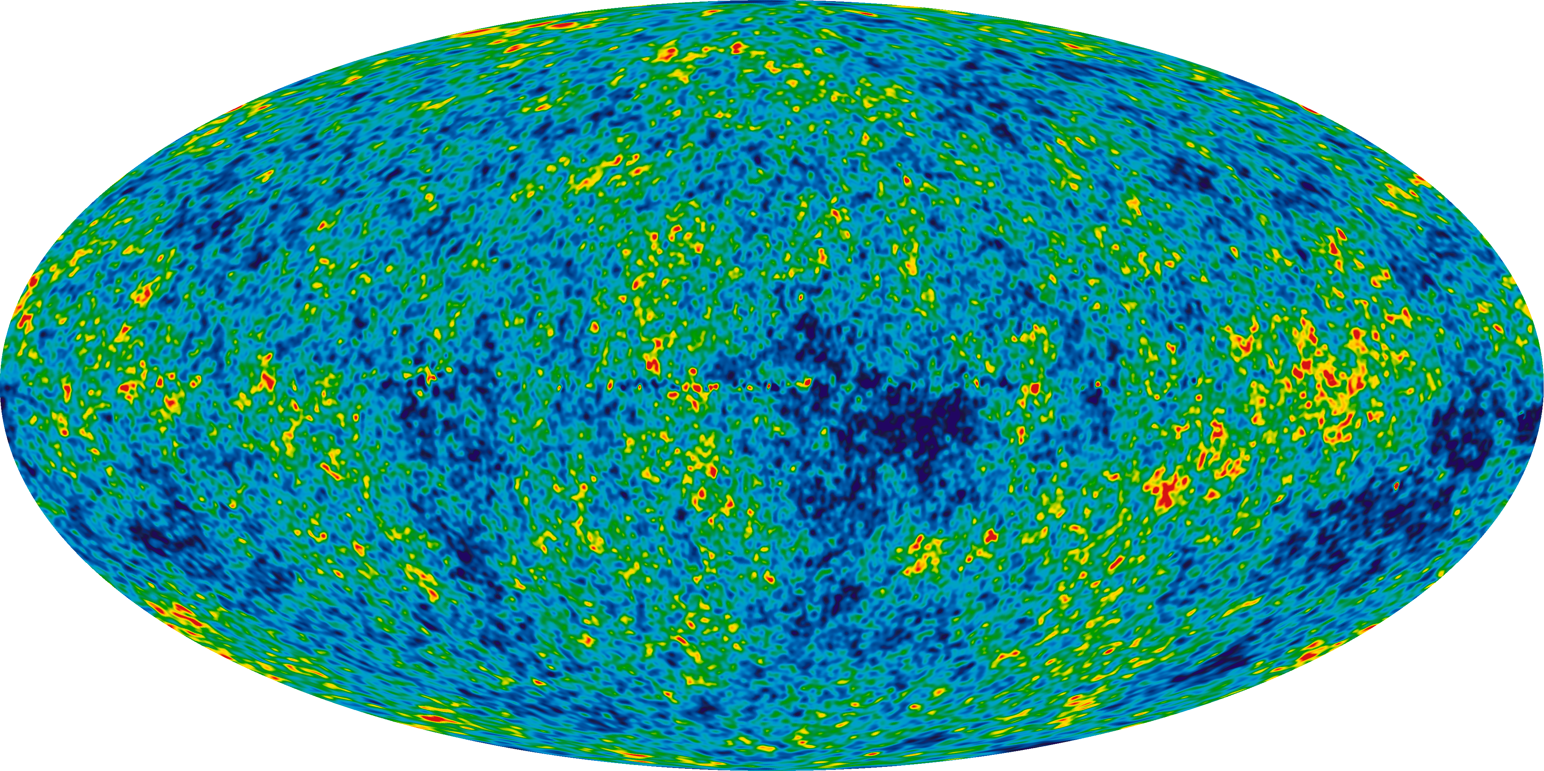
The cosmic microwave background: a baby picture
The CMB is ancient light from when the universe became transparent.
Tiny temperature differences later became the seeds of large-scale structure.
Lecture 1 · Cosmology background
Image: NASA / WMAP Science Team
12
Notes:
Explain transparency: before atoms formed, light scattered constantly. Around 375,000 years after the Big Bang, light could travel freely. The map is not a photo of galaxies; it is a temperature map of early radiation.

Slide 12
What the CMB tells us
The early universe was almost smooth — but not perfectly smooth.
Nearly
uniform
Tiny
ripples
Future
galaxies
The CMB connects the very early universe to the structure we observe today.
Lecture 1 · Cosmology background
13
Notes:
Highlight the key idea: small differences in density or temperature become the starting points for gravity to build cosmic structure.

Slide 13
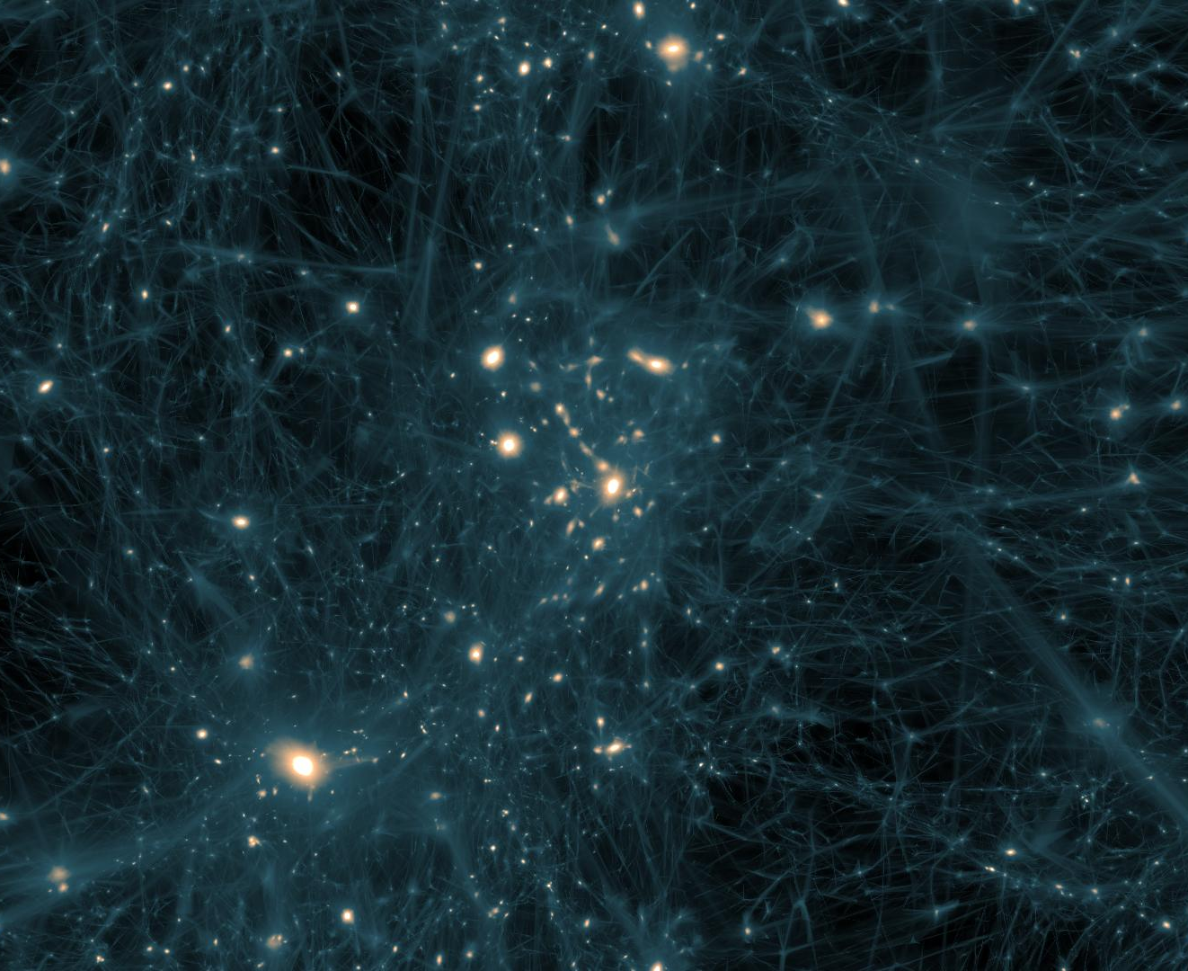
From tiny ripples to the cosmic web
Gravity amplifies small early differences into today’s web of galaxies.
Filaments
long threads of matter
Clusters
dense nodes where galaxies gather
Voids
large under-dense regions
This is large-scale structure.
Lecture 1 · Cosmology background
Image: NASA Scientific Visualization Studio / KIPAC simulation
26
Notes:
Define cosmic web vocabulary. Point out that galaxies are not randomly scattered; their pattern contains information about cosmic parameters.

Slide 14
Large-scale structure: vocabulary
These terms will appear repeatedly in cosmology papers.
Galaxy
Group / cluster
billions of stars bound by gravity
many galaxies in one dark matter halo
Filament
Void
bridge connecting clusters
large low-density region
Lecture 1 · Cosmology background
27
Notes:
Make this a vocabulary slide. Ask the student to repeat definitions or give analogies. Keep “halo” tied to dark matter.

Slide 15
How structure grows
Small differences become larger because gravity is an amplifier.
1
2
3
4
tiny density ripples
slightly denser regions pull matter
galaxies form in halos
filaments and clusters appear
This is why the CMB and galaxy surveys are connected.
Lecture 1 · Cosmology background
28
Notes:
Use gravity as an amplifier: more matter pulls in more matter, making a contrast stronger over time. Do not discuss perturbation theory.

Slide 16
What is the universe made of?
Most of the universe is not ordinary atoms.
~5% ordinary matter
~27% dark matter
~68% dark energy
Numbers vary slightly by dataset, but the lesson is stable: visible matter is only a small piece.
Lecture 1 · Cosmology background
16
Notes:
Use approximate ΛCDM composition values. Tell the student this is not a chemistry pie chart; it is mass-energy density of the universe.

Slide 17
Dark matter: matter we infer from gravity
It does not emit much light, but it pulls on things gravitationally.
We see:
stars, gas, galaxies, light
We measure:
gravity stronger than visible matter predicts
We infer:
there is extra mass: dark matter
visible galaxy +
invisible halo
Lecture 1 · Cosmology background
17
Notes:
Dark matter is not just “dark stuff”; it is a placeholder for matter-like gravity not accounted for by visible matter. Avoid discussing specific particles too deeply.

Slide 18
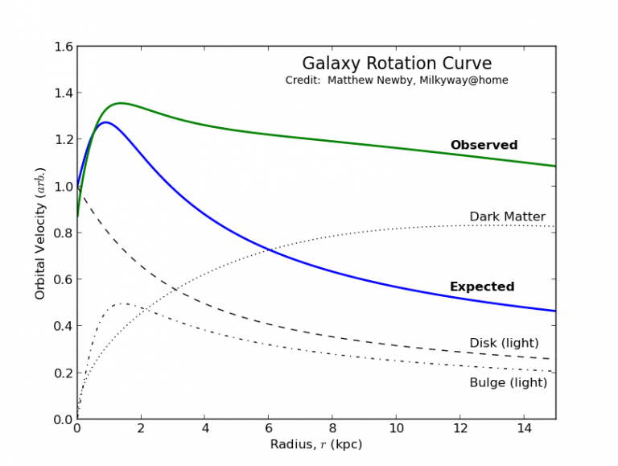
Evidence: galaxy rotation curves
Stars far from the center move too fast to be explained by visible matter alone.
Expected if only visible matter:
speed falls at large radius
Observed:
speed stays high
Interpretation:
an extended dark matter halo adds gravity
Lecture 1 · Cosmology background
Image: Matthew Newby / MilkyWay@home, educational rotation curve
18
Notes:
Walk through the axes. The exact numbers are less important than the shape: visible matter predicts declining speed, observed speed remains flatter.

Slide 19
Dark matter halos: the invisible scaffolding
Galaxies are thought to sit inside larger dark matter halos.
more mass
than we see
stronger
gravity
visible galaxy
dark matter halo
Lecture 1 · Cosmology background
19
Notes:
Use this as a mental model. A halo is not a glowing halo; it is a spatial distribution of mass inferred from gravitational behavior.

Slide 20
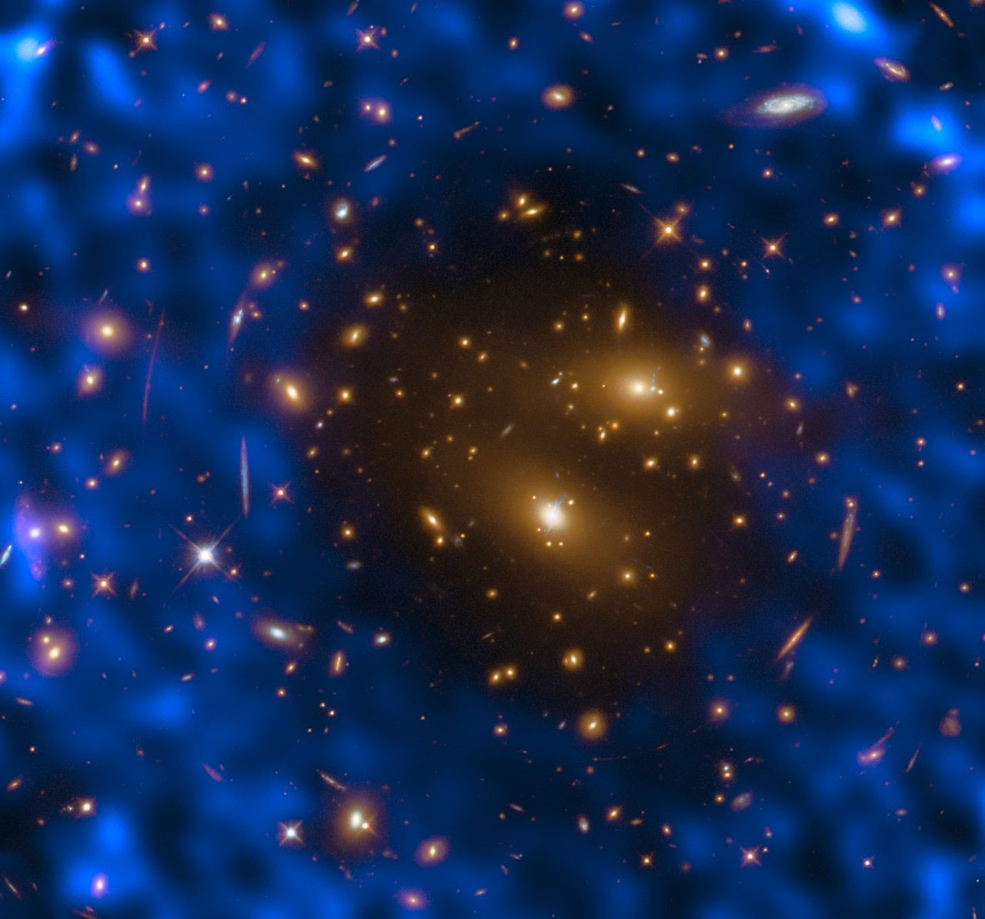
Evidence: clusters and lensing
Large masses bend light. This lets us map mass, including dark matter.
Mass bends light paths.
If the bending is stronger than visible galaxies predict, we infer extra invisible mass.
This is the bridge to weak lensing.
Lecture 1 · Cosmology background
Image: NASA/ESA; galaxy cluster with dark matter map / lensing
20
Notes:
Introduce lensing only as a preview. Strong lensing can make arcs; weak lensing makes tiny statistical distortions. The actual weak lensing lecture comes next.

Slide 21
Dark matter takeaway
Dark matter is not seen directly; it is inferred repeatedly from gravity.
Galaxies
Clusters
Cosmic web
rotation curves
motions + lensing
structure growth
One clue could be a mistake. Many independent clues become a scientific case.
Lecture 1 · Cosmology background
21
Notes:
This slide emphasizes converging evidence. Ask the student: why is multiple independent evidence stronger than a single observation?

Slide 22
Dark energy: the surprise
Gravity should slow expansion. Observations show the expansion is accelerating.
Expected:
slowing down
Observed:
speeding up
“Dark energy” names the unknown cause of this acceleration.
Lecture 1 · Cosmology background
22
Notes:
Keep this conceptual. The word dark energy is a label for the phenomenon in the standard model; its physical nature is still unknown.

Slide 23
How was accelerated expansion discovered?
Type Ia supernovae let astronomers compare distance with redshift.
Find a Type Ia
supernova
Use brightness
to estimate distance
Measure redshift
of its host galaxy
Compare with
expansion models
1
2
3
4
distance
from brightness
simple slowing model
distant supernovae
appeared dimmer/farther
than expected
Inference:
expansion was slower in the past
than it is today
redshift
Key idea: the discovery came from comparing two measurements — distance and redshift — not from directly “seeing” dark energy.
Lecture 1 · Cosmology background
23

Slide 24
Why stellar tracers matter: the distance ladder
To measure cosmic expansion, astronomers first need reliable distances.
A “standard candle” is an object whose true brightness can be estimated.
Compare true brightness with observed brightness → infer distance.
Supernovae are not ordinary stars:
they are stellar explosions, but their brightness is calibrated using stellar-distance tracers.
Distance ladder logic
Each rung is calibrated by the previous rung, so far-away measurements depend on careful nearby measurements.
Nearby stars
parallax gives
direct distances
Cepheid variables
pulsing stars reveal
intrinsic brightness
Type Ia supernovae
standard candles
in far galaxies
Expansion history
distance + redshift
trace acceleration
Exam-style chain: stellar tracer → distance estimate → redshift comparison → expansion history → dark energy question
Lecture 1 · Cosmology background
24

Slide 25
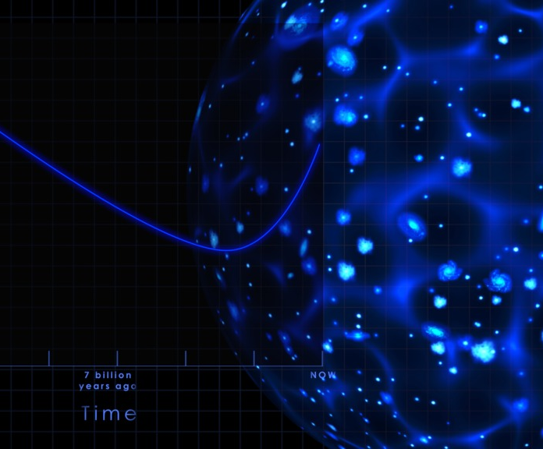
Expansion history: deceleration then acceleration
Matter dominated earlier; dark energy dominates today.
Earlier universe
Matter was denser, so gravity strongly affected expansion.
Recent universe
Dark energy becomes more important; expansion accelerates.
This motivates precision cosmology.
Lecture 1 · Cosmology background
Image: NASA Scientific Visualization Studio
23
Notes:
Interpret the NASA graphic: expansion history is not constant speed. It changed as the universe changed. Mention that measuring this history is a major goal of surveys.

Slide 26
Dark energy intuition
Think of two competing effects on cosmic distances.
Gravity
Dark energy
pulls matter together
drives accelerated expansion
Cosmology asks: which effect dominates at each time?
Lecture 1 · Cosmology background
24
Notes:
This is a simplified intuition; be precise that gravity does not stop expansion everywhere because expansion is a property of the cosmic scale factor. This slide is for intuition only.

Slide 27
What we know vs. what remains open
This is why cosmology is still active research.
Strong evidence
Open questions
• expansion
• CMB
• galaxy growth
• gravitational lensing
• What is dark matter?
• What is dark energy?
• How biased are our measurements?
• How do systematics affect inference?
Lecture 1 · Cosmology background
25
Notes:
Transition back to the project. Intrinsic alignment is one example of a systematic effect that can bias cosmological inference. Do not explain IA in detail yet.

Slide 28
Observational probes: different windows on the same universe
A probe is a measurement strategy that reveals one part of the cosmic story.
CMB
Supernovae
Redshift surveys
Weak lensing
early-universe radiation
expansion history
3D galaxy positions
mass through shape distortions
No single probe is perfect. Agreement across probes builds confidence.
Lecture 1 · Cosmology background
30
Notes:
Define observational probe explicitly. Make the ethical/scientific reasoning link: robust claims require multiple measurements and clear uncertainty.

Slide 29
Why large-scale structure is a data problem
The universe gives us maps, not direct answers.
Input
positions, redshifts, shapes, brightness
Processing
calibration, noise removal, selection effects
Model
cosmological parameters + astrophysical systematics
Output
constraints and uncertainty ranges
This is where scientific machine learning becomes useful.
Lecture 1 · Cosmology background
29
Notes:
This slide links cosmology to data science. A survey is a measurement pipeline. The final numbers depend on assumptions and systematic error modeling.

Slide 30
Bridge to the project: weak lensing
Weak lensing uses many tiny galaxy-shape distortions to map matter.
galaxy
image
mass
field
statistics
slightly
distorted
Problem for later: galaxy shapes are affected by lensing AND by astrophysical systematics.
Lecture 1 · Cosmology background
31
Notes:
This is a preview only. Do not explain intrinsic alignment deeply. The key is that weak lensing is an observational probe of matter, but the measured galaxy shapes are not pure lensing signals.

Slide 31
Mini-activity: build a reasoning chain
Choose one observation and connect it to one cosmology claim.
Observation / probe
Evidence pattern
Inference
Open question
redshift
farther galaxies
→ more redshift
space expands
how fast today?
Type Ia supernovae
dimmer/farther
than expected
acceleration
what is dark energy?
rotation curves
outer stars
too fast
dark matter
what particle?
CMB ripples
tiny early
differences
seeds of structure
which parameters?
galaxy clustering
non-random
3D galaxy map
cosmic web growth
how fast structure grows?
weak lensing
galaxy shapes
slightly aligned
mass map
how large are systematics?
Student task: choose one chain and explain it aloud in 60 seconds. Then say one possible systematic error.
Lecture 1 · Cosmology background
32
Notes:
Ask the student to pick one row and explain it aloud. This practices evidence-to-claim reasoning.

Slide 32
Lecture 1 summary: five big ideas
These are the ideas the next lecture will build on.
1
The universe has a history.
1
2
Expansion stretches light, causing redshift.
2
3
The CMB preserves early-universe information.
3
4
Dark matter and dark energy are inferred from observations.
4
5
Large-scale structure is a map of cosmic evolution.
5
Next: weak lensing and intrinsic alignment.
Lecture 1 · Cosmology background
33
Notes:
Review and ask the student which idea feels most intuitive and which feels most confusing.

Slide 33
Assignment after Lecture 1
Write a 300-word summary.
Prompt
Why does cosmology need observational probes?
Mention at least two examples:
redshift
CMB
galaxy surveys
dark matter evidence
large-scale structure
Success criteria: clear explanation, one concrete observation, one inference, and one open question.
Lecture 1 · Cosmology background
34
Notes:
Clarify that the assignment should be written in their own words. It is acceptable to use analogies from the lecture.

