Slide 1
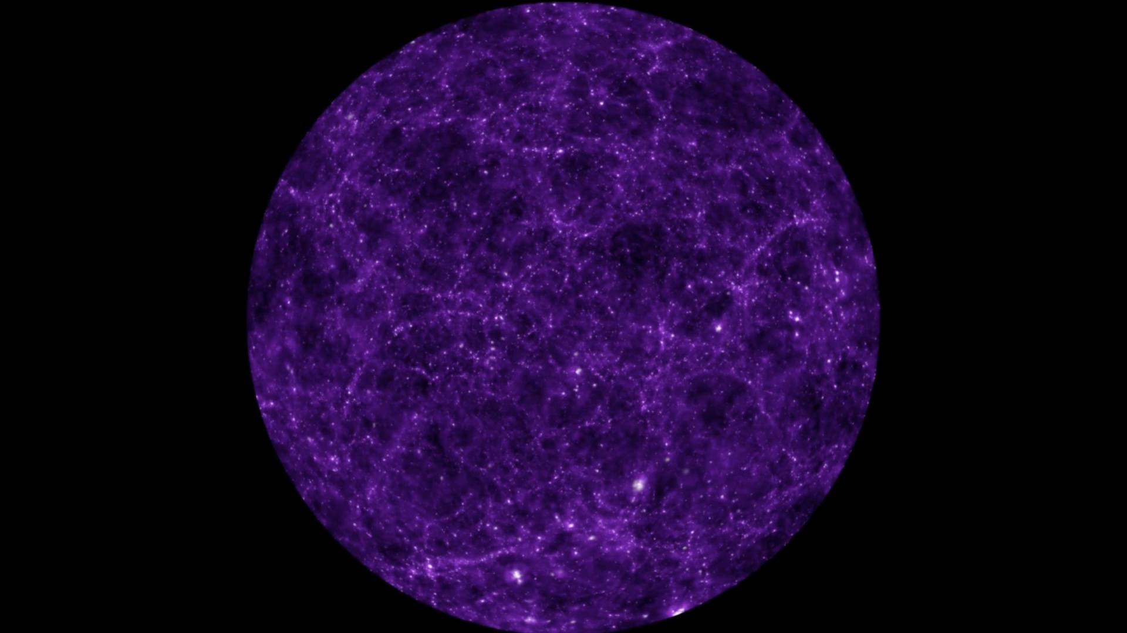
Lecture 2
Seeing the Invisible Universe
Weak gravitational lensing and intrinsic alignments
Today: how galaxy shapes become a map of matter — and how they can fool us
1/30
Notes:
Lecture 2 slide 1. Keep explanations at AP Physics level. Emphasize intuition before terminology.

Slide 2
Today’s story
A clear path from physical idea to research problem.
1
Gravity bends light
Mass changes the path of light.
2
Strong vs weak lensing
Visible arcs vs tiny statistical distortions.
3
Galaxy shapes as data
We infer patterns by averaging many galaxies.
4
Intrinsic alignment
Galaxies may be aligned before lensing.
5
Why ML later?
IA signals become complicated high-dimensional curves.
2/30
Notes:
Lecture 2 slide 2. Keep explanations at AP Physics level. Emphasize intuition before terminology.

Slide 3
Recap from Lecture 1
Cosmology needs observations because most of the Universe is not directly visible.
Dark matter
adds gravity
Large-scale
structure forms
We need a
cosmic map
Guiding question: How can we map invisible matter if we cannot see it?
3/30
Notes:
Lecture 2 slide 3. Keep explanations at AP Physics level. Emphasize intuition before terminology.

Slide 4
Start with an everyday analogy
Distortion can reveal what caused it.
Distortion pattern
Hidden cause
Inference
A glass lens bends a grid
4/30
Notes:
Lecture 2 slide 4. Keep explanations at AP Physics level. Emphasize intuition before terminology.

Slide 5
Einstein idea, simplified
Mass changes the path of light.
A straight light path
without mass
mass
A bent light path
near a massive object
The stronger the gravity nearby, the more the path can bend.
5/30
Notes:
Lecture 2 slide 5. Keep explanations at AP Physics level. Emphasize intuition before terminology.

Slide 6
The basic lensing geometry
Background galaxy → foreground mass → observer.
Background
galaxy
Observer
(telescope)
mass
Light takes bent paths around mass.
The telescope receives a distorted image, not a label saying “dark matter was here.”
6/30
Notes:
Lecture 2 slide 6. Keep explanations at AP Physics level. Emphasize intuition before terminology.

Slide 7
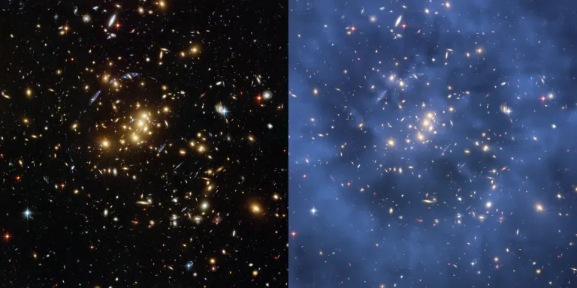
Lensing lets us weigh invisible matter
A distorted background can reveal mass in the foreground.
Visible galaxies
Shape distortions
Dark matter map
Key idea: we infer mass from the pattern of distorted images.
7/30
Notes:
Lecture 2 slide 7. Keep explanations at AP Physics level. Emphasize intuition before terminology.

Slide 8
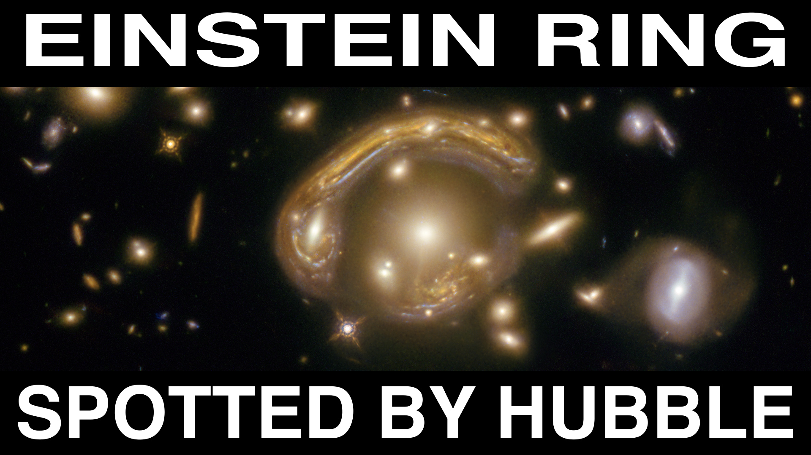
Strong lensing: the dramatic case
Arcs, rings, or multiple images can be visible by eye.
Strong lensing happens when alignment and mass are just right.
It can create arcs, rings, and multiple images.
Beautiful — but rare.
8/30
Notes:
Lecture 2 slide 8. Keep explanations at AP Physics level. Emphasize intuition before terminology.

Slide 9
Weak lensing: the subtle case
Every background galaxy is changed only a little.
Before lensing
random directions
After weak lensing
a tiny shared stretch
Weak lensing is not obvious in one galaxy. It appears as a pattern across many galaxies.
9/30
Notes:
Lecture 2 slide 9. Keep explanations at AP Physics level. Emphasize intuition before terminology.

Slide 10
Strong vs weak lensing
Same physics, different measurement style.
Strong lensing
Weak lensing
Visible arcs or rings
One object can be convincing
Rare, special alignment
Tiny shape changes
Needs many galaxies
Common across the sky
10/30
Notes:
Lecture 2 slide 10. Keep explanations at AP Physics level. Emphasize intuition before terminology.

Slide 11
Why weak lensing needs many galaxies
A single galaxy shape is too noisy to interpret.
average
pattern
many noisy shapes → one clearer signal
11/30
Notes:
Lecture 2 slide 11. Keep explanations at AP Physics level. Emphasize intuition before terminology.

Slide 12
Galaxies are not perfect circles
Their natural shapes are part of the measurement problem.
Real galaxy images already have size, stretch, orientation, blur, and noise.
So lensing measurement is not “detecting a bend” directly — it is estimating a tiny statistical change in shape.
12/30
Notes:
Lecture 2 slide 12. Keep explanations at AP Physics level. Emphasize intuition before terminology.

Slide 13
Ellipticity: stretch + direction
A gentle way to describe galaxy shape.
ellipticity
How stretched?
We do not need advanced math today. Think of ellipticity as a compact description of shape.
Which direction?
13/30
Notes:
Lecture 2 slide 13. Keep explanations at AP Physics level. Emphasize intuition before terminology.

Slide 14
Random shapes can average out
Weak lensing relies on statistics.
random natural shapes
average ≈ no preferred direction
Randomness is not a bug here — it is what makes averaging useful.
14/30
Notes:
Lecture 2 slide 14. Keep explanations at AP Physics level. Emphasize intuition before terminology.

Slide 15
Weak lensing creates a shared pattern
The signal is a small coherent distortion.
same tiny direction
Lensing signal = shared pattern after averaging many galaxies.
15/30
Notes:
Lecture 2 slide 15. Keep explanations at AP Physics level. Emphasize intuition before terminology.

Slide 16
Each galaxy is a noisy measurement
The observed shape mixes several effects.
observed shape = lensing distortion + intrinsic shape + noise
What gravity adds
What the galaxy already had
What measurement adds
Today’s main challenge: separating the cosmic signal from the non-lensing parts.
16/30
Notes:
Lecture 2 slide 16. Keep explanations at AP Physics level. Emphasize intuition before terminology.

Slide 17
From individual images to sky patches
Weak lensing studies many galaxies in a region of the sky.
average shape
for this patch
compare patches
across the sky
17/30
Notes:
Lecture 2 slide 17. Keep explanations at AP Physics level. Emphasize intuition before terminology.

Slide 18
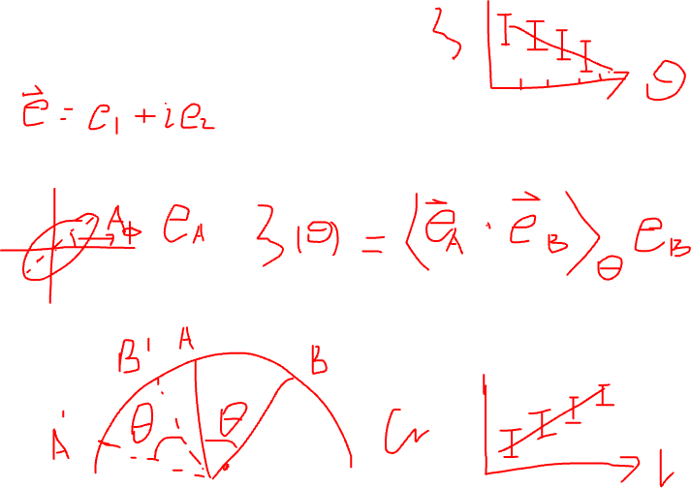
Correlation: “do two things vary together?”
We only need the intuition, not the formulas.
Galaxy A
shape direction
same direction more often than random?
Galaxy B
shape direction
Correlation asks whether galaxy shapes have a shared pattern.
In lensing, shared patterns can tell us about matter between us and those galaxies.
18/30
Notes:
Lecture 2 slide 18. Keep explanations at AP Physics level. Emphasize intuition before terminology.

Slide 19
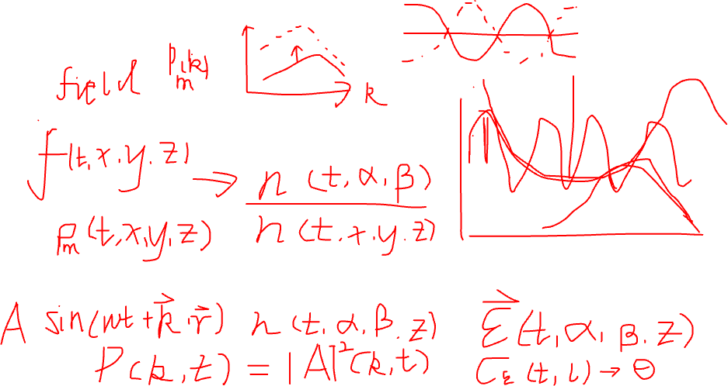
Two-point statistics, without heavy math
A “two-point” measurement compares pairs of galaxies.
separation on the sky
Count many galaxy pairs
Group by separation
Measure shared alignment
19/30
Notes:
Lecture 2 slide 19. Keep explanations at AP Physics level. Emphasize intuition before terminology.

Slide 20
Intrinsic alignment: the main complication
Galaxies can be aligned before lensing happens.
“Intrinsic” means built into the galaxy population itself.
Galaxies form inside the same cosmic web environment.
Their shapes may point in related directions even without lensing.
20/30
Notes:
Lecture 2 slide 20. Keep explanations at AP Physics level. Emphasize intuition before terminology.

Slide 21
Physical reason: shared environment
Local gravity and formation history can affect galaxy orientations.
cosmic filament
A shared environment can create a shared orientation.
21/30
Notes:
Lecture 2 slide 21. Keep explanations at AP Physics level. Emphasize intuition before terminology.

Slide 22
IA example: galaxies in the same filament
This alignment is not caused by the light path to us.
same local structure → similar shape directions
This can happen before the light travels to the telescope.
22/30
Notes:
Lecture 2 slide 22. Keep explanations at AP Physics level. Emphasize intuition before terminology.

Slide 23
Why IA is dangerous
It can look like weak lensing in the data.
Lensing signal
from matter
Observed shape
correlations
Intrinsic alignment
from formation
Same kind of measurement, mixed causes.
23/30
Notes:
Lecture 2 slide 23. Keep explanations at AP Physics level. Emphasize intuition before terminology.

Slide 24
Contamination in one line
If IA is not modelled, cosmological conclusions can be biased.
measured pattern = true lensing pattern + IA pattern + noise
true lensing
IA contamination
biased observation
Bias means the measurement points us slightly toward the wrong answer.
24/30
Notes:
Lecture 2 slide 24. Keep explanations at AP Physics level. Emphasize intuition before terminology.

Slide 25
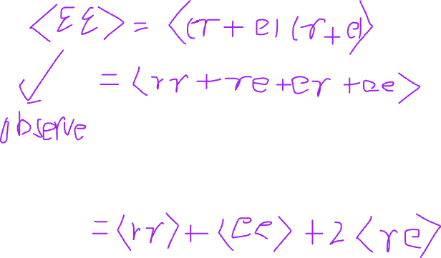
Three terms, conceptually
Names you will see in weak-lensing papers.
GG
Lensing–lensing
II
Intrinsic–intrinsic
GI
Gravity–intrinsic
the signal we want
galaxies aligned
with each other
foreground matter
related to galaxy shape
Today: learn the meaning. Later: model the curves.
25/30
Notes:
Lecture 2 slide 25. Keep explanations at AP Physics level. Emphasize intuition before terminology.

Slide 26
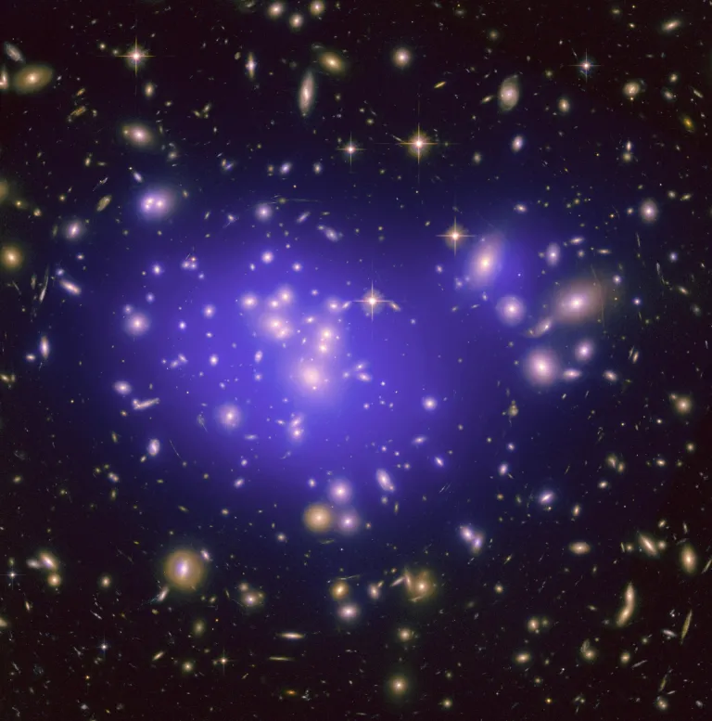
Why this matters for future surveys
Huge datasets make tiny biases important.
Euclid
Rubin LSST
Roman
When surveys measure millions to billions of galaxies, a small systematic effect can become scientifically important.
26/30
Notes:
Lecture 2 slide 26. Keep explanations at AP Physics level. Emphasize intuition before terminology.

Slide 27
IA spectra become high-dimensional curves
This connects to the project’s machine-learning goal.
Each curve can have many numbers
IA signal
Parameters change the curve shape
ML compression tries to keep the important information
scale / multipole
27/30
Notes:
Lecture 2 slide 27. Keep explanations at AP Physics level. Emphasize intuition before terminology.

Slide 28
Bridge to Lecture 3
How do we turn the science into a machine-learning task?
IA spectra
curves
High-dimensional
vectors
Compression
objective
Latent space
representation
Next: From science question to ML task
28/30
Notes:
Lecture 2 slide 28. Keep explanations at AP Physics level. Emphasize intuition before terminology.

Slide 29
Quick check: 5 questions
Use this to test understanding before the assignment.
Easy
1. What does gravitational lensing do to light?
Easy
2. Why is weak lensing harder to see than strong lensing?
Medium
3. Why do we need many galaxies to measure weak lensing?
Medium
4. What does intrinsic alignment mean?
Difficult
5. Why can intrinsic alignment bias weak-lensing measurements?
Suggested timing: 5 minutes individual thinking + 5 minutes discussion.
29/30
Notes:
Lecture 2 slide 29. Keep explanations at AP Physics level. Emphasize intuition before terminology.

Slide 30
Assignment: draw the concept diagram
Link lensing, galaxy shapes, and IA contamination.
Matter
foreground
Lensing
distortion
Your diagram should show two paths into the observed galaxy shape: one from lensing, one from IA.
Observed
shape
Add 3–5 short labels and one sentence explaining why IA is a systematic error.
Formation
environment
Intrinsic
alignment
Deliverable: one clear concept map + 150–200 word explanation
30/30
Notes:
Lecture 2 slide 30. Keep explanations at AP Physics level. Emphasize intuition before terminology.

