Slide 1
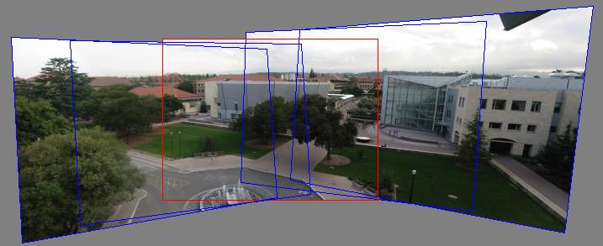

Idea: projecting images onto a common plane
each image is warped with a homography
We’ll see what this homography means later.
First -- Can’t create a 360 panorama this way…
mosaic PP

Slide 2
Project 3
Take pictures on a tripod (or handheld)
Warp to spherical coordinates (optional if using homographies to align images)
Extract features
Align neighboring pairs using RANSAC
Write out list of neighboring translations
Blend the images
Correct for drift
Now enjoy your masterpiece!

Slide 3


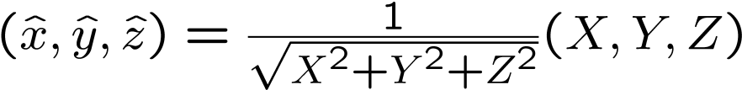





Spherical projection
  Map 3D point (X,Y,Z) onto sphere
Y
Z
X
  Convert to spherical coordinates
  Convert to spherical image coordinates
unit sphere
    s defines size of the final image
      often convenient to set s = camera focal length in pixels
unwrapped sphere
Spherical image

Slide 4
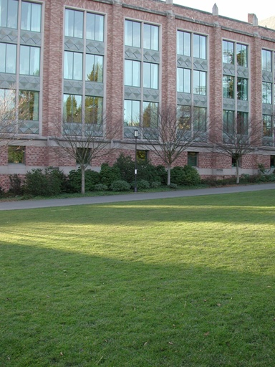
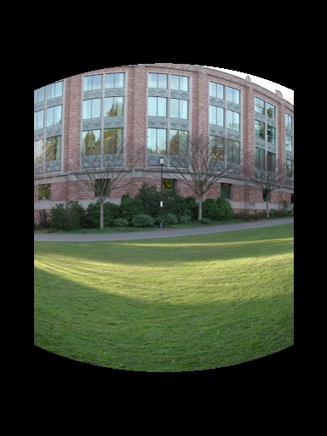
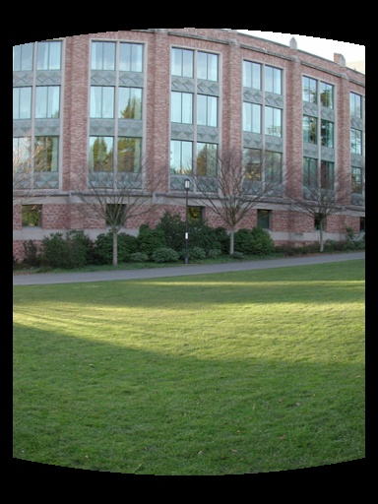
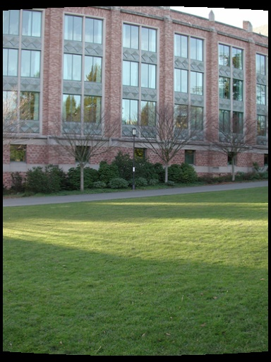
Spherical reprojection
input
f = 200 (pixels)
f = 400
f = 800
Map image to spherical coordinates
  need to know the focal length
Notes:
Therefore, it is desirable if the global motion model we need to recover is translation, which has only two parameters. It turns out that for a pure panning motion, if we convert two images to their cylindrical maps with known focal length, the relationship between them can be represented by a translation.
Here is an example of how cylindrical maps are constructed with differently with f’s. Note how straight lines are curved.
Similarly, we can map an image to its longitude/latitude spherical coordinates as well if f is given.

Slide 5
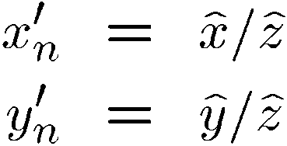
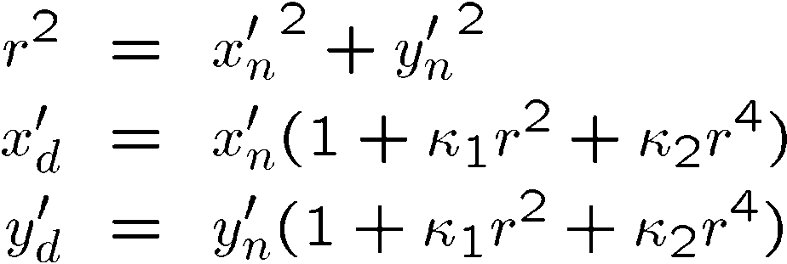
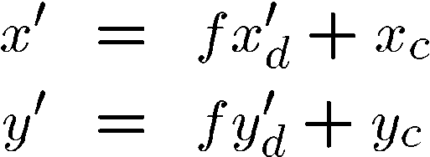
Modeling distortion
Project
to “normalized”
image coordinates
Apply radial distortion
Apply focal length
translate image center
To model lens distortion with panoramas
  Use above projection operation after projecting onto a sphere

Slide 6
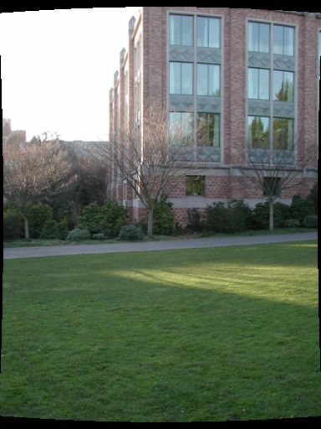
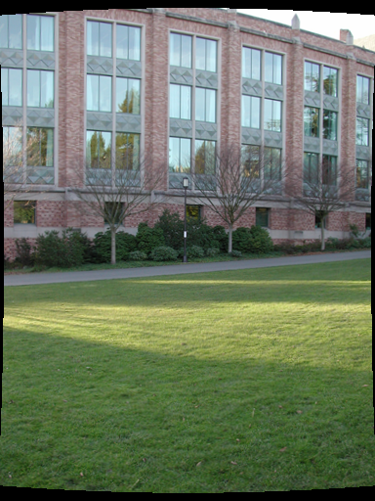
Aligning spherical images
Suppose we rotate the camera by θ about the vertical axis
  How does this change the spherical image?
    Translation by θ
  This means that we can align spherical images by translation
Notes:
Therefore, it is desirable if the global motion model we need to recover is translation, which has only two parameters. It turns out that for a pure panning motion, if we convert two images to their cylindrical maps with known focal length, the relationship between them can be represented by a translation.
Here is an example of how cylindrical maps are constructed with differently with f’s. Note how straight lines are curved.
Similarly, we can map an image to its longitude/latitude spherical coordinates as well if f is given.

Slide 7
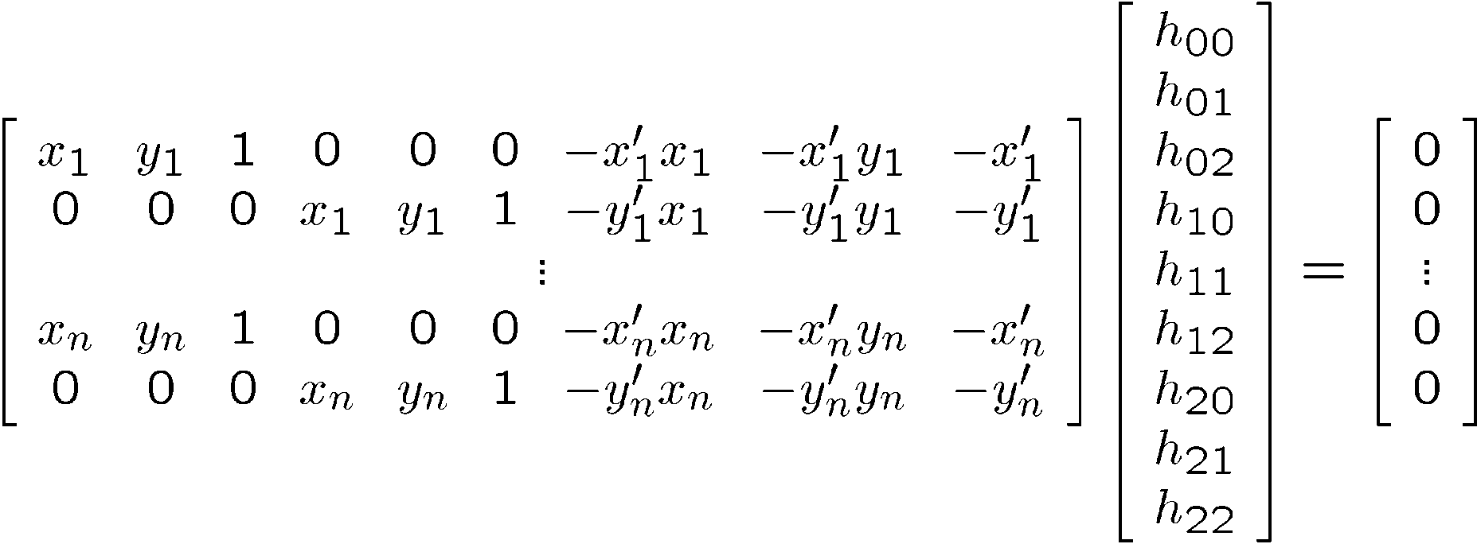





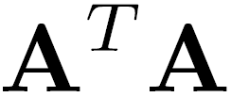
Solving for homographies
2n × 9
9
2n
Defines a least squares problem:
  Since is only defined up to scale, solve for unit vector
  Solution: = eigenvector of with smallest eigenvalue
  Works with 4 or more matches (8 rows in A). How do you find these points?

Slide 8
Assembling the panorama
Stitch pairs together, blend, then crop

Slide 9
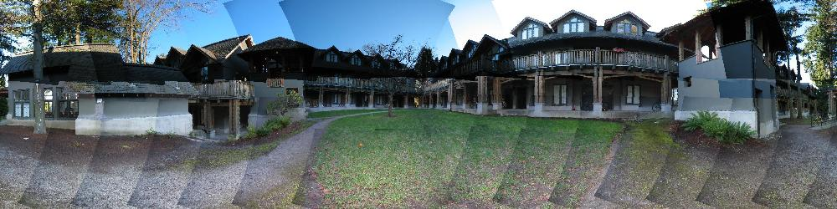
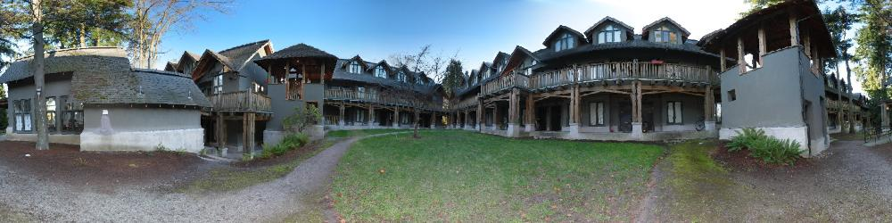
Blending
We’ve aligned the images – now what?

Slide 10
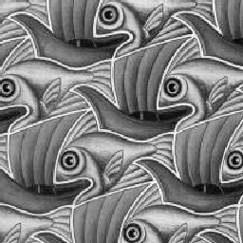
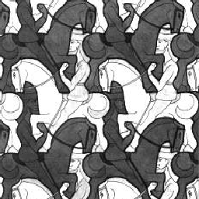
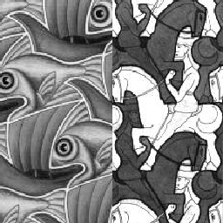
Image Blending

Slide 11
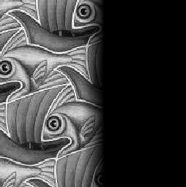
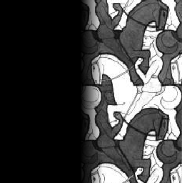

Feathering: Linear Interpolation
+
1
1
0
0
=

Slide 12
Alpha Blending
I₃
p
I₁
Optional: see Blinn (CGA, 1994) for details:
http://ieeexplore.ieee.org/iel1/38/7531/00310740.pdf?isNumber=7531&prod=JNL&arnumber=310740&arSt=83&ared=87&arAuthor=Blinn%2C+J.F.
I₂
Encoding blend weights: I(x,y) = (αR, αG, αB, α)
color at p =
Implement this in two steps:
  1. accumulate: add up the (α premultiplied) RGBα values at each pixel
  2. normalize: divide each pixel’s accumulated RGB by its α value
    Q: what if α = 0?
Notes:
A: render as black

Slide 13
Problem: Drift
(x₁,y₁)
(x_{n},y_{n})
copy of first image
Solution
  add another copy of first image at the end
  this gives a constraint: y_{n} = y₁
  there are a bunch of ways to solve this problem
    add displacement of (y₁ – y_{n})/(n -1) to each image after the first
    apply an affine warp: y’ = y + ax [you will implement this for P3]
    run a big optimization problem, incorporating this constraint
      best solution, but more complicated
      known as “bundle adjustment”

Slide 14
Demo

