Slide 1
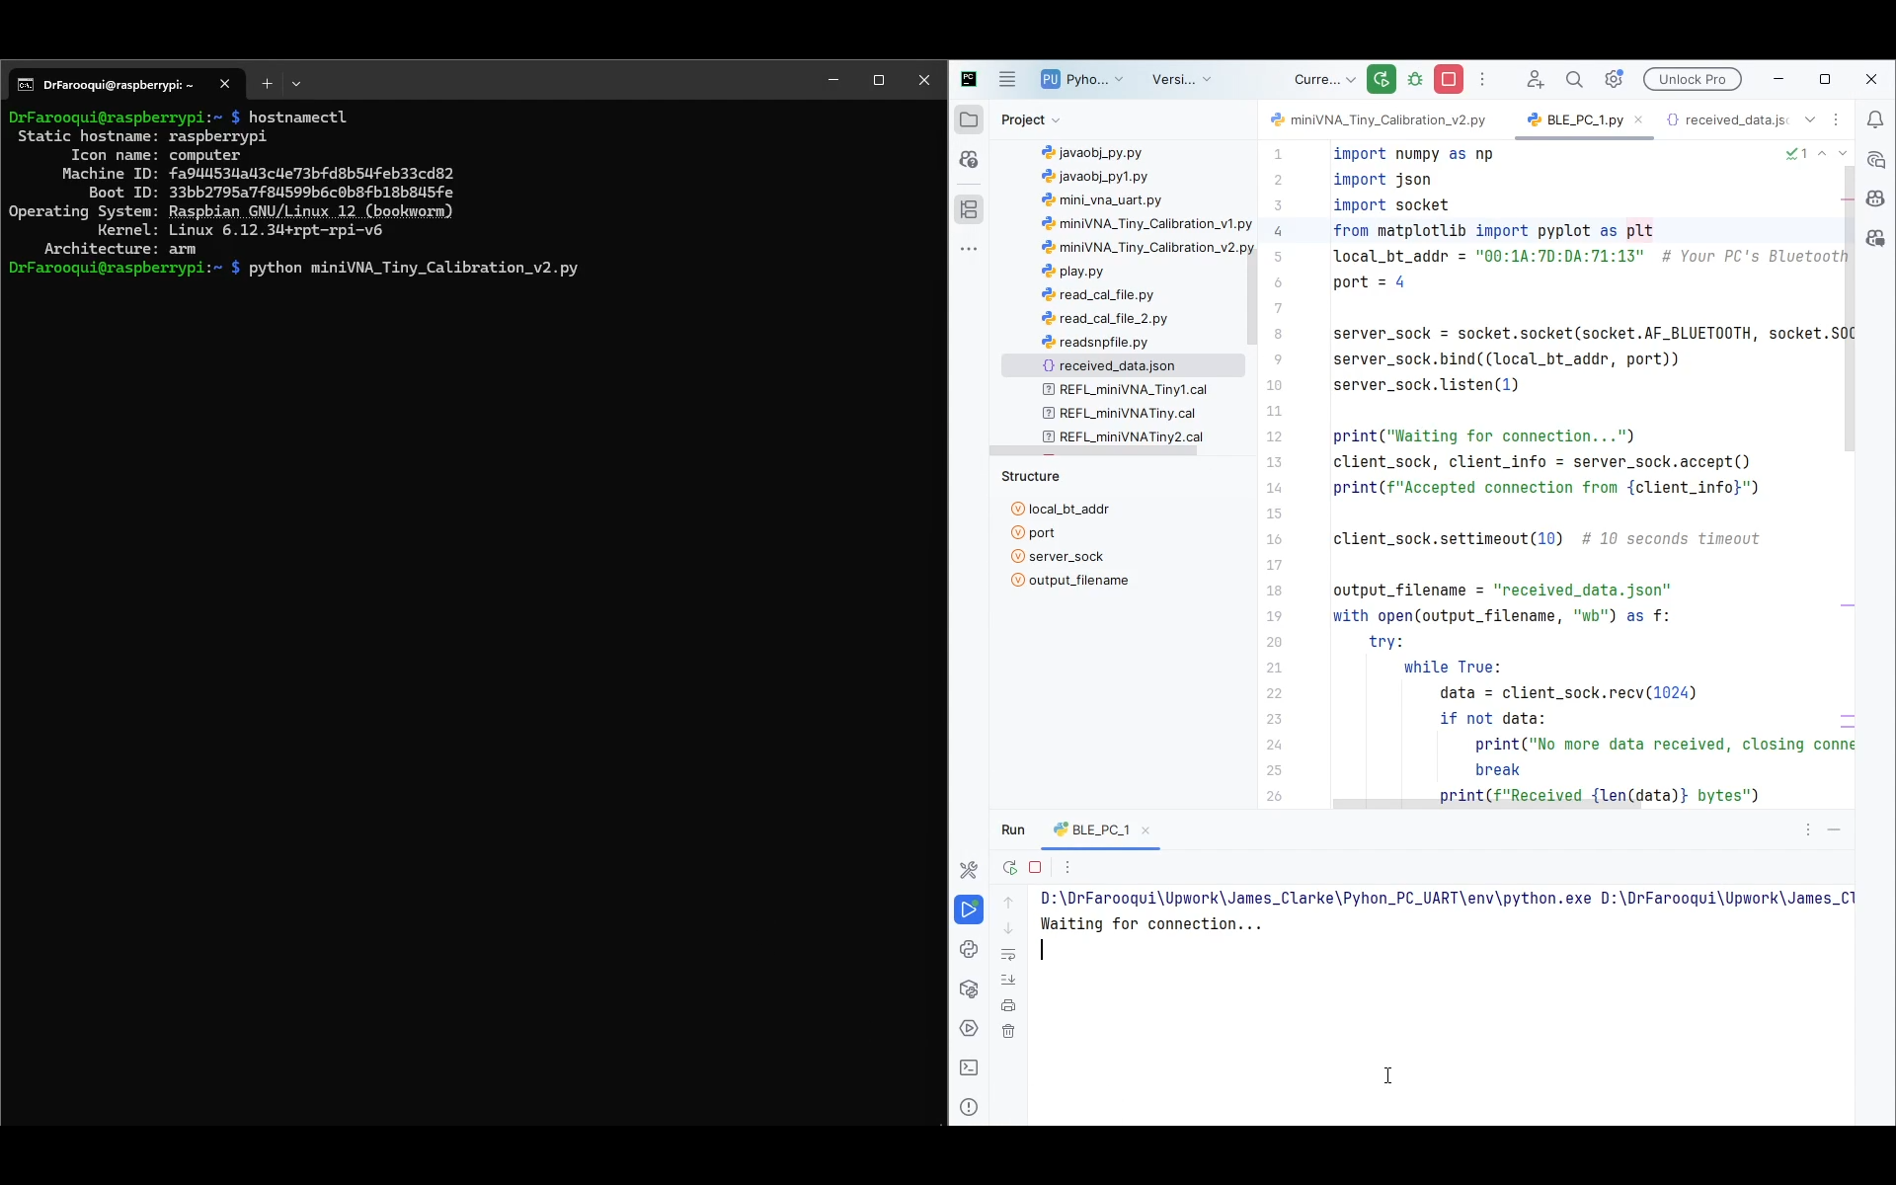
accessing Raspberry Pi Zero W, through SSH from PC
App running on PC to receive data through Bluetooth from Raspberry Pi Zero W

Slide 2
Scenario: Running a Python App on Raspberry Pi Zero W for miniVNA Tiny Calibration
Setup Raspberry Pi Zero W:
Install Raspberry Pi OS Lite (no GUI/desktop) on the Raspberry Pi Zero W.
Install all required Python modules needed to run developed app.
Hardware Connections:
Power the Raspberry Pi Zero W via USB cable connected to a PC.
Connect the miniVNA Tiny to the Raspberry Pi Zero W using a USB cable.
Running the Python Application:
Execute the Python script miniVNA_Tiny_Calibration_R_Pi_0.py on the Raspberry Pi Zero W.
This app performs the following tasks:
Initializes the miniVNA Tiny device.
Loads calibration data previously saved by a Java app (used due to the unavailability of a calibration standard).
Acquires measurement data from the miniVNA.
Applies calibration parameters to the acquired data.
Saves the calibrated data and intermediate debugging data into two separate JSON files.
Sends the JSON file containing calibrated data to the PC via Bluetooth.
PC-side Application:
On the PC, run the app BLE_PC_App.py which waits to receive data over Bluetooth.
Upon receiving the JSON data file, the PC app saves it and plots the S11 magnitude and phase.

Slide 3
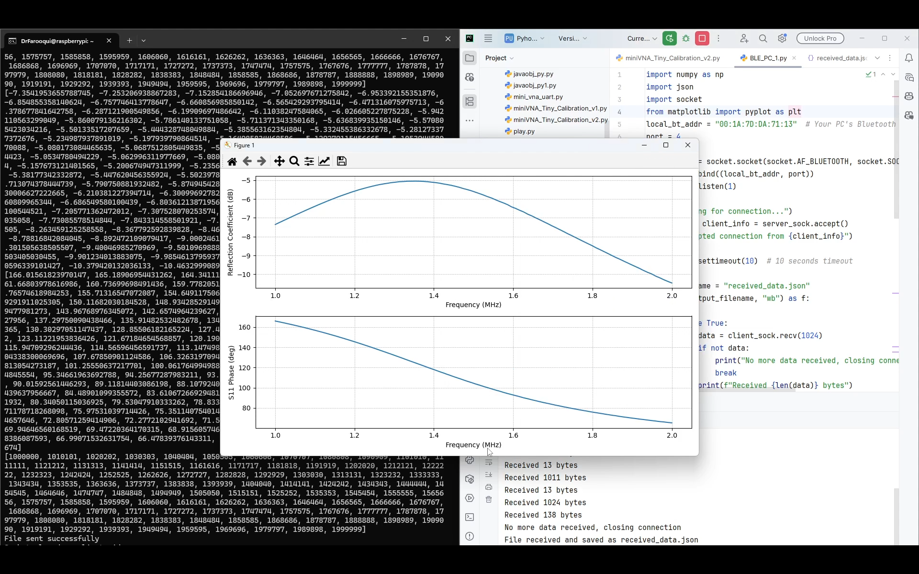
Data Acquired

