Slide 1


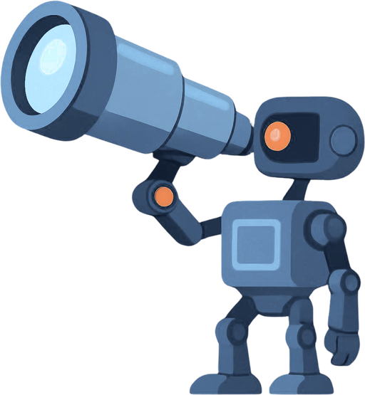
ASTROF
Autonomous scheduling through role-oriented federation
Team X
🤖 Kavya Sree Kammari
🤖 Sanyam Bhardwaj
🤖 Yasasree Lasya Annambhotla

Slide 2

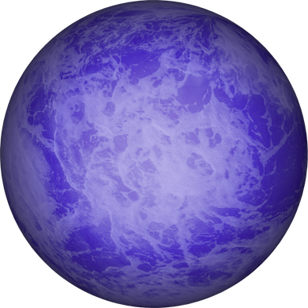
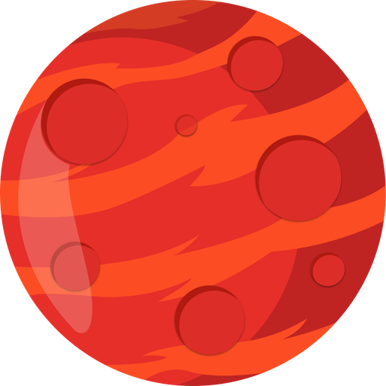

YOU HAVE 5 PLANETS
Too far
Too hot
Too cold
No Atmosphere
No water
WHICH ONE DO YOU OBSERVE TONIGHT?
PICK THE MOST EARTH-LIKE — RIGHT SIZE, RIGHT TEMPERATURE, POSSIBLE WATER.

Slide 3
BUT THE SKY ISN’T STATIC
& simple ranking is no longer enough.

Slide 4
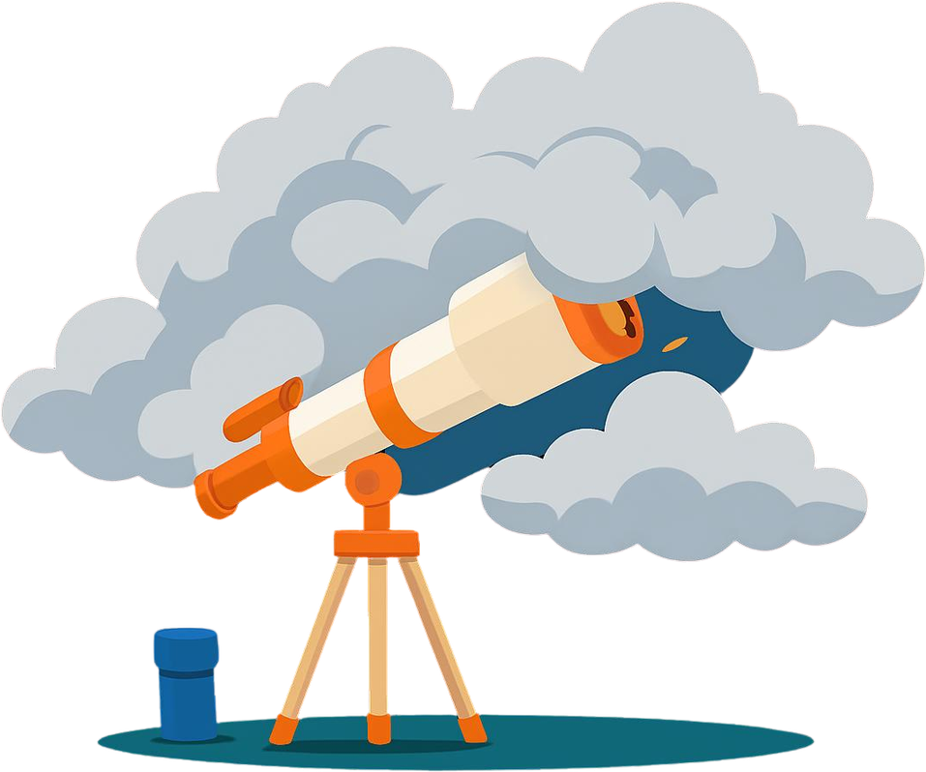
CHALLENGE 1: WEATHER CHAOS
CLOUDS ROLL IN
YOU GO BLIND
YOU LOSE TIME

Slide 5

CHALLENGE 2: EARTH ROTATION
PLANETS RISE AND SET
YOUR BEST TARGET… IS DISAPPEARING.

Slide 6
CHALLENGE 3: DEADLINES
THIS HAPPENS ONCE EVERY FEW YEARS.
MISS IT…YOU LOSE AND
THE UNIVERSE DOESN'T RESCHEDULE.

Slide 7
NOW LET’S SCALE IT UP
1 telescope → 5 planets · 26 telescopes → hundreds of thousands
5 telescopes
10 channels

Slide 8
NOW LET’S SCALE IT UP
1 telescope → 5 planets · 26 telescopes → hundreds of thousands
→
5 telescopes
10 channels
26 telescopes
650 channels
So the question is, both who talks to whom…And who decides what matters.

Slide 9
NEW PHENOMENON. INSTANT ADAPTATION.
Gravitational Wave Detected !!
IT REASONS. IT ADAPTS. INSTANTLY.
WITHIN HOURS: SCORING GRAVITATIONAL WAVES ALONGSIDE EVERYTHING IT ALREADY KNOWS.
THEY WEREN’T TOLD HOW TO COORDINATE.
THEY LEARNED IT.

Slide 10
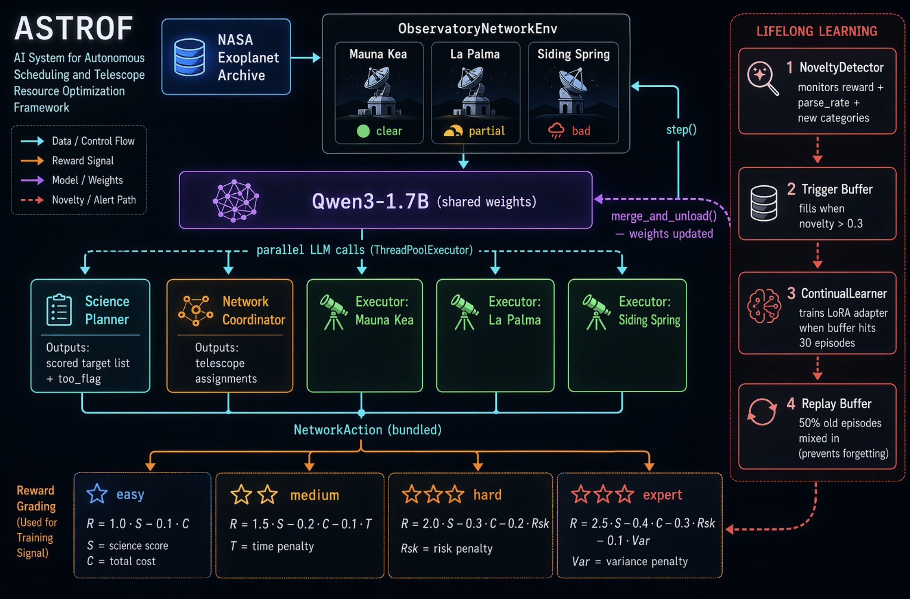

Slide 11
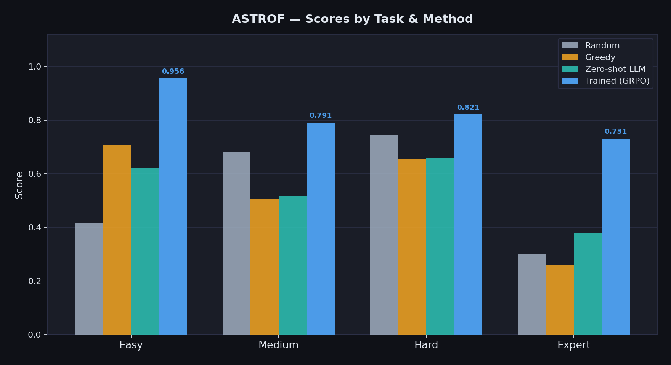

Slide 12
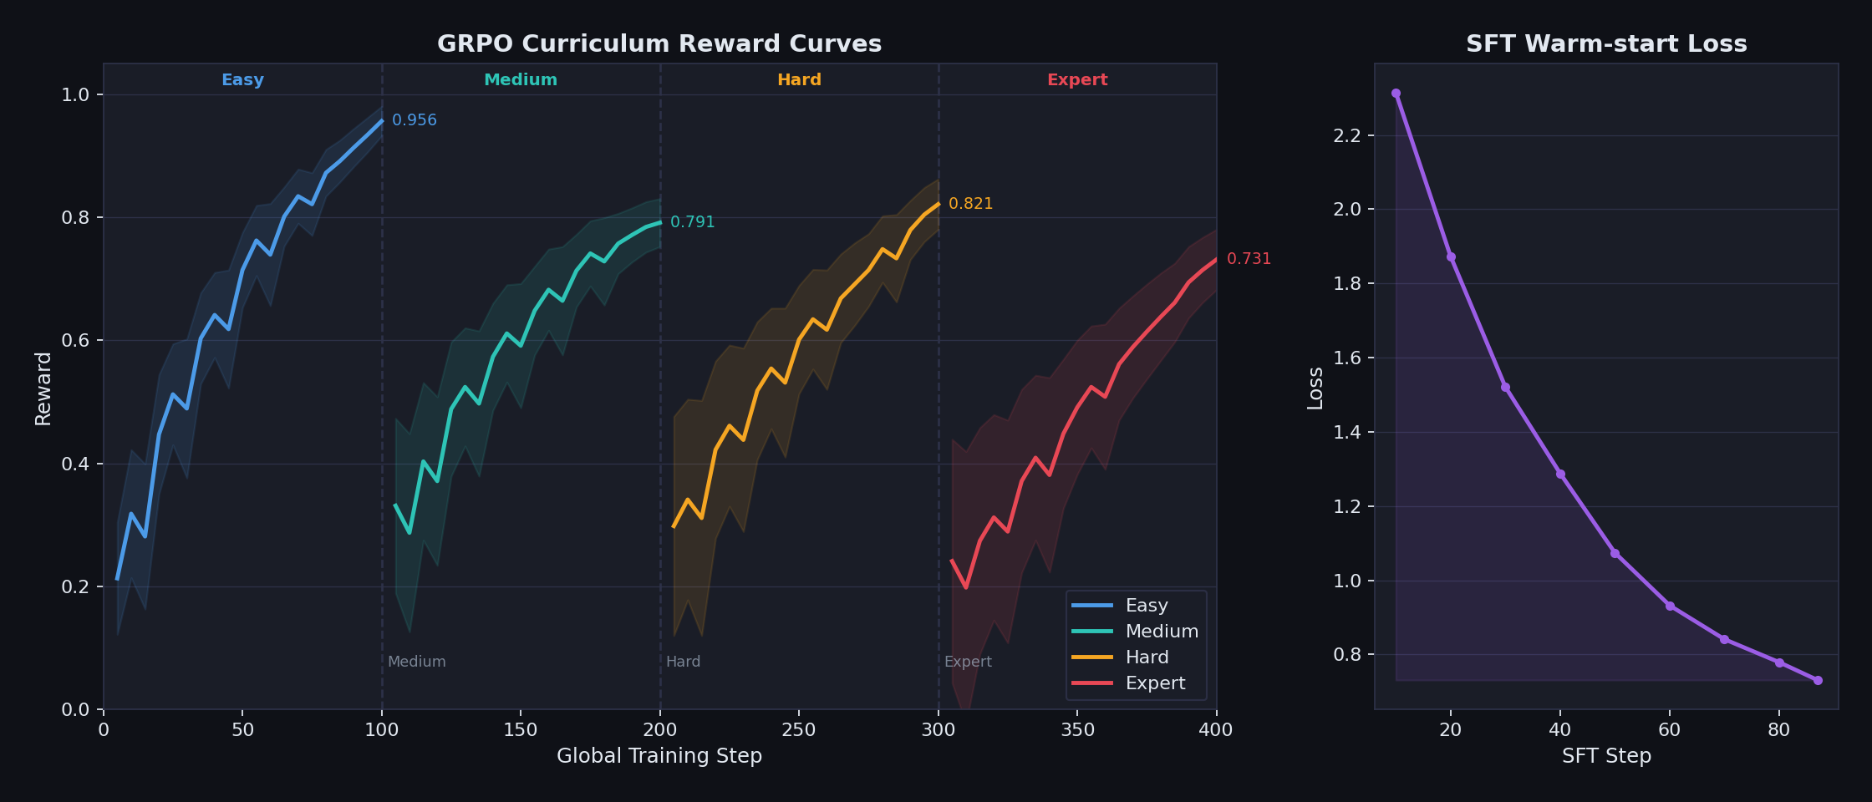

Slide 13

THE LAST ASTRONOMER DOESN’T RETIRE…
…THEY GET A TEAM THAT NEVER SLEEPS.
ASTROF
Multi-Agent · Long-Horizon · Lifelong Learning · Real NASA Data
BECAUSE THE UNIVERSE DOESN’T WAIT.

