Slide 1
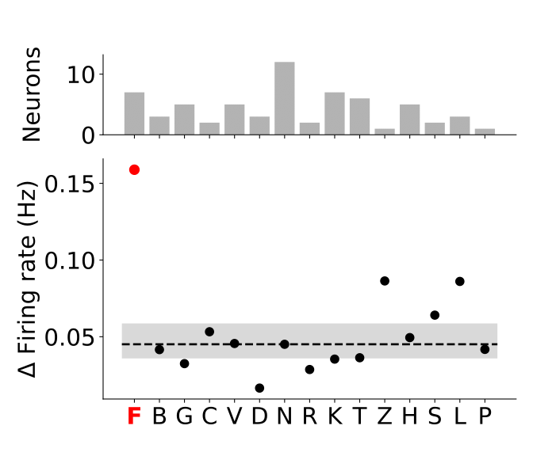
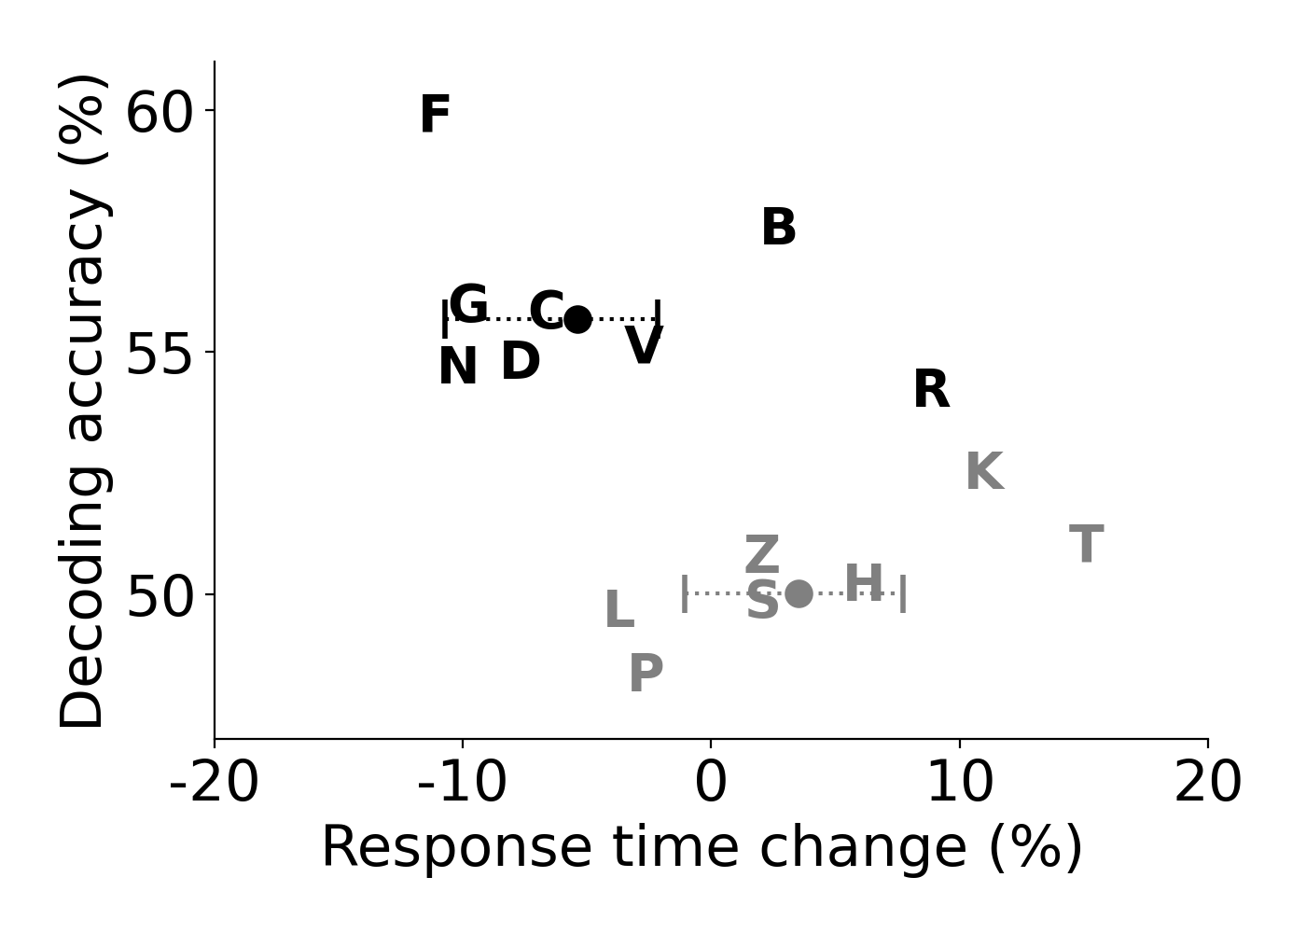
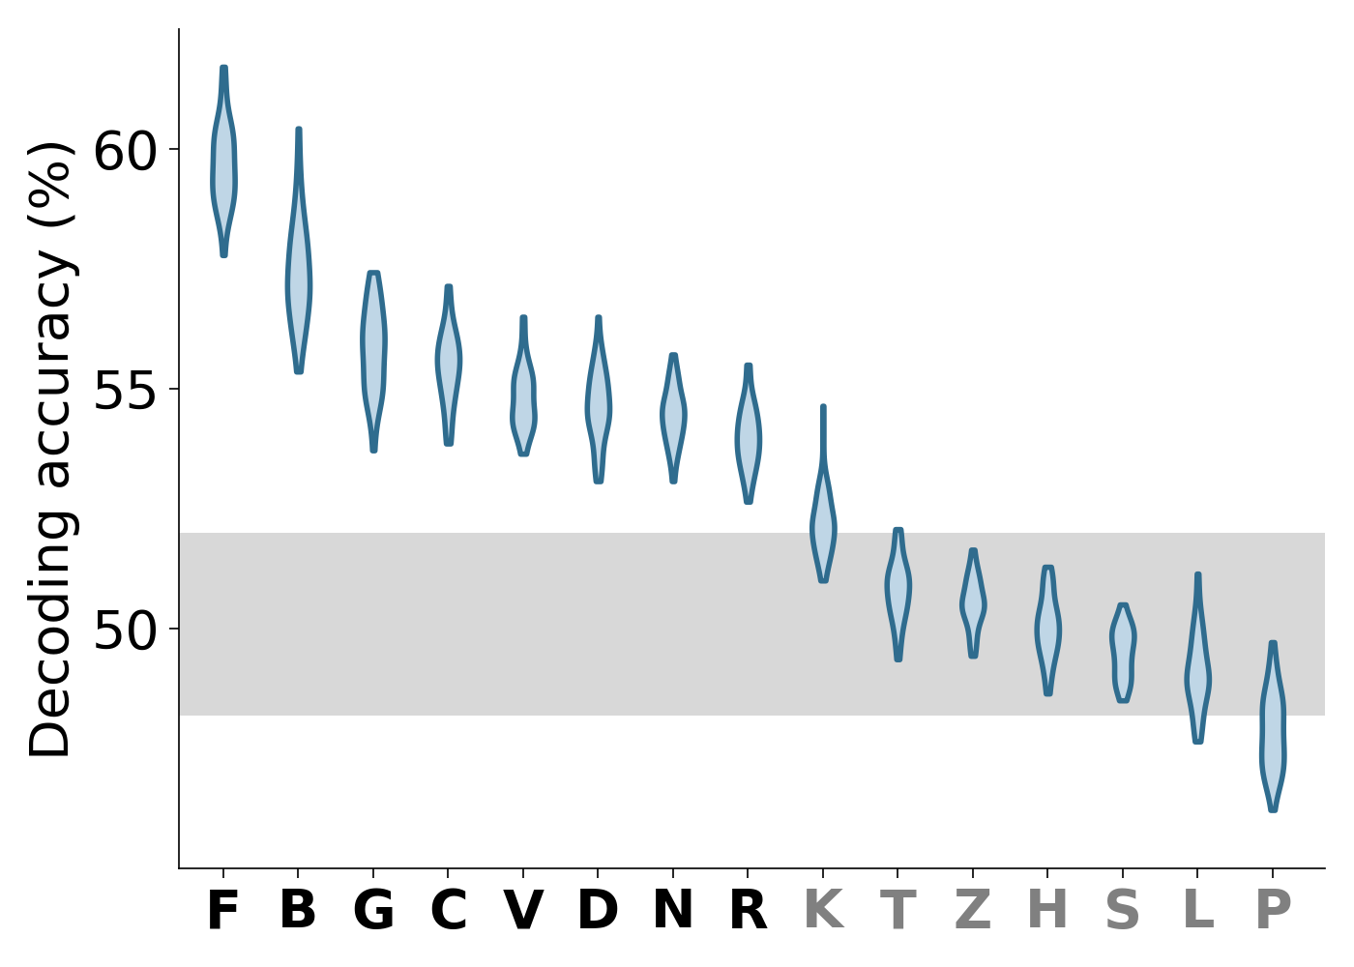
A
C
F AXIS
L AXIS
+
+
FTVR
ZLRN
ZLRN
FTVR
-
-
B
D

Slide 2
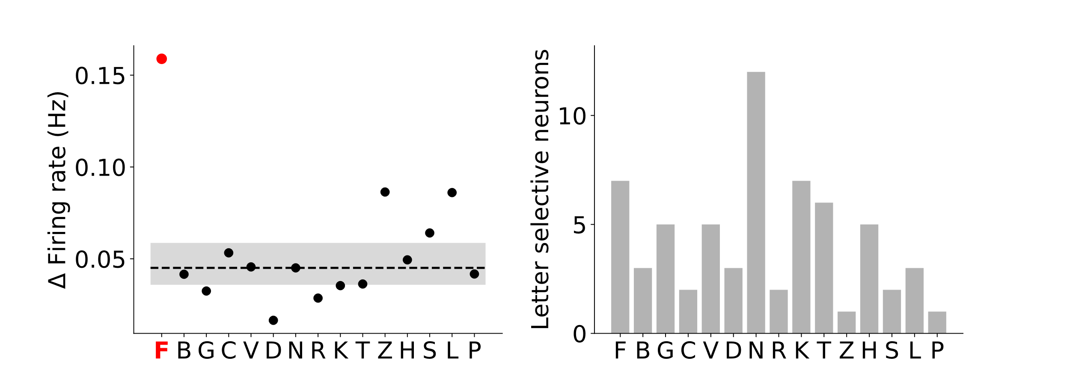
A
B
C
F AXIS
L AXIS
+
+
FTVR
ZLRN
ZLRN
FTVR
-
-
D
E

