Slide 1
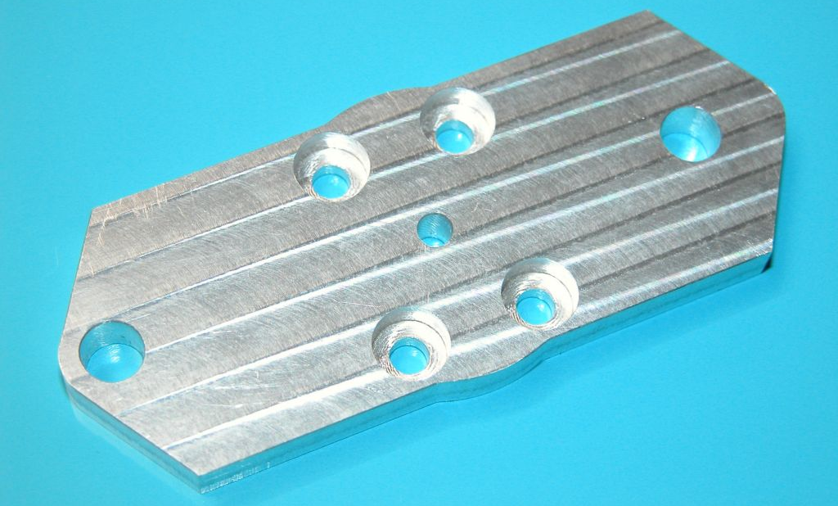
200mm
90mm
15mm

