Slide 1
Information Retrieval
A personalized Search Engine for microblog content
Matteo Angelo Costantini - 795125
Dario Gerosa - 793636
Michele Perrotta - 795152
https://github.com/CostantiniMatteo/progetto-ir

Slide 2
Goal
Crawl tweets dealing with different topics using Twitter APIs
Create a Search Engine
Must support both personalized and not personalized search
At least five user profiles with three topic of interest
Interest extracted from documents given by the user

Slide 3
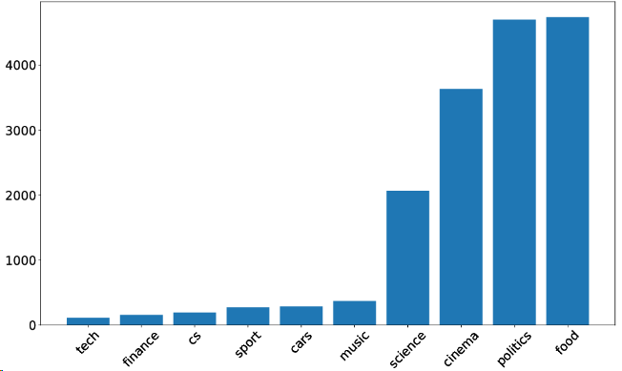
Crawler
Python script using tweepy APIs wrapper
Multiprocess approach to speed up the crawling process
Online PostgreSQL database for persistence
10 topics

Slide 4
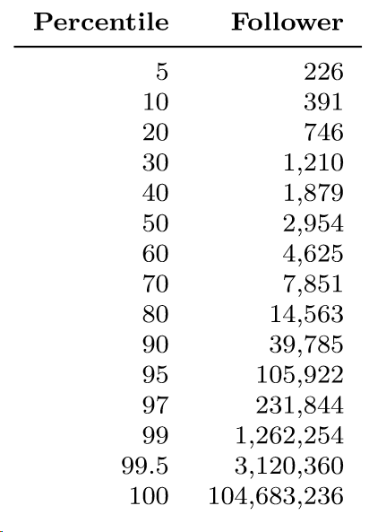
Dataset
~ 36 000 000 tweet
~ 16 000 users
Up to 3 200 tweet for each user
60 GB of data
Tweets only in English
JSON Format

Slide 5

Search Engine

Slide 6
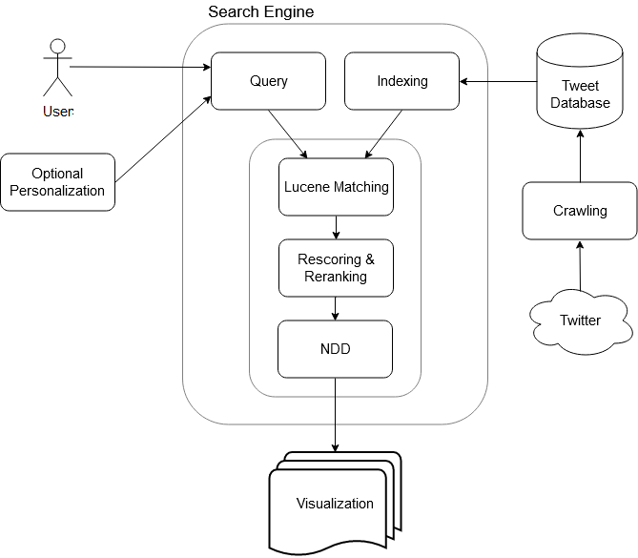
Overview
The Search Engine uses Lucene TF- IDF similarity to index the documents crawled from Twitter.
Query personalization is achieved using Query Expansion and bag-of-words model.
The final output is the product of a re-ranking phase using a combination of the Lucene matching algorithms with other custom scores followed by a Near Duplicate Detection step.
A Web App is used to interact with the Search Engine and visualize the results

Slide 7
Indexing
Analyzer:
Based on Lucene’s Classic Analyzer
Preserves URLs, emails and numbers separated with hyphens
Porter’s Stemmer
Removal of URLs and emails
Stopword removal using Lucene default list
Tokens normalized to lowercase
Indexer:
Lucene’s Classic Similarity
Refinement of the cosine-similarity based on TF-IDF
Indexed Fields:
Text, Hashtags for text search
Date for range queries
Retweet count, author’s data and other for scoring
Notes:
Porter’s qualche volta porta ad avere match che non vorremmo. Esempio: Full search con “Federer” restituisce risultati con “federal” (i risultati non sono comunque in cima)

Slide 8
Queries
Two main types of queries:
Based on recent information Focused on new tweets
Based on the whole information available in the dataset
Characteristics:
Both queries support personalization based on user interests
Re-Scoring based on Twitter’s nature
Near Duplicates Detection
Range queries on Date

Slide 9
Queries - 1
Boolean Model retrieves relevant documents and chronological ordering of the results
Selection of n most recent documents
Scoring of the subset of documents using the Vector Space Model with Lucene’s Classic Similarity and other Twitter-related factors such as:
Retweet rate
User’s influence
Presence of URL
Nagmoti, Rinkesh, Ankur Teredesai, and Martine De Cock. "Ranking approaches for microblog search." Proceedings of the 2010 IEEE/WIC/ACM International Conference on Web Intelligence and Intelligent Agent Technology-Volume 01. IEEE Computer Society, 2010.

Slide 10
Queries - 2
Default Lucene’s approach: Boolean Model followed by Vector Space Model to score the documents
Select the n most relevant documents
Re-score & Re-rank the subset using a linear combination of the Similarity Score and other Twitter-related factors such as:
Retweet rate
User’s influence
Presence of URL
Nagmoti, Rinkesh, Ankur Teredesai, and Martine De Cock. "Ranking approaches for microblog search." Proceedings of the 2010 IEEE/WIC/ACM International Conference on Web Intelligence and Intelligent Agent Technology-Volume 01. IEEE Computer Society, 2010.

Slide 11
Scoring
To Re-Score the documents we took into account the score given using the revised cosine similarity computed by Lucene but also other factors such as:
The number of followers of the author of a tweet
The number of retweets
The length of the text
The presence/absence of an URL
The tweet being a quote/retweet or not

Slide 12
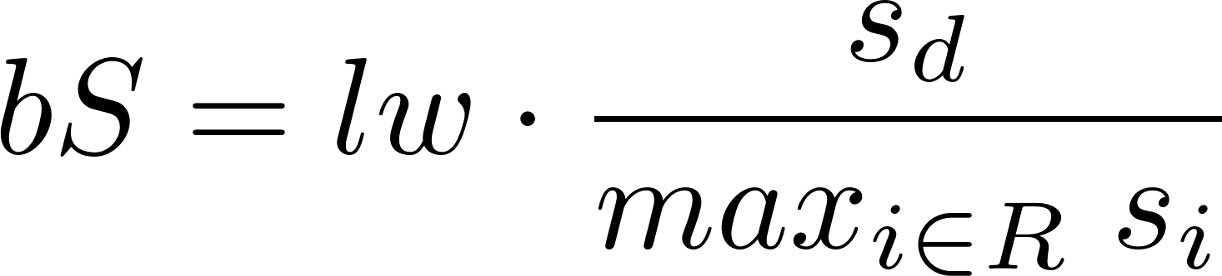
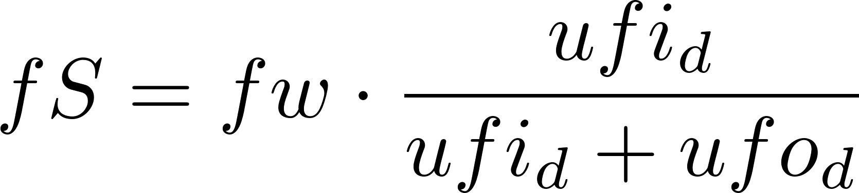
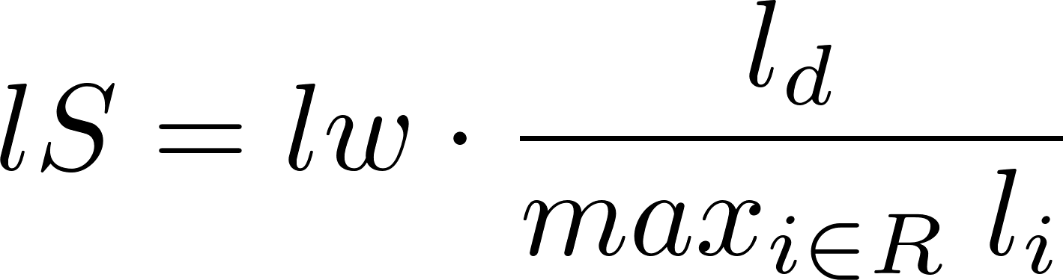
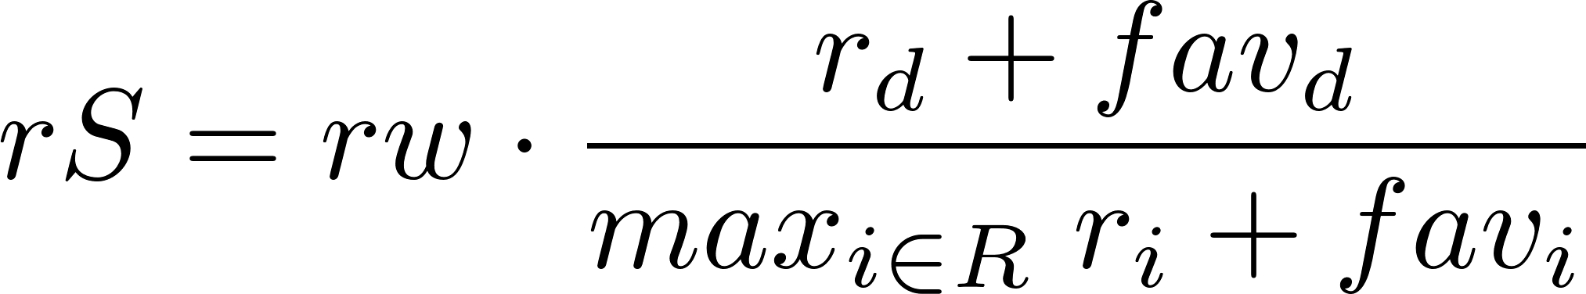
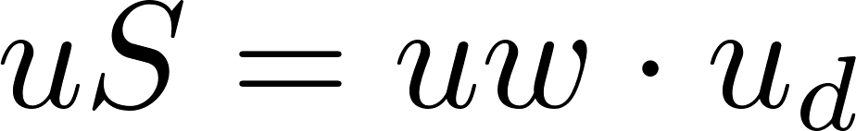
Scoring - Equations
Base Lucene Score
Follower Score
Retweet Score
Quote Score
Length Score
URL Score
Final Score:

Slide 13
Personalization
Outline
Document based personalization
Bag-of-Words model for each topic
Topic dependent
The bag is computed indexing the given documents and either using the whole set or using a subset of most informative (based on TF-IDF) terms
Query expansion to include the terms defining the interests of the user
Profiles:
Five users with different topics of interest
At least three topics for each user
At least 10 documents for each topic
A customizable user using the web app

Slide 14
Near Duplicate Detection
We chose to use the Overlap coefficient since the Jaccard coefficient led to a lot more false negatives when one tweet overlaps with another
The set used to compare the documents consists of the bi-grams extracted from the text of the tweet.
Not much slower that Jaccard coefficient approach on a limited number of documents (tested with about 150 documents)
Threshold at 80% of overlap

Slide 15
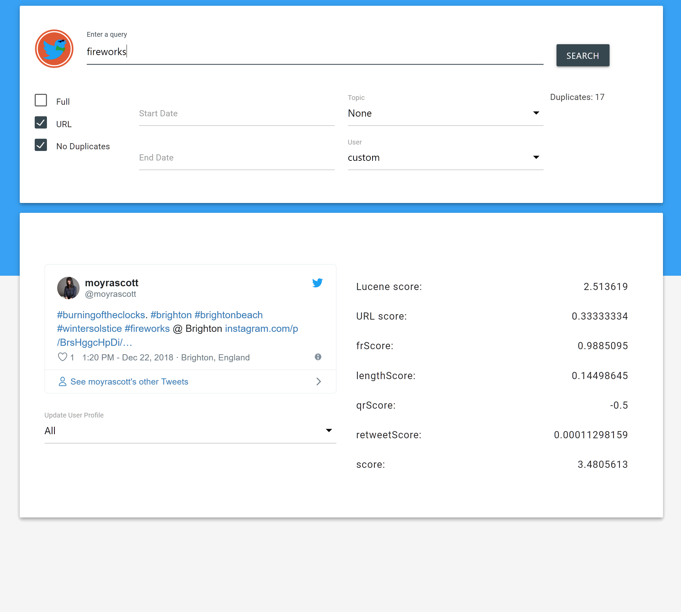
Interface
Supports:
Interactive tweets
Personalization based on user profile and topic
Range queries on the Date Fields
Duplicates detection and filter
URL scoring
User profile creation

Slide 16
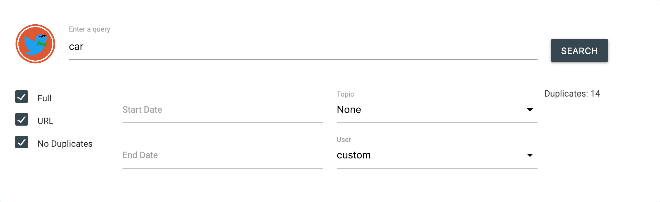

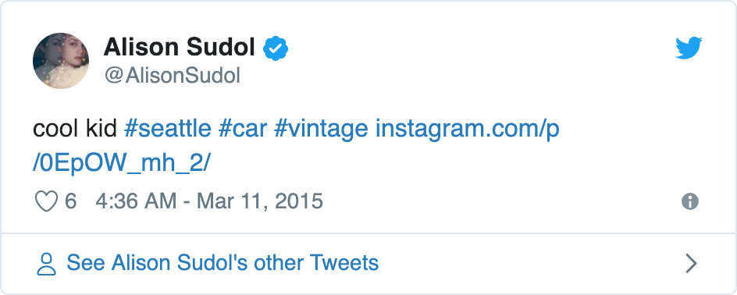
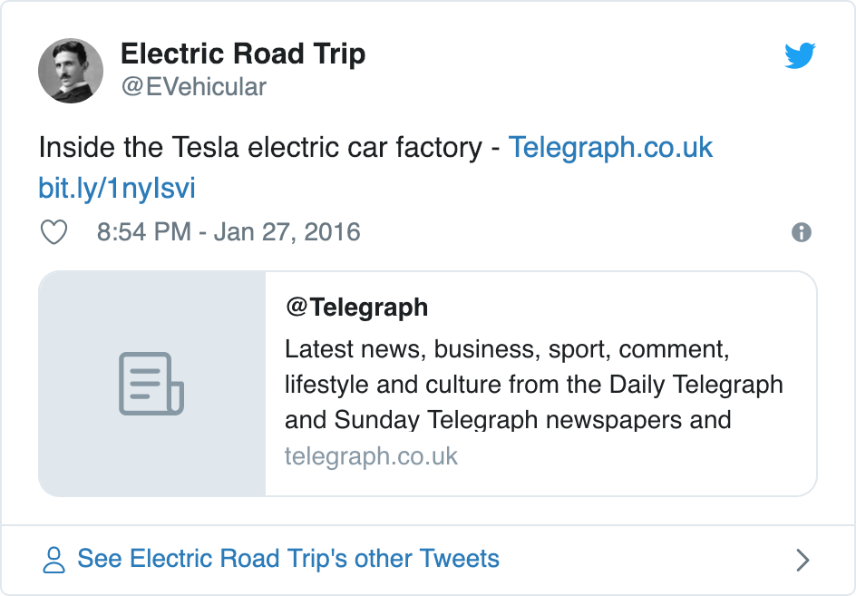
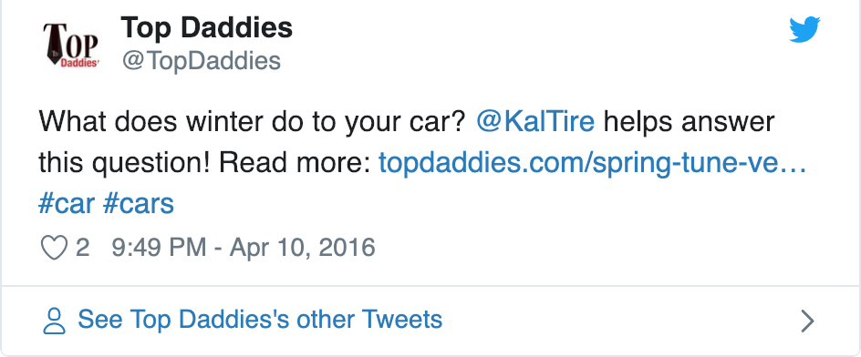
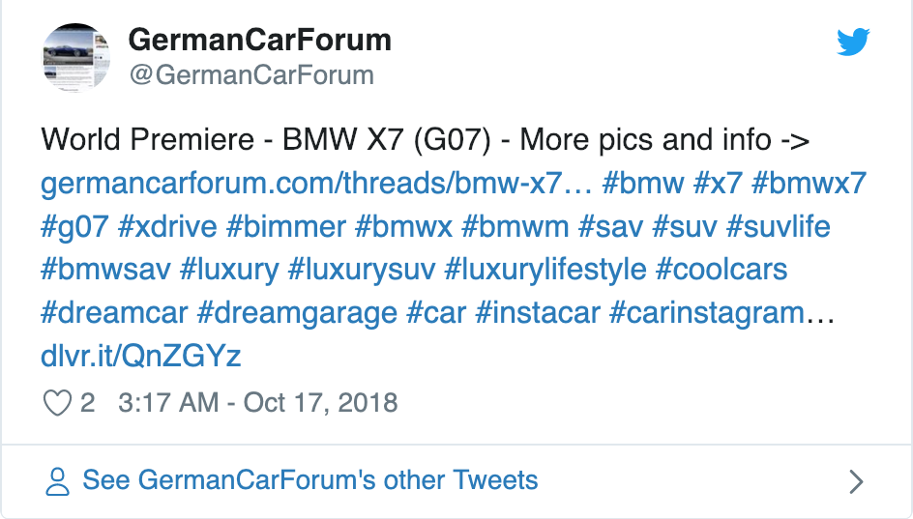
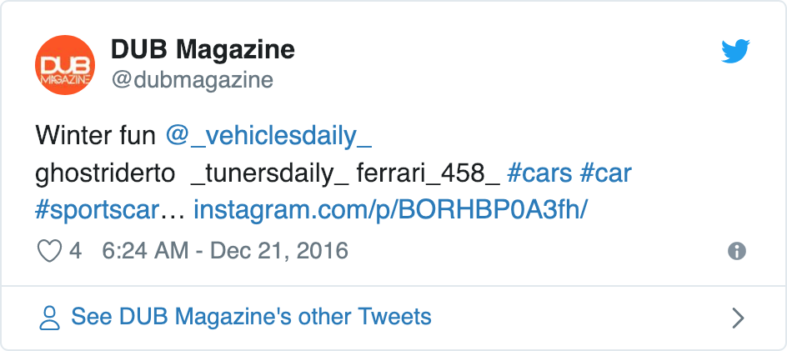
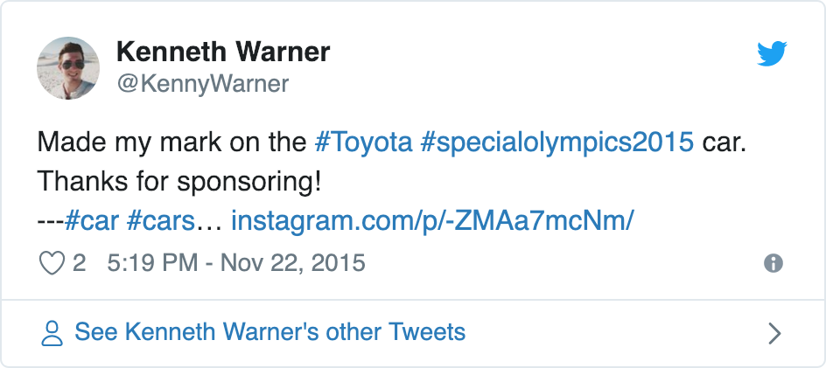
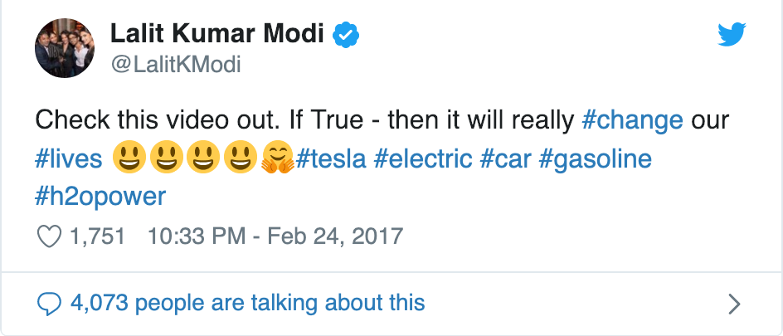
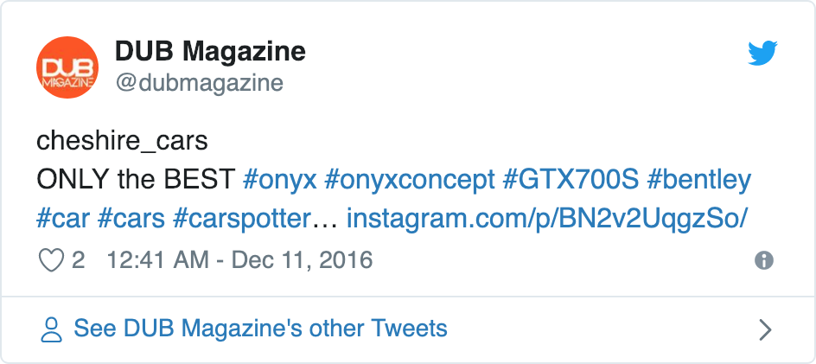
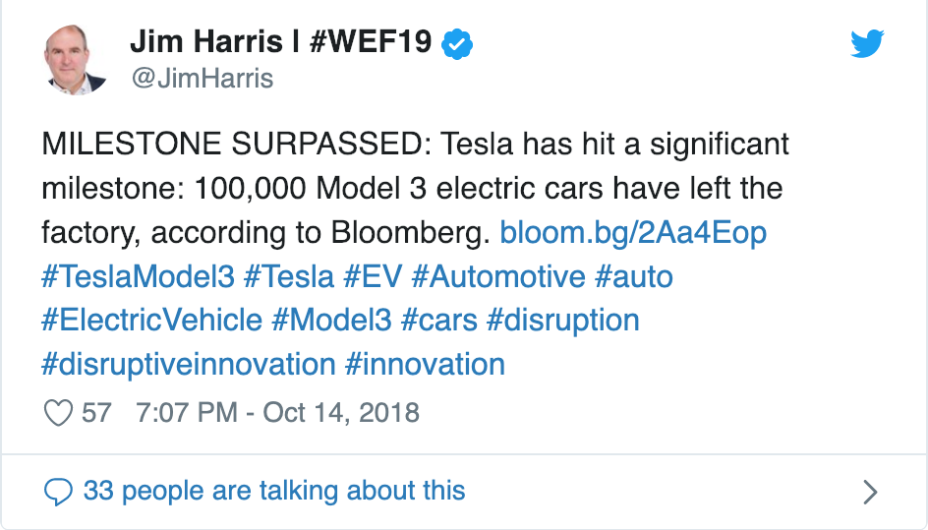
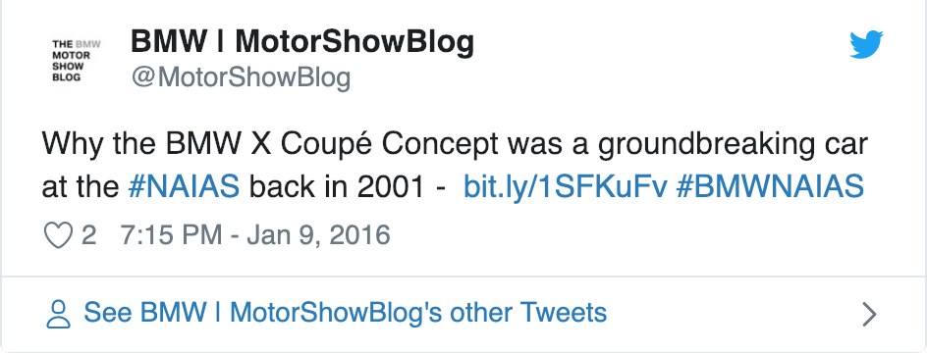
Query Personalization - Examples

Slide 17

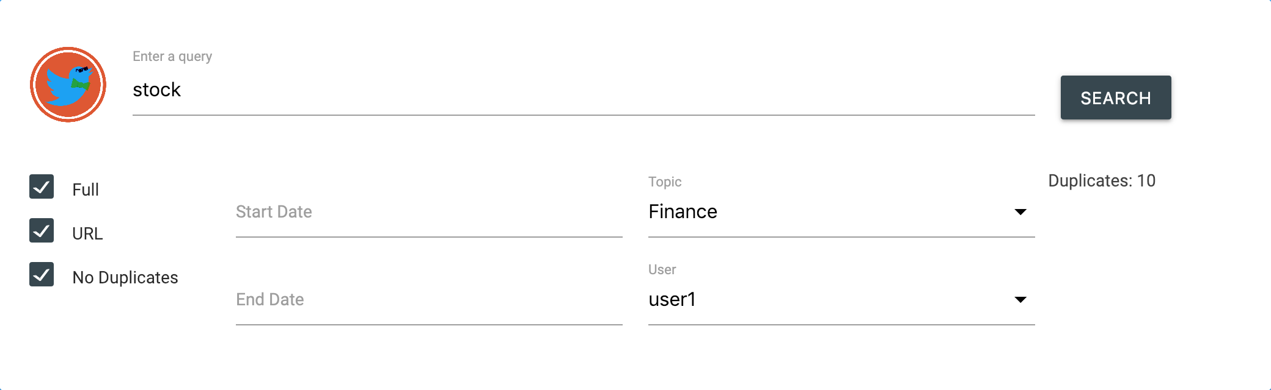
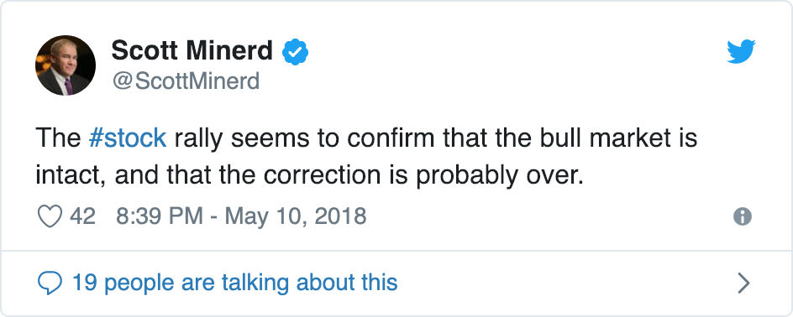
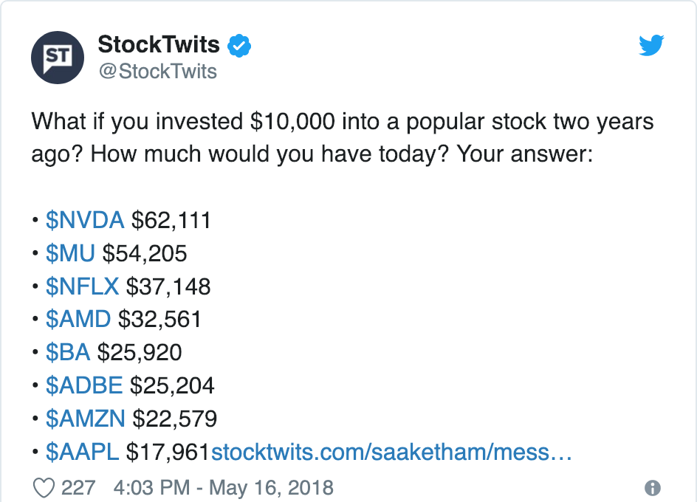
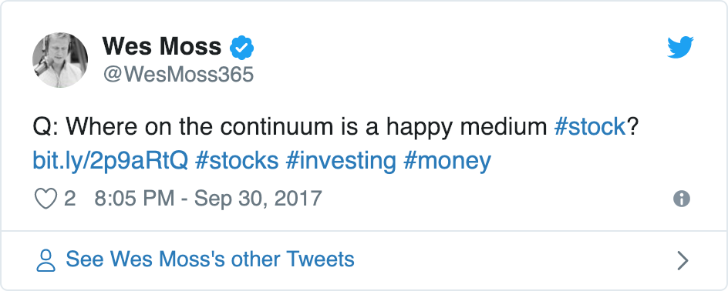
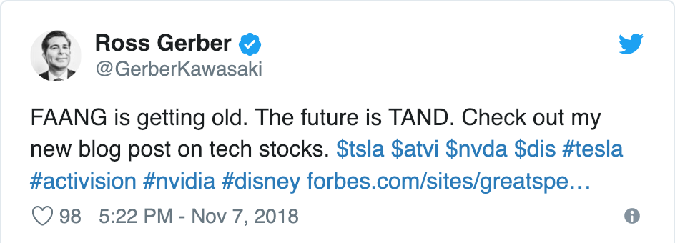
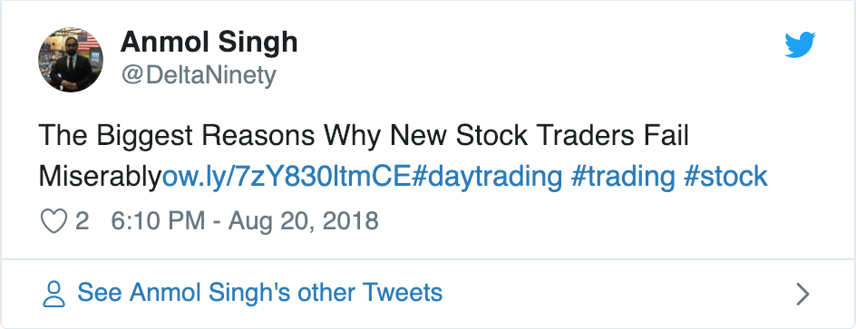

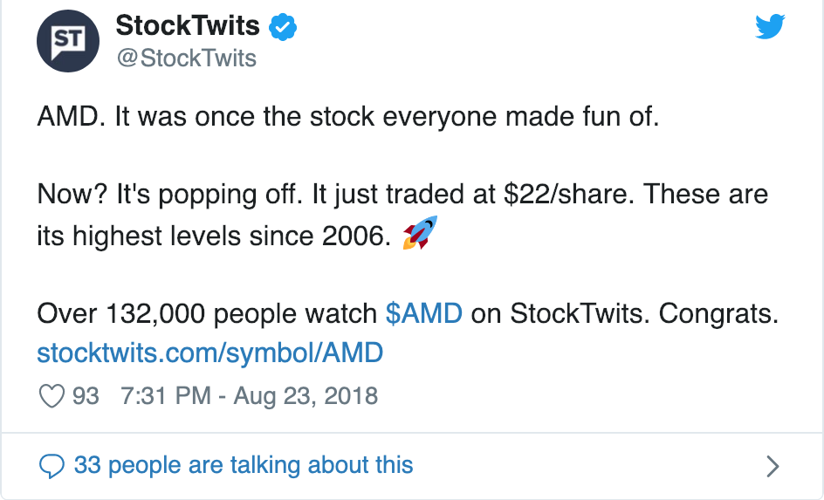
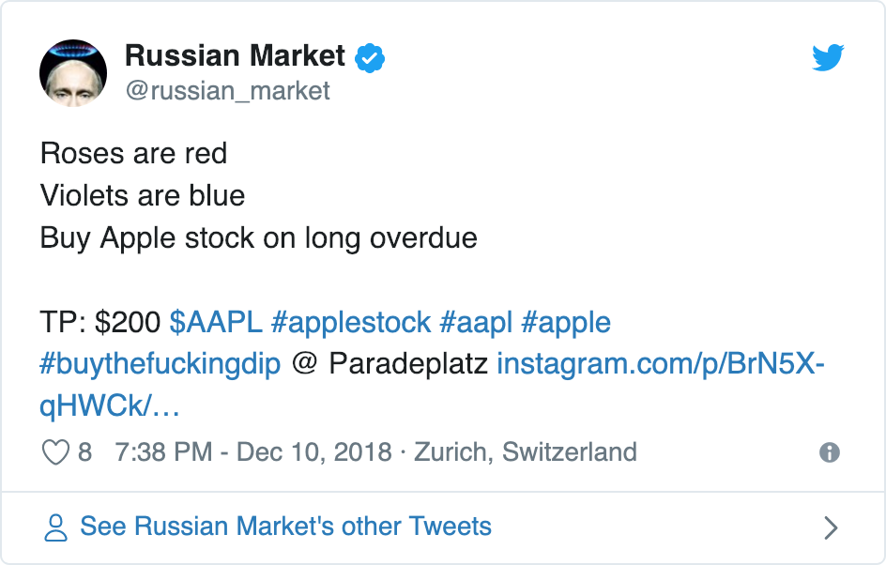
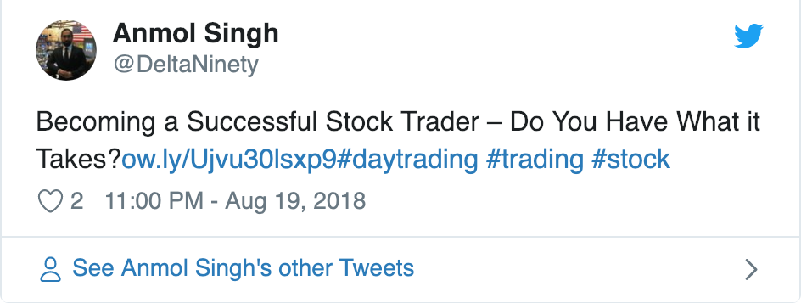
Query Personalization - Examples

Slide 18
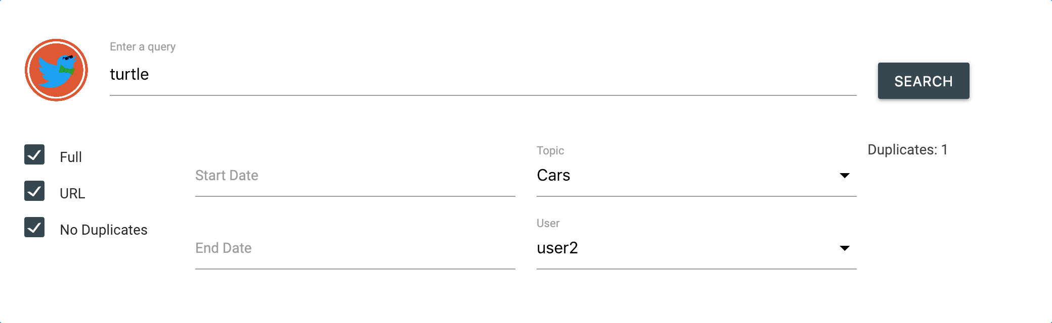

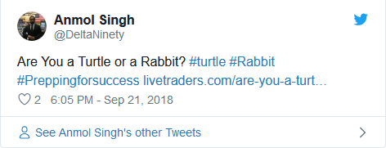
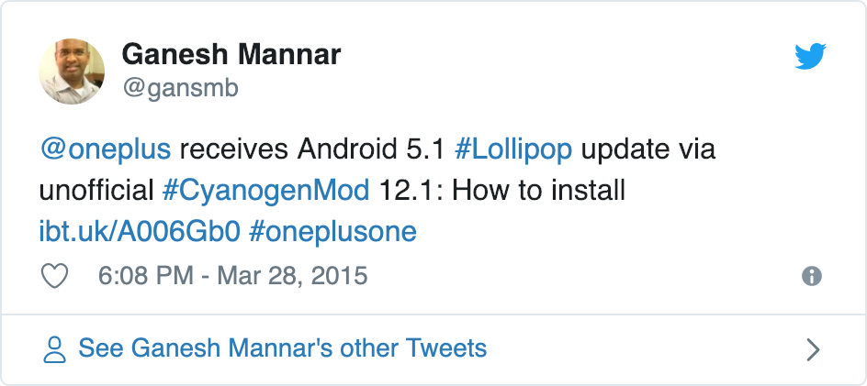
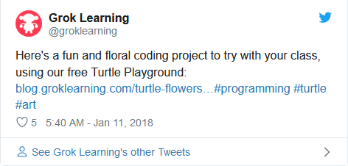
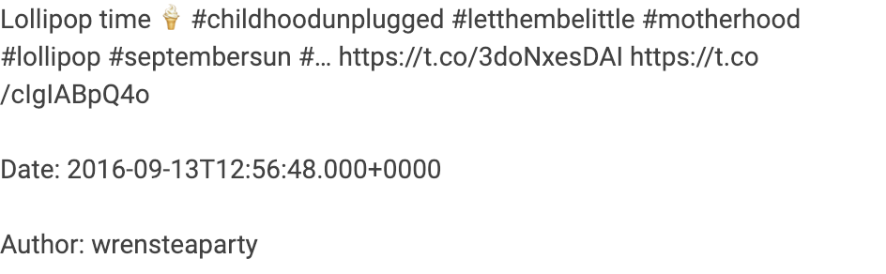
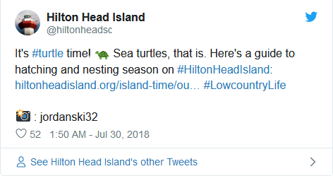
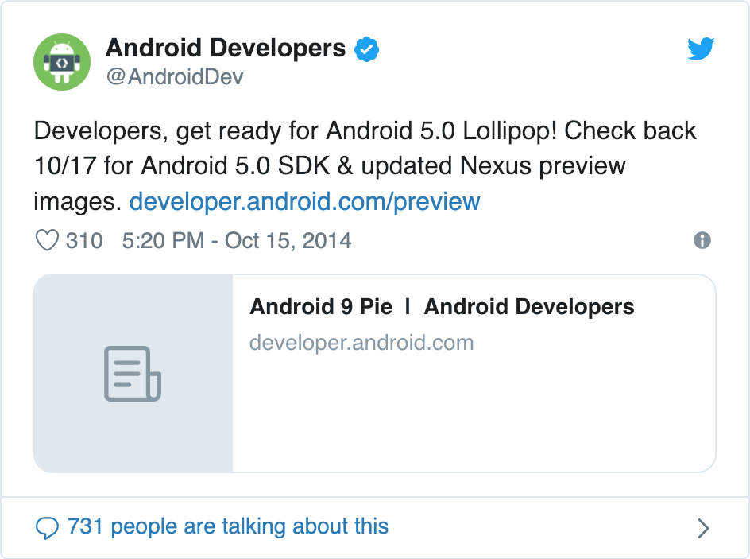
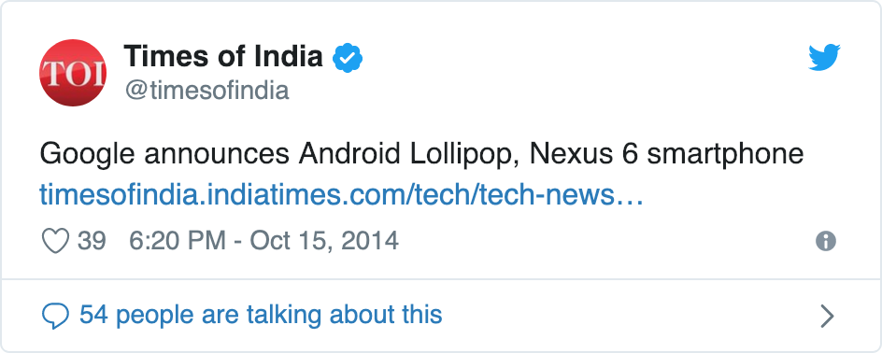
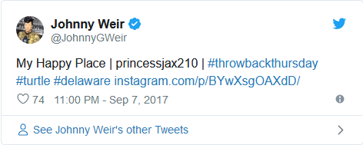
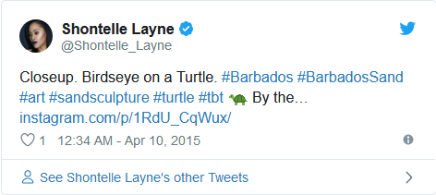
Query Personalization - Examples

Slide 19
Thanks for your attention

Slide 20
User 1:
cs: java programmer
cinema: avengers superheroes morricone sergio leone
tech: intel amd ryzen nvidia
politics: trump intel top secret russia
finance: nvidia amd apple microsoft stock
User 2:
tech: apple
music: motorhead ace of spades metallica soad
cars: tesla bmw
User 3:
sport: federer serena williams
science: physics higgs
cars: audi volkswagen
User 4:
sport: golf francesco molinari
music: madonna 50 cents
food: fruit pasta
User 5:
tech: lollipop android
food: lollipop candy marshmallows
sport: manchester united premier league chelsea arsenal

