Slide 1

GitHub for Developers
Instructor: Dan Costello Email: danc@onlc.com
Class begins at 10 Eastern time
For Class Audio Connection:
ONLC Office Locations – Audio is connected over Jabra™ speaker
Home or Office – Call: ____ Access Code: ____ # Enter the audio pin shown in the GoToMeeting panel
If you need assistance, call 800-288-8221

Slide 2
GitHub for Developers

Slide 3
Student introductions
Your name
Company affiliation
Title/function
GitHub experience
Your expectations for the course
Notes:
Ask students to introduce themselves and provide their backgrounds, product experience, and expectations for the course.
Record student expectations on a whiteboard or flip chart that you can reference during class.

Slide 4


Housekeeping
Class hours: 10:00-16:45
A.M./P.M. Breaks: 15 min.
Lunch Break: 1 hr.
ONLC Wifi access code (if present): 0123456789
If you need anything, please let us know!
Notes:
Explain class and facility logistics, using the bulleted list. Inform students about any emergency procedures, such as emergency exits, and plans in the event of fire or other emergencies.

Slide 5
The Courseware
The Book:

Slide 6
Classroom Setup
Windows 10

Slide 7
Course Outline
Getting Started With Collaboration
What is GitHub?
The GitHub Ecosystem
What is Git?
Exploring a GitHub Repository
Using GitHub Issues
Activity: Creating A GitHub Issue
Using Markdown
Understanding the GitHub Flow
The Essential GitHub Workflow
Branching with Git
Branching Defined
Activity: Creating A Branch with GitHub
Local Git Configuration
Checking Your Git Version
Git Configuration Levels
Viewing Your Configurations
Configuring Your User Name and Email
Configuring autocrlf
Working Locally with Git
Creating a Local Copy of the repo
Our Favorite Git command: git status
Using Branches locally
Switching Branches
Activity: Creating a New File
The Two Stage Commit
Collaborating on Your Code
Pushing Your Changes to GitHub
Activity: Creating a Pull Request
Exploring a Pull Request
Activity: Code Review
Editing Files on GitHub
Editing a File on GitHub
Committing Changes on GitHub
Merging Pull Requests
Merge Explained
Merging Your Pull Request
Updating Your Local Repository
Cleaning Up the Unneeded Branches
Viewing Local Project History
Using Git Log
Streamlining Your Workflow with Aliases
Creating Custom Aliases
Workflow Review Project: GitHub Games
User Accounts vs. Organization Accounts
Introduction to GitHub Pages
What is a Fork?
Creating a Fork
Workflow Review: Updating the README.md
Resolving Merge Conflicts
Local Merge Conflicts
Working with Multiple Remotes
Remote Merge Conflicts
Exploring
Searching for Events in Your Code
What is git bisect?
Finding the Bug in Our Project
Reverting Commits
How Commits Are Made
Safe Operations
Reverting Commits
Helpful Git Commands
Moving and Renaming Files with Git
Staging Hunks of Changes
Viewing Local Changes
Comparing Changes within the Repository
Creating a New Local Repository
Initializing a New Local Repository
Fixing Commit Mistakes
Revising Your Last Commit
Rewriting History with Git Reset
Understanding Reset
Reset Modes
Reset Soft
Reset Mixed
Reset Hard
Does Gone Really Mean Gone?
Getting it Back
You Just Want That One Commit
Oops, I Didn’t Mean to Reset
Merge Strategies: Rebase
About Git rebase
Understanding Git Merge Strategies
Creating a Linear History

Slide 8
Questions?

Slide 9
Getting Started With Collaboration

Slide 10
What is GitHub?

Slide 11
The GitHub Ecosystem

Slide 12
What is Git?

Slide 13
Exploring a GitHub Repository

Slide 14
Using GitHub Issues

Slide 15
Activity: Creating A GitHub Issue

Slide 16
Using Markdown

Slide 17
Understanding the GitHub Flow

Slide 18
The Essential GitHub Workflow

Slide 20
Branching with Git

Slide 21
Branching Defined

Slide 22
Activity: Creating A Branch with GitHub

Slide 23
Local Git Configuration

Slide 24
Checking Your Git Version

Slide 25
Git Configuration Levels

Slide 26
Viewing Your Configurations

Slide 27
Configuring Your User Name and Email

Slide 28
Configuring autocrlf

Slide 29
Working Locally with Git

Slide 30
Creating a Local Copy of the repo

Slide 31
Our Favorite Git command: git status

Slide 32
Using Branches locally

Slide 33
Switching Branches

Slide 34
Activity: Creating a New File
1. Create a new file with the following file name YOUR-USERNAME-YOUR-HOMETOWN.md.
For example, githubteacher-san-francisco.md.
2. Add a skeleton for your file with the following lines:
3. # HOMETOWN recommendations
4. ## Great Places to Eat
5. ## Fun Things to Do
6. Save your file.

Slide 35
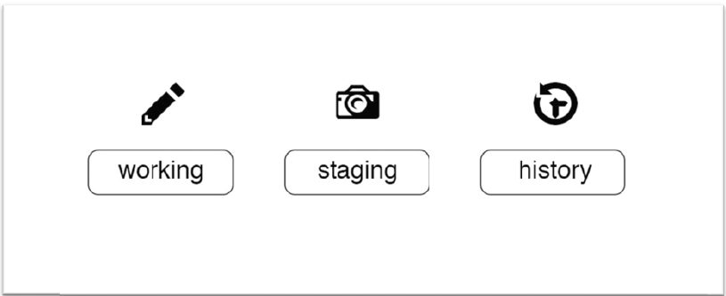
The Two Stage Commit
Files are:
Untracked
Modified
Staged
Committed

Slide 36
Collaborating on Your Code

Slide 37
Pushing Your Changes to GitHub

Slide 38
Activity: Creating a Pull Request
1. Click the Pull Request tab.
2. Click New Pull Request.
3. In the base dropdown, choose master
4. In the compare dropdown, choose your branch.
5. Type a subject line and enter a comment.
6. Use markdown formatting to add a header and a checklist to your Pull Request.
7. Include one of the keywords: closes, fixes, or resolves followed by the issue number
you created earlier to note which Issue the Pull Request should close. Example: This
resolves #3
8. Click Preview to see how your Pull Request will look.
9. Assign the Pull Request to yourself.
10. Click Create pull request.

Slide 39
Exploring a Pull Request
Conversation view
Commits view
Files changed view

Slide 40
Activity: Code Review
1. Click the Pull Request tab.
2. Use the Author drop down to locate your partner’s pull request.
3. Click Files Changed.
4. Hover over a single line in the file to see the blue +. Click the + to add a line comment.
5. Comment on the line and click Start review.
6. Repeat these steps to add 2-3 comments on the file.
7. Click Review in the top right corner.
8. Choose whether to Approve or Request changes
9. Enter a general comment for the review.
10. Click Submit review
11. Click the Conversation view to check out your completed review.

Slide 41
Editing Files on GitHub

Slide 42
Editing a File on GitHub
1. Click the pencil icon in the top right corner of the diff to edit the file using the GitHub file editor.
2. Add recommendations to the file based on the comments from your reviewer or your personal experience.

Slide 43
Committing Changes on GitHub
1. Scroll to the bottom of the page to find the Commit changes dialog box.
2. Type a Commit message.
3. Choose the option to Commit directly to your branch.
4. Click Commit changes.

Slide 44
Merging Pull Requests

Slide 45
Merge Explained
Who should merge a pull request?
The person who created the pull request?
A single person within the project team?
Anyone other than the person who created the pull request?

Slide 46
Merging Your Pull Request
1. Navigate to your Pull Request (HINT: Use the Author or Assignee drop downs to find your Pull Request quickly)
2. Click Conversation
3. Scroll to the bottom of the Pull Request and click the Merge pull request button
4. Click Confirm merge
5. Click Delete branch
6. Click Issues and confirm your original issue has been closed

Slide 47
Updating Your Local Repository
1. Start by switching back to your default branch: git checkout master
2. Retrieve all of the changes from GitHub: git pull

Slide 48
Cleaning Up the Unneeded Branches
1. Take a look at your local branches: git branch --all
2. Let’s see which branches are safe to delete: git branch --merged
3. Delete the local branch: git branch -d <branch-name>
4. Take another look at the list: git branch --all
5. Your local branch is gone but the remote tracking branch is still there. Delete the remote tracking branch: git pull --prune

Slide 49
Viewing Local Project History

Slide 50
Using Git Log
$ git log
$ git log --oneline
$ git log --oneline --graph
$ git log --oneline --graph --decorate
$ git log --oneline --graph --decorate --all
$ git log --stat
$ git log --patch

Slide 51
Streamlining Your Workflow with Aliases

Slide 52
Creating Custom Aliases
Original Command
$ git log --oneline --graph --decorate --all
Creating the Alias
$ git config --global alias.lol "log --oneline --graph --decorate --all"
Using the Alias
$ git lol

Slide 53
User Accounts vs. Organization Accounts
User: directly associated with User Id
Organization: container for User Ids

Slide 54
What is a Fork?
Full copy of a repository from one account to another

Slide 55
Creating a Fork
Navigate to the repo dan-ONLC/XGHDEV{nnnn}
Click Fork.
Select the account where you would like the fork to reside. Note: you may not see this step if you only have one GitHub account.

Slide 56
Workflow Review: Updating the README.md
Clone your fork of the repository: git clone https://github.com/YOURUSERNAME/github-games.git
Create a new branch called readme-update: git checkout -b readme-update
Edit the URL in the README.md.
Commit the changes to your branch.
Push your branch to GitHub: git push -u origin readme-update
Create a Pull Request in your repository.
Merge your Pull Request.
Delete the branch on GitHub.
Update your local copy of the repository: git pull --prune

Slide 57
Resolving Merge Conflicts

Slide 58
Local Merge Conflicts
Determine which file(s) are in conflict: git status
Open the file(s) listed under Unmerged Paths: in your text editor.
Look for the merge conflict markers (shown below).
<<<<<<<<< HEAD
Some text
=========
Some more text
>>>>>>>>> stats-update
Choose which version of the code you would like to keep.
Delete the conflict markers.
Save the file.
Close the text editor.
Check to see what git is tracking: git status
Mark the file as resolved: git add index.html
Complete the merge: git commit
Save the default commit message.

Slide 59
Working with Multiple Remotes

Slide 60
Remote Merge Conflicts
1. Add a new remote from the upstream fork: git remote add upstreamhttps://github.com/Dan-ONLC/XGHDEV{nnnn}.git
2. Confirm your remote settings: git remote -v
3. Pull down the remote tracking branches from the upstream fork: git fetch upstream
4. Create a local branch called shape-colors based on the shape-colors branch in your remote fork of the repository: git checkout -b shape-colors origin/shapecolors
5. See the difference between your branch and the upstream branch: git diff shapecolors upstream/shape-colors
6. Merge in the changes from the upstream fork’s shape-colors branch: git merge upstream/shape-colors
7. Update your remote fork with your local changes: git push
8. Create a Pull Request in your repository.

Slide 61
Searching for Events in Your Code

Slide 62
What is git bisect?
can help us detect specific events in our code
a bug was introduced
a new feature was added
a benchmark’s performance improved
works by cutting the history between two points in half and then checking you out to that commit

Slide 63
Reverting Commits

Slide 64
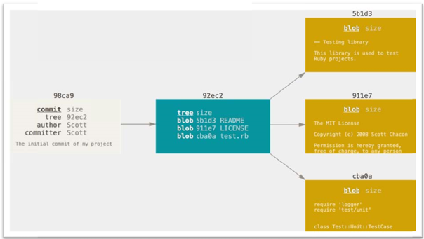
How Commits Are Made
Commit=unique snapshot

Slide 65
Safe Operations
Command | Cautions
revert | Generally safe since it creates a new commit.
commit --amend | Only use on local commits.
reset | Only use on local commits.
cherry-pick | Only use on local commits.
rebase | Only use on local commits.

Slide 66
Reverting Commits
Initialize the revert: git revert <SHA>
Type a commit message.
Push your changes to GitHub.

Slide 67
Helpful Git Commands

Slide 68
Moving and Renaming Files with Git
git mv <file> <newpath>/<newname>

Slide 69
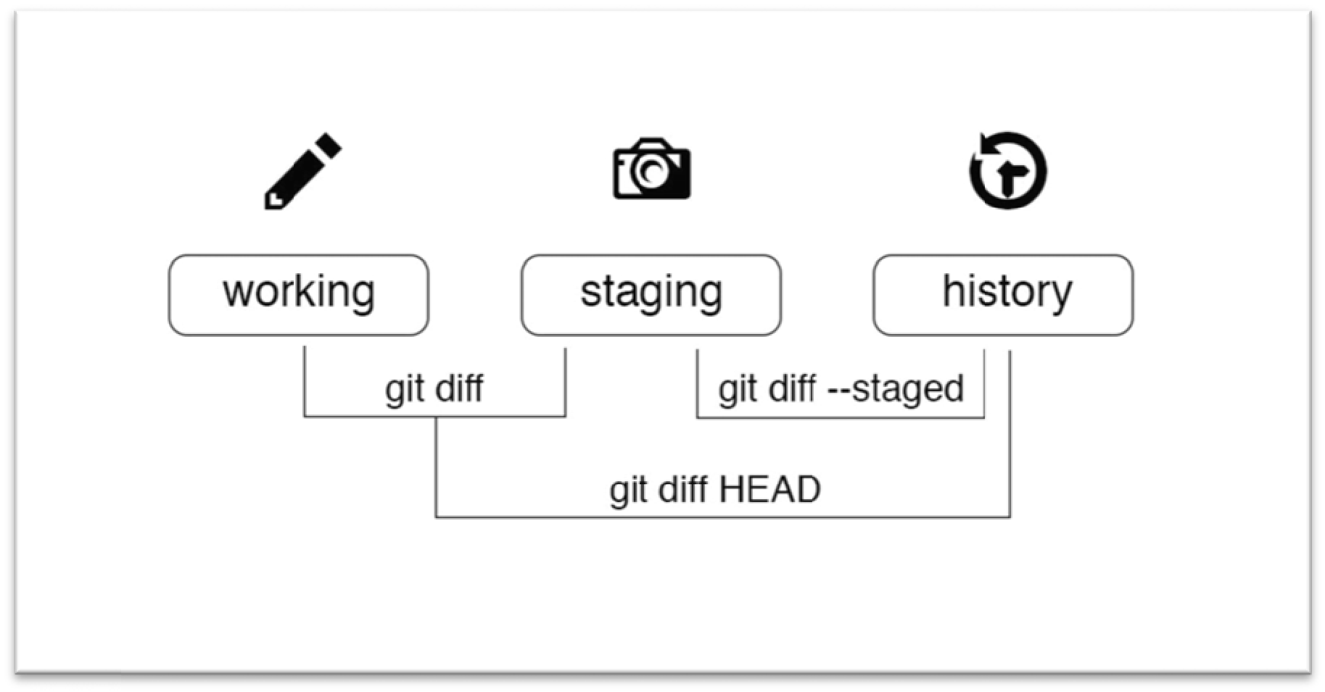
Viewing Local Changes
$ git diff
$ git diff --staged
$ git diff HEAD
$ git diff --color-words

Slide 70
Creating a New Local Repository
Navigate to the directory where you will place your practice repo (cd .. to get back to the parent folder).
Create a new directory and initialize it as a git repository: git init practice-repo
CD into your new repository: cd practice-repo
Create an empty new file named README.md: touch README.md
Add and commit the README.md file.

Slide 71
Fixing Commit Mistakes

Slide 72
Revising Your Last Commit
Create a new file: touch file7.txt
When you are adding files to the previous commit, they should be in the staging area. Move your file to the staging area: git add file7.txt
git commit --amend
The text editor will open, allowing you to edit your commit message.

Slide 73
Rewriting History with Git Reset

Slide 74
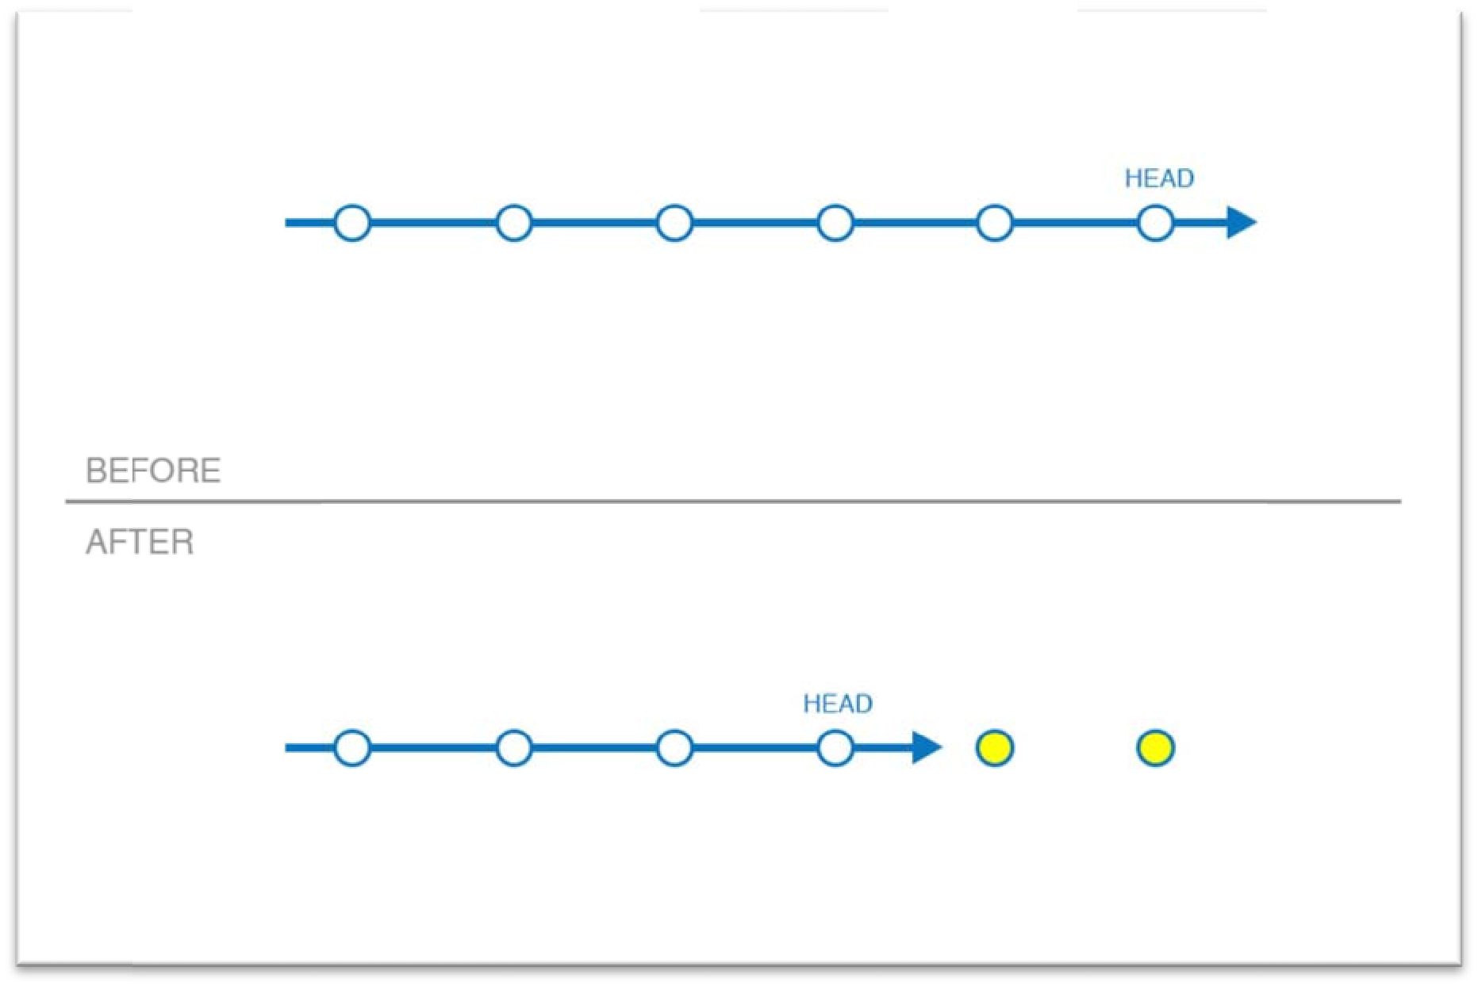
Understanding Reset

Slide 75
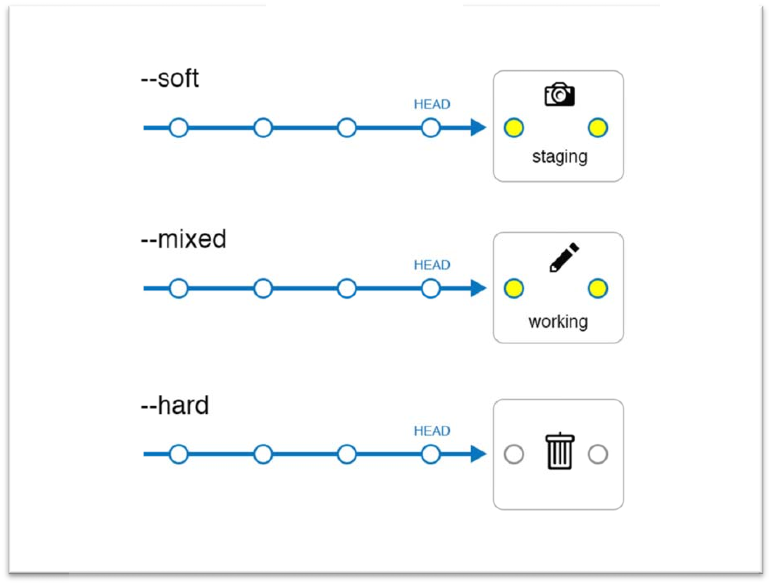
Reset Modes
Soft: Does not touch the index file or the working tree at all (but resets the head to <commit>, just like all modes do). This leaves all your changed files "Changes to be committed", as git status would put it.
Mixed (default): Resets the index but not the working tree (i.e., the changed files are preserved but not marked for commit) and reports what has not been updated.
Hard: Resets the index and working tree. Any changes to tracked files in the working tree since <commit> are discarded.

Slide 76
Reset Soft
1. View the history of our project: git log --oneline --decorate
2. Identify the current location of HEAD.
3. Go back two commits in history: git reset --soft HEAD~2
4. See the tip of our branch (and HEAD) is now sitting two commits earlier than it was before: git log --oneline --decorate
5. The changes we made in the last two commits should be in the staging area: git status

Slide 77
Reset Mixed
Once again, we will start by viewing the history of our project: git log --oneline
Go back one commit in history: git reset HEAD~
See where the tip of the branch is pointing: git log --oneline --decorate
The changes we made in the last commit have been moved back to the working directory: git status
Move the files to the staging area before we can commit them: git add file5.md file6.md
Re-commit the files: git commit -m "re-add file 5 and 6"

Slide 78
Reset Hard
Start by viewing the history of our project with: git log --oneline
Reset to the point in time where the only file that existed was the README.md: git reset --hard <SHA>
See that all of the commits are gone: git log --oneline
Notice your working directory is clean: git status
Ssee that the only file in your repository is the README.md: ls

Slide 79
Does Gone Really Mean Gone?

Slide 80
Getting it Back

Slide 81
You Just Want That One Commit

Slide 82
Oops, I Didn’t Mean to Reset

Slide 83
Merge Strategies: Rebase

Slide 84
About Git rebase

Slide 85
Understanding Git Merge Strategies

Slide 86
Creating a Linear History

Slide 87
Thank you!
Questions?
Survey: http://www.onlc.com/eval

