Slide 1

GitHub for Developers
Instructor: Dan Costello Email: danc@onlc.com
Class begins at 10 Eastern time
For Class Audio Connection:
ONLC Office Locations – Audio is connected over Jabra™ speaker
Home or Office – Call: ____ Access Code: ____ # Enter the audio pin shown in the GoToMeeting panel
If you need assistance, call 800-288-8221

Slide 2
GitHub for Developers

Slide 3
Student introductions
Your name
Company affiliation
Title/function
GitHub experience
Your expectations for the course
Notes:
Ask students to introduce themselves and provide their backgrounds, product experience, and expectations for the course.
Record student expectations on a whiteboard or flip chart that you can reference during class.

Slide 4


Housekeeping
Class hours: 10:00-16:45
A.M./P.M. Breaks: 15 min.
Lunch Break: 1 hr.
ONLC Wifi access code (if present): 0123456789
If you need anything, please let us know!
Notes:
Explain class and facility logistics, using the bulleted list. Inform students about any emergency procedures, such as emergency exits, and plans in the event of fire or other emergencies.

Slide 5
The Courseware
The Book:

Slide 6
Classroom Setup
Windows 10

Slide 7
Course Outline
Getting Started With Collaboration
What is GitHub?
The GitHub Ecosystem
What is Git?
Exploring a GitHub Repository
Using GitHub Issues
Activity: Creating A GitHub Issue
Using Markdown
Understanding the GitHub Flow
The Essential GitHub Workflow
Branching with Git
Branching Defined
Activity: Creating A Branch with GitHub
Local Git Configuration
Checking Your Git Version
Git Configuration Levels
Viewing Your Configurations
Configuring Your User Name and Email
Configuring autocrlf
Working Locally with Git
Creating a Local Copy of the repo
Our Favorite Git command: git status
Using Branches locally
Switching Branches
Activity: Creating a New File
The Two Stage Commit
Collaborating on Your Code
Pushing Your Changes to GitHub
Activity: Creating a Pull Request
Exploring a Pull Request
Activity: Code Review
Editing Files on GitHub
Editing a File on GitHub
Committing Changes on GitHub
Merging Pull Requests
Merge Explained
Merging Your Pull Request
Updating Your Local Repository
Cleaning Up the Unneeded Branches
Viewing Local Project History
Using Git Log
Streamlining Your Workflow with Aliases
Creating Custom Aliases
Workflow Review Project: GitHub Games
User Accounts vs. Organization Accounts
Introduction to GitHub Pages
What is a Fork?
Creating a Fork
Workflow Review: Updating the README.md
Resolving Merge Conflicts
Local Merge Conflicts
Working with Multiple Remotes
Remote Merge Conflicts
Exploring
Searching for Events in Your Code
What is git bisect?
Finding the Bug in Our Project
Reverting Commits
How Commits Are Made
Safe Operations
Reverting Commits
Helpful Git Commands
Moving and Renaming Files with Git
Staging Hunks of Changes
Viewing Local Changes
Comparing Changes within the Repository
Creating a New Local Repository
Initializing a New Local Repository
Fixing Commit Mistakes
Revising Your Last Commit
Rewriting History with Git Reset
Understanding Reset
Reset Modes
Reset Soft
Reset Mixed
Reset Hard
Does Gone Really Mean Gone?
Getting it Back
You Just Want That One Commit
Oops, I Didn’t Mean to Reset
Merge Strategies: Rebase
About Git rebase
Understanding Git Merge Strategies
Creating a Linear History

Slide 8
Questions?

Slide 9
Getting Started With Collaboration

Slide 10
What is GitHub?

Slide 11
The GitHub Ecosystem

Slide 12
What is Git?

Slide 13
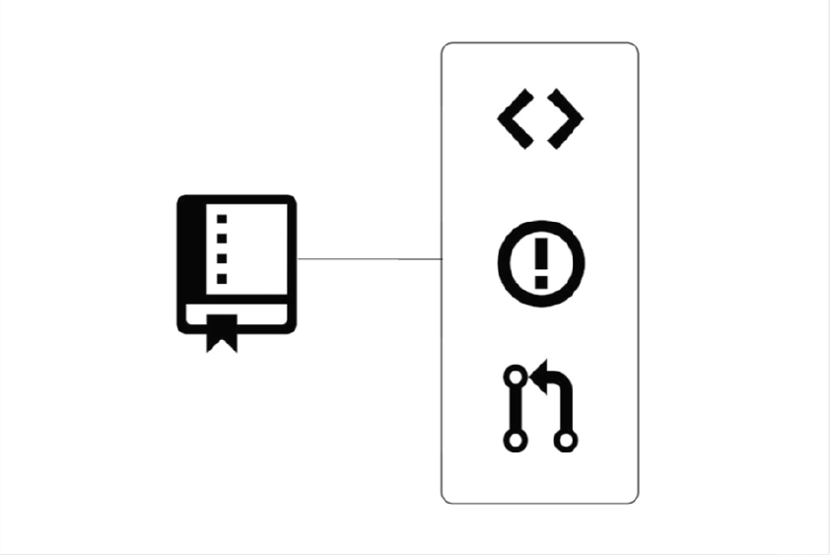
Exploring a GitHub Repository

Slide 14
Using GitHub Issues

Slide 15
Activity: Creating A GitHub Issue

Slide 16
Using Markdown

Slide 17
Understanding the GitHub Flow

Slide 18
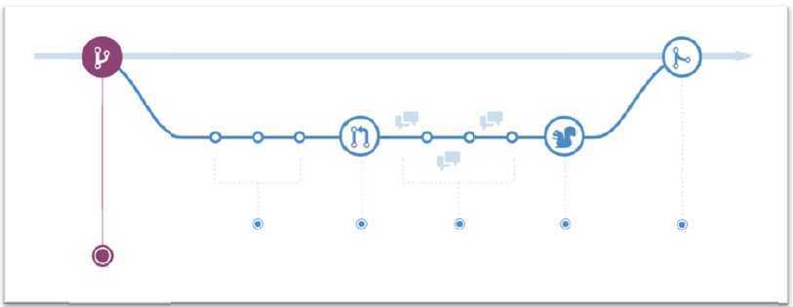
The Essential GitHub Workflow
The basics of working in GitHub

Slide 19
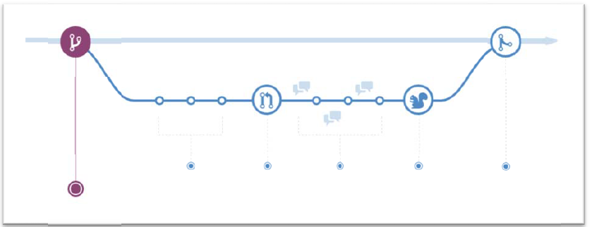
Branching with Git
Branch = copy of the project at a particular point in time

Slide 20
Activity: Creating A Branch with GitHub
1. Navigate to Code tab of the class repository.
2. Click the Master dropdown.
3. Enter the branch name 'github-username-hometown'.
4. Press Enter.

Slide 21
Local Git Configuration

Slide 22

Checking Your Git Version
git --version

Slide 23
Git Configuration Levels
System: All users on the computer
Global: User-level, for all repositories for your account
Local (default): Single repository

Slide 24

Viewing Your Configurations
git config <option> --list

Slide 25

Configuring Your User Name and Email
Username and email for your commits

Slide 26
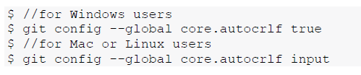
Configuring autocrlf
How git handles line breaks

Slide 27
Working Locally with Git

Slide 28

Creating a Local Copy of the repo
Copying = “Cloning”

Slide 29
Activity: Creating a Local Copy of the repo
Code tab
Clone or download
Copy URL
git clone <clone-url>

Slide 30

Our Favorite Git command: git status
Current state of your repository

Slide 31

Using Branches locally

Slide 32

Switching Branches

Slide 33
Activity: Creating a New File
1. Create a new file with the following file name YOUR-USERNAME-YOUR-HOMETOWN.md.
For example, githubteacher-san-francisco.md.
2. Add a skeleton for your file with the following lines:
3. # HOMETOWN recommendations
4. ## Great Places to Eat
5. ## Fun Things to Do
6. Save your file.

Slide 34
The Two Stage Commit

Slide 35
Collaborating on Your Code

Slide 36
Pushing Your Changes to GitHub

Slide 37
Activity: Creating a Pull Request

Slide 38
Exploring a Pull Request

Slide 39
Activity: Code Review

Slide 40
Editing Files on GitHub

Slide 41
Editing a File on GitHub

Slide 42
Committing Changes on GitHub

Slide 43
Merging Pull Requests

Slide 44
Merge Explained

Slide 45
Merging Your Pull Request

Slide 46
Updating Your Local Repository

Slide 47
Cleaning Up the Unneeded Branches

Slide 48
Viewing Local Project History

Slide 49
Using Git Log

Slide 50
Streamlining Your Workflow with Aliases

Slide 51
Creating Custom Aliases

Slide 52
Workflow Review Project: GitHub Games

Slide 53
User Accounts vs. Organization Accounts

Slide 54
Introduction to GitHub Pages

Slide 55
What is a Fork?

Slide 56
Creating a Fork

Slide 57
Workflow Review: Updating the README.md

Slide 58
Resolving Merge Conflicts

Slide 59
Local Merge Conflicts

Slide 60
Working with Multiple Remotes

Slide 61
Remote Merge Conflicts

Slide 62
Exploring

Slide 63
Searching for Events in Your Code

Slide 64
What is git bisect?

Slide 65
Finding the Bug in Our Project

Slide 66
Reverting Commits

Slide 67
How Commits Are Made

Slide 68
Safe Operations

Slide 69
Reverting Commits

Slide 70
Helpful Git Commands

Slide 71
Moving and Renaming Files with Git

Slide 72
Staging Hunks of Changes

Slide 73
Viewing Local Changes

Slide 74
Comparing Changes within the Repository

Slide 75
Creating a New Local Repository

Slide 76
Initializing a New Local Repository

Slide 77
Fixing Commit Mistakes

Slide 78
Revising Your Last Commit

Slide 79
Rewriting History with Git Reset

Slide 80
Understanding Reset

Slide 81
Reset Modes

Slide 82
Reset Soft

Slide 83
Reset Mixed

Slide 84
Reset Hard

Slide 85
Does Gone Really Mean Gone?

Slide 86
Getting it Back

Slide 87
You Just Want That One Commit

Slide 88
Oops, I Didn’t Mean to Reset

Slide 89
Merge Strategies: Rebase

Slide 90
About Git rebase

Slide 91
Understanding Git Merge Strategies

Slide 92
Creating a Linear History

Slide 93
Thank you!
Questions?
Survey: http://www.onlc.com/eval

