Slide 1

Github Introduction
Instructor: Dan Costello Email: danc@onlc.com
Class begins at 10 Eastern time
For Class Audio Connection:
ONLC Office Locations – Audio is connected over Jabra™ speaker
Home or Office – Call: xxx-xxx-xxxx Access Code: xxx xxx xxx# Enter the audio pin shown in the GoToMeeting panel
If you need assistance, call 800-288-8221

Slide 2
Welcome
Github Introduction

Slide 3

Introductions
Name
Company/Job Title
GitHub Experience
Programming/Development Experience
Expectations for the course

Slide 4

Courseware and Lab Machines
Courseware:
Lab machines
GoToMyPC
You will need a GitHub account:
https://github.com/join

Slide 5
Course Outline
Module 1 – Introduction to GitHub
Key concepts of GitHub
Module 2 – Viewing
Views and Graphs in GitHub
Monitoring GitHub
Module 3 – Editing
How to contribute via Forking
Adding Files
Creating Pull-Requests
Working with Folders (rename, moving)
Module 4 – Collaboration
Committing to a Branch
Collaborating on Pull-Requests:
--Issues
--Commenting
--Testing and Reviewing
--Best Practices
Module 5 – Creating and Configuring
Creating a Repository
Adding Collaborators
Configuring a Repository
Integration with other Systems
Working with Organizations
Module 6 – Downloading
Cloning Repositories
GitHub for Macintosh
GitHub for Windows
Configuring Command-Line Tools

Slide 6
Schedule, Facilities, and What To Do If You Need Something
10:00-16:45 Eastern Time
15-minute morning & afternoon breaks
1 hour lunch break
If you need anything, please let us know!

Slide 7
Questions?

Slide 8
Module 1 – Introduction to GitHub

Slide 9
Key concepts of GitHub
Git: a version control system
GitHub: a website where you can upload a copy of your Git repository
Commit: saving changes to a file or files
Commit message: description of why the change was made
Branch: a group of independent changes, separate from the main set of files
Master Branch: the default (production) branch
Feature branch: created to implement a feature
Release branch: any branch containing code that will be released into production

Slide 10
Key Concepts (c’t’d)
Merge: move completed work from one branch to another
Tag: reference to a specific historic commit
Check out: get project files as of a specific release
Pull Request: request for review & possible merge of changes
Issue: discussion topic for features & bugs
Wiki: lightweight documentation mechanism
Clone: create a local copy of a project
Fork: copy project into your own account
Gist: lightweight way of sharing code snippets

Slide 11
Module 2 – Viewing

Slide 12
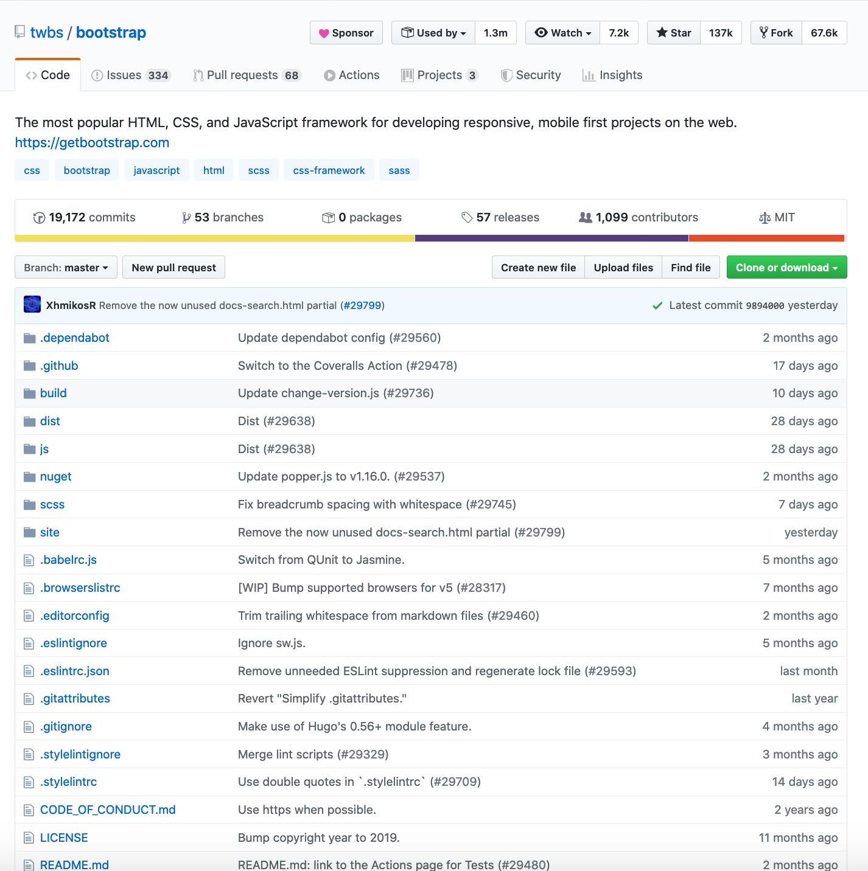
The Project Page
Project Name
Owner
Public/Private
Statistics
README.md
https://github.com/twbs/bootstrap

Slide 13
Views in GitHub
Commit History
Pull Requests
Issues
Projects

Slide 14
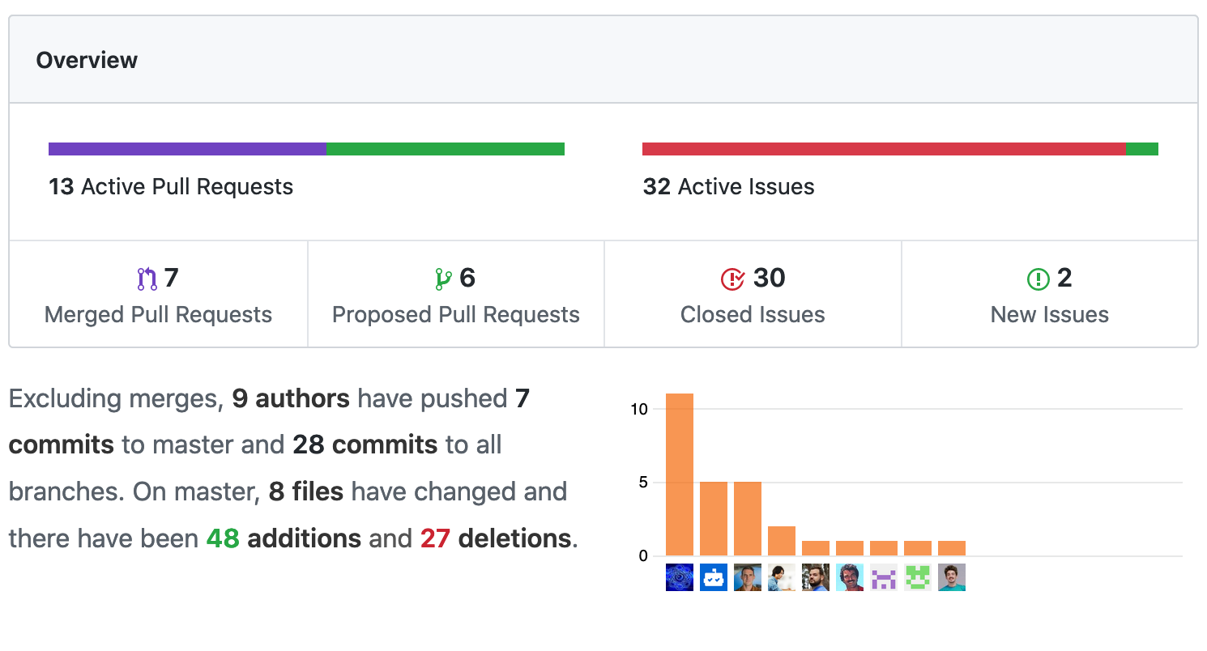
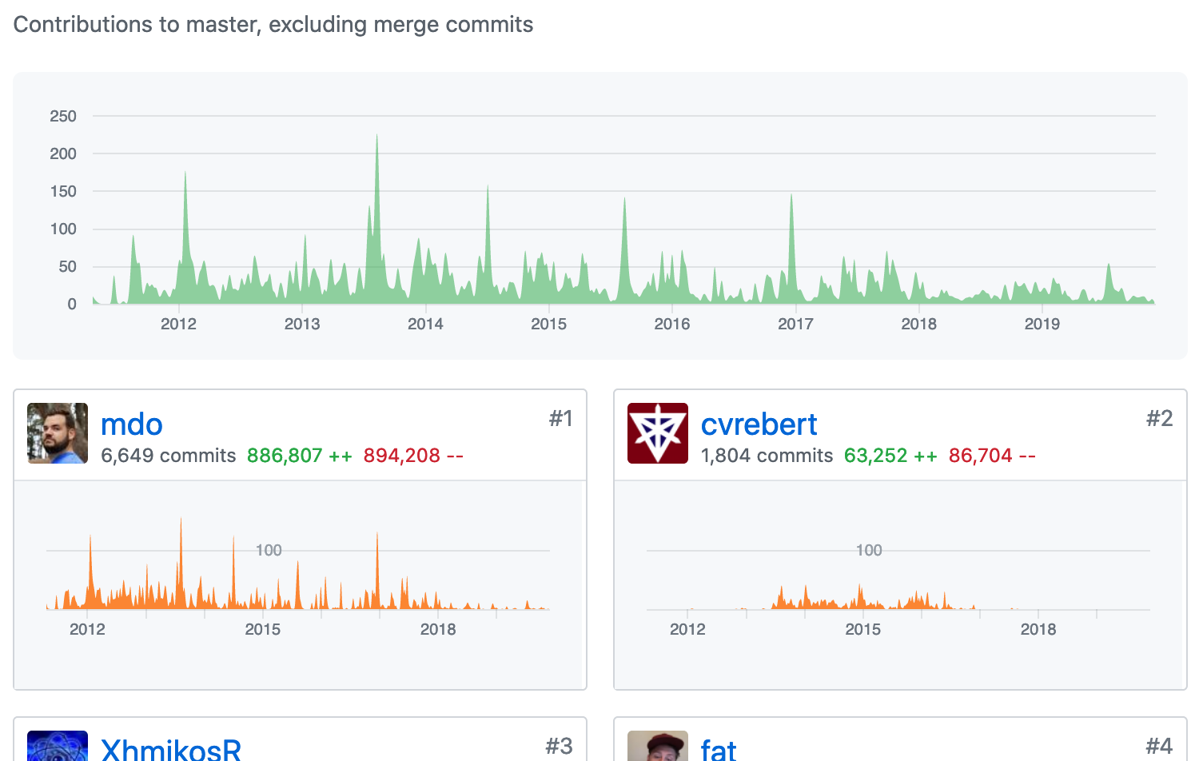
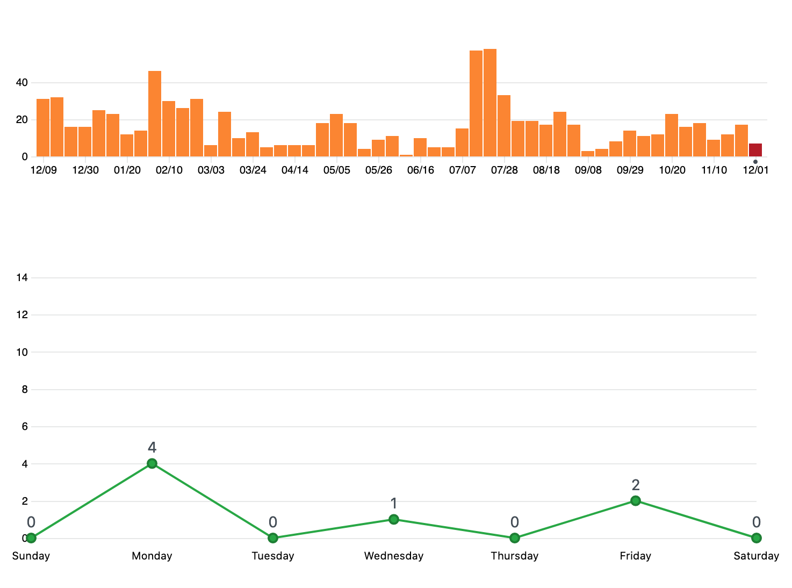
Views in GitHub (c’t’d)
The “Pulse”
The Contributors Graph
The Community Profile
The Commits Graph

Slide 15
Graphs in GitHub
Contributors Graph
Commits Graph
Code Frequency Graph
Punch Card Graph
Network Graph
Members List
Traffic Graph

Slide 16
Module 3 – Editing

Slide 17
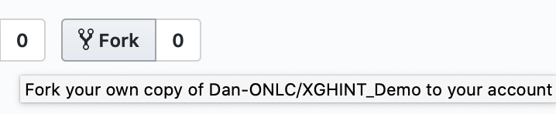
How to contribute via Forking
Locate the repository
Click the “Fork” button
Make your changes
Create a Pull Request

Slide 18

Adding Files
Click “Create new file”
Name & edit

Slide 19
Creating Pull-Requests
Click the “Create pull request” button
Enter a description of the request
Submit the request
(Possibly) Have a conversation with the repo maintainers about the request

Slide 20
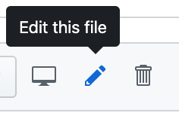


Working with Folders (rename, moving)
Folders = “just part of the path”
Edit the file
Change its name/path

Slide 21
Module 4 – Collaboration

Slide 22
Committing to a Branch

Slide 23
Collaborating on Pull-Requests:
Involving people: @mentions
Reviewing pull requests
Commenting on pull requests
Adding color to comments
https://github.com/ikatyang/emoji-cheat-sheet/blob/master/README.md
Contributing to pull requests
Testing a pull request
Who Should Merge a Pull Request?

Slide 24
Issues
Creating a New Issue
Managing Milestones for Issues
Referencing Issues in a Commit
Best Practices for Issues
Create “Bug” and “Feature” labels
Be careful when assigning issues
Make extensive use of labels

Slide 25
Best Practices
Create pull requests for everything
Make the titles descriptive
Take the time to comment
Run the tests
Have a clear policy for approving pull requests

Slide 26
Wikis
simple content management system
used for capturing end-user documentation, developer documentation, or both

Slide 27
Getting Started with a Wiki
Settings → Features
Wikis checkbox
click the Wiki tab on the right side of any page

Slide 28
Module 5 – Creating and Configuring

Slide 29
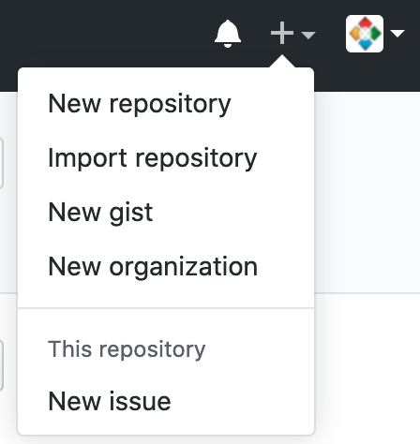
Creating a Repository
Click the + sign to the left of your username
Username/organization
Repo name
Public/Private
Create a README.md

Slide 30



Adding Collaborators
Settings → Collaborators → Search → Add collaborator

Slide 31
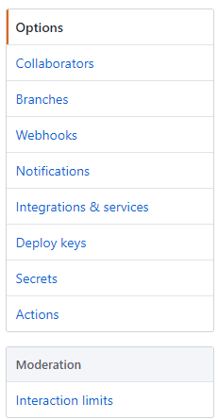
Configuring a Repository

Slide 32
Configuring Branches
Default Branch
Protected Branches

Slide 33
Integration with other Systems
GitHub API https://developer.github.com
GitHub Marketplace https://github.com/marketplace

Slide 34
Working with Organizations
Creating an Organization
[+ sign to right of username] → “New organization”

Slide 35
Module 6 – Downloading

Slide 36
Cloning Repositories
Why Clone a Repository?
GitHub Desktop
GitHub Desktop and Atom

Slide 37
GitHub for Windows
GitHub desktop: https://desktop.github.com/
Atom: https://atom.io/
(or VS Code): https://code.visualstudio.com/download

Slide 38
Configuring Command-Line Tools
https://gitforwindows.org/
git config --global user.name "YOUR_USERNAME“
git config --global user.email your_email_address@example.com
git config --global --list
git initpwd

