Slide 1
Good Morning
We will
start at
10:00 EST
Instructor: Dan Costello, MCT

Slide 2
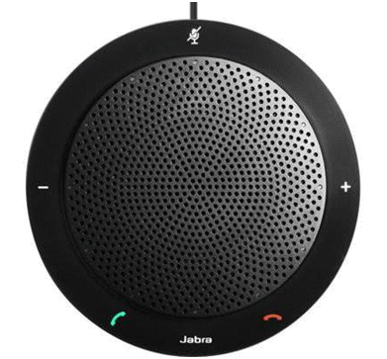
Course Title Here
Instructor: Dan Costello
Email: danc@onlc.com
  Class begins at 10 Eastern time
  For Class Audio Connection:
    ONLC Office Locations –
    Audio is connected over Jabra™ speaker
    Home or Office –
    Call: xxx-xxx-xxxx Access Code: xxx xxx xxx#
    Enter the audio pin shown in the GoToMeeting panel
  If you need assistance, call 800-288-8221

Slide 3
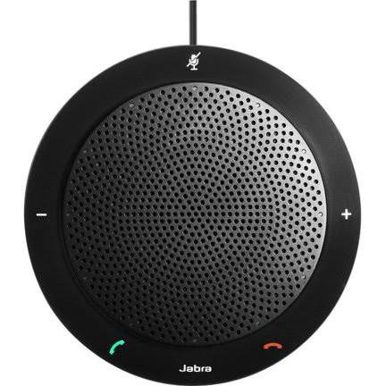
The Jabra Speaker
Mute Button – A ring of red lights appears around the speaker when the phone is muted.
A single white light appears above the Jabra logo when the phone is not muted.
Volume Down
Volume Up
The On/Off Hook buttons have no function when connected to GoToMeeting audio.

Slide 4

A.M. Break:
11:00-11:15 EST
Questions? Comments?
Dan’s e-mail: danc@onlc.com
Dan’s cell #: (413) 455-0856

Slide 5


Lab: 12:00-12:45
Lunch: 12:45-13:30
Questions? Comments?
Dan’s e-mail: danc@onlc.com
Dan’s cell #: (413) 455-0856

Slide 6
Lunch: 12:45-13:30
Lab: 13:30-14:30
P.M. Break: 14:30-14:45
Questions? Comments?
Dan’s e-mail: danc@onlc.com
Dan’s cell #: (413) 455-0856

Slide 7
A.M. Break: 11:30-11:45
Lab: 11:45-12:45
Lunch: 12:45-13:30
Questions? Comments?
Dan’s e-mail: danc@onlc.com
Dan’s cell #: (413) 455-0856

Slide 8
Lab: 12:15-12:45
Lunch: 12:45-13:30
Lab: 13:30-14:00
Questions? Comments?
Dan’s e-mail: danc@onlc.com
Dan’s cell #: (413) 455-0856

Slide 9
A.M. Break: 11:15-11:30
Lab: 11:30-12:15
Questions? Comments?
Dan’s e-mail: danc@onlc.com
Dan’s cell #: (413) 455-0856

Slide 10
Lab: 14:30-15:00
P.M. Break: 15:00-15:15
Questions? Comments?
Dan’s e-mail: danc@onlc.com
Dan’s cell #: (413) 455-0856

Slide 11
Good Morning
Lab:
10:00-10:45
Questions? Comments?
Dan’s e-mail: danc@onlc.com
Dan’s cell #: (413) 455-0856

Slide 12
Lab:
15:45-Done
Have a
great night!
Questions? Comments?
Dan’s e-mail: danc@onlc.com
Dan’s cell #: (413) 455-0856

Slide 13
Good Morning
We will
start at
10:00 EST
Questions? Comments?
Dan’s e-mail: danc@onlc.com
Dan’s cell #: (413) 455-0856

Slide 14
Thank You
Have a
great night!
Questions? Comments?
Dan’s e-mail: danc@onlc.com
Dan’s cell #: (413) 455-0856

Slide 15
Thank You
http://www.onlc.com/eval
Have a
great weekend!
Questions? Comments?
Dan’s e-mail: danc@onlc.com
Dan’s cell #: (413) 455-0856

Slide 16
NOTES:
ONLC Azure Database Connection
Server: onlcdb.database.windows.net
DB: AdventureWorksLT
User: student
Password: Pa55w.rd

