Slide 1
Splunk Fundamentals: Level 2
Notes:
Welcome to Splunk Fundamentals, Level 2 from ONLC Training Centers. My name is Dan Costello, and I’ll be delivering this on-demand training.
(Next slide)
XSPLK2.00.01.01.CourseIntro.OneNote.Lecture

Slide 2
Course Outline
Module 1: Introduction and review
Module 2: Getting data into Splunk
Module 3: Building an Operational Intelligence App
Module 4: Advanced Querying
Module 5: Analytics and Machine Learning
Module 6: Optimization
Notes:
In this course, we’ll begin with a review of some Splunk fundamentals. Then in Module 2, we’ll discuss various kinds of data sources that Splunk can consume and how to configure them. In Module 3, we’ll begin the process of constructing a Splunk app for operational intelligence. In Module 4, we’ll look at some advanced querying techniques and review a number of useful search commands. In Module 5, we’ll get an introductory look at Analytics and Machine Learning in Splunk. And in Module 6, we’ll discuss optimizing Splunk.
(Next slide)

Slide 3

The Courseware
Improving Your Splunk Skills
Contains selected material from Implementing Splunk 7 and Splunk Operational Intelligence Cookbook
GitHub site for code files: https://github.com/PacktPublishing/Improving-your-Splunk-skills
Supplemental notes: https://bit.ly/ONLCXSPLK2
Notes:
(Next slide)

Slide 4
Classroom Setup
Windows 10
Machine username: student
Machine password: Pa55w.rd
Splunk 8.01, Python 2 (for compatibility w/book files)
Splunk username: admin
Splunk password: password
Course Files:
C:\Improving-your-Splunk-skills-master
C:\XSPLK2ClassFiles
Notes:
(Next slide)

Slide 5
Classroom Setup, Continued
To set up your own environment to match the one we use for the class:
Download and install Splunk 8.0.1 (64-bit version)
https://www.splunk.com/en_us/download/previous-releases.html
Clone the GitHub repository for the book:
https://github.com/PacktPublishing/Improving-your-Splunk-skills
Clone our GitHub repository with additional class files:
https://github.com/ONLC-ClassMaterials/XSPLK2ClassFiles
Notes:
(Next slide)

Slide 6



Classroom Setup, Continued
Installing the class app
Log on to Splunk
Manage apps
Install app from file
Browse to C:\XSPLK2ClassFiles\Apps\XSPLK2_App.spl
Upload
This installs an app that contains all of the assets you’ll need for later labs

Slide 7
Module 1: Introduction and Review
Notes:
XSPLK2.01.01.01.Mod1Intro.OneNote.Lecture

Slide 8
Module 1: Introduction and Review
Splunk Enterprise Features
Search Review
Common Commands
Search Modes
Best Practices

Slide 9
Splunk Enterprise
Server-based software that enables indexing and search of enterprise data
Facilities for analysis and visualization
Flexible, extensible, multi-platform
Notes:
XSPLK2.01.02.01.SplunkEnterpriseFeatures.OneNote.Lecture
(Next slide)

Slide 10
Splunk Enterprise Features
Indexing: organize data from websites, applications, servers, databases, operating systems, etc. for quick summarization and retrieval
Search: query specified in Search Processing Language (SPL) to retrieve data from index. Searches can be saved for reuse.
Alerts: automated notification when search criteria are met
Dashboards: collections of panels of modules like search boxes, fields, charts, etc.
Notes:
(Next slide)

Slide 11
Splunk Enterprise Features (c’t’d)
Data models: pre-summarized and organized collections of data from one or more indexes
Pivots: tables, charts, or data visualizations created using the Pivot Editor, which is based on a Data Model
Reports: saved searches that can be run ad hoc or on a schedule, or can be embedded in one or more dashboards

Slide 12
Search Review
Keyword searches: search for terms in the raw data
Phrases: “enclosed in quotes”
Field searches: match value of specific field, e.g., ip_address=1.2.3.4
Wildcard operator: *
Boolean operators: AND, OR, NOT (case-sensitive)
Notes:
XSPLK2.01.03.01.SearchReview.OneNote.Lecture
(Next slide)

Slide 13

The Search pipeline
Output of one search phrase can be “piped” to the next using the | operator

Slide 14
Common commands
table: generates a table containing specified fields
rename: renames a field in results
sort: sorts results by specified field, ascending/descending
fields: includes or removes specified fields
lookup: looks up values from external data source
Notes:
XSPLK2.01.04.01.CommonCommands.OneNote.Lecture
(Next slide)

Slide 15
Transforming commands
Commands that convert results into a data table
chart, timechart, stats, top, rare, contingency, highlight, etc…

Slide 16
Search mode
Fast: speeds up searches by limiting types of data returned
Verbose: returns as much event information as possible, slower performance.
Smart: (default) toggles search behavior based on whether the search contains transforming commands.
Transforming = fast
Non-transforming = verbose
Notes:
XSPLK2.01.05.01.SearchMode.OneNote.Lecture

Slide 17
Search best practices
All events indexed by time ∴ search by time whenever possible
Limit I/O
Narrow the time window
Specify the index, source, or source type
Be as specific as possible
Limit number of events queried
Avoid NOT
https://docs.splunk.com/Documentation/Splunk/8.0.0/Search/Quicktipsforoptimization
Notes:
XSPLK2.01.06.01.SearchBestPractices.OneNote.Lecture
(Next slide)

Slide 18
Search best practices (c’t’d)
Filter Early
Use field-value pairs before the first pipe
Use filtering commands before calculating commands
Filter unnecessary fields from search results
Use non-streaming (blocking) commands as late as possible
https://docs.splunk.com/Documentation/Splunk/8.0.0/Search/Quicktipsforoptimization

Slide 19
Module 2: Getting Data Into Splunk
Notes:
XSPLK2.02.01.01.Mod2Intro.OneNote.Lecture

Slide 20
Module 2: Getting Data Into Splunk
Data Inputs
Indexing files & directories
Indexing Windows event logs
Getting data through network ports
Scripted inputs
Using a Universal Forwarder
The HTTP Event Collector
Getting data from databases
Adding structure to data with field extractions
Adding meaning to data with tags & event types
Sample data for this class

Slide 21
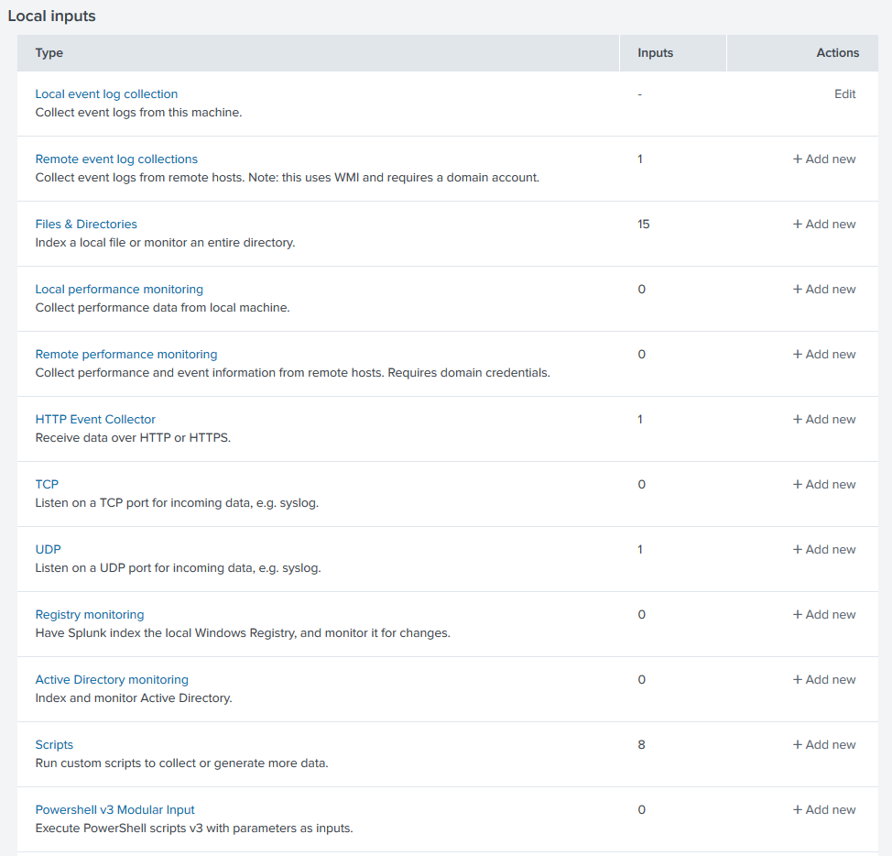
Data Inputs
Splunk provides flexible, extensible connectors for getting data from a wide variety of sources
Data may be directly consumed by the indexer or received from a forwarder
Notes:
XSPLK2.02.02.01.DataInputs.Page385.Lecture
(Next slide)

Slide 22
Indexing
Indexed data gets a sourcetype = specific schema for data
e.g. access_combined, cisco_syslog, log4j
Splunk also collects certain default fields
timestamp, host, source, sourcetype

Slide 23
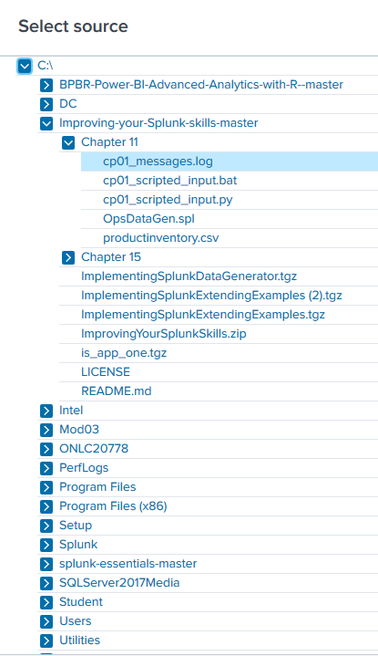

Indexing files and directories
Settings→Data Inputs→Files & directories → + Add New
Browse to file or directory
Specify sourcetype
Enter any additional settings
Notes:
XSPLK2.02.03.01.IndexingFilesAndDirectories.Page386.Lecture
(next slide)

Slide 24
Adding a file or directory using the CLI
Splunk’s “add monitor” operation
Parameters for choosing additional options, e.g., sourcetype
Notes:
(next slide)

Slide 25
Adding a file or directory input using inputs.conf
Manually edit inputs.conf
System: C:\Splunk\etc\system\local
App: C:\Splunk\etc\apps\<appName>\local
User: C:\Splunk\etc\users\<userName>\<appName>\local
Notes:
(next slide)

Slide 26
One-time indexing of files
CLI add oneshot command

Slide 27
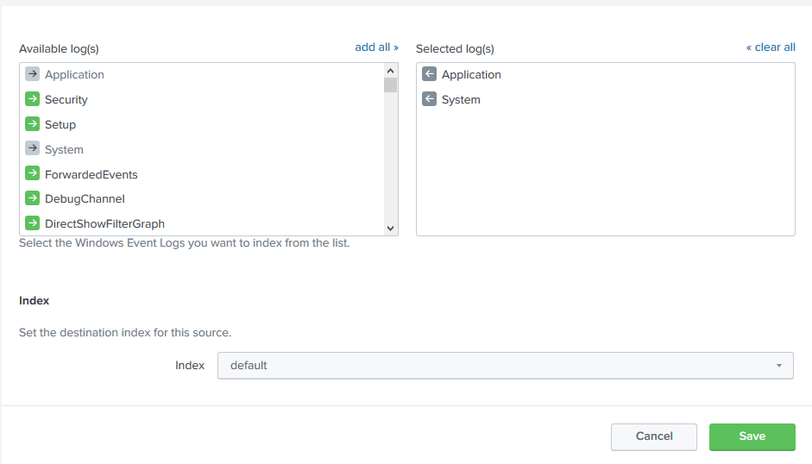
Indexing the Windows Event Logs
Local via Settings→Data inputs→Local event log collection
Remote via Universal Forwarder
Notes:
XSPLK2.02.04.01.WindowsEventLogs.Page393.Lecture

Slide 28

Getting data through network ports
Settings→Data inputs→[TCP|UDP]→+Add new
Enter port, sourcetype, optional parameters
Can also be done via the CLI, inputs.conf
Notes:
XSPLK2.02.05.01.NetworkPorts.Page394.Lecture

Slide 29
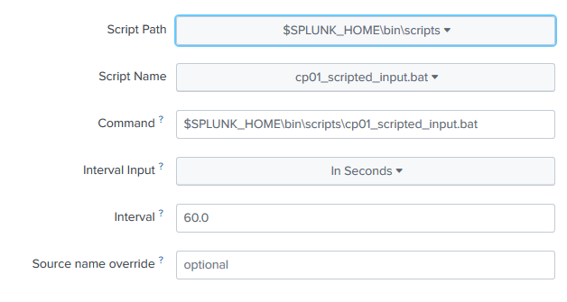
Scripted inputs
Place your script in $SPLUNK_HOME\bin\scripts
Specify a .bat, .sh or .py file
Specify an interval
Notes:
XSPLK2.02.06.01.ScriptedInputs.Page398.Lecture

Slide 30
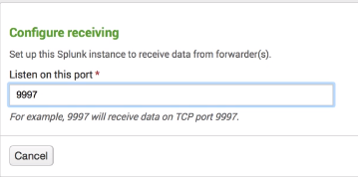
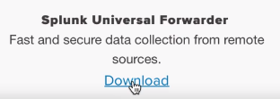
Configuring a Universal Forwarder
The Splunk Universal Forwarder can be installed on remote machines to forward their data to one or more indexers
https://www.splunk.com/en_us/resources/videos/splunk-education-getting-data-in-with-forwarders.html
Notes:
XSPLK2.02.07.01.UniversalForwarder.Page406.Lecture

Slide 31
Using the HTTP Event Collector (HEC)
Creates an HTTP Endpoint
Settings→Data inputs→Http Event Collector→+ Add New
Configure global settings
Create a new token
The token identifies the calling application
Notes:
XSPLK2.02.08.01.TheHTTPEventCollector.Page410.Lecture

Slide 32
Getting data from databases using DB Connect
Splunk DB Connect is available from the Splunkbase
Allows connection to popular RDBMSs via JDBC drivers
Requires install of JRE, necessary drivers
Notes:
XSPLK2.02.09.01.DataFromDatabases.Page414.Lecture

Slide 33
Adding Custom Field Extractions
Some fields pre-defined
Built-in sourcetypes, e.g. timestamp, hostname
Extraction of key-value pairs from JSON-formatted logs
Some must be user-defined
Delimited
Regex
Notes:
XSPLK2.02.10.01.CustomFieldExtractions.Page426.Lecture
(next slide)

Slide 34
Regular Expressions (“rex”,”regex”) in Splunk field extractions
Capture group: matching text (?<field_name>capture pattern) more matching text
Non-capturing group: matching text (?:pattern) more matching text
Example:
131.253.24.135 logon test_user
(?<ip>\d+\.\d+\.\d+\.\d+) (?<result>\w+) (?<user>.*)
ip field=“131.253.24.135”, result field=“logon”, user field=“test_user”
Notes:
(next slide)

Slide 35
Adding structure to data with field extractions
Field extractions use delimiters or a regex to extract specific data from unstructured data
Add using wizard or directly from extractions page in settings

Slide 36
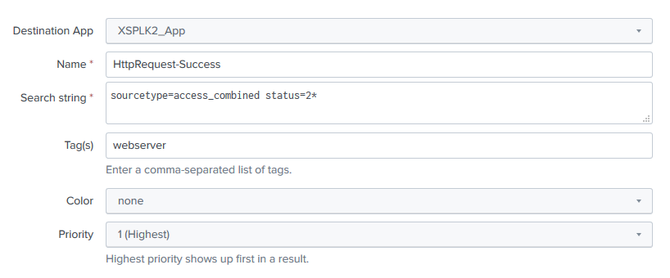
Adding meaning to data with event types
Event=one record in a log
Event types convert a chunk of SPL to a key-value pair
Characterize events, e.g. eventtype=“HttpRequest-Success”
Created from event types page
Notes:
XSPLK2.02.11.01.EventTypesAndTags.Page429.Lecture

Slide 37
Adding meaning to data with tags
Tags allow grouping of other criteria with a label
Assigned to field=value pairs
Create on tags page

Slide 38
Sample Data for this class
Meant to mimic N-tier e-commerce web application
C:\Splunk\etc\apps\OpsDataGen\data
access_log: web access log, access_combined source type
app_log: application log, log4j source type
hvac_log: csv sensor data, metrics_csv source type
Notes:
XSPLK2.02.12.01.SampleData.Page421.Lecture

Slide 39
Lab 2: Getting Data In
Indexing files and directories p 386
Getting data through network ports p 394
Using scripted inputs p 398
Receiving data using the HTTP Event Collector p 410
Loading the sample data for this book p 421
Defining field extractions p 426
Defining event types and tags p 429
Installing the Machine Learning Toolkit p 432
Notes:
XSPLK2.02.13.00.LabIntro.Page386.Lab
XSPLK2.02.13.01.IndexFilesAndDirectories.Page386.Lab
XSPLK2.02.13.02.GetDataThroughNetworkPorts.Page394.Lab
XSPLK2.02.13.03.UsingScriptedInputs.Page398.Lab
XSPLK2.02.13.04.HEC.Page410.Lab
XSPLK2.02.13.05.LoadingSampleData.Page421.Lab
XSPLK2.02.13.06.DefiningFieldExtractions.Page426.Lab
XSPLK2.02.13.07.EventTypesAndTags.Page429.Lab
XSPLK2.02.13.08.InstallingMLToolkit.Page432.Lab

Slide 40
Module 3: Building an Application
Notes:
XSPLK2.03.01.01.Mod3Intro.OneNote.Lecture

Slide 41
Module 3: Building an Application
Application architecture
Creating an app
Adding assets
Customizing dashboards
Dynamic drilldown
Adding a form to your dashboard
Adding geographical maps
Highlighting data by range
Scheduling PDF delivery of a dashboard

Slide 42
Application Architecture
A Splunk App is a container for:
Reports
Dashboards
Custom Assets
Stored as a folder in $SPLUNK_HOME/etc/apps
Can be packaged as .tgz or .spl
Notes:
XSPLK2.03.02.01.ApplicationArchitecture.Page435.Lecture
(Next slide)

Slide 43
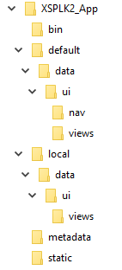
App folder structure
bin – binary assets, e.g. Python files
default – publisher’s configurations & views
local – end user configurations & views
lookups – csv files used as lookups for app
metadata – app permissions
static – static assets, e.g. icons

Slide 44


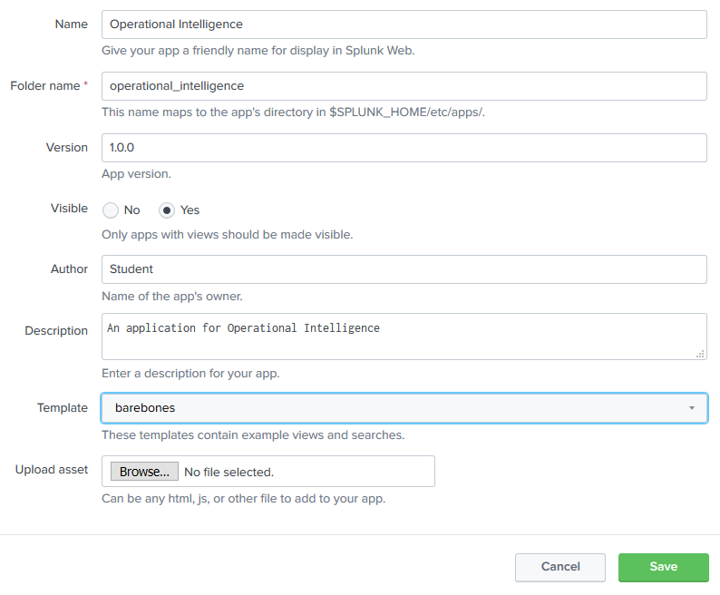
Creating an app from the UI
Manage Apps
Click “Create app”
Fill in the form
App name
App directory
Version
Author
Etc.
Notes:
XSPLK2.03.03.01.CreatingAnApp.Page437.Lecture

Slide 45
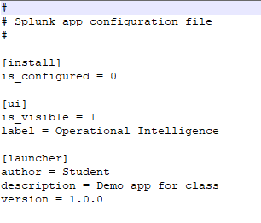
Creating an app from another app
Copy app directory
Edit default\app.conf
Restart Splunk

Slide 46
Deleting an app
Delete the app directory
Restart Splunk

Slide 47

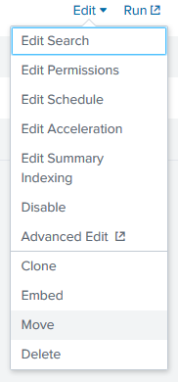
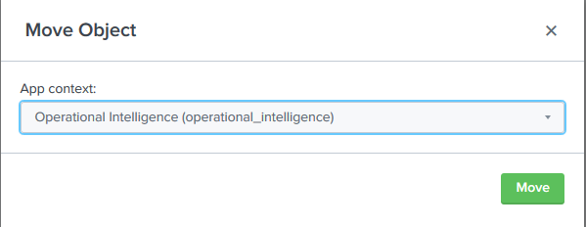
Adding Assets
Create reports & dashboards
Copy/move reports & dashboards from existing apps
Notes:
XSPLK2.03.04.01.AddingAssets.Page441.Lecture

Slide 48
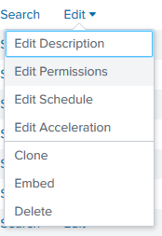
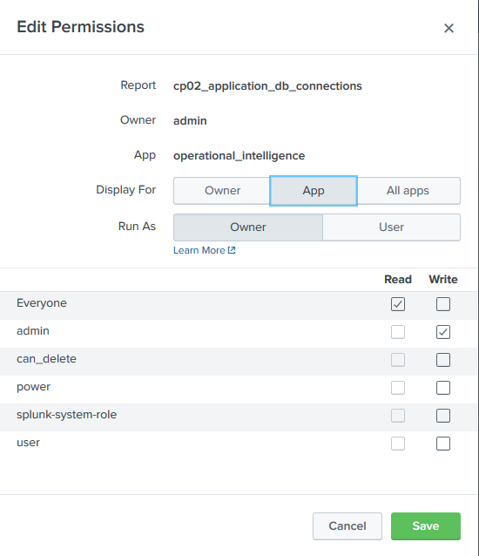
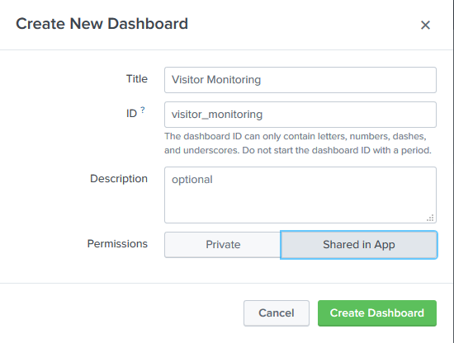
Changing Object Permissions
Owner=only visible to user
Stored in $SPLUNK_HOME\etc\users\<username>\<appname>\local\
App=visible to all users of the app
“Part of” the app
Stored in $SPLUNK_HOME\etc\apps\<appname>\local\
Notes:
XSPLK2.03.05.01.ChangingObjectPermissions.Page441.Lecture

Slide 49
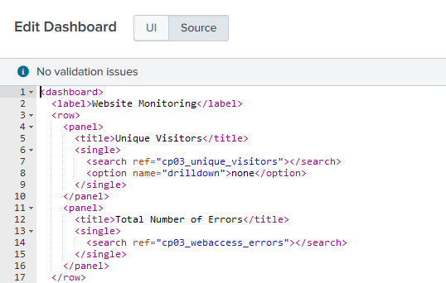
Customizing Dashboards
In the UI using the integrated editor
By directly modifying the Simple XML
Notes:
XSPLK2.03.06.01.CustomizingDashboards.Page448.Lecture

Slide 50
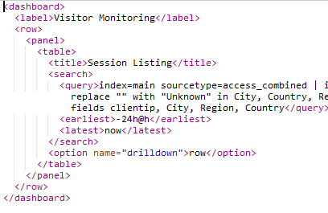

Dynamic Drilldown
Run a search when a row or cell is clicked
Enable from UI or XML
Notes:
XSPLK2.03.07.01.DynamicDrilldown.Page454.Lecture

Slide 51
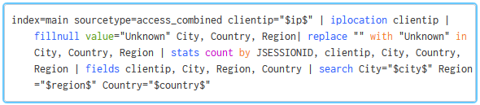
Adding a form to your dashboard
Add controls
Modify search to include tokens
Notes:
XSPLK2.03.08.01.AddingAForm.Page459.Lecture

Slide 52
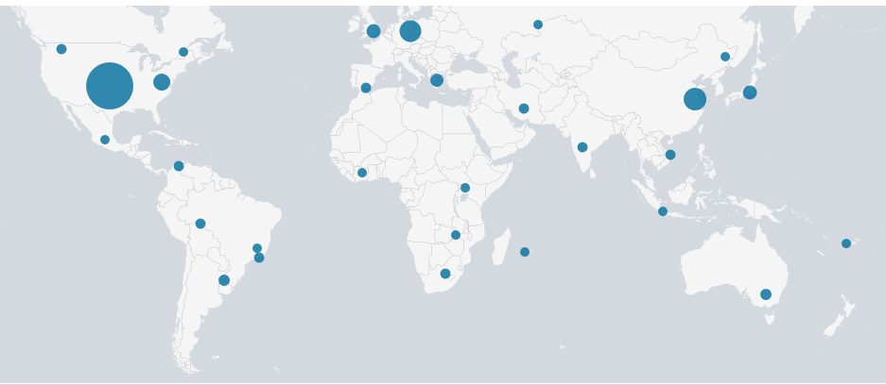
Adding geographical maps
Notes:
XSPLK2.03.09.01.AddingGeographicalMaps.Page471.Lecture

Slide 53
Adding geographical maps
iplocation – look up location information
City, country, metro code, region, time zone, latitude, longitude
geostats – generates statistics for rendering maps, e.g., “count of occurrences in geographical area”
geom – adds a “geom” field containing polygons to be used by chloropleth maps

Slide 54
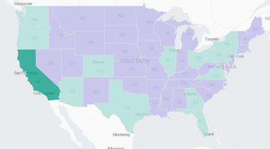
Chloropleth maps
Show regions with color density
geom – adds a “geom” field containing polygons to be used by chloropleth maps
http://localhost:8000/en-US/app/operational_intelligence/search?q=search%20index%3Dmain%20sourcetype%3Daccess_combined%20%7C%20iplocation%20clientip%20%7C%20fillnull%20value%3D%22Unknown%22%20Country%20%7C%20stats%20count%20by%20Country%20%7C%20fields%20Country%2C%20count%20%7C%20geom%20geo_countries%20featureIdField%3DCountry&display.page.search.mode=smart&dispatch.sample_ratio=1&workload_pool=&earliest=-24h%40h&latest=now&display.general.type=statistics&display.page.search.tab=statistics&display.visualizations.mapping.type=choropleth&sid=1576631602.373

Slide 55
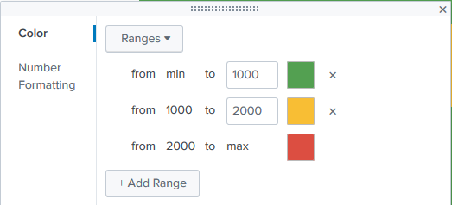
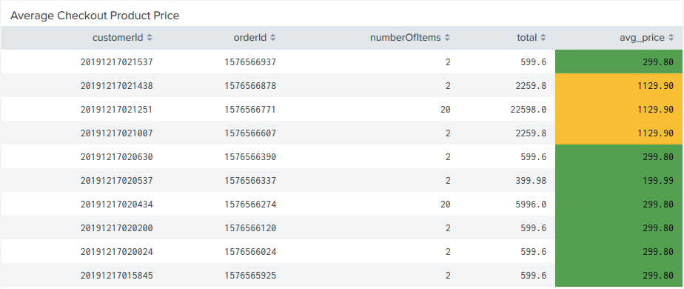
Highlighting Data by Range
Notes:
XSPLK2.03.10.01.HighlightingDataByRange.Page477.Lecture

Slide 56
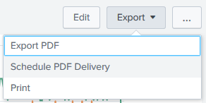
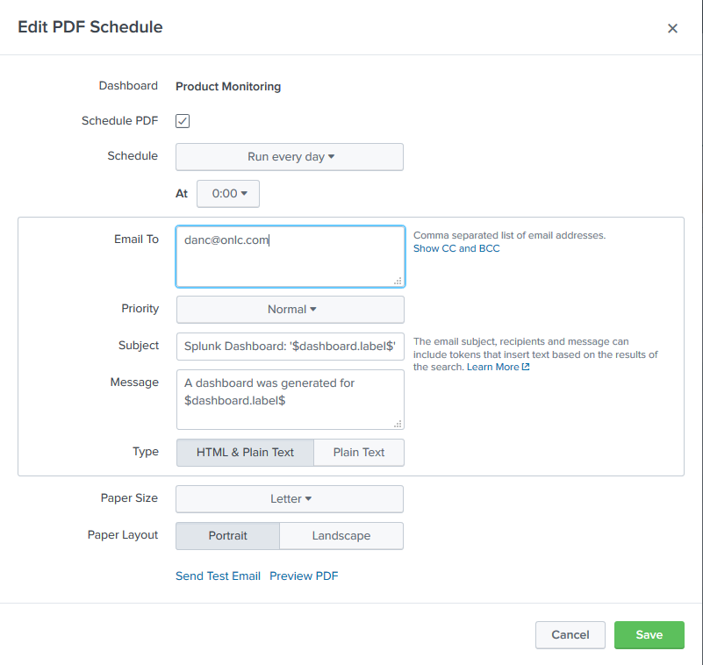
Scheduling PDF Delivery
Export → Schedule PDF Delivery
Populate form fields
Requires valid SMTP server configuration
Notes:
XSPLK2.03.11.01.SchedulingPDFDelivery.Page482.Lecture

Slide 57
Lab 3: Building an Operational Intelligence Application
Creating an Operational Intelligence application p 437
Adding dashboards and reports p 441
Organizing the dashboards more efficiently p 448
Dynamically drilling down on activity reports p 454
Creating a form to search web activities p 459
Linking web page activity reports to the form p 466
Displaying a geographical map of visitors p 471
Highlighting Average Product Price p 477
Scheduling the PDF delivery of a dashboard p 482
NOTE: The lab instructions assume that the assets you will move into your application are located in the default Search app, but in our environment they are located in the ONLC Splunk Fundamentals 2 app.
Notes:
XSPLK2.03.12.00.Lab3Intro.OneNote.Lab
XSPLK2.03.12.01.CreatingAnApp.Page437.Lab
XSPLK2.03.12.02.AddingDashboardsAndReports.Page441.Lab
XSPLK2.03.12.03.OrganizingDashboardsEfficiently.Page448.Lab
XSPLK2.03.12.04.DynamicDrilldown.Page454.Lab
XSPLK2.03.12.05.CreatingSearchForm.Page459.Lab
XSPLK2.03.12.06.LinkingReportsToForm.Page466.Lab
XSPLK2.03.12.07.DisplayingGeographicMap.Page471.Lab
XSPLK2.03.12.08.HighlightingAvgProdPrice.Page477.Lab
XSPLK2.03.12.09.SchedPDFDelivery.Page482.Lab

Slide 58
Module 4: Advanced Search
Notes:
XSPLK2.04.01.01.Mod4Intro.OneNote.Lecture

Slide 59
Module 4: Advanced Search
The search command
The where command
The eval command
The fields command
The fillnull command
The transaction and stats commands
The join command
The concurrency command
The associate command
The trendline command
Using the Job Inspector

Slide 60

The search command
Implied at the beginning of a search, generative
Also used in subsearches
In the pipeline adds an inline filter, streaming
Allows for inline SPL semantics
Notes:
XSPLK2.04.02.01.TheSearchCommand.OneNote.Lecture

Slide 61

The where command
Another way of adding an inline filter
SQL-like semantics
Case-sensitive
Notes:
XSPLK2.04.03.01.TheWhereCommand.OneNote.Lecture

Slide 62


The eval command
General-purpose command for
Performing calculations
Formatting, data conversion
Branching logic
Allows in-line generation of new fields
Notes:
XSPLK2.04.04.01.TheEvalCommand.OneNote.Lecture

Slide 63

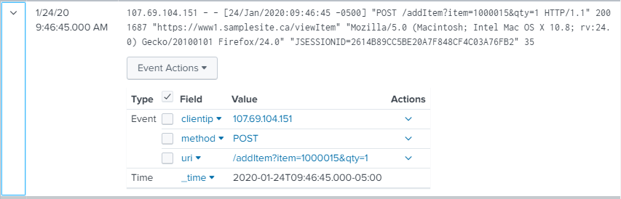
The fields command
Keeps or removes fields from search results based on the field list criteria
Fields [+/-] <fieldlist>
Notes:
XSPLK2.04.05.01.TheFieldsCommand.OneNote.Lecture

Slide 64
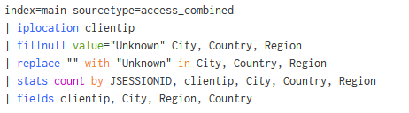
The fillnull command
Replaces null values in fields
fillnull value=“<string>” <field1> <field2> …
Notes:
XSPLK2.04.06.01.TheFillnullCommand.OneNote.Lecture

Slide 65

The transaction and stats commands
transaction – group events based on attribute
Adds a “duration” field = time between first and last events
stats – aggregates values
SUM(), AVG(), MIN(), MAX(), COUNT(), etc…
Notes:
XSPLK2.04.07.01.TheTransactionAndStatsCommands.OneNote.Lecture

Slide 66

transaction parameters
startswith, endswith – define transaction boundaries
Notes:
XSPLK2.04.08.01.TransactionParameters.OneNote.Lecture
(next slide)

Slide 67
transaction parameters
maxpause – limit pause between events for grouping
maxspan – limit transaction duration
maxevents – limit total # of events per transaction

Slide 68

The join command
Matches events between searches based on a specified field
Can be used with subsearches
Possible (probable) performance concerns
Notes:
XSPLK2.04.09.01.TheJoinCommand.OneNote.Lecture

Slide 69
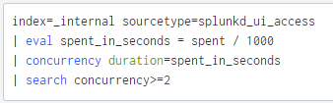
The concurrency command
Find “overlapping” events → If an event’s start time occurs within duration seconds of another event’s start time, the two events are concurrent
Generates a “concurrency” field with number of concurrent events
Notes:
XSPLK2.04.10.01.TheConcurrencyCommand.OneNote.Lecture

Slide 70

The associate command
Identify correlations between fields
Reference_Key, Reference_Value, Target_Key fields = fields being analyzed
Description field = more easily readable result
supcnt parameter = minimum number of times a given field/value combination must occur to be included in evaluation
Notes:
XSPLK2.04.11.01.TheAssociateCommand.OneNote.Lecture

Slide 71
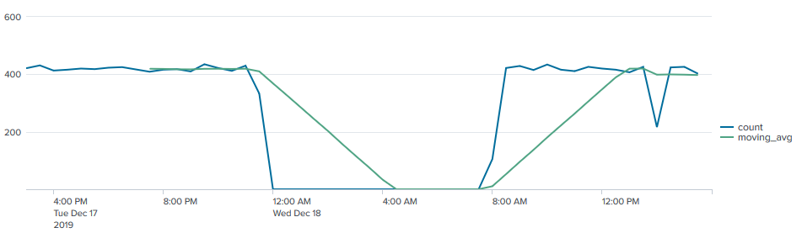

The trendline command
Generates a moving average
trendline <trendtype><lag>(field)
Trendtype:
sma = simple moving average
ema = exponential moving average
wma = weighted moving average
Notes:
XSPLK2.04.12.01.TheTrendlineCommand.OneNote.Lecture

Slide 72
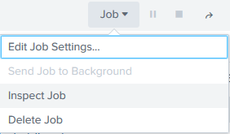
Using the Job Inspector to optimize your search
Shows execution costs & job properties
Allows identification of longest-running steps in a search
https://docs.splunk.com/Documentation/Splunk/8.0.0/Search/ViewsearchjobpropertieswiththeJobInspector
Notes:
XSPLK2.04.13.01.JobInspector.OneNote.Lecture

Slide 73
Lab 4: Advanced Search
Calculating the average session time on a website p 490
Calculating the average execution time for multi-tier web requests p 498
Displaying the maximum concurrent checkouts p 506
Analyzing the relationship of web requests p 512
Notes:
XSPLK2.04.14.00.Lab4Intro.OneNote.Lab
XSPLK2.04.14.01.CalcAvgSessionTime.Page490.Lab
XSPLK2.04.14.02.CalcAvgExecTime.Page498.Lab
XSPLK2.04.14.03.MaxCncrntCheckouts.Page506.Lab
XSPLK2.04.14.04.AnalyzeRltnshpWebReqs.Page512.Lab

Slide 74
Module 5: Analytics and Machine Learning
Notes:
XSPLK2.05.01.01.Mod5Intro.OneNote.Lecture

Slide 75
Module 5: Analytics and Machine Learning
The predict command
The fit command
The apply command
The eventstats command
The anomalies command
The anomalousvalues command
The anomalydetection command
The cluster command
Detecting outliers
Forecasting time series
Using macros

Slide 76
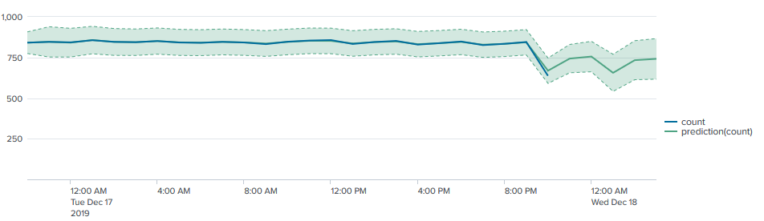

The predict command
Linear regression on timeseries
Confidence interval
Notes:
XSPLK2.05.02.01.ThePredictCommand.OneNote.Lecture

Slide 77

The fit command
From the Machine Learning Toolkit
Fits a machine learning model to search results
Linear or logistic regression
Use “into” to store model for use with apply
Notes:
XSPLK2.05.03.01.TheFitCommand.OneNote.Lecture

Slide 78

The apply command
From the Machine Learning Toolkit
Use model fitted with “fit into”
Notes:
XSPLK2.05.04.01.TheApplyCommand.OneNote.Lecture

Slide 79
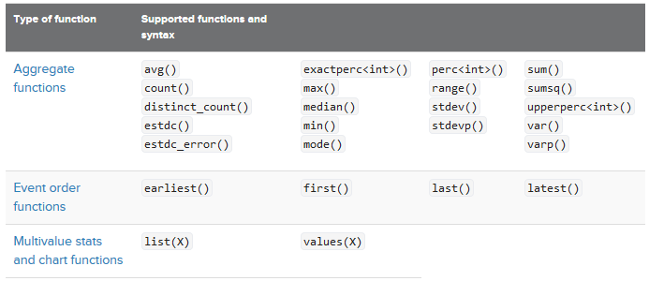
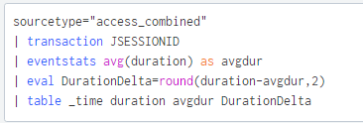
The eventstats command
Compute summary information
Notes:
XSPLK2.05.05.01.TheEventstatsCommand.OneNote.Lecture

Slide 80

The anomalies command
Assigns an “unexpectedness score” to each event
Uses a proprietary algorithm
Notes:
XSPLK2.05.06.01.TheAnomaliesCommand.OneNote.Lecture

Slide 81
The anomalousvalue command
Computes an anomaly score for each field of each event, relative to the values of this field across other events
Notes:
XSPLK2.05.07.01.TheAnomalousValueCommand.OneNote.Lecture

Slide 82

The anomalydetection command
Identifies anomalous events
Combines capabilities of anomalousvalue and outlier
https://docs.splunk.com/Documentation/Splunk/latest/SearchReference/Anomalydetection
Notes:
XSPLK2.05.08.01.TheAnomalyDetectionCommand.OneNote.Lecture

Slide 83

The cluster command
Groups events together based on how similar they are to each other
Use to identify patterns
https://docs.splunk.com/Documentation/Splunk/latest/SearchReference/Cluster
Notes:
XSPLK2.05.09.01.TheClusterCommand.OneNote.Lecture

Slide 84

Detecting outliers
Machine Learning Toolkit can detect numeric and categorical outliers
Threshold methods (numeric):
Standard deviation
Median absolute deviation
Interquartile range
Notes:
XSPLK2.05.10.01.DetectingOutliers.OneNote.Lecture

Slide 85
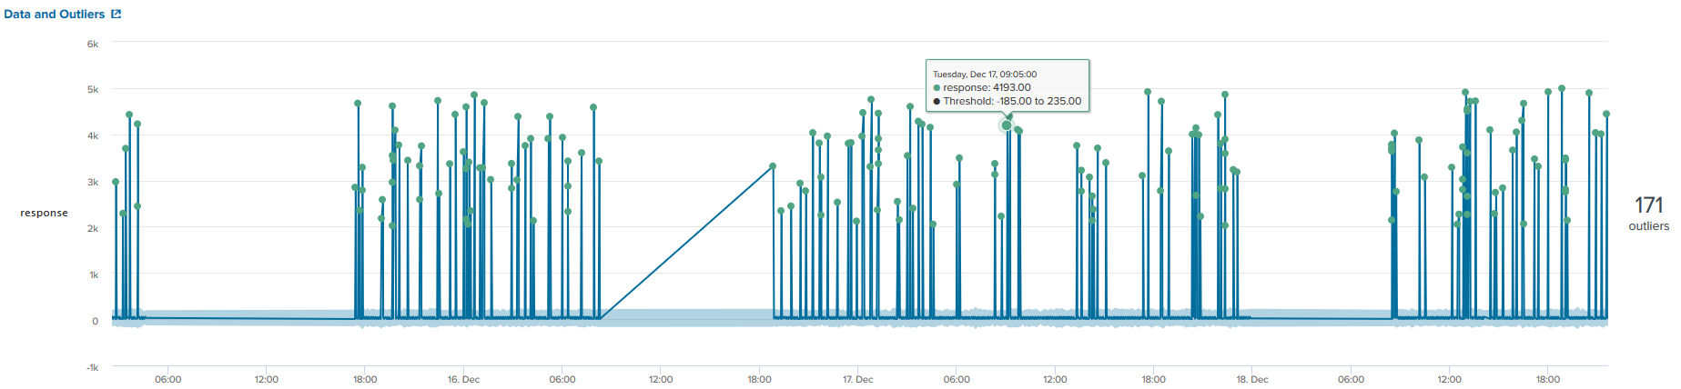
Detecting outliers
Create a search, specify method and multiplier
http://localhost:8000/en-US/app/Splunk_ML_Toolkit/showcase_outlier_detection

Slide 86
Detecting outliers, Median Absolute Deviation method
Conceptual flow:
Generate table of values to analyze
Find the median, compute absolute deviation from median for each record
Find median of all deviations (medianAbsDev)
Multiply medianAbsDev by a constant to find upper & lower bounds
Anything outside the bounds is an outlier
http://localhost:8000/en-US/app/Splunk_ML_Toolkit/showcase_outlier_detection

Slide 87
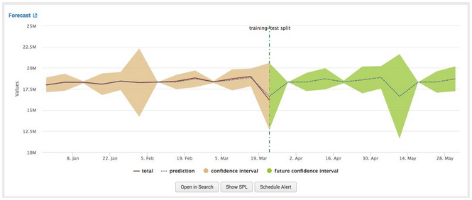
Forecasting Time Series
The Machine Learning Toolkit provide several algorithms for predictive analysis
Notes:
XSPLK2.05.11.01.ForecastingTimeSeries.OneNote.Lecture

Slide 88
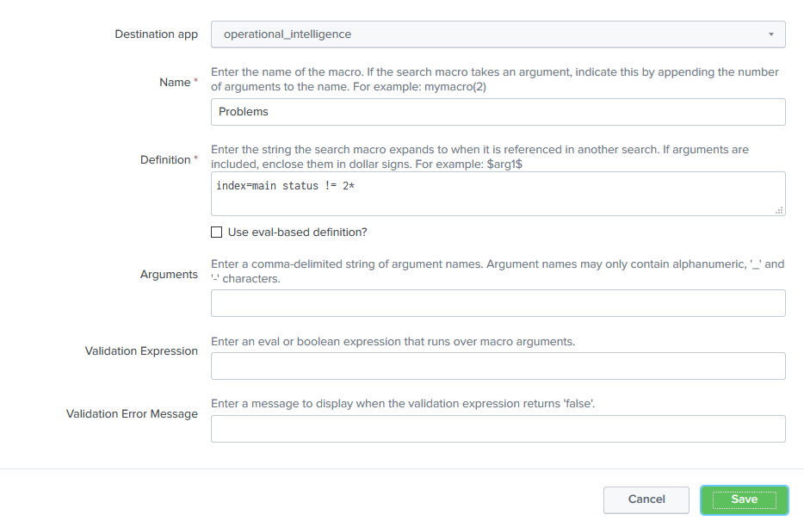
Macros
Chunk of SPL with a name
Can take parameters
Settings → Advanced Search → Search macros →+ Add New
Invoke with `<macro name>`
Notes:
XSPLK2.05.12.01.Macros.OneNote.Lecture

Slide 89
Lab 5: Analytics and Machine Learning
Predicting website-traffic volumes p 518
Finding abnormally sized web requests p 525
Identifying potential session spoofing p 532
Detecting outliers in server response times p 538
Forecasting weekly sales p 547
Notes:
XSPLK2.05.13.00.Lab5Intro.OneNote.Lab
XSPLK2.05.13.01.PredictingTraffic.Page518.Lab
XSPLK2.05.13.02.FindingAbnormalSizeReqs.Page525.Lab
XSPLK2.05.13.03.IdentifyPotentlSpoof.Page532.Lab
XSPLK2.05.13.04.DetectOutliersSrvrRspns.Page538.Lab
XSPLK2.05.13.05.ForecastWeeklySales.Page547.Lab

Slide 90
Module 6: Optimizing Search
Notes:
XSPLK2.06.01.01.Mod6Intro.OneNote.Lecture

Slide 91
Module 6: Optimizing Search
Data summarization
Summary indexing
Report acceleration

Slide 92
Data summarization
Summary indexing – creation of separate indexes containing pre-aggregated data
Report acceleration – automates creation of summarized data associated with specific reports
Data model acceleration – similar to report acceleration but for data models
Notes:
XSPLK2.06.02.01.DataSummarization.Page559.Lecture

Slide 93
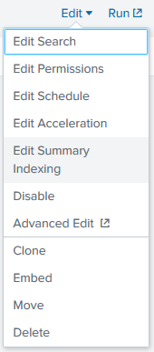
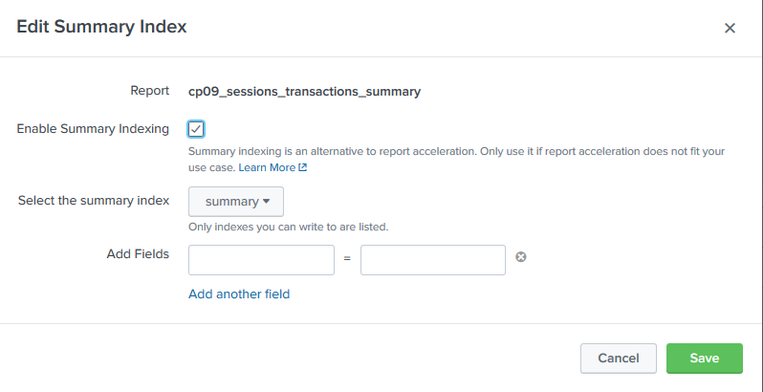
Summary indexing
Scheduled report that summarizes data
Summarized values written to a separate index
Second report generated based on summary index
Notes:
XSPLK2.06.03.01.SummaryIndexing.Page559.Lecture

Slide 94
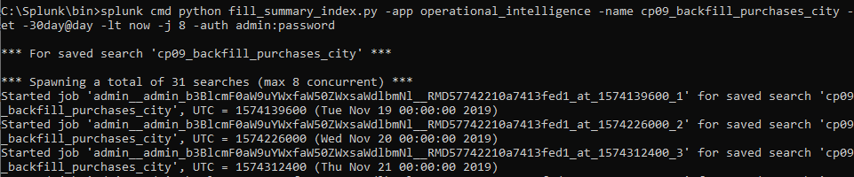
Backfilling a summary index
The fill_summary_index.py script
Included with Splunk, populates a summary index with historical data
Notes:
XSPLK2.06.04.01.BackfillingSummaryIndex.Page559.Lecture
(Next slide)

Slide 95

Backfilling with addinfo and collect
Execute search over timeframe to index
Use addinfo to add necessary information for summary indexing
Use collect to insert data from specified report into specified index

Slide 96
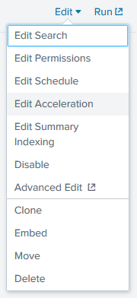
Report Acceleration
Settings→Searches, reports, and alerts→<report_to_accelerate>→Edit Acceleration
Choose time range to accelerate
Preferable to Summary Indexing
Kicking off report acceleration = clicking a checkbox and selecting a time range
Splunk automatically shares report acceleration summaries with similar searches
Automatic backfill
Report acceleration summaries are stored alongside the buckets in your indexes
Notes:
XSPLK2.06.05.01.ReportAcceleration.Page560.Lecture

Slide 97
Lab 6: Optimization
Calculating an hourly count of sessions versus completed transactions p 561
NOTE: In this lab you create an index that is populated by a scheduled job, which runs every hour. This means that no significant results will be observable at the end of the lab, as the job will not have had time to run yet.
Backfilling the number of purchases by city 571
Displaying the maximum number of concurrent sessions over time p 584
Notes:
XSPLK2.06.06.00.Lab6Intro.OneNote.Lab
XSPLK2.06.06.01.CalcHourlySessions.Page561.Lab
XSPLK2.06.06.02.BackfillNumPrchsCty.Page571.Lab
XSPLK2.06.06.03.DispMaxCncrrntSess.Page584.Lab

Slide 98
Appendix: Customization
Notes:
XSPLK2.07.01.01.AppendixIntro.OneNote.Lecture

Slide 99
Appendix: Customization
Customizing the application navigation
Custom visuals
Remotely querying Splunk’s REST API

Slide 100
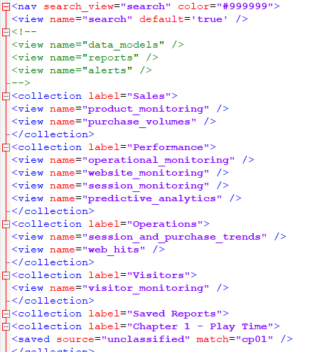
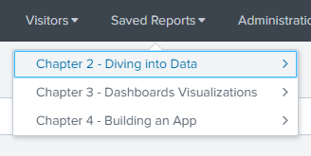
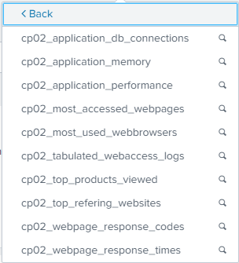
Customizing the application navigation
Create default.xml at <approot>\data\ui\nav
Hierarchy of menus
Notes:
XSPLK2.07.02.01.CustomizingAppNav.Page598.Lecture

Slide 101

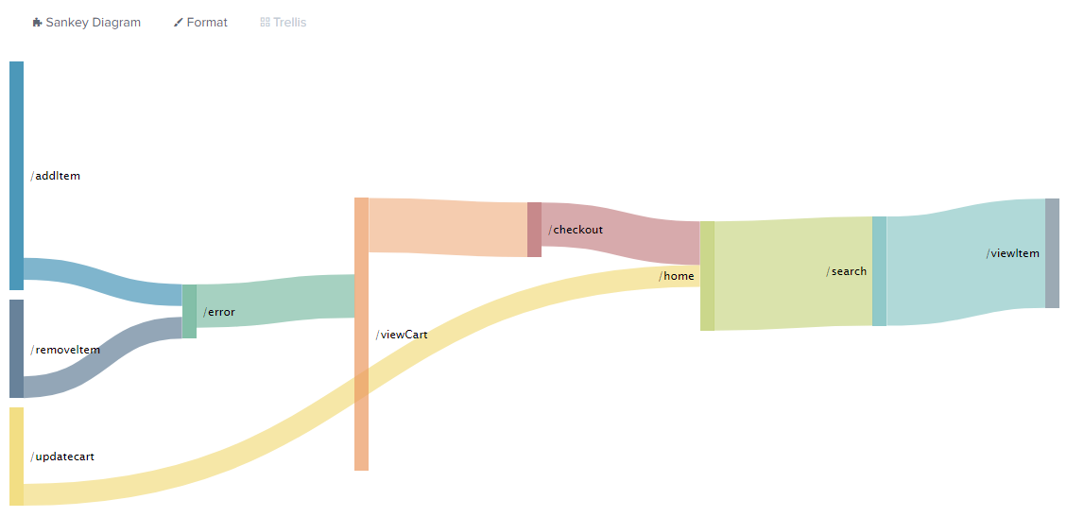
Custom visuals
Other ways of visualizing data, packaged as apps
Notes:
XSPLK2.07.03.01.CustomVisuals.Page603.Lecture

Slide 102
Remotely querying Splunk’s REST API
Standard RESTful endpoint
Exposes a large amount of Splunk functionality
Notes:
XSPLK2.07.04.01.QueryingRESTAPI.Page627.Lecture

Slide 103

Thank you!
Notes:
XSPLK1.08.01.01.ThankYou.OneNote.Lecture
This concludes Splunk Fundamentals: Level 2, from ONLC Training Centers. I hope you’ve enjoyed it. Thank you for watching!

Slide 104
Notes:
Thank you for watching.

