Slide 1

Introduction to Tableau Prep
Instructor: Dan Costello Email: danc@onlc.com
Class begins at 10 Eastern time
For Class Audio Connection:
ONLC Office Locations – Audio is connected over Jabra™ speaker
Home or Office – Call: ____ Access Code: ____ # Enter the audio pin shown in the GoToMeeting panel
If you need assistance, call 800-288-8221

Slide 2
Introduction to Tableau Prep

Slide 3
Student introductions
Your name
Company affiliation
Title/function
Tableau experience
Your expectations for the course
Notes:
Ask students to introduce themselves and provide their backgrounds, product experience, and expectations for the course.
Record student expectations on a whiteboard or flip chart that you can reference during class.

Slide 4


Housekeeping
Class hours: 10:00-16:45
A.M./P.M. Breaks: 15 min.
Lunch Break: 1 hr.
ONLC Wifi access code (if present): 0123456789
If you need anything, please let us know!
Notes:
Explain class and facility logistics, using the bulleted list. Inform students about any emergency procedures, such as emergency exits, and plans in the event of fire or other emergencies.

Slide 5

The Courseware
The Book: Prepare Your Data for Tableau
GitHub site for code files:
Supplemental notes: http://bit.ly/ONLCXTBP10

Slide 6
Classroom Setup
Windows 10
Course Files

Slide 7
Course Outline
Introduction & Tableau Prep Builder Tableau Prep Builder Tableau Prep Builder Interface Steps in Tableau Prep Builder Features of a Workflow Input and Output Connect to Microsoft Excel Data Interpreter Configuration Window Data Sampling Connect to Tableau Data Extract File Connect to Text File Other Features
Data Cleaning Profile Pane: An In-Depth Analysis Functions Tracking Changes String Calculations Group and Replace Automatic Group and Replace Functions Manual Grouping Examples Aggregation and Pivot Aggregations Aggregation Functions Group By Examples Pivot Joins and Unions Join Types of Joins Example Union Example Tableau Prep Builder Conductor Tableau Prep Builder Conductor Prerequisites Publishing Workflows to Server (Discussed) Scheduling Workflows to Server (Discussed)

Slide 8

Related Classes

Slide 9
Questions?

Slide 10
ETL

Slide 11
What is ETL?
Extract: Get the data from its current location
Transform: Modify the data to suit your analytical needs
Load: Transfer the data to the repository your analytical tool will use

Slide 12
Extract

Slide 13
Transform
“Clean” data = remove or repair erroneous entries
“Shape” data = get data in a form that’s compatible with your analytic needs
Join & denormalize
Replace codes
Unpivot

Slide 14
Load

Slide 15
About the Demo Data
ZTCA → Census
USALEEP
GEOCORR Education Data
The SplitWise Blog

Slide 16
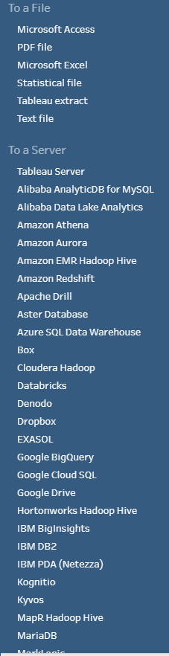
Connecting to Data

Slide 17
Server-Based Data Sources

Slide 18
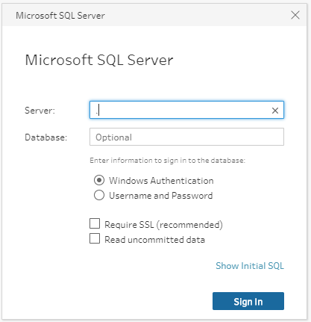
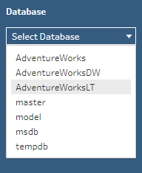

Connect to SQL Server

Slide 19
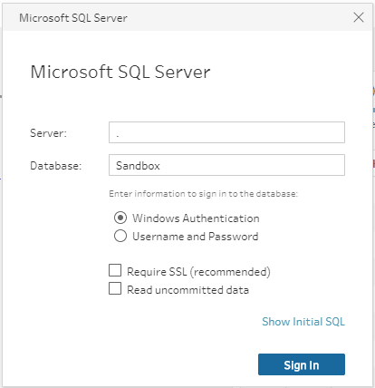
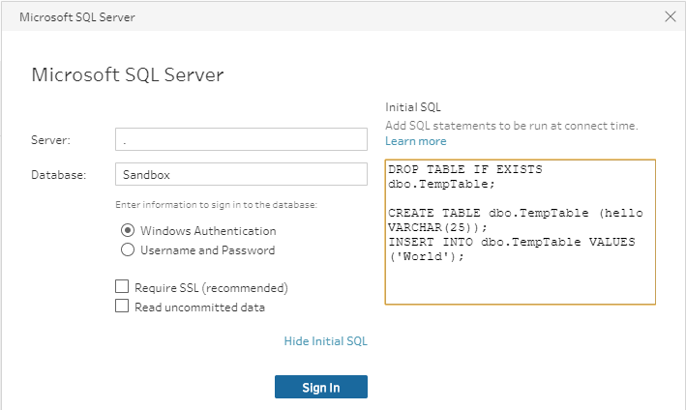
Initial SQL

Slide 20
Working with Tableau Data Extracts

Slide 21
Working with File-Based Data Sources

Slide 22
Connecting to Microsoft Access

Slide 23
Connecting to Microsoft Excel

Slide 24
Connecting to PDF Files

Slide 25
Connecting to Text Files

Slide 26
UNION Joins

Slide 27
The Data Preview Pane

Slide 28
Introduction & Tableau Prep Builder

Slide 29

Tableau Prep Builder

Slide 30
Tableau Prep Builder Interface

Slide 31
Steps in Tableau Prep Builder

Slide 32
Features of a Workflow

Slide 33
Lab 1: Getting started with Tableau Prep Builder

Slide 34
Input and Output

Slide 35
Connect to Microsoft Excel

Slide 36
Data Interpreter

Slide 37
Configuration Window

Slide 38
Data Sampling

Slide 39
Connect to Tableau Data Extract File

Slide 40
Connect to Text File

Slide 41
Other Features

Slide 43
Data Cleaning

Slide 44
Profile Pane: An In-Depth Analysis

Slide 45
Functions

Slide 46
Tracking Changes

Slide 47
String Calculations

Slide 49
Group and Replace

Slide 50
Automatic Group and Replace Functions

Slide 51
Manual Grouping

Slide 52
Examples

Slide 54
Aggregation and Pivot

Slide 55
Aggregations

Slide 56
Aggregation Functions

Slide 57
Group By

Slide 58
Examples

Slide 59
Pivot

Slide 61
Joins and Unions

Slide 62
Join

Slide 63
Types of Joins

Slide 64
Example

Slide 65
Union

Slide 66
Example

Slide 68
Tableau Prep Builder Conductor

Slide 69
Tableau Prep Builder Conductor

Slide 70
Prerequisites

Slide 71
Publishing Workflows to Server (Discussed)

Slide 72
Scheduling Workflows to Server (Discussed)

Slide 74
Thank you!
Questions?
Survey: http://www.onlc.com/eval

