Slide 1

Introduction to Tableau Prep
Instructor: Dan Costello Email: danc@onlc.com
Class begins at 10 Eastern time
For Class Audio Connection:
ONLC Office Locations – Audio is connected over Jabra™ speaker
Home or Office – Call: ____ Access Code: ____ # Enter the audio pin shown in the GoToMeeting panel
If you need assistance, call 800-288-8221

Slide 2
Introduction to Tableau Prep

Slide 3
Student introductions
Your name
Company affiliation
Title/function
Tableau experience
Your expectations for the course
Notes:
Ask students to introduce themselves and provide their backgrounds, product experience, and expectations for the course.
Record student expectations on a whiteboard or flip chart that you can reference during class.

Slide 4


Housekeeping
Class hours: 10:00-16:45
A.M./P.M. Breaks: 15 min.
Lunch Break: 1 hr.
ONLC Wifi access code (if present): 0123456789
If you need anything, please let us know!
Notes:
Explain class and facility logistics, using the bulleted list. Inform students about any emergency procedures, such as emergency exits, and plans in the event of fire or other emergencies.

Slide 5

The Courseware
The Book: Prepare Your Data for Tableau
GitHub site for code files:
Supplemental notes: http://bit.ly/ONLCXTBP10

Slide 6
Classroom Setup
Windows 10
Course Files

Slide 7
Course Outline
Introduction & Tableau Prep Builder Tableau Prep Builder Tableau Prep Builder Interface Steps in Tableau Prep Builder Features of a Workflow Input and Output Connect to Microsoft Excel Data Interpreter Configuration Window Data Sampling Connect to Tableau Data Extract File Connect to Text File Other Features
Data Cleaning Profile Pane: An In-Depth Analysis Functions Tracking Changes String Calculations Group and Replace Automatic Group and Replace Functions Manual Grouping Examples Aggregation and Pivot Aggregations Aggregation Functions Group By Examples Pivot Joins and Unions Join Types of Joins Example Union Example Tableau Prep Builder Conductor Tableau Prep Builder Conductor Prerequisites Publishing Workflows to Server (Discussed) Scheduling Workflows to Server (Discussed)

Slide 8

Related Classes

Slide 9
Questions?

Slide 10
Module 1: ETL & Demo Data

Slide 11
What is ETL?
Extract: Get the data from its current location
Transform: Modify the data to suit your analytical needs
Load: Transfer the data to the repository your analytical tool will use

Slide 12
Extract
Connect to data at its source
RDBMS systems, files, web services, etc.
Combine data from multiple sources

Slide 13
Transform
“Clean” data = remove or repair erroneous entries
“Shape” data = get data in a form that’s compatible with your analytic needs
Join & denormalize
Replace codes
Unpivot

Slide 14
Load
Push cleaned & shaped data into destination

Slide 15
About the Demo Data
ZTCA → Census
USALEEP
GEOCORR Education Data
The SplitWise Blog

Slide 16
Abbreviation | Definition
state | State code
county | County code
cousubfp | County subdivision code
placefp | Place code
zcta5 | ZIP census tabulation area
metdiv10 | metdiv10
sduni | Unified school district (2010)
cntysc | cntysc
placesc | placesc
stab | State abbreviation
cntyname | County name
cousubnm | County subdivision name
placenm | Place name
mdivname10 | 2010 Metro div name
zipname | ZCTA name
uschlnm10 | Unified school district name 2010
pop10 | Total population (2010)
afact | placesc to state allocation factor

Slide 17
Part I: Extract

Slide 18
Module 2: Connecting to Data

Slide 19
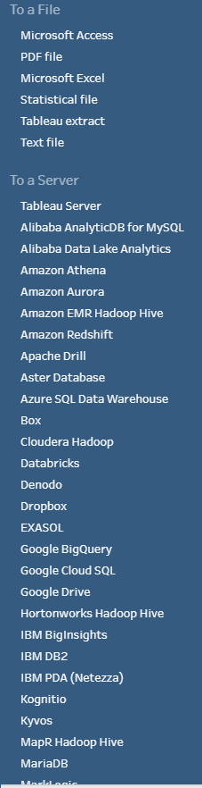
Connecting to Data
Dozens of file- & server-based data sources
ODBC & JDBC connections

Slide 20
Server-Based Data Sources
Most major RDBMS systems supported
SQL Server, Oracle, MySQL, DB2, MongoDB, etc.
General pattern similar for all
Specify server name/address
Possibly specify DB name
Authenticate (username & password)

Slide 21
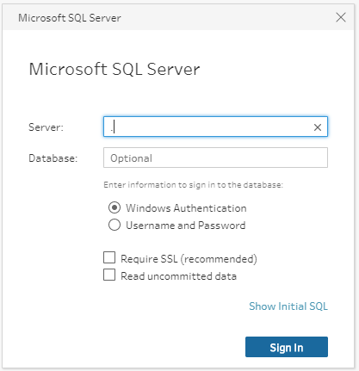
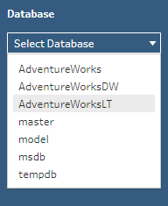

Connect to SQL Server

Slide 22
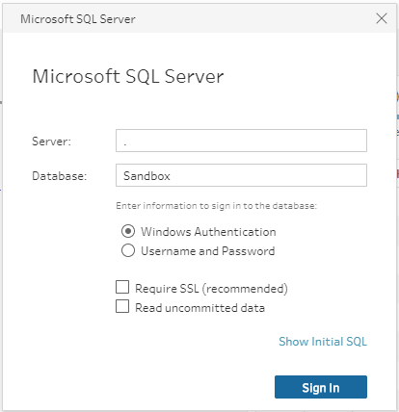
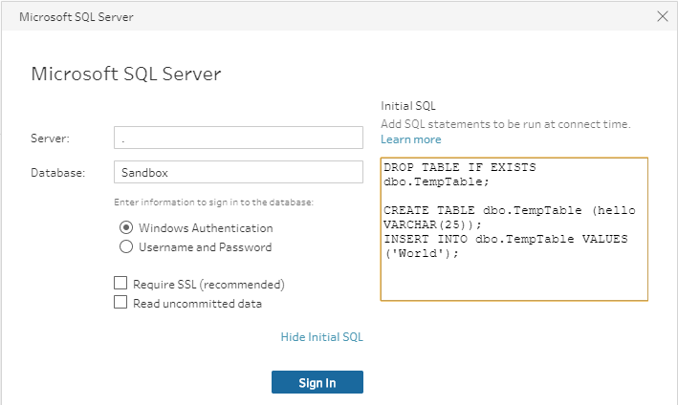
Initial SQL

Slide 23
Working with Tableau Data Extracts

Slide 24
Working with File-Based Data Sources

Slide 25
Connecting to Microsoft Access

Slide 26
Connecting to Microsoft Excel

Slide 27
Connecting to PDF Files

Slide 28
Connecting to Text Files

Slide 29
Lab 2: Connecting to Data

Slide 30
Module 3: UNION Joins

Slide 31
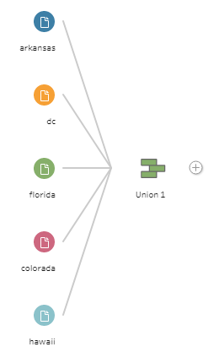
UNION Joins

Slide 32
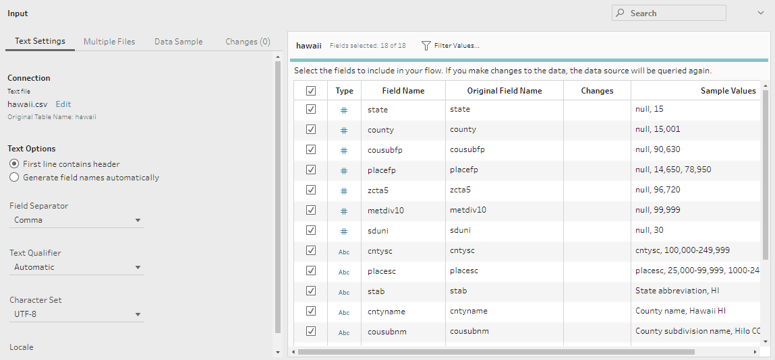
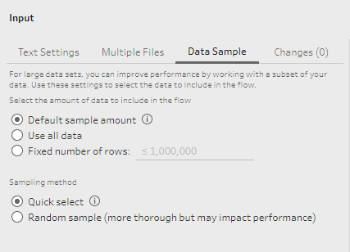
The Data Preview Pane

Slide 33
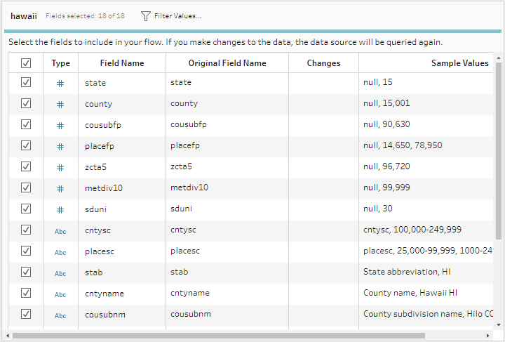
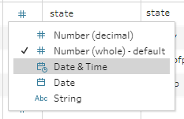
Data Types

Slide 34



Changes

Slide 35
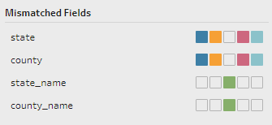

Reviewing the Union Step

Slide 36
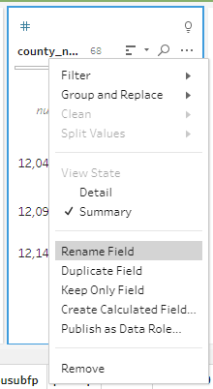
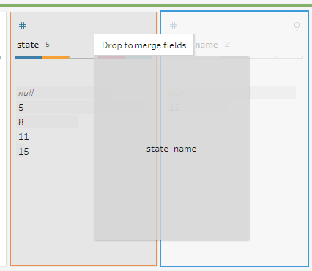
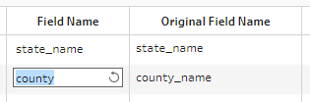
Aligning Fields

Slide 37
Wildcard Union Joins

Slide 38
Which Is Better?

Slide 39
Lab 3: UNION Joins
Exercise 4.1: UNION Join, pp. 27-32
Exercise 4.2: Wildcard UNION, pp. 41-44
Exercise 4.3: Refine a Wildcard UNION, pp. 47-48

Slide 40
Module 4: Joins

Slide 41
What is a Table?

Slide 42
Equijoins

Slide 43
Join Types

Slide 44
Inner Joins

Slide 45
Left Joins

Slide 46
Right Joins

Slide 47
Outer Joins

Slide 48
The Shape of Your Data

Slide 49
Missing Data

Slide 50
Finding Missing Records

Slide 51
Bringing It All Together

Slide 52
Join Clause Recommendations

Slide 53
Part II: Transform

Slide 54
Module 5: Auditing & Cleaning Your Data

Slide 55
Auditing Your Data

Slide 56
Cleaning Your Data

Slide 57
Merge and Clean

Slide 58
Making Data More Consistent

Slide 59
Splitting Fields

Slide 60
Recommendations

Slide 61
Handling NULL Values

Slide 62
Filtering Records

Slide 63
Module 6: Group and Replace

Slide 64
Group and Replace

Slide 65
Manual Selection

Slide 66
Grouping by Pronunciation

Slide 67
Grouping by Common Characters

Slide 68
Grouping by Spelling

Slide 69
Module 7: Aggregating and Pivoting Data

Slide 70
Aggregating Data

Slide 71
Pivoting Data

Slide 72
Unpivoting Data

Slide 73
Part III: Load

Slide 74
Module 8: Output

Slide 75
Outputting to files

Slide 76
Outputting to other destinations

Slide 77
Module 9: Prep Builder Conductor and Publishing Workflows to Tableau Server

Slide 78
Tableau Prep Builder Conductor

Slide 79
Publishing Workflows to Server (Discussed)

Slide 80
Scheduling Workflows to Server (Discussed)

Slide 81
Appendix: Preparing Data In Tableau

Slide 82
Thank you!
Questions?
Survey: http://www.onlc.com/eval

