Slide 1

Introduction to Tableau Prep
Instructor: Dan Costello Email: danc@onlc.com
Class begins at 10 Eastern time
For Class Audio Connection:
ONLC Office Locations – Audio is connected over Jabra™ speaker
Home or Office – Call: 571-317-3129 Access Code: 947 253 813 # Enter the audio pin shown in the GoToMeeting panel
If you need assistance, call 800-288-8221

Slide 2
Introduction to Tableau Prep

Slide 3
Student introductions
Your name
Company affiliation
Title/function
Tableau/BI experience
Your expectations for the course
Notes:
Ask students to introduce themselves and provide their backgrounds, product experience, and expectations for the course.
Record student expectations on a whiteboard or flip chart that you can reference during class.

Slide 4


Housekeeping
Class hours: 10:00-16:45
A.M./P.M. Breaks: 15 min.
Lunch Break: 1 hr.
ONLC Wifi access code (if present): 0123456789
If you need anything, please let us know!
Notes:
Explain class and facility logistics, using the bulleted list. Inform students about any emergency procedures, such as emergency exits, and plans in the event of fire or other emergencies.

Slide 5
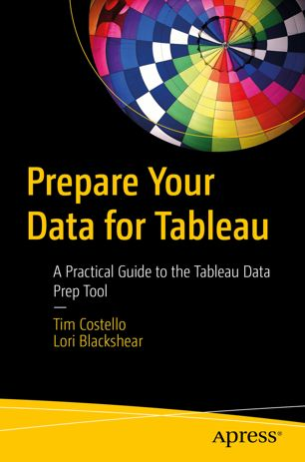
The Courseware
The Book: Prepare Your Data for Tableau
Supplemental notes: http://bit.ly/ONLCXTBP10

Slide 6
Classroom Setup
Windows 10
Prep Builder and Tableau Desktop trial editions
Course Files at C:\XTBP10ClassFiles
SQL Server
Username: Student, Password: Pa55w.rd

Slide 7
Course Outline
Module 1: ETL & Demo Data
What is ETL
About the Demo Data
A Brief Tour of Tableau Prep Builder
Running a flow from the command line
Part I: Extract
Module 2: Connecting to Data
Connecting to Data
Connect to SQL Server
Working with Tableau Data Extracts
Working with File-Based Data Sources
Connecting to Microsoft Access
Connecting to Microsoft Excel
Connecting to PDF Files
Connecting to Text Files
Lab 2: Connecting to Data
Module 3: UNION Joins
UNION Joins
Aligning Fields
Wildcard Union Joins
Lab 3: UNION Joins
Module 4: Joins
What is a Table?
Keys
Equijoins
Inner Joins
Left Joins
Right Joins
Outer Joins
The Shape of Your Data
Finding Missing Records
Lab 4: Joins
Part II: Transform
Module 5: Auditing & Cleaning Your Data
Auditing Your Data
Merge and Clean
Calculated Fields
Splitting Fields
Handling NULL Values
Filtering Records
Lab 5: Auditing and Filtering
Module 6: Group and Replace
Group and Replace
Grouping by Pronunciation
Grouping by Common Characters
Grouping by Spelling
Lab 6: Group and Replace
Module 7: Aggregating and Pivoting Data
Aggregating Data
Pivoting/Unpivoting Data
Lab 7: Aggregating & Pivoting
Part III: Load
Module 8: Output
Outputting to files
Lab 8: Output
Module 9: Prep Builder Conductor and Publishing Workflows to Tableau Server
Tableau Prep Conductor
Publishing Workflows to Server (Discussed)
Scheduling Workflows on the Server (Discussed)

Slide 8
Related Classes
Tableau Desktop Level 1: Introduction
Tableau Desktop Level 2: Intermediate
Tableau Desktop Level 3: Advanced
Tableau Data Visualizations

Slide 9
Questions?

Slide 10
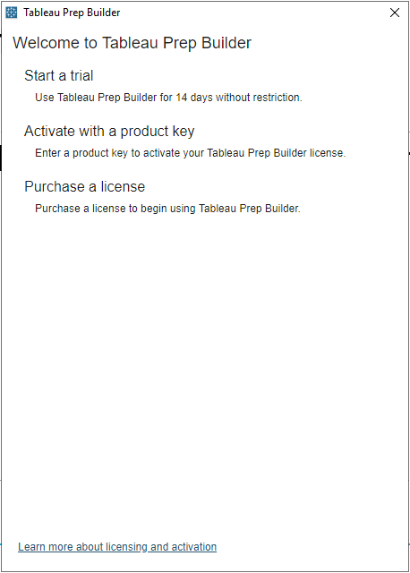
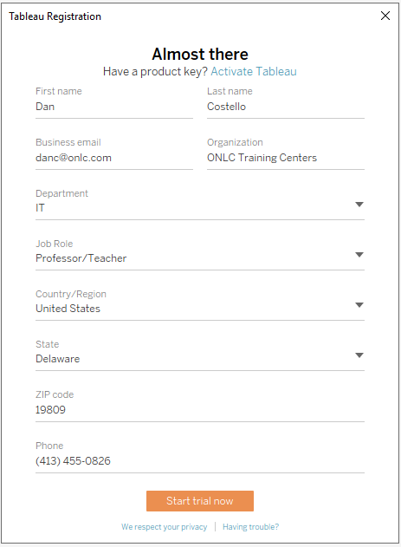
Initial Setup
Enter info for trial edition of Tableau Prep Builder

Slide 11
Module 1: ETL & Demo Data

Slide 12
What is ETL?
Extract: Get the data from its current location
Transform: Modify the data to suit your analytical needs
Load: Transfer the data to the repository your analytical tool will use

Slide 13
Extract
Connect to data at its source
RDBMS systems, files, web services, etc.
Combine data from multiple sources

Slide 14
Transform
“Clean” data = remove or repair erroneous entries
“Shape” data = get data in a form that’s compatible with your analytic needs
Join & denormalize
Replace codes
Unpivot

Slide 15
Load
Push cleaned & shaped data into destination

Slide 16
About the Demo Data
ZCTA → Census
USALEEP
GEOCORR Education Data
The SplitWise Blog

Slide 17
GEOCORR Education Data
State-by-state csv files
School district data
Abbreviation | Definition
state | State code
county | County code
cousubfp | County subdivision code
placefp | Place code
zcta5 | ZIP census tabulation area
metdiv10 | metdiv10
sduni | Unified school district (2010)
cntysc | cntysc
placesc | placesc
stab | State abbreviation
cntyname | County name
cousubnm | County subdivision name
placenm | Place name
mdivname10 | 2010 Metro div name
zipname | ZCTA name
uschlnm10 | Unified school district name 2010
pop10 | Total population (2010)
afact | placesc to state allocation factor

Slide 18
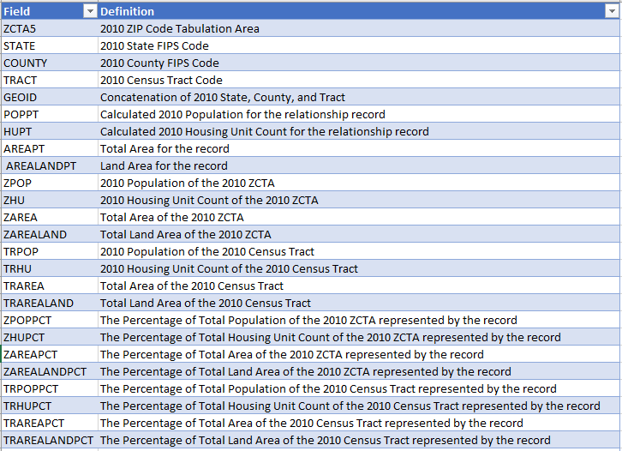
ZCTA → Census
Zcta_tract_rel_10
Population data from the 2010 census

Slide 19
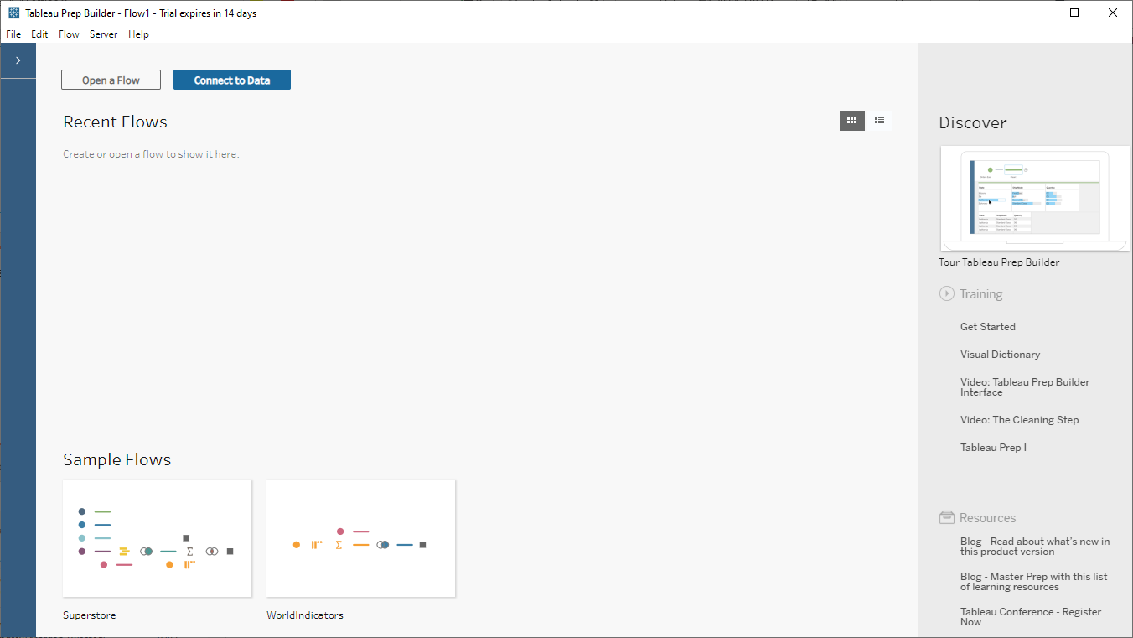
A Brief Tour of Tableau Prep Builder

Slide 20
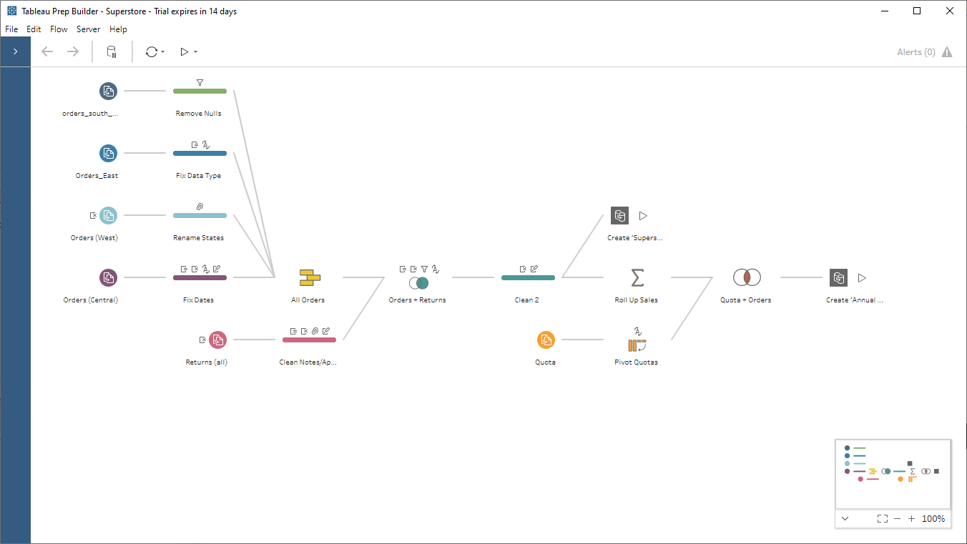
Workflows (or just “flows”)
“Steps” with connectors that represent the flow of data

Slide 21
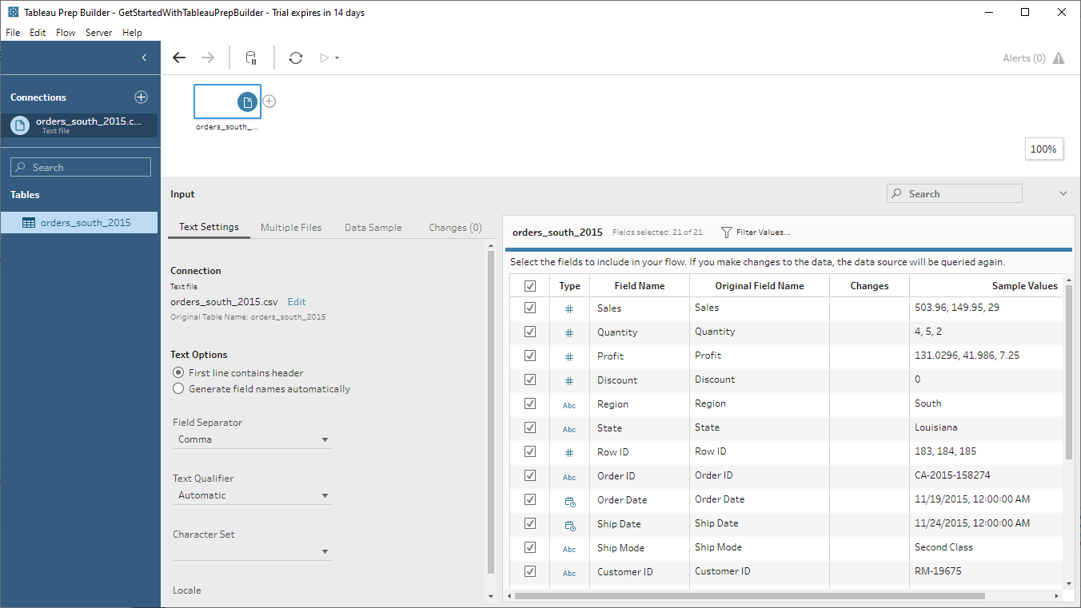
Adding a data source step
Flow Pane
Input Pane

Slide 22
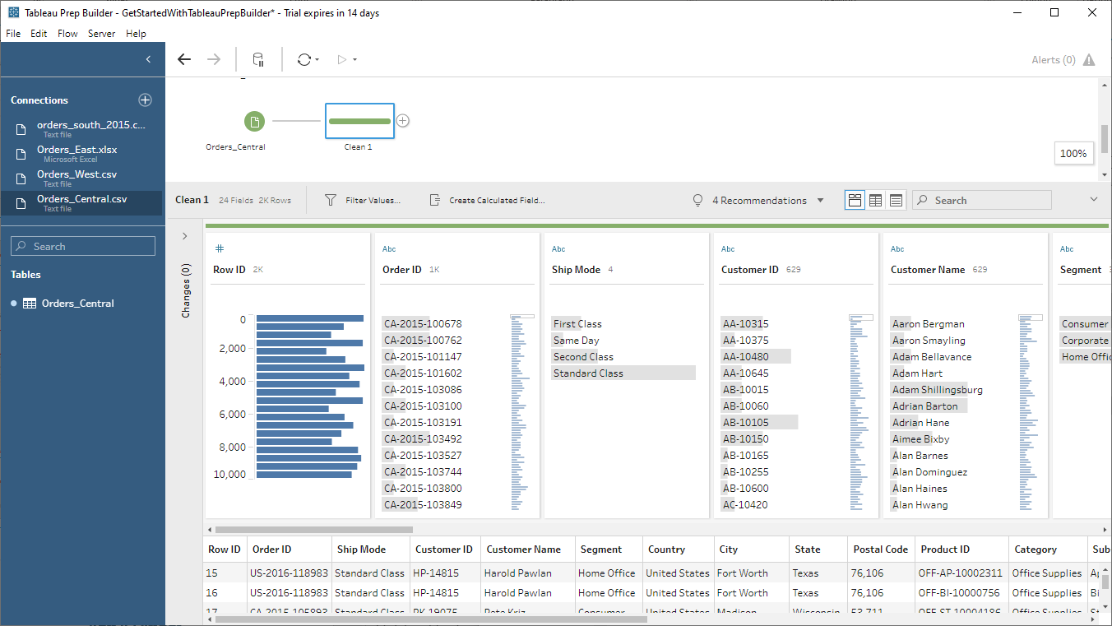
Adding a cleaning step
Flow Pane
Toolbar
Profile Pane
Data grid

Slide 23
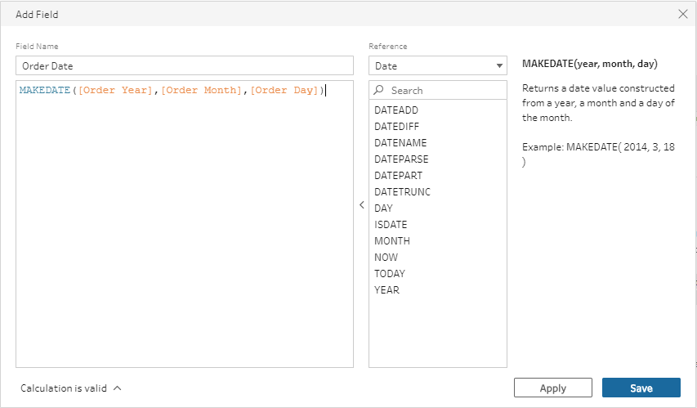
Create calculated fields
Same expression language as Tableau Desktop
Dozens of functions available

Slide 24
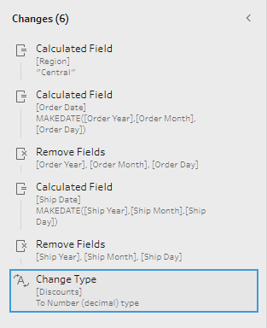
Track Changes
Prep Builder remembers the changes you’ve made
Reorganize/edit at will

Slide 25
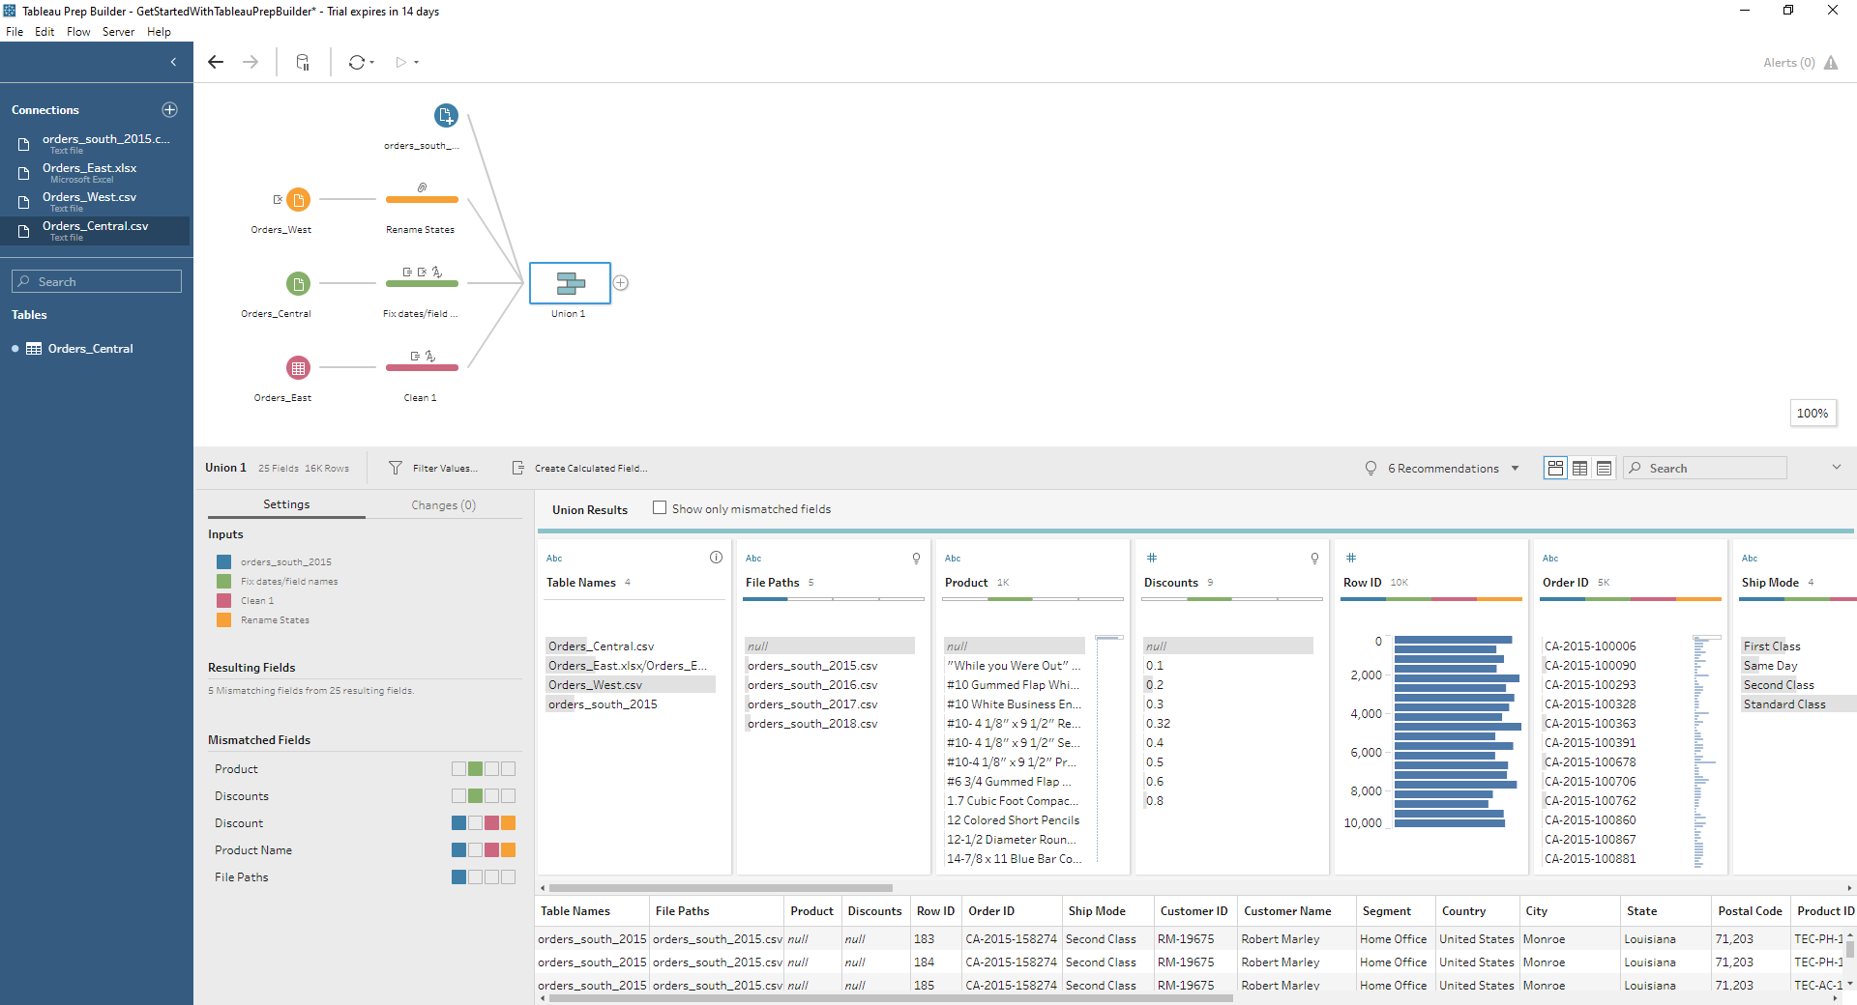
Add a union step

Slide 26
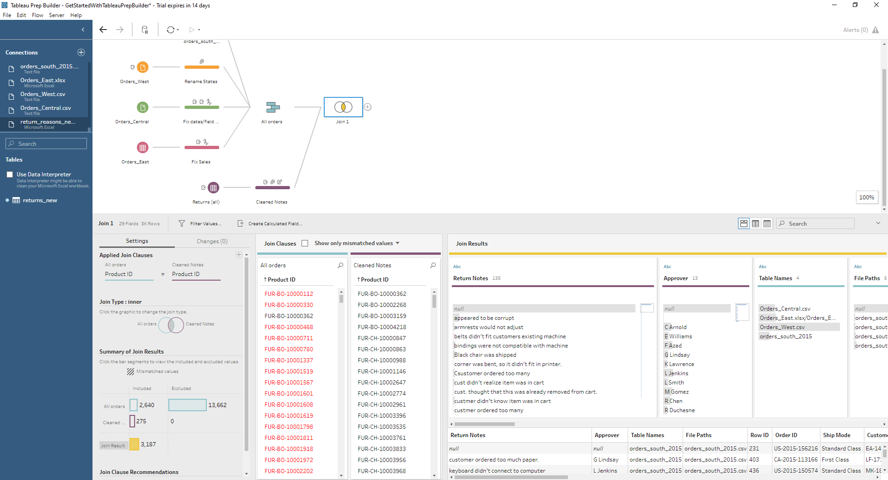
Join data

Slide 27
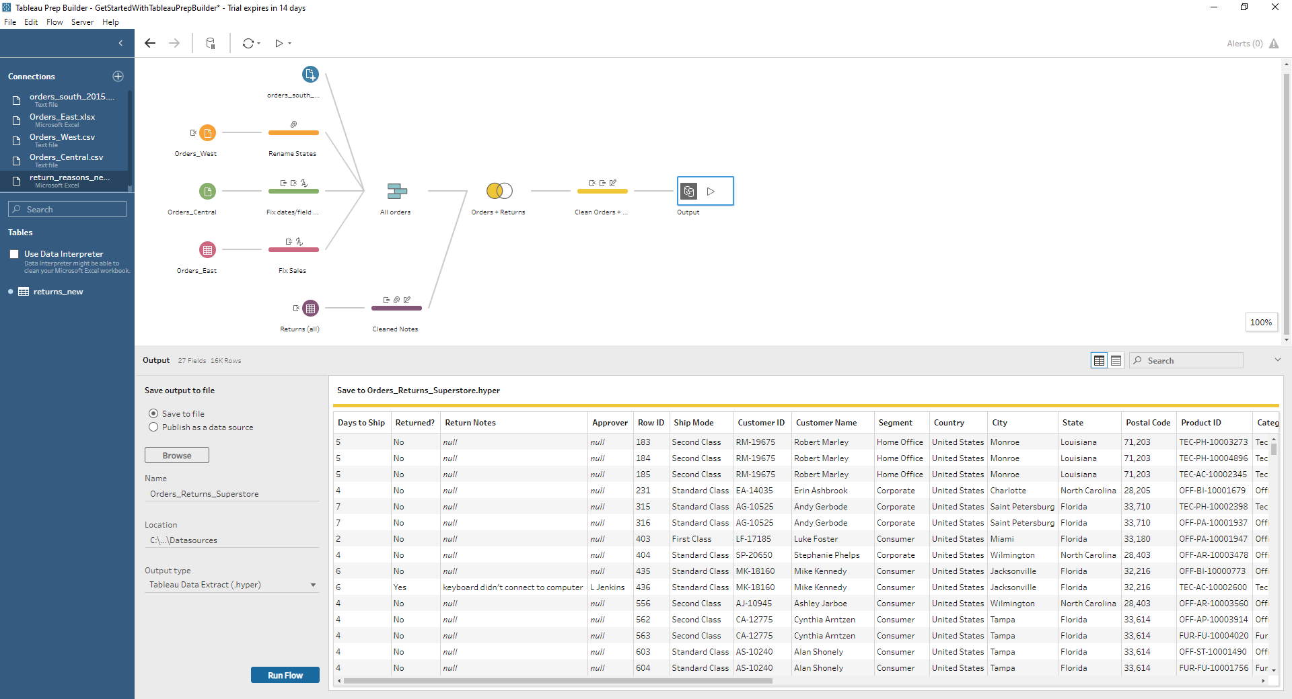
Output to a file

Slide 28


Running the flow
From the output step
For the whole file

Slide 29
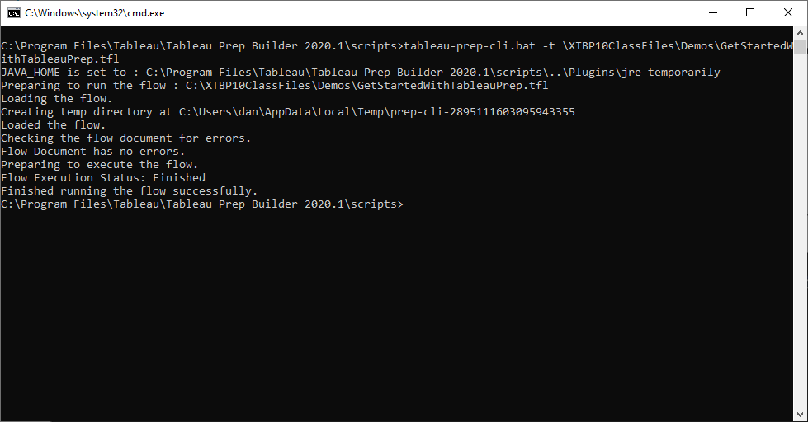
Running a flow from the command line

Slide 30

Part I: Extract
A.M. Break:
11:25-11:40 EST
Questions? Comments?
Dan’s e-mail: danc@onlc.com
Dan’s cell #: (413) 455-0856

Slide 31
Part I: Extract

Slide 32
Module 2: Connecting to Data

Slide 33
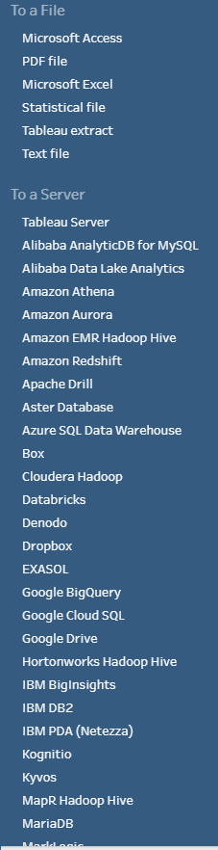
Connecting to Data
Dozens of file- & server-based data sources
ODBC & JDBC connections

Slide 34
Server-Based Data Sources
Most major RDBMS systems supported
SQL Server, Oracle, MySQL, DB2, MongoDB, etc.
General pattern similar for all
Specify server name/address
Possibly specify DB name
Authenticate (username & password)

Slide 35
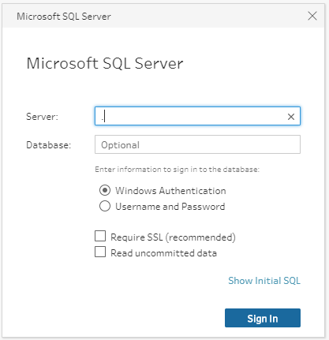
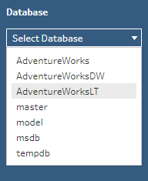

Connect to SQL Server
Server name and optional DB name
Authentication
Optional initial SQL

Slide 36
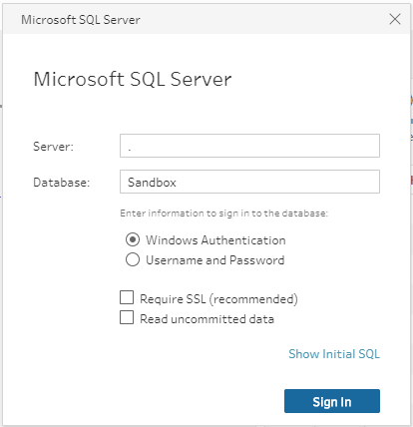
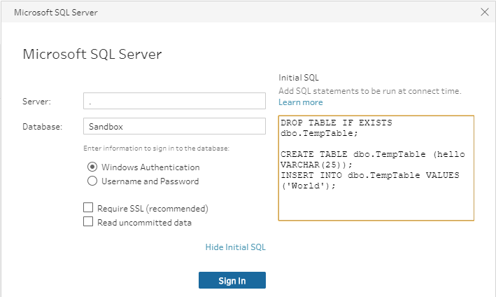
Initial SQL
Query to run upon connecting
Create/drop objects
Generate/update data

Slide 37
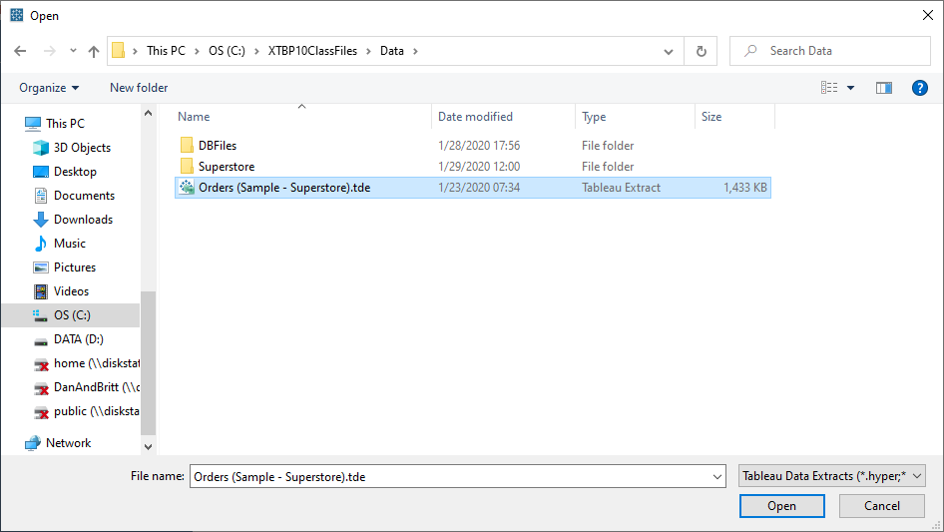
Working with Tableau Data Extracts
Simple way of loading .tde and .hyper files
Transform & export

Slide 38
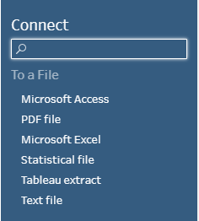
Working with File-Based Data Sources
Access, PDF, Excel, .tde, .hyper, csv, tsv, etc.
Single files or entire directories (wildcard union)

Slide 39
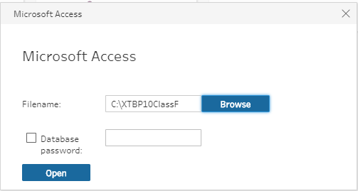
Connecting to Microsoft Access
Connect to file
Select tables/views

Slide 40
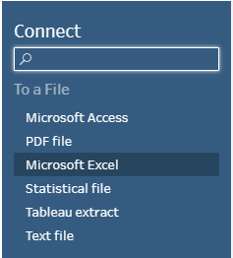
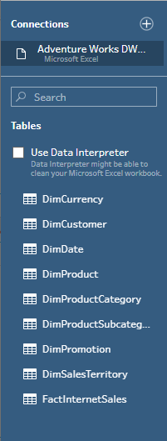
Connecting to Microsoft Excel
Like a database… but not a database
Worksheets & named ranges show as tables
Generally requires cleanup, e.g. fixing data types, removing columns, etc.

Slide 41
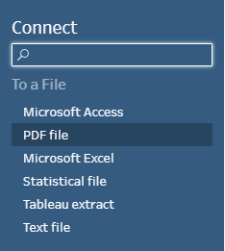
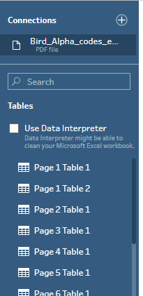
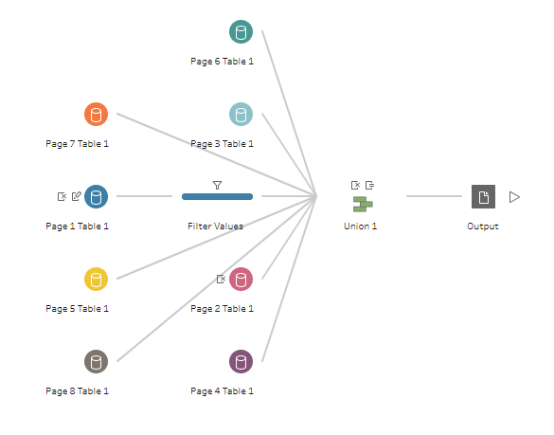
Connecting to PDF Files
Prep finds tables & text in PDFs
Almost always requires cleanup

Slide 42
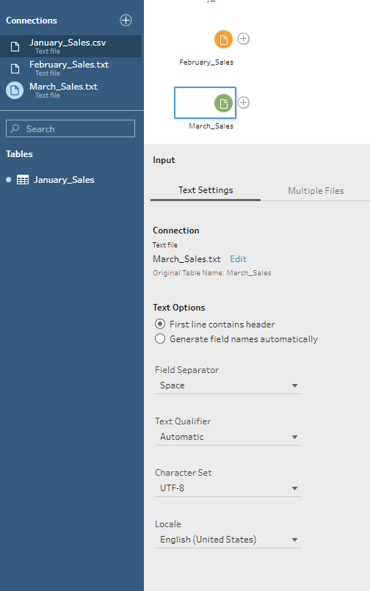
Connecting to Text Files
CSV, TSV, Fixed-width, etc.
Currently no support for JSON or XML
Need a converter, e.g. CSVJSON, CONVERTCSV
Automatically detects encoding, delimiters, etc.
Single or multiple files

Slide 43
Lab 2: Connecting to Data
Lab: 12:45-13:05
Lunch: 13:05-14:05
Experiment with connecting to data
Data files in: C:\XTBP10Classfiles\Data
SQL Server: pp. 14-18 (Use a period (.), i.e., the local machine, for the server name)
Tableau Data Extracts: p. 19
Skip Access, pp. 20-21
Excel: pp. 22-23
PDF Files: p. 24
Text files: pp. 24-25
Questions? Comments?
Dan’s e-mail: danc@onlc.com
Dan’s cell #: (413) 455-0856
20 minutes

Slide 44
Module 3: UNION Joins

Slide 45
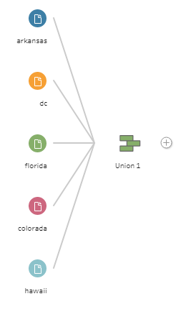
UNION Joins
Combine multiple tables with like sets of rows into a single table
Month | Product | Sales
January | Apples | 3
January | Bananas | 2
January | Grapes | 4
Month | Product | Sales
January | Apples | 3
January | Bananas | 2
January | Grapes | 4
February | Apples | 2
February | Bananas | 4
February | Grapes | 3
Month | Product | Sales
February | Apples | 2
February | Bananas | 4
February | Grapes | 3

Slide 46
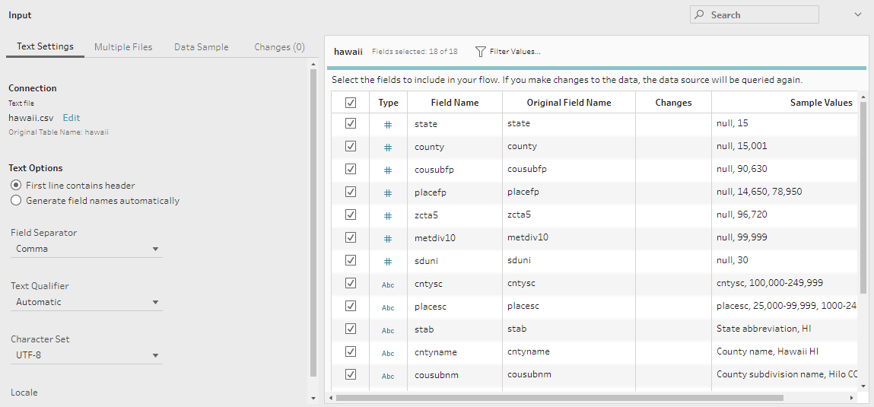
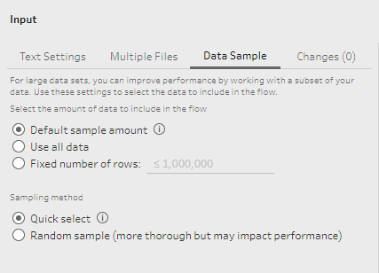
The Data Preview Pane
Provides data source details & an overview of data & structure

Slide 47
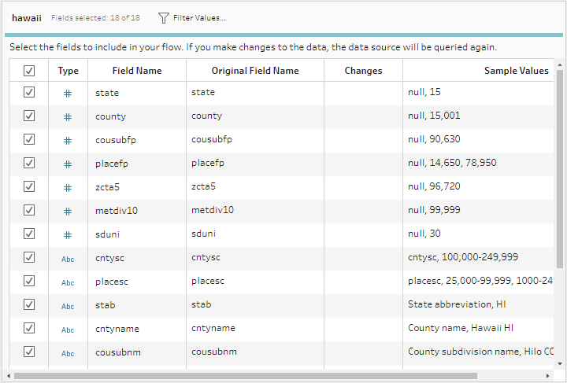
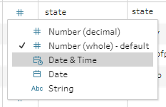
Data Types
Data types are important!
May be wrong for certain data sources, e.g. text files
Can be adjusted in the preview pane, cleaning steps, join steps, etc.

Slide 48
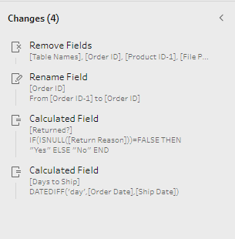



Changes
Prep Builder keeps track of your changes
A record of the transformations that will be performed when the flow is executed
Visible for individual fields and entire steps
Can be reordered, edited, and deleted

Slide 49
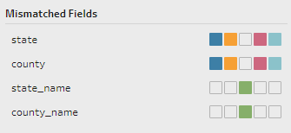

Reviewing the Union Step
Union depends on like field names, similar data types
If two tables don’t align, the union step shows that you have mismatched fields

Slide 50
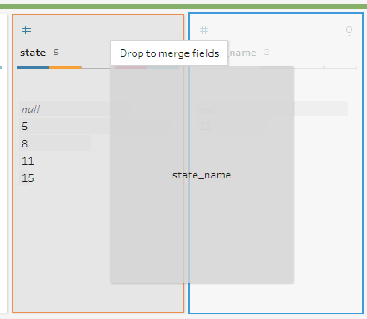
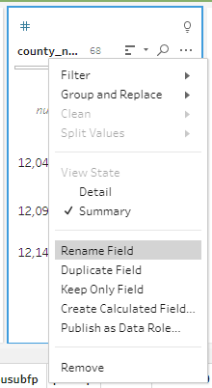
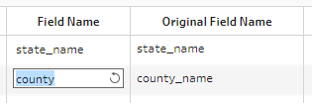
Aligning Fields
Multiple strategies:
Rename fields in the data sources
Rename fields in a subsequent step (including the union step itself)
Drag & drop to merge fields in the union step
Use “mismatched fields” feature

Slide 51
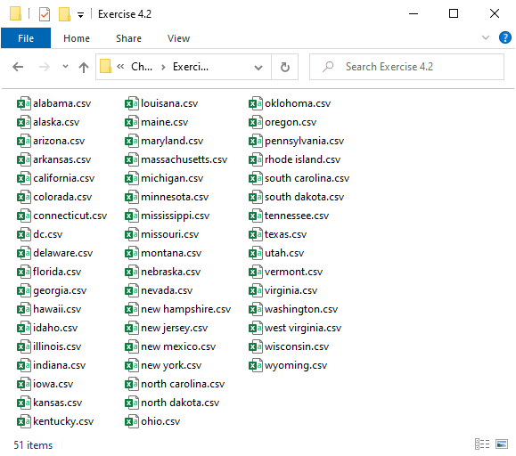
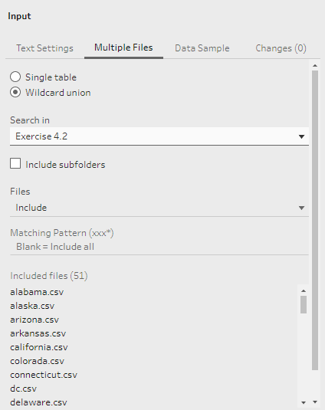
Wildcard Union Joins
Folder containing multiple files with same (or similar) schema
Select based on a pattern

Slide 52
Which Is Better?
One-off or ongoing?
Automated systems → Identical files = Wildcard
Ad hoc/manual data entry, disparate sources = judgement call
Wildcard may require so much tuning that it’s more work than manual

Slide 53
Lab 3: UNION Joins
Lab: 14:45-15:15
P.M. Break: 15:15-15:30
Exercise 4.1: UNION Join, pp. 27-32
Exercise 4.2: Wildcard UNION, pp. 41-44
Exercise 4.3: Refine a Wildcard UNION, pp. 47-48
Questions? Comments?
Dan’s e-mail: danc@onlc.com
Dan’s cell #: (413) 455-0856
30 Minutes

Slide 54
Module 4: Joins

Slide 55
What is a Table?
Month | Product | Sales
January | Apples | 3
January | Bananas | 2
January | Grapes | 4
February | Apples | 2
February | Bananas | 4
February | Grapes | 3
Data structured in rows & columns
Columns have: names, data types
Define the schema of the table, do not (usually) change
Rows are records, i.e., collections of related data
A table usually corresponds to a specific entity, e.g., customer, product, process, location, etc.

Slide 56
Keys
ProductKey | ProductAlternateKey | EnglishProductName | StandardCost | Color | ListPrice
310 | BK-R93R-62 | Road-150 Red, 62 | 2171.2942 | Red | 3578.27
311 | BK-R93R-44 | Road-150 Red, 44 | 2171.2942 | Red | 3578.27
312 | BK-R93R-48 | Road-150 Red, 48 | 2171.2942 | Red | 3578.27
313 | BK-R93R-52 | Road-150 Red, 52 | 2171.2942 | Red | 3578.27
314 | BK-R93R-56 | Road-150 Red, 56 | 2171.2942 | Red | 3578.27
315 | BK-R68R-58 | Road-450 Red, 58 | 884.7083 | Red | 1457.99
Primary keys: Values that uniquely identify rows in a table
Foreign keys: Values that reference a primary key (e.g. a “lookup” column)
Usually, though not necessarily, numeric
ProductKey | SalesAmount | TaxAmt | Freight
310 | 3578.27 | 286.2616 | 89.4568
311 | 3578.27 | 286.2616 | 89.4568
310 | 3578.27 | 286.2616 | 89.4568
312 | 3578.27 | 286.2616 | 89.4568
312 | 3578.27 | 286.2616 | 89.4568
313 | 3578.27 | 286.2616 | 89.4568
314 | 3578.27 | 286.2616 | 89.4568
314 | 3578.27 | 286.2616 | 89.4568
311 | 3578.27 | 286.2616 | 89.4568

Slide 57
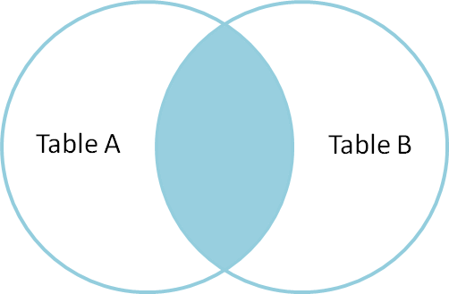
Equijoins
ProductKey | ProductAlternateKey | EnglishProductName | StandardCost | Color | ListPrice
310 | BK-R93R-62 | Road-150 Red, 62 | 2171.2942 | Red | 3578.27
311 | BK-R93R-44 | Road-150 Red, 44 | 2171.2942 | Red | 3578.27
312 | BK-R93R-48 | Road-150 Red, 48 | 2171.2942 | Red | 3578.27
313 | BK-R93R-52 | Road-150 Red, 52 | 2171.2942 | Red | 3578.27
314 | BK-R93R-56 | Road-150 Red, 56 | 2171.2942 | Red | 3578.27
315 | BK-R68R-58 | Road-450 Red, 58 | 884.7083 | Red | 1457.99
Most common
Keep only records with keys that match in both tables
ProductKey | SalesAmount | TaxAmt | Freight
310 | 3578.27 | 286.2616 | 89.4568
311 | 3578.27 | 286.2616 | 89.4568
310 | 3578.27 | 286.2616 | 89.4568
312 | 3578.27 | 286.2616 | 89.4568
312 | 3578.27 | 286.2616 | 89.4568
313 | 3578.27 | 286.2616 | 89.4568
314 | 3578.27 | 286.2616 | 89.4568
314 | 3578.27 | 286.2616 | 89.4568
311 | 3578.27 | 286.2616 | 89.4568

Slide 58
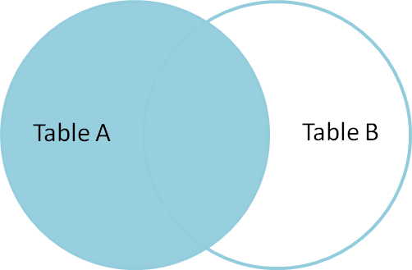
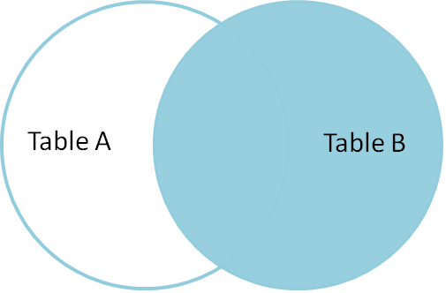
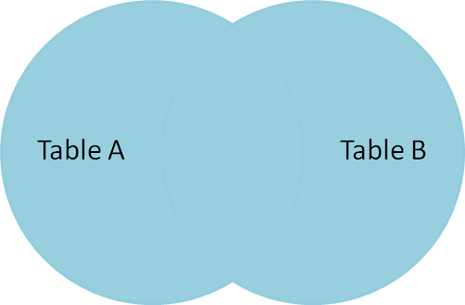
Join Types
Inner
Left
Right
Outer

Slide 59
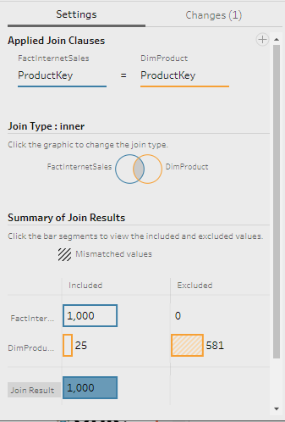
Inner Joins
Only keep rows that match in both tables
Unrelated records on both sides will be excluded
E.g., “All products for which there were sales, and the corresponding sales information.”

Slide 60
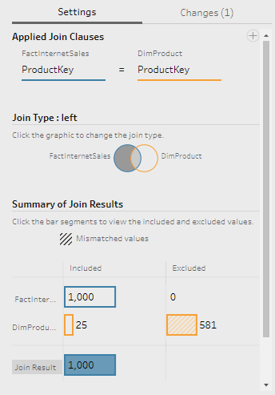
Left Joins
Keep all rows from the “left” table and any rows that match from the “right”
Everything from the left is included, unrelated records from the right are excluded
E.g., “All products regardless of whether they were sold or not, and any corresponding sales information.”

Slide 61
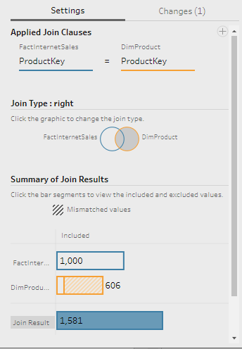
Right Joins
Keep all rows from the “right” table and any rows that match from the “left”
Everything from the right is included, unrelated records from the left are excluded
E.g., “All sales regardless of whether or not there is corresponding product information, and any product information that exists.”

Slide 62
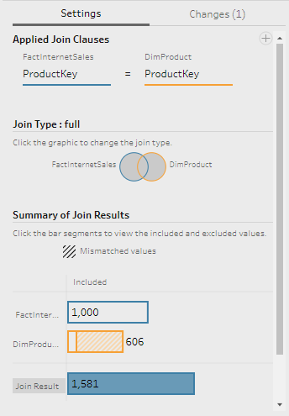
Outer Joins
Keep all rows from both side of the join, matching where matches exist but still retaining all rows, matched or not
E.g., “All products regardless of whether they were sold or not, any corresponding sales information, and any sales information not associated with any products.”

Slide 63
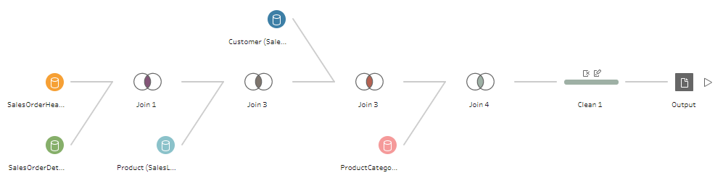
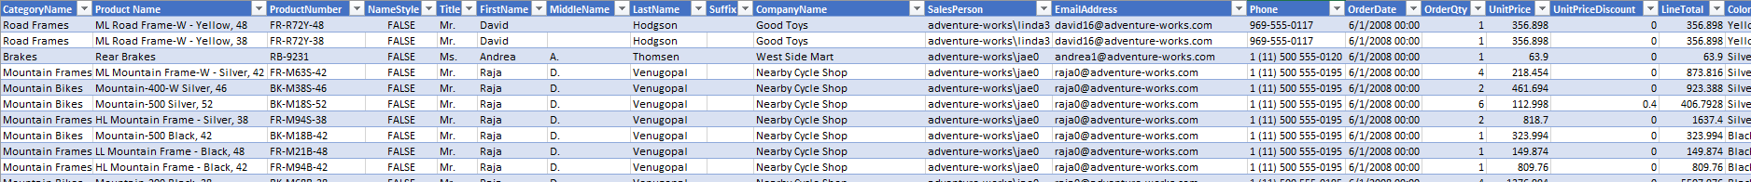
The Shape of Your Data
Use joins to restructure or “denormalize” data to better suit your analytical needs

Slide 64


Missing Data
A very common problem: data from disparate systems that should match perfectly, but doesn’t
E.g., some records show up in the shipping table that don’t match any records in inventory, and vice versa

Slide 65

Finding Missing Records
The join step shows you which things were matched, and which weren’t

Slide 66


Finding Missing Records
It also includes the option to “Show only mismatched values”
Provides insight into where the problems are

Slide 67




Bringing It All Together
Prep provides tools for dealing with anomalies
Switch Join Type to full
Add a calculated field to fill in missing values
Add another calculated field to describe the issue

Slide 68


Join Clause Recommendations
Prep Builder shows you the join clauses that are active and allows you to edit them
It will also identify candidates for the join clause and “recommend” them

Slide 69
Lab 4: Joins
Lab:
16:15-Done
Exercise 5.1: pp. 58-66
“Missing Data”, “Finding Missing Records”, “Bringing it all together”: pp. 67-74
Have a
great night!
Questions? Comments?
Dan’s e-mail: danc@onlc.com
Dan’s cell #: (413) 455-0856
30 Minutes

Slide 70
Part II: Transform
Good Morning
We will
start at
10:00 EST
Questions? Comments?
Dan’s e-mail: danc@onlc.com
Dan’s cell #: (413) 455-0856

Slide 71
Part II: Transform

Slide 72
Module 5: Auditing & Cleaning Your Data

Slide 73

Auditing Your Data
Get an overview of your data
Identify anomalies, outliers, and errors

Slide 74
The data
(Just for reference)

Slide 75


Histograms
Numeric fields are broken into bins
Text fields show one bar per discrete value

Slide 76
Cleaning Your Data
Data can contain errors & inconsistencies
Best case: invalid results, e.g., NULLs where there should be answers
Worst case: valid-but-incorrect results

Slide 77



Merge and Clean
Merge Fields “collapses” multiple columns into one, eliminating nulls

Slide 78




Merge and Clean
Cleaning includes a number of transforms: Trim Space, Remove Extra Spaces, Remove All Spaces, Remove Numbers, Remove Punctuation, etc.

Slide 79



Calculated Fields
Dozens of options
Write custom logic, e.g., math, text manipulation, regular expressions, etc.

Slide 80


Splitting Fields
Automatic Split=split on common delimiters
(actually generates a series of calculated fields)
Custom Split…= you choose the delimiter

Slide 81

Recommendations
Prep analyzes data and makes recommendations
Includes proposed data roles, deletions, data type changes, etc.

Slide 82


Handling NULL Values
Replace with something meaningful, e.g., “NA”,””,0,”Unknown”, etc.
Filter records where NULL makes them invalid

Slide 83


Filtering Records
Records can be filtered on almost any condition
General rule: only keep the data you need
Old records
Invalid records

Slide 84
Lab 5: Auditing and Filtering
Exercise 6.1: pp. 79-89
Exercise 7.1: pp. 91-94
Exercise 7.2: pp. 94-104
Exercise 7.3: pp. 105, 110-118
Lab: 11:00-12:00
A.M. Break: 12:00-12:15
Questions? Comments?
Dan’s e-mail: danc@onlc.com
Dan’s cell #: (413) 455-0856
45 Minutes

Slide 85
Module 6: Group and Replace

Slide 86
Group and Replace
Often, a series of wrong values must be corrected to a single correct value
This is done automatically when you update a value
It can also be done manually or algorithmically

Slide 87



Manual Selection
Manually choose multiple terms to collapse into one

Slide 88

Grouping by Pronunciation
Algorithmic detection of similar terms
Accuracy slider gives some control
Typically will still require further manual work

Slide 89

Grouping by Common Characters
Works by matching words with small “distance” between the characters they contain
Minimal control
Allows manual adjustment

Slide 90

Grouping by Spelling
Similar to Common Characters, gives more control

Slide 91
Lab 6: Group and Replace
Follow instructions on pp. 123-129
Lab: 12:40-12:55
Lunch: 12:55-13:55
Questions? Comments?
Dan’s e-mail: danc@onlc.com
Dan’s cell #: (413) 455-0856
15 minutes

Slide 92
Module 7: Aggregating and Pivoting Data

Slide 93



Aggregating Data
Group by some common attribute
Summarize other (usually numeric) columns

Slide 94

Pivoting/Unpivoting Data
Change the “shape” of data
Data may be provided in the form of a pivot table (cross-tablular)
Analysis typically requires attribute columns & value columns

Slide 95
Lab 7: Aggregating & Pivoting
Note: The “texas.csv” file used in this lab is located at C:\XTBP10ClassFiles\Labfiles\Chapter 9, and the fbi crime rates file is at C:\XTBP10ClassFiles\Labfiles\Chapter 10
“Aggregating Data”, pp. 132-134
“Pivot”, pp. 138-145
“Unpivot”, pp. 146-148
Lab: 14:30-15:00
P.M. Break: 15:00-15:15
Questions? Comments?
Dan’s e-mail: danc@onlc.com
Dan’s cell #: (413) 455-0856
30 Minutes

Slide 96
Part III: Load

Slide 97
Module 8: Output

Slide 98


Outputting to files
File formats: .tde, .hyper, .csv

Slide 99

Outputting to other destinations
Prep can also output to a server or Tableau Online

Slide 100
Lab 8: Output
Exercise 11.1, pp. 151-155
Lab: 15:35-15:45
Questions? Comments?
Dan’s e-mail: danc@onlc.com
Dan’s cell #: (413) 455-0856
10 Minutes

Slide 101
Module 9: Prep Builder Conductor and Publishing Workflows to Tableau Server

Slide 102

Tableau Server

Slide 103
Tableau Server

Slide 104
Tableau Server
Central storage of Tableau assets
Data sources, reports
Browser-based viewing of reports
Scheduling of tasks, e.g., running flows

Slide 105

Tableau Prep Conductor
Part of the Data Management Add-on
Included in current release of Tableau Server
Schedule & Monitor Flows on the server

Slide 106



Publishing Workflows to Server
From Prep Builder:
Sign in to server
Publish flow to chosen project

Slide 107
Scheduling Workflows on the Server (Discussed)

Slide 108

Scheduling Workflows on the Server
Add schedule from flow toolbar
Choose from list of prepared schedules

Slide 109

Viewing tasks on the server
Tasks page
View, edit, delete

Slide 110


Adding safe file locations
Use tsm command line tool

Slide 111
Thank you!
Questions?
Survey: http://www.onlc.com/eval

