Slide 1

Introduction to Tableau Prep
Instructor: Dan Costello Email: danc@onlc.com
Class begins at 10 Eastern time
For Class Audio Connection:
ONLC Office Locations – Audio is connected over Jabra™ speaker
Home or Office – Call: ____ Access Code: ____ # Enter the audio pin shown in the GoToMeeting panel
If you need assistance, call 800-288-8221

Slide 2
Introduction to Tableau Prep

Slide 3
Student introductions
Your name
Company affiliation
Title/function
Tableau experience
Your expectations for the course
Notes:
Ask students to introduce themselves and provide their backgrounds, product experience, and expectations for the course.
Record student expectations on a whiteboard or flip chart that you can reference during class.

Slide 4


Housekeeping
Class hours: 10:00-16:45
A.M./P.M. Breaks: 15 min.
Lunch Break: 1 hr.
ONLC Wifi access code (if present): 0123456789
If you need anything, please let us know!
Notes:
Explain class and facility logistics, using the bulleted list. Inform students about any emergency procedures, such as emergency exits, and plans in the event of fire or other emergencies.

Slide 5

The Courseware
The Book: Prepare Your Data for Tableau
GitHub site for code files:
Supplemental notes: http://bit.ly/ONLCXTBP10

Slide 6
Classroom Setup
Windows 10
Course Files

Slide 7
Course Outline
Introduction & Tableau Prep Builder Tableau Prep Builder Tableau Prep Builder Interface Steps in Tableau Prep Builder Features of a Workflow Input and Output Connect to Microsoft Excel Data Interpreter Configuration Window Data Sampling Connect to Tableau Data Extract File Connect to Text File Other Features
Data Cleaning Profile Pane: An In-Depth Analysis Functions Tracking Changes String Calculations Group and Replace Automatic Group and Replace Functions Manual Grouping Examples Aggregation and Pivot Aggregations Aggregation Functions Group By Examples Pivot Joins and Unions Join Types of Joins Example Union Example Tableau Prep Builder Conductor Tableau Prep Builder Conductor Prerequisites Publishing Workflows to Server (Discussed) Scheduling Workflows to Server (Discussed)

Slide 8

Related Classes

Slide 9
Questions?

Slide 10
Module 1: ETL & Demo Data

Slide 11
What is ETL?
Extract: Get the data from its current location
Transform: Modify the data to suit your analytical needs
Load: Transfer the data to the repository your analytical tool will use

Slide 12
Extract

Slide 13
Transform
“Clean” data = remove or repair erroneous entries
“Shape” data = get data in a form that’s compatible with your analytic needs
Join & denormalize
Replace codes
Unpivot

Slide 14
Load

Slide 15
About the Demo Data
ZTCA → Census
USALEEP
GEOCORR Education Data
The SplitWise Blog

Slide 16
Part I: Extract

Slide 17
Module 2: Connecting to Data

Slide 18
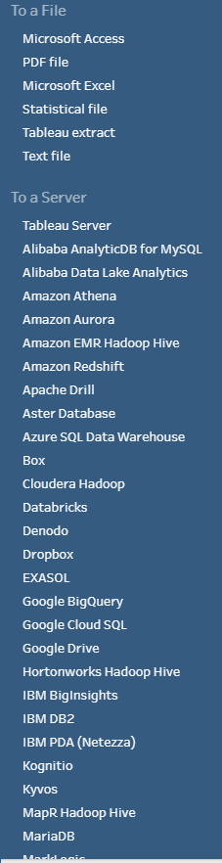
Connecting to Data

Slide 19
Server-Based Data Sources

Slide 20
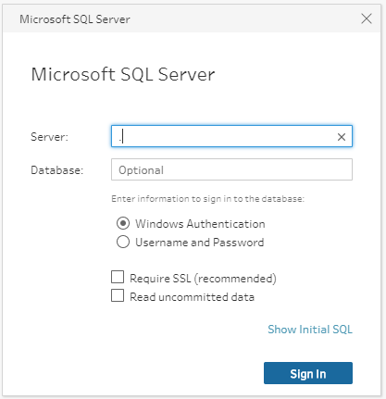
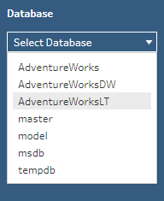

Connect to SQL Server

Slide 21
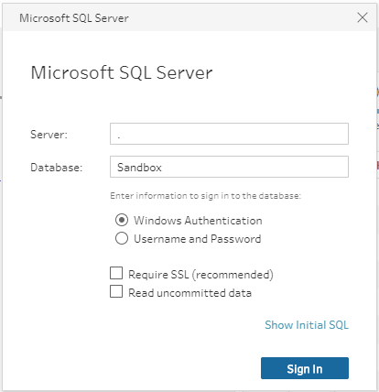
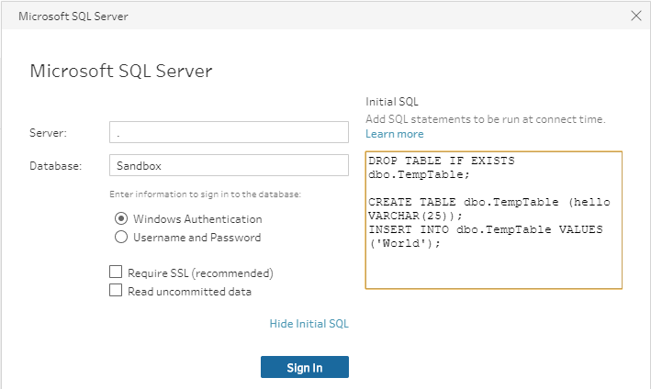
Initial SQL

Slide 22
Working with Tableau Data Extracts

Slide 23
Working with File-Based Data Sources

Slide 24
Connecting to Microsoft Access

Slide 25
Connecting to Microsoft Excel

Slide 26
Connecting to PDF Files

Slide 27
Connecting to Text Files

Slide 28
Module 3: UNION Joins

Slide 29
UNION Joins

Slide 30
The Data Preview Pane

Slide 31
Data Types

Slide 32
Changes

Slide 33
Reviewing the Union Step

Slide 34
Wildcard Union Joins

Slide 35
Which Is Better?

Slide 36
Module 4: Joins

Slide 37
What is a Table?

Slide 38
Equijoins

Slide 39
Join Types

Slide 40
Inner Joins

Slide 41
Left Joins

Slide 42
Right Joins

Slide 43
Outer Joins

Slide 44
The Shape of Your Data

Slide 45
Missing Data

Slide 46
Finding Missing Records

Slide 47
Bringing It All Together

Slide 48
Join Clause Recommendations

Slide 49
Part II: Transform

Slide 50
Module 5: Auditing & Cleaning Your Data

Slide 51
Auditing Your Data

Slide 52
Cleaning Your Data

Slide 53
Merge and Clean

Slide 54
Making Data More Consistent

Slide 55
Splitting Fields

Slide 56
Recommendations

Slide 57
Handling NULL Values

Slide 58
Filtering Records

Slide 59
Module 6: Group and Replace

Slide 60
Group and Replace

Slide 61
Manual Selection

Slide 62
Grouping by Pronunciation

Slide 63
Grouping by Common Characters

Slide 64
Grouping by Spelling

Slide 65
Module 7: Aggregating and Pivoting Data

Slide 66
Aggregating Data

Slide 67
Pivoting Data

Slide 68
Unpivoting Data

Slide 69
Part III: Load

Slide 70
Module 8: Output

Slide 71
Outputting to files

Slide 72
Outputting to other destinations

Slide 73
Module 9: Prep Builder Conductor and Publishing Workflows to Tableau Server

Slide 74
Tableau Prep Builder Conductor

Slide 75
Publishing Workflows to Server (Discussed)

Slide 76
Scheduling Workflows to Server (Discussed)

Slide 77
Appendix: Preparing Data In Tableau

Slide 78
Thank you!
Questions?
Survey: http://www.onlc.com/eval

