Slide 1

Introduction to Tableau Prep
Instructor: Dan Costello Email: danc@onlc.com
Class begins at 10 Eastern time
For Class Audio Connection:
ONLC Office Locations – Audio is connected over Jabra™ speaker
Home or Office – Call: ____ Access Code: ____ # Enter the audio pin shown in the GoToMeeting panel
If you need assistance, call 800-288-8221

Slide 2
Introduction to Tableau Prep

Slide 3
Student introductions
Your name
Company affiliation
Title/function
Tableau experience
Your expectations for the course
Notes:
Ask students to introduce themselves and provide their backgrounds, product experience, and expectations for the course.
Record student expectations on a whiteboard or flip chart that you can reference during class.

Slide 4


Housekeeping
Class hours: 10:00-16:45
A.M./P.M. Breaks: 15 min.
Lunch Break: 1 hr.
ONLC Wifi access code (if present): 0123456789
If you need anything, please let us know!
Notes:
Explain class and facility logistics, using the bulleted list. Inform students about any emergency procedures, such as emergency exits, and plans in the event of fire or other emergencies.

Slide 5

The Courseware
The Book: Prepare Your Data for Tableau
GitHub site for code files:
Supplemental notes: http://bit.ly/ONLCXTBP10

Slide 6
Classroom Setup
Windows 10
Course Files

Slide 7
Course Outline
Introduction & Tableau Prep Builder Tableau Prep Builder Tableau Prep Builder Interface Steps in Tableau Prep Builder Features of a Workflow Input and Output Connect to Microsoft Excel Data Interpreter Configuration Window Data Sampling Connect to Tableau Data Extract File Connect to Text File Other Features
Data Cleaning Profile Pane: An In-Depth Analysis Functions Tracking Changes String Calculations Group and Replace Automatic Group and Replace Functions Manual Grouping Examples Aggregation and Pivot Aggregations Aggregation Functions Group By Examples Pivot Joins and Unions Join Types of Joins Example Union Example Tableau Prep Builder Conductor Tableau Prep Builder Conductor Prerequisites Publishing Workflows to Server (Discussed) Scheduling Workflows to Server (Discussed)

Slide 8

Related Classes

Slide 9
Questions?

Slide 10
Module 1: ETL & Demo Data

Slide 11
What is ETL?
Extract: Get the data from its current location
Transform: Modify the data to suit your analytical needs
Load: Transfer the data to the repository your analytical tool will use

Slide 12
Extract
Connect to data at its source
RDBMS systems, files, web services, etc.
Combine data from multiple sources

Slide 13
Transform
“Clean” data = remove or repair erroneous entries
“Shape” data = get data in a form that’s compatible with your analytic needs
Join & denormalize
Replace codes
Unpivot

Slide 14
Load
Push cleaned & shaped data into destination

Slide 15
About the Demo Data
ZTCA → Census
USALEEP
GEOCORR Education Data
The SplitWise Blog

Slide 16
Part I: Extract

Slide 17
Module 2: Connecting to Data

Slide 18
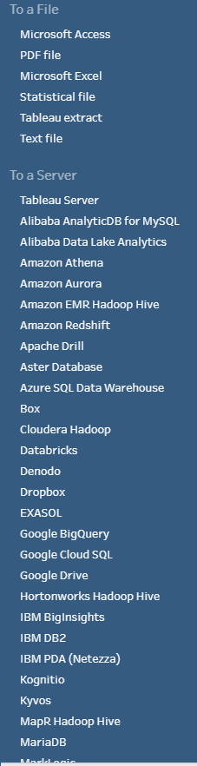
Connecting to Data
Dozens of file- & server-based data sources
ODBC & JDBC connections

Slide 19
Server-Based Data Sources
Most major RDBMS systems supported
SQL Server, Oracle, MySQL, DB2, MongoDB, etc.
General pattern similar for all
Specify server name/address
Possibly specify DB name
Authenticate (username & password)

Slide 20
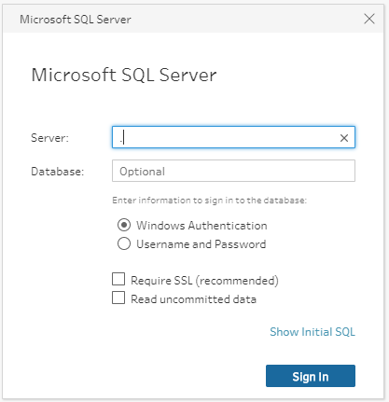
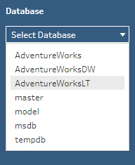

Connect to SQL Server

Slide 21
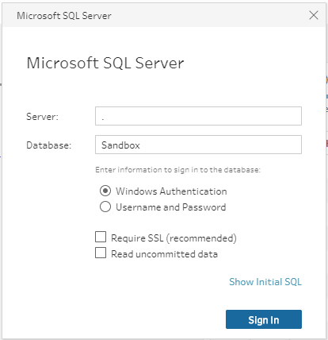
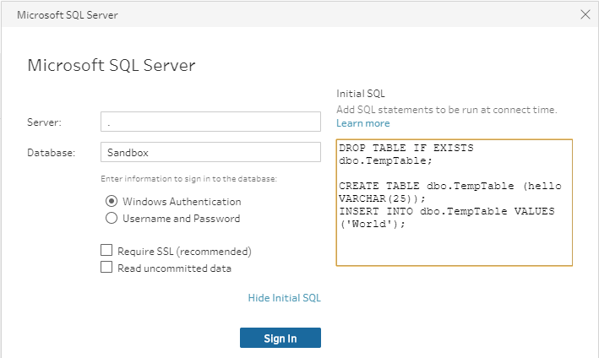
Initial SQL

Slide 22
Working with Tableau Data Extracts

Slide 23
Working with File-Based Data Sources

Slide 24
Connecting to Microsoft Access

Slide 25
Connecting to Microsoft Excel

Slide 26
Connecting to PDF Files

Slide 27
Connecting to Text Files

Slide 28
Lab 2: Connecting to Data

Slide 29
Module 3: UNION Joins

Slide 30
UNION Joins

Slide 31
The Data Preview Pane

Slide 32
Data Types

Slide 33
Changes

Slide 34
Reviewing the Union Step

Slide 35
Wildcard Union Joins

Slide 36
Which Is Better?

Slide 37
Lab 3: UNION Joins
Exercise 4.1: UNION Join, pp. 27-32
Exercise 4.2: Wildcard UNION, pp. 41-44
Exercise 4.3: Refine a Wildcard UNION, pp. 47-48

Slide 38
Module 4: Joins

Slide 39
What is a Table?

Slide 40
Equijoins

Slide 41
Join Types

Slide 42
Inner Joins

Slide 43
Left Joins

Slide 44
Right Joins

Slide 45
Outer Joins

Slide 46
The Shape of Your Data

Slide 47
Missing Data

Slide 48
Finding Missing Records

Slide 49
Bringing It All Together

Slide 50
Join Clause Recommendations

Slide 51
Part II: Transform

Slide 52
Module 5: Auditing & Cleaning Your Data

Slide 53
Auditing Your Data

Slide 54
Cleaning Your Data

Slide 55
Merge and Clean

Slide 56
Making Data More Consistent

Slide 57
Splitting Fields

Slide 58
Recommendations

Slide 59
Handling NULL Values

Slide 60
Filtering Records

Slide 61
Module 6: Group and Replace

Slide 62
Group and Replace

Slide 63
Manual Selection

Slide 64
Grouping by Pronunciation

Slide 65
Grouping by Common Characters

Slide 66
Grouping by Spelling

Slide 67
Module 7: Aggregating and Pivoting Data

Slide 68
Aggregating Data

Slide 69
Pivoting Data

Slide 70
Unpivoting Data

Slide 71
Part III: Load

Slide 72
Module 8: Output

Slide 73
Outputting to files

Slide 74
Outputting to other destinations

Slide 75
Module 9: Prep Builder Conductor and Publishing Workflows to Tableau Server

Slide 76
Tableau Prep Builder Conductor

Slide 77
Publishing Workflows to Server (Discussed)

Slide 78
Scheduling Workflows to Server (Discussed)

Slide 79
Appendix: Preparing Data In Tableau

Slide 80
Thank you!
Questions?
Survey: http://www.onlc.com/eval

