Slide 1
Raiffeisen AI Course
Introduction to AI

Slide 2
Decoding the Black Box
Introduction on
How Machine Learning Models Make Decisions

Slide 3
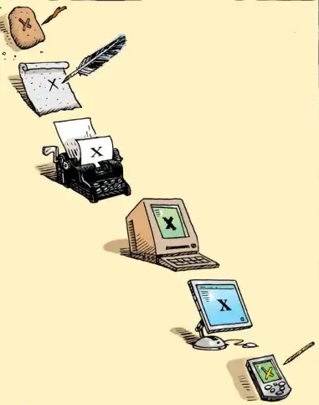
What is important to get
Machine learning has evolved like a growing mind: starting with basic rules, learning from mistakes, and gradually mastering complex ideas.
Understanding this journey makes the magic of AI feel less like magic and more like a story of progress.
To grasp complex ideas, we must first understand the basic rules

Slide 4
Content
Gradient descent
Tree based algorithms
Neural Networks
Natural Language Processing
Sentiment analysis model
Text autocomplete model

Slide 5
Gradient descent - black-box tool
The most popular learning method in Machine Learning
Used in many algorithms from classical ML algorithms to deep neural networks
Many people use it but do not understand it
Gradient descent - a way to minimize an objective function

Slide 6
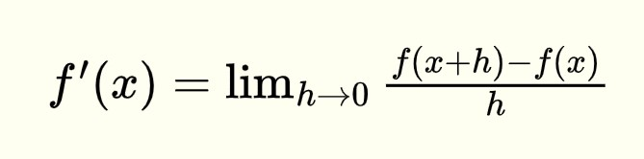
Derivata de gradul I
Derivata unei funcții f(x) reprezintă rata de variație a funcției în raport cu variabila sa.
(X^{y})’ = yX^{y-1}
(X²)’ = 2X
(E²)’ = 2E * E’
(2X)’ = 2

Slide 7

Speed - Acceleration
T - Time (measured in seconds)
V - speed (km/h * 10)
Interval 0 - 3s:
1.5s - acceleration
1.5s - break
V: [0 : 3] -> [0 : 9]
V(T) = 4T(3 - T)

Slide 8
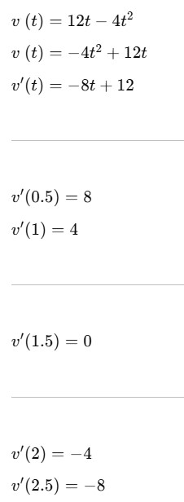
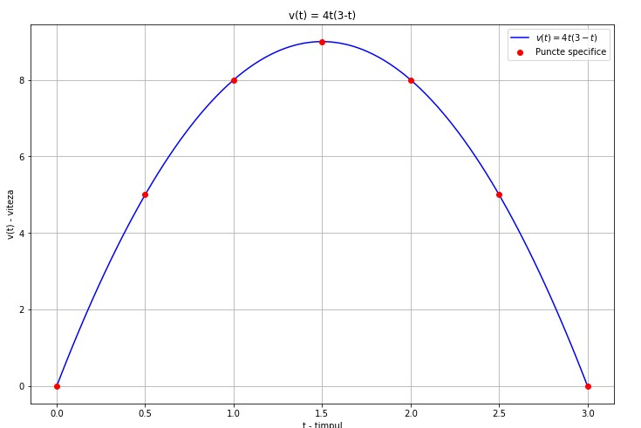
Exemplu: v(t) = 4t(3 - t)

Slide 9
Gradient descent weights
Gradient descent models use weights
X - feature
Y - target
A - weight
X * a = Y
A - “magic variable”
X
Y

Slide 10
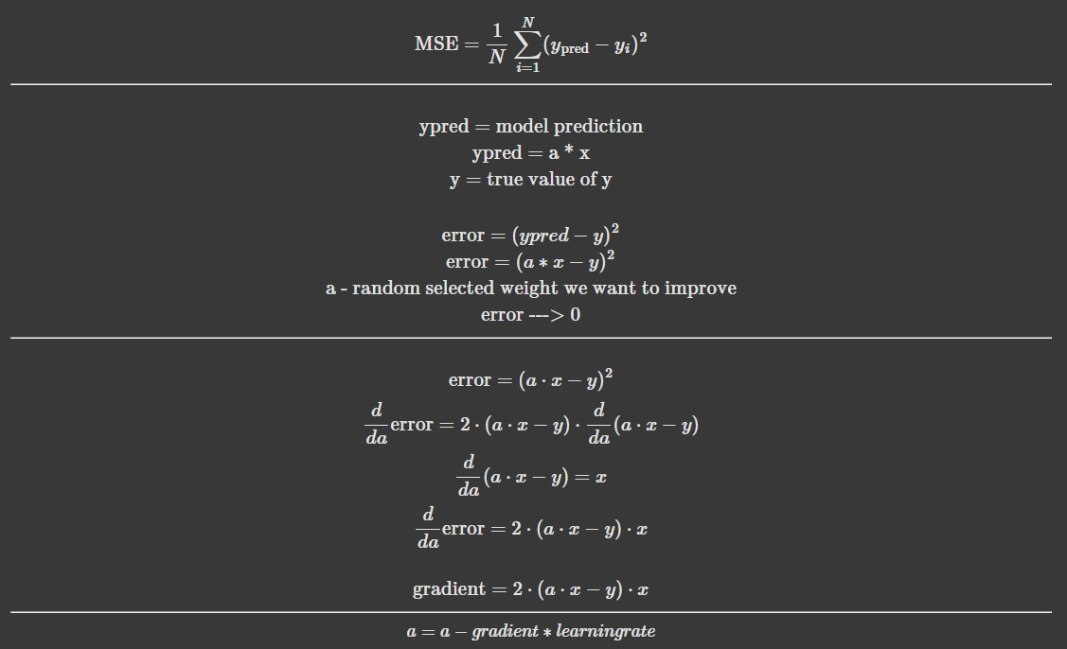
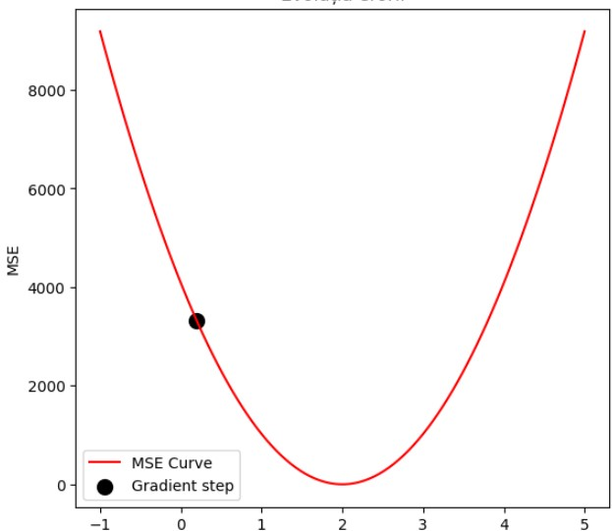
Learning step
(Ypred - Y)**2

Slide 11
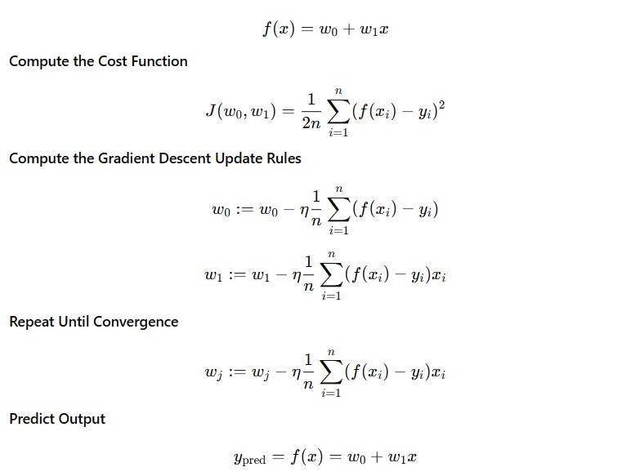
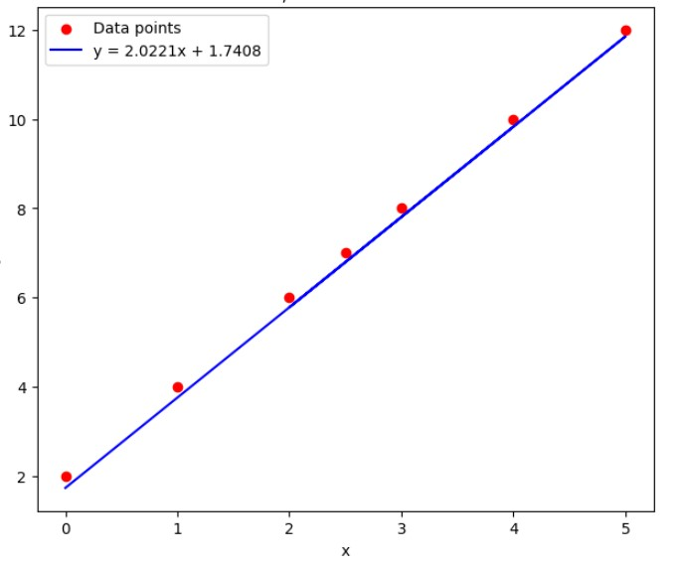
Linear regression

Slide 12
Q1. Gradient descent variants
Which method is better?
SGD - one point per step
Batch GD - all points per step
Variant | Description | Time | Memory
Stochastic GD | One point | ? | ?
Batch GD | All points | ? | ?

Slide 13
Gradient descent variants
Variant | Description | Time | Memory
Stochastic GD | One point | Slow | Low
Batch GD | All points | Fast | High

Slide 14
Gradient descent variants
Variant | Description | Time | Memory
Stochastic GD | One point | Slow | Low
Batch GD | All points | Fast | High
Variant | Description | Time | Memory
Stochastic GD | One point | Slow | Low
Batch GD | All points | Fast | High
Mini-Batch GD | Batches | Medium | Medium

Slide 15
Q2. Starting point
If we start the gradient from 2 random points both will go in the same point?

Slide 16
Q2. Starting point
If we start the gradient from 2 random points both will go in the same point?

Slide 17
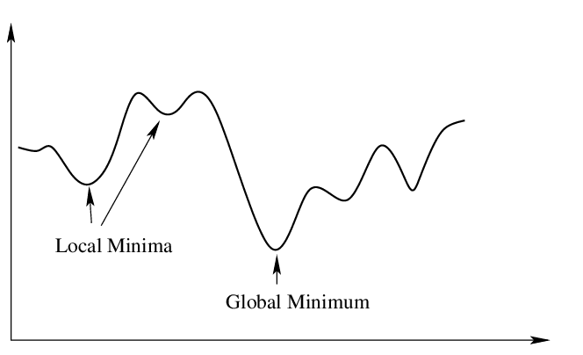
Q2. Starting point
If we start the gradient from 2 random points both will go in the same point?

Slide 18
Q3. Will GD conduct to ZERO error?

Slide 19
Q4. We always need global minimum?

Slide 20
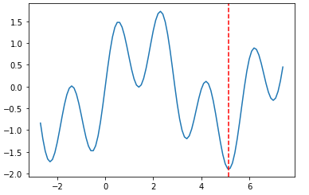
Q4. We always need global minimum?

Slide 21
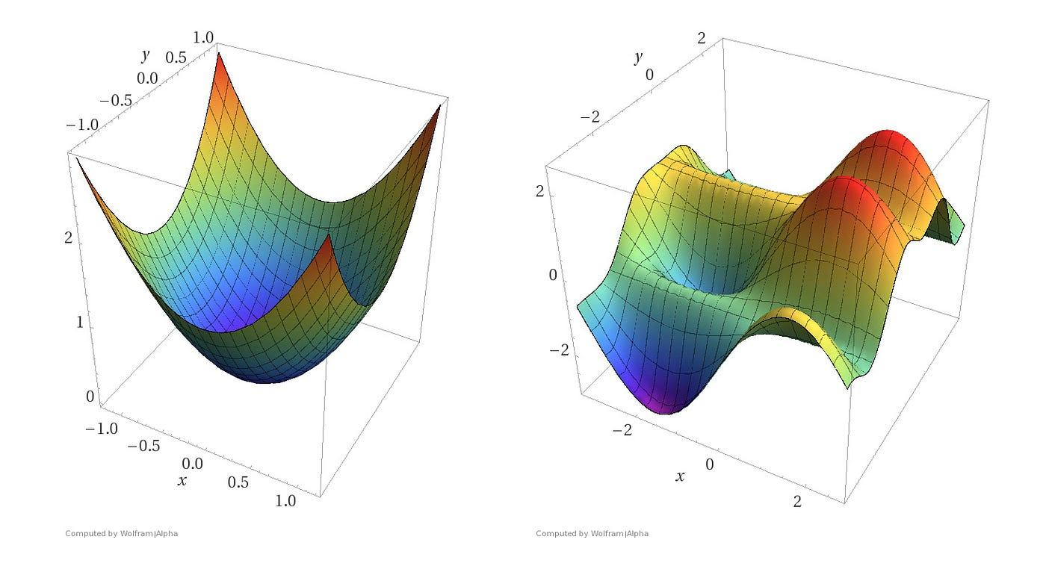
Local and global minim

Slide 22

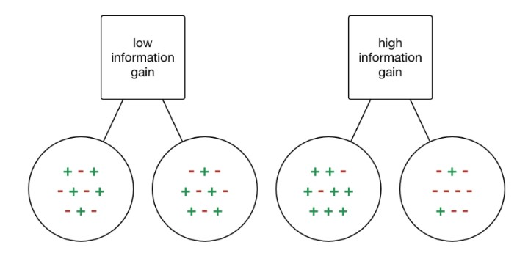
Decision Tree
Yesterday
Entropy is a measure of the randomness in the information being processed
No
Yes
Weather
NO
Yesterday | Weather | Time | Decision
No | Sunny | Weekend | YES
No | Sunny | Workday | YES
Yes | Rainy | Weekend | NO
No | Rainy | Workday | NO
Yes | Sunny | Workday | NO
Yes | Sunny | Weekend | NO
No | Rainy | Weekend | YES
Rainy
Sunny
Time
YES
Weekend
Workday
YES
NO

Slide 23
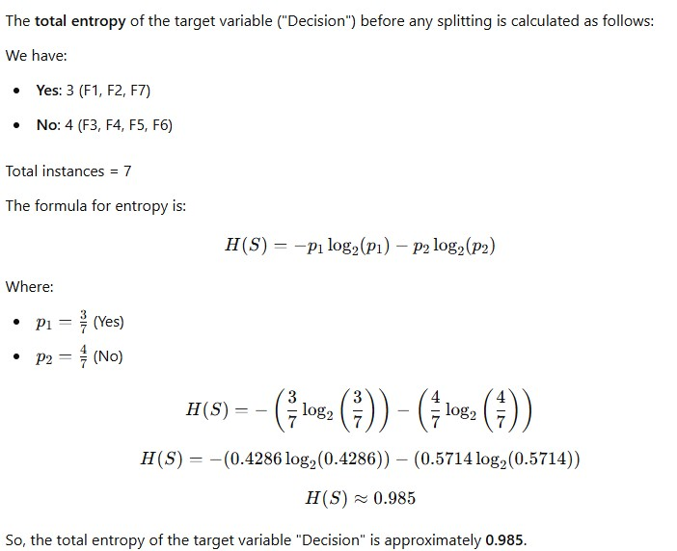
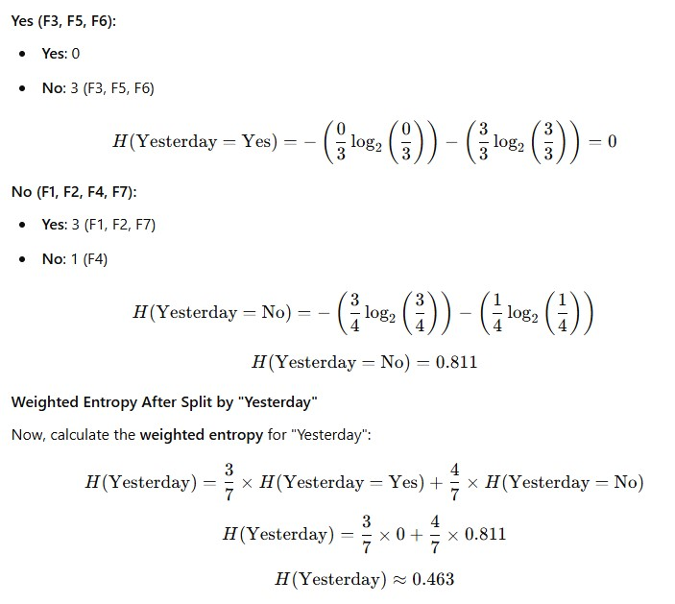

Slide 24
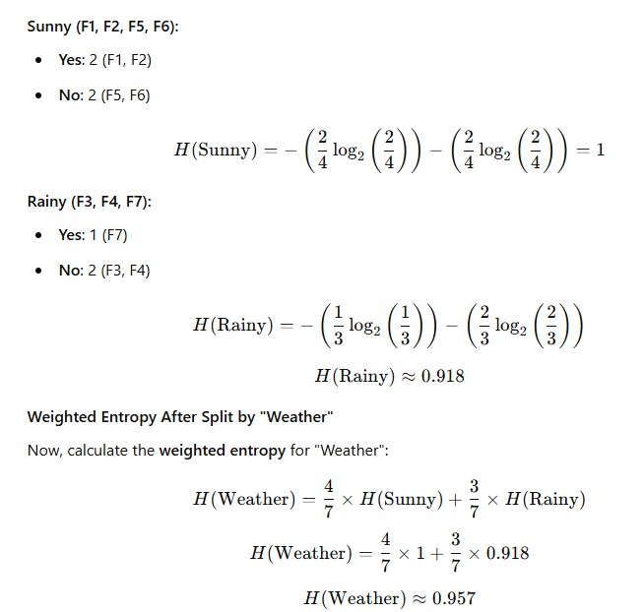
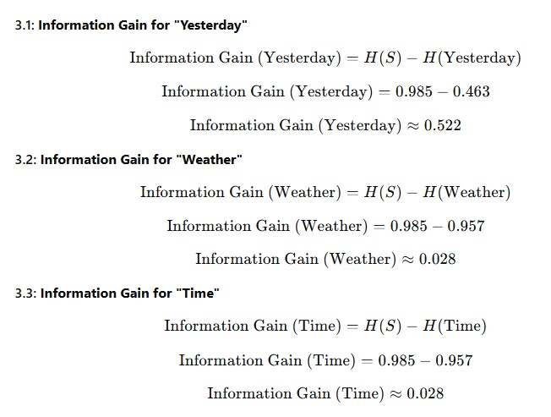

Slide 25
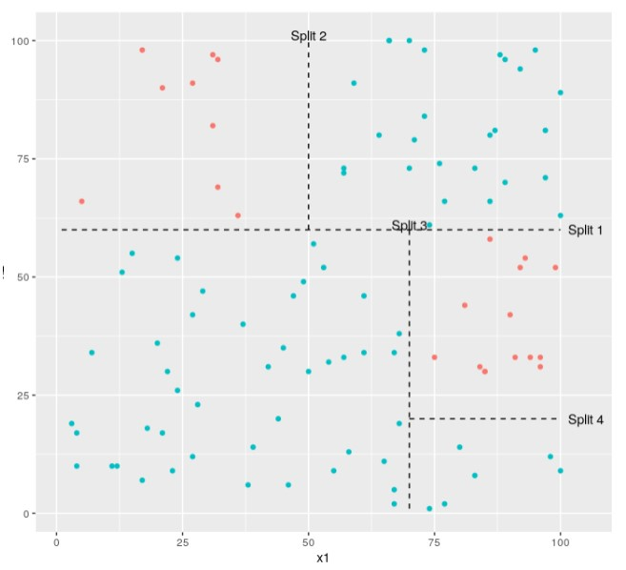
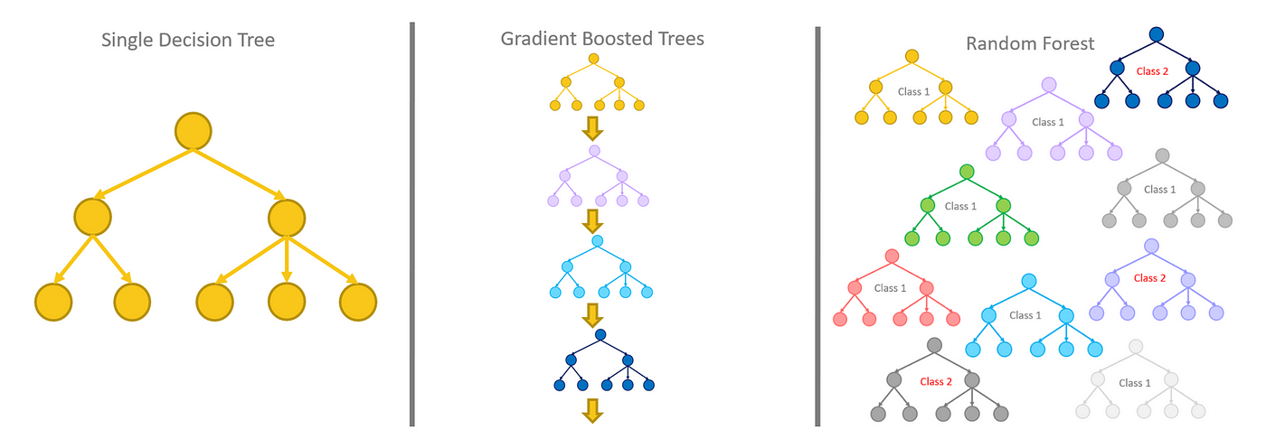
Bagging and boosting
Underfitting
Overfitting
Model complexity
Bagging - reduces complexity (reduce overfitting)
Boosting - increase complexity (reduce underfitting)

Slide 26
Q1
Which model is more complex and learn more:
One decision tree with all features and samples
Two decision trees with features and samples splitted

Slide 27
Q2
Can we use string features for categorical variables is a decision tree?

Slide 28
Q3
How high correlated features may affect a decision tree?

Slide 29
Q4
How a decision tree works with outliers

Slide 30
Text features
Models works only with numeric features
How we transform text features in numeric features
Label Encoding
One Hot Encoder
TF-IDF vectorizer

Slide 31
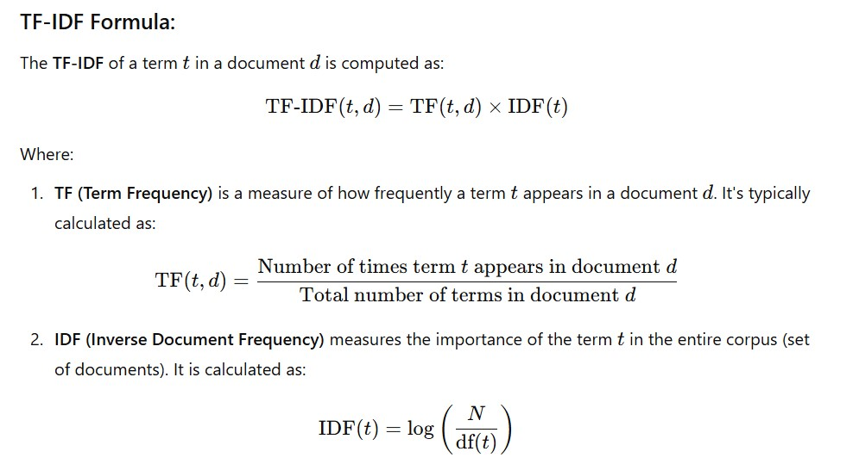

Slide 32
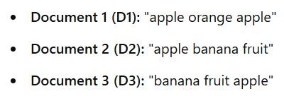
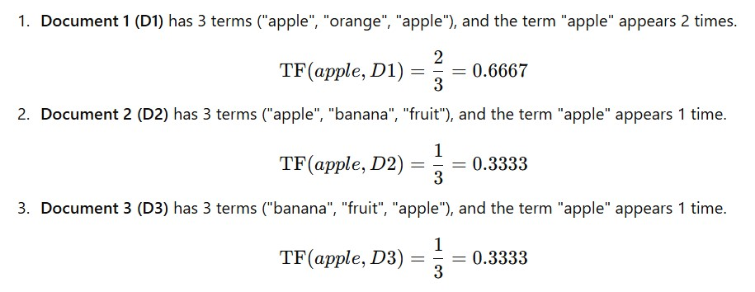
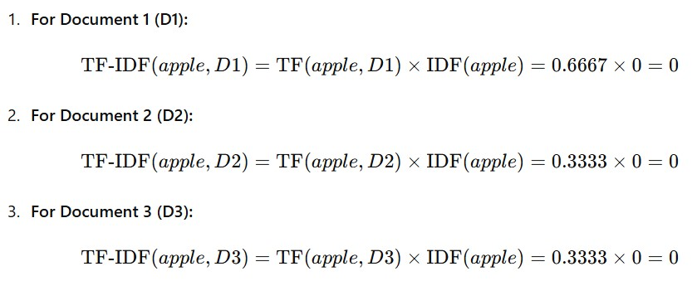


Slide 33
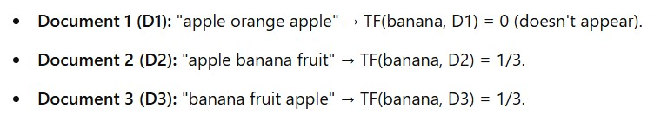
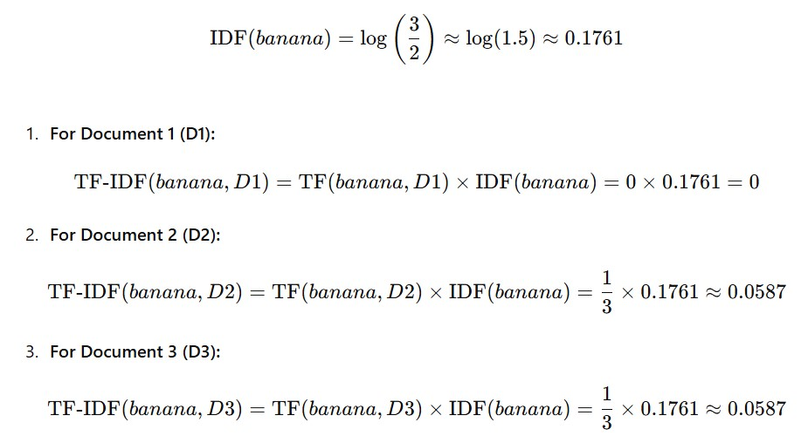

Slide 34
Output example
 | w1 | w2 | w3 | w4 | w5 | w6
D1 | 0 | 0.157 | 0.053 | 0 | 0.021 | 0.251
D2 | 0.027 | 0 | 0 | 0.058 | 0.027 | 0
D3 | 0 | 0.058 | 0.053 | 0 | 0.027 | 0.072
D4 | 0.002 | 0 | 0.157 | 0.027 | 0 | 0.157

Slide 35
Questions
Q1. How is TF-IDF in terms of natural language understanding?
Q2. How is TF-IDF in terms of memory?

Slide 36
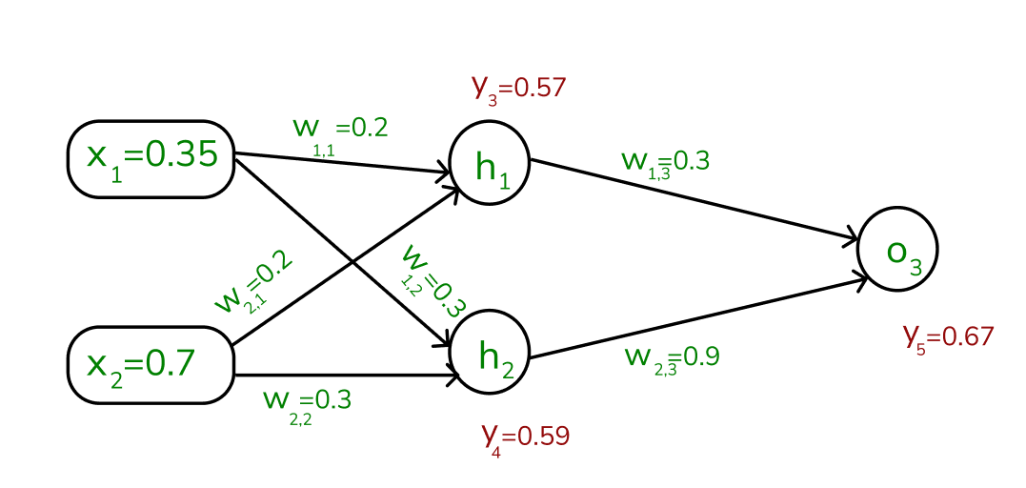
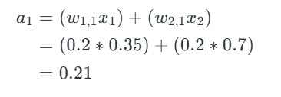
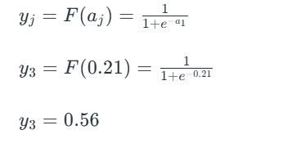
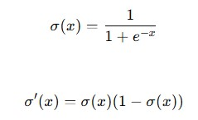

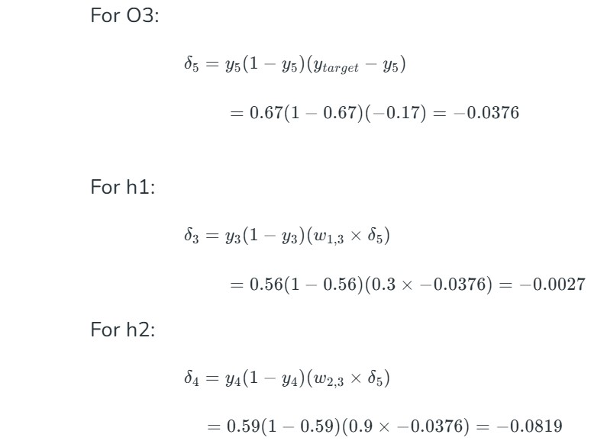
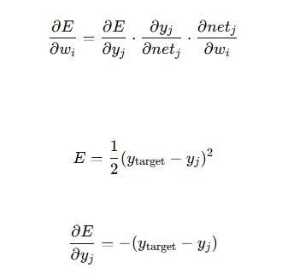
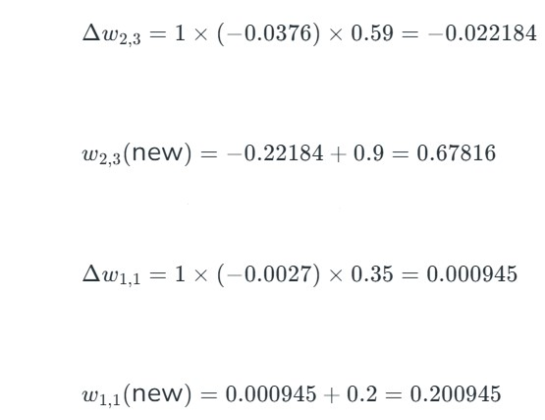
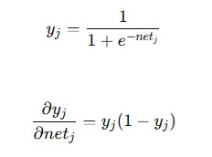
Neural Networks

Slide 37
Questions
What is the role of activation functions in hidden layers?

Slide 38
Word embeddings
A word embedding is a learned representation of a word such that the words with same meaning have similar representation.
The geometric relationship between words should reflect the semantic relationship.
The vocabulary is predefined and learned over a large corpus of text.
KING - MAN + WOMAN = QUEEN

Slide 39
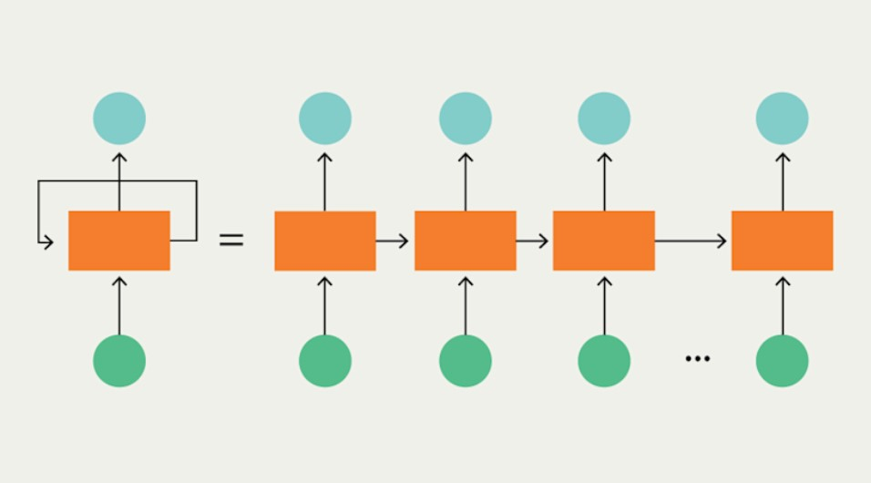
Recurrent neural networks
[dog, cat, fox]
[[0.1, 0.2, 0.3, 0.4],
[0.5, 0.6, 0.7, 0.8],
[0.9, 0.1, 0,5, 0.7]]

Slide 40
Demo
Text autocomplete
Word2Vec
RNN - LSTM
Evaluation

Slide 41
Transformers
Like the RNNs, transformers can handle distant information
RNNs struggle with long sequence data.
Transformers are not based on recurrent connections
Transformers are more efficient to implement at scale
Transformers are made up of stacks of transformer blocks, each of which is a multilayer network made by combining:
● simple linear layers
● feedforward networks
● self-attention layers
Self-attention allows a network to directly extract and use information from arbitrarily large contexts without the need to pass it through intermediate recurrent connections as in RNNs

Slide 42
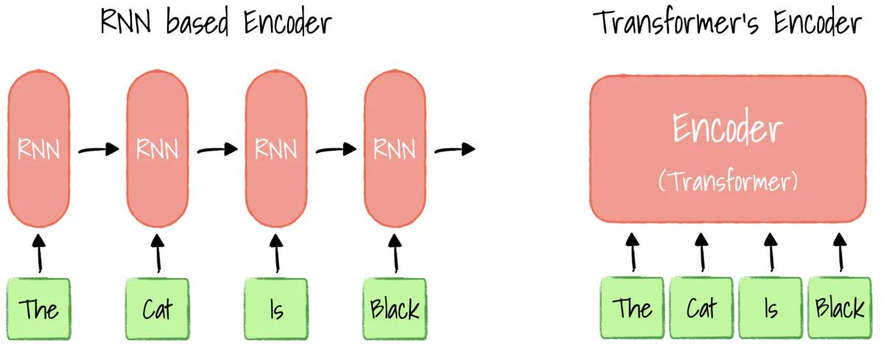
Transformers

Slide 43
Questions?

