Slide 3
Getting looser
1
2

Slide 4
Getting looser

Slide 5
Getting tighter

Slide 6
Getting tighter

Slide 7
Diagonal

Slide 8
Diagonal

Slide 9
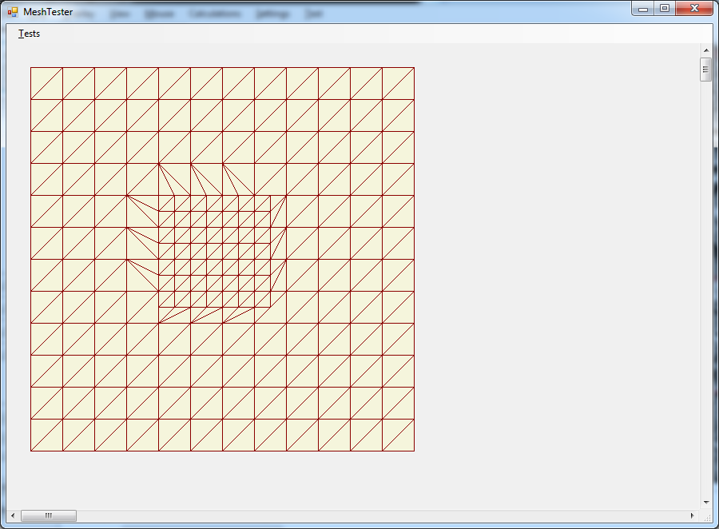

Slide 10
