Slide 1
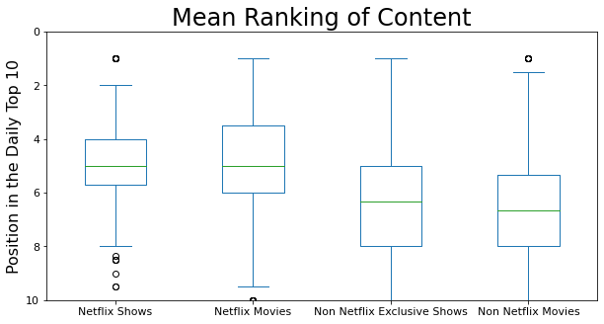
What Kind of Content Appeared in the Daily Top 10?
Using the ranking in the Daily Top 10 as a metric for popularity:
It appears that Netflix produced content ranked higher on average
Shows tended to do slightly better than movies
https://www.kaggle.com/datasets/prasertk/netflix-daily-top-10-in-us

Slide 2
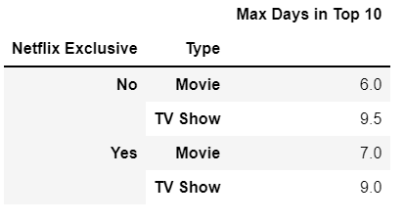
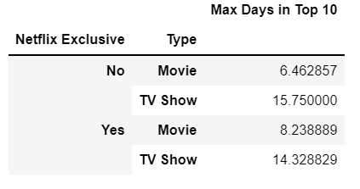
What Kind of Content Appeared in the Daily Top 10?
Median
Now let’s look at how many days something spent in the top 10
Shows spent more time in the Top 10 than movies
Little difference between Netflix and non-Netflix content
Mean
Mean time in the Top 10 shows a much stronger lean towards shows, indicating the presence of outliers
https://www.kaggle.com/datasets/prasertk/netflix-daily-top-10-in-us

Slide 3
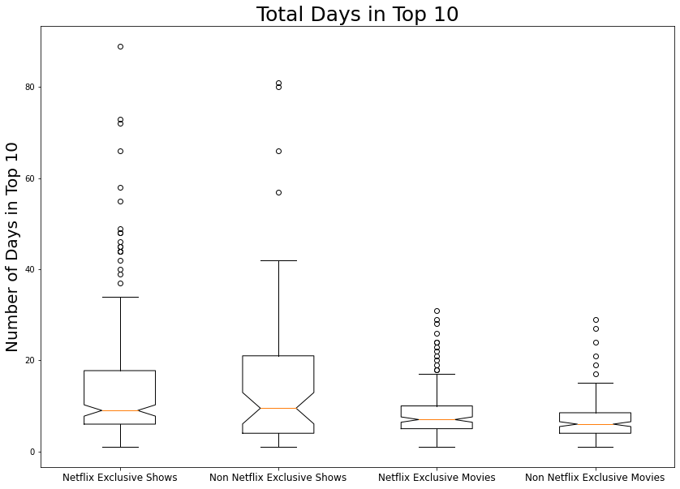
What Kind of Content Appeared in the Daily Top 10?
The bulk of shows were on the Top 10 list for 5 to 20 days, with frequent outliers staying much longer
Movies stayed on the Top 10 mostly for less than 10 days, and never more than 40
Important to note that “Cocomelon” was removed from the data for this graph, it appeared a total of 428 days out of 710. Making the Top 10 list 60% of the time
https://www.kaggle.com/datasets/prasertk/netflix-daily-top-10-in-us

Slide 4
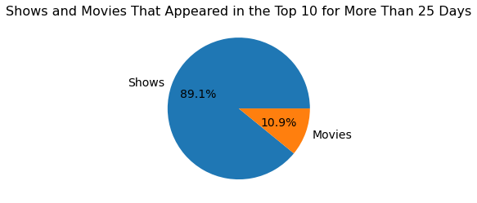
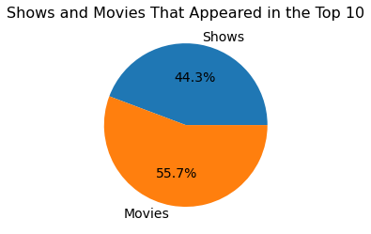
What Kind of Content Appeared in the Daily Top 10?
Limiting our view to only those shows and movies that were in the Top 10 for 25 days or more, we see that it is mostly shows.
Even though movies appeared more often in the Top 10, shows spent far more time there
https://www.kaggle.com/datasets/prasertk/netflix-daily-top-10-in-us

Slide 5
What Kind of Content Appeared in the Daily Top 10?
Shows appeared in the Daily Top 10 more often and stayed for much longer than movies
While shows tended to do somewhat better than movies on average, the top performing slots were overwhelmingly slanted towards shows.

