Slide 1
Netflix Movie and TV Show Trend
Rolly Costillas, Derek Mast, Kemly Adebisi
Matthew Hill, Chang Woon Jang

Slide 2
Introduction
Background and Datasets
Question: How does Netflix keep its user base interested and continue to do so?
1) Movies or TV shows in the past?
2) Specific genres of movies and TV shows based on past trends?
3) Relationship between a country and the number of movies and TV shows?
4) Does is this trend consistent each country?
5) Is it reflection of what Netflix wants to focus on?
Kaggle Datasets and OMDBapi
Pandas/Matplotlib/Numpy/Scipy/Python API

Slide 3
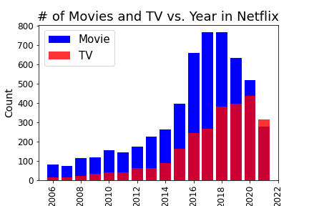
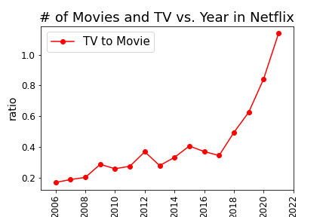

Movie and TV Productions from 2006 to 2021
https://www.kaggle.com/datasets/shivamb/netflix-shows

Slide 4
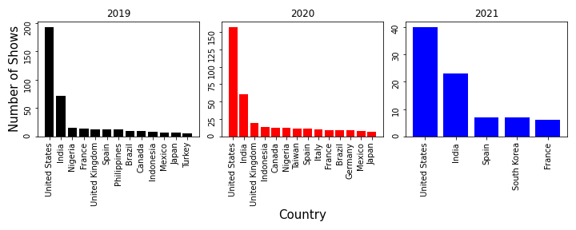
Production by Country from 2019 to 2021
https://www.kaggle.com/datasets/shivamb/netflix-shows

Slide 5
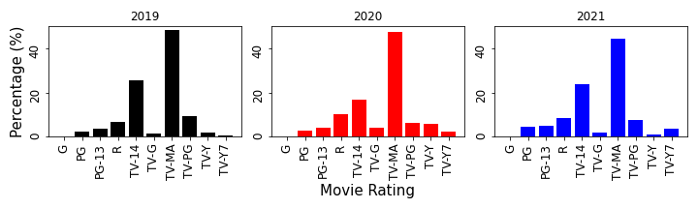
Popularity by Movie Rating from 2019 to 2021
https://www.kaggle.com/datasets/shivamb/netflix-shows

Slide 6
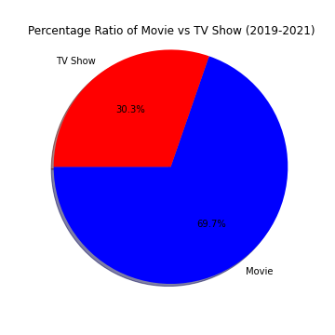

Slide 7
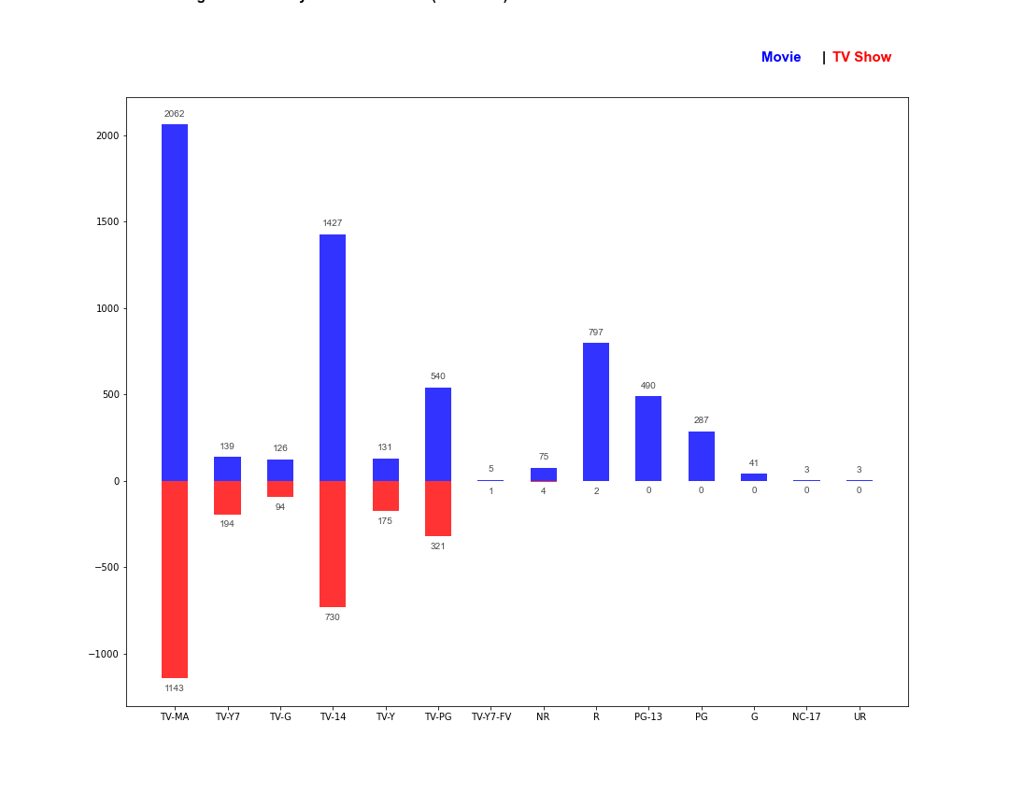

Slide 8
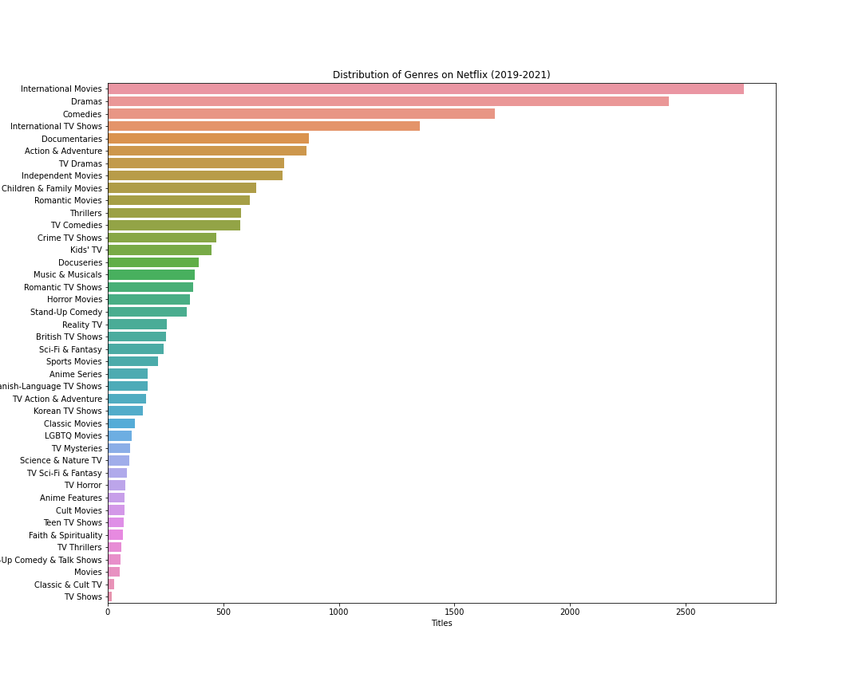

Slide 9
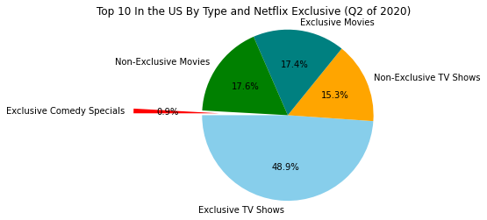
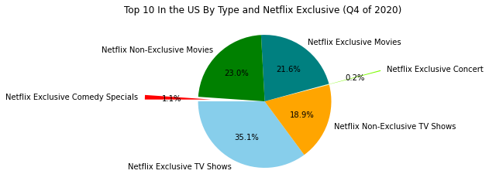

Slide 10
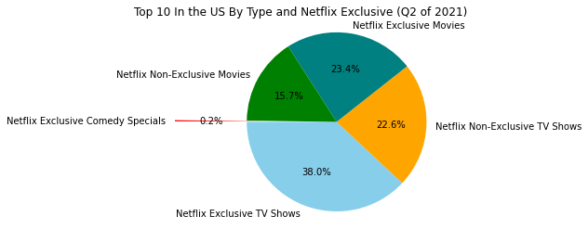
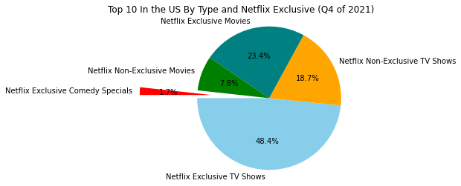

Slide 11
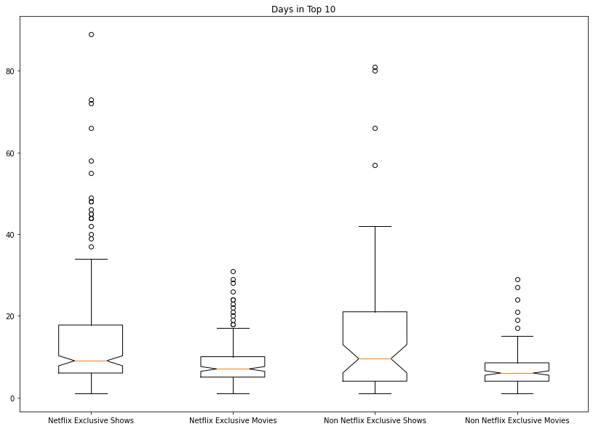

Slide 12
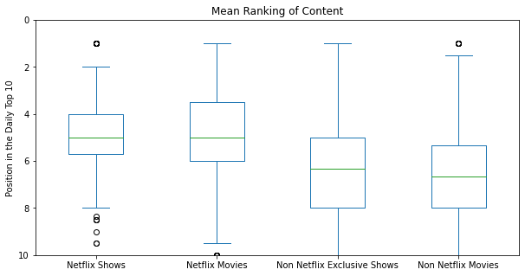

Slide 13
