Slide 1











Introduction
Barefoot College International
Our Team
Barefoot College International (BCI) is a globally recognized non-profit organization that empowers rural women through solar energy & education. By training women as solar engineers (Solar Mamas), BCI provides clean, renewable energy to some of the most remote and under-served villages in the world. This grassroots approach not only addresses energy poverty but also promotes gender equality by placing women at the forefront of climate action.
Kaustubh Mhaisekar
Meenakshi Sharma
Nirmit Ghughu
Executive Summary
Projected Impact
Many rural communities face severe energy poverty, limiting access to essential services like education, healthcare, and digital inclusion. Existing infrastructure is inadequate, which perpetuates poverty and undermines efforts to build self-sufficient, resilient communities.
We propose expanding the Solar Mamas project with stronger solar systems for both homes & communities. It includes more powerful equipment, resources, and training more women to maintain the systems. By improving energy access, this fosters economic empowerment, better health outcomes, and enhanced digital connectivity and education.
24/7 Power for Community Facilities in the village, reduced dependence on fuel by 90% leading to savings of about
$15 per month per household
Prarthna Pahuja
Tanu
Gangrade
Grant Utilisation
Providing clean water for over 500 people in the community, reducing waterborne illnesses by 40%
Delivering digital education to 100+ students annually
in the community, increasing secondary school
graduation rates by 25%
5000+ patients' consultations per year in the community, improved maternal and neonatal survival rates, reduced child mortality from preventable diseases
Energy Poverty: A Dark Crisis
Without electricity, there is no lighting available after dark, making it difficult to
leave the house after sunset
Basic amenities such as fans, phone charging, clean water access, light bulbs,
radio etc. are unavailable
Clinics can't refrigerate vaccines, power medical equipment, or provide
safe childbirth at night
Women and girls bear the heaviest burden, spending
hours collecting firewood
or fetching water
Students can't study after dark, and lack of internet and
digital devices limit learning
outcomes & opportunities
Solar Mamas Around The World
Zanzibar,Tanzania
Guatemala
Vanuatu
Senegal
Solar Mamas electrified off-grid Maasai villages, enabling night-time birthing in rural clinics and safer learning environments for children.
Solar Mamas brought light to remote mountainous communities, replacing kerosene lamps and reviving Mayan women's leadership.
After Cyclone Pam, Solar Mamas restored energy access to disaster-hit islands, ensuring resilience through solar-powered recovery.
Solar Mamas provided sustainable energy access in regions far from the national grid, improving education and livelihoods.

Slide 2

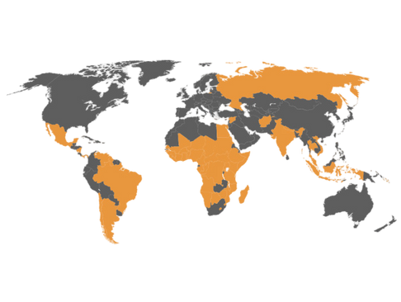





Background
Mission Statement
Global Impact
BCI's core belief is that women from marginalized communities are powerful agents of sustainable change.
They believe providing vocational and educational opportunities to women and training them as Solar Mamas will ensure long term climate, economic & social resilience and eradicate energy poverty for rural communities globally.
2000+ villages in 96 countries worldwide. They work primarily with communities with little or no infrastructure, majority of them currently in the African Continent.
History
Who are Solar Mamas?
Solar Mamas are rural women, often with little or no education, trained to become solar engineers.
Through an intensive training program, these women learn to assemble, install, repair, and maintain solar panels and home lighting systems.
They then return to their non-electrified villages and set up rural electronic workshops and bring clean, renewable energy to their communities.
This not only provides sustainable lighting and reduces reliance on harmful fuels, but also empowers the women with new skills, financial independence, and a respected role as agents of change within their communities.
BCI was incorporated as a company and opens its first international training
center in Zanzibar
Pacific Island countries expansion, and doubling the size of entry level solar systems
2015
2025
Demographics
The Enriche program was rolled out to provide
education &
Empowerment for rural women
Continued expansion and pop-up training centers opened in Madagascar,
Senegal, Guatemala.
2016
2019-22
Women
Children
Rural Population
Problem
Current Programs
2024 Annual Budget
There are about 930 million people in the world without access to electricity. People in such households, especially women face a major hindrance in economic opportunities, education, & healthcare.
BCI works with grassroots communities to improve livelihoods, protect planetary and human health, and to foster overall growth and of these communities. They address 15 of the 17 United Nations Sustainable Development Goals through these 3 programs:
Funding - $3M
Expenses - $2.9M
Over 33% of the global population is still dependent on wood-based fuels for their primary household energy consumption- making them prone to respiratory problems, ocular diseases, risk of fires and accidental burnings.
These households spend up to 30% of their income on resources like kerosene, firewood, charcoal etc.
Less than 10% of the women in such households have livelihood skills they can derive income from, as they have to spend a significant portion of their day on unpaid domestic work like collecting firewood, pumping water etc.
No access to radios or the internet, cuts off communities from government schemes, support networks etc leading to social exclusion and further marginalization.
Solar
Enriche
Livelihoods
Training rural women to become Solar Engineers aka
Solar Mamas
Empower women with life skills, confidence, and knowledge to become agents of sustainable change
Develop local craft & vocational skills enabling individuals to generate income & become self reliant
Size of Organization
Full time staff: 84
Volunteers: 6

Slide 3
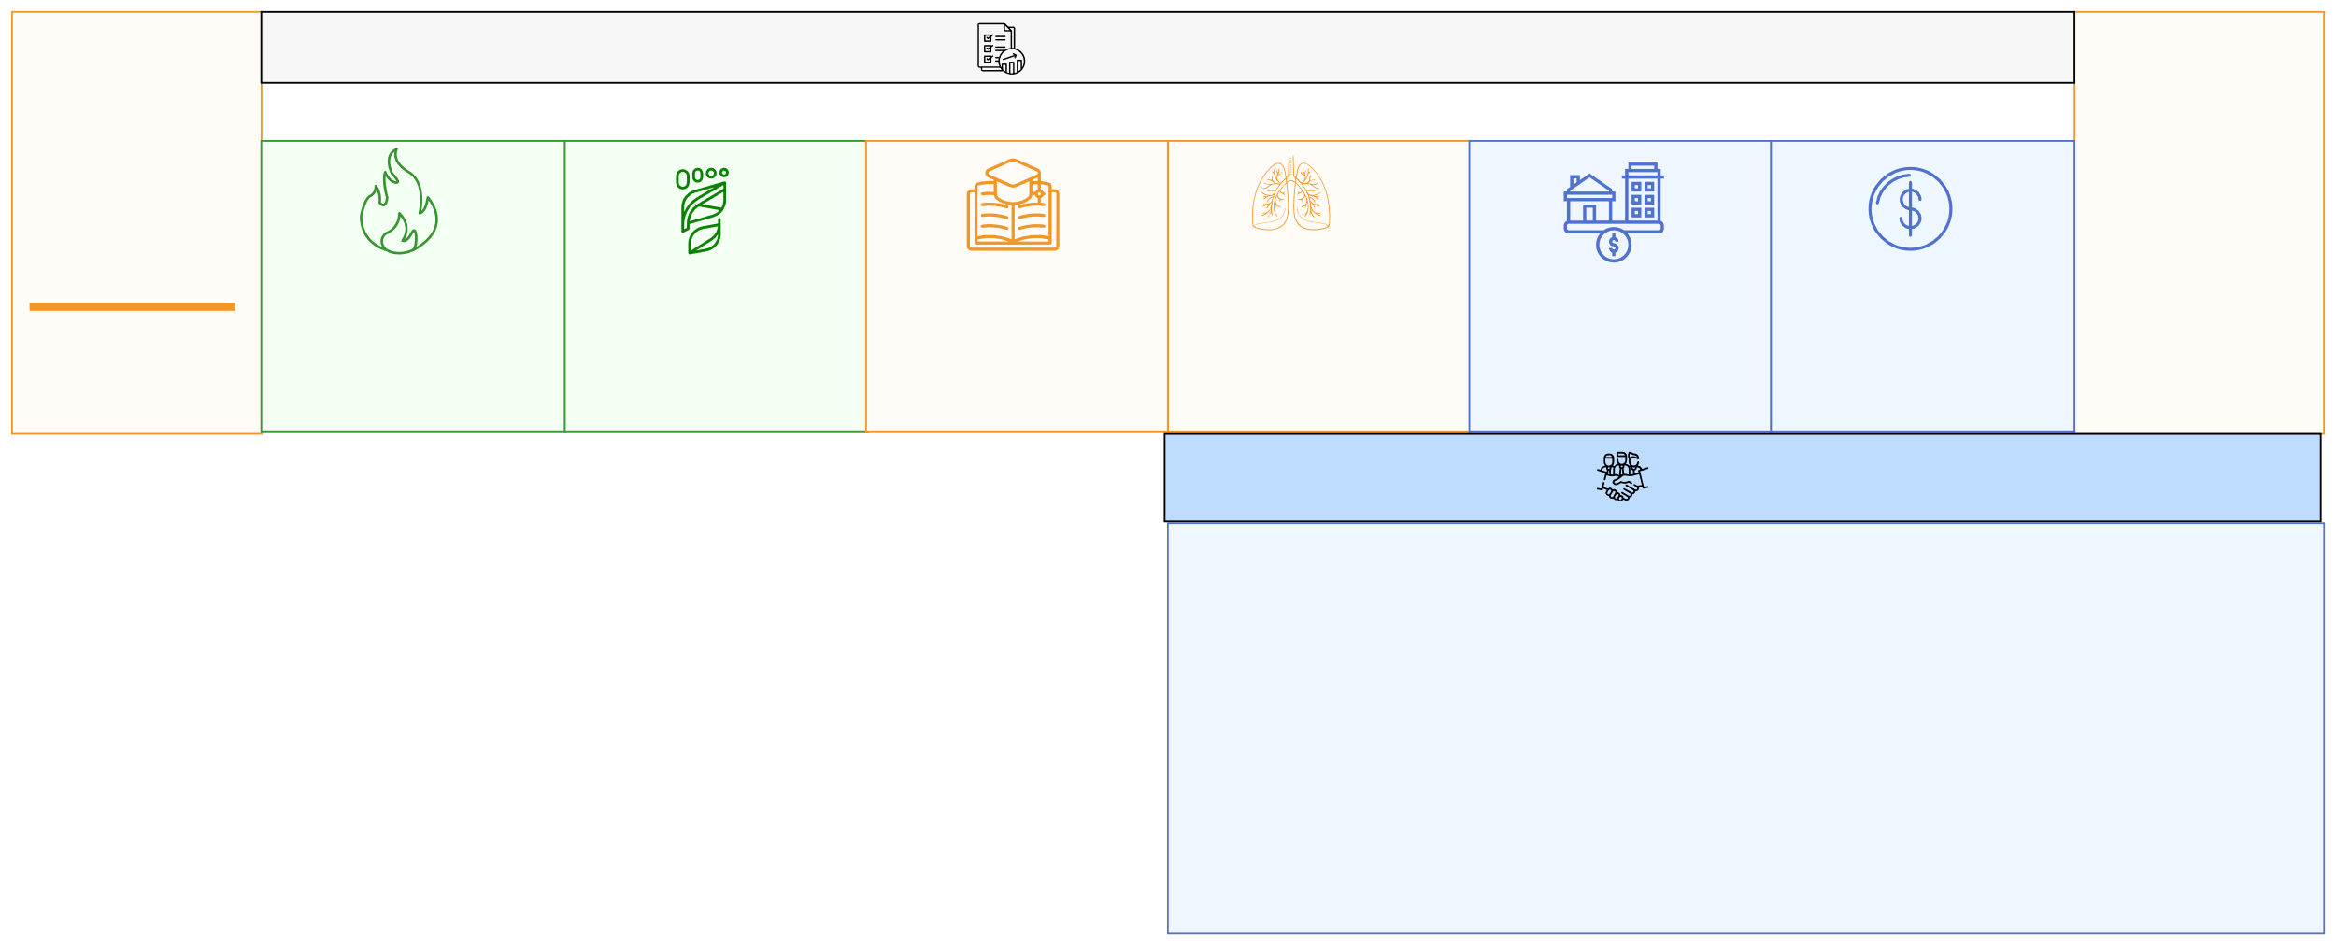




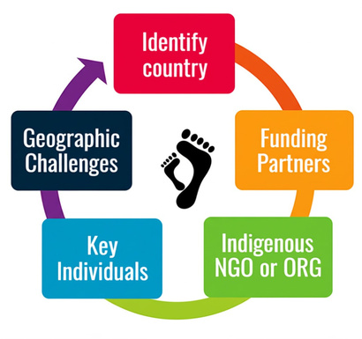












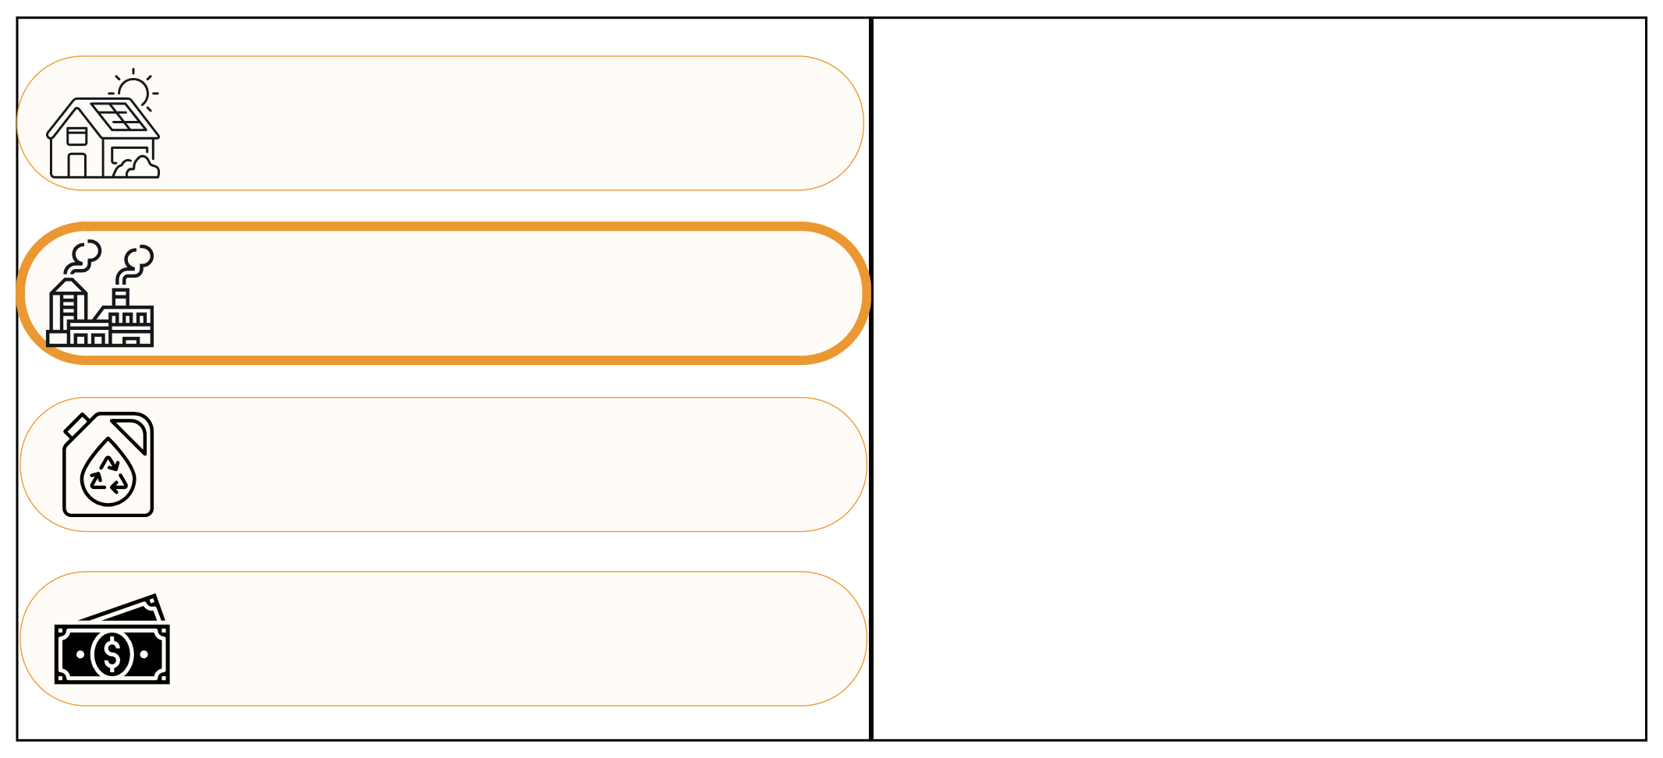
Impact and Effectiveness
Current Impact
Environmental
Health & Education
Financial
4.2k+
7m+
90%
78%
30%
70%
50%
Increase in household income
35%
Solar
Mamas
Reduction in Fossil Fuel usage
Improvement in Carbon Offset
Increase in
educational attainment
Reduction in ocular, respiratory diseases
Reduction in energy costs
Total
Beneficiaries
Business Model
Partnerships
BCI operates as a not-for-profit social enterprise that empowers rural communities—especially women—through hands-on training in solar engineering, artisan crafts, and community leadership. Its business model combines philanthropic funding
with earned income from the sale of artisan
products and solar services, reinvesting proceeds to sustain and expand community-led initiatives. This approach prioritizes self-reliance, low overhead, and reinvestment into local development.
Carbon Emissions Saved (Metric tons)
Measuring the impact
Leadership
Solar electrified
212,500 households
Performance measurement focuses on three core areas: Environment, Women, and Economic Empowerment. Additional domains include domestic, health, productive, education, and public impact.
Global Indicators are used to specifically track progress toward SDGs.
Routine monitoring is conducted, with data collected and analyzed with a baseline assessment 6 months after solar equipment is installed, and 2 further evaluation after 12 and 24 months.
Sue Stevenson: Director of Strategic Partnerships and International Development
Prayag Ichangimath: Director of Solar Program Development and Innovation
Manu Singh: Director of ENRICH+ and Educational Program Development
John Cheesemond & Steven Sandler:
Directors of Finance and Regulatory Compliance
33,351+ metric tons of carbon emissions saved this year alone
More than a 100 million liters of kerosene saved due to solar shift
$550 million net lifecycle
cost savings

Slide 4

Project Proposal
Current Limitations and Challenges
Limited Power Output
Digital Divide
Digital Literacy
Energy Poverty
Existing solar infrastructure in the communities provide only basic energy and lighting, restricting the ability to power larger devices or support community infrastructure.
Many Solar Mamas and their communities lack reliable internet access and digital devices, limiting
opportunities for online education, medicine, and digital financial services.
While some digital tools have been introduced, many Solar Mamas have only minimal training in using mobiles, tablets or internet resources, restricting their ability to leverage technology for broader community benefit
The absence of dependable electricity directly limits
access to quality education and healthcare. Students
can't study after dark; clinics can’t refrigerate vaccines etc.—perpetuating poverty & slowing community progress.
Our Proposal
An uplift of the current Solar Mamas project to create more resilient and economically active communities. This proposal aims to empower existing under-served communities by providing access to more reliable and powerful, self-sufficient solar energy. This initiative will combine household systems with larger community-based solar solutions, installing equipment and resources to create a foundation for economic growth, improved healthcare, and digital inclusion.
Community Level Energy System ($80k)
Household Level Energy Access ($70k)
BCI will install centralized solar micro-grids using lithium battery storage, and hybrid inverters.
The system will be supported by distribution infrastructure including poles, meters, and cabling to power key community facilities.
Solar Mamas will be trained to handle installation and basic maintenance.
Each household will be equipped with a solar home lighting system that includes a solar panel, a battery, and LED lamps.
Solar lanterns will be distributed to ensure portable lighting options.
Solar mamas will assist in deployment, user orientation, and minor troubleshooting within the village cluster.
Healthcare infrastructure ($50k)
Educational resources ($50k)
A solar-powered healthcare package will be established, including refrigerators for vaccine and medicine storage, fans, lighting, and a water pump to supply clean water.
BCI will train auxiliary healthcare workers from the community and develop locally relevant content to support primary care delivery.
A solar backup system for uninterrupted operation of basic health services.
BCI will deploy a digital education kit composed of laptops, projectors, lighting, and fans powered by the solar infrastructure.
Community-level instructors will be trained to use these tools for blended learning environments.
Tailored educational content will be developed and delivered using this setup.

Slide 5
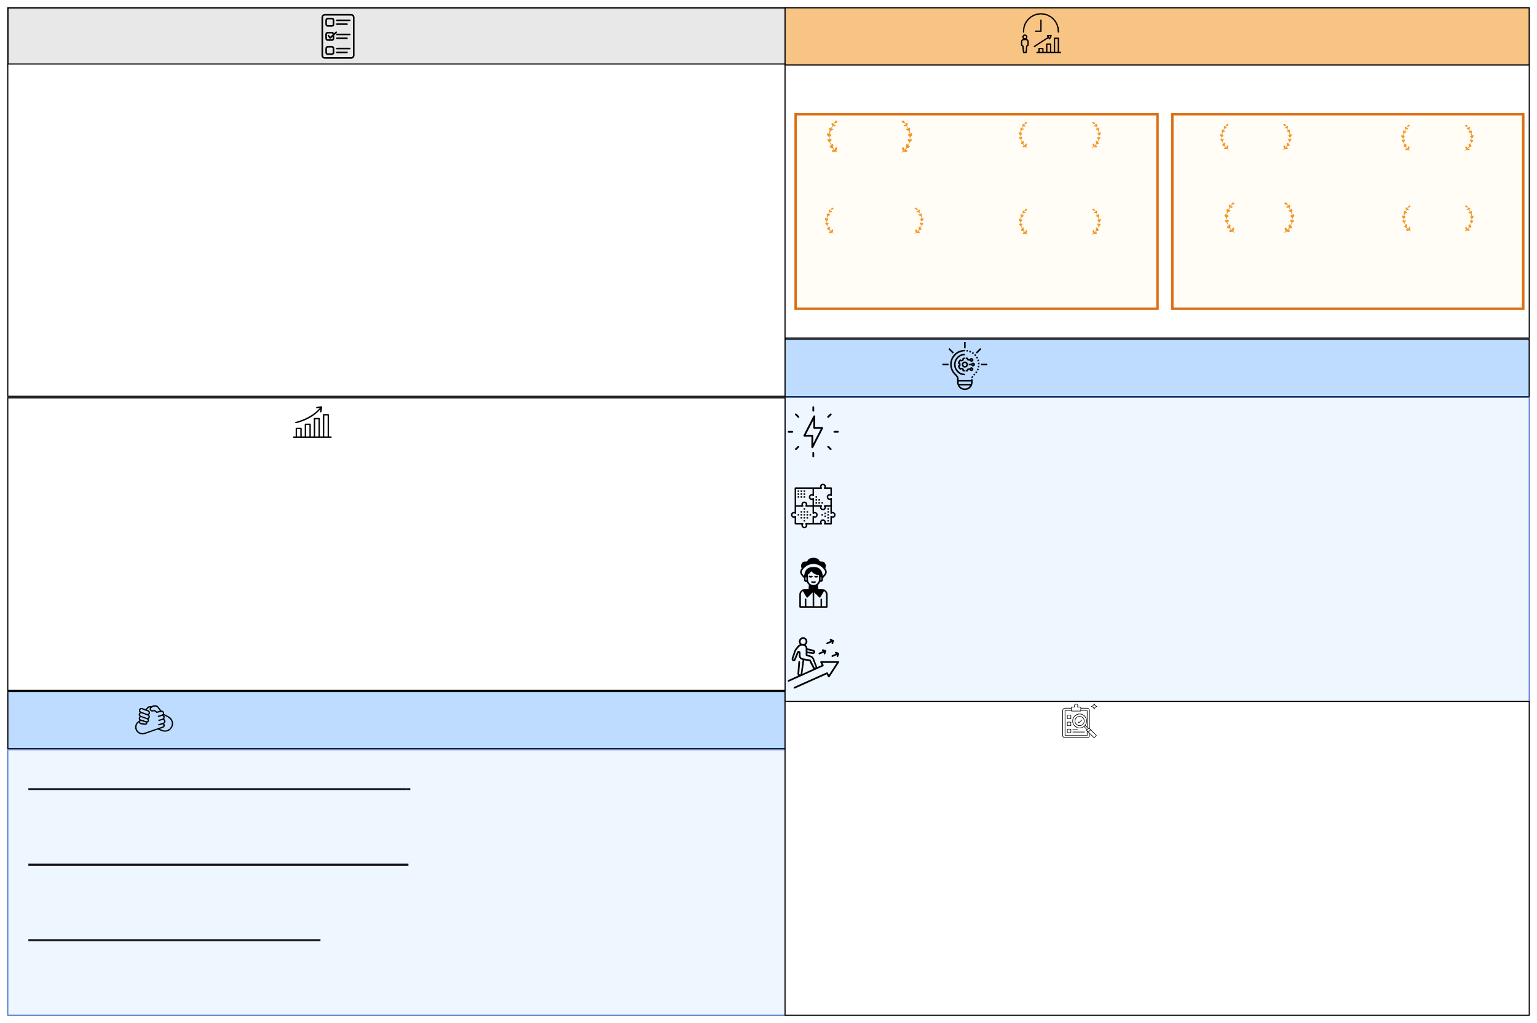

Project Proposal
Goals
Projected Impact
The overall goal is to give beneficiaries the self-sufficient energy means to achieve a GDP per capita level of $1000 per year.
Deliver baseline electricity of 1000kWh per person per year through a mix of village micro-grids and solar home systems.
Achieve universal household electrification within the target community in < 24 months, eliminating kerosene and diesel for lighting and phone charging.
Equip and solar-power core social services — one primary clinic and one school — with 24/7 electricity for refrigeration, digital learning, lighting, ventilation, and water pumping.
Build resilient local capacity by training at least 7 community members (with gender parity emphasis) as Solar Mamas/technicians and two auxiliary healthcare workers.
Immediate Community Level Impact
Long Term
Global Impact
24/7
500+
90%
40%
Powered community facilities
People get clean water supply
Reduction in
Diesel Dependence
Cuts in waterborne illnesses
5000+
100+
$15
25%
Annual patient consultations
Students gain digital education
Per month cost reduced per household on kerosene
Increase in secondary school graduation rates
How is this proposal innovative?
Scalability
Energy as a Foundation for GDP Growth: This proposal is aligned with the 1000 kWh per person per year threshold—directly targeting the energy-GDP link to unlock sustained economic development.
This project is designed with a modular and community-driven approach, making it easily replicable across different regions.
By standardizing core components—such as household solar kits and microgrid installations—the model can be adapted to suit various community sizes and energy needs.
Once piloted successfully, local solar mamas can be trained to install and maintain systems, creating a network of grassroots energy champions.
Partnerships with local governments and NGOs can further support replication, allowing the model to expand organically without heavy reliance on centralized infrastructure.
Integrated Infrastructure Approach: Instead of isolating sectors (energy, health, education), this program coordinates energy deployment in a unified plan—ensuring simultaneous upliftment in all from a shared power backbone.
Local Ownership and Gender-Led Implementation: By training “Solar Mamas”, the program shifts technical roles to local women. This community-led model is designed to reduce dependence on external technicians or agencies.
Scalability Through Modularity and Cost-Tracking: The model is modular—combining solar-home systems and scalable micro-grids making it adaptable to villages of varying sizes and replicable in other regions with minimal adaptation.
How else can Goldman Sachs help?
Evaluation
Strategic Partnerships for Scaling Impact: BCI can leverage Goldman Sachs' experience in initiatives like One Million Black Women or 10,000 Women to drive economic growth and opportunity.
Skills-Based Volunteering and Mentorship: Goldman Sachs employees can provide pro bono expertise in areas such as financial literacy, digital skills, entrepreneurship, and business management, serving as mentors and coaches for women entrepreneurs.
Marketing and Communications: Volunteers with expertise in marketing and communications can help expand its digital presence through collaborations with some of Goldman Sachs' publications like Womenomics.
Evaluation will be done through a framework using both quantitative & qualitative tools:
KPIs will track outcomes across energy access, healthcare, education, and local capacity building—such as the number of households electrified, patients treated, students using digital tools, and women trained as Solar Mamas.
Baseline surveys with beneficiary households will assess improvements in energy reliability, cost savings, and service access and focus group discussions will capture user satisfaction and qualitative insights.
School and clinic records will provide service usage data.
Field visits & technician reports will verify functionality & address any service gaps.
Feedback loops with the community will ensure the program remains adaptive and accountable.

Slide 6

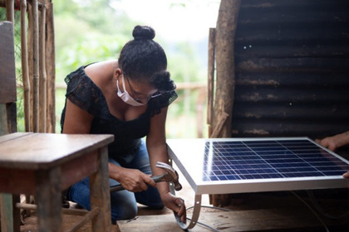

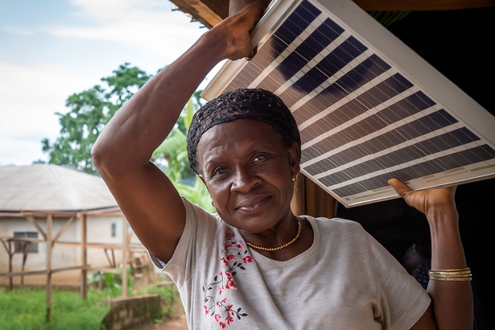
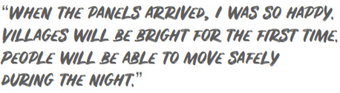
Conclusion
Women: The World’s Most Undervalued Asset
Women are the world’s most undervalued asset — and yet, they hold the key to transformative, lasting change. At BCI, we’ve seen firsthand how investing in rural women unlocks ripple effects that strengthen entire communities. Globally, women continue to face systemic barriers in education, employment, and leadership, limiting not only their potential but the world’s growth. According to a McKinsey report, closing the gender gap could add $28 trillion to the global GDP.
BCI's work proves that when women are trusted with knowledge and tools, they become leaders, innovators, and change-makers. They bring light — literally and figuratively — to their villages. This is not just about equality; it's about survival, sustainability, and smart economics. Let’s stop seeing women as beneficiaries and start recognizing them as the driving force behind global progress.
"Empowering women is no longer an option, it is an economic and business imperative. At Goldman Sachs, we believe that when women do better, we all do better"
-WOMENOMICS: COVID-19’S IMPACT (June 2021)
Marta's Journey
Niembain Charlotte-
Grandmother and Solar Mama
Niembain Charlotte is a 60-year-old grandmother and former farmer from Cameroon who became a "Solar Mama" through BCI. Charlotte had left school early to fulfill family responsibilities and became a widow in 2007, raising a daughter and grandson on her own. After training, Charlotte began installing solar home lighting systems in Mpagne, a remote rainforest village accessible only by a difficult clay road. Her work brought solar electricity to 2,800 villagers in areas previously dependent on wood and kerosene for lighting. As a Solar Mama, she not only installs and maintains solar systems but also serves as a role model, demonstrating that age and educational background are no barriers to leadership and technical expertise.
Once a domestic worker & widowed mother of 4 in rural Guatemala, Marta overcame personal tragedy and poverty to become a trained solar engineer through BCI. With her daughter, she installed solar lighting systems in 100 homes across 3 villages, bringing light to 700 men, women and children. The installations brought families their first Christmas with clean, renewable light—saving the community approximately $800 and improving safety and dignity. Marta’s story demonstrates how BCI’s model empowers women to become agents of change, not only electrifying homes but also spreading knowledge within their communities.

