Slide 1
Backpropagation
Artificial Neural Network Learning

Slide 2
Network
Start untrained
Forward Propagate
Provides Garbage
Backward Propagate
Forward Propagate
Provides Garbage
Repeat 4 – 6 until no more garbage
Hopefully it has generalized

Slide 3
Network Definitions
Neuron
Sums up many input values
Activates – reLU (rectified linear unit)
Output = Max(0, input)
Non-linear possibility space
Contains weighted output paths
Not constrained
Layer
[]Neurons + bias
Full connection to next layer - bias

Slide 4
Derivative Terms
dOut/dNet = 0 || 1
dNet/dOut = weight
dErr/dOut = (out – expected)*2

Slide 5
Construction
Pass an array of integers
Creates the shape of the network
https://www.khanacademy.org/computer-programming/network-visualizer/6501225063186432
Random weight values [x, x+1]
Learn rate parameter
Test function sets this now

Slide 6
Forward Propagation
Make Matrices
One x outputs in a layer
Outputs in a layer x Nodes of next Layer
Matrix multiplication
[0.2, 2.4, 0.3, 1.0] X [[0.3, 0.4, -1.1], [-0.1, 2.5, 0.4], [-0.4, -0.2, -1.0], [1.0, 0.1, 1.6]
Increment Layer Multiply again

Slide 7
Backward Propagation
Output wrt Net Input
Contained within the node
Derivative of activation function
0 or 1 with reLU
Net Input wrt Output
Not contained
Equals the weight constant of the Output

Slide 8
Backward Propagation How I do it
Start at layer to update + 2 = L
Derivative is assigned to the neurons in layer L
Then next layers (Sum the Derivatives * Weight) * dOut/dNet
Finally the Output Layer derivatives

Slide 9
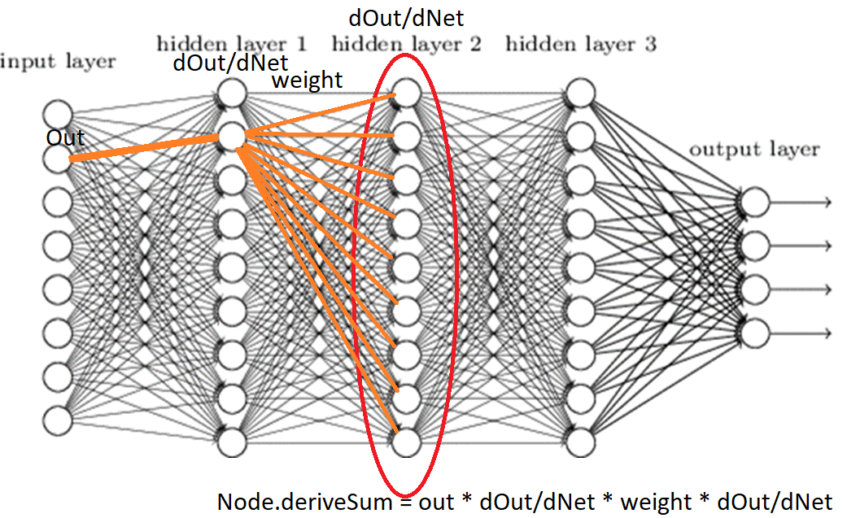

Slide 10
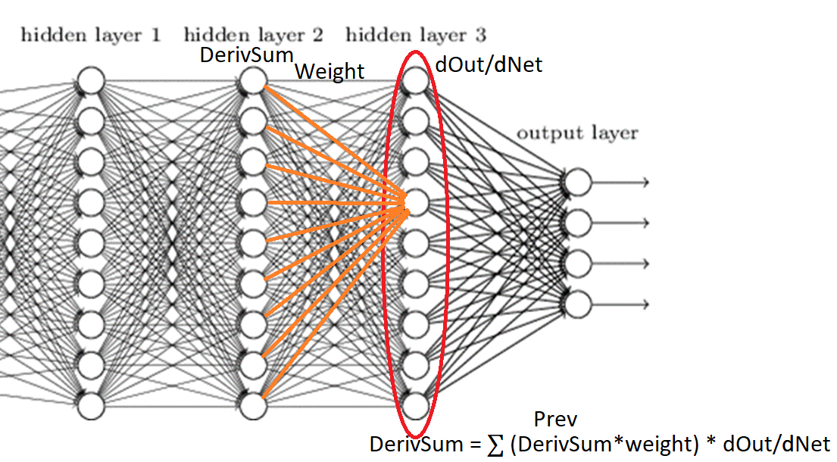

Slide 11
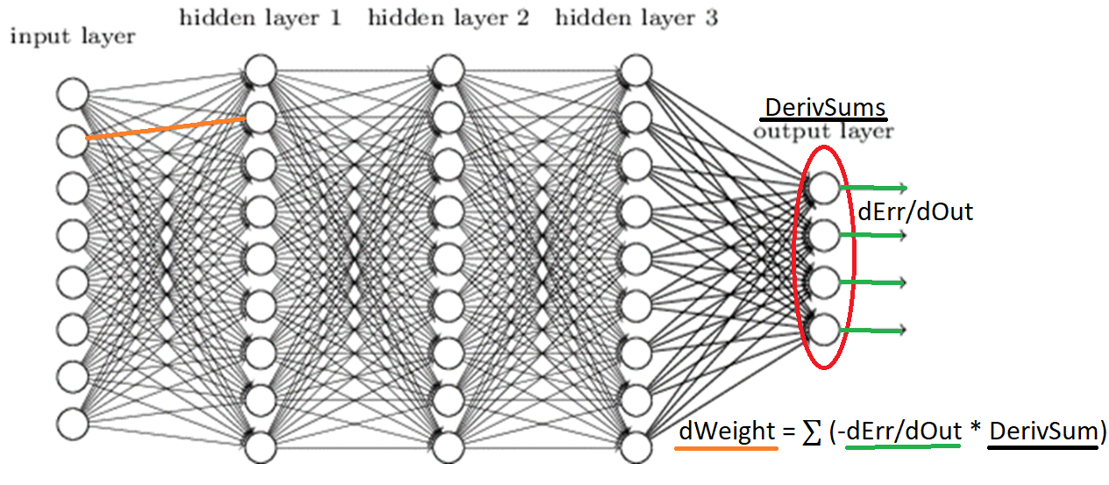

Slide 12
Backward Propagation Patterns
Number nodes used in each layer multiplied
Equals the number of paths
Groups of three (net wrt out, out wrt net, net wrt out)
First and last “reused-ish”
Out wrt net * ∑ net wrt outn
Outn wrt netn * ∑ netn wrt outnn
Don’t forget the Bias
WRT out sum up
WRT net Multiply

Slide 13
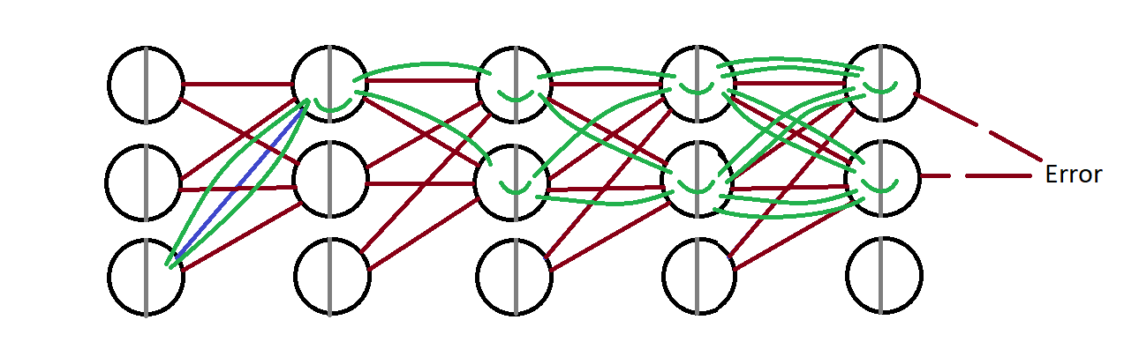

Slide 14
