Slide 1
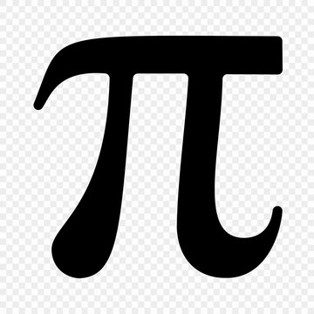
Fun Methods for Calculating
Colton Roe

Slide 2
Goals and Overview
Approximate π using three methods
Monte Carlo
Buffon’s Needle
Collision Simulation
Focus on the implementations rather than math
Live Simulation / Animation for each method

Slide 3
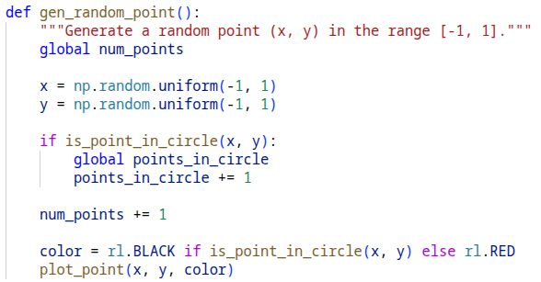

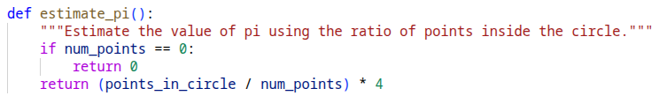
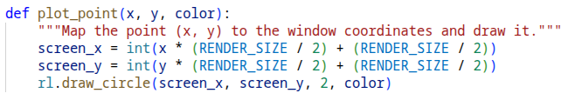
Monte Carlo Sampling
Generate a random point in a square
Check if it’s within the circle
Repeat this for many points
Estimate Pi using the formula:

Slide 4
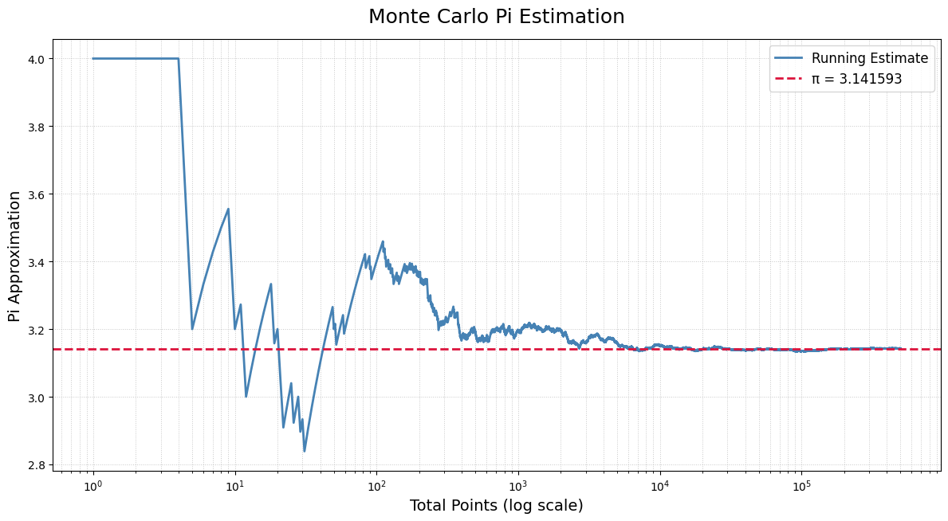
Monte Carlo Results
Final estimate: 3.142392 (500,000 points, 3 correct digits)
Error: 0.0324%
Lots of variation at low sample size
Converges slowly with many, many points needed for more correct digits

Slide 5

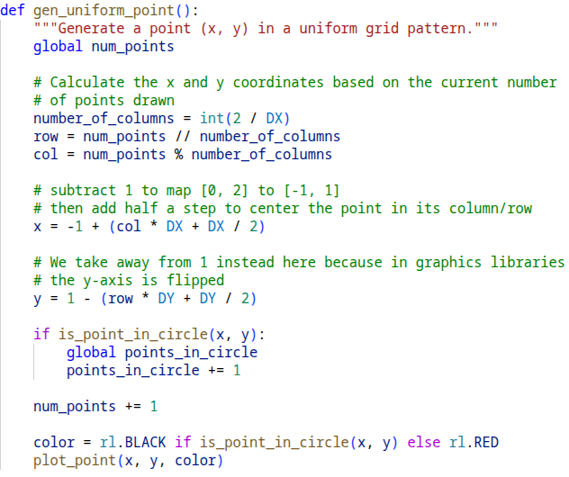
“Monte Carlo” with a Uniform Distribution
Divide the square into evenly spaced points
Check if each point is within the circle
Then we use the same formula as before:

Slide 6
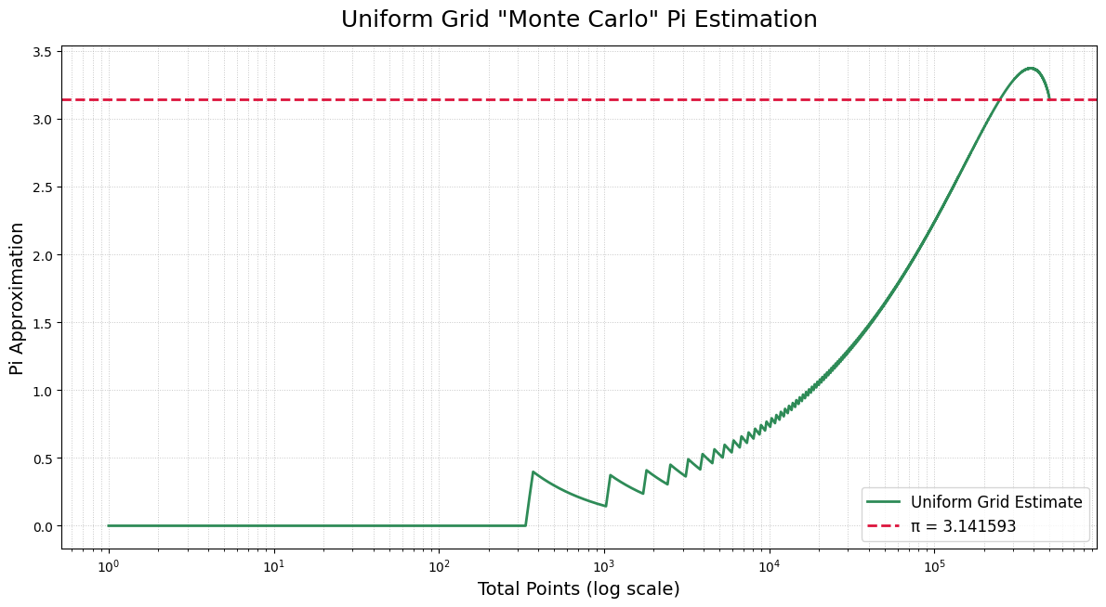
Uniform Distribution Results
Final estimate: 3.141504 (500,000 points, 5 correct digits)
Error: 0.0028%
Not accurate until all points are accounted for

Slide 7
Uniform Distribution Conclusion
Method | Pi Approximation | Error | Correct Digits
Monte Carlo | 3.142392 | 0.0324% | 3
Uniform Sampling | 3.141504 | 0.0028% | 5
At 500,000 points the uniform sampling produced a more accurate estimate
Monte Carlo has a high variance between runs due to randomness
The uniform sampling is deterministic, it will give the same result for the same number of points

Slide 8
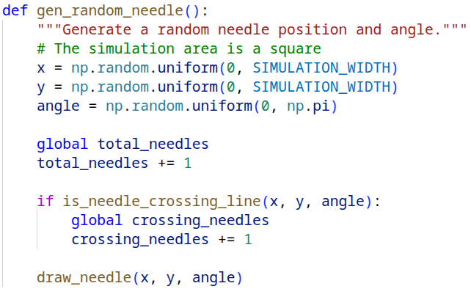

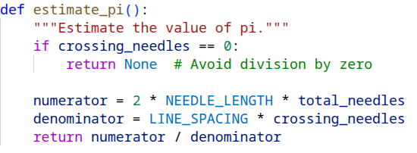
Buffon’s Needle
Drop a needle randomly onto parallel lines
Check if the needle crosses a line
Repeat many times
Use crossing probability to estimate pi:

Slide 9
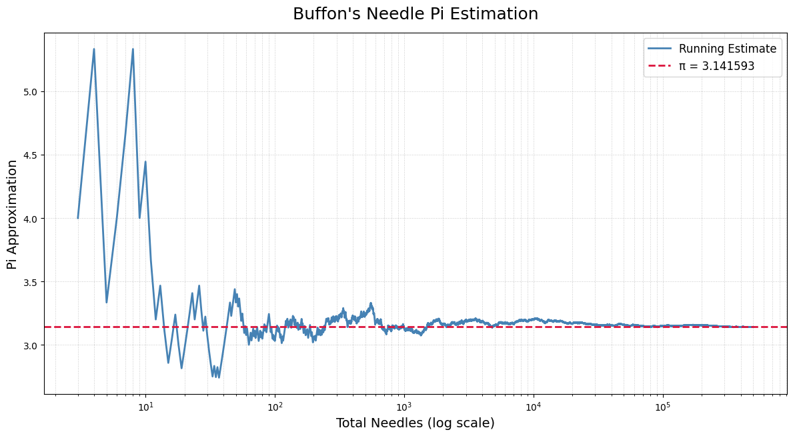
Buffon’s Needle Results
Final estimate: 3.146851 (500,000 needles, 3 correct digits)
Error: 0.1674%
High variation like Monte Carlo due to random sampling

Slide 10
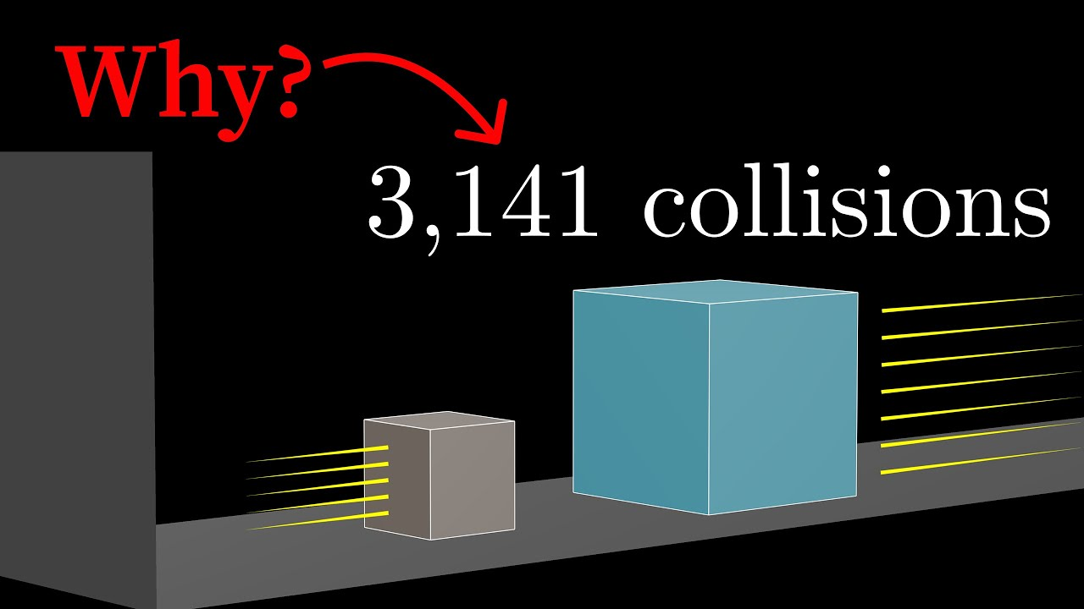
3Blue1Brown Video
https://youtu.be/6dTyOl1fmDo?si=2Ytav6EkIzkjxDS_
My simulation is inspired by 3Blue1Brown: “Why colliding blocks compute pi”

Slide 11
Collision Simulation
Two blocks on a friction-less surface with a wall
One block moves with constant velocity towards the other
The blocks collide elastically until no more collisions occur
Mass ratio controls how many digits of pi emerge
Implementation details
Euler’s method is too inaccurate for collisions
Use an event driven simulation instead

Slide 12
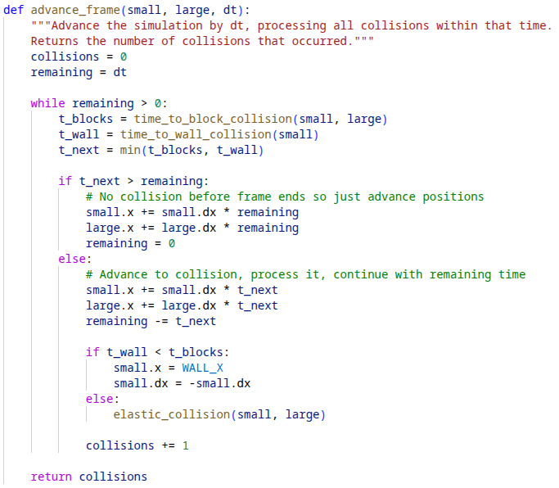
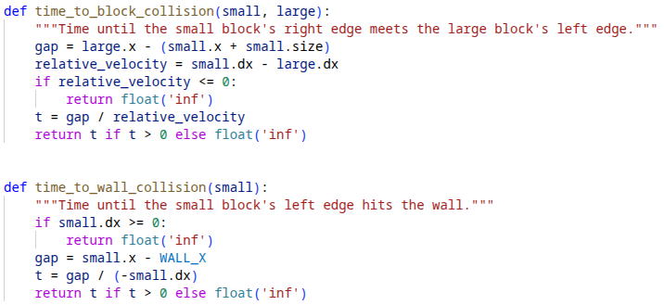
Implementation
Compute the time to next collision
If no collision: advance positions normally
If collision occurs:
Jump to exact collision time
Apply elastic collision
Repeat for the remaining time in the animation frame

Slide 13
Questions?

