Slide 1
Indoor Fitness Application
Joshua Cotterell

Slide 2
The Problem
People experiencing harsh weather conditions may find it difficult or unmotivated to run
Some people may be more motivated to exercise if the activity had a game-like environment
There is little opportunity to compete with friends
They may not like running with others/in a gym
Notes:
People may not like running with others – allow them to monitor how well they’re doing without having a gym membership

Slide 3
Aim
Incentivise people to exercise more by providing an application that can be used indoors and monitors their activity

Slide 4
Objectives
Build a mobile application
Monitor the user’s activity (steps, reps, hours done)
Allow user to share their data with others (friends/family)
Allow users to compete with others
Provide useful tips for the user
Compare with previous data or with a friend
Compare with similar data – for improvement
Notes:
Extended into something that distinguishes it from current technologies.
Could be a game.

Slide 5
My plan
Semester 1
Determine why people struggle to motivate themselves to run
Ensure the features I implement address these issues
Pick appropriate languages with which to develop the app
Semester 2
Build a prototype for devices running iOS
Research current technologies to distinguish my application from what is available
Notes:
1 – try to build an app to solve these problems
2 – comfortable with, have a device, popular
3 – try to find the best way to make this happen
Waterfall

Slide 6
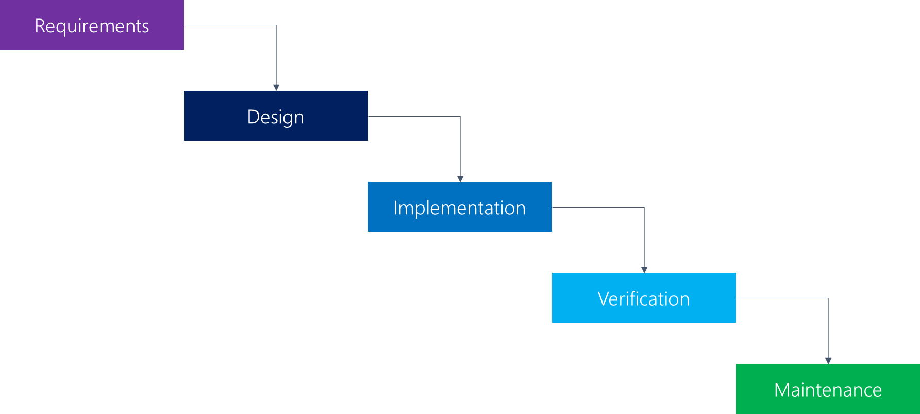
My plan – Waterfall Process Model

Slide 7
Potential
Virtual Reality (headset)
Immersive Experience (TV/Monitor)
Physical Therapy
Extend the application into a game

Slide 8
Summary
Address problems that currently exist that prevent people from exercising
Develop an application that solves these problems
Allow my application to be extended further to offer a new way to exercise

