Slide 1
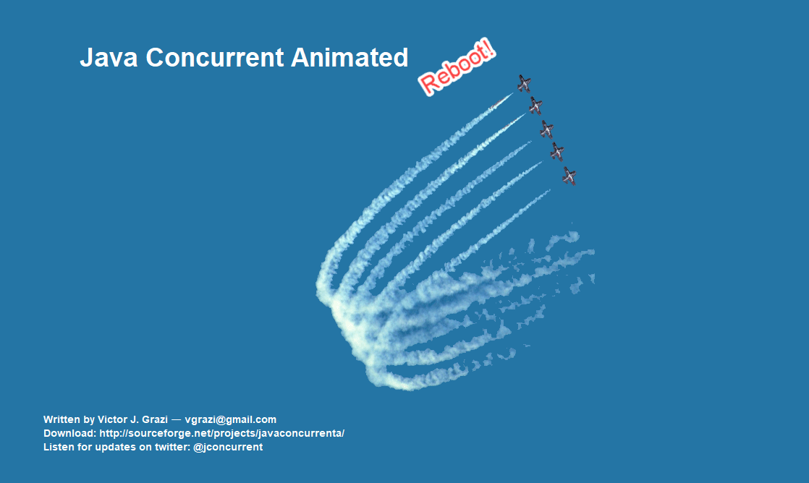

Java Concurrent Animated
Re-boot!
Visualizing the Java Concurrency APIs
by Victor Grazi - vgrazi@gmail.com
Twitter - @vgrazi
Please feel free to contribute:
http://github.com/vgrazi/JavaConcurrentAnimatedReboot

