Slide 1
Advanced Java Data Locality and Data IPC Transport Solutions:
An Introduction to OpenHFT
ben.cotton@jpmorgan.com
ben.cotton@alumni.rutgers.edu
Jan 27, 2015

Slide 2

For real-time Java deployments (with the strictest SLAs) the problem of JVM “Stop the World” GC activity (on medium-lived on-Heap objects) is a MONSTROUS problem.
2

Slide 3


Simple Remedy?
Design Java developments and deployments so that medium-lived Collections (e.g. that “old dog” HashMap) object instance(s) are taught a “new trick” …. That “new trick” is simple: take HashMap completely Off-Heap.
Good Boy!
Off-Heap you go …
The Heap
3

Slide 4
But What kind of HashMap are we putting Off-Heap?
java.util.HashMap ?
Collections.synchronizedMap( java.util.HashMap ); ?
java.util.concurrent.ConcurrentHashMap ?
something entirely different ?
ANSWER: something very different (indeed)!
OpenHFT’s Chronicle Map SOLUTION
net.openhft.chronicle.map.ChronicleMap
4

Slide 5
What exactly is OpenHFT?
100% Open Source
Designed to empower Higher Frequency Trading (HFT)
https://github.com/OpenHFT (developer source repo)
http://www.openhft.net (Products. Services. Training)
Provides modules that empower ultra low latency Java deployments to achieve REAL-TIME compliance (with even their strictest of SLAs)
Java-Lang (Marshalling / GC Free De-Marshalling / Thread-SAFE / IPC-SAFE / Off-Heap/ 64-bit ByteBuffers)
Chronicle-Queue (persisted low-latency Queue messaging and Logging)
Chroncile-Map (ChronicleMap, Thread-SAFE/IPC-SAFE/Off-Heap)
Chronicle-Engine Fast Data Framework.
Java-Runtime-Compiler (builds OpenHFT native impl classes – in process – of user supplied JBI interfaces)
Java-Thread-Affinity (allows JVM Threads to be pinned by affinity to specific OS cpus)
TransFIX (ultra low latency FIX engine)
5

Slide 6
What really is OpenHFT?
OpenHFT is a 100% OSS solution that empowers Java developers to deliver the highest performing and most flexible
Data Locality (Optimised memory layout)
And
Data IPC Transport (waaay faster than UDP/TCP)
Capabilities.
6

Slide 7
PART 1
OpenHFT as an Advanced Java Data Locality Provider
(That’s right folks! We’re going Off-Heap)
7

Slide 8
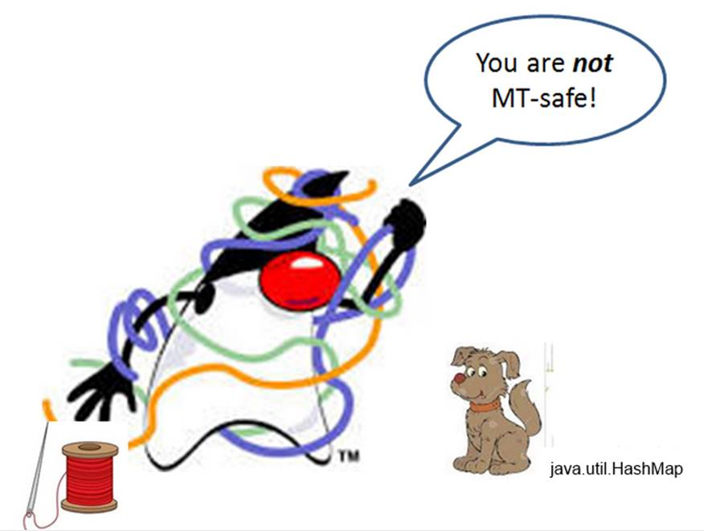
java.util.HashMap
8

Slide 9
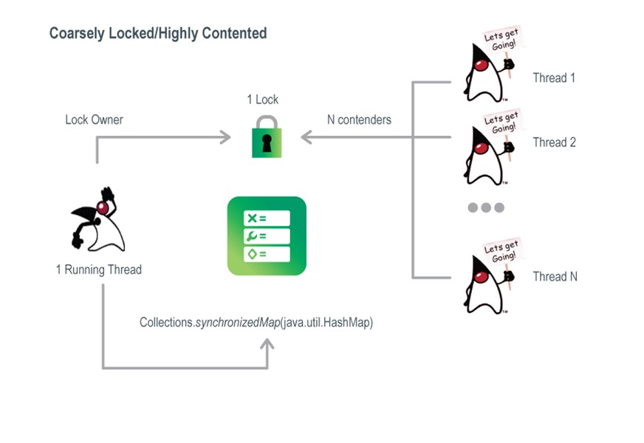
Collections.synchronizedMap( java.util.HashMap );
9

Slide 10
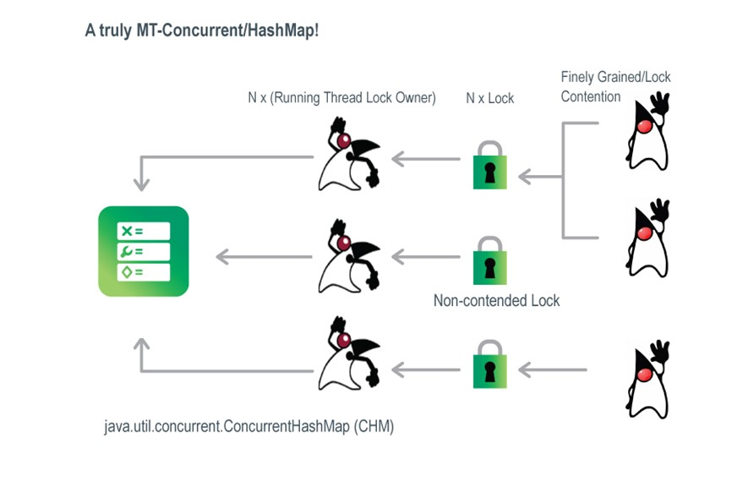
10

Slide 11
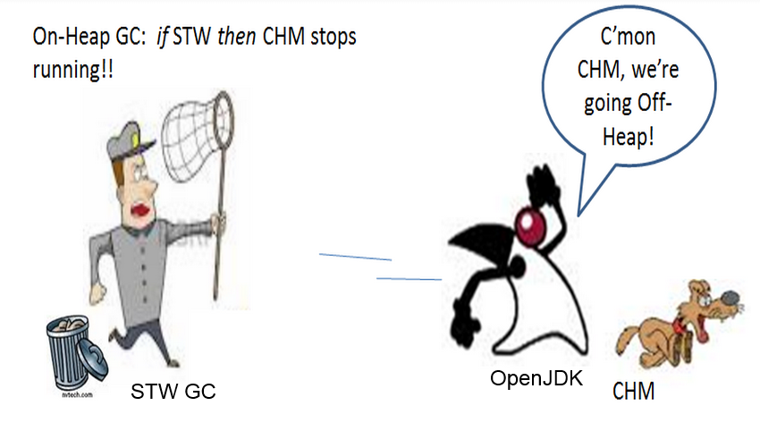
11

Slide 12
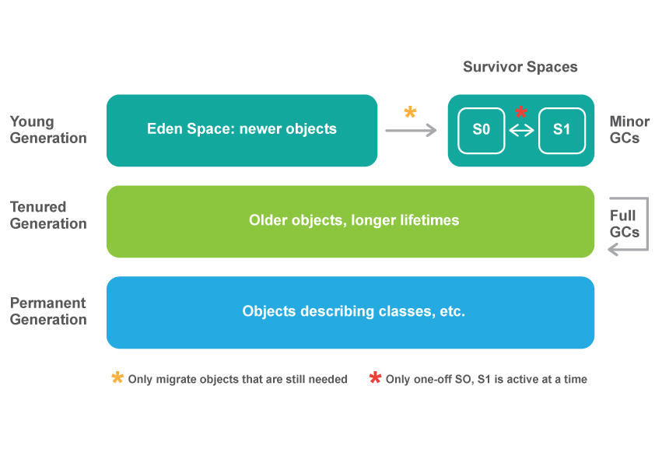
Java Heap Layout: Through the Generations View
12

Slide 13
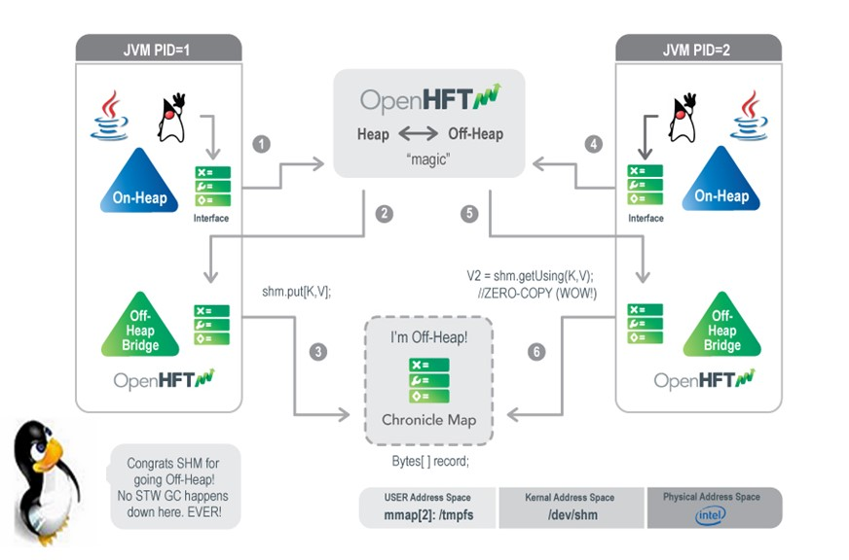
OpenHFT: Off-Heap ChronicleMap … an Architectural View
13

Slide 14
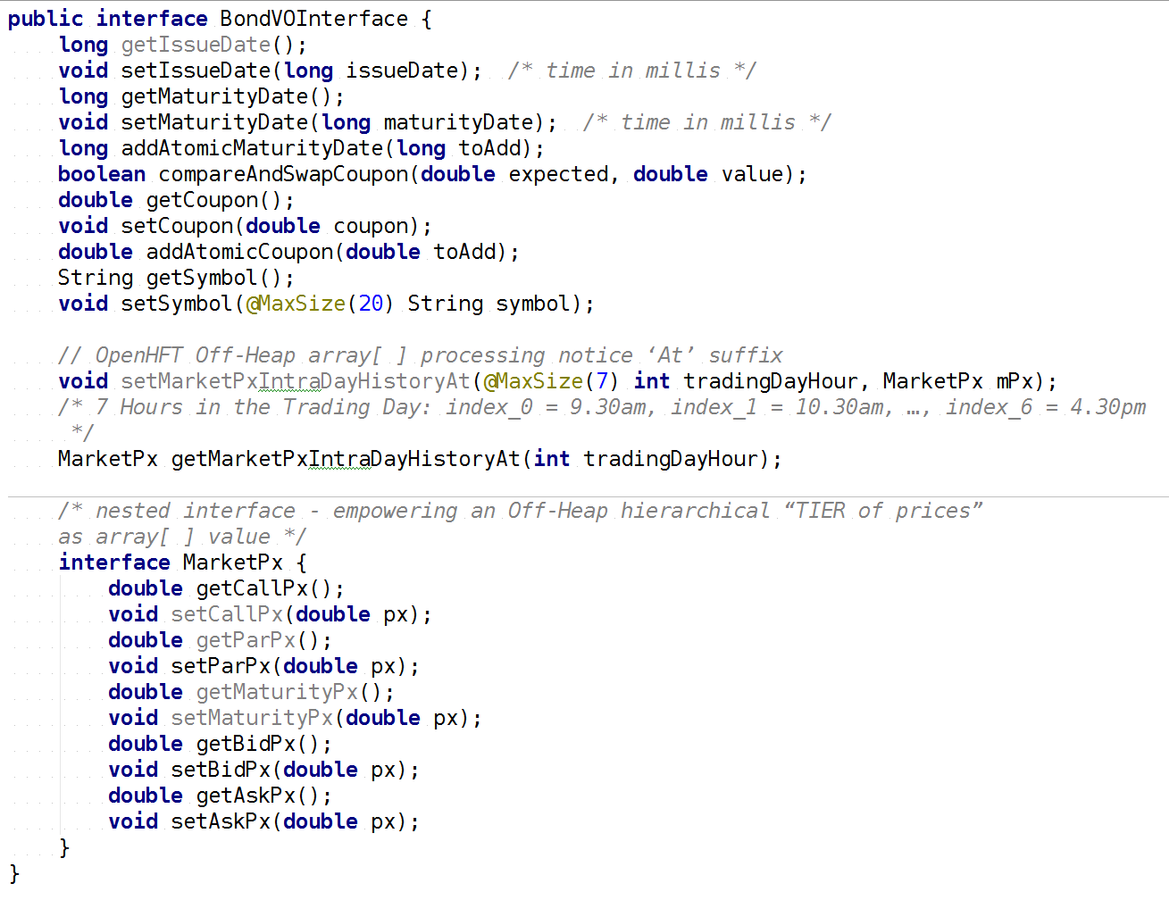
OpenHFT : Step #1 (PID 1)
14

Slide 15
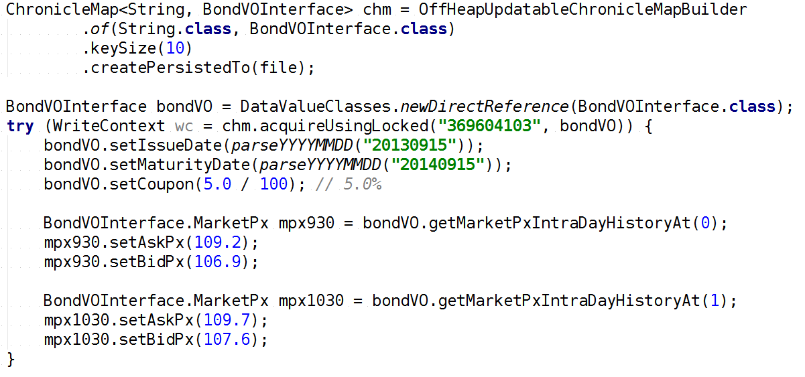
OpenHFT : Step #2 (PID 1) – thread safe write to off heap
15

Slide 16
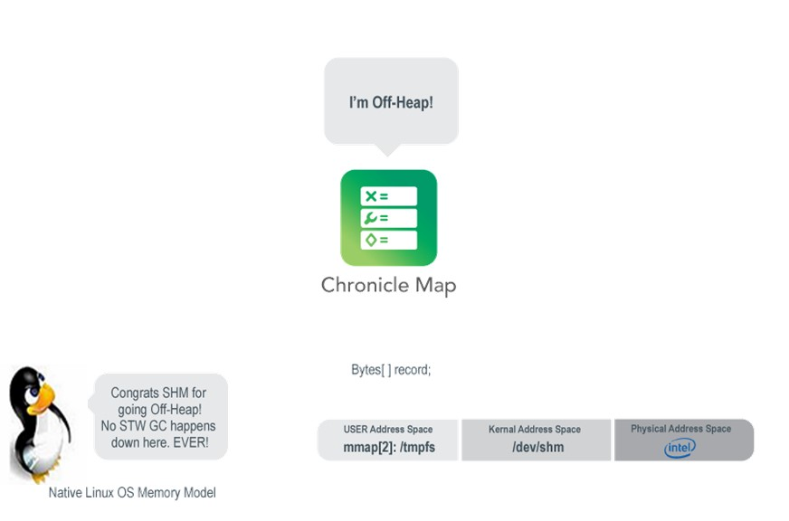
OpenHFT : Step #3 (PID 1)
16

Slide 17
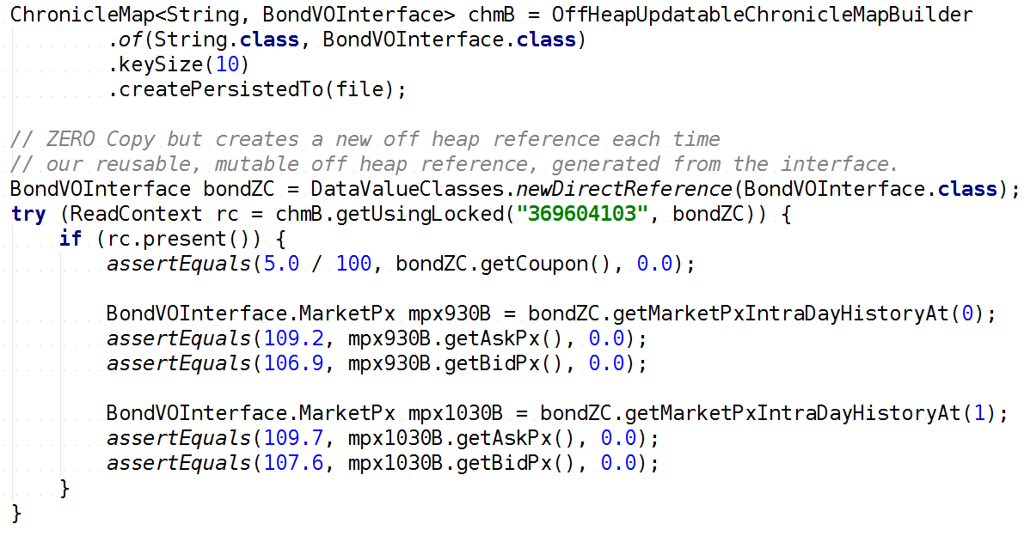
OpenHFT : Step #4 (PID 2) – thread safe read (concurrent)
17

Slide 18
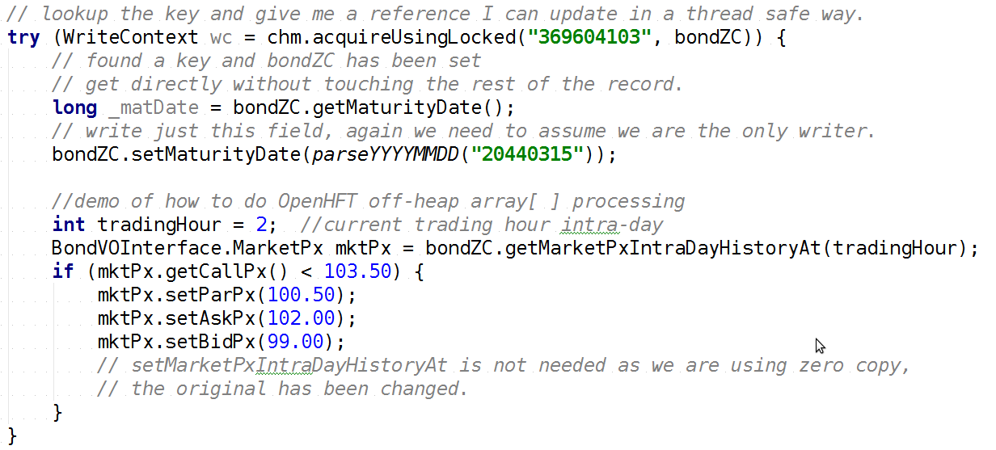
OpenHFT : Step #5 (PID 2) update an existing entry (thread safe)
18

Slide 19
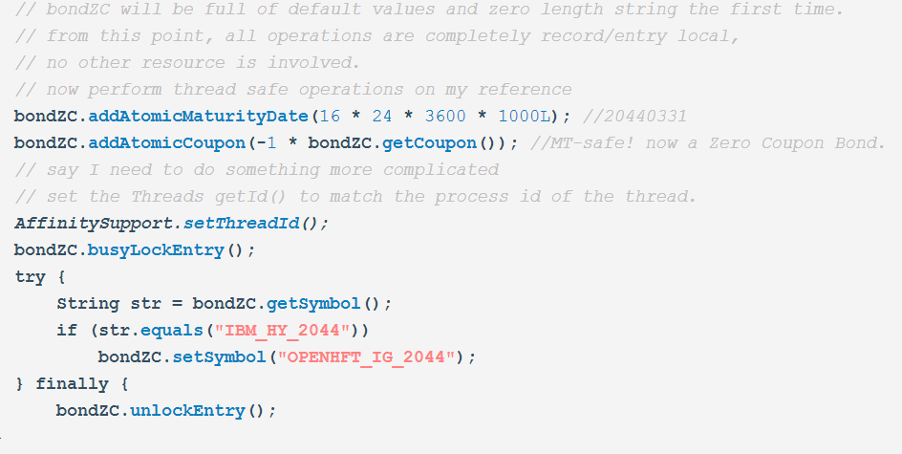
OpenHFT : Step #6 (PID 2)
19

Slide 20
OpenHFT : Step #6 (PID 2)
OpenHFT code sample demo Summary:
MT-SAFE operations
IPC-SAFE operations
IPC-ATOMIC operations
ZERO-COPY (*)
GC-Free Marshalling/De-Marshalling
Ambition to provide the symmetry of java.util.concurrent.* API support across native Linux processes (not just Threads!)
Nanosecond transport latency (stay tuned for details)
* (note on Map<K,V > type domain support status).
S
20

Slide 21
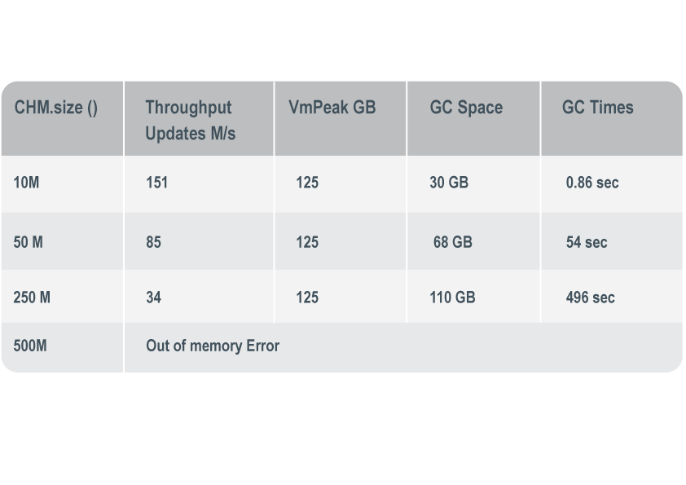
Performance Results: CHM vs. SHM On Linux 14.04, dual E5-2650 v2 @ 2.60GHz, 128 GB memory, each entry updated 32 times.
ConcurrentHashMap -Xmx110g -Xms110g -verbose:gc
21

Slide 22
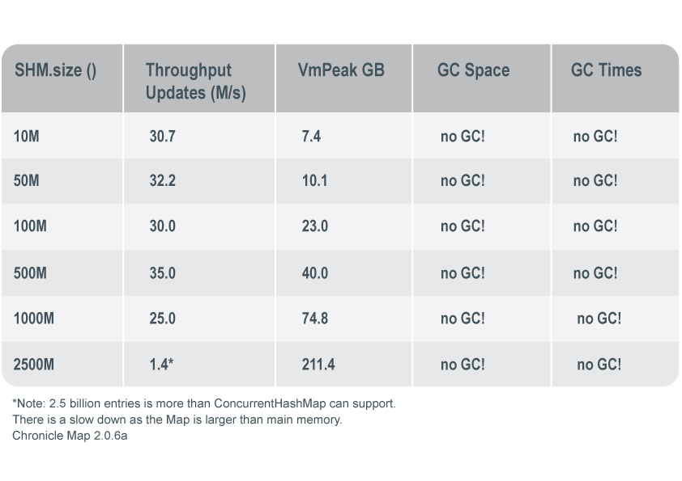
Performance Results: CHM vs. SHM On Linux 14.04, dual E5-2650 v2 @ 2.60GHz, 128 GB memory, each entry updated 32 times.
22

Slide 23
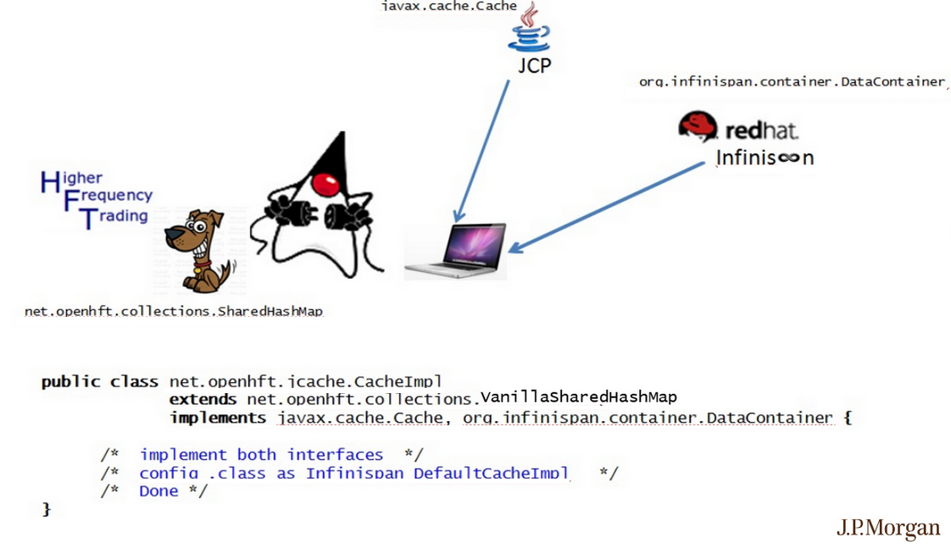

OpenHFT as an Off-Heap JCACHE Provider (e.g. RedHat JDG Infinispan)
23

Slide 24
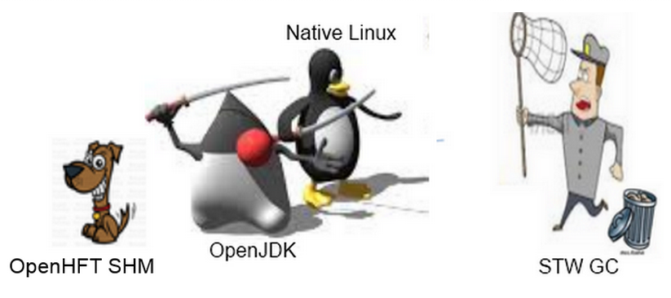
OpenHFT empowers developers to use OpenJDK and Native Linux OS to 100% protect their medium-lived Java Collections (ChronicleMap) from being impacted by STW GC pauses.
24

Slide 25
PART 2
OpenHFT as an Advanced Java IPC Transport Provider
(That’s right folks! UDP/TCP now joined by native Linux /dev/shm IPC)
25

Slide 26
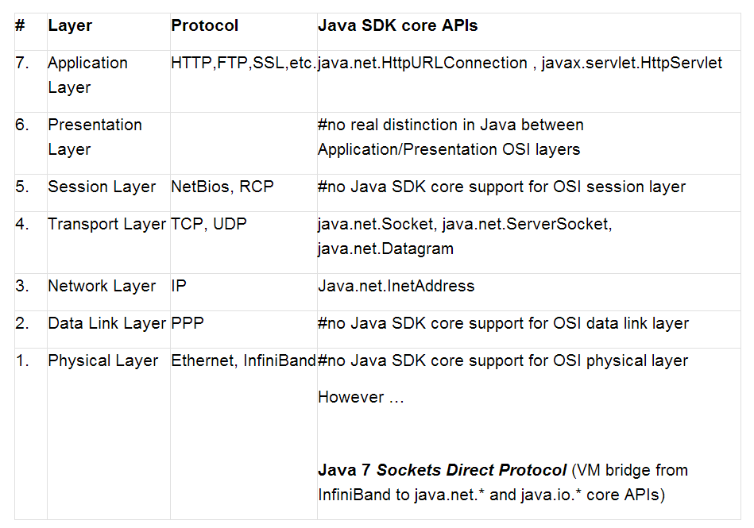
OSI Model of Networking Layers:
26

Slide 27
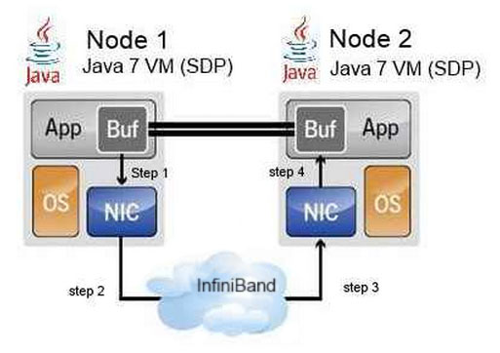
Java 7 Sockets Direct Protocol: Delivering SDP/IB as a Transport
27

Slide 28
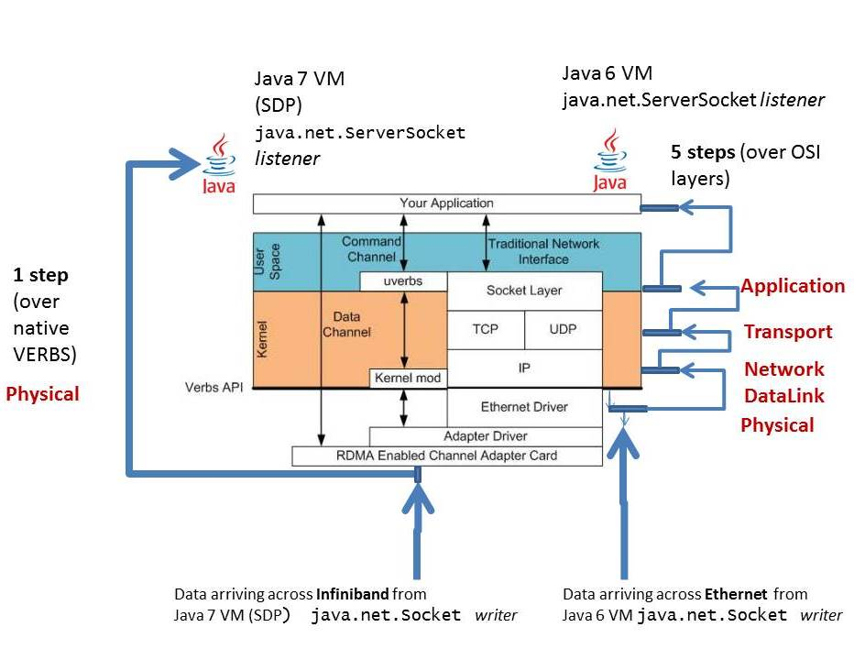
Java 7 Sockets Direct Protocol: Delivering to Java its first RDMA capability
28

Slide 29
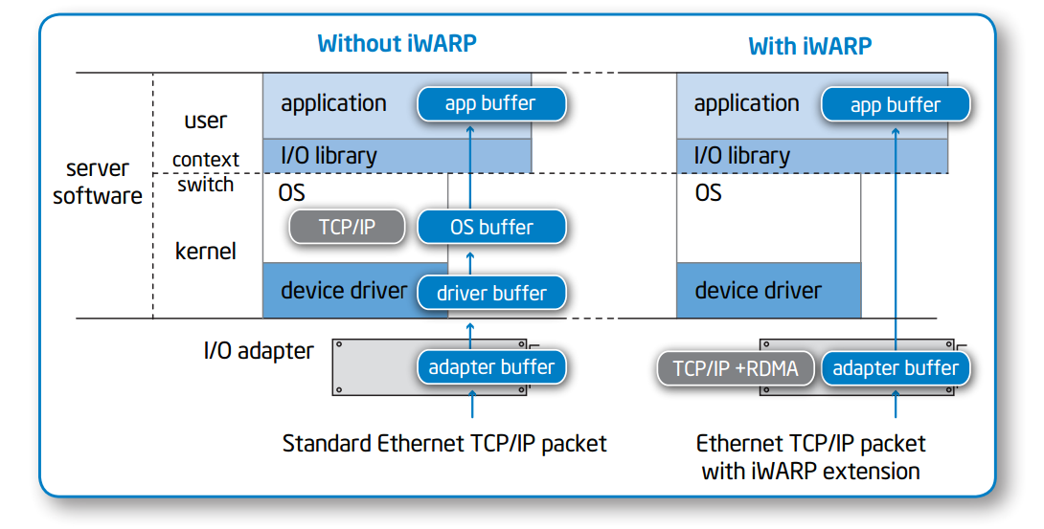
Intel iWARP: potential to empower Java 9 with SDP/10gE as a Transport
With SDP/10gE Java 9 will be able to deliver RDMA to the Java Ethernet masses!
29

Slide 30

OpenHFT as a /dev/shm IPC Transport Provider:
“I want to be disruptive rather than rehash or just slightly improve existing products.”
08/14/2014
Ah, the glory!
peter.lawrey@higherfrequencytrading.com
30

Slide 31
OpenHFT as a /dev/shm IPC Transport Provider:
ZERO COPY capability
Advanced BytesMarshallable impl of Externalizable – for CBV Copy tolerant parts of Liquidity Risk AE.
ZERO GC
CAPACITY LIMITED ONLY BY PHYSICAL RAM
CONSISTENTLY 438% Faster than On JVM Heap Cache<K,V> like operands
JPM Tests show= Mean 350 nano-second /dev/shm latency (ZC Entry<K,V> transport, RDR_DIM Mock)
DOES NOT SUPPORT FULLY-TRANSITIVE GENERIC V=Object Graph as Cache<K,V> Operand. Currently {String, primitive} for ZC. NO immediate Plug-N-Play w/ RDR_DIM Operands used by Liquidity Risk AE
NOT YET ADAPTED w/in RedHat JDG as JSR-107 compliant Cache<K,V> Operand.
31

Slide 32
PROOF IS IN THE TEST RESULTS: What do we get using OpenHFT vs. RedHat JDG?
OpenHFT /dev/shm/SharedHashMap<K,V> as operand provider:
To try , run the following command in 2 separated terminals ( (rm /dev/shm/*) Left player must be started first!):
java \
org.junit.runner.JUnitCore \ net.openhft.collections.fromdocs.com.jpmorgan.pingpong_latency.PingPongPlayerLeft
java \
org.junit.runner.JUnitCore \ net.openhft.collections.fromdocs.com.jpmorgan.pingpong_latency.PingPongPlayerRight
32424: 1 x _bondEntryV.getCoupon() (last _couponL=[5.00 %]) in 37.0 nanos
32425: 1 x _bondEntryV.getCoupon() (last _couponL=[5.00 %]) in 37.5 nanos
32423: 1 x _bondEntryV.getCoupon() (last _couponR=[4.00 %]) in 37.0 nanos
32424: 1 x _bondEntryV.getCoupon() (last _couponR=[4.00 %]) in 31.0 nanos
Full results at https://github.com/Cotton-Ben/HugeCollections/tree/master/collections/src/test/java/net/openhft/collections/fromdocs/com/jpmorgan/pingpong_latency
32

Slide 33
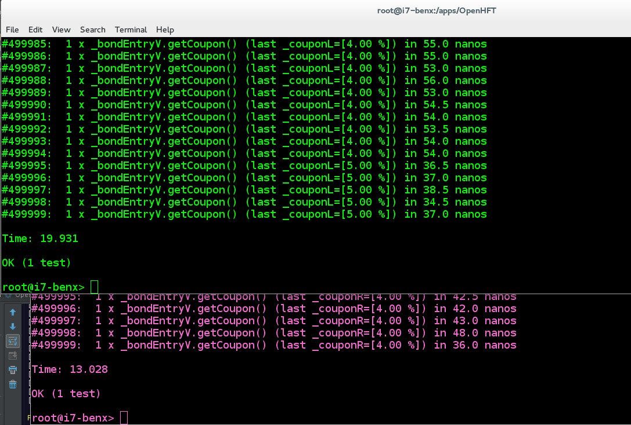
OpenHFT /dev/shm/SharedHashMap<K,V> as operand provider:
33

Slide 34
PROOF IS IN THE TEST RESULTS: What do we get using OpenHFT vs. RedHat JDG?
RedHat JDG and JCACHE<K,V> as operand provider:
To try with a distributed cache, run the following command in separated terminals:
java \
-cp "target/classes:target/dependency/*“ \
org.infinispan.quickstart.clusteredcache.Node \
-d LEFT
java \
-cp "target/classes:target/dependency/*“ \
org.infinispan.quickstart.clusteredcache.Node \
-d RIGHT
counter=[217924] cache.put('369604103',3.000%); took 92,599 nanos
counter=[217925] cache.put('369604103',6.000%); took 90,062 nanos
counter=[42529] fl=[5%] = cache.get('369604103'); took 52,624 nanos
counter=[42530] fl=[6%] = cache.get('369604103'); took 47,981 nanos
( full results at https://github.com/Cotton-Ben/infinispan-quickstart/tree/master/clustered-cache )
34

Slide 35
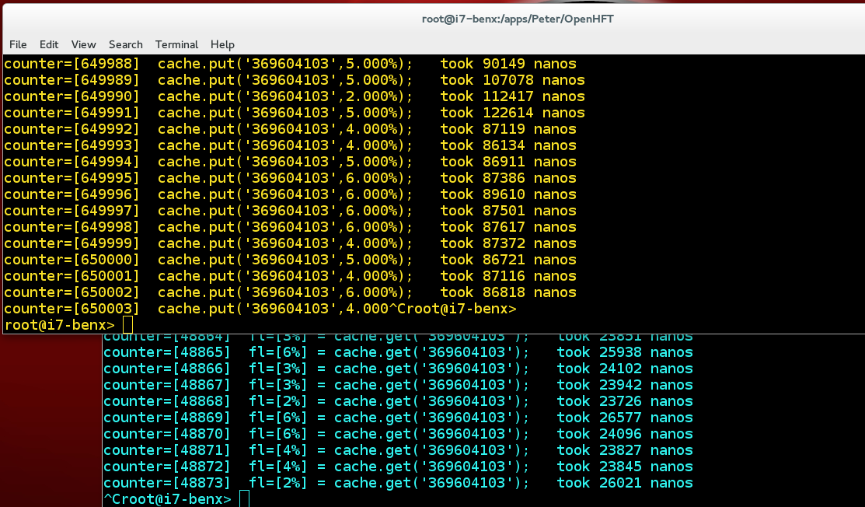
RedHat JDG and JCACHE<K,V> as operand provider (1,000x slower)
35

Slide 36
Bottom Line = Tests by Real-Time Liquidity Risk Technology AggEng team imperically demonstrate that OpenHFT off-heap over /dev/shm IPC transport is 1,000x faster than RedHat JDG on-heap over UDP OSI-Loopback IPC transport.
IMMEDIATE NEXT STEPS:
NO DOUBT ABOUT IT = We need the OpenHFT off heap capability made available to us via the RedHat JDG product and its JCACHE API!
Explicit commits from Mircea re: adapting Peter’s OpenHFT SHM as RedHat JDG interoperable JSR-107 Cache<K,V>. RedHat customer support case?
Explicit commits from Bela re: “short circuiting” all node ←→ node transport resolution to use /dev/shm IPC as transport (instead of TCP/UDP) whenever possible … RedHat customer support case?
Explicit commits from Peter re: supporting above with OpenHFT as the Off-Heap provider. JPM retain OpenHFT via support subscription?
Continued commits/time planning re: Ben, Dmitry, Xiao efforts to maintained Fork’d repo and build sound/complete/confirming tests.
36

Slide 37
THE END
Note: For all things re OpenHFT
Please contact:
Peter.Lawrey@higherfrequencytrading.com
www.openhft.net
Peter.Lawrey@higherfrequencytrading.com
www.openhft.net
37

