Slide 1


https://github.com/OpenHFT/Chronicle-Algorithms/tree/master/src/main/java/net/openhft/chronicle/algo/locks
JDK 8+ && JEP-383
ChronicleStampedLock.java

Slide 2
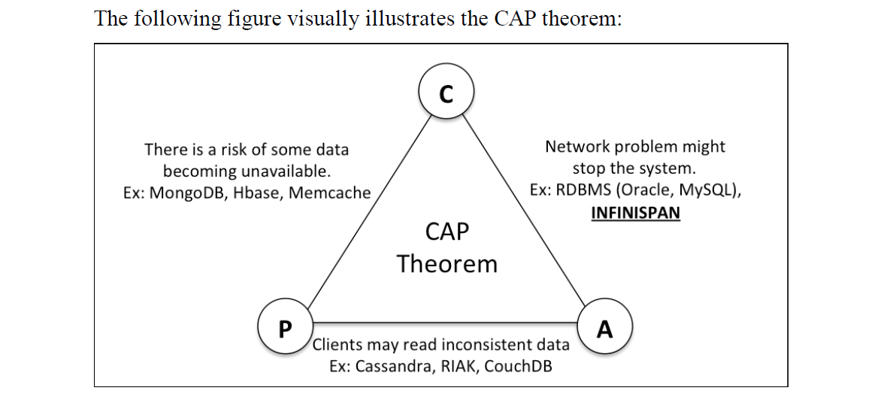
, Chronicle
In it BasEc join point CAP, Chronicle renders consistency via traditional protocols (e.g. Gossip, HeartBeat, etc.)

Slide 4






@t=1
…
@t >= 3
@t=2
/dev/shm/ChronicleStampedLock
Stmp = csl.tryOptimisticRead();
Stmp = csl.tryWriteLock();
?Dirty == csl.validate(Stmp);
ChronicleMap<K,V>
/dev/shm/BondVOInterface
@ www.xsede.org
Via https://jira.ncsa.illinois.edu/projects/DA/
@t=0
@t=0
JVM pid 2
JVM pid 1
ChronicleMap<String, BondVOInterface> chm =
ChroinicleMapBuilder…createPersistedTo(
“/dev/shm/BondVOInterface"
);
DirtyReadIntolerant
.java
DirtyReadOffender
.java

Slide 5
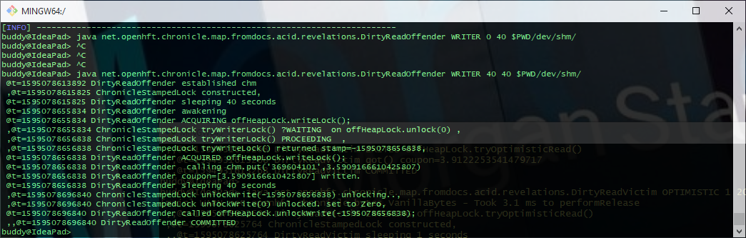
@t=0
@t = 3
@t=2

Slide 6
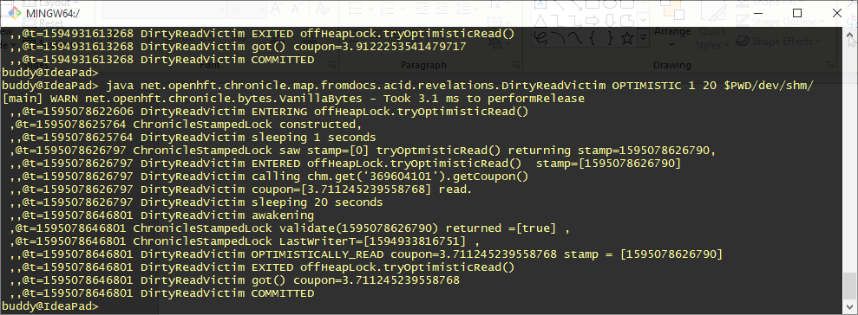
@t=0
@t=1
@t >= 3

Slide 7
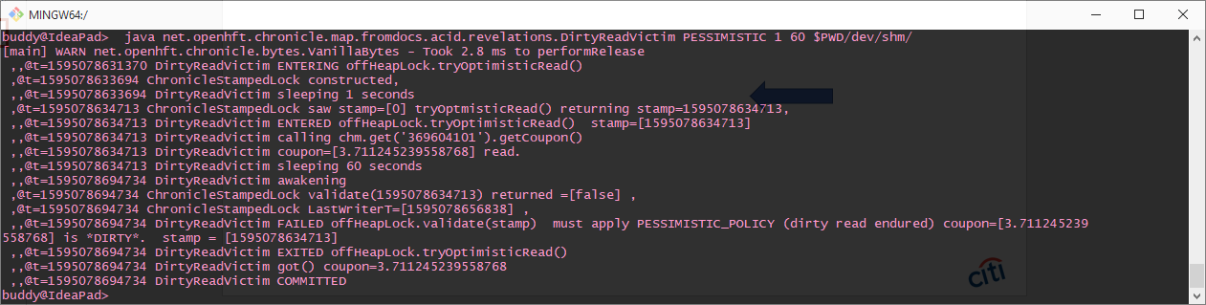
@t=0
@t=1
@t >= 3

