Slide 1

Liquidity Risk Technology Core Services AggEng Team’s Usage Considerations/Concerns wrt RedHat JDG:
Our Search for an Advanced Off-Heap Zero-Copy Java IPC Transport Capability Provider (OpenHFT)
An Historical “Once Upon a Time” Presentation …

Slide 2



In the beginning, instance of AggEng_Grid = {N1, N2, …N30}
POS data: perfectly, non-redundantly, distributed across 30 node Grid.
RDR_DIM data: non-perfect, redundantly, distributed across 30 node Grid
PROS: locality advantages, have more RDR_DIM local means faster
CONS: redundancy places an unwelcome stress on GRID data capacity
REMEDY GOAL: provide operational RDR_DIM with zero redundancy.
JPMC LRI AE
POS|RDR_DIM
O PERAND SET
P
D
P
D
P
D
…
RH JDG 5.3
ISPN/JGRPS
ISPN/JGRPS
ISPN/JGRPS
JDK 1.7
1
2
30
LRI4U060.svr.us.ny.jpmorgan.com
RHEL 5.10

Slide 3
Next, same instance of AggEng_Grid = {N1, N2, …N30}: USE JNI/C++ on /dev/shm/RDR_DIM
PROS: Decades reliable Unix/C++/C tactics for operating on /dev/shm
CONS: Risks to the entire grid should a subtle bug cause JVM crash
REMEDY GOAL: Do something similar w/ dev/shm/ but not using any JNI/C++ but rather using 100% Java (NIO and MemoryMappedFiles)
JNI/C++
JNI/C++
JNI/C++
P
P
P
JPMC LRI AE
POS|RDR_DIM
O PERAND SET
…
RH JDG 5.3
ISPN/JGRPS
ISPN/JGRPS
ISPN/JGRPS
JDK 1.7
1
2
30
/dev/shm/RDR_DIM (50gb)
RHEL 5.10
LRI4U060.svr.us.ny.jpmorgan.com

Slide 4
Next, same instance of AggEng_Grid = {N1, N2, …N30}: USE 100% Java on /dev/shm/RDR_DIM (java.nio.MappedByteBuffer)
PROS: 100% Java supported API and capability … very popular if CBV COPY is acceptable
CONS: NIO alloc() limits. fails to deliver CBR ZC. Not only just the Entry<k,V>, the whole Cache<k,V> transports
REMEDY GOAL: There is no such thing as a Java ZERO-COPY call-by-reference IPC capability! It is all call-by-value in Java and that means the monstrous 50gb /dev/shm/RDR_DIM will *copy* itself into the JVM Node’s address space on each invoke: HELP! What we have is USELESS.
100% Java NIO
100% Java NIO
CBV 50gb Operand
*COPY* to
JVM ==
USELESS!
100% Java NIO
P
P
P
JPMC LRI AE
POS|RDR_DIM
O PERAND SET
…
RH JDG 5.3
ISPN/JGRPS
ISPN/JGRPS
ISPN/JGRPS
JDK 1.7
1
2
30
/dev/shm/RDR_DIM (50gb)
RHEL 5.10
LRI4U060.svr.us.ny.jpmorgan.com

Slide 5
Next, same instance of AggEng_Grid = {N1, N2, …N30}: Find a Off-Heap ZERO-COPY Java IPC provider (/dev/shm/ native Transport)
PROS: we can attain Java CBR ZC via a niche off-heap provider. Not radical. Only REF not VALUE copies are transported.
CONS: we will likely have to use a solution built around sun.misc.Unsafe
REMEDY GOAL: Find a Java ZERO-COPY call-by-reference IPC capability PROVIDER
Java ZC /dev/shm
IPC
PROVIDER
Java ZC /dev/shm
IPC
PROVIDER
Java ZC /dev/shm
IPC
PROVIDER
P
P
P
JPMC LRI AE
POS|RDR_DIM
O PERAND SET
…
RH JDG 5.3
ISPN/JGRPS
ISPN/JGRPS
ISPN/JGRPS
JDK 1.7
1
2
30
/dev/shm/RDR_DIM (50gb)
RHEL 5.10
LRI4U060.svr.us.ny.jpmorgan.com

Slide 6
Next, same instance of AggEng_Grid = {N1, N2, …N30}: The Search for Provider
PROS: surveying numerous candidate providers may empower us with distinctive choices.
CONS: credible searches for such a provider sets is limited, non-mainstream.
REMEDY GOAL: Martin? Peter? Apache DirectMemory? WHO?
Java ZC /dev/shm
IPC
PROVIDER
Java ZC /dev/shm
IPC
PROVIDER
Java ZC /dev/shm
IPC
PROVIDER
P
P
P
JPMC LRI AE
POS|RDR_DIM
O PERAND SET
…
RH JDG 5.3
ISPN/JGRPS
ISPN/JGRPS
ISPN/JGRPS
JDK 1.7
1
2
30
/dev/shm/RDR_DIM (50gb)
RHEL 5.10
LRI4U060.svr.us.ny.jpmorgan.com

Slide 7

Next, same instance of AggEng_Grid = {N1, N2, …N30}: Martin?
PROS: extremely articulate, established “off-heap” leader. Leads Mechanical-Sympathy community
CONS: not forthright with solution delivery. Wants to be paid up front. Very terse with our Q&A and inquiry into any solution details.
REMEDY GOAL: Wants 20,000 GBP to Train Us on building a Java ZERO-COPY /dev/shm IPC solution. WE’re interested, but have not yet cut a purchase order.
Java ZC /dev/shm
IPC
PROVIDER
Java ZC /dev/shm
IPC
PROVIDER
Java ZC /dev/shm
IPC
PROVIDER
P
P
P
JPMC LRI AE
POS|RDR_DIM
O PERAND SET
…
RH JDG 5.3
ISPN/JGRPS
ISPN/JGRPS
ISPN/JGRPS
JDK 1.7
1
2
30
/dev/shm/RDR_DIM (50gb)
RHEL 5.10
LRI4U060.svr.us.ny.jpmorgan.com

Slide 8

Next, same instance of AggEng_Grid = {N1, N2, …N30}: Peter and OpenHFT?
PROS: Exceptionally, unmistakably brilliant. Exceedingly generous, gentle. Committed to problem solving. Won’t abandon us as “don’t get it”. Will “suffer” with us when we get confused, “by our side”. Special.
CONS: Product set is not known to be in mainstream use. User not introduced to products via Tutorials and Developer Guides … currently only intro is via Git hosted unit-tests and community forums.
REMEDY GOAL: JPM deep-dive on OpenHFT library. We need to do lots of diligence work to soundly/completely assess Peter as solution provider.
Java ZC /dev/shm
IPC
PROVIDER
Java ZC /dev/shm
IPC
PROVIDER
Java ZC /dev/shm
IPC
PROVIDER
P
P
P
JPMC LRI AE
POS|RDR_DIM
O PERAND SET
…
RH JDG 5.3
ISPN/JGRPS
ISPN/JGRPS
ISPN/JGRPS
JDK 1.7
1
2
30
/dev/shm/RDR_DIM (50gb)
RHEL 5.10
LRI4U060.svr.us.ny.jpmorgan.com

Slide 9

Next, same instance of AggEng_Grid = {N1, N2, …N30}: Apache Direct Memory?
PROS: Backed by ASF, the world’s leading OSS provider. Used by Hazelcast Off-Heap solution.
CONS: Hard to find an individual “go to guy” with which to richly interact.
REMEDY GOAL: Survey the use of Apache DM to solve this problem. Try and find “go to” leaders w/in Apache DM community.
Java ZC /dev/shm
IPC
PROVIDER
Java ZC /dev/shm
IPC
PROVIDER
Java ZC /dev/shm
IPC
PROVIDER
P
P
P
JPMC LRI AE
POS|RDR_DIM
O PERAND SET
…
RH JDG 5.3
ISPN/JGRPS
ISPN/JGRPS
ISPN/JGRPS
JDK 1.7
1
2
30
/dev/shm/RDR_DIM (50gb)
RHEL 5.10
LRI4U060.svr.us.ny.jpmorgan.com

Slide 10

After much internal JPM analysis of candidate solution providers, Peter Lawrey’s OpenHFT solution emerged as the leader.
After Peter and Ben’s article @InfoQ published globally, the considerations/merits of the OpenHFT solution, OpenHFT was unmistakably confirmed as the leading sound/complete solution provider.

Slide 11
Winning SOLUTION PROVIDER = Peter Lawrey and OpenHFT
“I want to be disruptive rather than rehash or just slightly improve existing products.”
08/14/2014
Ah, the glory!

Slide 12
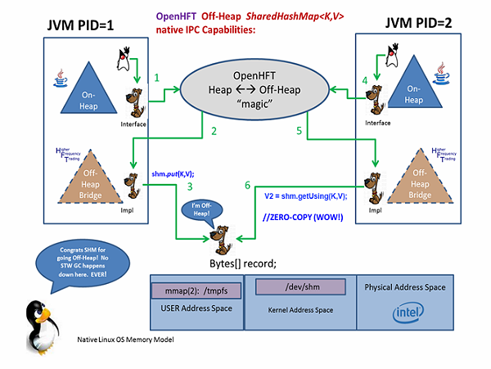
Winning SOLUTION PROVIDER = Peter Lawrey and OpenHFT
.jar

Slide 13

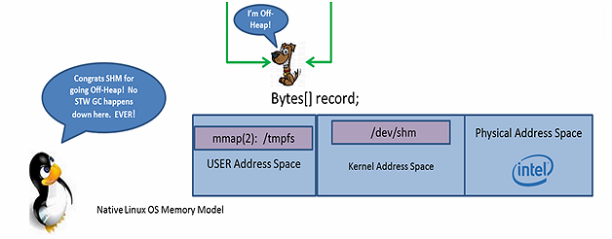
OpenHFT.net
Off-Heap
SHM
ZERO COPY capability
Advanced BytesMarshallable impl of Externalizable – for CBV Copy tolerant parts of Liquidity Risk AE.
ZERO GC
CAPACITY LIMITED ONLY BY PHYSICAL RAM
CONSISTENTLY 438% Faster than On JVM Heap Cache<K,V> like operands
JPM Tests show= Mean 350 nano-second /dev/shm latency (ZC Entry<K,V> transport, RDR_DIM Mock)
DOES NOT SUPPORT FULLY-TRANSITIVE GENERIC V=Object Graph as Cache<K,V> Operand. Currently {String, primitive} for ZC. NO immediate Plug-N-Play w/ RDR_DIM Operands used by Liquidity Risk AE
NOT YET ADAPTED w/in RedHat JDG as JSR-107 compliant Cache<K,V> Operand.

Slide 14
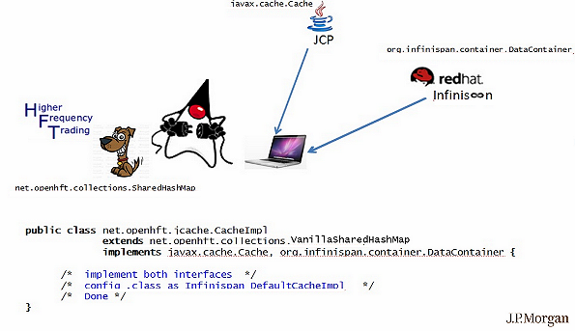



JPM LRI CS team will explicitly help design/develop/test to resolve concern= OpenHFT Solution NOT YET ADAPTED AS RedHat JDG JSR-107 compliant Cache<K,V> Operand. (Peter @OpenHFT, Mircea/Adrian @RedHat planned support for Ben, Dmitry, Charles @JPM)

Slide 15
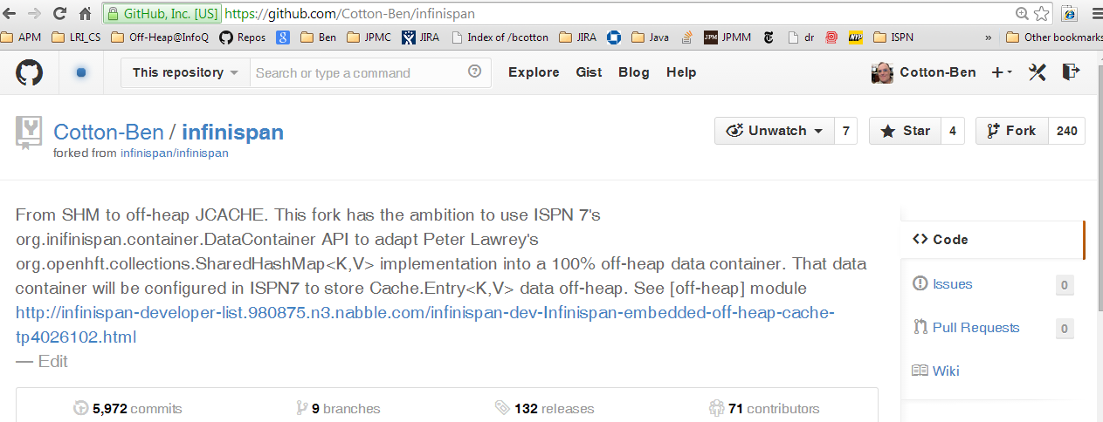
Ben, Dmitry, Xiao: Forked/Cloned explicit GitHUB repo to manage the OpenHFT/ISPN 7 build adoption.

Slide 16
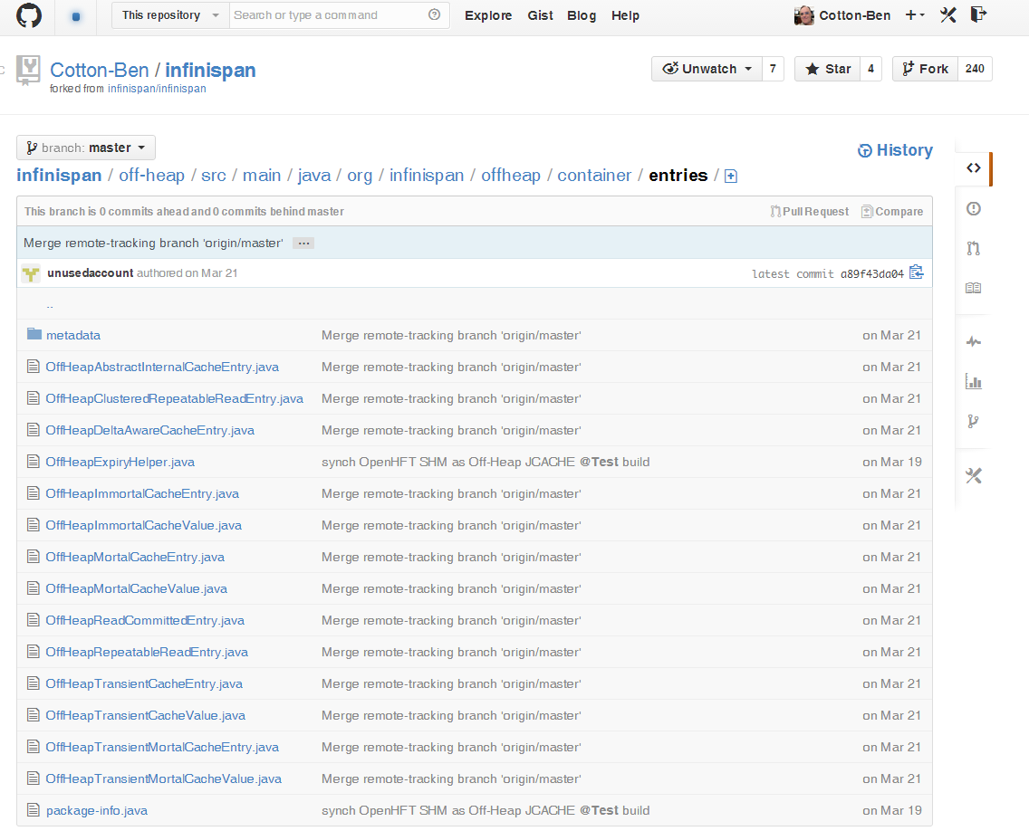

Slide 17
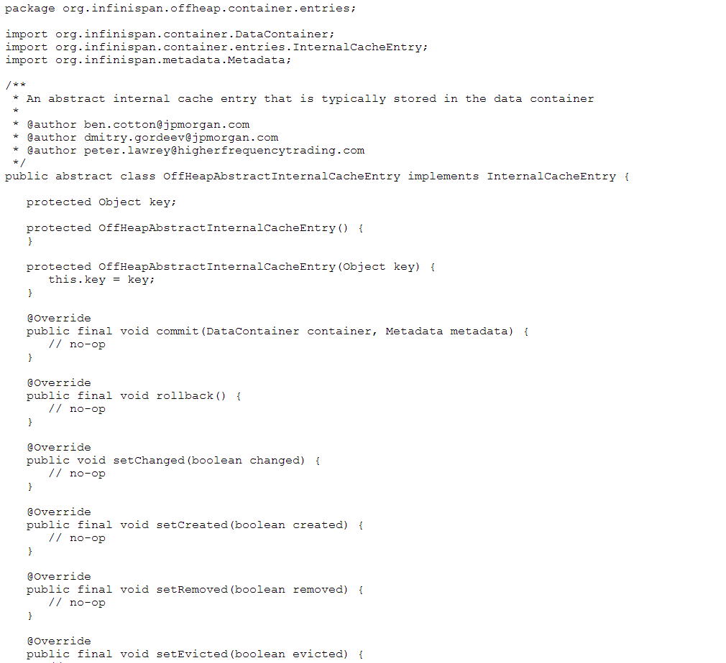
E.g.
https://raw.githubusercontent.com/Cotton-Ben/infinispan/master/off-heap/src/main/java/org/infinispan/offheap/container/entries/OffHeapAbstractInternalCacheEntry.java

Slide 18
//Mock RDR_DIM
public interface BondRDR_VOInterface {
void busyLockEntry() throws InterruptedException;
void unlockEntry();
long getIssueDate();
void setIssueDate(long issueDate);
long addAtomicIssueDate(long toAdd);
long getMaturityDate();
void setMaturityDate(long maturityDate);
long addAtomicMaturityDate(long toAdd);
double getCoupon();
void setCoupon(double coupon);
double addAtomicCoupon(double toAdd);
void setSymbol(@MaxSize(20) String symbol);
String getSymbol();
}

Slide 19
PID1 = Producer of Off-Heap /dev/shm/RDR_DIM data
SharedHashMap<String, BondRDR_VOInterface> shmP = new SharedHashMapBuilder()
.generatedValueType(true)
.entrySize(512)
.create(
new File(“/dev/shm/myBondRDR_PortfolioSHM"),
String.class,
BondRDR_VOInterface.class
);
BondRDR_VOInterface bondVO = DataValueClasses.newDirectReference(BondRDR_VOInterface.class);
BondRDR_VOInterface copyRDR = shmP.acquireUsing("369604103", bondVO);
copyRDR.setIssueDate(parseYYYYMMDD("20130915"));
copyRDR.setMaturityDate(parseYYYYMMDD("20330915"));
copyRDR.setCoupon(5.0 / 100); // 5.0%
// all 3 .setXXX() operations trigger a COPY into Off-Heap /dev/shm/

Slide 20
PID2 = Consumer of Off-Heap /dev/shm/RDR_DIM data
SharedHashMap<String, BondRDR_VOInterface> shmC = new SharedHashMapBuilder()
.generatedValueType(true)
.entrySize(512)
.create(
new File(“/dev/shm/myBondRDR_PortfolioSHM"),
String.class,
BondRDR_VOInterface.class
);
BondRDR_VOInterface bondVO = DataValueClasses.newDirectReference(BondRDR_VOInterface.class);
BondRDR_VOInterface zcRDR = shmC.acquireUsing("369604103", bondVO);
double _coupon = zcRDR.getCoupon();
assertEquals( 0.05, _coupon, 0.0); // it works! ☺
//ZERO COPY of bondVO Off-Heap /dev/shm/ reference
//ZERO COPY of shmC Map<K,V> reference
//ZERO COPY of zcRDR Entry<K,V> reference
//1x 8-byte COPY into On-Heap _coupon reference from Off-Heap zcRDR.coupon reference

Slide 21
PROOF IS IN THE TEST RESULTS: What do we get using OpenHFT vs. RedHat JDG?
OpenHFT /dev/shm/SharedHashMap<K,V> as operand provider:
To try , run the following command in 2 separated terminals ( (rm /dev/shm/*) Left player must be started first!):
java \
org.junit.runner.JUnitCore \ net.openhft.collections.fromdocs.com.jpmorgan.pingpong_latency.PingPongPlayerLeft
java \
org.junit.runner.JUnitCore \ net.openhft.collections.fromdocs.com.jpmorgan.pingpong_latency.PingPongPlayerRight
32424: 1 x _bondEntryV.getCoupon() (last _couponL=[5.00 %]) in 37.0 nanos
32425: 1 x _bondEntryV.getCoupon() (last _couponL=[5.00 %]) in 37.5 nanos
32423: 1 x _bondEntryV.getCoupon() (last _couponR=[4.00 %]) in 37.0 nanos
32424: 1 x _bondEntryV.getCoupon() (last _couponR=[4.00 %]) in 31.0 nanos
Full results at https://github.com/Cotton-Ben/HugeCollections/tree/master/collections/src/test/java/net/openhft/collections/fromdocs/com/jpmorgan/pingpong_latency

Slide 22
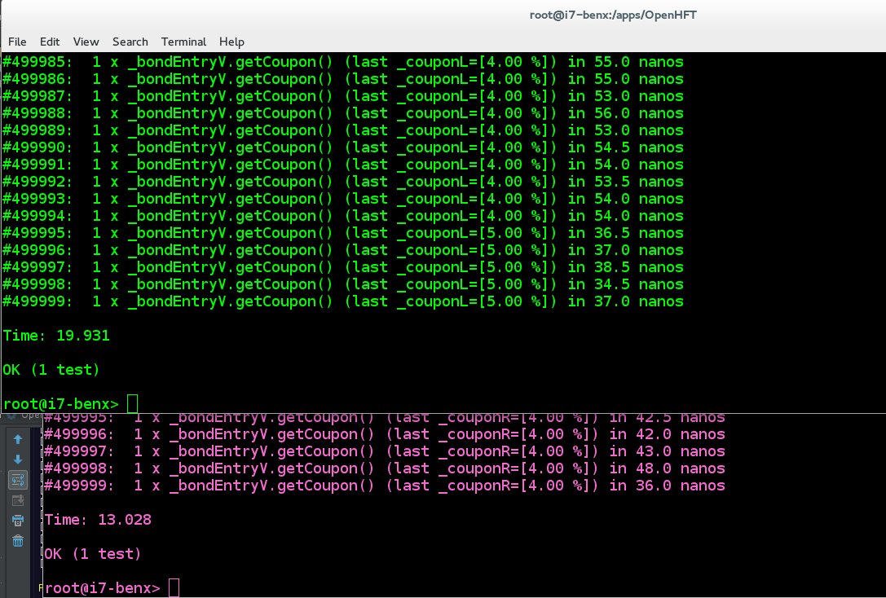
OpenHFT /dev/shm/SharedHashMap<K,V> as operand provider:

Slide 23
PROOF IS IN THE TEST RESULTS: What do we get using OpenHFT vs. RedHat JDG?
RedHat JDG and JCACHE<K,V> as operand provider:
To try with a distributed cache, run the following command in separated terminals:
java \
-cp "target/classes:target/dependency/*“ \
org.infinispan.quickstart.clusteredcache.Node \
-d LEFT
java \
-cp "target/classes:target/dependency/*“ \
org.infinispan.quickstart.clusteredcache.Node \
-d RIGHT
counter=[217924] cache.put('369604103',3.000%); took 92,599 nanos
counter=[217925] cache.put('369604103',6.000%); took 90,062 nanos
counter=[42529] fl=[5%] = cache.get('369604103'); took 52,624 nanos
counter=[42530] fl=[6%] = cache.get('369604103'); took 47,981 nanos
(full results at https://github.com/Cotton-Ben/infinispan-quickstart )

Slide 24
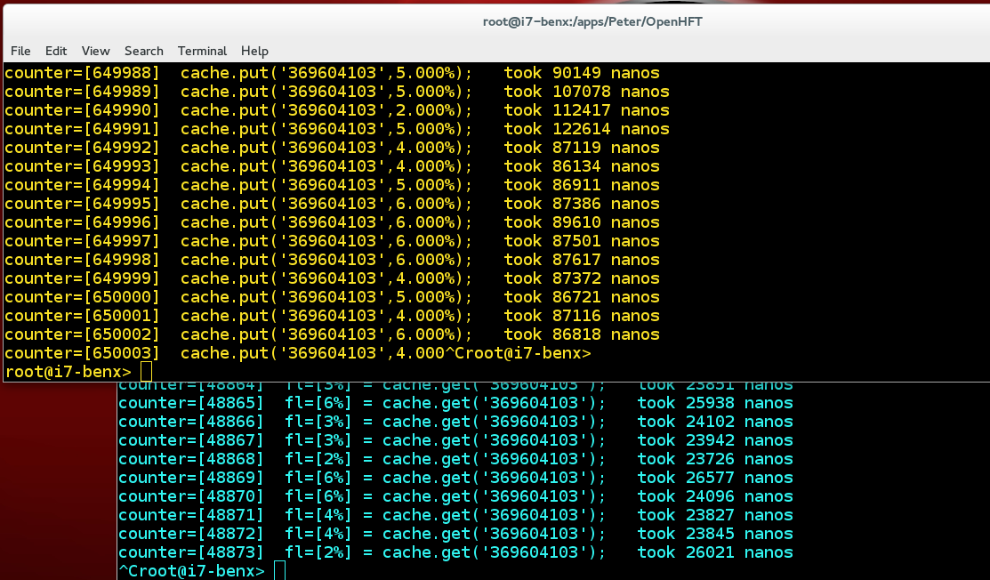
RedHat JDG and JCACHE<K,V> as operand provider (1,000x slower)

Slide 25
Bottom Line = Tests by AggEng team imperically demonstrate that OpenHFT off-heap over /dev/shm IPC transport is 1,000x faster than RedHat JDG on-heap over UDP OSI-Loopback IPC transport.
IMMEDIATE NEXT STEPS:
NO DOUBT ABOUT IT = We need the OpenHFT off heap capability made available to us via the RedHat JDG product and its JCACHE API!
Explicit commits from Mircea re: adapting Peter’s OpenHFT SHM as JDG interoperable JSR-107 Cache<K,V>. RedHat customer support case?
Explicit commits from Bela re: “short circuiting” all node ←→ node transport resolution to use /dev/shm IPC as transport (instead of TCP/UDP) whenever possible … RedHat customer support case?
Explicit commits from Peter re: supporting above with OpenHFT as the Off-Heap provider. JPM retain OpenHFT via support subscription?
Continued commits/time planning re: Ben, Dmitry, Xiao efforts to maintained Fork’d repo and build sound/complete/confirming tests.

