Slide 1
Week 3
Let’s Talk About Transforms
ISTA 322 - Data Engineering

Slide 2
Last week - recap
Data types and data structures
Python refresher
Introduction to Google colab / Jupyter notebooks

Slide 3
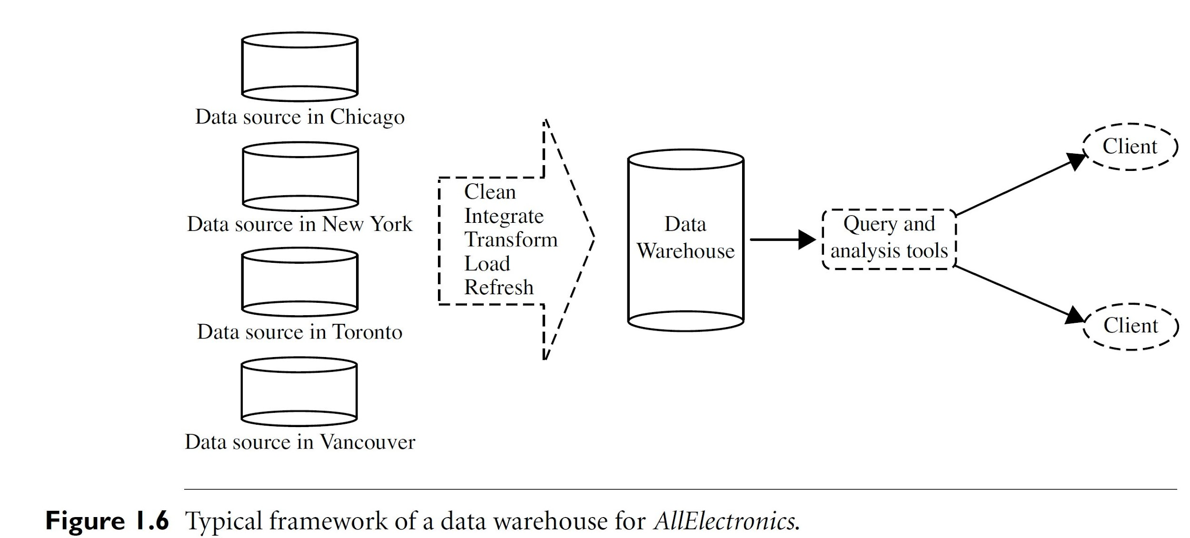
Middle out

Slide 4
Starting with the T in ETL
Why?
You all know some python
Most of you have done some kind of data transforms
It’s the core of ETL
The other ends are a bit more of making technology work for you (sorta)
Overall, easier to build from the T in ETL

Slide 5
Data transforms
Transforms are key to making data useful
Two general purposes of transforms
Fixing errors
Making data useable / relevant
We’ll cover major examples within each
Solid foundation / framework
You’ll need to learn more throughout your careers
* Importance of “learning to learn”
Depends a lot on existing data quality and infrastructure

Slide 6
Fixing errors
Existing data can be filled with errors
Lack of precision
Data was entered wrong
Missing values
Bad fills
Unnecessary
Too many columns
End user doesn’t actually need
Long mappings
Repetitive
Duplication?
Not normalized?

Slide 7
Making data useable / relevant
Different clients will have different needs
Need to transform data into a format that is useful
Business intelligence
Aggregate daily statistics
Make key metrics to display
Filtering
Data science
Extract data from strings
Scale & alter units
Binning/grouping
New features
Of course there are more, but not covering them all

Slide 8
One ETL to rule them all
Couple notes
Don’t think you’re going to set up just one ETL
Just because you work with a DE doesn’t mean you won’t have to do an ETL
ETL doesn’t have to fix everything
We’re focused on a general framework here!

Slide 9
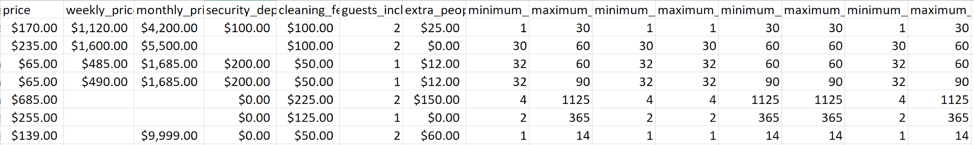
Transforms - errors
Data sources can be filled with errors
Bad defaults might need to be fixed
Fill empty cells with 9999
Allow too wide of range on data input
Just allowing empty cells
Could be fine
Might need to fill

Slide 10
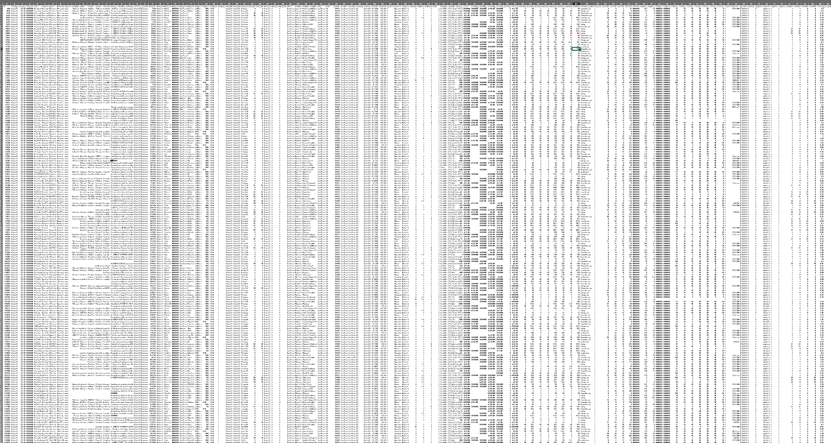
Transforms - errors
Data sources can be filled with errors
Bad defaults might need to be fixed
Fill empty cells with 9999
Allow too wide of range on data input
Just allowing empty cells
Could be fine
Might need to fill
Excessive data!
106 columns
Unnecessary data
Remove identifying info?

Slide 11
Transforms - Making data useable / relevant
Many ways to accomplish this
Extract data from strings
Splitting columns to parse information
Regex fun times ‘[0-9]{5}$’
Data type conversions
time
userID
action
domain
2008-01-31 15:54:25 __RequestVerificationToken_Lw__=2ADB2 ;+.ASPXAUTH=C31HDWD05KU00943S /product/YJ29IOCVQ http://www.abc.com
2005-12-08 02:36:30 __RequestVerificationToken_Lw__=13233 ;+.ASPXAUTH=H7HTS9Q9CC8ZXSERD/product/MVI9HHP8A http://www.ebay.com
2015-06-07 23:27:58 __RequestVerificationToken_Lw__=B322B ;+.ASPXAUTH=58SZL3FPGFUS8KLNA /search/P5XKO3AC9 http://www.abc.com
2009-03-12 03:16:27 __RequestVerificationToken_Lw__=1A1C2 ;+.ASPXAUTH=VBWZJJR6CG85YSOM3/product/A13025WBT http://www.shophealthy.co
2014-07-23 08:36:03 __RequestVerificationToken_Lw__=2B1C2 ;+.ASPXAUTH=VXBLEXUC177T4S7AA /search/5PI9XD6LZ http://www.facebook.com

Slide 12
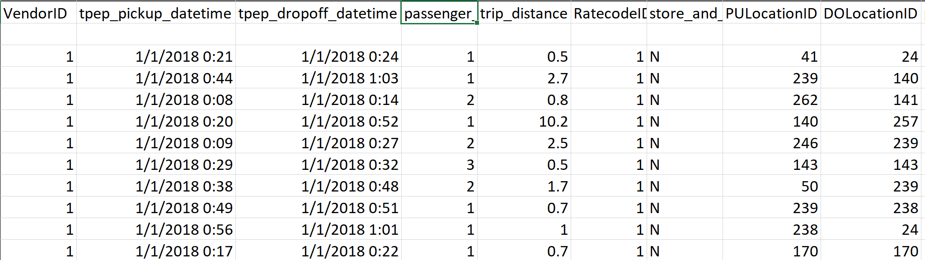
Transforms - Making data useable / relevant
Working with event level data
Binning
‘short’, ‘medium’, ‘long’ trips from trip distance
Aggregating
Number of trips per time, popular locations

Slide 13
Transforms - Making data useable / relevant
Working with event level data
Altering units
Calculating useful metrics
Trip time
Speed of trip
Speed at different times

Slide 14
Checking your data
You should constantly test the ‘integrity’ of your data by asking questions and checking expectations
General external formats
Right number of digits in zip/phone/social/ID/etc
Bounded in reality
Age in 0-115
Webpage had more views than clicks
Only positive for some measures
Appropriate data structure
Right number of rows and columns
Correct data types

Slide 15
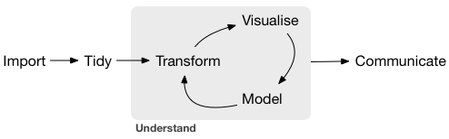
Wrapping up
The actual actions depend on the data and what you’re going to use it for
You’ll still need to do a lot of this even if you’re not a DE
Lots of my other DS classes have data cleaning lessons!
Don’t be afraid to use a subset to work on
Let’s go actually do this

Slide 16
Tasks for this week
Jupyter notebook
Data Transforms

