Slide 1
Week 1
Where Does Data Come From & Tools for Data Engineering
ISTA 322 - Data Engineering

Slide 2
Recap of last lecture
Data volumes have boomed in the last 20 years
Some early companies were effective in using this
This and other things (media, research) drove the potential for data scientists to use big data
Early efforts did not go well as data is often in messy, not in immediately useful formats
And there was lots of it which limited ability to process
Early DS roles involved a lot of data engineering
Now, there are explicit DE roles
DE is all about making data useful for analysis

Slide 3
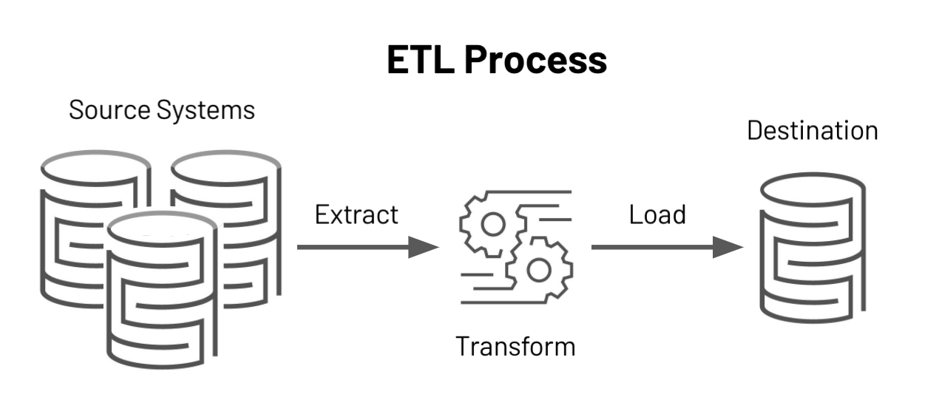
Where are we going today?
Talk about where all these data are coming from
The (generally) main job of a DE - making *ETLs
Technologies using in DE and what subset we’ll use
*ETL: Extract, transform, load
https://databricks.com/glossary/extract-transform-load

Slide 4
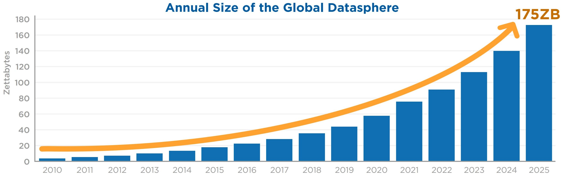
Where do data come from?
There are tons of data and the amount being collected is exploding.
What generates these data?
Events!
1 Zetabyte is
- 350 trillion
songs
- 100k copies
of wikipedia

Slide 5
How events create data
Events - data of actions performed by entities
Clicked on an ad
Left the page
Searched for something
Tried to log in
Made a transaction
Scrolled up or down
Liked, reacted, retweeted, hearted, shared
Uploaded a photo or video
Doesn’t have to be human… temperature probe recording, machine finishing a job, airplane sensors measuring tons of stuff, etc.
Also will record time and who did it

Slide 6
How events create data
Events will then be linked to other data that’s collected
e.g. you click on Tiger King
{time : 07:26, event : click_watch, show_id : tk_S1E1, user_id : x88}
These events are linked to other data that’s known about you or the show
There will be a table that contains show info
{show_id : tk_S1E1, tags : [‘drama’, ‘reality’], runtime : 55min }
And user info
{user_id : x88, age : 35, gender : ‘M’, OS : [‘wind’, ‘andro’]}

Slide 7

Event data at Netflix
With this data arriving at over 2 million events per second, getting it into a database that can be queried quickly is formidable. We need sufficient dimensionality for the data to be useful in isolating issues and as such we generate over 115 billion rows per day.
This was in 2020 - Ref @ Netflix Tech Blog
They ‘only’ generated 10 billion rows a day in 2015
Ref @ Netflix Tech Blog

Slide 8
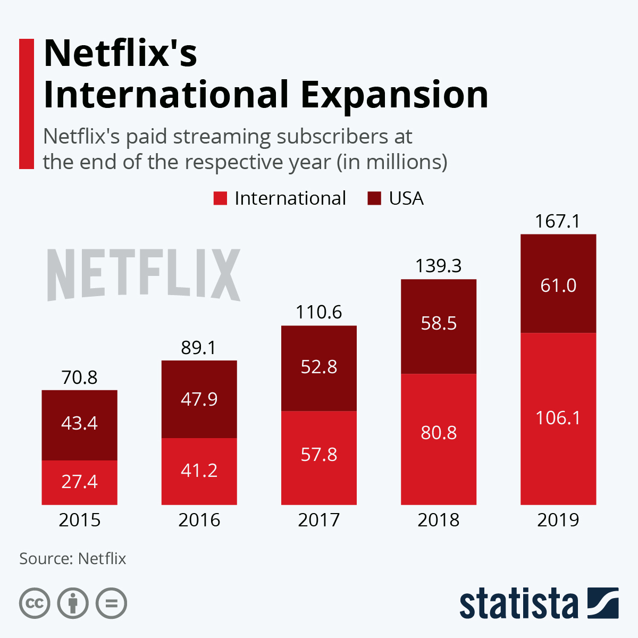
How events create data
In just 5 years Netflix increased the amount of data collected by 10x (115 billion vs 10 billion)
Number of subscribers only increased by 2.5 – ref
Increased granularity of data collected
This allows for more complex models & better analytics
“We need sufficient dimensionality for the data to be useful in isolating issues”
Remember, models need n x m matrix
More dimensions = more features in the matrix
More features = more models & better predictions
∴ more money

Slide 9
Not all events
Of course, not all data collected is structured like this
Some is just stored in a database across multiple tables
Each transaction in a convenience store
TABLE ID: STORE
store_id | store_state | country
az_23 | AZ | USA
az_45 | AZ | USA
ca_12 | CA | USA
to_39 | Ontario | Canada
TABLE ID: TRANSACTIONS
transact_id | store_id | UPC | price
x88943 | az_23 | 49914 | 2.57
x88943 | az_23 | 99371 | 1.99
a85921 | to_39 | 95831 | 8.99
a85921 | to_39 | 99492 | 5.49
a85921 | to_39 | 27482 | 4.49
z88930 | az_45 | 33491 | 0.99

Slide 10
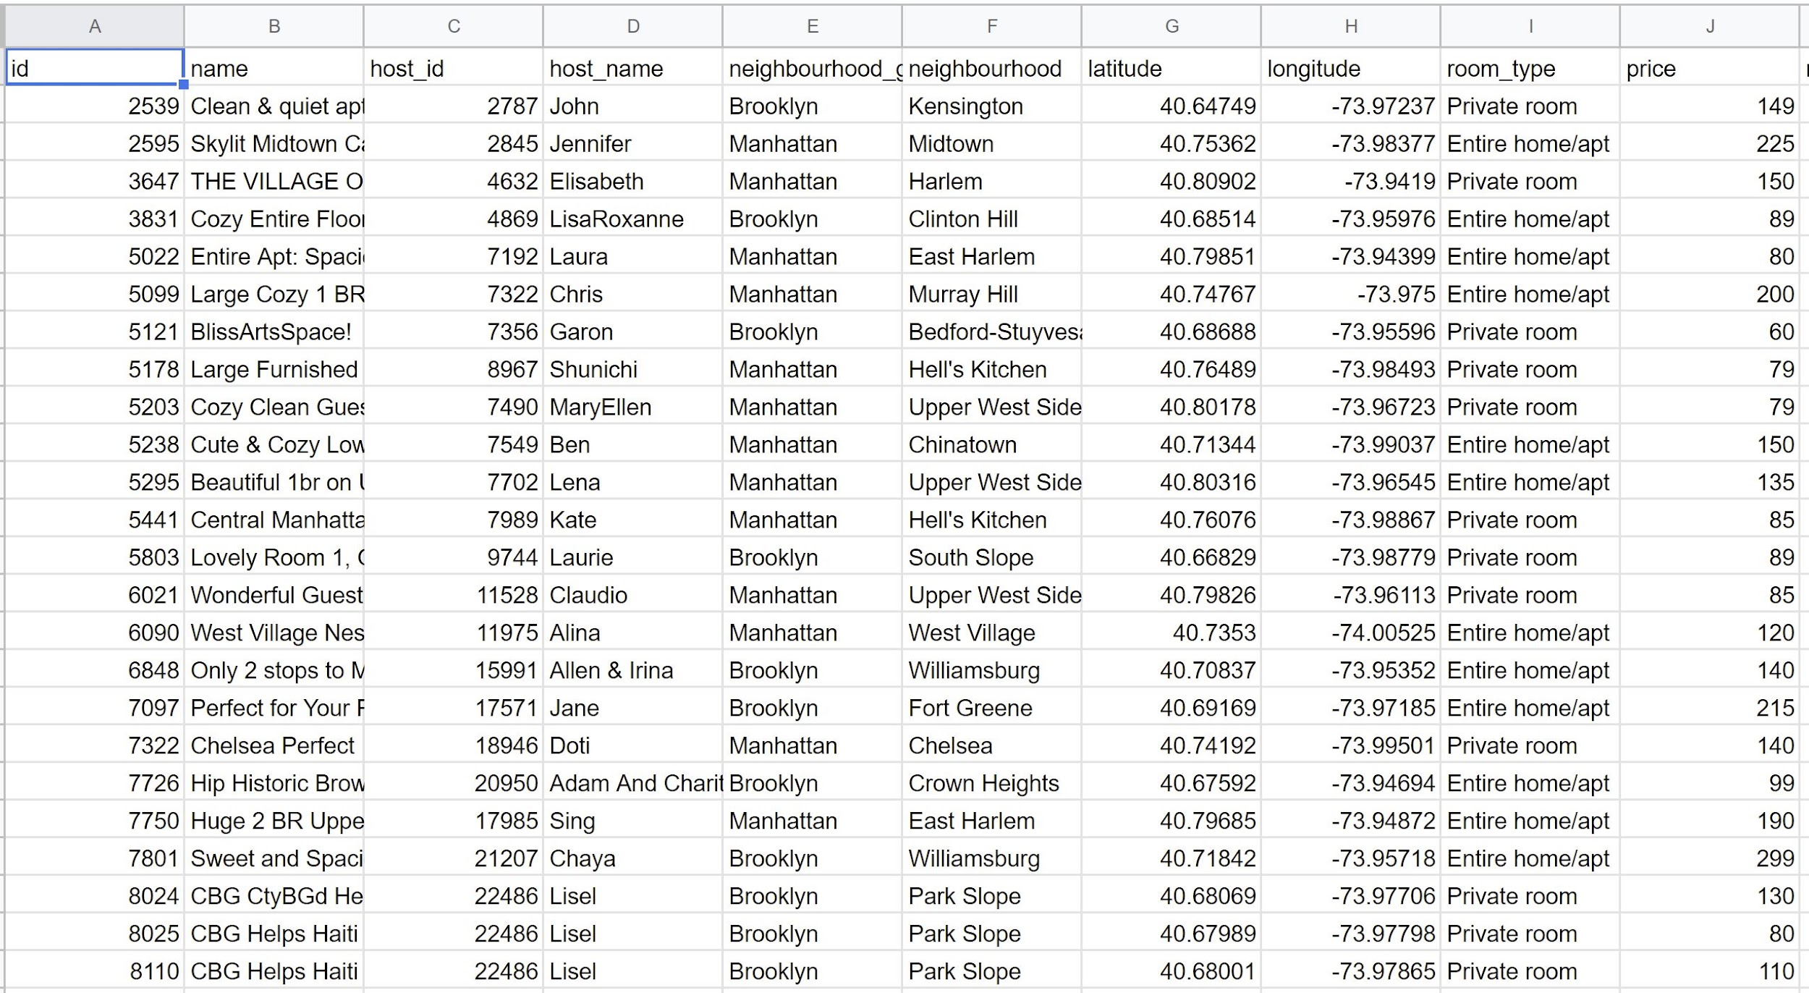
Not all events
Of course, not all data collected is structured like this
Some is just stored in a database across multiple tables
Each transaction in a convenience store
And data collected might not be optimized

Slide 11
So what does a DE do again?
Takes data from these various databases that are recording events/transactions/information
Reorganizes it in some way or another into a format that lets people do analytics or data science
Puts it in a database for them to use.
This process has a general name - ETL
Extract - Transform - Load

Slide 12
ETL
ETLs are essentially the core of DE
That raw data in structured, semi-structured, or unstructured format is all stored in a data lake
The transform step is going to remove errors, create features, scale values, aggregate data for metrics and whatever else is needed to support analytics and DS
The transformed data is stored in a data warehouse

Slide 13
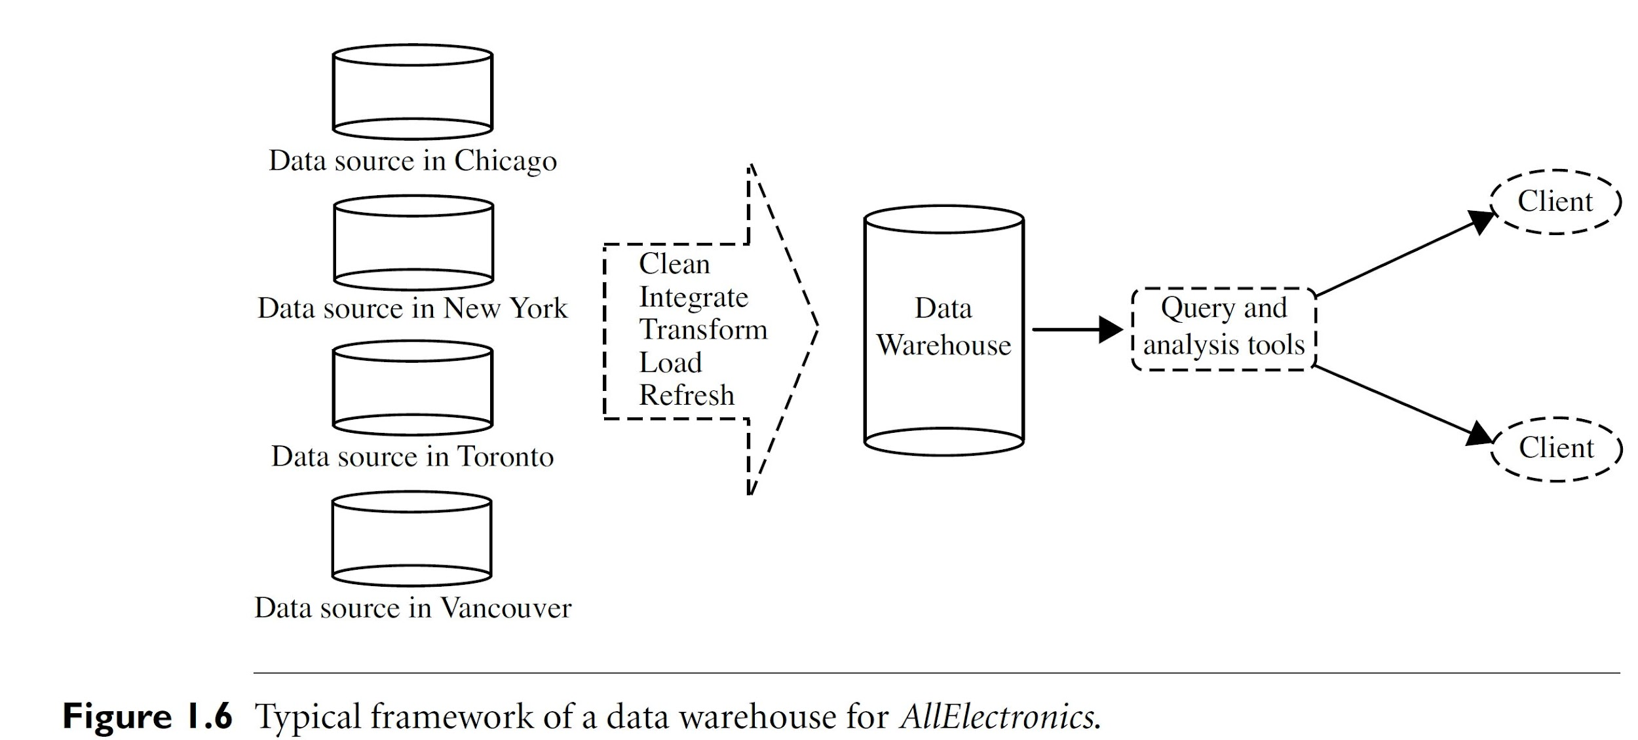
ETL
From reading - Ch1 Data Mining Concepts and Techniques

Slide 14
But how to deal with so many events?
OK, our goal is to get the data into a useful format
But we’re dealing lots of data
Average computer has say 16gb of memory
A decade ago Facebook was dealing with 10+ gb of processed data a day
Amazon’s daily login datafile alone is 1tb
Obviously this is the other challenge of DE
How to deal with massive volumes of data fast enough to be useful
Can’t let it take hours/days/weeks to process on one machine

Slide 15
Enter big data technologies
The other part of of being a DE is using big data processing frameworks that allow for much, much faster data processing
Technologies like hadoop/mapreduce and Spark utilized clusters of machines to distribute framework and optimize speed

Slide 16
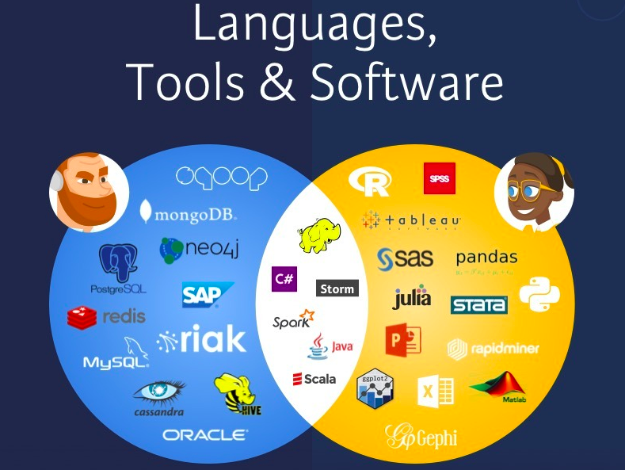
Enter big data technologies
The other part of of being a DE is using big data processing frameworks that allow for much, much faster data processing
Technologies like hadoop/mapreduce and Spark utilized clusters of machines to distribute framework and optimize speed

Slide 17
Enter big data technologies
The other part of of being a DE is using big data processing frameworks that allow for much, much faster data processing
Technologies like hadoop/mapreduce and Spark utilized clusters of machines to distribute framework and optimize speed
It’s a massive ecosystem of tools - We’re only going to learn some of the essential tools

Slide 18
A bit more about the technologies we’re going to use
Languages / technologies
Python and pandas
SQL - Likely PostgreSQL
Pyspark locally
Pyspark via Databricks
Environments
We’ll be working in Jupyter Notebooks
Use Google Colaboratory - Google cloud based Jupyter Notebook
You’ll download a notebook, upload and open there
You’re welcome to use a local install, but I won’t be providing tutorials (I can’t troubleshoot 40 installs of all the libraries)
AWS - Pull from and set up database on AWS
Databricks - Cloud notebook based analytics/DS platform

