Slide 1
Week 2
Data Types and Formats
ISTA 322 - Data Engineering

Slide 2
This week in data engineering
Based on Slack intros we have some pretty diverse skill sets
Some with lots of coding but maybe less python
Some with more DS data skills
Some with a bit of both
This is a good thing!
This week: quick review of different ways data are represented via data types and in different formats
Might not be new for some of you - that’s ok
Also start working with data (2 Jupyter notebooks + HW1 due Sept 5th)

Slide 3
What is data anyway?
Data - Collection of facts consisting of numbers/words that are taken though measurements with the goal of describing things
Let’s create data on me
Get weight - 230lbs
Get height - 72”
Hair color - brown
These are measurements that describe me
Level of precision is determined by tool used
Also at data entry
Obviously numbers and words

Slide 4
Describing data
Should be simple: numbers and words
But there’s more nuance than that
Numbers
Continuous vs discrete, binary vs non-binary
Words
Nominal vs ordinal, numbers stored as text, text coded as numbers, T/F
Nuance is important to accurately describe reality
Practical reasons too (e.g. storage, modeling)

Slide 5
Describing data - Overview
Variable
Numerical
Categorical
Discrete
Continuous
Nominal
Ordinal

Slide 6
Continuous vs. discrete
Useful to think whether data is continuous or discrete
Discrete - data that can only have certain values
Limited amount of ‘in-between’ numbers
Continuous - data that can take any value (continuum)
Any ‘in-between’ number is possible
3
2
1
0
Discrete
Continuous

Slide 7
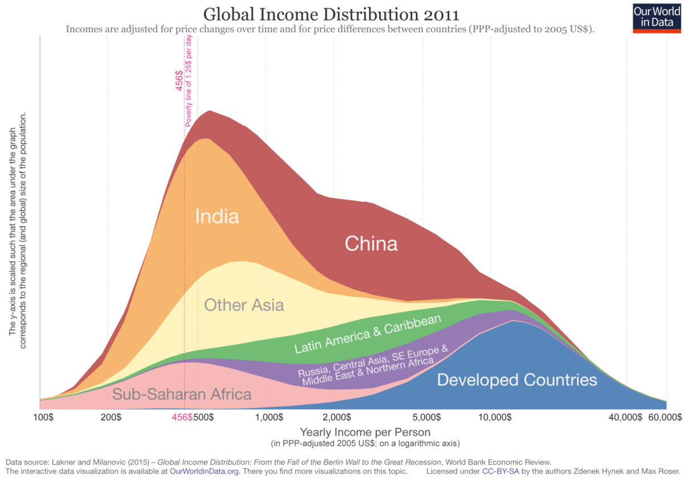
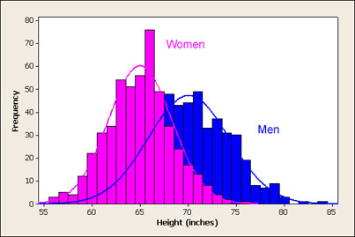
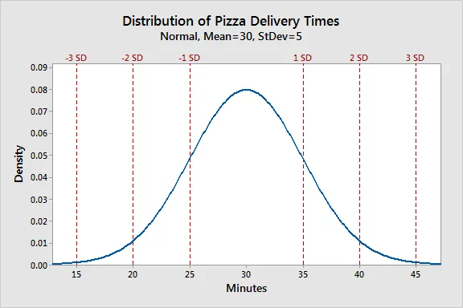
Datatypes - Numeric continuous - Float
Continuous numeric datatypes you’re familiar with
Height, weight, sales per store, etc
Can have any value in a range
Have a decimal
Float datatype

Slide 8
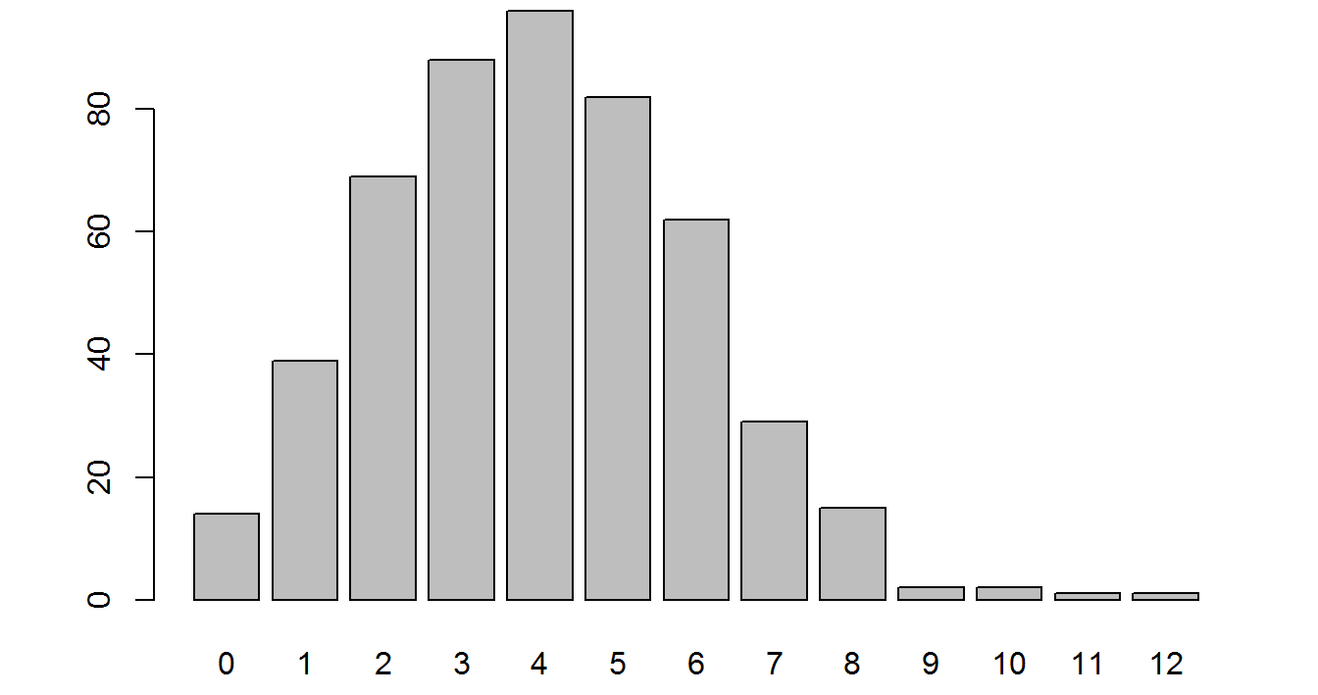
Datatypes - Numeric discrete - Integer
Number of clicks, number of sales, passengers on a plane
These are numeric
Can have any whole value in a range
But they’re not continuous
Can’t have fractional values
No half clicks, half sales, half passengers, etc
Integer datatype
Number of purchases

Slide 9
Datatypes - Numeric discrete - Binary
Binary datatypes are very common to indicate yes/no or present/absent
yes = 1, no = 0
purchased | purch_b
yes | 1
no | 0
no | 0
no | 0
yes | 0
no | 0

Slide 10
Datatypes - Numeric discrete - Binary
Binary datatypes are very common to indicate yes/no or present/absent
yes = 1, no = 0
Many ML models need numeric
Can encode levels of strings
One hot encoding
Integer datatype
OS
windows
android
mac
mac
windows
android

Slide 11
Datatypes - Numeric discrete - Binary
Binary datatypes are very common to indicate yes/no or present/absent
yes = 1, no = 0
Many ML models need numeric
Can encode levels of strings
One hot encoding
Integer datatype
OS | win_b | and_b | mac_b
windows | 1 | 0 | 0
android | 0 | 1 | 0
mac | 0 | 0 | 1
mac | 0 | 0 | 1
windows | 1 | 0 | 0
android | 0 | 1 | 0

Slide 12
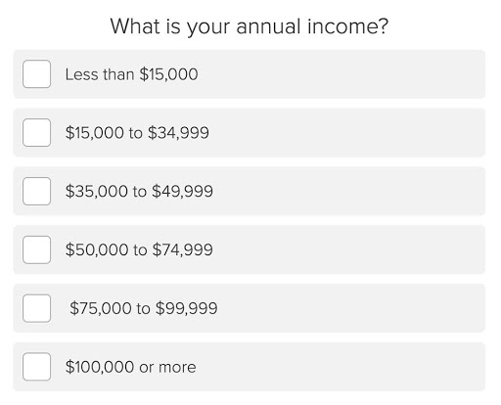
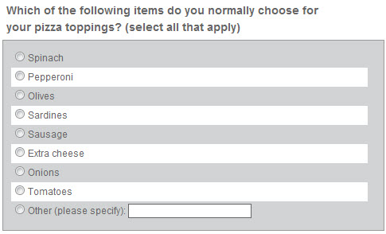
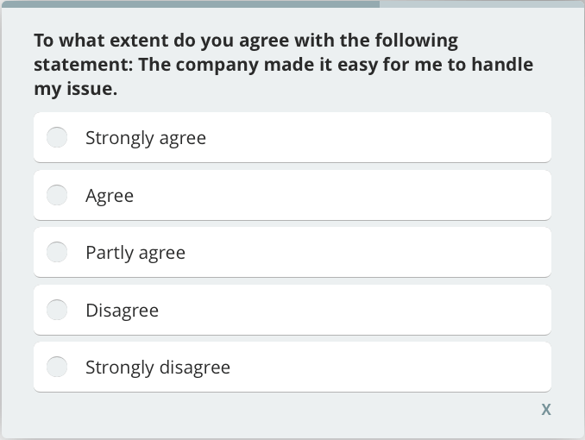
Nominal vs. ordinal
Ordinal
Values have a hierarchy/relative value to each other
Nominal
Values are independent of each other

Slide 13
Datatypes – Categorical - Strings
Strings are any length of alphanumeric characters
Could be nominal – aka text!
‘black’, ‘brown’, ‘blonde’, ‘red’
‘Pineapple on pizza is good, change my mind’
‘Y'all shouldn’t be having parties with 100 people’
‘2013-01-12 07:54:22 __RequestToken_Lw__=2B3CC Channie Tununak’
Could be ordinal
‘small’, ‘medium’, ‘large’
‘extremely unhappy’, ‘unhappy’, ‘neutral’, ‘happy’, ‘extremely happy’
String datatype

Slide 14
Datatypes - Categorical - Boolean
Booleans are a lot like binary
Two values, True and False
Not strings, though
True = 1
False = 0
Frequently used in logical statements
If x is TRUE, then do y
Boolean datatype

Slide 15
Datatypes - Datetimes
Time data is really important for rolling up data
Sales in a hour/day/month
Average monthly temperature
Number of requests per minute
Frequently imported as strings
‘02/18/2020 12:12:47’
But can’t do critical operations with them as strings
Casting to datetime allows program to understand these as continuous values
Datetime datatype
Not native in python - need ‘datetime’ module
SQL does have them

Slide 16
Datatypes
The exact syntax and methods you’ll use to manipulate these will vary across tools
And there’s more nuance within
But it’s important to think about the data type and if the values make sense for its type
Again, probably review for many of you
But still can’t be said enough :)

Slide 17
Moving on to Data Structures
Data structures are ‘how’ data types are organized
Numeric data stored in a list: [67, 49, 88, 95, 77]
Numeric data is a data type
List is the way it’s stored
Lists, data frames, and dictionaries
Most have seen, but we’ll run through them quick

Slide 18
Lists
Ordered sequence of elements
Test_scores = [67, 49, 88, 95, 77]
print(test_scores)
Output: [67, 49, 88, 95, 77]
Can be updated, added to, sliced, etc using different methods in python
Can also be strings or mixed
Dan_info = [230, 72, ‘brown’]
[]

Slide 19
Dataframe
Not native to python - Need Pandas
Just a 2-D object with labeled columns and rows
Multiple lists bound together
Test_scores = [67, 49, 88, 95, 77]
Study_time = [35, 14, 75, 89, 68]
School_year = [‘fr’, ‘jr’, ‘sr’, ‘sr’, ‘fr’]
Pandas is very powerful for data wrangling
test_scores | study_time | school_year
67 | 35 | fr
49 | 14 | jr
88 | 75 | sr
95 | 89 | sr
77 | 68 | fr

Slide 20
Dictionary
Dictionaries are key-value pairs
{key:value , key:value}
Dan_dict = {name: ‘dan’, height: 72, weight: 230}
Dictionaries can be searched quickly if you know they key
Can be converted to data frames
JSON files are organized sets of key-value pairs

Slide 21
Exciting huh?
OK, not the most thrilling topic, but we need to make sure we’re all on the same page
Other part of this week will be coding
But just need to cover a bit on several key data formats
Flat files, relational database, json

Slide 22
Flat files
Flat files refer to 2 dimensional data
csv, tsv
Each row represents an observation
Only one file containing all info
Often great for analysis
It’s a data frame!
Slower to search
Inefficient storage
transact_id | store_id | store_state | country | UPC | price
x88943 | az_23 | AZ | USA | 49914 | 2.57
x88943 | az_23 | AZ | USA | 99371 | 1.99
a85921 | to_39 | Ontario | Canada | 95831 | 8.99
a85921 | to_39 | Ontario | Canada | 99492 | 5.49
a85921 | to_39 | Ontario | Canada | 27482 | 4.49
z88930 | az_45 | USA | USA | 33491 | 0.99

Slide 23
Relational database
TABLE ID: STORE
store_id | store_state | country
az_23 | AZ | USA
az_45 | AZ | USA
ca_12 | CA | USA
to_39 | Ontario | Canada
Goal will be to put transformed data into relational database
The ‘L’ in ETL
Tables ‘relate’ to one another based on keys
Efficient
Can be queried in many ways (e.g. SQL)
TABLE ID: TRANSACTIONS
transact_id | store_id | UPC | price
x88943 | az_23 | 49914 | 2.57
x88943 | az_23 | 99371 | 1.99
a85921 | to_39 | 95831 | 8.99
a85921 | to_39 | 99492 | 5.49
a85921 | to_39 | 27482 | 4.49
z88930 | az_45 | 33491 | 0.99

Slide 24
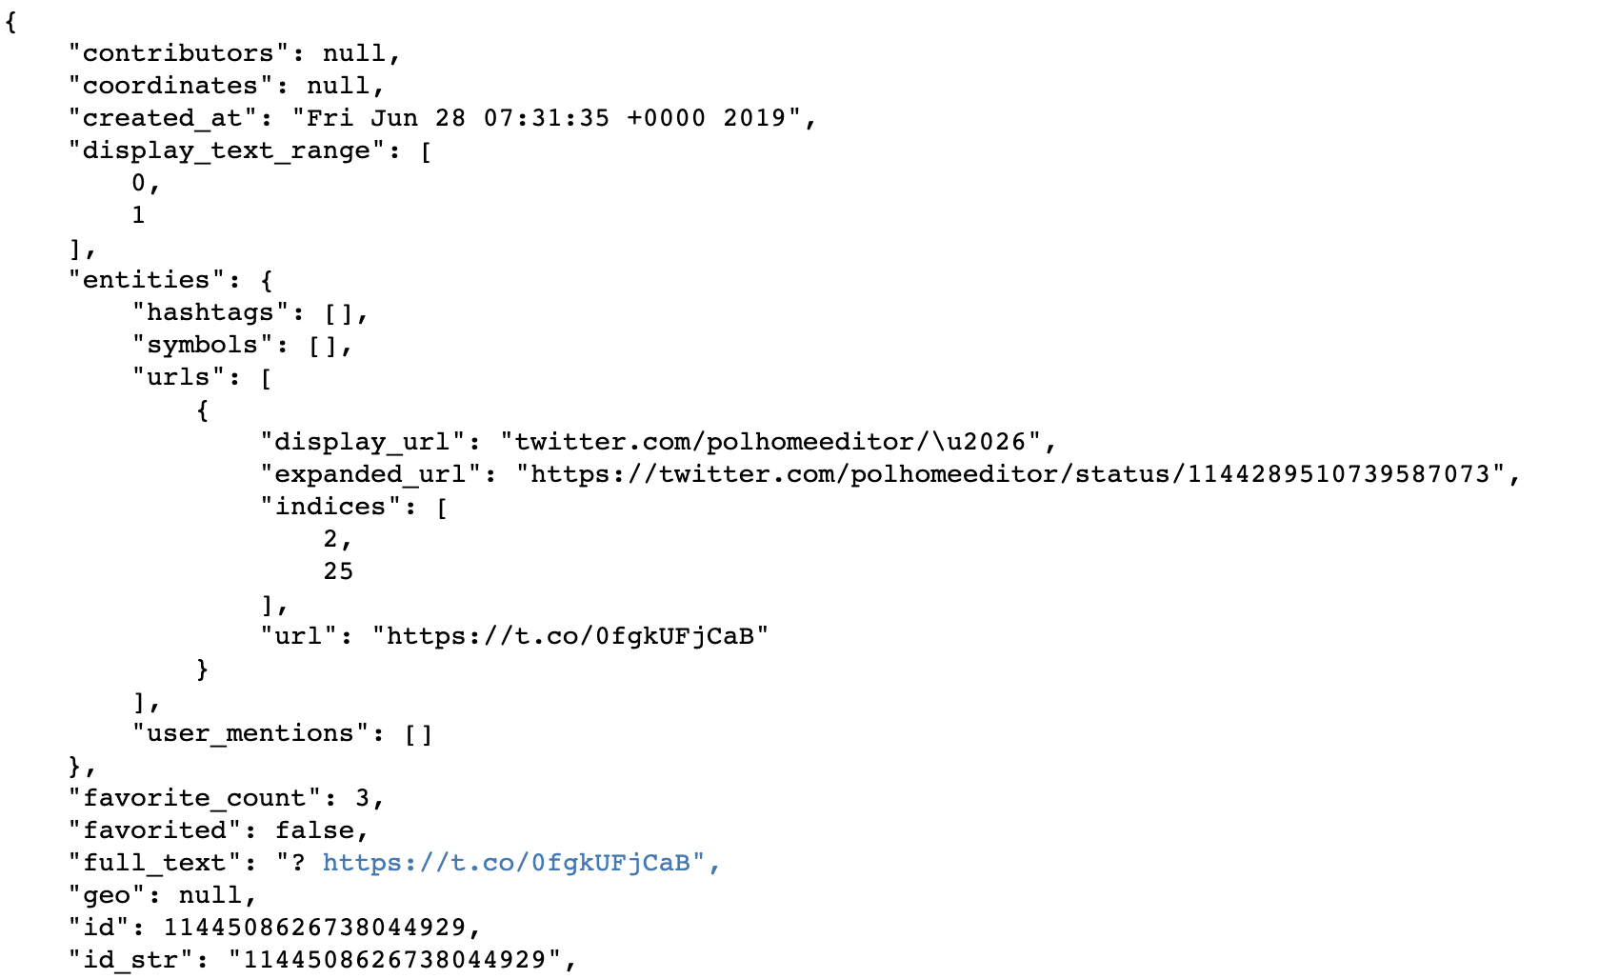
JSON
Table: Tweet_info
t_id | t_time | t_coord
1144.. | Fri Jun | null
Semi-structured
Need to parse and load into DB
Keys = column names
Values = observations
Can then query
Table: Tweet_urls
t_id | disp_url | url
1144.. | twitter.com. | t.co/0f...
Table: Tweet_social
t_id | n_fav | favorited
1144.. | 3 | false

Slide 25
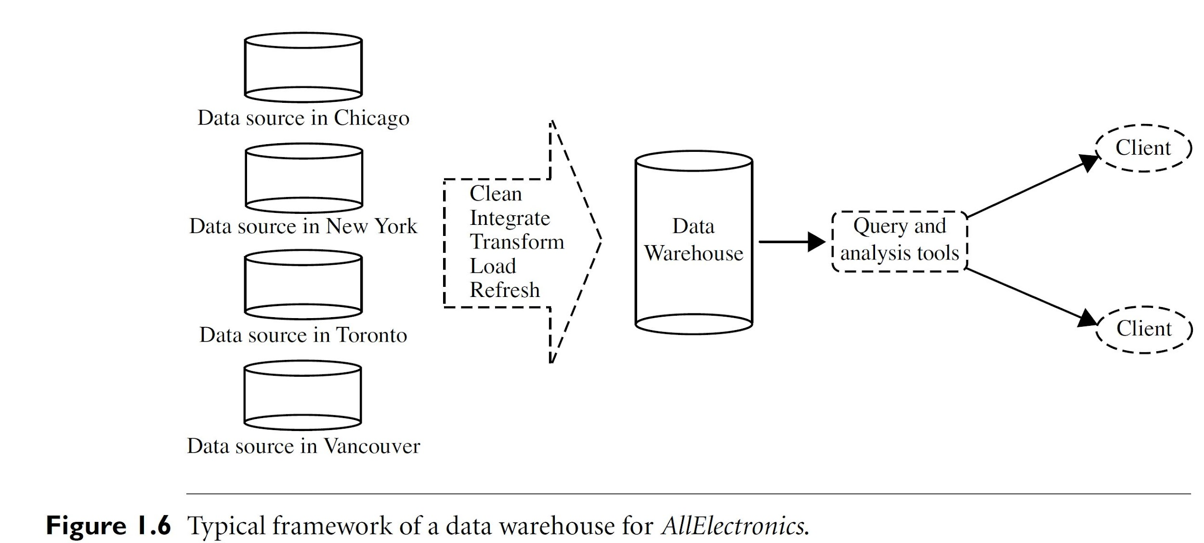
Recap
Need to know data types, put into structures, manipulate
Move into database in organized framework so can be queried and analyzed
csv
tsv
JSON
XML
...

Slide 26
Recap
It’s ok if some bits are not clear
Just to make sure everybody is on the same general page
These are more concepts that we will be applying across languages
Other part of this week (and rest of the class) we’ll be applying these ideas and more.

Slide 27
Tasks for this week
Jupyter notebooks
Google colab and Python basics
Functions and loops
Homework 1
* Make a copy on your google drive to work on it.
When done, download as .ipynb and upload to D2L

