Slide 1
dbt

Slide 2
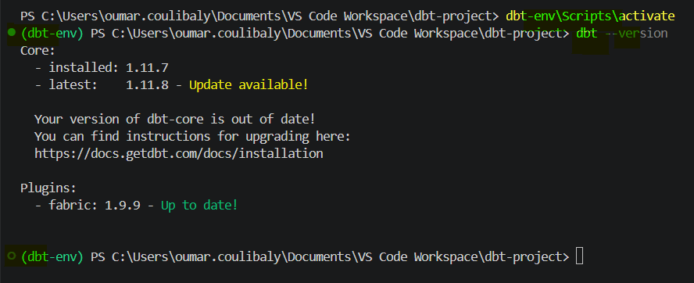
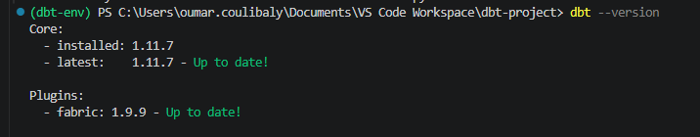
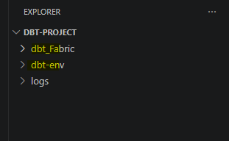
dbt
https://www.udemy.com/course/simplifying-data-pipelines-using-dbt/learn/lecture/54953001?start=300#overview
To install dbt core into your local machine (not esay) the following steps are needed :
Create a folder like this VS code folder/dbt_project/
From VS code open that folder
Create a virtual environment like dbt-env
Ask the following prompt to chatgpt “I want to install dbt core to my local machine using Vs code and virtual envirment , can please gide step by step”
When installation succeeded you should have the following :
Note : In my case I create a dbt for a Fabric project.

Slide 3
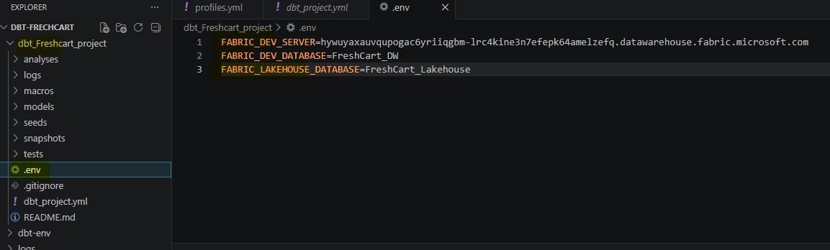
Dbt-set up in 6 setp
A -Important steps (write the below code 1 by 1) :
python –version #(python version verification)
pip –version #(pip version verification)
code . #(code verification)
python -m venv dbt-env #(create virtul environment this very crucial )
pip install dbt-core #(install dbt-core)
pip install dbt-fabric #(install fabric plugging)
dbt –version #(check dbt version)
dbt init dbt_Freshcart_project #(initialise a new dbt project )
B-/ Create .env file (to create environment variables for
Fabric_DEV_SERVER= connectionstring of Fabric datawarehouse
Fabric_DEV_DATABASE= your fabrivc datawarehouse
FABRIC_LAKEHOUSE_DATABASE = fabric lakehouseName
C-/ Go to your file explorer C drive
C:\Users\oumar.coulibaly\.dbt open or create profiles.yml
dbt_Fabric:
target: dev
outputs:
dev:
type: fabric
driver: 'ODBC Driver 18 for SQL Server'
server: "{{ env_var('FABRIC_DEV_SERVER') }}"
database: "{{ env_var('FABRIC_DEV_DATABASE') }}"
schema: dbo
authentication: CLI
threads: 4
connect_timeout: 30
retries: 2
D-/ Autthentication

Slide 4
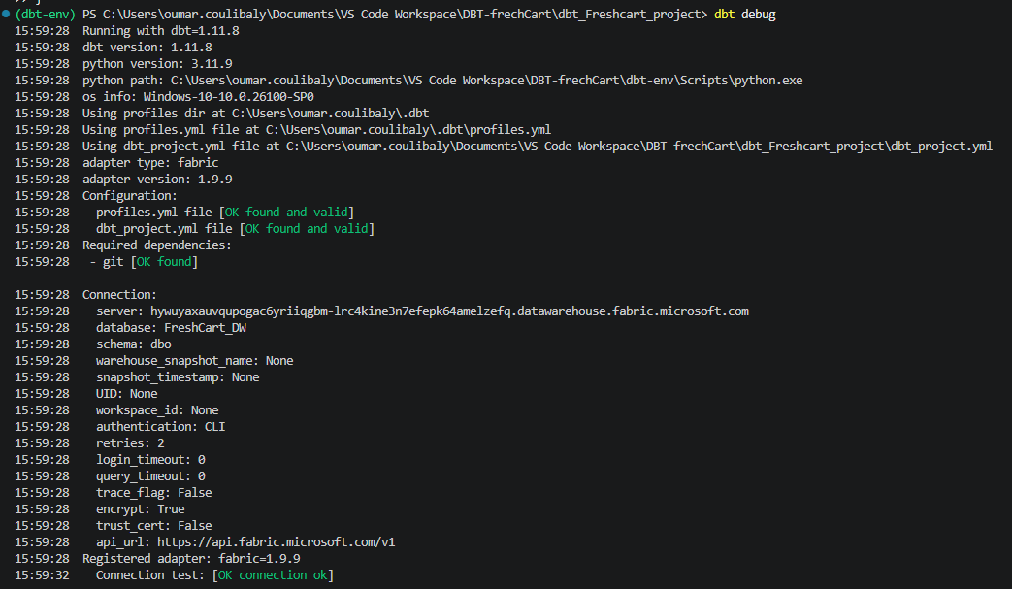
dbt
https://www.udemy.com/course/simplifying-data-pipelines-using-dbt/learn/lecture/54953001?start=300#overview
D-/ Autthentication (wiill authentocate you using the .env file )
(dbt-env) PS C:\Users\oumar.coulibaly\Documents\VS Code Workspace\DBT-frechCart\dbt_Freshcart_project>
Get-Content .env | ForEach-Object {
if ($_ -match "^(.*?)=(.*)$") {
[System.Environment]::SetEnvironmentVariable($matches[1], $matches[2], "Process")
}
}
E-/ Check authe ntication
dbt debug #(check authentication)
If output look like following , you are good done with the set up

Slide 5
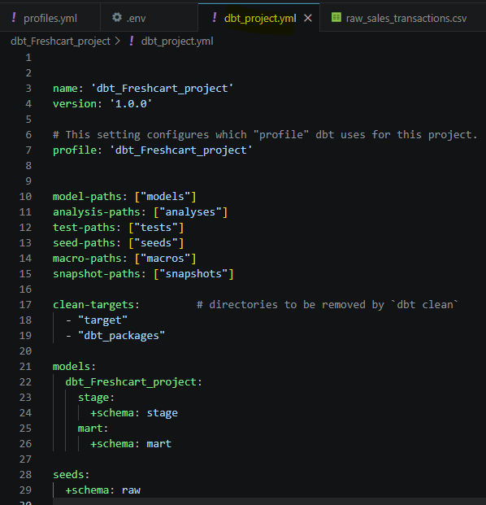
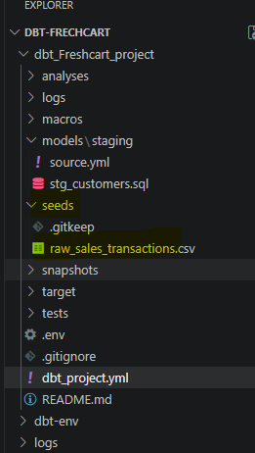

Dbt_project.yml
Make sure models is filed exactly like in picture stage – mart and seeds and save the file
Now Dag and brop a file in the seeds section like below. And run the following in the terminal
bt_Freshcart_project> dbt seed
Output should be :
Note : this the semi manual processing of the file wicth will populate the datawarese with
a table named : dbo_raw.raw_sales_trabsactions
If we want to do the same thing using data already existing in the lakehouse (full automate
Processing) we should use source.yml file
Now
1. Create 2 folders (staging , mart ) in the models folder to macth with project.yml file

Slide 6
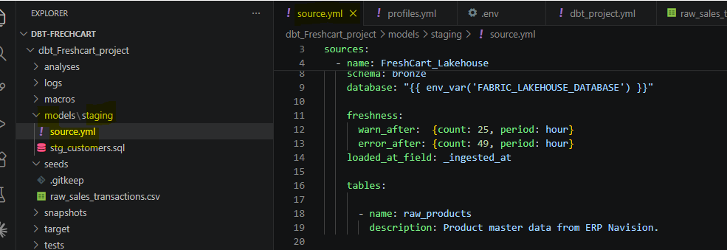
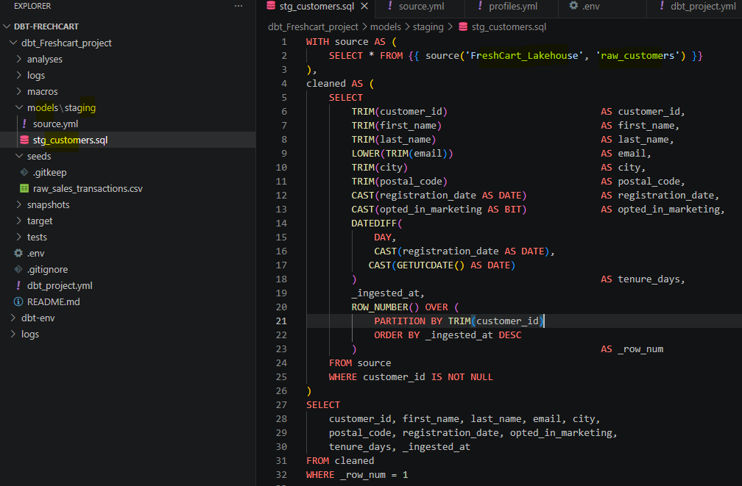
Dbt_project.yml + Source.yml
0. Create a source.yml file in the staging
The code inside this file look like this : with the soure name , schema , database and all the needed table exalple raw_prodiucts
Create stg_customers.sql witch will contains the sql statement
3. Building this in the terminal will create a new table into the datawarehouse
Note :
source.yml (define de source of data)
dbt_projrct.yml ( define the destination )
Make sure the are present and good configured.

Slide 7
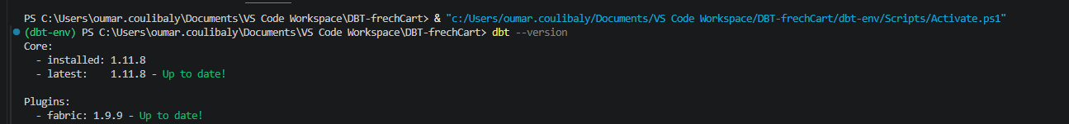
Use dbt project and venv exists
Start Venv : from the top project run the following :
& "c:/Users/oumar.coulibaly/Documents/VS Code Workspace/DBT-frechCart/dbt-env/Scripts/Activate.ps1"
2. Authentication to you fabric :
Get-Content .env | ForEach-Object {
if ($_ -match "^(.*?)=(.*)$") {
[System.Environment]::SetEnvironmentVariable($matches[1], $matches[2], "Process")
}
}
3. dbt run --select dim_customer #(see table exist after crating sql file )
4. dbt show --select stg_customers #(see table values)
5. dbt test --select stg_customers stg_sales #(run some test on stg_customer and stg_sales see staging/schema.yml )

Slide 8
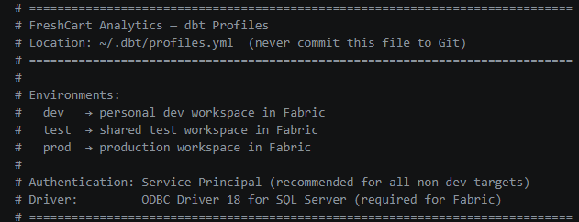
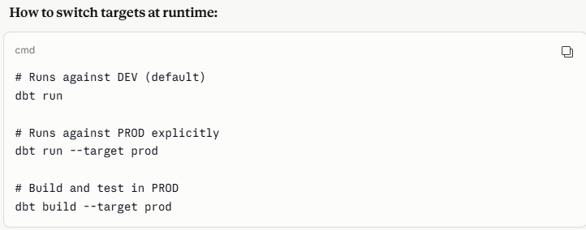
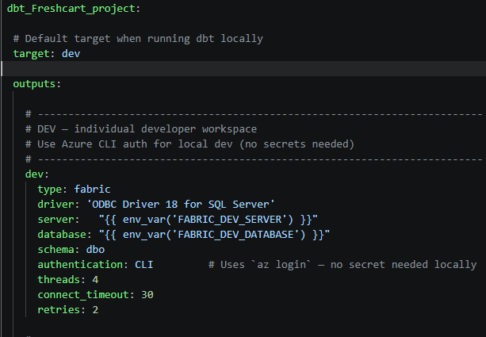
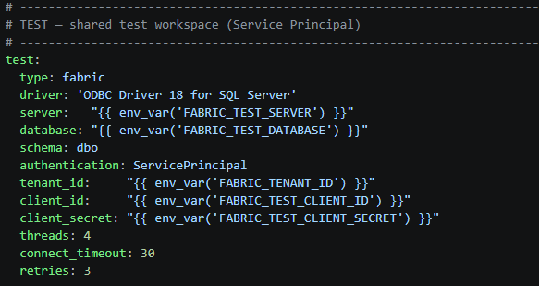
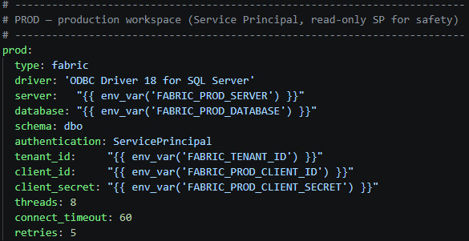
Implemenation .env and profile.yml files
Define dbt_Freshcart_project\.env file to store all variable values (conn-string-dwh, dwh, Lkh )
Define C:\Users\oumar.coulibaly\.dbt\profile.yml file in 1 document (for deployment containing the target environments dev, test, prod)

Slide 9
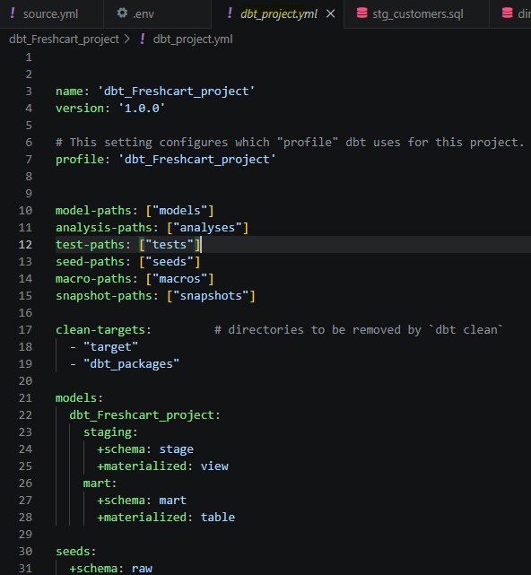
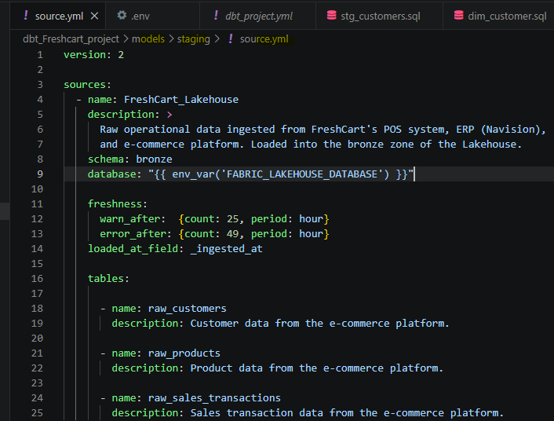
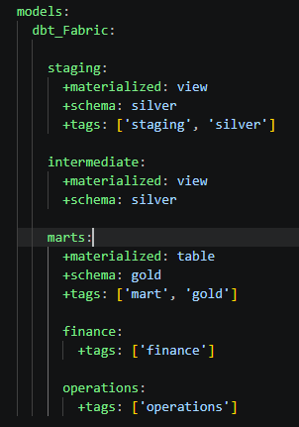
Implemenation source.yml and project.yml
3. Define dbt_Freshcart_project\source fi containing source system info (in this case it’s the Lkh , scheam and tables )
4. Define dbt_Freshcart_project\dbt_project.yml file (for the mapping tussen fabric Lkh and dwh with dbt objects )
In (dbt) models\staging\ stg_customer fabric (bronze) raw_customers get transformed
to become dbo_silver.stg_customer in the dwh.

Slide 10
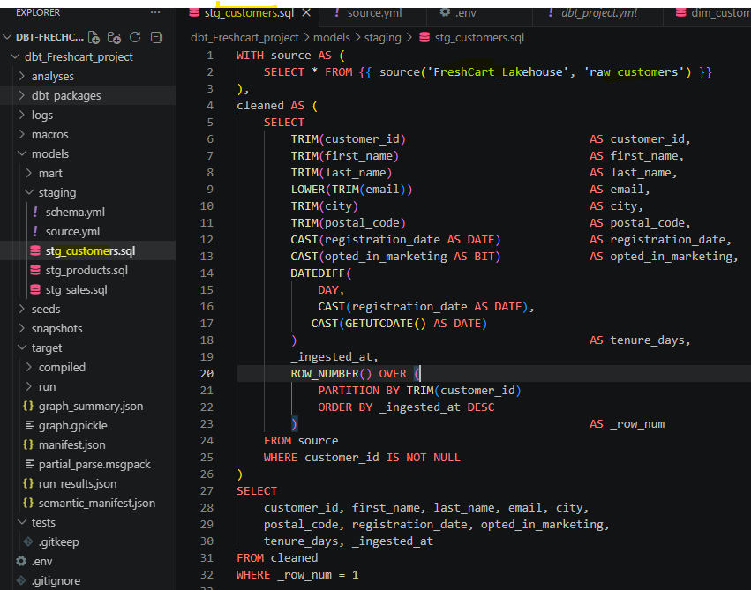
Implemenation customers.sql
5. In (dbt) models\staging\ stg_customer fabric (bronze) raw_customers get transformed
to become dbo_silver.stg_customer in the dwh.
In the staging folder (dbt) , create a files call customer.sql (the same process is all tables in the datamodel)
The source is defined at section 3 , the business logic should be aggreed by the business
6. Test if it works
dbt run --select stg_customer customer #(see table exist after crating sql file )
7.Run some data quality chek using schema.yml file

