Slide 1



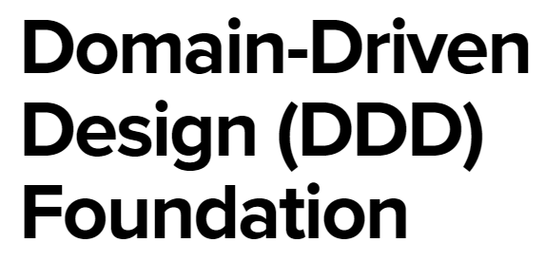
Roles
Data Analyst
Data Engineer
BI Analyst Developer
Oumar Coulibaly
BI Analyst Developer- Data Analyst /Data Engineer
Skills
Analytical Thinking Technical Analysis Pipeline development
Notebooks development
Data flows development
Power App
Logic Apps
Azure Functions
T-SQL/Pythons/DAX/Power Query /M language
MS Fabric /Power Bi workspace Administration Business process automation (Power automate) Manual testing Automation testing (using dbt)
CI/CD Git and Devops
Unit:
Projects & Analysis
City:
Brussels
Relevant Work Experience
01/2026 - Present - | Laco Nv | BI Developer
As an experienced BI Developer, Oumar developed a data platform for our clients using Microsoft Fabric. He focused on building a scalable data architecture, including monitoring, data transformation pipelines, notebooks, and dataflows, and on delivering business insights through semantic models and Power BI reporting. For another customer, he implemented internal automation solutions for HR, inventory, and finance processes. He also supported customers by delivering Leave Request and Expense Report apps using Power Apps, Power Automate, and Logic App 01/2023 - 12/2025 - | Delhaize| Power BI Expert As a Power BI Expert, Oumar supported the business with functional data analysis and the development, management, and maintenance of reporting solutions. He was responsible for creating Power BI semantic models, interactive dashboards, dataflows, and data-marts, as well as implementing RLS, OLS, and CLS. He also provided operational support by resolving issues and handling incidents. In addition, he contributed to data engineering tasks, including setting up pipelines and notebooks using Microsoft Fabric and Databricks. He has a capacity level admin privileges allowing him to create and manage workspaces , manages its access.
01/2020 - 12/2022 | AG Insurance | BI Consultant As a BI Consultant at AG, Oumar worked on several data integration projects for the Risk Division, Security Division, Employee Benefits, Life, Finance, and Daily Operational Support teams. The focus was on extracting data from multiple sources, transforming it, and loading it into dedicated target destinations. This work was delivered using both on-premises Microsoft integration solutions (SSIS, SSRS, SSAS) and Azure cloud platforms (Azure Data Factory, Azure Synapse, ADLS). In addition to ETL/ELT development, Oumar contributed to setting up and managing the analytics layer, including creating data models in SSAS Tabular (BIM model) to prepare reporting. Finally, he created several management reports connecting to both cloud sources (Azure Database, ADLS, Unity Catalog) and on-premises sources (SQL databases, CSV, Excel).
.
Profile
Oumar is an experienced Data & BI Consultant with over 8 years of expertise in data analysis and business intelligence, working across sectors such as Energy, Insurance, and Retail. He combines a strong analytical mindset with solid technical expertise, enabling him to translate complex data into clear, high-performing dashboards and insights that drive business value.
He brings strong expertise in Power BI, DAX, and Azure, supported by a solid background in data engineering, data management, and end-to-end BI delivery (ETL/ELT). With in-depth knowledge of data modeling and performance optimization, he designs and implements scalable, well-governed BI solutions in Microsoft SQL Server and Azure environments.
Fluent in Dutch, French, and English, he effectively bridges the gap between business and IT.
Education and Certificates
DP-700: Microsoft Fabric Data Engineer 2025
DP-600: Microsoft Fabric Analytics Engineer 2024
DA-100: Analyzing Data Microsoft Power BI 2022
DP-203: Data Engineering on MS Azure 2021
Querying Microsoft SQL Server 2017
Bachelor Business IT and Management
High School | 2012 – 2017 State Exam program 2 | 2010 – 2012
Economics and Management Sciences,
Cote D’Ivoire | 2008 – 2010​
Languages French
English
Dutch

