Slide 1

SAGE End Sprint 4 Presentation
Andrew, Blake, Cheick
10/31/2024

Slide 2
Last Sprint Standup Points
What have we done
Implemented keyword comparison algorithm
Document upload screen
Refined GUI
Memory database (frontend)
What still needs to be done
Prompt Engineering (Rollover to next sprint)
Issues so far
Time management with midterms

Slide 3
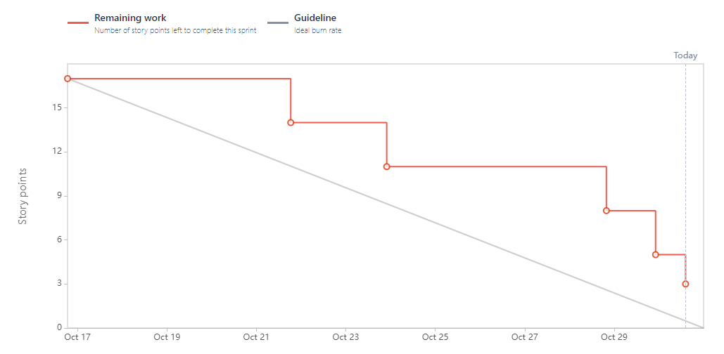
Last Sprint burndown Chart

Slide 4
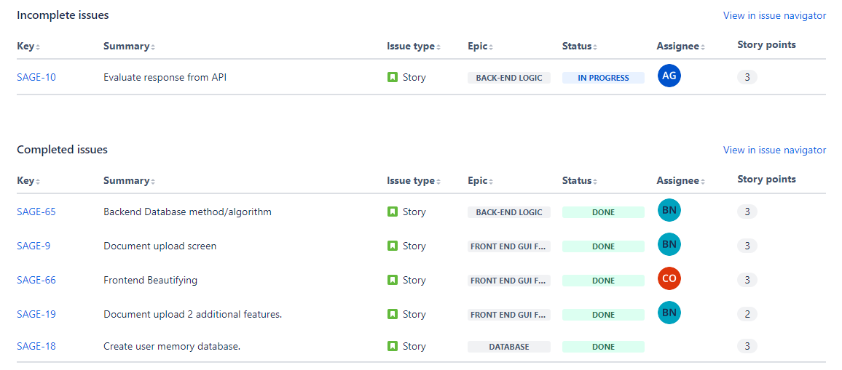
Last Sprint Backlog

Slide 5

Sprint 4 Retrospective
What went well:
Most productive sprint yet
Team communication is still on point
What needs work:
Time management with midterms
One task rollover

Slide 6
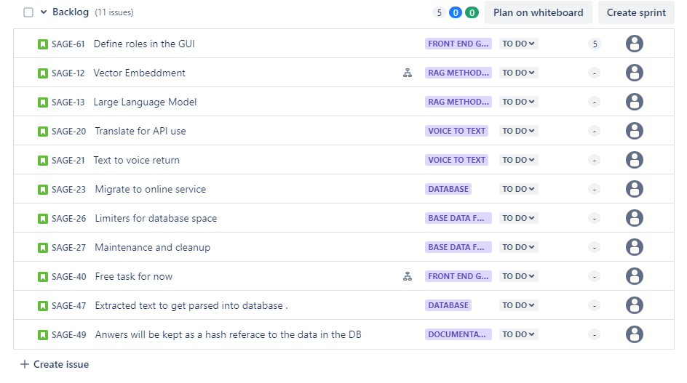
Product Backlog

Slide 7
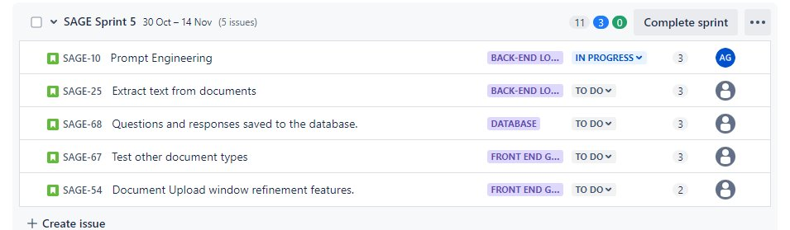
Story point estimate Sprint 5

Slide 8
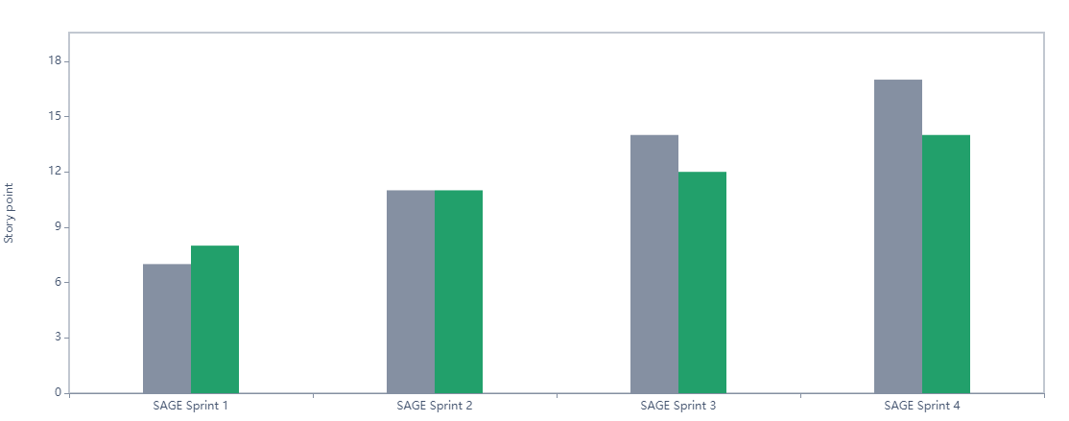
Velocity Chart

Slide 9
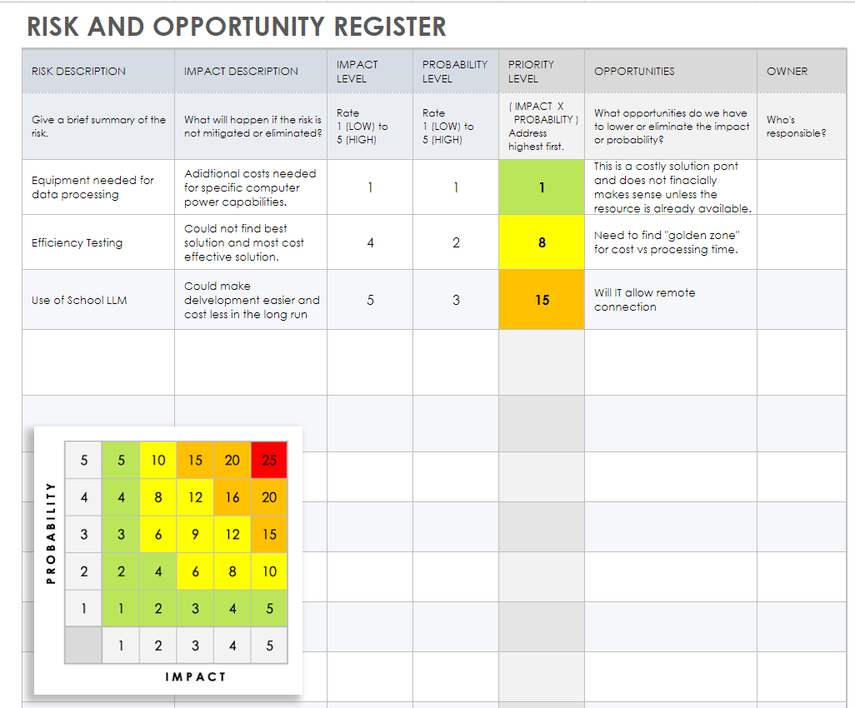

Slide 10
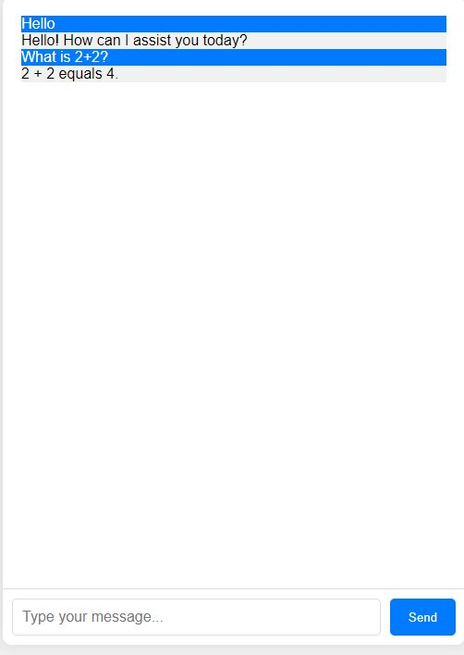
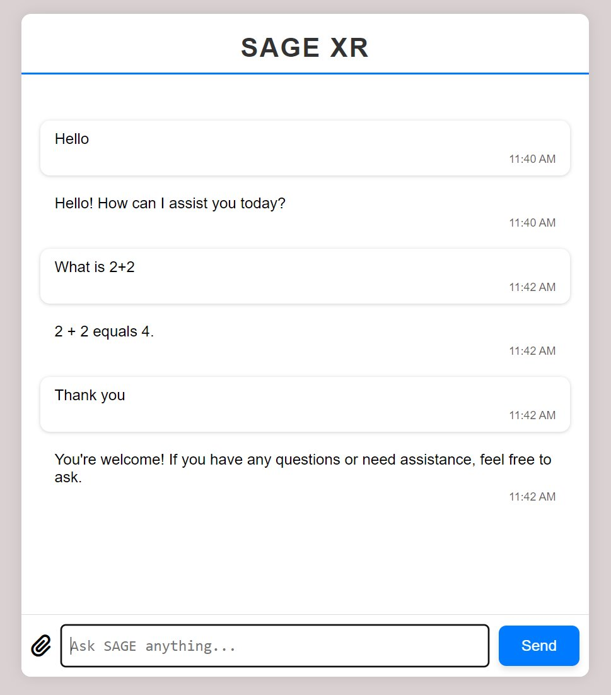
Updated GUI

Slide 11

Any Questions?

