Slide 1
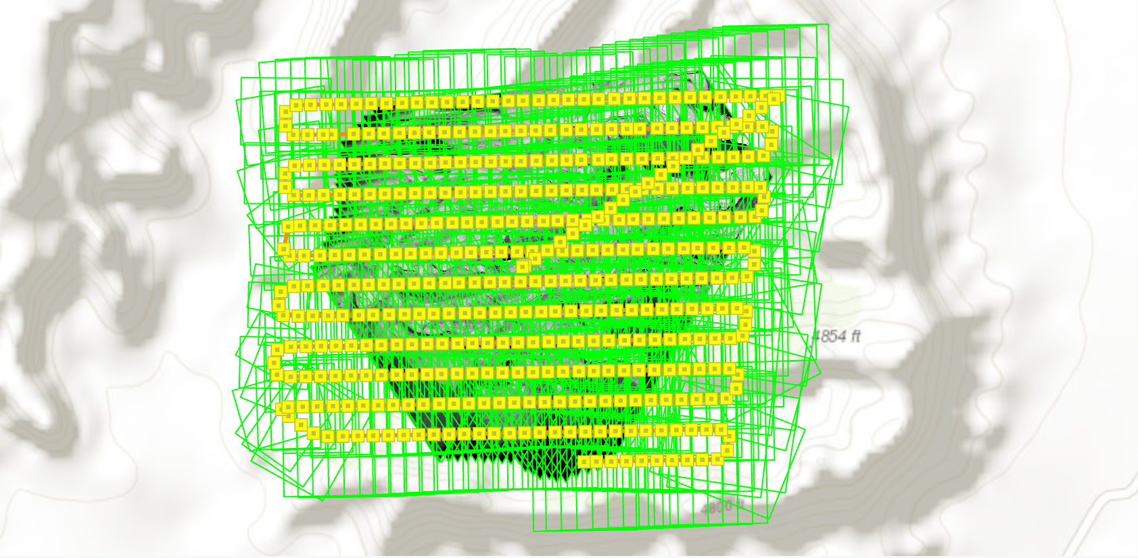
Photogrammetry Presentation By Jacob Williams

Slide 2

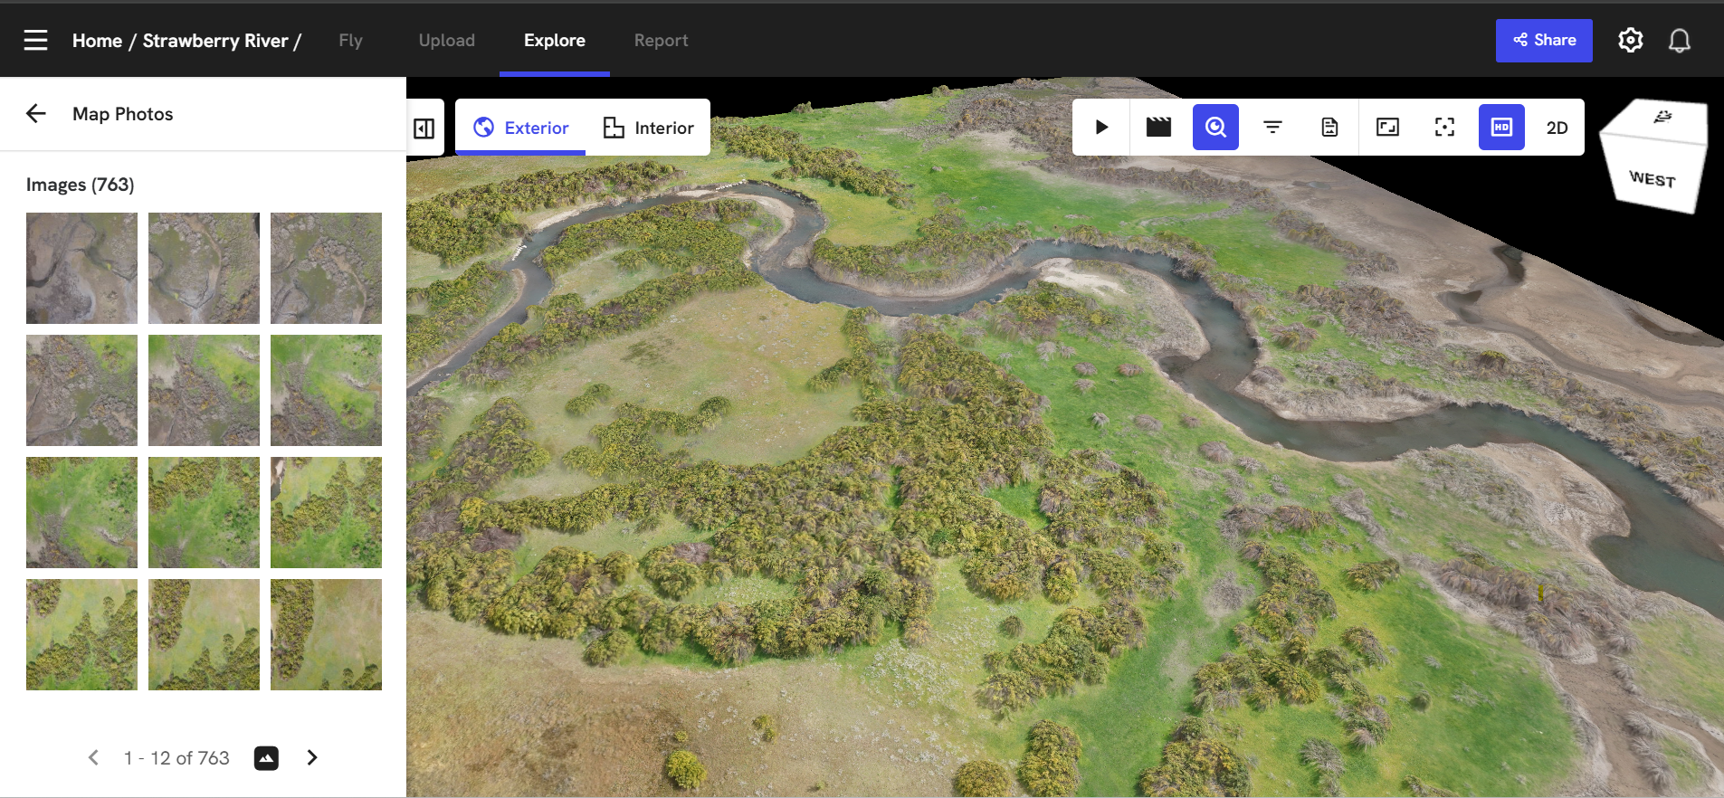
Drone Deploy

Slide 3
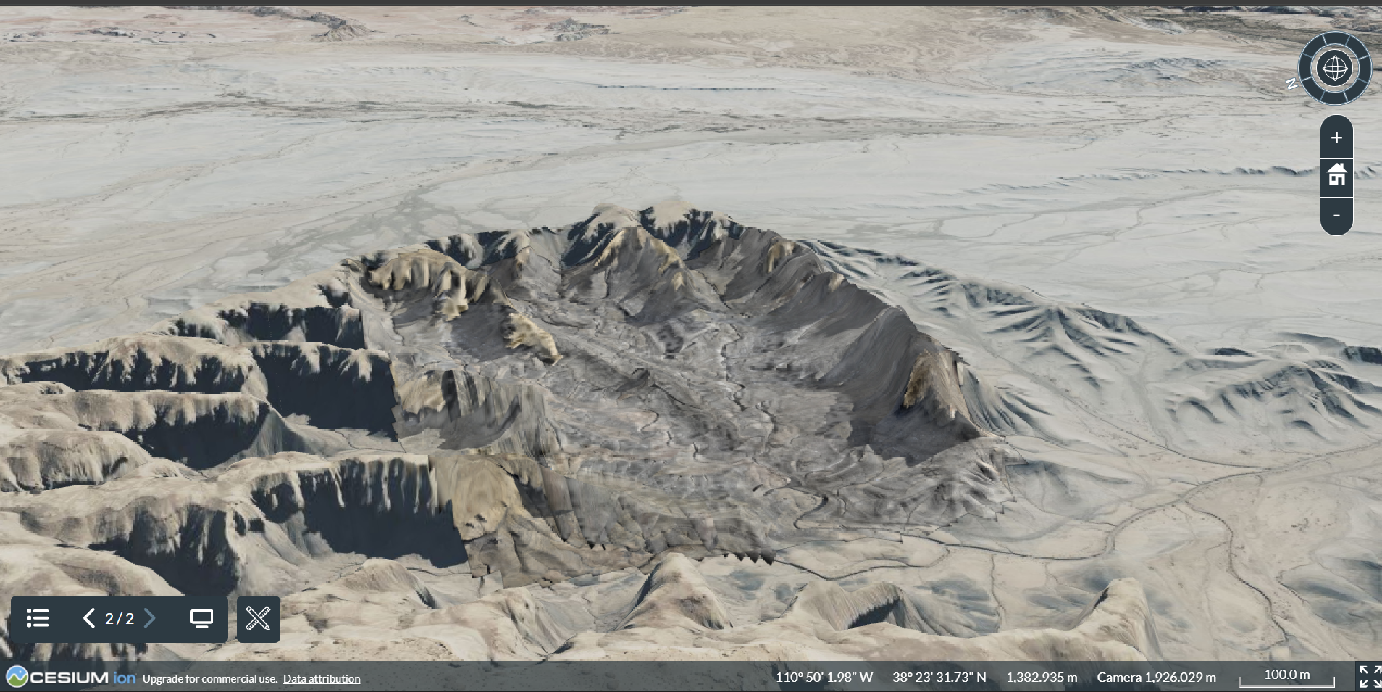
Long Dong Spire Cesium Ion Earth View

Slide 4
Comparison
Software | ArcGIS Pro | Agisoft Metashape
GPU | NVIDIA L40S-12Q | NVIDIA GeForce RTX 3070
Total Processing Time | 4 Hours 3 Minutes 33 Seconds | 47 Minutes 19 Seconds
GPS Accuracy | average 22 cm | 52.9 cm
Pixel Accuracy | 0.44 pix | 0.727 pix
Headache Factor | 5/5 | 2/5
Tie Points | 6,204,525 | 7,878,546

Slide 5
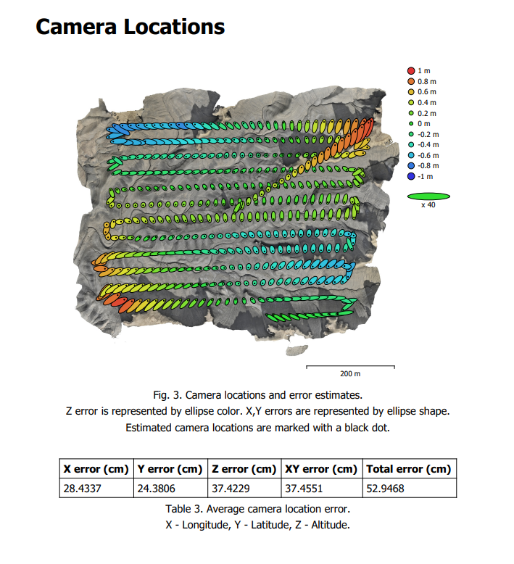
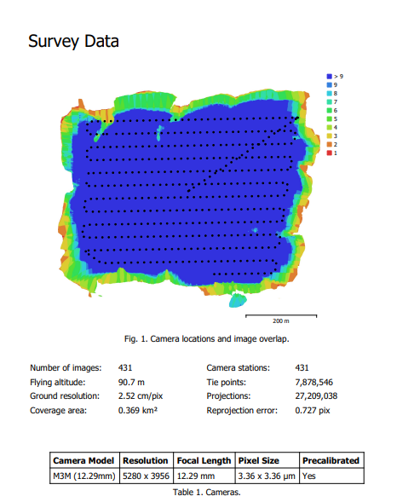
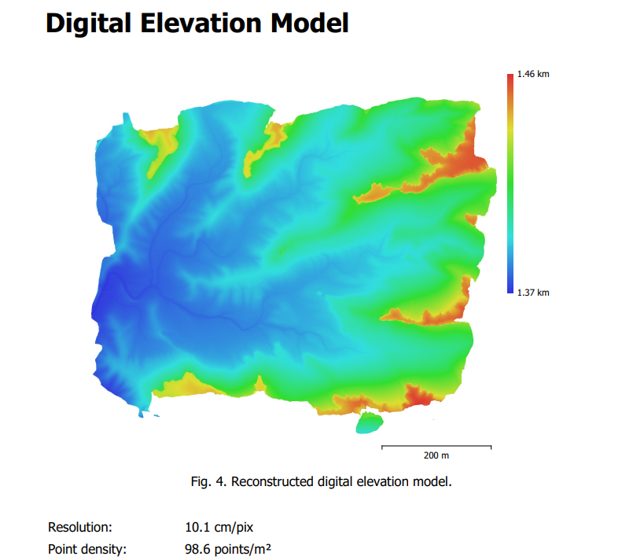
Visualizations

Slide 6
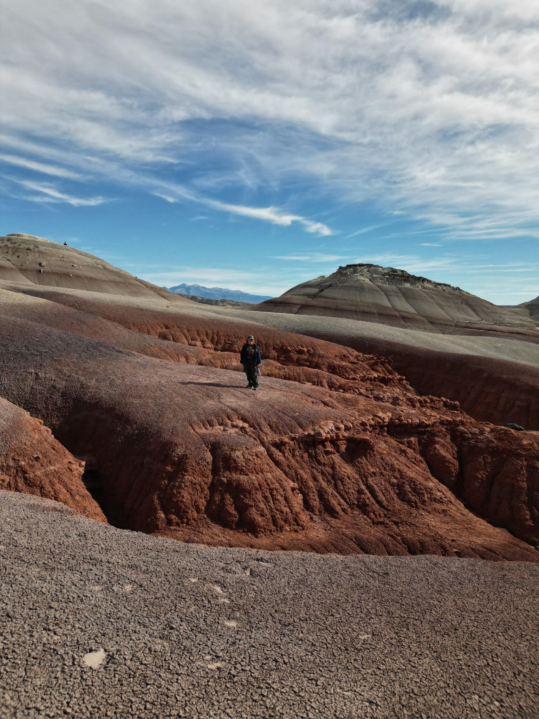
Learnings
An .obj file doesn’t include gps position while a .tif file does.
The Orangina Wingtra requires a lot more processing power (26GB, 763 photos) than Quimby (3GB, 431 photos).
The current license BYU students has for ArcGIS Pro only allows for 2D processing.

Slide 7
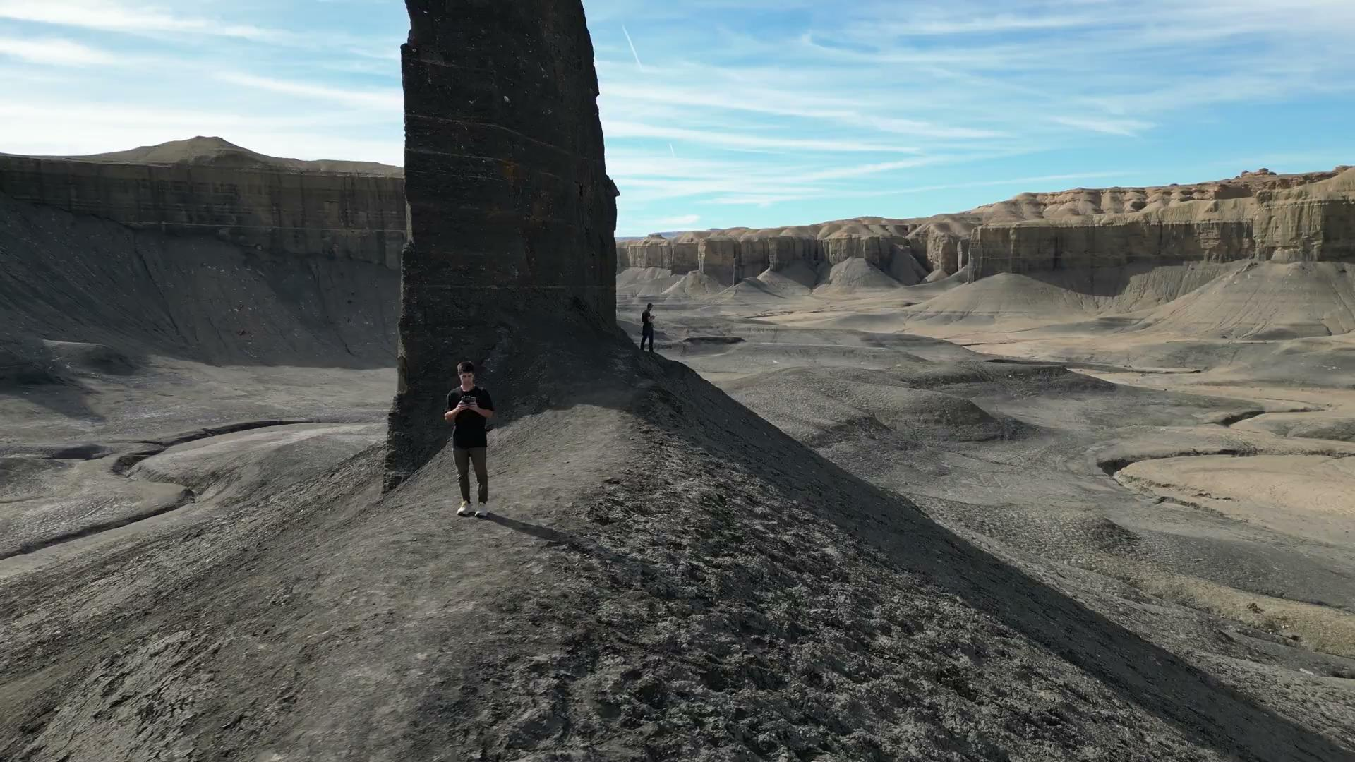
Drone Video

