Slide 1
Sonification of Radio Waves
Audible RFI
Student: Faisal Umar
University: University of Adelaide, Bachelor of Computer Science
Supervisor: Lawrence Toomey, CSIRO Summer 23/24

Slide 2
Background and purpose
Background:
Previous LOCUST modules: detecting local radio signals and galactic H1 respectively
This one: take radio input from a source and convert into audio for humans
Purpose:
Allow students another method to participate in Science classes and engage with Radio Astronomy as a gateway to STEM and increase accessibility

Slide 3
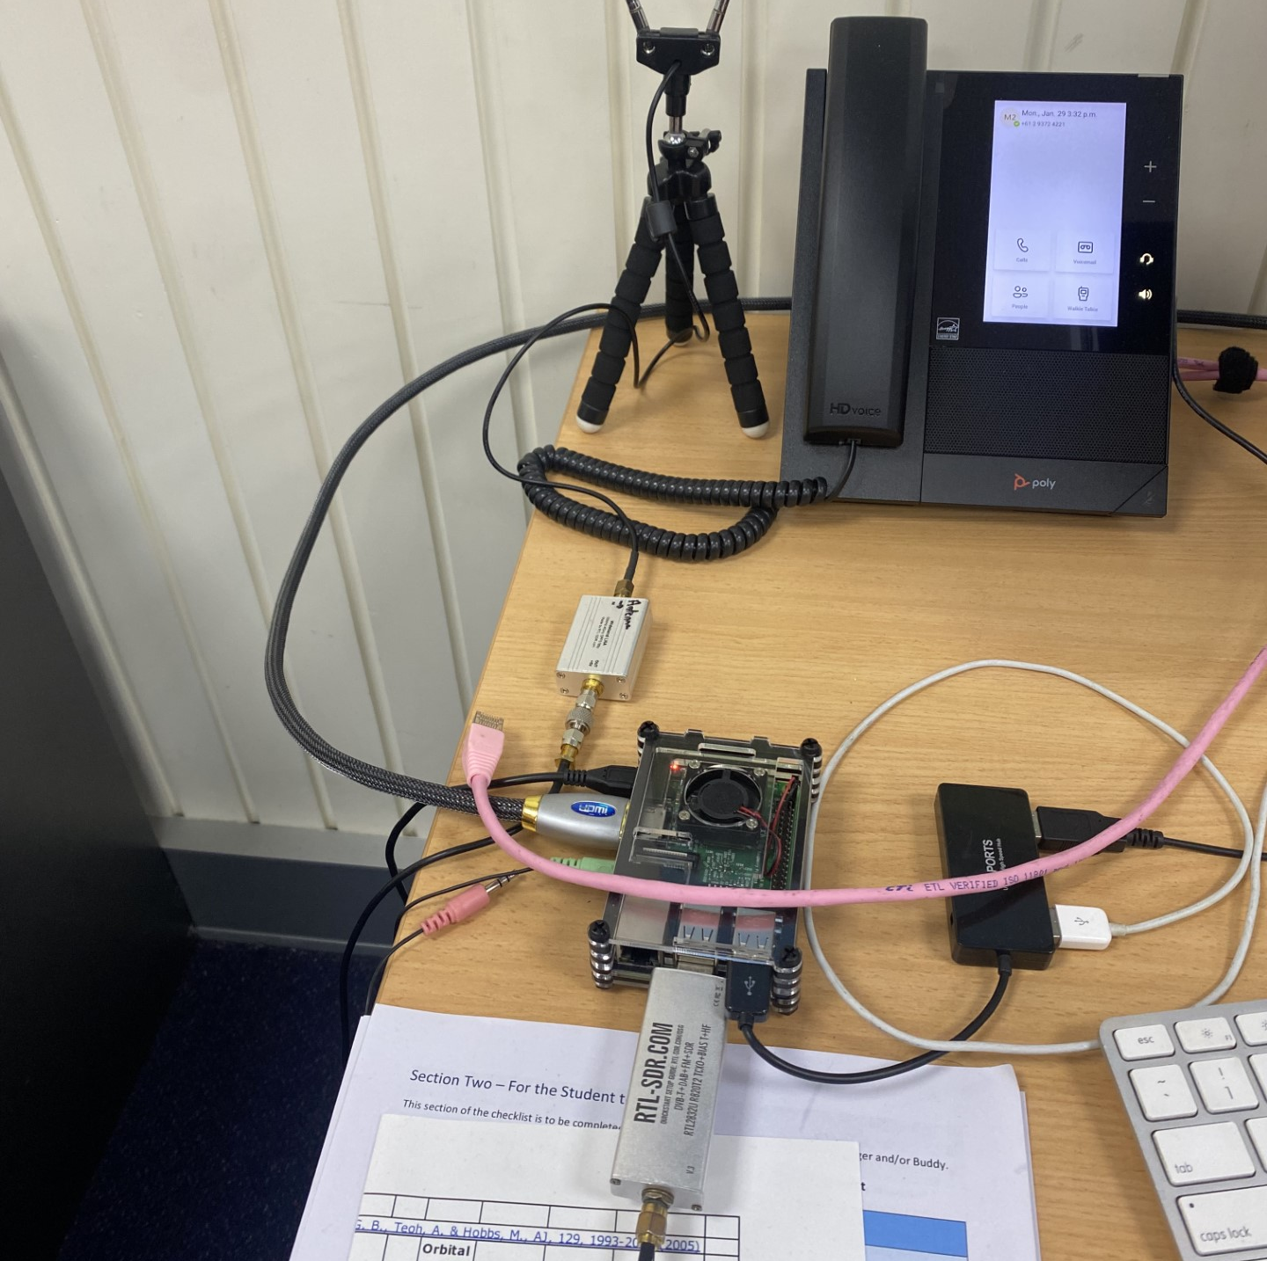
Set-up
Antennae
Radio antennae
Amplifier
Digitiser
Raspberry Pi
Radio Frequency range: 25 MHz – 1765 MHz
Bandwidth ~ 2 MHz
Target audio range: 20 Hz – 20 kHz
Amplifier
Raspberry Pi
Digitiser

Slide 4

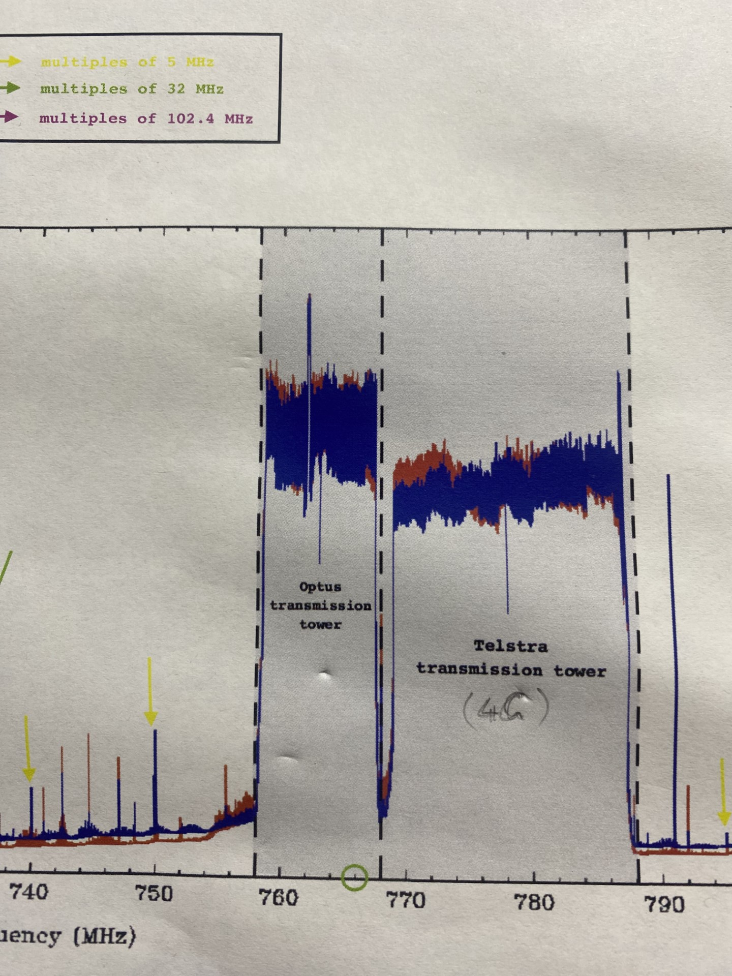
Result and completed Features
Radio Peak
Audio sample
Central frequency 761 MHz in Optus range
Produced by synthesis of individual frequency bins corresponding audio
Plot for distribution of 1 second sample at 761 MHz
Audio is a tone due to generated audio per bin being approx. 0.02 Hz apart
Narrow 2 MHz band causes difficulty in differentiating peaks, especially in wide-band cases like planes

Slide 5
Program Design
Loop when user wants new frequency
appStart.py
Open radio connect
Get frequency
sonifiWaves.py
Get sounds
Play sounds
Return sound objects
pyGameAudioOutput.py
Create sound objects
Play sound objects
Return frequency bins
freqArrayMaker.py
Get samples
Process samples

Slide 6

Code – Data Processing
Challenge/s:
Get complex number sample from the RTL-SDR library
Feed data into matplotlib PSD() function
Get back array of amplitudes and corresponding frequency bins
Learning:
Abstraction
Python library imports
Interpolation

Slide 7
Code - Sonification
Challenge/s:
Sound generation time
Audio synthesis
Learning:
Math
Asynchronous programming

Slide 8
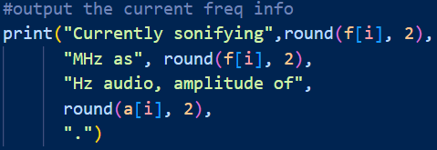
Code – UI and Saving
Challenge/s:
Output saved as .txt file
UI is terminal based instructions and diagnostics
Learning:
OS operations in Python

Slide 9
Future and Incomplete Work
Tactile interface
Real time plots
Smoother transition to enable real-time audio
Save generated audio
Speed up using GPU
Add Bluetooth

