Slide 1
SimPy1

Slide 2
Recap
What is a process / pathway?
Series of steps in order to achieve something. Has a beginning and an end.
What is a process map?
Visual representation of a process
What is a simulation model?
Representation of a process in code

Slide 3
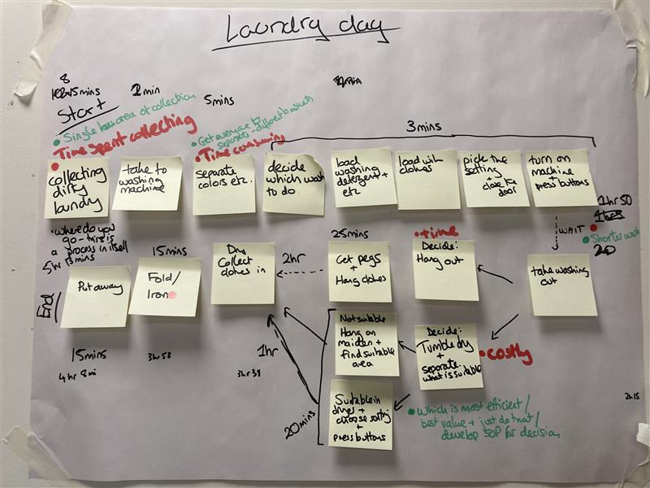
Process map from lean training

Slide 4
Recap Exercise 1:
Groups of 3(?)
Discuss what system/pathway you want to model (maybe choose something you are familiar with in the hospital).
Have a go at drawing your system/pathway.
Think about what questions you might want to ask your model? (Identifying bottlenecks? Queue size?, queue length?, utilisation of something?)

Slide 5
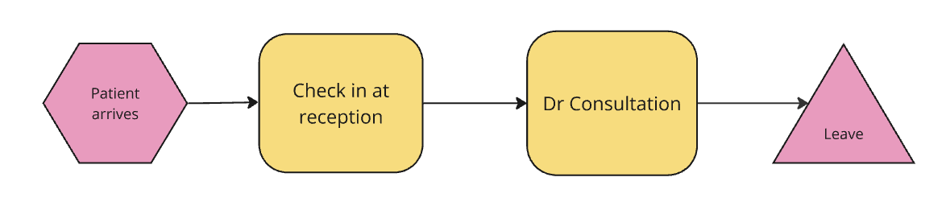
Pathway

Slide 6
Recap Part 2: Core model parts
Entities
Generators
Resources
Queues
Sinks
Model boundary

Slide 7
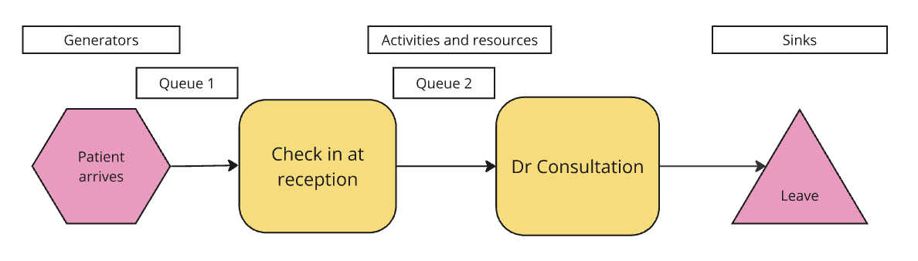
Pathway
Entity: Patients
Model boundary: Clinic boundary

Slide 8
Part 3: Behaviours – leaving this for now
Is the system:
First in, first out (FIFO)
Or, is there prioritisation?
Terminating or non-terminating
When significant queues build up, strange things start happening
The bigger queues get, the more likely these things are to happen:
Reneging
Baulking
Jockeying
Note: When these things start happening, activity no longer = demand. Simulation is a good way of illustrating this.
Resource unavailability

Slide 9
Recap Part 4: Numbers
Generators need mean inter-arrival times
Number of resources.
Resources need activity times
Prioritisation: what percentage are high priority?
After what length of time are people likely to renege/baulk/jockey? Or is there a maximum length of time you would expect people to wait?

Slide 10
Pathway
Resource: Receptionists = 1. Mean Activity Time 2 min, SD 0.5 min Lognormal distribution
Resource: Drs = 1.
Mean Activity Time 10 min, SD 2 min Lognormal distribution
Arrive on average every 10 mins, Exponential distribution
Priority – patients all equal priority
Entity: Patients
Model boundary: Clinic boundary

Slide 11
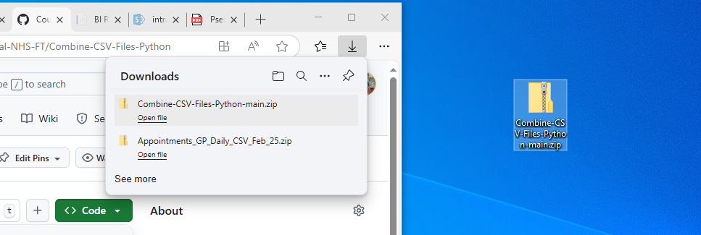
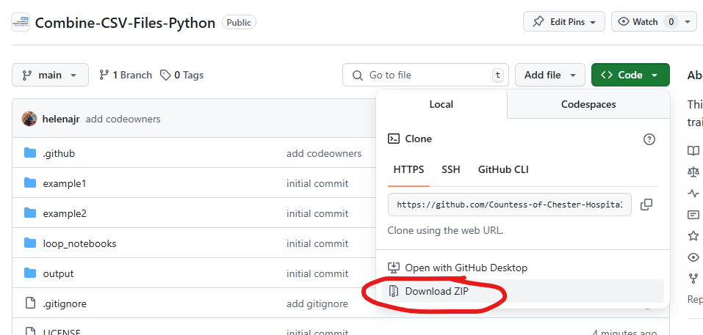
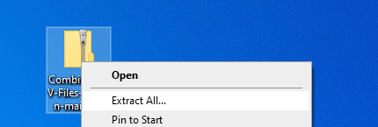
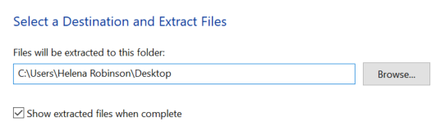
Code Talk Through
Get a copy of the code

Slide 12

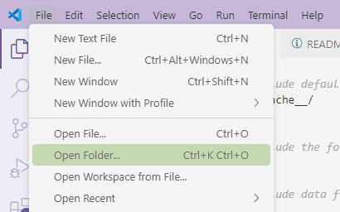
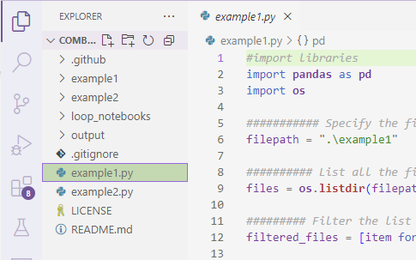
Open the folder you’ve created in VSCode – open model.py

Slide 13
Run the code
Run it as is
Take a look at the outputs
Change the inputs and have a look at the effect on the outputs
Change number of receptionists / drs / patients / activity times etc
How short do consultation times have to be to keep the max wait < 30 mins for example?

Slide 14
Change the model
The receptionist has an additional duty – they also take phone calls. They receive a phone call on average every 15 mins and these also last on average 2 mins (sd. 0.5 mins).
How would you represent this in the diagram and in the code?
Can you incorporate this into the code – how does it affect the queuing times?

Slide 15
Change the model 2
Now patients see a receptionist, then see a nurse, then see a doctor.
Change the code to reflect this.

