Slide 1


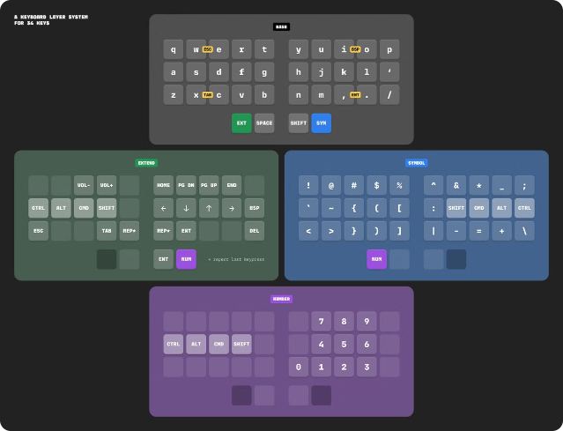


SQL/Foundation: The Core of SQL
IS 9075-2, commonly known as SQL/Foundation, defines the fundamental aspects of the Structured Query Language (SQL). This international standard serves as the bedrock for SQL database management systems, laying down the rules and structures that govern how databases are created, manipulated, and queried.
by 21UCS182_Dhruv Rohatgi

Slide 2

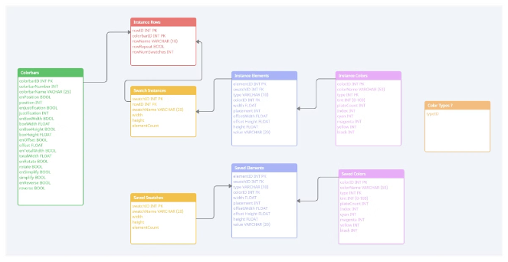
Data Types and Structures
1
Numeric
SQL/Foundation defines various numeric data types, including integers (INT), decimal numbers (DECIMAL), and floating-point numbers (FLOAT), allowing you to store and manage numerical data with precision and efficiency.
2
Character
Character data types, such as VARCHAR and CHAR, are used to store text and strings, enabling you to represent and manipulate textual information within your database.
3
Date and Time
SQL/Foundation provides dedicated data types for representing dates and times, including DATE, TIME, and TIMESTAMP, allowing you to store and manage temporal data with accuracy and consistency.
4
Binary
Binary data types, such as BLOB and VARBINARY, are used to store raw binary data, such as images, audio files, and other multimedia content, allowing you to manage non-textual data within your database.

Slide 3


Data Definition Language (DDL)
1
CREATE
The CREATE command is used to define new database objects, such as tables, views, and indexes. It allows you to specify the structure and properties of these objects, laying the foundation for your database schema.
2
ALTER
The ALTER command is used to modify existing database objects, such as changing table columns, adding or removing constraints, or updating object properties. It allows you to adjust and refine your database schema as your requirements evolve.
3
DROP
The DROP command is used to delete database objects, such as tables, views, and indexes. It removes these objects from your database schema, allowing you to manage and organize your database structure effectively.

Slide 4
Data Manipulation Language (DML)
SELECT
INSERT
UPDATE
DELETE
The SELECT command is used to retrieve data from one or more tables in your database. It allows you to filter, sort, and aggregate data, enabling you to extract specific information and analyze your data effectively.
The INSERT command is used to add new rows to a table in your database. It allows you to input data into your database, populating your tables with relevant information and expanding your data store.
The UPDATE command is used to modify data in existing rows of a table. It allows you to change values within your database, ensuring that your data remains accurate and up-to-date.
The DELETE command is used to remove rows from a table in your database. It allows you to manage your data by removing outdated or irrelevant information, keeping your database streamlined and efficient.

Slide 5


Data Integrity and Security
Transactions
Ensure atomicity, consistency, isolation, and durability (ACID) of data modifications, guaranteeing data integrity through reliable operations.
Constraints
Define rules and restrictions on data values, ensuring data consistency and accuracy by enforcing specific limitations.
Error Handling
Provide mechanisms for detecting and managing errors, ensuring data integrity and database stability by handling unexpected events gracefully.
User Authentication
Control access to the database by verifying user identities, limiting access to authorized users and protecting sensitive data.
Permissions
Define specific access privileges for users and roles, enabling fine-grained control over data access and ensuring data security.

