Slide 1





The Power of SQL: A Comprehensive Framework
SQL (Structured Query Language) has become the de facto standard for database management, providing a powerful and flexible language for interacting with relational databases. The ISO/IEC 9075-1 standard, known as the SQL/Framework, is the foundational document that defines the syntax, semantics, and implementation guidelines for this essential technology. This comprehensive framework sets the stage for the seamless integration of SQL-based applications across a wide range of industries and applications.
by 21UCS182_Dhruv Rohatgi

Slide 2
Key Components of the SQL/Framework
Data Definition Language (DDL)
Data Manipulation Language (DML)
Data Control Language (DCL)
The SQL/Framework also covers the DCL, which includes statements for managing user permissions and access control. These commands enable database administrators to enforce security policies and ensure that only authorized personnel can interact with sensitive data, a critical aspect of modern data management.
The SQL/Framework specifies the DDL, which includes statements for creating, modifying, and deleting database schema objects such as tables, views, and indexes. These powerful commands enable database administrators to manage the underlying structure of the data, ensuring data integrity and consistency.
The DML, as defined in the SQL/Framework, provides the means for querying, inserting, updating, and deleting data within database tables. These statements form the core of SQL's data management capabilities, empowering developers to build powerful, data-driven applications.

Slide 3

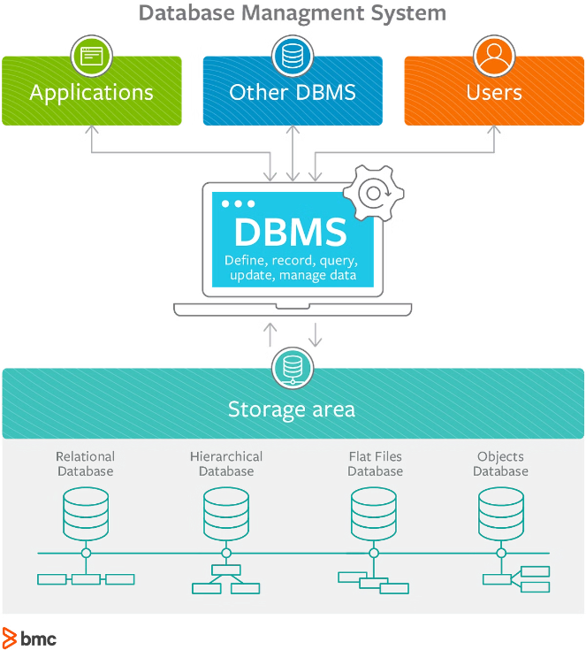
Driving SQL Standardization and Interoperability
1
Standardization
The primary goal of the SQL/Framework is to establish a standardized approach to SQL, ensuring compatibility and interoperability across different database management systems (DBMS). This standardization promotes portability of SQL-based applications, allowing developers to build solutions that can seamlessly integrate with a wide range of DBMS platforms.
2
Syntax and Semantics
The SQL/Framework defines the precise syntax and semantics of SQL commands, ensuring consistent interpretation and execution of SQL statements across different DBMS implementations. This standardization enables seamless collaboration and data exchange between teams and organizations, fostering a cohesive SQL ecosystem.
3
Extensibility and Flexibility
While the SQL/Framework defines the core SQL language, it also allows for optional features and extensions. This flexibility enables DBMS vendors to innovate and introduce new capabilities, while maintaining compatibility with the standard. This balance between standardization and innovation ensures that SQL remains a powerful and adaptable tool for database management.

