Slide 1

Stacking the Genetic Deck
Jonathan Anomaly

Slide 2
What do we know about heritability?
All traits are heritable.
Complex traits are polygenic: they’re influenced by many genes of small effect.
Rare genetic variants can have larger effects on complex traits, usually negative.

Slide 3







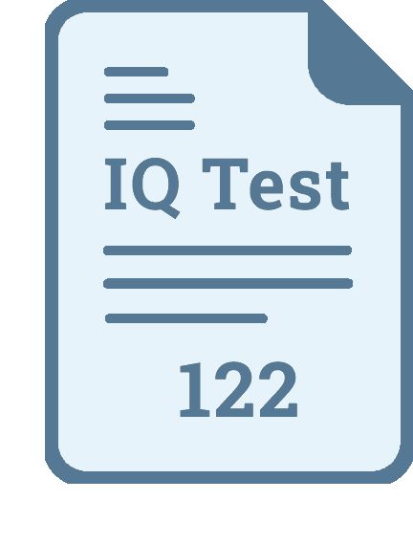
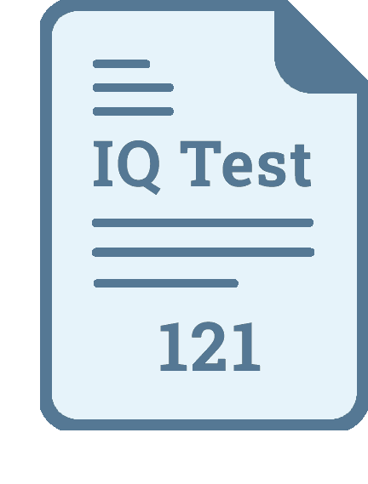
Twin Studies
Monozygotic twins
separated at birth
Doctors
Engineers

Slide 4
Heritability Estimates
Height
General intelligence (g)
Personality traits
Political orientation
~ 90% heritable
~ 75% heritable
~ 50% heritable
~ 40% heritable

Slide 5
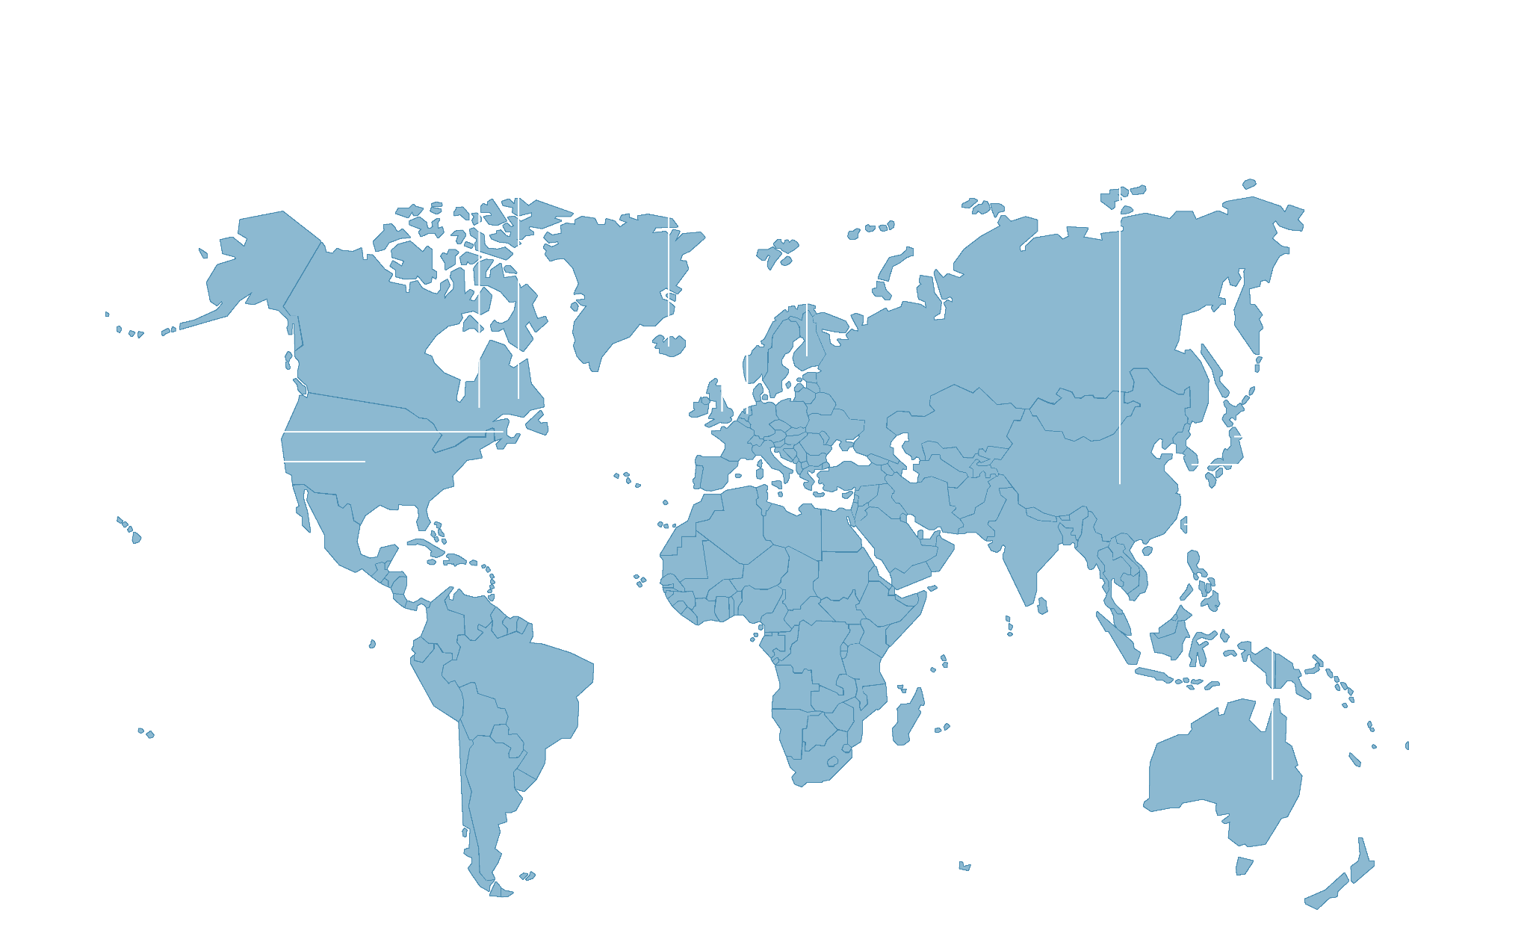
Genome-Wide Association Studies

Slide 6
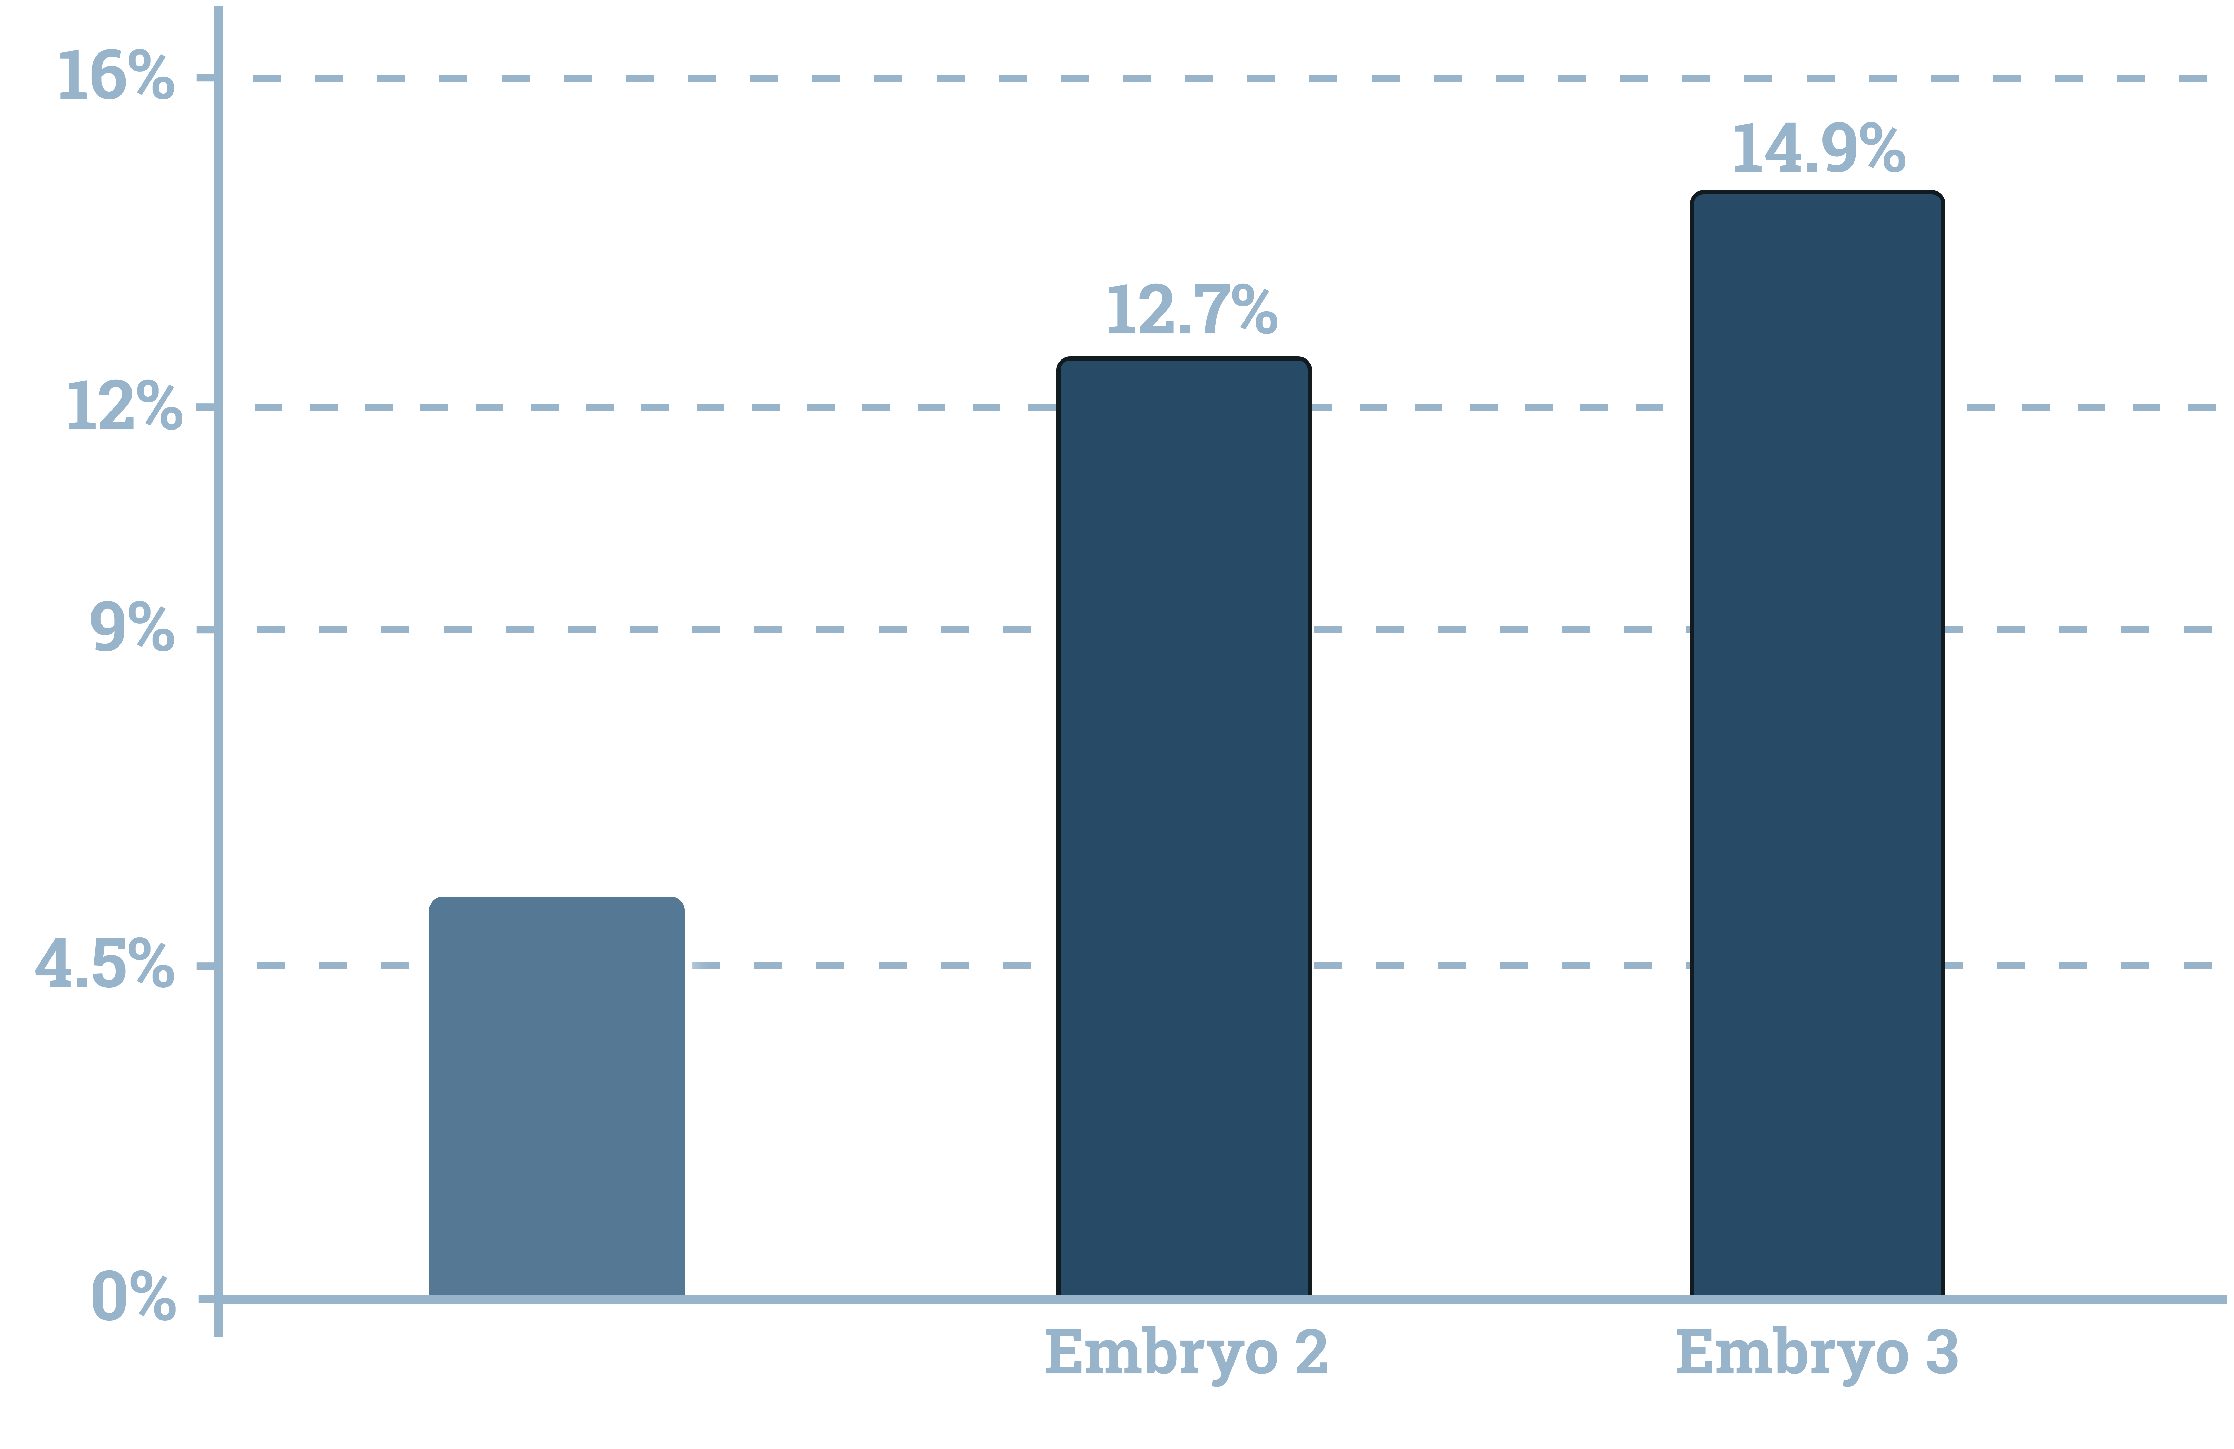
Polygenic Scores
Lifetime risk of schizophrenia

Slide 7


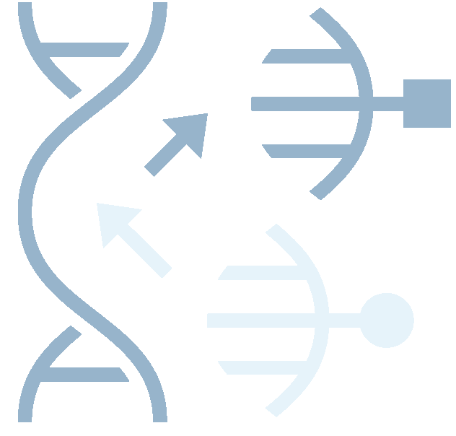



How to influence children’s traits
1. Mate selection
2. Gene editing (CRISPR)
3. Embryo selection (IVF + PGT)

Slide 8
Gains from selection depend on number of embryos – e.g. IQ
For ten embryos:
Range
14 IQ points

Slide 9
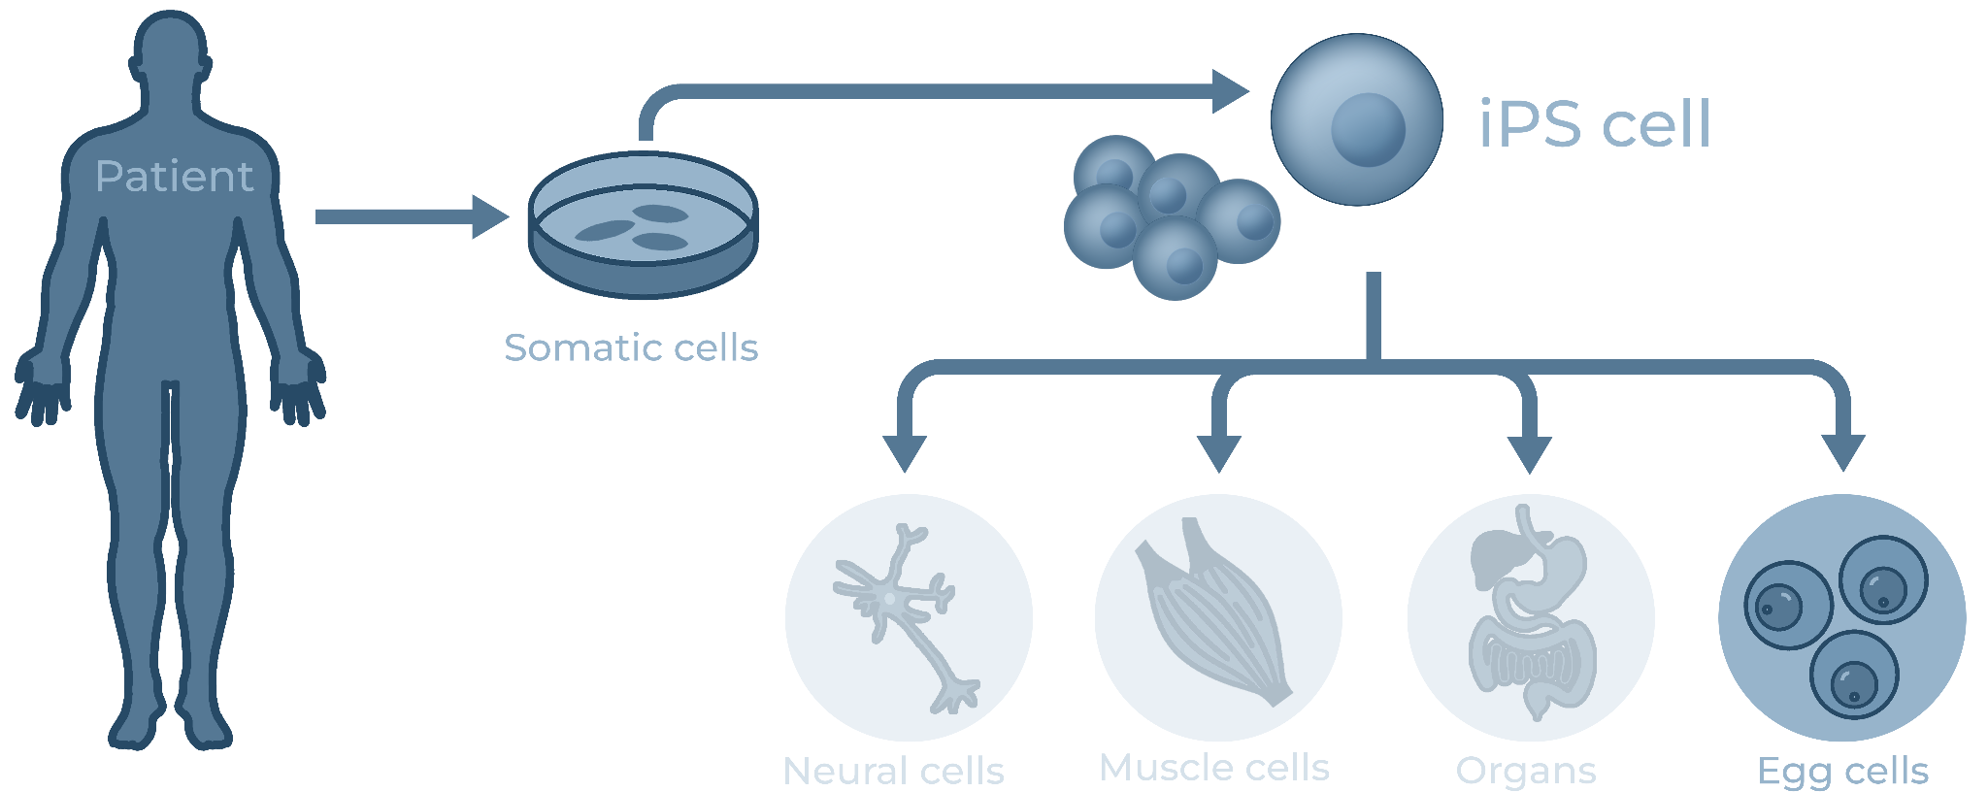
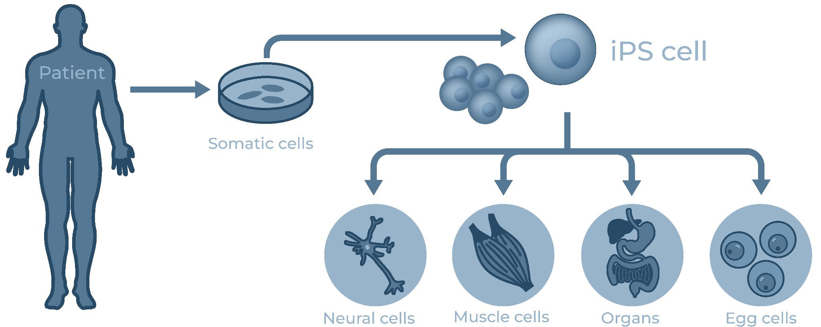
In-vitro-gametogenesis will supercharge selection

Slide 10
Benefits of minimizing genetic disease
INDIVIDUAL
Longer, better, more fulfilling life
SOCIAL
Economic productivity
Benefit rather than cost on health systems

Slide 11
Benefits of enhancing intelligence
INDIVIDUAL
Longer life, better health, more income (Plomin & Deary) More stable relationships, less criminality (Beaver, Boutwell, Murray)
SOCIAL
Economic productivity and scientific innovation (Bostrom)
Cooperation in collective action problems (Jones)

Slide 12



What traits can we influence?
Mental traits
Aesthetic traits
Health traits
Intelligence
Schizophrenia
Bipolar Disorder
Severe Depression
Height
BMI Hair color
Body shape
Cancer
Diabetes
Heart Disease
Rheumatoid Arthritis

Slide 13
Reasons to support genetic selection
Nature does not select for human happiness
Civilization preserves harmful mutations
Evolutionary mismatch is pervasive
Arms races create incentives

Slide 14

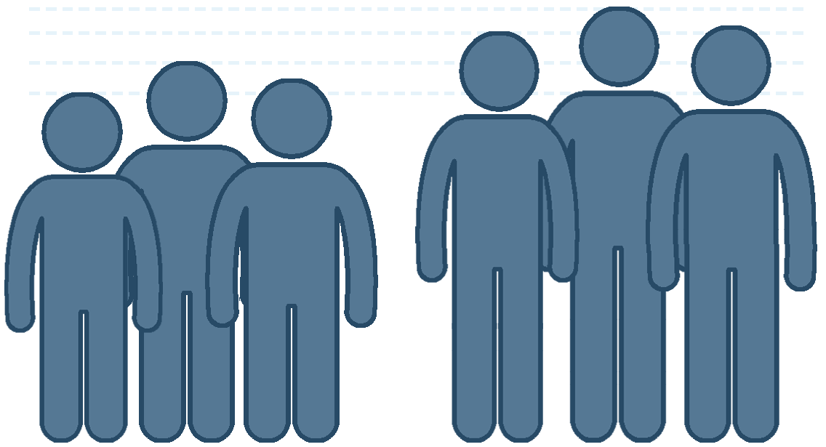
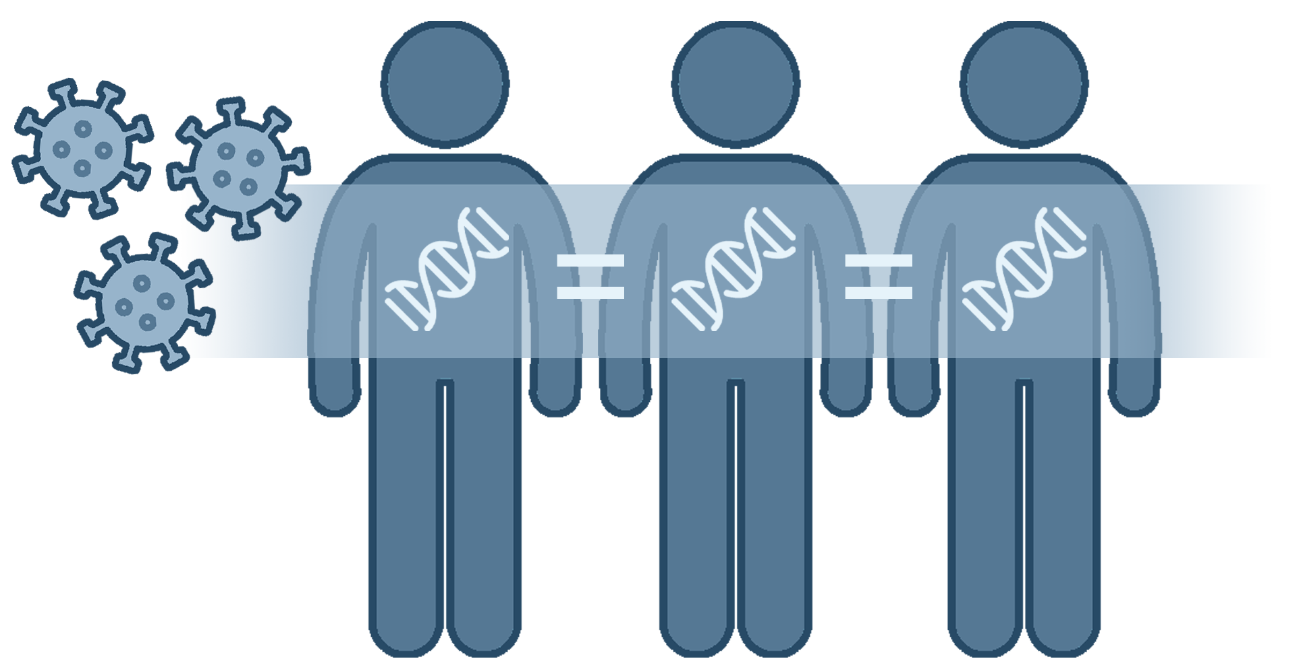
Reasons to worry about genetic selection: Collective Action Problems
Sex Ratios (imbalances)
Height (arms races)
Immunity (monocultures)

Slide 15
Solution: Regulatory Parsimony
When legislation is necessary to prevent serious harms resulting from collective action problems, we should aim for simple rules that apply to all.
We should also take the least restrictive alternative among the feasible set of laws.
(Adapted from: Presidential Bioethics Report on Synthetic Biology, 2010)

Slide 16
Regulatory Parsimony Justified
1. Complex laws are easier for powerful people to navigate.
2. Too many laws can crowd out social norms.
3. Restrictive laws can encourage learned helplessness and black markets.

Slide 17

Embryo selection for IQ

