Slide 1

Notions de probabilité (rappels)

Slide 2
The Basics
Probability is simply how likely something is to happen.
Whenever we’re unsure about the outcome of an event, we can talk about the probabilities of certain outcomes—how likely they are.
The analysis of events governed by probability is called statistics.

Slide 3
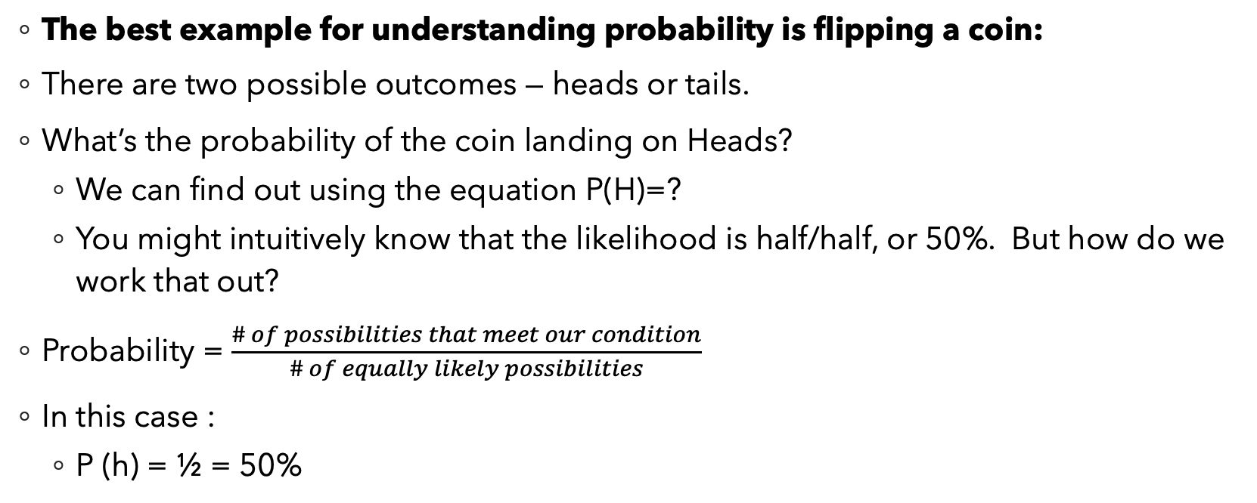
Flipping a Coin
The best example for understanding probability is flipping a coin:
There are two possible outcomes — heads or tails.
What’s the probability of the coin landing on Heads?
We can find out using the equation P(H)=?
You might intuitively know that the likelihood is half/half, or 50%. But how do we work that out?
Probability = $\frac{\# of possibilities that meet our condition}{\# of equally likely possibilities}$
In this case :
P (h) = ½ = 50%

Slide 4
Example
More generally :
Probability of an event = (# of ways it can happen) / (total number of outcomes)
Rolling a die:
What is hte probability of rolling a 1 ?
What is the probability of rolling a 2 or a 6 ?
What is the probability of rolling an even number ?

Slide 5
Sample Space
Sample sppce => all of the possible outcomes of an « experiment »
Example :
What is the sample space in the case where our experiment consists in flipping 3 coins ?
HHH
HHT
HTH
HTT
THH
THT
TTH
TTT

Slide 6

Sample Space
What is the probability of getting exactly 2 heads when flipping 3 coins :
P(« exactly 2 heads ») = $\frac{how many possible outcomes are associated with the event ?}{number of possible outcomes}$
= 3 / 8

Slide 7
Union, Intersection, and Complement
What is a set ?
Fundamentally, just a collection of distinct objects, which can be anything :
A = {56, 😀, blue, orange, 99, Jim, Claire}
B = {65, 🙁, blue, red, 100, James, Clara}
The union of two sets contains all the elements contained in either set (or both sets).
The union is notated A ⋃ B.
More formally, x ∊ A ⋃ B if x ∊ A or x ∊ B (or both)

Slide 8
Union, Intersection, and Complement
The intersection of two sets contains only the elements that are in both sets.
The intersection is notated A ⋂ B.
More formally, x ∊ A ⋂ B if x ∊ A and x ∊ B
The complement of a set A contains everything in a given universe that is not in the set A.
The complement is notated A’.

Slide 9
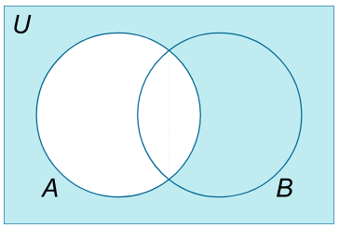
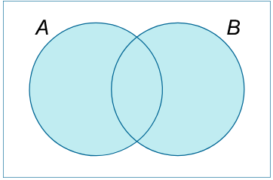
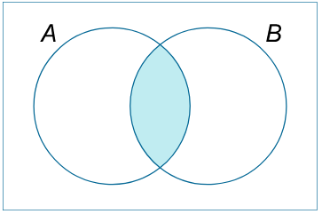
Venn Diagrams
Union
Intersection
Complement

Slide 10
Set Operations Example
If :
A = {3, 7, -5, 0, 13}
B = {0, 17, 13, ⭐, Blue}
C = {Pink, ⭐, 3, 17}
Then what would this set be : A \ (A ⋂ (B \ C)’) ⋃ (B ⋂ C) ?
NB : (A \ B) is the difference bewteen sets A and B, ie. the set that contains exactly all the elements in A but not in B.

Slide 11
General Addition Rule for Probability
Imagine we have a bag in which there are:
8 green cubes
9 green spheres
5 yellow cubes
7 yellow spheres
We consider the event where we pull out an object, each object having the same probability of being pulled out from the bag :
What is P (cube) ?
What is P (yellow) ?
What is P( yellow cube) ?
What is P (yellow or cube) ?

Slide 12
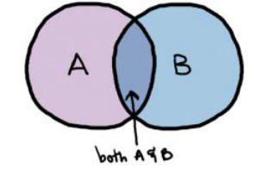

General Addition Rule for Probability
P (yellow or cube) = $\frac{\# of yellow objects + \# of cubes − \#of elmts counted twice }{total number of objects}$
= (12 + 13 – 5) / 29 = 20/29
General rule :
P (A or B) = P (A U B) = P (A) + P (B) – P (A $∩$ B)

Slide 13
Monty Hall Problem/Brain-teaser
You are a contestant at a game show:
There are three doors behind which are hidden
A goat
A car
And another goat
The rules are that you must first pick a door.
After that, the game show host opens one of the remaining doors (behind wihich there is a goat) and asks you if you wish to switch and choose the other remaining door…
So the question is:
Should you switch or should you stick to your guns and keep your initial choice ?

Slide 14
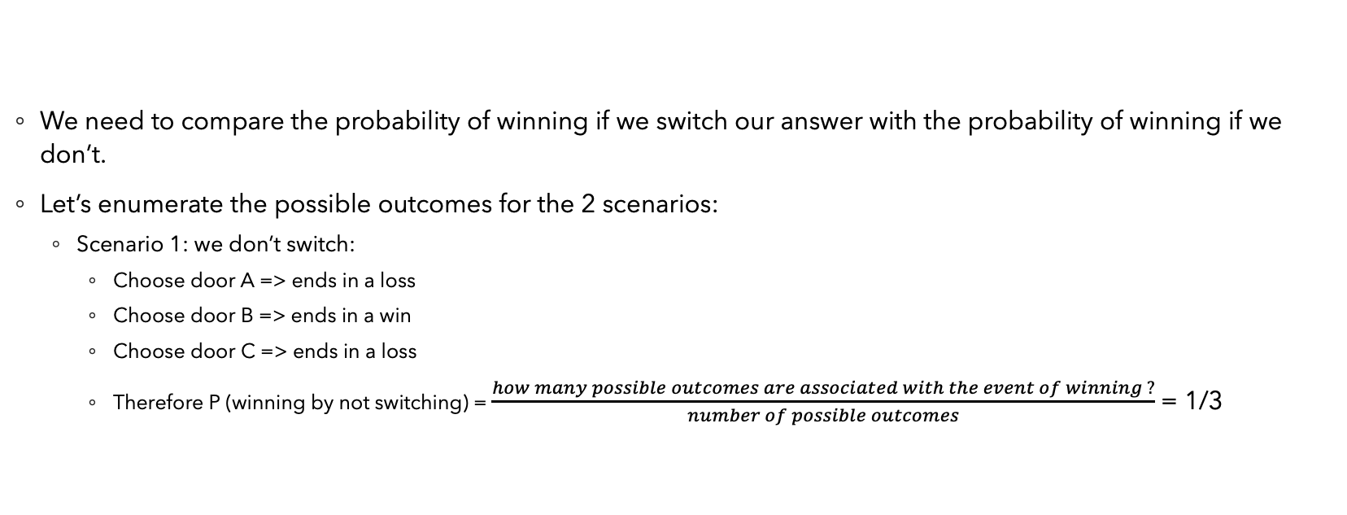
Solution
Door A: Goat Door B: Car Door C: Goat
We need to compare the probability of winning if we switch our answer with the probability of winning if we don’t.
Let’s enumerate the possible outcomes for the 2 scenarios:
Scenario 1: we don’t switch:
Choose door A => ends in a loss
Choose door B => ends in a win
Choose door C => ends in a loss
Therefore P (winning by not switching) = $\frac{how many possible outcomes are associated with the event of winning ?}{number of possible outcomes}$ = 1/3

Slide 15
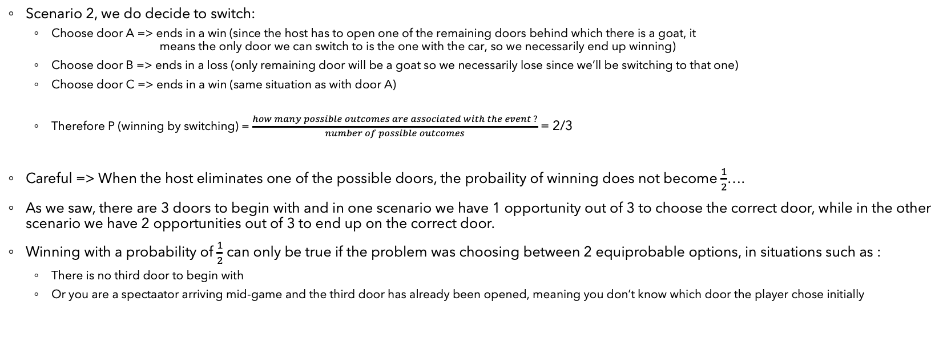
Solution
Scenario 2, we do decide to switch:
Choose door A => ends in a win (since the host has to open one of the remaining doors behind which there is a goat, it means the only door we can switch to is the one with the car, so we necessarily end up winning)
Choose door B => ends in a loss (only remaining door will be a goat so we necessarily lose since we’ll be switching to that one)
Choose door C => ends in a win (same situation as with door A)
Therefore P (winning by switching) = $\frac{how many possible outcomes are associated with the event ?}{number of possible outcomes}$ = 2/3
Careful => When the host eliminates one of the possible doors, the probaility of winning does not become $\frac{1}{2}$….
As we saw, there are 3 doors to begin with and in one scenario we have 1 opportunity out of 3 to choose the correct door, while in the other scenario we have 2 opportunities out of 3 to end up on the correct door.
Winning with a probability of $\frac{1}{2}$ can only be true if the problem was choosing between 2 equiprobable options, in situations such as :
There is no third door to begin with
Or you are a spectaator arriving mid-game and the third door has already been opened, meaning you don’t know which door the player chose initially

Slide 16
Solution
For more detailed explanations :
https://www.youtube.com/watch?v=Xp6V_lO1ZKA
https://www.youtube.com/watch?v=XiKMMt3Mm4k
https://www.youtube.com/watch?v=4Lb-6rxZxx0

