Slide 1

Linguistique de corpus en anglais
Armand STRICKER
armand.stricker@universite-paris-saclay.fr
armandnlp@gmail.com

Slide 2
Class structure
2hrs => try to divide classes into theory + practice
Either over 1 class or over 2 classes depending on the subject matter => goal is that you take something from this class that may be useful later (job, job interview, research…)
I will adapt the material as we go along and try to simplify and clarify as much as possible
Work on the practical parts as pairs => try to go over everything together always and divide the tasks. Very important to explain what you did to your partner clraly => means you understand + important skill when you work with a team in a company or within a research group
Grades : probably an exam or a project during the final class (what you prefer + how much work you already have)

Slide 3
Course « requirements »
Helps to have a laptop that you can bring :
Familiarize yourself with your machine as much as possible
Means you can continue exploring/play around at home with what was done in class
A little maths:
Probability
Manipulate equations
Some linear algebra
Computer/programming skills:
Python
Unix shell

Slide 4
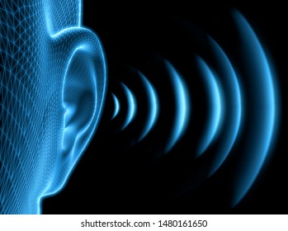
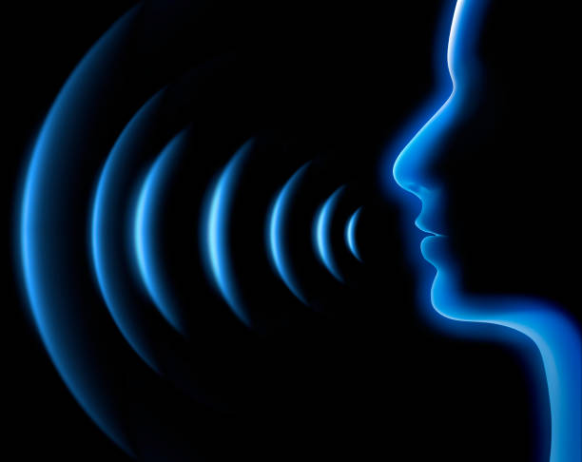
Overview of linguistics
Input: sound wave
Phonetics
Phonology
Morphology
Syntax
Semantics
Pragmatics
Output: meaning

Slide 5
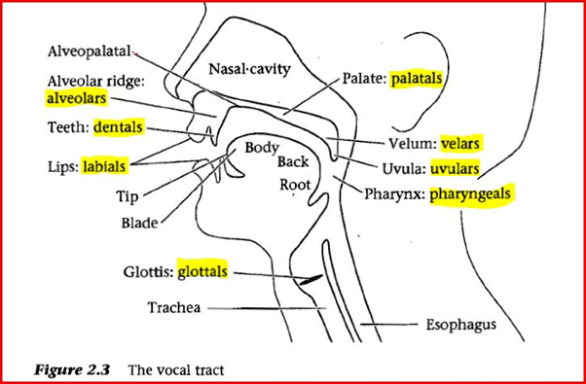
Overview of linguistics
Input: sound wave
Phonetics
Phonology
Morphology
Syntax
Semantics
Pragmatics
Output: meaning

Slide 6
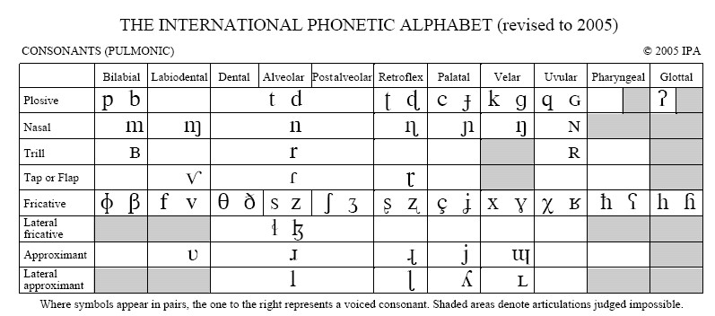
Overview of linguistics
Consonants
Input: sound wave
Phonetics
Phonology
Morphology
Syntax
Semantics
Pragmatics
Output: meaning

Slide 7
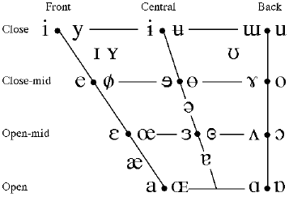
Overview of linguistics
Vowels
Input: sound wave
Phonetics
Phonology
Morphology
Syntax
Semantics
Pragmatics
Output: meaning

Slide 8
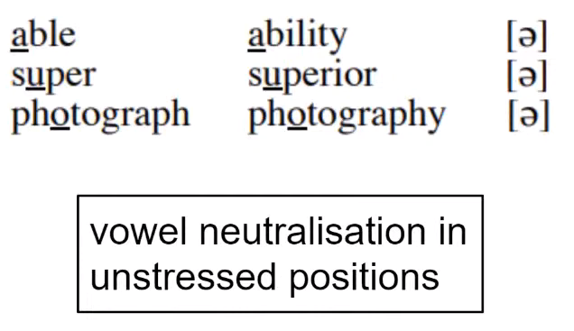
Overview of linguistics
Input: sound wave
Phonetics
Phonology
Morphology
Syntax
Semantics
Pragmatics
Output: meaning

Slide 9
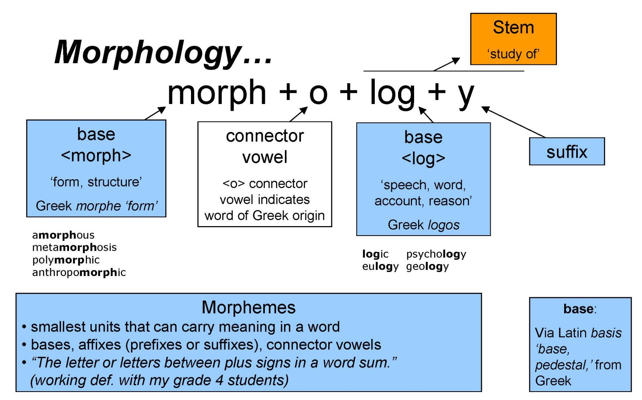
Overview of linguistics
Input: sound wave
Phonetics
Phonology
Morphology
Syntax
Semantics
Pragmatics
Output: meaning

Slide 10
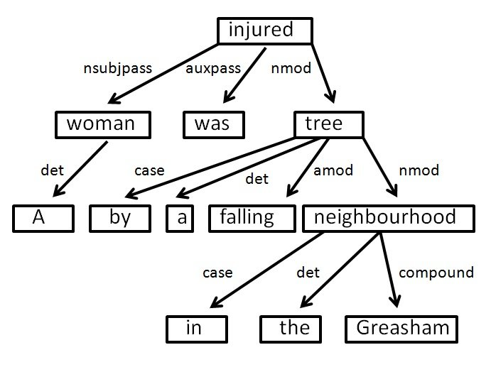
Overview of linguistics
Input: sound wave
Phonetics
Phonology
Morphology
Syntax
Semantics
Pragmatics
Output: meaning
A woman was injured by a falling tree in the Greasham neighbourhood

Slide 11
SYntax
Ambiguities
The boy saw the man with the telescope.

Slide 12
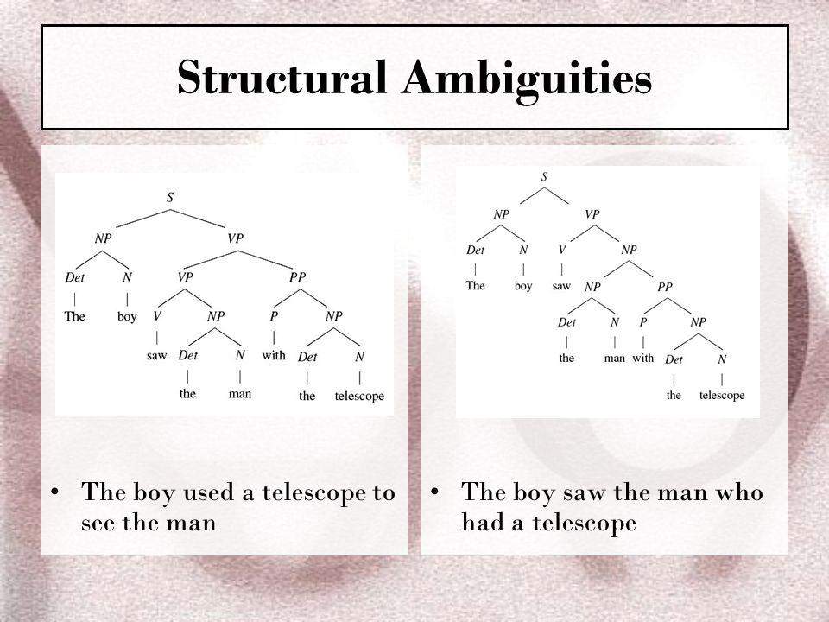
SYntax

Slide 13
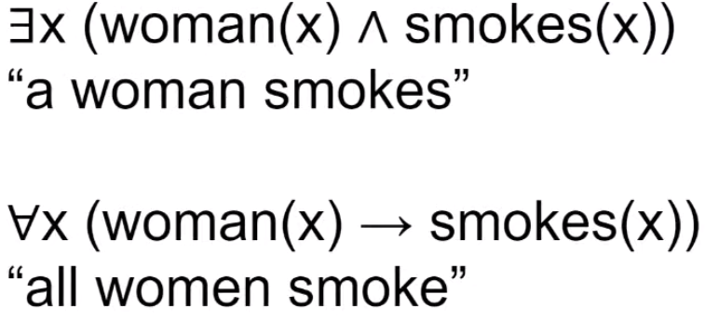
Overview of linguistics
First Order Logic
Input: sound wave
Phonetics
Phonology
Morphology
Syntax
Semantics
Pragmatics
Output: meaning

Slide 14
Overview of linguistics
Input: sound wave
Phonetics
Phonology
Morphology
Syntax
Semantics
Pragmatics
Output: meaning
« To know the meaning of a [declarative] sentence is to know
what the world would have to be like for the sentence to be true. »
Dowty & al., 1981, Introduction to Montague Semantics

Slide 15
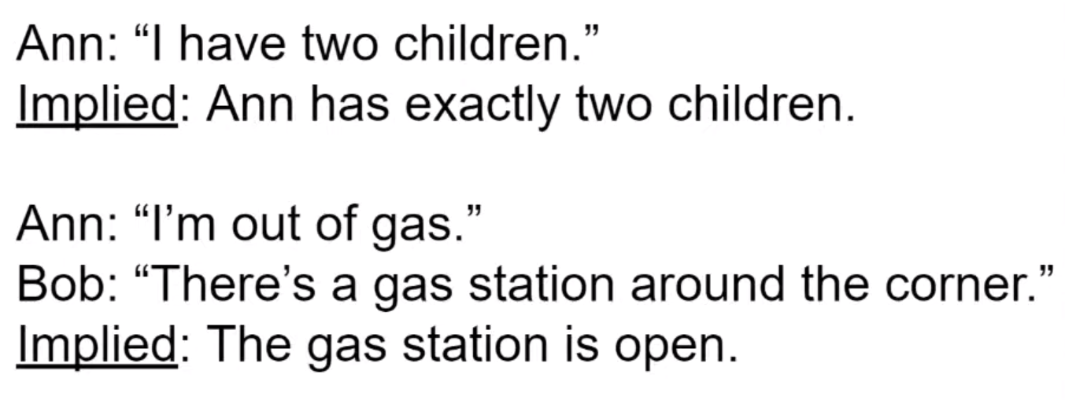
Overview of linguistics
Input: sound wave
Phonetics
Phonology
Morphology
Syntax
Semantics
Pragmatics
Output: meaning
« Reading between the lines »
If she had more, the sentence would still be true…

Slide 16
Overview of linguistics
Input: sound wave
Phonetics
Phonology
Morphology
Syntax
Semantics
Pragmatics
Output: meaning
The Story of the Mate and the Captain (Meibauer 2005, adapted from Posner 1980) :
A captain and his mate have a long-term quarrel. The mate drinks more rum
than is good for him, and the captain is determined not to tolerate this behaviour any longer. When the mate is drunk again, the captain writes in the logbook: “Today, 11th October, the mate is drunk.” When the mate reads this entry during his next watch, he gets angry.
Then, after a short moment of reflection, he writes in the logbook: “Today, 14th October, the captain is not drunk.”

Slide 17
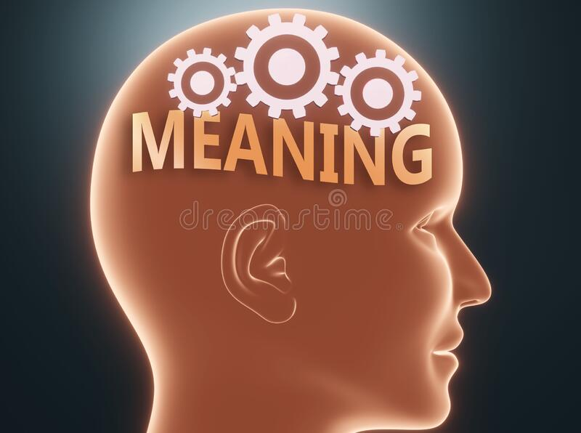
Overview of linguistics
Input: sound wave
Phonetics
Phonology
Morphology
Syntax
Semantics
Pragmatics
Output: meaning

Slide 18
What is a corpus ?
A book ?
An article ?
An archive ?

Slide 19
Definition
(McArthur, Tom. (ed.) 1992. The Oxford Companion to the English. Oxford & New York: Oxford University Press.)
CORPUS:
(1) A collection of texts, especially if complete and self-contained: the corpus of Anglo-Saxon verse.
(2) In linguistics and lexicography, a body of texts, utterances, or other specimens considered more or less representative of a language, and usually stored as an electronic database. Currently,computer corpora may store many millions of running words, whose features can be analyzed by means of tagging (the addition of identifying and classifying tags to words and other formations) and the use of concordancing programs.

Slide 20
Definition
(Crystal, David. 1992. An Encyclopedic Dictionary of Language and Languages. Oxford: Blackwell.)
A collection of linguistic data, either compiled as written texts or as a transcription of recorded speech. The main purpose of a corpus is to verify a hypothesis about language - for example, to determine how the usage of a particular sound, word, or syntactic construction varies. Corpus linguistics deals with the principles and practice of using corpora in language study. A computer corpus is a large body of machine-readable texts.
A collection of naturally occurring language text, chosen to characterize a state or variety of a language.
(John Sinclair. 1991. Corpus, Concordance, Collocation.
Oxford: Oxford University Press.)

Slide 21
So a corpus in not just any kind of text…
Sample/collection which is representative with regards to the research hypothesis/goal of the user
Defined size and content
Electronically stored
easier to obtain information on frequencies, grammatical patterns, collocations with a computer vs. Manually
costs of new analyses are lower compared to manual counting
Should be freely available if used for research purposes, so the research results can be contrasted, compared and repeated

Slide 22
Why use corpora ?
Objective verification of results (same study can be done by several parties to verify the results)
Corpora show how people really use the language. They do not provide imaginary, idealized examples
Generally, in linguistics, single sentences used as perimeter of study vs. Full texts
Quantitative data shows what occurs frequently and what occurs rarely in the language
Thanks to computers’ compute power, we can conduct fast, complex studies and process more material than by hand

Slide 23
What is corpus linguistics ?
Corpus linguistics is a methodology to obtain and analyze the language data either quantitatively or qualitatively
It can be applied in almost any area of language studies
The object of a study is language used authentically, naturally and can encompass many different contexts (political speeches, tweets on twitter, news articles, novels, movies scripts…)
Corpus linguistics is not a separate branch of linguistics (like e.g. sociolinguistics) or a theory of language

Slide 24
Corpus linguistics, computational linguistics and Natural Language processing
Fields overlap and are sometimes used interchangeably (computational linguistics and NLP especially)
Computational linguists and NLP specialists often dicuss problems and solutions together.

Slide 25
NLP|CL tasks
Tokenization
Customer service couldn’t be better! = “customer service” “could” “not” “be” “better”.

Slide 26
NLP|CL tasks
Part-of-speech tagging
“Customer service”: NOUN, “could”: VERB, “not”: ADVERB, be”: VERB, “better”: ADJECTIVE, “!”: PUNCTUATION

Slide 27
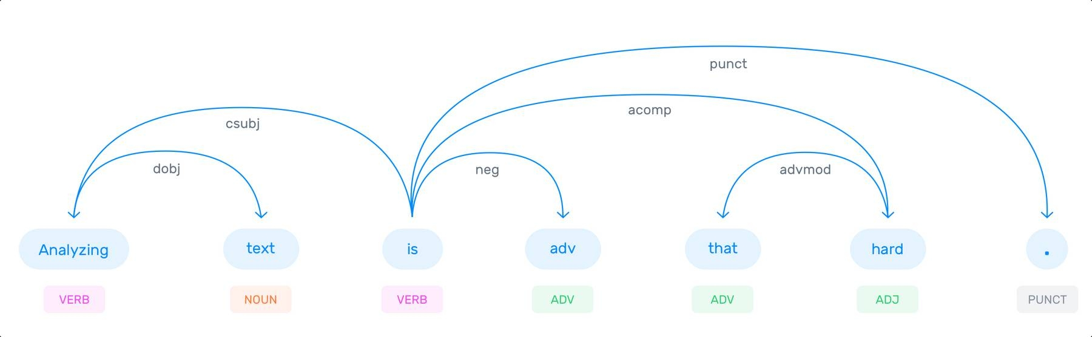
NLP|CL tasks
Dependency Parsing

Slide 28
NLP|CL tasks
Word Sense Disambiguation
You should read this book; it’s a great novel!
You should book the flights as soon as possible.
You should close the books by the end of the year.
You should do everything by the book to avoid potential complications.

Slide 29
NLP|CL tasks
Named Entity Recognition (NER)
Susan lives in Los Angeles

Slide 30
NLP|CL tasks
Text Classification
Sentiment analysis for example :
“I really like the new design of your website!” → Positive
“I’m not sure if I like the new design” → Neutral
“The new design is awful!” → Negative

Slide 31
Modern-day NLP|CL applications
E-mail filters
Virtual assistants
Online search engines
Predictive text
Monitoring brand sentiment on social media
Quickly sorting customer feedback
Chatbots
Automatic summarization
Machine translation
Natural language generation

Slide 32
Demo : Generating Text
Google Colab demo
Copy.ai

